Slide 1


CMPE 142
Operating Systems
February 19 Class Meeting
Department of Computer Engineering
San Jose State University
Spring 2021
Instructor: Ron Mak
www.cs.sjsu.edu/~mak

Slide 2
Processes
A process is basically an abstraction of a
running program.
  The most central concept in any operating system.
  It consists of some activity on the computer.
  It has a program, input, output, memory, registers, etc., and a state.
Each process runs in its own address space.
  If a program (such as a spreadsheet) is running more than once at the same time, each is an individual process with a separate address space.

Slide 3
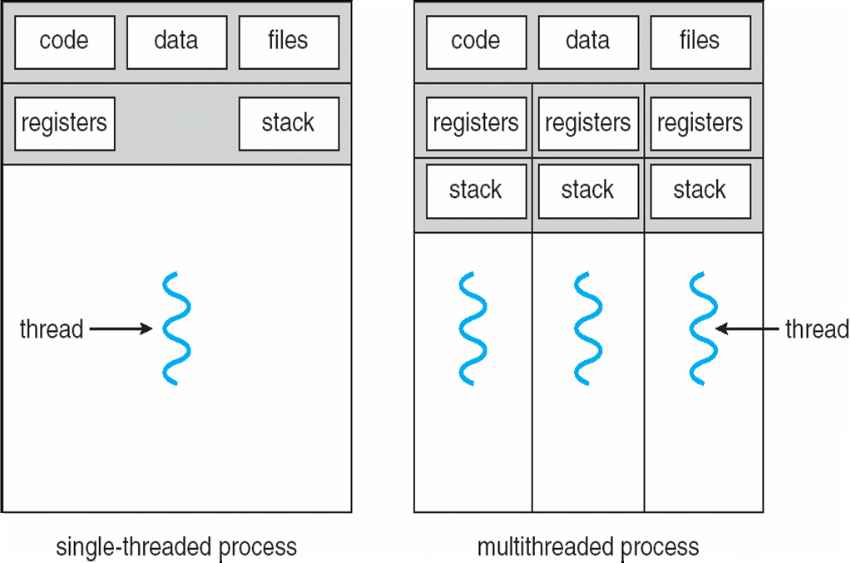
Threads
Operating System Concepts, 10th edition
by Abraham Silberschatz, Greg Gagne, and Peter B. Galvin
Wiley, 2018, ISBN 978-1119456339

Slide 4
Interprocess Communication
Processes within a system may be
independent or cooperating.
  A cooperating process can affect or be affected
  by other executing processes.
  An independent process cannot affect or be affected by other executing processes.
Reasons for processes to cooperate:
  Information sharing
  Computation speedup
  Modularity
  Convenience

Slide 5
Interprocess Communication, cont’d
Interprocess communication (IPC)
  Needed by cooperating processes.
  Exchange data and information.
Two models of IPC:
  Shared memory
  Message passing

Slide 6
Interprocess Communication, cont’d
Message passing
Shared memory
Operating System Concepts, 10th edition
by Abraham Silberschatz, Greg Gagne, and Peter B. Galvin
Wiley, 2018, ISBN 978-1119456339

Slide 7
IPC: Shared Memory
Establish a shared-memory region.
  Once established, all accesses to the region are treated the same as regular memory accesses.
  No OS kernel intervention required to communicate.
  Allows maximum speed and convenience.
  Faster than message passing.
A shared-memory region typically resides in the address space of the process that created it.
  Any other process that wishes to communicate
  using this region must attach the region
  to its address space.

Slide 8
IPC: Shared Memory, cont’d
With shared memory, cooperating processes:
  Agree to override the protection mechanisms of the OS that prevent one process from addressing
  another process’s memory.
  Exchange data by reading and writing
  in the shared-memory region.
Cooperating processes must arrange among themselves not to step on each other.
  Don’t write simultaneously to the same location.

Slide 9
Shared Memory: Producer-Consumer
A “producer” process can pass data
to a “consumer” process using shared memory.
Use the POSIX API for shared memory.
  This API organizes shared memory as
  memory-mapped files, which associate
  the shared-memory region with a file.
  The shared memory region must have a name.

Slide 10
Shared Memory: Producer
#include <stdio.h>
#include <stdlib.h>
#include <string.h>
#include <fcntl.h>
#include <unistd.h>
#include <sys/mman.h>
#include <sys/stat.h>
#include "globals.h"
int main(int argc, char *args[])
{
int shm_fd; // shared memory file descriptor
void *ptr; // pointer to shared memory object
shm_fd = shm_open(NAME, O_CREAT | O_RDWR, 0666);
ftruncate(shm_fd, SIZE);
ptr = mmap(0, SIZE, PROT_WRITE, MAP_SHARED, shm_fd, 0);
sprintf(ptr, "%s", args[1]);
return 0;
}
producer.c
const int SIZE = 4096;
const char *NAME = "CMPE 142
globals.h
Create the shared memory
object and configure its size.
Memory map the shared memory object
and write to it.

Slide 11
Shared Memory: Consumer
consumer.c
#include <stdio.h>
#include <stdlib.h>
#include <string.h>
#include <fcntl.h>
#include <sys/mman.h>
#include <sys/stat.h>
#include "globals.h"
int main()
{
int shm_fd; // shared memory file descriptor
void *ptr; // pointer to shared memory object
shm_fd = shm_open(NAME, O_RDONLY, 0666);
ptr = mmap(0, SIZE, PROT_READ, MAP_SHARED, shm_fd, 0);
printf("%s\n", (char *) ptr);
shm_unlink(NAME);
return 0;
}
const int SIZE = 4096;
const char *NAME = "CMPE 142
globals.h
Open the shared memory
object and memory map it.
Read from the shared memory
object and then remove it.

Slide 12
Shared Memory: Producer-Consumer, cont’d
A more general producer-consumer model:
  The producer process repeatedly adds data
  to the shared memory.
  The consumer process repeatedly retrieves data
  from the shared memory.
Both processes run concurrently.
In order for this to work, both processes
must be synchronized.
  What could happen if they’re not synchronized?

Slide 13
Interprocess Communication, cont’d
Message passing
Shared memory
Operating System Concepts, 10th edition
by Abraham Silberschatz, Greg Gagne, and Peter B. Galvin
Wiley, 2018, ISBN 978-1119456339

Slide 14
IPC: Message Passing
Useful for exchanging small amounts of data.
Easier to implement than shared memory.
  No conflicts involving one process
  stepping on the other.
Slower than shared memory.
  Implemented with system calls.
  Requires OS kernel intervention.

Slide 15
IPC: Message Passing, cont’d
Cooperating processes can communicate and synchronize their actions without sharing
the same address space.
  No shared memory regions.
Particularly useful in a distributed environment.
  Communicating processes do not necessarily
  need to know where the other processes reside.

Slide 16
IPC: Message Passing, cont’d
Messages can be fixed or variable length.
Fixed length: Easier system-level implementation, but makes programming
more difficult.
Variable length: Harder system-level implementation, but simpler programming.

Slide 17
Message Passing: Direct Communication
Cooperating processes must be able
to refer to each other by their names.
The processes must establish
a communications link.
  Capacity?
  Unidirectional? Bidirectional?

Slide 18
Message Passing: Direct Communication, cont’d
Send and receive primitives:
  send(P, message)
  Send a message to process P.
  receive(Q, message)
  Receive a message from process Q.
  receive(id, message)
  Receive a message from any process,
  as identified by the process id.

Slide 19
Message Passing: Indirect Communication
Send and receive messages from mailboxes
or ports shared by cooperating processes.
Send and receive primitives:
  send(A, message)
  Send a message to mailbox A.
  receive(A, message)
  Receive a message from mailbox A.

Slide 20
Message Synchronization
Message passing may be blocking
or nonblocking.
  AKA synchronous and asynchronous, respectively.

Slide 21
Message Synchronization, cont’d
Blocking send
  The sending process is blocked until
  the message is received.
Nonblocking send
  The sending process sends the message
  and continues operating.
Blocking receive
  The receiver blocks until a message is available.
Nonblocking receive
  The receive either retrieves a message or a null.

Slide 22
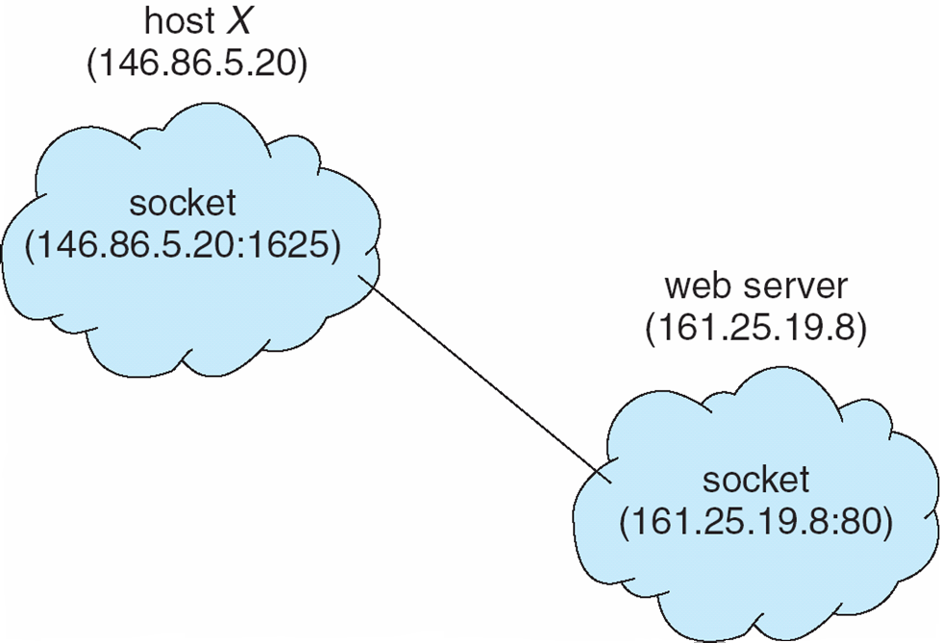
Client-Server Communications: Sockets
A socket is a communications endpoint.
Two processes can communicate over a network using a pair of
sockets, one per
process.
A socket has an
IP address and a
port number.
Operating System Concepts, 10th edition
by Abraham Silberschatz, Greg Gagne, and Peter B. Galvin
Wiley, 2018, ISBN 978-1119456339

Slide 23
Client-Server Communications: RPC
Remote Procedure Calls (RPC) abstract procedure calls between processes on networked systems.
Stub: Client-side proxy for the actual procedure
that resides on the server.
The client-side stub locates the server
and marshals the parameters.
  Convert the parameter values to a form
  that can be transmitted over the network.

Slide 24
Client-Server Communications: RPC, cont’d
The server-side skeleton receives this message, unmarshals the parameters, and performs the procedure on the server.

Slide 25
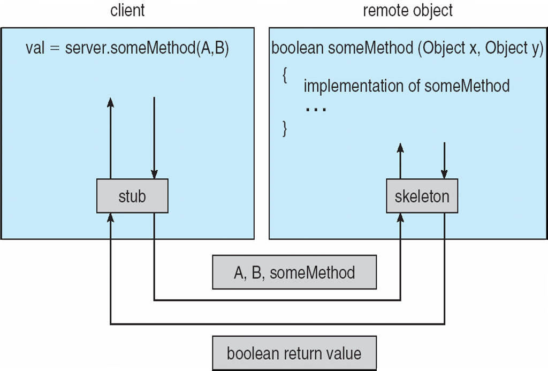
Client-Server Communications: RPC, cont’d
Marshalling and unmarshalling

Slide 26
IPC: Pipes
Pipes are communications conduits
for cooperating processes.
A pipe is a special type of file accessed using ordinary read() and write() system calls.
Typically, a parent process creates a pipe
and then forks a child process.
  The parent process makes the pipe available
  to the child process to use in order to
  communicate with the child.

Slide 27
IPC: Pipes, cont’d
Example
  fd[0]: File descriptor of the read end of the pipe
  fd[1]: File descriptor of the write end of the pipe
Both the parent and child
process share the fd array.
Pipe
Parent
x
fd[1] write
fd[0] read
Not used
Not used
x
fd[1] write
fd[0] read
Child

Slide 28
IPC: Named Pipes
Two independent processes can exchange data via a named pipe.
  AKA a first-in-first-out (FIFO) queue.
  The two process must share the name of the pipe.
  The pipe allows bidirectional communication.
Created by the POSIX mkfifo() function.
  Lasts as long as the system is up or until it is deleted.
Any process can open it for reading and writing.
  Must be open at both ends simultaneously for reading and writing operations.

Slide 29
Named Pipe Example
Two independent processes WriteRead and ReadWrite communicate with each other via a named pipe.
  The pipe has “filepath” /tmp/cmpe142.
The processes alternate sending and receiving messages to and from each other.
  Process WriteRead first writes to the pipe
  and then reads from it.
  Process ReadWrite first reads from the pipe
  and then writes to it.

Slide 30
Named Pipe Example, cont’d
#include <stdio.h>
#include <string.h>
#include <fcntl.h>
#include <sys/stat.h>
#include <sys/types.h>
#include <unistd.h>
#include "globals.h"
int main()
{
int fd;
char message[BUFFER_SIZE];
mkfifo(FIFO_PATH, 0666);
while (1)
{
fd = open(FIFO_PATH, O_WRONLY);
fgets(message, BUFFER_SIZE, stdin);
WriteRead.c
const char *FIFO_PATH = "/tmp/cmpe142";
const int BUFFER_SIZE = 80;
globals.h
Create the named pipe (FIFO).
First open the FIFO
in write-only mode.
Read a message from stdin.

Slide 31
Named Pipe Example, cont’d
write(fd, message, strlen(message) + 1);
close(fd);
if (strlen(message) <= 1) break;
fd = open(FIFO_PATH, O_RDONLY);
read(fd, message, sizeof(message));
if (strlen(message) <= 1) break;
printf("Process ReadWrite said: %s\n", message);
close(fd);
}
printf("Process WriteRead done!\n");
return 0;
}
Write the message to
the FIFO and close it.
Now open the FIFO
in read-only mode
and read from it.
Print the message from
the FIFO and close it.

Slide 32
Named Pipe Example, cont’d
#include <stdio.h>
#include <string.h>
#include <fcntl.h>
#include <sys/stat.h>
#include <sys/types.h>
#include <unistd.h>
#include "globals.h"
int main()
{
int fd;
char message[BUFFER_SIZE];
mkfifo(FIFO_PATH, 0666);
while (1)
{
fd = open(FIFO_PATH, O_RDONLY);
read(fd, message, BUFFER_SIZE);
if (strlen(message) <= 1) break;
ReadWrite.c
const char *FIFO_PATH = "/tmp/cmpe142";
const int BUFFER_SIZE = 80;
globals.h
Create the named pipe (FIFO).
First open the FIFO
in read-only mode
and read from it.

Slide 33
Named Pipe Example, cont’d
Print the message from
the FIFO and close it.
printf("Process WriteRead said: %s\n", message);
close(fd);
fd = open(FIFO_PATH, O_WRONLY);
fgets(message, BUFFER_SIZE, stdin);
write(fd, message, strlen(message) + 1);
close(fd);
if (strlen(message) <= 1) break;
}
printf("Process ReadWrite done!\n");
return 0;
}
Now open the FIFO
in write-only mode.
Read a message from stdin.
Write the message to
the FIFO and close it.
Demo

Slide 34
Break

Slide 35
Process Synchronization
Multiple cooperating processes executing concurrently must synchronize their operations.
Share information.
  Shared memory or message passing.
Don’t step on each other.
  Example: Don’t have multiple processes simultaneously modify the same memory location.

Slide 36
Process Synchronization, cont’d
Properly sequence their operations.
  One process depends on another.
  Example: Process B depends on output
  generated by Process A. Therefore,
  Process B must wait until Process A
  has produced its output.

Slide 37
Race Condition
A race condition occurs when
  Multiple processes access and modify
  some shared data.
  The final result depends on the order
  that the processes modified the data.
A very bad situation!
  Results are often unpredictable and unrepeatable.
  Extremely hard to debug.
  Must avoid!

Slide 38
Race Condition Example
Suppose variable count is shared by two processes.
count++ can be implemented as:
  register1 ⬅ count
  register1 ⬅ register1 + 1
  count ⬅ register1
count-- can be implemented as:
  register2 ⬅ count
  register2 ⬅ register2 – 1
  count ⬅ register2
Suppose the value of count is 5 and that
process P1 executes count++ at the same time that process P2 executes count--.

Slide 39
Race Condition Example, cont’d
count = 5
  count++
  register1 ⬅ count
  register1 ⬅ register1 + 1
  count ⬅ register1
  count--
  register2 ⬅ count
  register2 ⬅ register2 – 1
  count ⬅ register2
Process | Operation | Result
P1 | register1 ⬅ count | register1 = 5
P1 | register1 ⬅ register1 + 1 | register1 = 6
P2 | register2 ⬅ count | register2 = 5
P2 | register2 ⬅ register2 - 1 | register2 = 4
P1 | count ⬅ register1 | count = 6
P2 | count ⬅ register2 | count = 4
Whether the value of count ends up as 4 or 6 depends on the order of execution of the last two instructions.

Slide 40
Mutual Exclusion
One way to avoid race conditions is to
prevent more than one process from reading and writing the shared data at the same time.
This is called mutual exclusion.
  Operating systems provide different primitives
  to enforce mutual exclusion.

Slide 41
Critical Region
A critical region (AKA critical section)
is the part of a process’s code
that operates on some shared data.
  NOTE: A critical region is code, not data.
We must prevent two processes
from being in their critical regions
for the same shared data
at the same time.

Slide 42
To Prevent Race Conditions
Mutual exclusion: No two processes may be simultaneously inside their critical regions
for the same shared data.
Progress: No process running outside
its critical region may block other processes.
Bounded waiting: No process should have to wait forever to enter its critical region.

Slide 43
To Prevent Race Conditions, cont’d
When a process is in its critical region,
other processes must be blocked
from entering their critical regions.
No assumptions may be made about
the number of CPUs or their speeds.

Slide 44
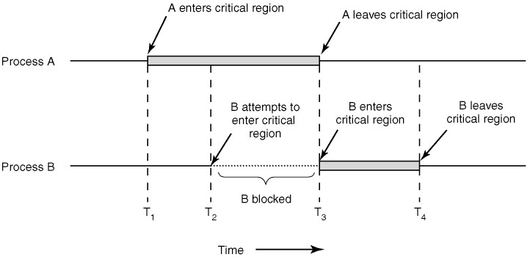
Critical Region, cont’d
Modern Operating Systems, 4th edition
by Andrew Tanenbaum & Herbert Bos
Pearson, 2014, ISBN 978-0133591620

Slide 45
Critical Region vs. Shared Memory
Do not confuse critical region
with the shared data.
  Two (or more) processes can share a piece of data.
The code in a process that accesses that shared data is that process’s critical region
with respect to that shared data.

Slide 46
Critical Region, cont’d
The code in the critical region of each process for some shared data can be different from the code in the critical region of another process.
  For example, one process’s critical region writes
  to the shared data, and another process’s critical region reads from the shared data.
Each shared data has its own set of critical regions among the processes that access it.
  What the code in the critical regions have in common is that they access the same shared data.

Slide 47
Lock Variables
A shared lock variable is one way
to implement a critical region.
  The value of the lock is either 0 or 1.
If a process wants to enter its critical region:
  It first tests the lock.
  If the lock is 0, the process sets the lock to 1
  and enters its critical region.
  If the lock is already 1, the process waits
  until the lock becomes 0.

Slide 48
Lock Variables
Therefore:
  Lock value 0 means no process
  is in its critical region.
  Lock value 1 means a process
  is in its critical region.
What is the problem with this solution?
  A race condition testing and setting the lock.

Slide 49
Busy Waiting
Suppose we have a shared turn variable.
  turn == 0: Process P0 can enter its critical region.
  turn == 1: Process P1 can enter its critical region.
// Process P0 loops forever.
for (;;)
{
// Wait for my turn.
while (turn != 0)
{
// do nothing
}
critical_region_P0();
turn = 1; // your turn
noncritical_region_P0();
}
// Process P1 loops forever.
for (;;)
{
// Wait for my turn.
while (turn != 1)
{
// do nothing
}
critical_region_P1();
turn = 0; // your turn
noncritical_region_P1();
}
What can go wrong
with taking turns?

Slide 50
Busy Waiting, cont’d
// Process P0 loops forever.
for (;;)
{
// Wait for my turn.
while (turn != 0)
{
// do nothing
}
critical_region_P0();
turn = 1; // your turn
noncritical_region_P0();
}
// Process P1 loops forever.
for (;;)
{
// Wait for my turn.
while (turn != 1)
{
// do nothing
}
critical_region_P1();
turn = 0; // your turn
noncritical_region_P1();
}
Busy waiting: Continuously test a variable
until it has some value.
  A lock that uses busy waiting is called a spin lock.
  Wastes CPU time: Use only when the wait will be short.
  Poor choice if one process is much slower than the other.

Slide 51
Peterson’s Solution
Suppose we have two processes, P0 and P1.
  Share integer variable turn and boolean array flag.
  flag[n] == true : Pn wants to enter its critical region.
P0: flag[0] = true;
turn = 1; // other process
while (flag[1] == true
&& turn == 1)
{
// busy wait
}
critical_region_P0();
flag[0] = false;
P1: flag[1] = true;
turn = 0; // other process
while (flag[0] == true
&& turn == 0)
{
// busy wait
}
critical_region_P1();
flag[1] = false;
http://en.wikipedia.org/wiki/Peterson's_algorithm

Slide 52
Peterson’s Solution, cont’d
P0: flag[0] = true;
turn = 1; // other process
while (flag[1] == true
&& turn == 1)
{
// busy wait
}
critical_region_P0();
flag[0] = false;
P1: flag[1] = true;
turn = 0; // other process
while (flag[0] == true
&& turn == 0)
{
// busy wait
}
critical_region_P1();
flag[1] = false;
P0 and P1 can never be in their critical regions at the same time.
If P0 is in its critical region, then either:
  flag[1] is false (P1 has left its critical region), or
  turn is 0 (P1 is just now trying to enter its critical region,
  but it is currently waiting its turn).
In both cases, P1 cannot be in its critical region
when P0 is in its critical region (and vice versa).

Slide 53
Test and Set Lock Instruction
Suppose this routine:
can be incorporated into a single atomic instruction TSL that cannot be interrupted.
  Set a boolean variable passed by reference to TRUE.
  Return its original value.
If the original value was TRUE, a process
is not allowed to enter its critical region.
boolean TestAndSetLock(boolean *target)
{
boolean original_value = *target;
*target = TRUE;
return original_value;
}

Slide 54
Test and Set Lock Instruction
boolean TestAndSetLock(boolean *target)
{
boolean original_value = *target;
*target = TRUE;
return original_value;
}
for (;;)
{
while (TestAndSetLock(&lock))
{
// busy wait
}
critical_region();
lock = FALSE;
}
Eventually, the original value of the lock will be set to FALSE by another process, allowing entry into the critical region.
Why must TSL be atomic?

Slide 55
Busy Waiting, cont’d
All the solutions so far to mutual exclusion, including Peterson’s Solution and TSL,
require busy waiting.
Busy waiting wastes CPU cycles.

Slide 56
Priority Inversion Problem
Suppose a preemptive process scheduling algorithm always runs a high priority process H whenever H is ready.
A low priority process L is in its critical region to access a resource that it shares with H.
Process H goes into a busy wait loop before entering its critical region.
Because H is running, L never gets a chance
to leave its critical region.
Both processes hang with H forever busy waiting.

Slide 57
Sleep and Wakeup
void producer()
{
for (;;)
{
item = produce_item();
if (count == N) sleep();
insert_item(item);
count++;
if (count == 1)
{
wakeup(consumer);
}
}
}
void consumer()
{
for (;;)
{
if (count == 0) sleep();
item = remove_item();
count--;
if (count == N-1)
{
wakeup(producer);
}
consume_item(item);
}
}
A race condition with shared variable count:
  The buffer is empty, so the consumer sees count to be 0.
  Right then, the producer runs, increments count to 1,
  and tries to wake up the consumer.
  The consumer is already awake, so the wakeup call is lost.
  The consumer runs again. It saw count was 0, and so goes to sleep.
  The producer fills up the buffer and never wakes up the consumer.

Slide 58
Semaphores
We need a way to keep track of wakeup calls
so that we don’t lose them.
A semaphore is a shared variable that holds
an integer value and has atomic actions:
Testing and modifying a semaphore’s value
must all be done without interruption.
wait(s)
{
while (s <= 0) block;
s--;
}
signal(s)
{
s++;
}

Slide 59
Semaphores, cont’d
A semaphore that can have any integer value
is a counting semaphore.
  A counting semaphore is usually just called a semaphore.
Use a semaphore to ensure processes that depend on each other will execute in the proper sequence:
  Statement S2 can only execute after statement S1.
S1;
signal(s);
wait(s);
S2;

Slide 60
Mutexes
A binary semaphore only has the values 0 or 1.
  AKA a mutex, to implement mutual exclusion:
wait(m);
critical_region();
signal(m);

Slide 61
Synchronized Producers and Consumers
Use semaphores to ensure producers and consumers execute in the proper sequence:
Semaphore empty_slots_available
  Keeps track of the number of empty slots
  in the shared buffer.
  Initialize it to the buffer size.
Semaphore filled_slots_available
  Keeps track of the number of filled slots
  in the shared buffer.
  Initialize it to 0.

Slide 62
Synchronized Producers
Before adding an item:
  Wait on semaphore empty_slots_available.
  If the count is equal to the buffer size,
  the buffer is full, so the producer must block
  until an empty slot becomes available.
    Decrease count of empty slots.
After adding an item:
  Signal semaphore filled_slots_available.
    Increase the count of filled slots.

Slide 63
Synchronized Consumers
Before removing an item:
  Wait on semaphore filled_slots_available.
  If the count is 0 or negative, the buffer is empty,
  so the consumer must block
  until a filled slot becomes available.
    Decrease the count of filled slots.
After removing an item:
  Signal semaphore empty_slots_available.
    Increase the count of empty slots.

Slide 64
Synchronized Producers and Consumers, cont’d
Semaphores empty_slots_available
and filled_slots_available
keep the producer and consumer processes
operating in proper sequence.
Don’t let a producer insert into a full buffer.
Don’t let a consumer remove from
an empty buffer.

Slide 65
Synchronized Producers and Consumers, cont’d
buffer
x
x
x
x
x
x
x
x
in
out
The buffer and its in and out pointers
are shared data.
Use the mutex buffer_mutex to enforce mutual exclusion.
  Each process’s critical region operates on the shared data.
Also need a print_mutex to protect printing.

Slide 66
Problems with Semaphores
You must be very careful when
programming with semaphores.
  Coding errors can be very hard to detect.
Example errors:
  Exchange the order of calling wait() and signal():
  Multiple processes will execute their critical regions simultaneously.
signal(mutex);
// critical region
wait(mutex);

Slide 67
Problems with Semaphores, cont’d
Example errors:
  Replace a call to signal() with wait():
  Your program will hang.
  Omit a call to signal() or wait():
  Either multiple processes will violate mutual exclusion, or your program will hang.
wait(mutex);
// critical region
wait(mutex);

