Slide 1
CMPE 142 Operating Systems February 12 Class Meeting
Department of Computer Engineering San Jose State University Spring 2021 Instructor: Ron Mak
www.cs.sjsu.edu/~mak

Slide 2
Processes
A process is basically an abstraction of a running program.
The most central concept in any operating system.
It consists of some activity on the computer.
It has a program, input, output, memory, registers, etc., and a state.
Each process runs in its own address space.
If a program (such as a spreadsheet) is running more than once at the same time, each is an individual process with a separate address space.

Slide 3
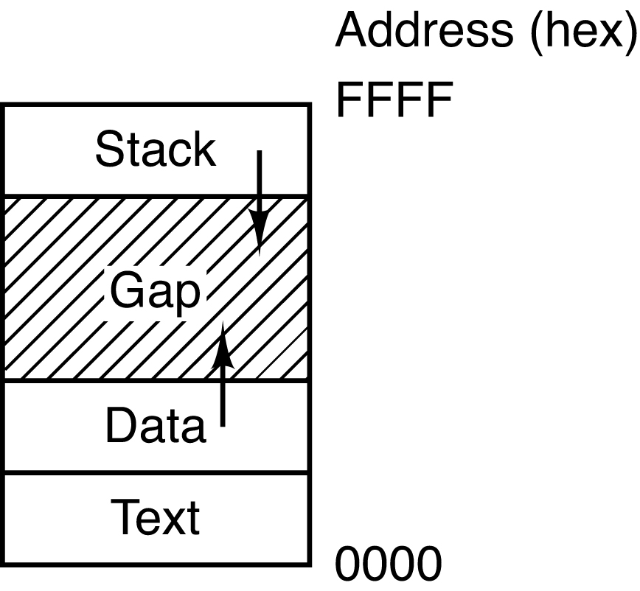
Processes in Memory
A UNIX process’s address space is divided into three segments:
text segment: the program code.
data segment: includes the heap for dynamically allocated data (grows upwards into higher memory addresses).
stack segment: the runtime stack (grows downwards into lower memory addresses).
gap: unused memory space
When the gap is used up,
a “heap-stack collision”
has occurred, and you
have an “out of memory”
runtime error.
Modern Operating Systems, 4th edition
by Andrew Tanenbaum & Herbert Bos
Pearson, 2014, ISBN 978-0133591620

Slide 4
Memory Layout of a C Program
Operating System Concepts, 10th edition
by Abraham Silberschatz, Greg Gagne, and Peter B. Galvin
Wiley, 2018, ISBN 978-1119456339

Slide 5
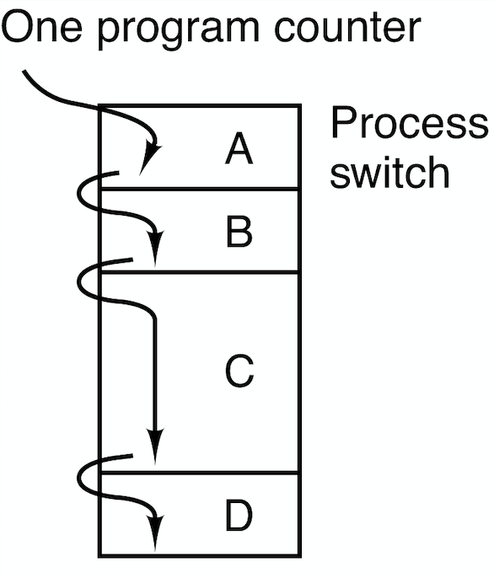
Process Models
Multiprogramming with multiple running programs.
One program counter per CPU.
Each program has its own virtual CPU.
The real CPU rapidly switches from one program to another.
Process switching AKA context switching
Modern Operating Systems, 4th edition
by Andrew Tanenbaum & Herbert Bos
Pearson, 2014, ISBN 978-0133591620

Slide 6
Process Models, cont’d
Only one program is active on a CPU at any instant.
Each program has its own logical program counter.
When a program runs, its logical program counter is switched into the machine’s physical program counter.
Modern Operating Systems, 4th edition
by Andrew Tanenbaum & Herbert Bos
Pearson, 2014, ISBN 978-0133591620

Slide 7
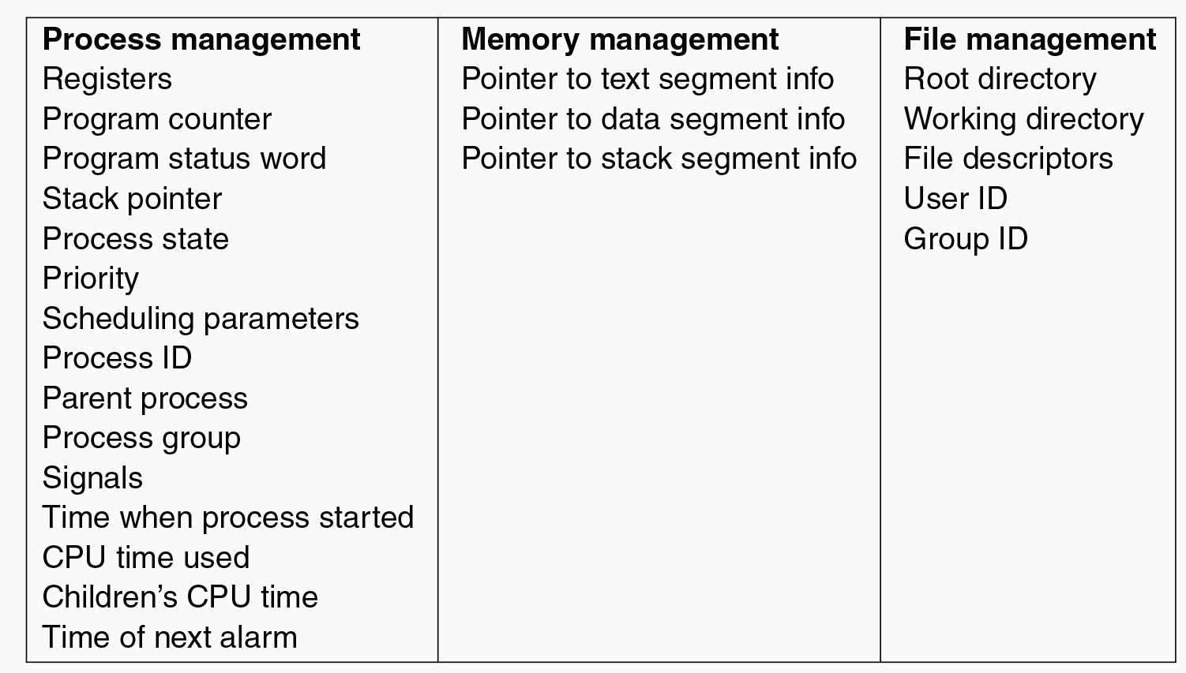
Process Control Block
The OS maintains a process table to keep track of processes.
Each entry of the table is a process control block, (PCB) which contains a process’s state information.
Modern Operating Systems, 4th edition
by Andrew Tanenbaum & Herbert Bos
Pearson, 2014, ISBN 978-0133591620

Slide 8
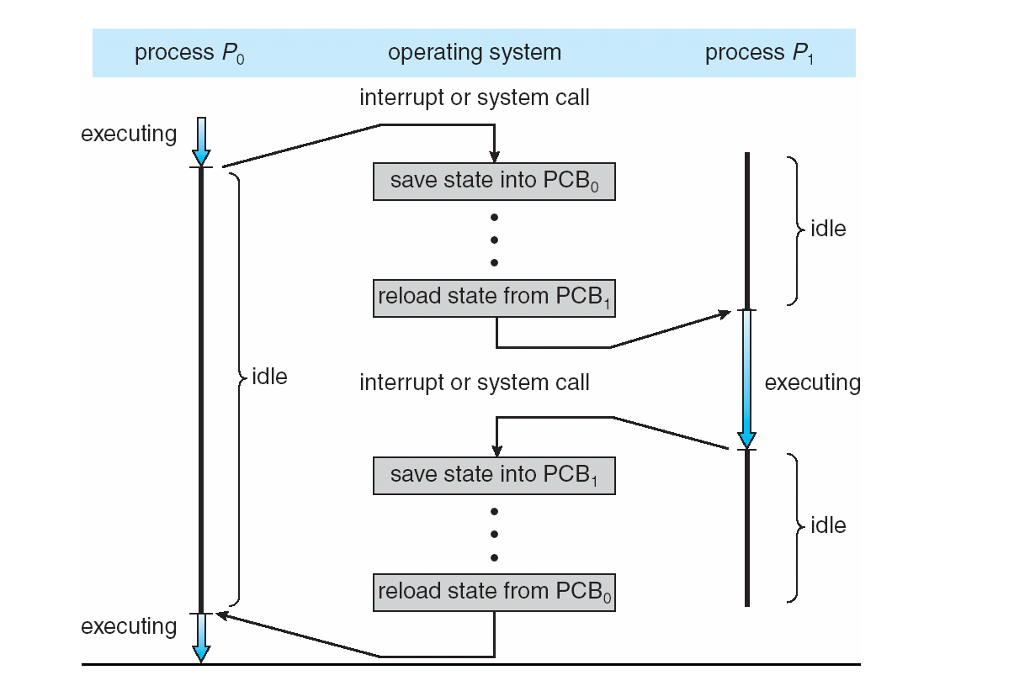
Context Switching
Operating Systems: Design and Implementation, 3rd ed.
By Andrew Tanenbaum & Albert Woodhull
Prentice-Hall, Inc., 2006, ISBN 978-0131429383

Slide 9
Process Creation
Principal events that cause processes to be created:
System initialization.
Execution of a process creation system call by a running process, such as fork().
A user request to create a new process.
Initiation of a batch job.
job: An application run on the computer.

Slide 10
Process Termination
Conditions that cause a process to terminate:
Normal exit (voluntary).
Error exit (voluntary).
Fatal error (involuntary).
Killed by another process (involuntary).
Cascading termination
On some operating systems, when a process terminates, so do its child processes.

Slide 11
Process Creation and Termination
What does the exec()
system call do?
Operating Systems: Design and Implementation, 3rd ed.
By Andrew Tanenbaum & Albert Woodhull
Prentice-Hall, Inc., 2006, ISBN 978-0131429383

Slide 12
Process States
Running
Using the CPU at that instant.
Ready
Runnable, but temporarily stopped to let another process run.
Blocked
Unable to run until some external event happens.
Modern Operating Systems, 4th edition
by Andrew Tanenbaum & Herbert Bos
Pearson, 2014, ISBN 978-0133591620

Slide 13
Process Scheduling Goals
The process scheduler decides which process can run, i.e., which process can have the CPU.
The goal is to keep all parts of the computer system as busy as possible.
Which scheduling algorithm to use depends on
the type of system
how it’s used
what policies are in place

Slide 14
Process Behavior
A compute-bound process spends most of its time computing.
Long CPU bursts and infrequent I/O waits.
An I/O-bound process spends most of its time waiting for I/O operations to complete.
Long I/O waits punctuated by short CPU bursts.

Slide 15
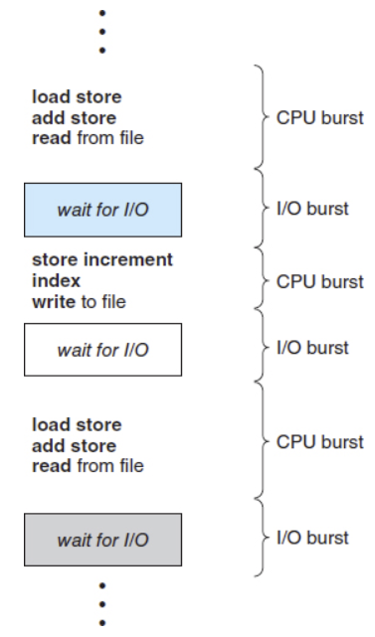
Process Behavior, cont’d
A process may be:
computing ⎼ using the CPU
performing I/O
Operating System Concepts, 10th edition
by Abraham Silberschatz, Greg Gagne, and Peter B. Galvin
Wiley, 2018, ISBN 978-1119456339

Slide 16
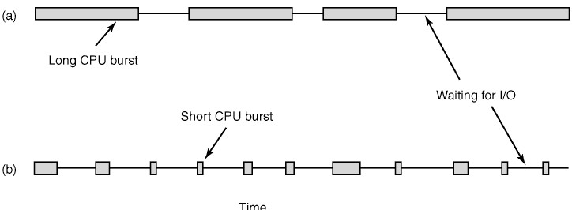
Process Behavior, cont’d
As CPUs become faster relative to disks:
Programs are becoming more I/O bound.
Scheduling I/O-bound processes becomes more important.
Modern Operating Systems, 4th edition
by Andrew Tanenbaum & Herbert Bos
Pearson, 2014, ISBN 978-0133591620

Slide 17
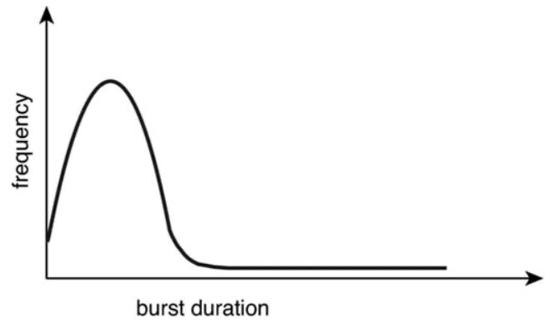
Process Behavior, cont’d
Operating System Concepts, 10th edition
by Abraham Silberschatz, Greg Gagne, and Peter B. Galvin
Wiley, 2018, ISBN 978-1119456339
Graph of CPU burst durations.
CPU-bound process: A few long bursts.
I/O bound process: Many short bursts.

Slide 18
When to Schedule
When scheduling is absolutely required:
When a process exits.
When a process blocks on I/O, or on a semaphore.
When scheduling usually done (although not absolutely required):
When a new process is created.
When an I/O interrupt occurs.
When a clock interrupt occurs.

Slide 19
Types of Scheduling Algorithms
Preemptive
Each process is assigned a time interval to run, called the quantum or time slice.
At the end of a process’s time quantum, the scheduler suspends the process and schedules another process to run.
Non-preemptive
The scheduler allows a process to run until it blocks:
waiting for I/O
waiting for another process
The process can voluntarily releases the CPU.

Slide 20
Scheduling Criteria
CPU utilization
Keep the CPU as busy as possible.
Throughput
Number of processes that complete their execution per time unit.
Turnaround time
The amount of elapsed time from when a process enters the ready queue to when it completes execution.

Slide 21
Scheduling Criteria, cont’d
Waiting time
The sum of all the time a process spends waiting in the ready queue.
Includes the time waiting to start and the time while blocked.
Response time
In an interactive environment, the amount of elapsed time from when a request was submitted until the first response is produced.

Slide 22
Scheduling Criteria, cont’d
Proportionality
“Simple” tasks (as perceived by human users) should take little time.
“Complex” tasks can take longer time.

Slide 23
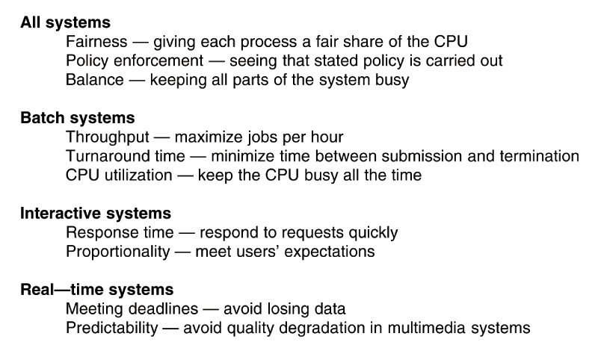
Scheduling Goals
Modern Operating Systems, 4th edition
by Andrew Tanenbaum & Herbert Bos
Pearson, 2014, ISBN 978-0133591620

Slide 24
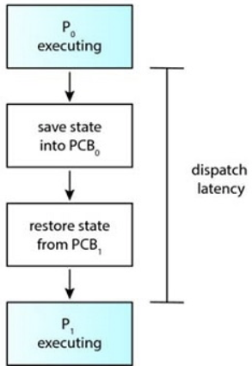
Dispatcher
The dispatcher component of the OS gives control of the CPU to the process that was selected by the process scheduler.
It should operate as fast as possible and minimize dispatch latency, since it’s involved in every context switch.
Operating System Concepts, 10th edition
by Abraham Silberschatz, Greg Gagne, and Peter B. Galvin
Wiley, 2018, ISBN 978-1119456339

Slide 25
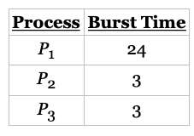
First-Come First-Served (FCFS)
Suppose that the processes arrive in the order P₁, P₂, P₃:
The scheduling timeline with FCFS is:
Waiting times:
P₁ = 0
P₂ = 24
P₃ = 27
Average waiting time: (0 + 24 + 27)/3 = 17
Preemptive or
non-preemptive?
Operating System Concepts, 10th edition
by Abraham Silberschatz, Greg Gagne, and Peter B. Galvin
Wiley, 2018, ISBN 978-1119456339

Slide 26
Shortest Job First (SJF)
Now suppose that the processes arrive in the order P₂, P₃, P₁:
Then the scheduling timeline with SJF is:
Waiting times:
P₁ = 6
P₂ = 0
P₃ = 3
Average waiting time: (6 + 0 + 3)/3 = 3
Much better
than SJF.
Operating System Concepts, 10th edition
by Abraham Silberschatz, Greg Gagne, and Peter B. Galvin
Wiley, 2018, ISBN 978-1119456339

Slide 27
Shortest Job First (SJF), cont’d
Schedule short processes ahead of long processes.
Shortest Job First (SJF) gives the optimal average waiting time for a given set of processes.
How can you know in advance each process’s expected run time (execution duration)?
It’s possible if you run the same jobs frequently and record the average of how long each one takes.

Slide 28
Practice Problem #1
Assume:
What is the average turnaround time with the FCFS scheduling algorithm?
With the SJF scheduling algorithm?
Process | Arrival Time | Burst Time
P₁ | 0.0 | 8
P₂ | 0.4 | 4
P₃ | 1.0 | 1
P₁ P₂ P₃
P₁ P₃ P₂

Slide 29
Shortest Remaining Time (SRT)
When a new process arrives, its expected run time is compared to the expected remaining run time of the currently executing process.
If the new process needs less time to finish than the current process, the scheduler suspends the current process and starts the new process.
The suspended process is put at the end of the ready queue.

Slide 30
Shortest Remaining Time (SRT), cont’d
New short jobs get good service.
As with Shortest Job First, you must know in advance each process’s expected run time.

Slide 31
Round Robin (RR)
Each process is assigned a time interval (quantum) during which it is allowed to run.
If the process is still running at the end of its quantum, the CPU is preempted and given to the next process.
The preempted process moves to the end of the ready queue.
Preemption can also occur if a process blocks.
Modern Operating Systems, 4th edition
by Andrew Tanenbaum & Herbert Bos
Pearson, 2014, ISBN 978-0133591620

Slide 32
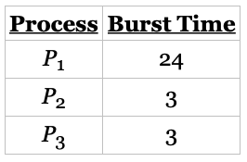
Round Robin (RR), cont’d
Suppose that the processes arrive in the order P₁, P₂, P₃ with quantum 4:
The scheduling timeline with RR is:
Typically, RR has higher average turnaround than SJF, but with better response time for interactive programs.
Operating System Concepts, 10th edition
by Abraham Silberschatz, Greg Gagne, and Peter B. Galvin
Wiley, 2018, ISBN 978-1119456339

Slide 33
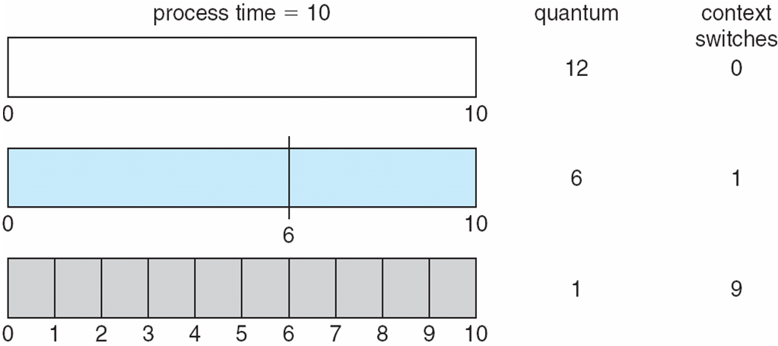
Time Quantum Size vs. Context Switch Time
RR performance depends heavily on the size of the time quantum.
A smaller time quantum increases the number of processor switches.
Recall each context switch takes time.
Examples with one process of 10 time units:
Operating System Concepts, 10th edition
by Abraham Silberschatz, Greg Gagne, and Peter B. Galvin
Wiley, 2018, ISBN 978-1119456339

Slide 34
Context Switch Overhead
Each context switch incurs certain OS administrative overhead:
Save and load registers and memory maps.
Switch memory maps.
Update system tables and lists.
Flush and reload the cache.
etc.

Slide 35
Break
1:35

Slide 36
Scheduling Interactive Systems
Turnaround time varies with the time quantum.
Increasing the time quantum can increase response time.
Example with 100 msec quantum:
10 users press carriage return simultaneously.
The last user must wait 1 second for a response

Slide 37
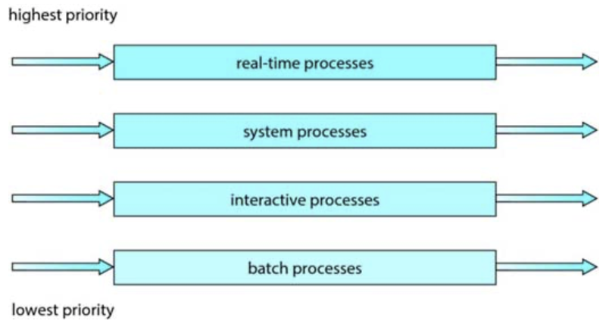
Highest Priority First (HPF)
Priorities can be defined internally or externally.
Internal: computed by some measurable quantity
Examples: time limits, memory requirements, number of open files, CPU burst durations, etc.
External: importance, company policies, type, etc.
Examples by type:
Operating System Concepts, 10th edition
by Abraham Silberschatz, Greg Gagne, and Peter B. Galvin
Wiley, 2018, ISBN 978-1119456339

Slide 38
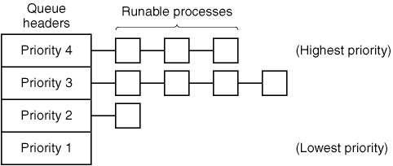
Highest Priority First (HPF), cont’d
HPF scheduling with four priority classes:
For preemptive scheduling, use round-robin within each priority class.
Modern Operating Systems, 4th edition
by Andrew Tanenbaum & Herbert Bos
Pearson, 2014, ISBN 978-0133591620

Slide 39
Highest Priority First (HPF), cont’d
A serious problem with HPF is starvation.
The lowest priority processes may never get to execute.
A solution is aging.
As time progresses, the process scheduler automatically raises the process’s priority.
HPF can be preemptive.
A higher priority task that’s arriving can preempt a currently executing process with a lower priority.

Slide 40
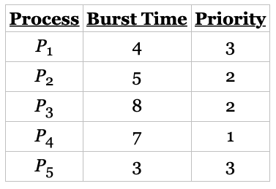
Highest Priority First (HPF), cont’d
Assume that these processes are all in the ready queue, and that 1 is the highest priority:
Use round-robin scheduling for processes with equal priority and time quantum 2:
In this example, process P₄ has the highest priority, so it will run to completion.
Processes P₂ and P₃ have the next-highest priority, and they will execute in a
round-robin fashion. Notice that when process P₂ finishes at time 16, process P₃
is the highest-priority process, so it will run until it completes execution. Now, only
processes P₁ and P₅ remain, and as they have equal priority, they will execute in
round-robin order until they complete.
Operating System Concepts, 10th edition
by Abraham Silberschatz, Greg Gagne, and Peter B. Galvin
Wiley, 2018, ISBN 978-1119456339

Slide 41
Practice Problem #2
Process | Burst Time | Priority
P₁ | 10 | 3
P₂ | 1 | 1
P₃ | 2 | 3
P₄ | 1 | 4
P₅ | 5 | 2
Assume that all arrived at time 0 in the order P₁, P₂, P₃, P₄, P₅ and that 1 the highest priority:
Draw timelines for the scheduling algorithms FCFS, SJF, HPF (non-preemptive), and RR.
What is the turnaround time of each process for each of these scheduling algorithms?
What is the total waiting time for each process with each of these scheduling algorithms?
Which of these scheduling algorithms results in the minimum average waiting time over all the processes?

Slide 42
Practice Problem #2
Timelines:
 | 1 | 2 | 3 | 4 | 5 | 6 | 7 | 8 | 9 | 10 | 11 | 12 | 13 | 14 | 15 | 16 | 17 | 18 | 19
FCFS | P1 | P1 | P1 | P1 | P1 | P1 | P1 | P1 | P1 | P1 | P2 | P3 | P3 | P4 | P5 | P5 | P5 | P5 | P5
SJF | P2 | P4 | P3 | P3 | P5 | P5 | P5 | P5 | P5 | P1 | P1 | P1 | P1 | P1 | P1 | P1 | P1 | P1 | P1
HPF | P2 | P5 | P5 | P5 | P5 | P5 | P1 | P1 | P1 | P1 | P1 | P1 | P1 | P1 | P1 | P1 | P3 | P3 | P4
RR | P1 | P2 | P3 | P4 | P5 | P1 | P3 | P5 | P1 | P5 | P1 | P5 | P1 | P5 | P1 | P1 | P1 | P1 | P1
Turnaround times:
Process | Burst Time | Priority
P₁ | 10 | 3
P₂ | 1 | 1
P₃ | 2 | 3
P₄ | 1 | 4
P₅ | 5 | 2
 | P1 | P2 | P3 | P4 | P5
FCFS | 10 | 11 | 13 | 14 | 19
SJF | 19 | 1 | 4 | 2 | 9
HPF | 16 | 1 | 18 | 19 | 6
RR | 19 | 2 | 7 | 4 | 14

Slide 43
Shortest Process Next
As in Shortest Job Next in a batch system, schedule the shortest interactive process next.
Use past command run times to predict which interactive process will have the shortest time next.

Slide 44
Shortest Process Next, cont’d
Use aging to compute the weighted sum of past run times T₀, T₁, T₂, etc. of a process by dividing the sums by 2:
T₀
T₀/2 + T₁/2
T₀/4 + T₁/4 + T₂/2
T₀/8 + T₁/8 + T₂/4 + T₃/2
The older run times
progressively become
less significant.

Slide 45
Lottery Scheduling
Processes are given “lottery tickets” that enable them to use system resources, such as the CPU.
Higher priority processes get more lottery tickets.
Cooperating processes can exchange tickets.

Slide 46
Fair-Share Scheduling
The scheduler takes into account the user who owns a process before scheduling it.
An owner of processes gets a fair share of the machine, no matter how many processes he or she owns.
Example:
User 1 owns processes A, B, C, and D.
User 2 owns processes e.
If each user gets an equal share of the machine, then with Round Robin scheduling:
A e B e C e D e A e B e C e D e ...

Slide 47
Scheduling Realtime Systems
Time is essential.
External physical devices generate events.
A process must react to an event within a fixed amount of time.
Events may be periodic (occur at regular intervals) or aperiodic (occur unpredictably).

Slide 48
Scheduling Realtime Systems, cont’d
Hard real time
Absolute deadlines that must be met.
Soft real time
A small number of deadline misses are tolerable.

Slide 49
Scheduling Interrupt-Handler Routines
A process scheduler also handles interrupts.
A device controller raises an interrupt by signaling the interrupt request line.
The CPU checks the line after every instruction.
When the CPU catches (senses) an interrupt, it dispatches the interrupt to an interrupt-handler routine at a fixed memory address.
The handler clears the interrupt by servicing the device.

Slide 50
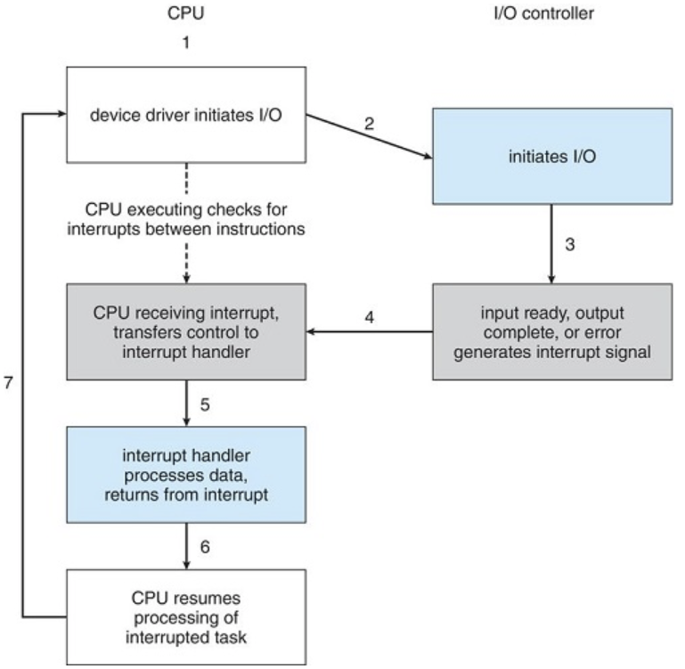
An Interrupt-Driven I/O Cycle
Operating System Concepts, 10th edition
by Abraham Silberschatz, Greg Gagne, and Peter B. Galvin
Wiley, 2018, ISBN 978-1119456339

Slide 51
Assignment #3
Write a program in C or C++ that simulates six process scheduling algorithms:
First-come first-served (FCFS) [non-preemptive]
Shortest job first (SJF) [non-preemptive]
Shortest remaining time (SRT) [preemptive]
Round robin (RR) [preemptive]
Highest priority first (HPF) [non-preemptive] with 4 priority levels
Highest priority first (HPF) [preemptive] with 4 priority levels

Slide 52
Assignment #3, cont’d
Run each scheduling algorithm for 100 quanta.
Label them 0 through 99.
Before each run of an algorithm, create 20 simulated processes in the ready queue.
Each simulated process is simply a data structure that stores information about the process.
For each simulated process, randomly generate:
Arrival time: a float value from quanta 0 through 99.
Expected run time: a float value from 0.1 through 10 quanta.
Priority: integer 1, 2, 3, or 4 (1 is highest)
Include any other attributes that you may need.

Slide 53
Assignment #3, cont’d
Tip: While debugging your program, you may want the same sequence of pseudo-random numbers during each run.
Set the seed of the random number generator to a fixed value, such as 0.
For a different sequence for each run, set the seed to the current clock value.
See rand() and srand() in C and C++
https://www.geeksforgeeks.org/rand-and-srand-in-ccpp/
https://www.geeksforgeeks.org/generating-random-number-range-c/

Slide 54
Assignment #3, cont’d
Assume only one CPU and one ready queue.
Sort the simulated processes in the ready queue by arrival time.
Your process scheduler can do process switching only at the start of each time quantum.
For this assignment, consider only CPU time for each process
No I/O wait times.
No process switching overhead.

Slide 55
Assignment #3, cont’d
For RR, use a time slice of 1 quantum.
For HPF, use 4 priority queues.
For preemptive scheduling, use RR with a time slice of 1 quantum for each priority queue.
For non-preemptive scheduling, use FCFS.
For both preemptive and non-preemptive schedule, add aging to help prevent starvation.
After a process has waited for 5 quanta at a priority level, bump it up to the next higher level.

Slide 56
Assignment #3, cont’d
Each simulation run should last until the completion of the last process, even if it goes beyond 100 quanta.
No process should get the CPU for the first time after time quantum 99.
Run each scheduling algorithm simulation 5 times to get averages for the output statistics (next slide).
Clear the ready queue before each run and create a new set of simulated processes.

Slide 57
Assignment #3, cont’d
Output for each algorithm run (total 30 runs):
The sorted contents of the ready queue before the start of the run:
Each process’s name (such as A, B, C, ...) and its arrival time, expected run time, and priority.
A timeline of the 100+ quanta run that shows which process ran during each quantum, such as ABCDABCD ...
Show a process’s name in a quantum even if it completed execution before the end of that quantum.
The CPU can be idle during the last part of a quantum if a process completes before the end of the quantum. (No need to show the idle time within a quantum.)
Show a hyphen - if a quantum is completely unused.

Slide 58
Assignment #3, cont’d
Output for each algorithm run, cont’d:
Calculated statistics:
average turnaround time for the processes that ran
average waiting time for the processes that ran
how many processes in the ready queue that never ran
throughput of the algorithm per 100 quanta
$\frac{number of completed processes × 100 quanta }{total quanta to complete the processes}$

Slide 59
Assignment #3, cont’d
Report (1 or 2 pages)
The average statistics over 5 runs for each scheduling algorithm.
Discuss which algorithm appears to be best for each of the calculated statistics.

Slide 60
Assignment #3, cont’d
Create a zip file containing:
Your C of C++ source files.
A text file containing output from your simulation runs.
Your report as a PDF.

Slide 61
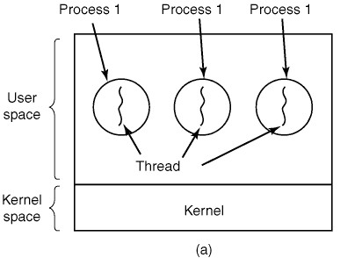
Threads
Traditionally, each process has its own address space and a single thread of control.
Modern Operating Systems, 4th edition
by Andrew Tanenbaum & Herbert Bos
Pearson, 2014, ISBN 978-0133591620

Slide 62
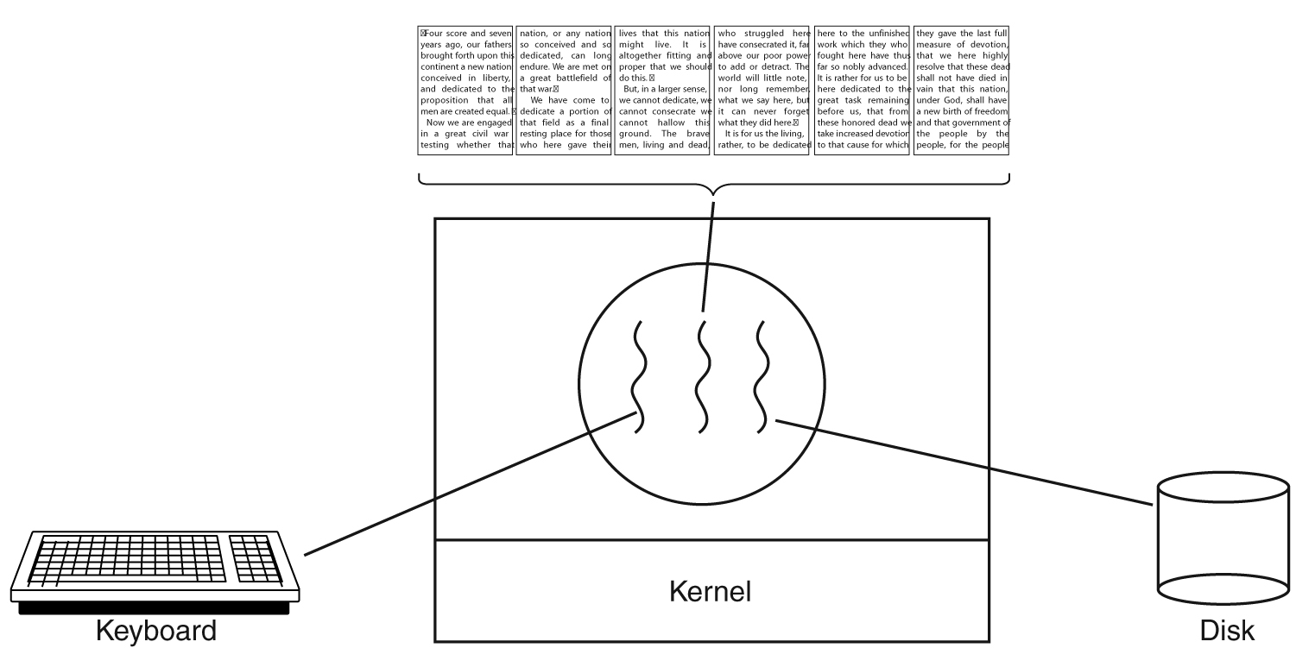
Threads, cont’d
Operating systems can support a process having multiple threads of control all running in the same address space.
A word processor process with three threads of control:
Modern Operating Systems, 4th edition
by Andrew Tanenbaum & Herbert Bos
Pearson, 2014, ISBN 978-0133591620

Slide 63
Threads, cont’d
Each thread (AKA lightweight process) has:
A program counter.
Registers to hold its current working variables.
A runtime stack.

Slide 64
Threads, cont’d
Additions to the Process Control Block (PCB) to support threads:
Modern Operating Systems, 4th edition
by Andrew Tanenbaum & Herbert Bos
Pearson, 2014, ISBN 978-0133591620

Slide 65
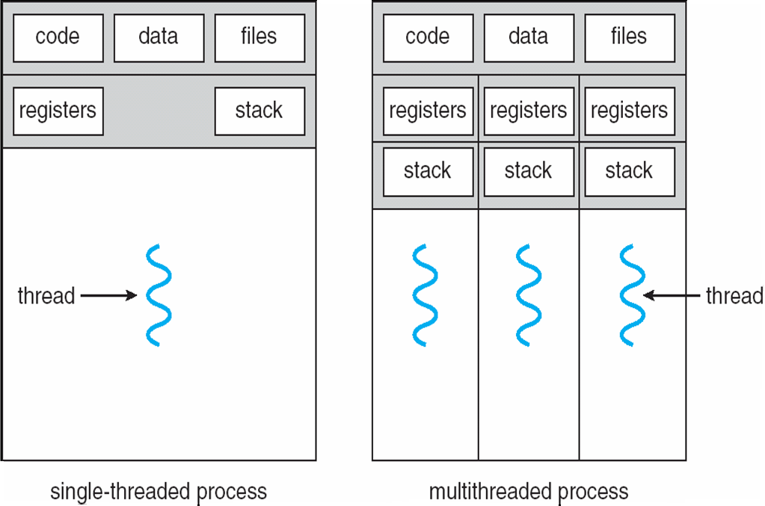
Threads, cont’d
Operating System Concepts, 10th edition
by Abraham Silberschatz, Greg Gagne, and Peter B. Galvin
Wiley, 2018, ISBN 978-1119456339

Slide 66
Benefits of Threads
Responsiveness
Resource Sharing
Economy
Scalability

Slide 67
Threads and Multicore Systems
Multicore systems present additional challenges to programmers, including:
Dividing activities
Balance
Data splitting
Data dependency
Testing and debugging

Slide 68
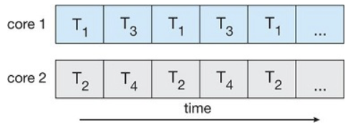
Concurrent Execution of Threads
Single core system:
Multicore system:
Operating System Concepts, 10th edition
by Abraham Silberschatz, Greg Gagne, and Peter B. Galvin
Wiley, 2018, ISBN 978-1119456339

Slide 69
Thread Scheduling
Two levels of concurrency: processes and threads.
User-level threads
The OS kernel doesn’t know about user threads.
The process’s thread scheduler schedules its threads to run during each time quantum.
Each process maintains its own private thread table.
Kernel-level threads
The OS kernel picks the threads to run.
It may or may not consider which process the thread belongs to.

Slide 70
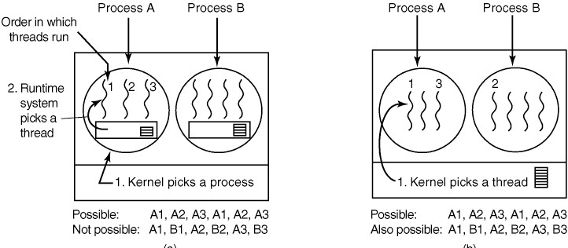
Thread Scheduling, cont’d
Possible scheduling of user-level threads.
Modern Operating Systems, 4th edition
by Andrew Tanenbaum & Herbert Bos
Pearson, 2014, ISBN 978-0133591620

Slide 71
Thread Scheduling, cont’d
Possible scheduling of kernel-level threads.
Modern Operating Systems, 4th edition
by Andrew Tanenbaum & Herbert Bos
Pearson, 2014, ISBN 978-0133591620

Slide 72
Thread Scheduling, cont’d
Performance differences between user-level and kernel-level threads:
A thread switch from one user-level thread to another within the same process is fast.
A thread switch with kernel-level threads can involve a complete process switch.
Kernel-level thread switching is optimized if the switches are as much as possible among threads within the same process.

Slide 73
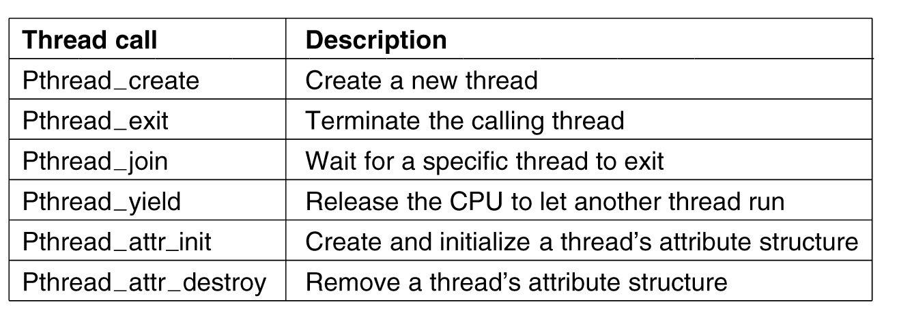
POSIX Threads
The POSIX standard for threads is implemented by the Pthreads package.
Actually, the Pthreads function names are all in lower case: pthread_create, pthread_exit, pthread_attr_init, etc.
Modern Operating Systems, 4th edition
by Andrew Tanenbaum & Herbert Bos
Pearson, 2014, ISBN 978-0133591620

