Slide 1


CMPE 142
Operating Systems
February 5 Class Meeting
Department of Computer Engineering
San Jose State University
Spring 2021
Instructor: Ron Mak
www.cs.sjsu.edu/~mak

Slide 2
Project Teams

Slide 3
What is an Operating System?
System Software
compilers, file browsers, web browsers,
terminal windows, utilities, etc.
User Software
applications, document editors,
graphics tools, spreadsheets, IDEs, etc.
API
Command-line Shell
GUI
Resource Managers (Kernel)
processes, memory, files, storage, interrupts, security, network, virtual machines, etc.
Operating
system
Device Drivers
Physical Hardware
API: application programming interface
  make POSIX system calls from programs
GUI: graphical user interface
  windows, menus, buttons, etc.
IDE: integrated development environment
  Eclipse, CLion, etc.
Portable Operating
System Interface

Slide 4
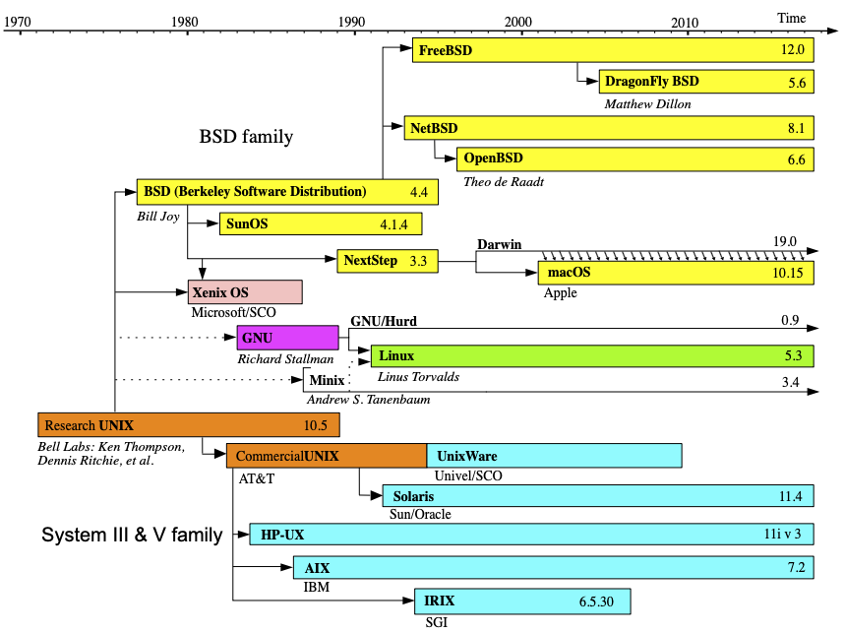
Evolution of UNIX
CMPE 142
CMPE 142
https://upload.wikimedia.org/wikipedia/commons/c/cd/Unix_timeline.en.svg

Slide 5
The bash Shell
bash is the default shell and command language for Linux.
  shell: a command interpreter for the
  command-line interface to Linux.
We will use bash to demonstrate UNIX/Linux features as our example operating system.
Example programs will use POSIX calls to show how these features are implemented.

Slide 6
Virtual Views of the Computer
Processes
  You run programs.
  Instead of scheduling and managing CPUs.
Memory
  Allocate to your programs statically or dynamically.
  Instead of dealing with physical memory addresses.
  Use more memory than physically present.
Files
  You work with named collections of persistent data.
  Instead of disk sectors and sector addresses.

Slide 7
Virtual Views of the Computer, cont’d
Input and output (I/O)
  Your programs read and write files.
  Instead of communicating with hardware devices.
In summary, an operating system (OS) enables
  You to interact with a computer
  at a higher, more user-friendly level.
  Your programs not to have to work directly
  with the physical hardware.

Slide 8
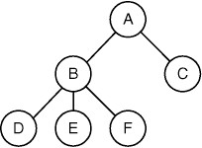
Abstraction: Processes
A process is an executing program.
It uses memory resources (an address space).
It uses machine registers.
It can create (“spawn”) child processes and thereby create a process tree.
Processes may need
to communicate with
each other.
  IPC = interprocess
  communication
Modern Operating Systems, 4th edition
by Andrew Tanenbaum & Herbert Bos
Pearson, 2014, ISBN 978-0133591620

Slide 9
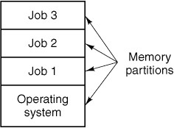
Abstraction: Memory
Early operating systems + computer hardware support together enabled multiprogramming.
  Each process’s address space in physical memory resided in a separate memory partition.
Modern operating systems implement virtual memory that is larger than physical memory.
Operating Systems: Design and Implementation, 3rd ed.
By Andrew Tanenbaum & Albert Woodhull
Prentice-Hall, Inc., 2006, ISBN 978-0131429383

Slide 10
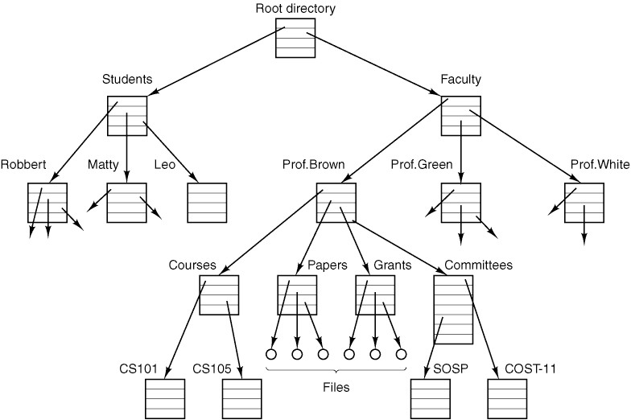
Abstraction: File Systems
An operating system provides users and programmers with a file system.
  A very high-level abstract view of data
  stored on disks.
  Data files are named.
  Data files are stored
  hierarchically in
  directories (folders).
  Users can create, delete,
  move, and copy files.
  Programs can read and
  write files.
Modern Operating Systems, 4th edition
by Andrew Tanenbaum & Herbert Bos
Pearson, 2014, ISBN 978-0133591620

Slide 11
OS Concept: API
The application programming interface (API) allows programs to make system calls to the operating system.
Typical types of system calls:
  process management
  signaling
  file management
  file system management
  protection
  time management

Slide 12
Example System Call: fork()
A process creates a child process by making
a fork() system call.
  fork() makes an exact copy of the parent process’s address space for the child process.
  The parent and child processes will then
  each have a separate address space.
Both processes continue executing
at the point of the fork() call,
each within its address space.

Slide 13
Example System Call: fork()
After a fork operation, how does a process determine whether it’s the original (parent) process or the child process?
  Parent: The fork() call returns the process id (pid)
  of the child process that was just created.
  Child: The fork() call returns 0.

Slide 14
Example System Call: fork()
#include <stdio.h>
#include <sys/types.h>
#include <sys/wait.h>
#include <unistd.h>
int main(void)
{
printf("Parent: Process started.\n");
printf("Parent: Forking a child.\n");
pid_t pid = fork();
if (pid != 0)
{
int status;
printf("Parent: Waiting for child with pid %d to complete ...\n", pid);
waitpid(pid, &status, 0);
printf("Parent: ... terminated!\n");
}
else
{
printf(" Child: Process started with pid %d.\n", getpid());
printf(" Child: 5 second idle:");
int i;
for (i = 5; i > 0; i--)
{
printf("%2d", i); fflush(stdout);
sleep(1);
}
printf(" terminated!\n");
}
return 0;
}
forktest.c
The two processes fork at this point.
Executed by the parent.
Executed by the child.
Demo

Slide 15
How to Call the Functions
Use Google.
  Example: Google “C fork()”
Or use the “man” (manual) pages.
  Example: On the command line, type the command
  Use the keyboard arrow and page keys to scroll.
  Press the Q key to exit.
You will also see what .h header files you need.
man fork
Demo

Slide 16
How to Compile and Run a C Program
To compile a C source file (for example, forktest.c) on the bash command line:
  After the -o is the name you want for the executable program. It does not have to be the same name as the .c source file.
  If your program consists of multiple .c source files, you should use *.c instead.
To run the program (for example, forktest) after you’ve successfully compiled it:
cc -o forktest forktest.c
./forktest
Demo

Slide 17
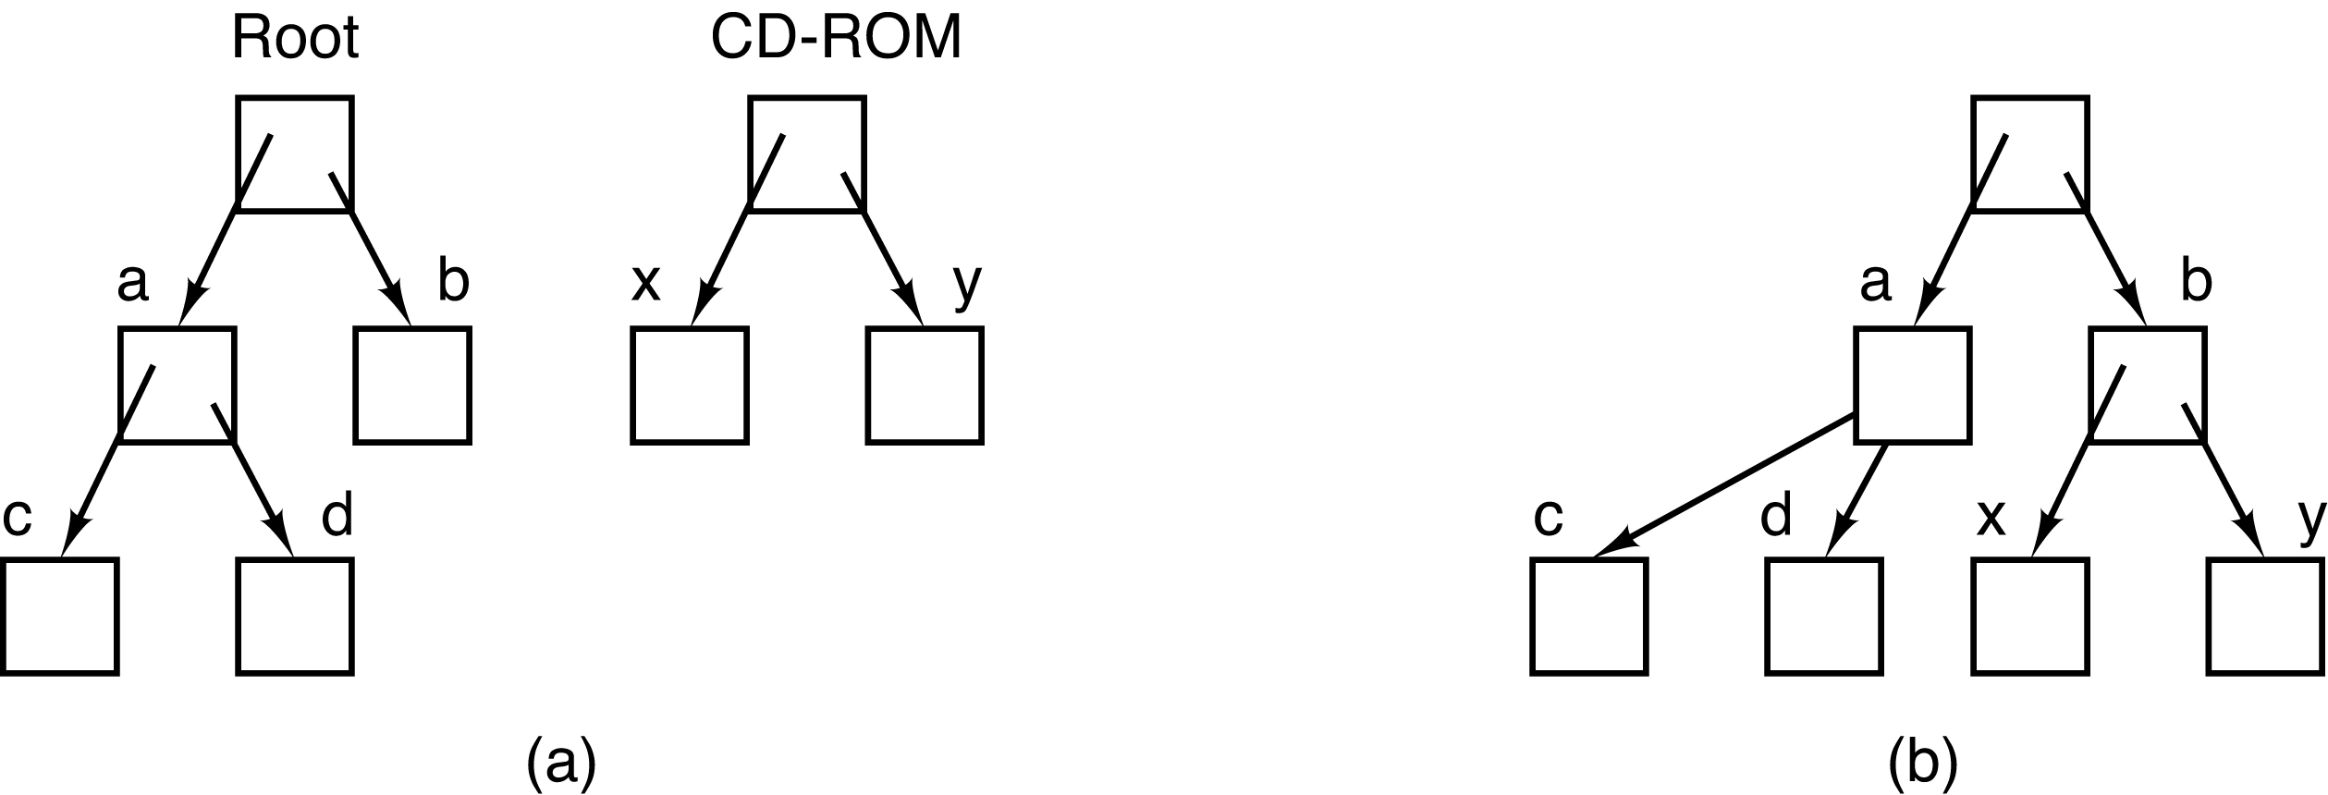
OS Concept: Mounted File Systems
“Mount” an external file system located on removable media such as a CD ROM.
  Graft the external file system
  onto the main file system hierarchy.
/b/y
Before mounting, the files on
the CD ROM are not accessible.
After mounting, the files have
become part of the file hierarchy.
Modern Operating Systems, 4th edition
by Andrew Tanenbaum & Herbert Bos
Pearson, 2014, ISBN 978-0133591620

Slide 18
OS Concept: stdin and stdout
For a program run on the command line:
  stdin: The standard input is the keyboard.
  (cin in C++)
  stdout: The standard output is the terminal.
  (cout in C++)
For error messages:
  stderr: The standard error is the terminal.
  (cerr in C++)

Slide 19
OS Concept: stdin and stdout, cont’d
Echo stdin to stdout with program name prefix.
#include <stdio.h>
const int MAX_LENGTH = 256;
int main(int argc, char *args[])
{
char *progname = args[0];
char buffer[MAX_LENGTH];
while (fgets(buffer, sizeof(buffer), stdin) > 0)
{
printf("%s: %s", progname, buffer);
}
printf("Done!\n");
return 0;
}
echo.c
By default, printf()
writes to stdout.

Slide 20
OS Concept: stdin and stdout, cont’d
#include <iostream>
#include <string>
using namespace std;
int main(int argc, char *args[])
{
string progname(args[0]);
string buffer;
while (getline(cin, buffer))
{
cout << progname << ": " << buffer << endl;
}
cout << "Done!" << endl;
return 0;
}
echo.cpp
Demo

Slide 21
How to Compile and Run a C++ Program
To compile a C++ source file (for example, tagger.cpp) on the bash command line:
  After the -o is the name you want for the executable program. It does not have to be the same name as the .cpp source file.
  If your program consists of multiple .c source files, you should use *.cpp instead.
To run the program (for example, echo) after you’ve successfully compiled it:
g++ -o echo echo.cpp
Note: g++ not c++
./echo
Demo

Slide 22
OS Concept: Shell
The shell is the command-line interpreter
that allows you to type commands to the operating system.
  Run application programs and system utilities.
  “Redirect” a program’s input and output.
  Run multiple programs and “pipe” one program’s output to another program as the latter’s input.
The bash shell is the POSIX standard for Linux.

Slide 23
Shell: I/O Redirection
The shell enables you to redirect a program’s stdin on the command line with the < operator:
  Now the echo program will read stdin from text file hello-in.txt.
You can redirect a program’s stdout on the command line with the > operator:
  Now the echo program will write to text file
  hello-out.txt, overwriting its previous contents.
  Use the >> operator to append to an output file.
./echo < hello-in.txt
./echo < hello-in.txt > hello-out.txt
Demo

Slide 24
Shell: I/O Redirection, cont’d
The bash shell has more I/O redirection capabilities.
  Example: Redirect stderr
  See https://linuxize.com/post/bash-redirect-stderr-stdout/

Slide 25

OS Concept: Pipes
Pipes are a mechanism for
interprocess communication (IPC).
  One process writes to one end of a pipe.
  Another process reads from the other end.
  Each process believes it is doing file I/O.
Therefore, one process can send data to another process while both are running.
  A pipe is unidirectional.
Modern Operating Systems, 4th edition
by Andrew Tanenbaum & Herbert Bos
Pearson, 2014, ISBN 978-0133591620

Slide 26
OS Concept: Pipe Example
globals.h
#ifndef GLOBALS_H_
#define GLOBALS_H_
#include <stdio.h>
#include <string.h>
#include <unistd.h>
#define BUFFER_SIZE 256
// File descriptors.
enum { READ_END = 0, WRITE_END = 1 };
// Parent and child processes.
// fd is the array of file descriptors.
void parent(int fd[]);
void child(int fd[]);
#endif /* GLOBALS_H_ */
Why have the
lines in red?

Slide 27
OS Concept: Pipe Example, cont’d
main.c
#include "globals.h"
int main(void)
{
int fd[2]; // file descriptors for the pipe
// Create the pipe.
pid_t pipe_id = pipe(fd);
if (pipe_id < 0)
{
fprintf(stderr,"pipe() failed");
return pipe_id;
}
// Fork a child process.
pid_t pid = fork();
if (pid > 0) parent(fd);
else if (pid == 0) child(fd);
else
{
fprintf(stderr, "fork() failed");
return pid;
}
return 0;
}
Create the pipe
Fork a child process.

Slide 28
OS Concept: Pipe Example, cont’d
#include "globals.h"
void parent(int fd[])
{
char buffer[BUFFER_SIZE];
printf("Parent started.\n");
// Close the unused READ end of the pipe.
close(fd[READ_END]);
for (;;)
{
if (fgets(buffer, sizeof(buffer), stdin) <= 0) break;
// Remove the '\n' at the end.
buffer[strlen(buffer) - 1] = '\0';
// Write to the WRITE end of the pipe.
write(fd[WRITE_END], buffer, strlen(buffer));
}
// Close the WRITE end of the pipe.
close(fd[WRITE_END]);
printf("Parent done.\n");
}
parent.c
The parent process
writes to the pipe.

Slide 29
OS Concept: Pipe Example, cont’d
#include "globals.h"
void child(int fd[])
{
char buffer[BUFFER_SIZE];
printf("Child started.\n");
// Close the unused WRITE end of the pipe.
close(fd[WRITE_END]);
// Read from the READ end of the pipe.
ssize_t size;
for (;;)
{
size = read(fd[READ_END], buffer, BUFFER_SIZE);
if (size <= 0) break;
if (size < BUFFER_SIZE) buffer[size] = '\0';
printf("Child: Read '%s' from the pipe.\n", buffer);
}
// Close the READ end of the pipe.
close(fd[READ_END]);
printf("Child done.\n");
}
child.c
The child process
reads from the pipe.

Slide 30
Shell: Pipes
In the bash shell, you can pipe one program’s output to another program’s input with the | pipe operator on the command line:
  The shell creates the processes (running programs).
The stdout of the first process becomes the stdin for the second process.
Both processes are running concurrently.
  Whenever the first process writes,
  the second process can read.
program1 | program2

Slide 31
Shell: Pipe Example
Suppose we have a distributed application where messages are routed from one node of the network to another.
  Each node geo-tags every message it receives before sending to the next node of the route.
We will simulate this application on a single laptop by representing each node by a process.
  All the processes will run concurrently as messages are routed from one “node” to another.
  We will use the shell’s pipe feature to execute the processes and route the messages.

Slide 32
Shell: Pipe Example, cont’d
#include <iostream>
#include <string>
using namespace std;
int main(int argc, char *args[])
{
string tag(args[1]);
string message;
cout << "Node " << tag << " started." << endl;
cout.flush();
while (getline(cin, message))
{
cout << "[" << tag << ": " << message << "]" << endl;
cout.flush();
}
cout << "Node " << tag << " done!" << endl;
return 0;
}
What will happen if you type the following command in the bash shell?
./tagger SJSU | ./tagger UCLA | ./tagger Stanford
Demo
tagger.cpp

Slide 33
Break
15 minutes
2:15

Slide 34
POSIX
Portable Operating System Interface
  First specified by the IEEE Computer Society in 1988 to maintain compatibility between operating systems (mostly but not only UNIX-based OS’s)
API system calls
Command-line commands and scripts
Utility programs
POSIX-certified and mostly POSIX-compliant operating systems
  See https://en.wikipedia.org/wiki/POSIX#POSIX-oriented_operating_systems

Slide 35
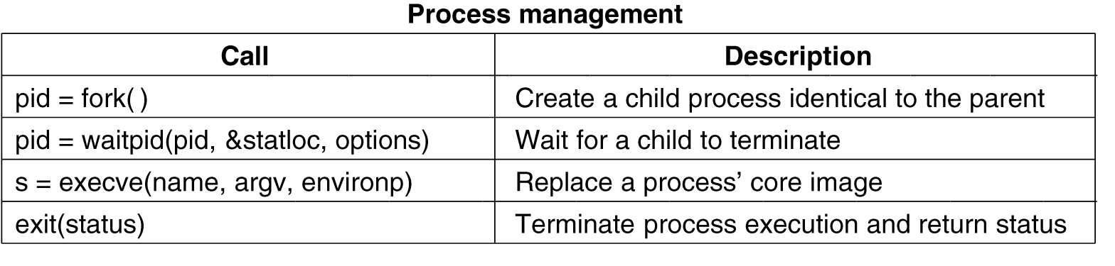
POSIX Library Functions
Some of the key system calls from the POSIX systems library.
  For a more complete list, see https://www.mkompf.com/cplus/posixlist.html
Modern Operating Systems, 4th edition
by Andrew Tanenbaum & Herbert Bos
Pearson, 2014, ISBN 978-0133591620

Slide 36
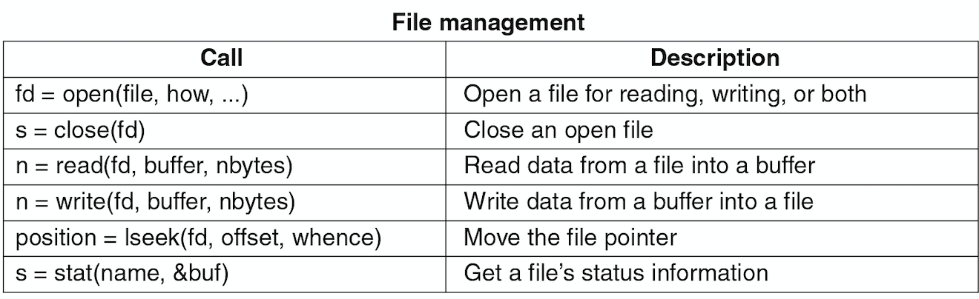
POSIX Library Functions, cont’d
Modern Operating Systems, 4th edition
by Andrew Tanenbaum & Herbert Bos
Pearson, 2014, ISBN 978-0133591620

Slide 37
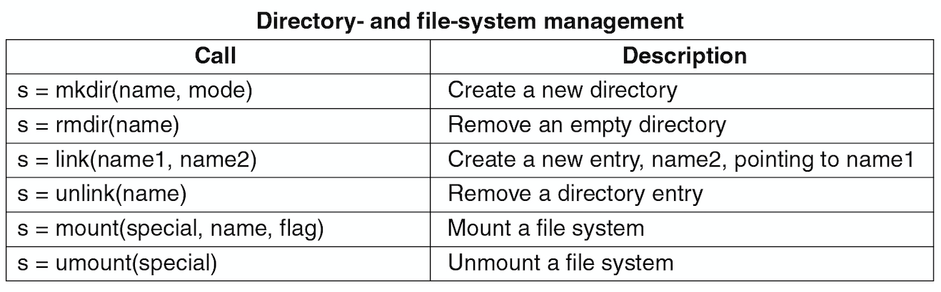
POSIX Library Functions, cont’d
Modern Operating Systems, 4th edition
by Andrew Tanenbaum & Herbert Bos
Pearson, 2014, ISBN 978-0133591620

Slide 38
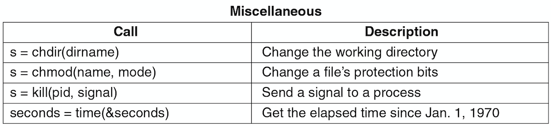
POSIX Library Functions, cont’d
Modern Operating Systems, 4th edition
by Andrew Tanenbaum & Herbert Bos
Pearson, 2014, ISBN 978-0133591620

Slide 39
Kernel Mode vs. User Mode
An OS such as UNIX executes its
critical system software in kernel mode.
  This is one way the OS protects itself.
As a user, you run application programs and utility programs such as editors, compilers, and browsers in user mode.
  System calls made by your programs can invoke
  OS code that is executed in kernel mode.
On the command line, you can become
super user and bypass some of the
OS protection mechanisms.

Slide 40
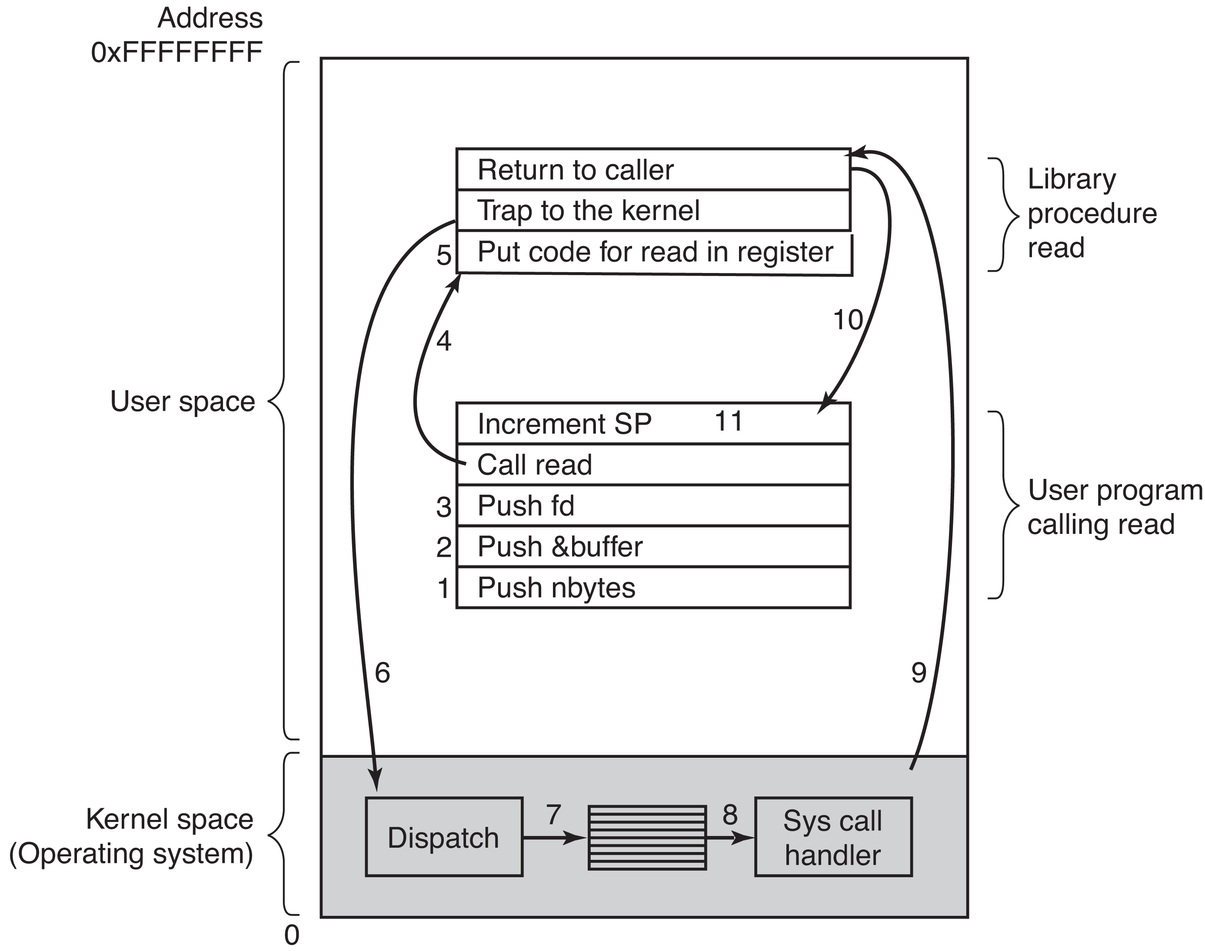
Workflow of a System Call
Invoke the system call
count = read(fd, buffer, nbytes)
Push nbytes
Push &buffer
Push fd
Invoke the read library routine.
Put the system call code for read
in a register.
TRAP instruction switches to kernel mode to access the dispatcher in
the OS kernel.
Dispatcher accesses the read handler.
Execute the read handler.
Return to the user program at the point after the TRAP instruction.
Push in reverse order
on the runtime stack.
Modern Operating Systems, 4th edition
by Andrew Tanenbaum & Herbert Bos
Pearson, 2014, ISBN 978-0133591620

Slide 41
Operating System Structure
There are various ways to organize the code
of an operating system.
  Monolithic
  Layered
  Virtual machines
  Client-server
  Distributed

Slide 42
OS Structure: Monolithic
The original classic way an OS was designed.
No structure.
  A collection of routines.
  Each routine can call any other routine.
  No information hiding.
A challenge to build and link.
An even bigger challenge to maintain and debug.
Every software engineer should read
the book The Mythical Man-Month
about the development of IBM OS/360.

Slide 43
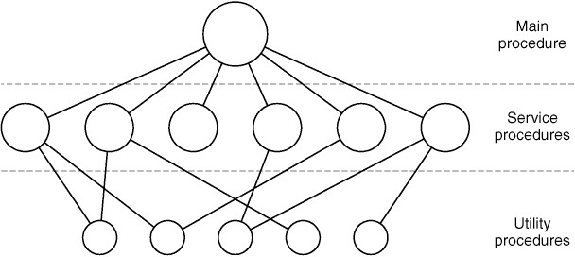
OS Structure: Layered
Organize the OS as a hierarchy of layers.
  Each layer built on top of the one below it.
Modern Operating Systems, 4th edition
by Andrew Tanenbaum & Herbert Bos
Pearson, 2014, ISBN 978-0133591620

Slide 44
OS Structure: Layered, cont’d
Layers of the THE operating system.
  For a Dutch computer in the late 1960s.
  The bottommost layer 0 provided multiprogramming.
Modern Operating Systems, 4th edition
by Andrew Tanenbaum & Herbert Bos
Pearson, 2014, ISBN 978-0133591620

Slide 45
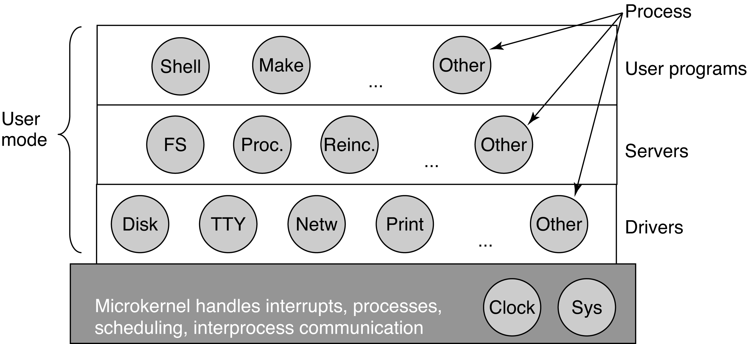
OS Structure: Microkernel
Put as much OS code as possible outside of the kernel and into user space.
  A bug in kernel code then has a much smaller chance of crashing the system.
Modern Operating Systems, 4th edition
by Andrew Tanenbaum & Herbert Bos
Pearson, 2014, ISBN 978-0133591620

Slide 46
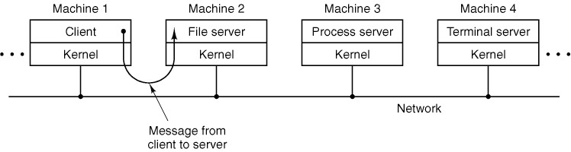
OS Structure: Client-Server
Servers provide OS services.
  Can run in different machines on the network.
Pass messages to make service requests.
  The service sends back the reponse.
Clients do not need to know where on the network the services are provided.
Modern Operating Systems, 4th edition
by Andrew Tanenbaum & Herbert Bos
Pearson, 2014, ISBN 978-0133591620

Slide 47
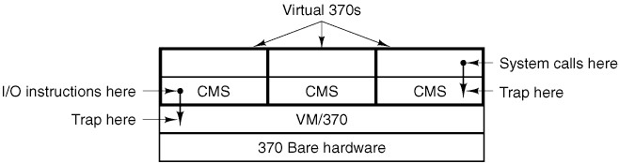
OS Structure: Virtual Machines
Virtual machines (VMs) were first developed
for the IBM 370 in the late 1960s.
  Each virtual machine behaves like
  a separate physical machine.
  Controlled by a virtual machine monitor.
Modern Operating Systems, 4th edition
by Andrew Tanenbaum & Herbert Bos
Pearson, 2014, ISBN 978-0133591620

Slide 48
OS Structure: Virtual Machines
Modern VM monitors include:
  VirtualBox
  VMware
  KVM
  OpenVZ
  Xen

Slide 49
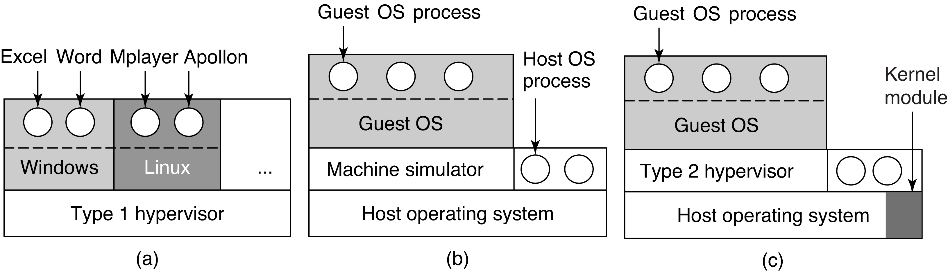
Hypervisors
hypervisor: new term for “virtual machine monitor”
Type 1 has no host OS support.
Type 2 uses binary translation but does not have good performance.
Type 3 is used today by VirtualBox, VMware, etc.
Modern Operating Systems, 4th edition
by Andrew Tanenbaum & Herbert Bos
Pearson, 2014, ISBN 978-0133591620

Slide 50
Processes
A process is basically an abstraction of a
running program.
  The most central concept in any operating system.
  It consists of some activity on the computer.
  It has a program, input, output, memory, registers, etc., and a state.
Each process runs in its own address space.
  If a program (such as a spreadsheet) is running more than once at the same time, each is an individual process with a separate address space.

Slide 51
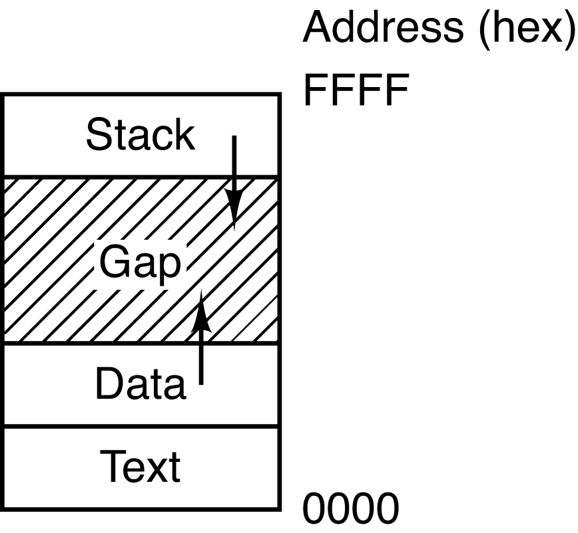
Processes in Memory
A UNIX process’s address space is divided into three segments:
  text segment: the program code.
  data segment: includes the heap for dynamically allocated data (grows upwards into higher memory addresses).
  stack segment: the runtime stack (grows downwards into lower memory addresses).
  gap: unused memory space
When the gap is used up,
a “heap-stack collision”
has occurred, and you
have an “out of memory”
runtime error.
Modern Operating Systems, 4th edition
by Andrew Tanenbaum & Herbert Bos
Pearson, 2014, ISBN 978-0133591620

Slide 52
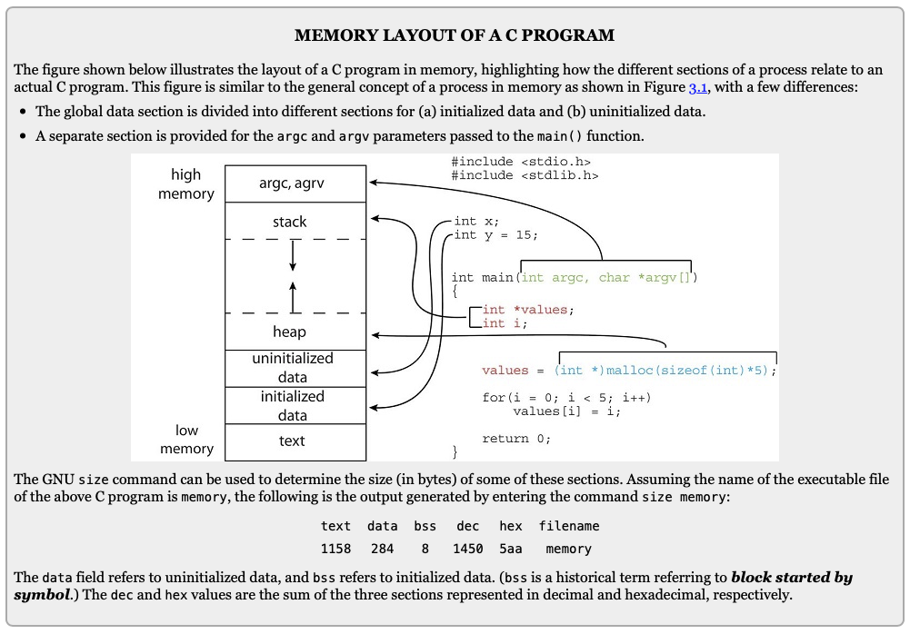
Memory Layout of a C Program
Operating System Concepts, 10th edition
by Abraham Silberschatz, Greg Gagne, and Peter B. Galvin
Wiley, 2018, ISBN 978-1119456339

Slide 53
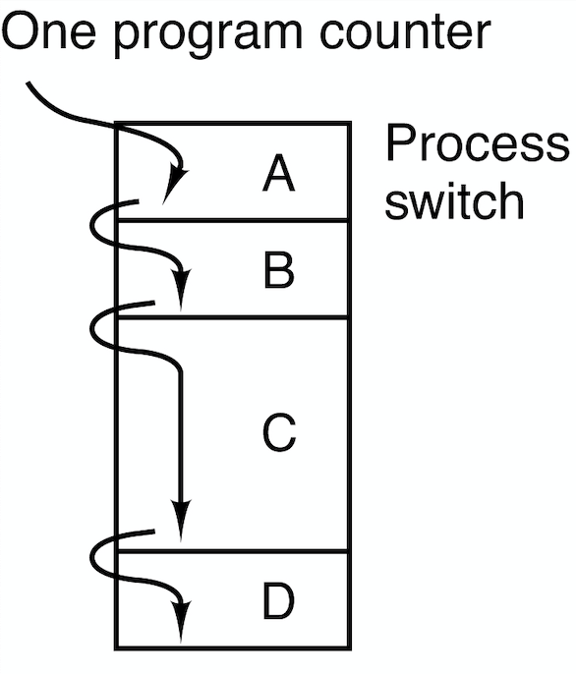
Process Models
Multiprogramming with
multiple running programs.
One program counter
per CPU.
Each program has its
own virtual CPU.
The real CPU rapidly
switches from one
program to another.
  Process switching AKA context switching
Modern Operating Systems, 4th edition
by Andrew Tanenbaum & Herbert Bos
Pearson, 2014, ISBN 978-0133591620

Slide 54
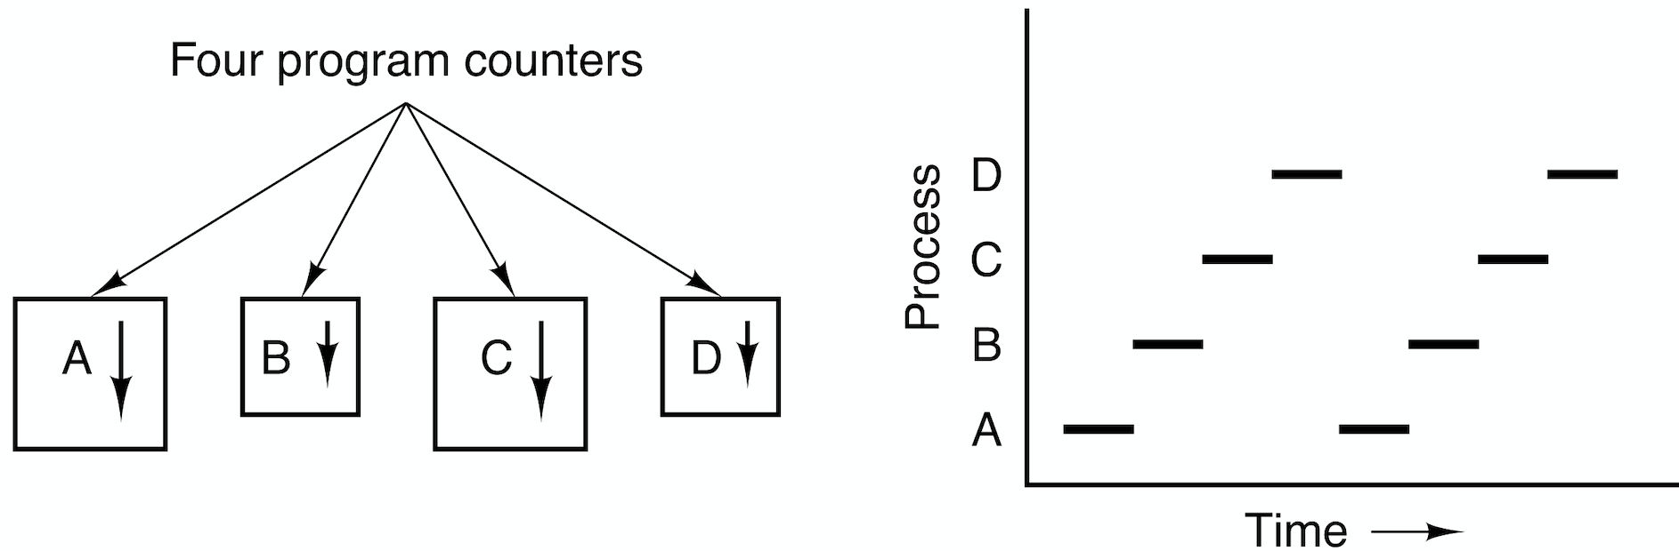
Process Models, cont’d
Only one program is active on a CPU
at any instant.
  Each program has its own logical program counter.
  When a program runs, its logical program counter is switched into the machine’s physical program counter.
Modern Operating Systems, 4th edition
by Andrew Tanenbaum & Herbert Bos
Pearson, 2014, ISBN 978-0133591620

Slide 55
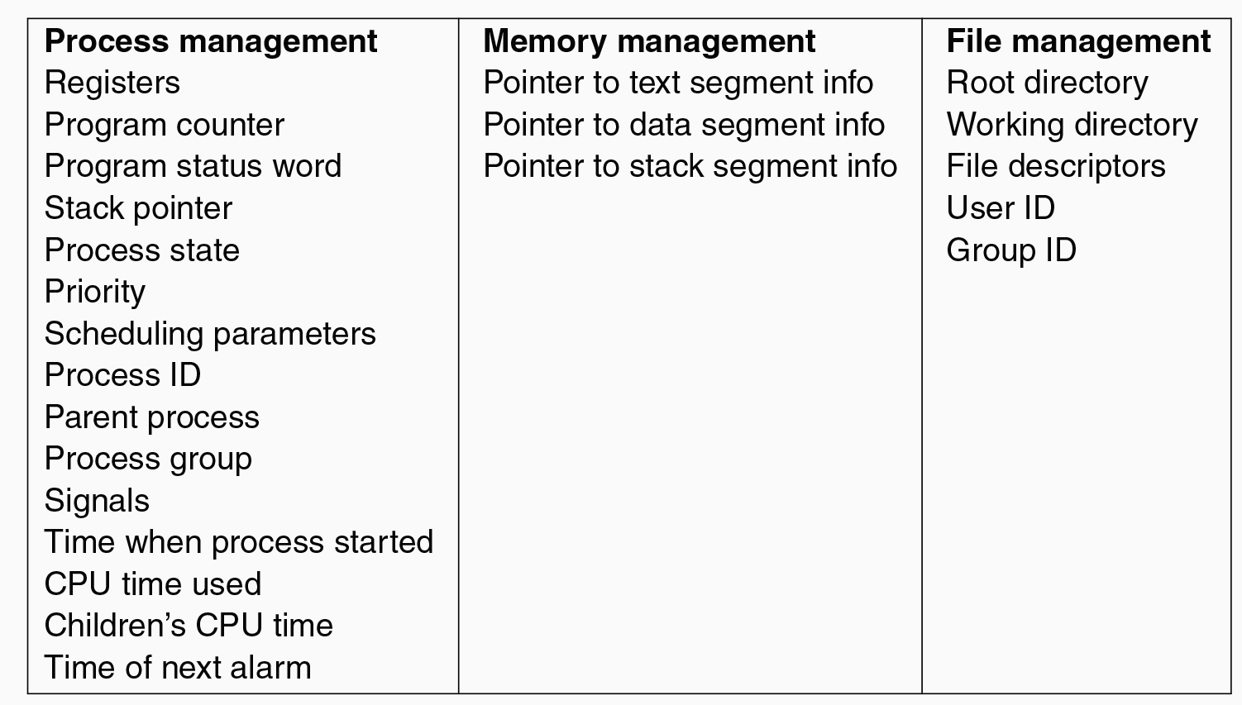
Process Control Block
The OS maintains a process table to keep track of processes.
  Each entry of the table is a process control block, (PCB) which contains a process’s state information.
Modern Operating Systems, 4th edition
by Andrew Tanenbaum & Herbert Bos
Pearson, 2014, ISBN 978-0133591620

Slide 56
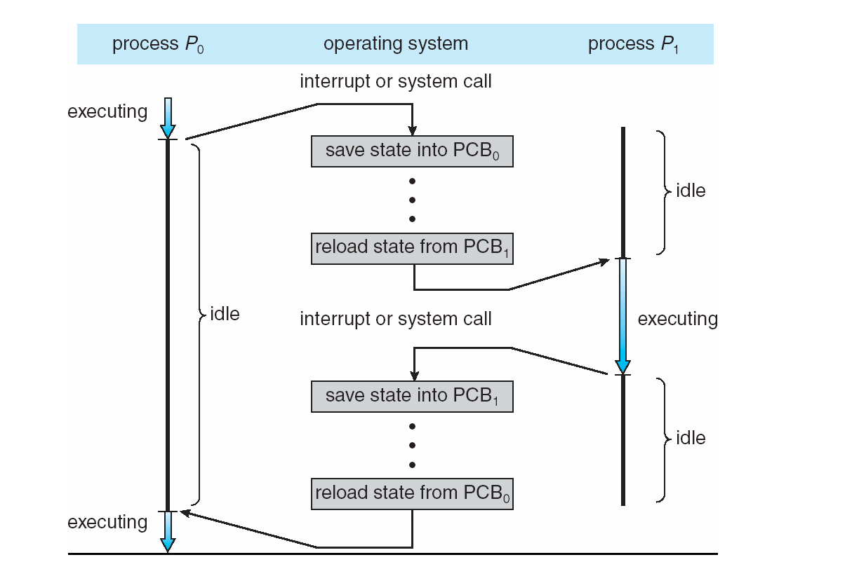
Context Switching
Operating Systems: Design and Implementation, 3rd ed.
By Andrew Tanenbaum & Albert Woodhull
Prentice-Hall, Inc., 2006, ISBN 978-0131429383

Slide 57
Process Creation
Principal events that cause
processes to be created:
  System initialization.
  Execution of a process creation system call
  by a running process, such as fork().
  A user request to create a new process.
  Initiation of a batch job.

Slide 58
Process Termination
Conditions that cause a process to terminate:
  Normal exit (voluntary).
  Error exit (voluntary).
  Fatal error (involuntary).
  Killed by another process (involuntary).
Cascading termination
  On some operating systems, when a process terminates, so do its child processes.

Slide 59
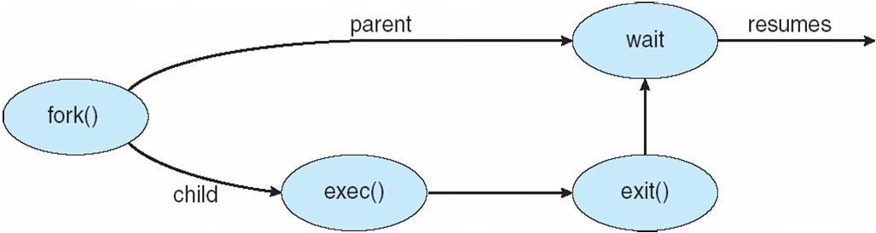
Process Creation and Termination
What does the exec()
system call do?
Operating Systems: Design and Implementation, 3rd ed.
By Andrew Tanenbaum & Albert Woodhull
Prentice-Hall, Inc., 2006, ISBN 978-0131429383

Slide 60
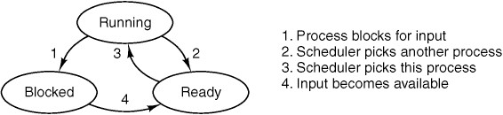
Process States
Running
  Using the CPU at that instant.
Ready
  Runnable, but temporarily stopped to let another process run.
Blocked
  Unable to run until some external event happens.
Modern Operating Systems, 4th edition
by Andrew Tanenbaum & Herbert Bos
Pearson, 2014, ISBN 978-0133591620

