Slide 1


CMPE 142
Operating Systems
January 29 Class Meeting
Department of Computer Engineering
San Jose State University
Spring 2021
Instructor: Ron Mak
www.cs.sjsu.edu/~mak

Slide 2
Basic Info
Office hours
  TuTh 4:30 – 5:30 PM via Zoom
  ENG 250 (but working from home)
Website
  Faculty webpage: http://www.cs.sjsu.edu/~mak/
  Class webpage:
  http://www.cs.sjsu.edu/~mak/CMPE142/index.html
  Syllabus
  Assignments
  Lecture notes

Slide 3
Goals of the Course
Learn the basic concepts of
an operating system (OS).
  Resource management.
  Protection and security.
Learn how to interact with an operating system.
  Enter commands in a terminal window.
  Write and run command (“shell”) scripts.
  Manipulate OS components via a graphical user interface (GUI).

Slide 4
Goals of the Course, cont’d
Learn how to write programs that will
run on an operating system.
  Make system calls using functions from the application programming interface (API).
  Write applications that use multiprocessing
  and multithreading.
We’ll try to keep this class
real-world and practical.

Slide 5
Course Learning Outcomes
UNIX (via macOS) and Linux will be our primary OS examples throughout the semester.
  Understand OS concepts as implemented
  by UNIX and Linux.
Learn how to use UNIX and Linux.
  Interact with and make use of their facilities
  from the command line and shell scripts.
  Make system calls from C and C++ programs.
  Write multithreaded programs.

Slide 6
The Bottom Line
Become a more efficient and effective computer user.
Write programs that are more powerful and feature-rich.
Acquire important survival skills
that make you a better employee.

Slide 7
Rough Course Timeline
Introduction
Processes and threads
Memory management
Midterm
Storage and file management
I/O management
Virtual systems
Multiprocessor systems
Security
Final

Slide 8
Recommended
Modern Operating Systems, 4th edition
  Andrew S. Tanenbaum and Herbert Bos
  Pearson, 2014
  ISBN 978-0133591620
Operating System Concepts, 10th edition
  Abraham Silberschatz, Greg Gagne, and Peter B. Galvin
  Wiley 2018
  ISBN 978-1119456339
Linux Command Line and Shell Scripting Bible, 4th ed.
  Richard Blum and Christine Bresnahan
  Wiley 2021
  ISBN 978-1-119-70091-3
Online: https://linuxconfig.org/bash-scripting-tutorial-for-beginners

Slide 9
Project Teams
Assignments will be done
by small project teams.
Form your own teams of 3 members each.
Choose your team members wisely!
  Be sure you’ll be able to meet and communicate
  with each other and work together well.
  No moving from team to team.
Each team member will receive the same score on each team assignment.

Slide 10
Project Teams, cont’d
Submit your team information into Canvas (under “Assignments/Miscellaneous”)
by Wednesday, February 3:
  Your team name
  A list of team members and email addresses
Only one student per team
needs to submit team information.

Slide 11
Individual Responsibilities
  You are personally responsible for participating
  and contributing to your team’s work, and for
  understanding each part of the work for every
  assignment whether or not you worked on that part.

Slide 12
Postmortem Assessment Report
At the end of the semester, each student will individually turn in a short (one page) report:
  A brief description of what you learned in the course.
  An assessment of your personal accomplishments
  for your project team.
  An assessment of the contributions of each of
  your project team members.
This report will be seen only by the instructor.

Slide 13
Your Individual Overall Class Grade
60% assignments*
15% midterm**
25% final**
    * team score
    ** individual score
During the semester, keep track of your progress in Canvas.
At the end of the semester, students with the median score will get the B- grade.
Higher and lower grades will then be assigned based on
how the scores cluster above and below the median.
Therefore, your final class grade will be based primarily on your performance relative to the other students in the class.
Your final class grade will be adjusted
up or down depending on your
level and quality of participation,
as reported by your
teammates’ postmortem reports.

Slide 14
Please Submit to Canvas
A signed copy of the Honesty Pledge.
A copy of your transcript with the
prerequisite courses highlighted:
  CMPE 102 and CMPE 126 (C- grades or better)
  Computer engineering or software engineering majors only
Submit under “Assignments/Miscellaneous”.
These are required by the
Computer Engineering Department.
I’m obligated to drop any student
who cannot show the prerequisite courses
on his or her transcript.

Slide 15
Take roll!

Slide 16
What is an Operating System?
System Software
compilers, file browsers, web browsers,
terminal windows, utilities, etc.
User Software
applications, document editors,
graphics tools, spreadsheets, IDEs, etc.
API
Command-line Shell
GUI
Resource Managers (Kernel)
processes, memory, files, storage, interrupts, security, network, virtual machines, etc.
Operating
system
Device Drivers
Physical Hardware
API: application programming interface
  make POSIX system calls from programs
GUI: graphical user interface
  windows, menus, buttons, etc.
IDE: integrated development environment
  Eclipse, CLion, etc.
Portable Operating
System Interface

Slide 17
Virtual Views of the Computer
Processes
  You run programs.
  Instead of scheduling and managing CPUs.
Memory
  Allocate to your programs statically or dynamically.
  Instead of dealing with physical memory addresses.
  Use more memory than physically present.
Files
  You work with named collections of persistent data.
  Instead of disk sectors and sector addresses.

Slide 18
Virtual Views of the Computer, cont’d
Input and output (I/O)
  Your programs read and write files.
  Instead of communicating with hardware devices.
In summary, an operating system (OS) enables
  You to interact with a computer
  at a higher, more user-friendly level.
  Your programs not to have to work directly
  with the physical hardware.

Slide 19
Computer Hardware Generations
Generation 1 (1945 – 55)
  Vacuum tubes and plugboards
Generation 2 (1955 – 65)
  Transistors and batch systems
Generation 3 (1965 – 80)
  ICs and multiprogramming
Generation 4 (1980 – present)
  Personal and mobile computers

Slide 20
Historical Perspective
Early computer systems did not have
operating systems.
  Small amount of physical memory.
  Can only run one program at a time.
The program that you ran on an early computer system was the only program that was running.
  You wrote code that allocated memory within an address range, controlled I/O devices, and (if there were disk drives) read and wrote disk sectors using sector addresses.
  Maybe your program could link to I/O libraries.

Slide 21
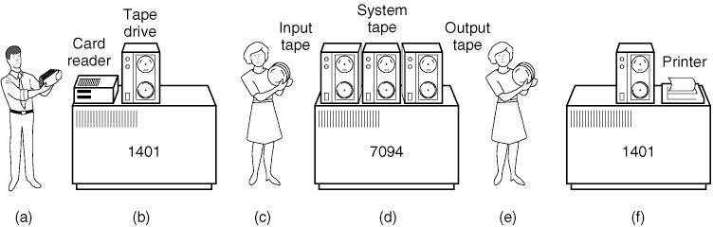
Historical Perspective
Early batch computer systems
  Programmers bring punched cards
  to the IBM 1401 computer system.
  The 1401 reads a
  batch of jobs onto
  magnetic tape.
Operating Systems: Design and Implementation
Tanenbaum & Woodhull
(c) 2006 Prentice-Hall, Inc. All rights reserved. 0-13-142938-8

Slide 22
Historical Perspective, cont’d
Early batch computer systems
  A computer operator carries the input tapes
  to a “large scale” IBM 7094.
  The IBM 7094 does
  the heavy-duty
  computing and
  writes output tapes.
Operating Systems: Design and Implementation
Tanenbaum & Woodhull
(c) 2006 Prentice-Hall, Inc. All rights reserved. 0-13-142938-8

Slide 23
Historical Perspective, cont’d
Early batch computer systems
  The operator carries
  the output tapes
  to the IBM 1401.
  The 1401 prints
  the output.
Operating Systems: Design and Implementation
Tanenbaum & Woodhull
(c) 2006 Prentice-Hall, Inc. All rights reserved. 0-13-142938-8

Slide 24
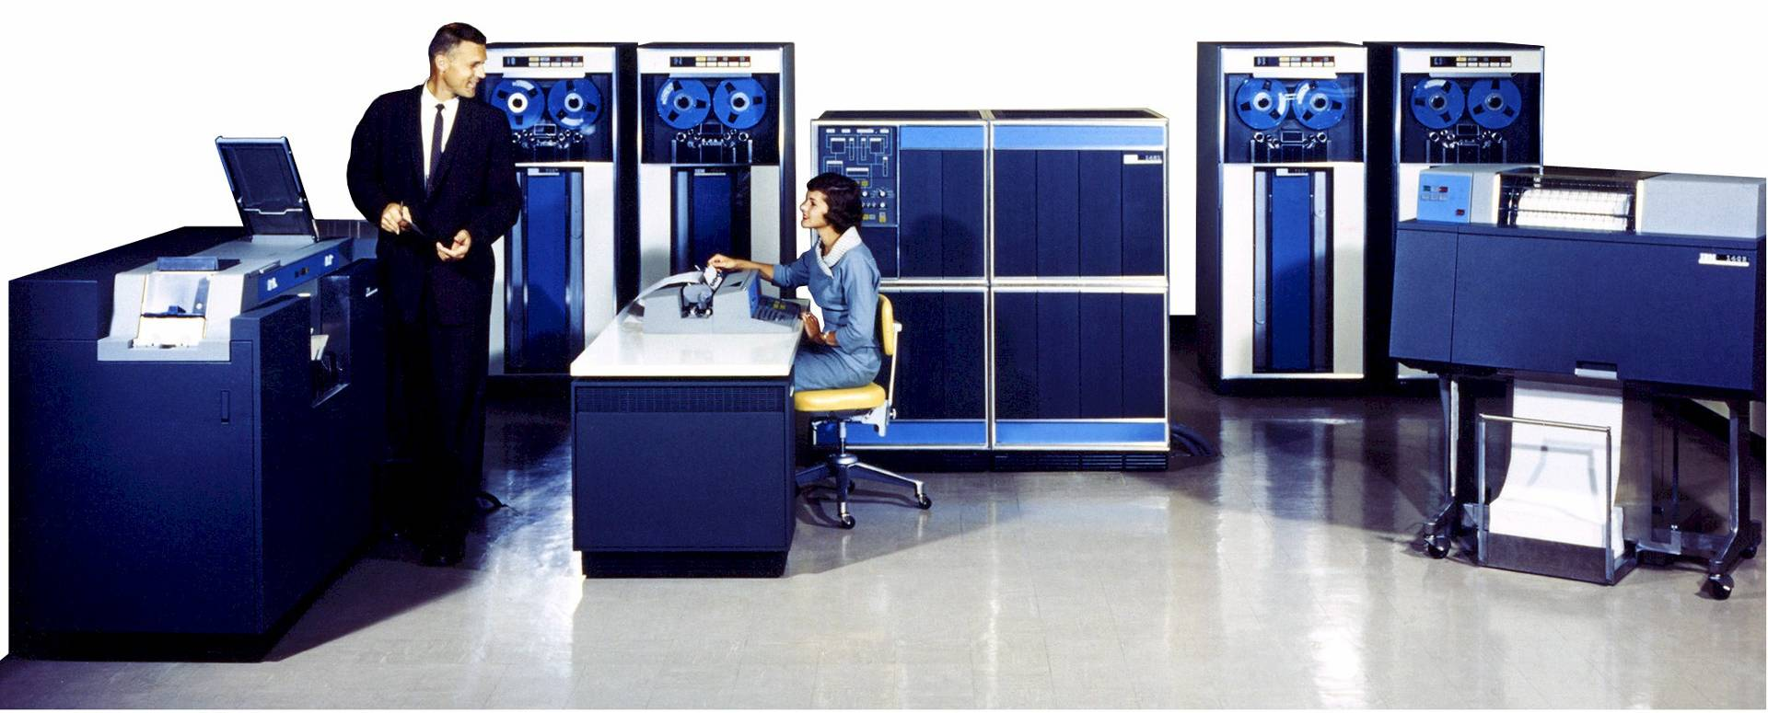
The IBM 1401
A “small scale” computer system developed in the late 1950s
and popular through the 1960s.
(No operating system)
1402 Card Read Punch
1407 Console
1401 CPU
729 Tape Drive
1403 Line Printer

Slide 25
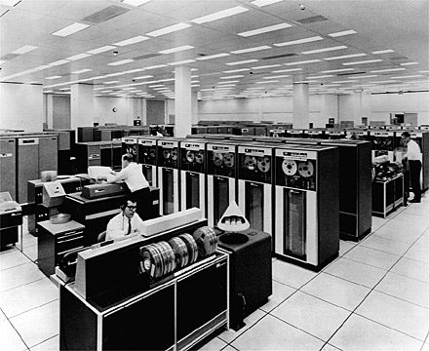
The IBM 7094
Used for “large scale”
scientific computing
during the 1960s.
(IBSYS operating system)

Slide 26
Historic Operating Systems
CTSS (Compatible Time Sharing System), 1962
  Developed at MIT for the IBM 7094.
OS/360, mid 1960s to early 1970s
  Ran on the IBM 360 computer system.
  Both commercial and scientific computing.
  Small models (IBM 1401 size) to large models
  (larger than the IBM 7094).
  Supported multiprogramming to better utilize the CPU.
  Supported I/O spooling (simultaneous peripheral operations online)
  JCL (job control language)

Slide 27
Historic Operating Systems, cont’d
MULTICS (Multiplexed Information and Computing Service), 1969
  Developed by MIT, Bell Labs, and General Electric.
  Goal was to support hundreds of simultaneous timesharing users.
  Mixed success: Ran on Honeywell mainframe computers until the late 1990s.
UNIX, 1970s
  Developed by Ken Thompson at Bell Labs.
  Started as a stripped-down single-user version of MULTICS.

Slide 28
Historic Operating Systems, cont’d
CP/M (Control Program for Microcomputers), 1974
  Written by Gary Kildall originally for the Intel 8080.
MS-DOS (Microsoft Disk Operating System), early 1980s
  Written for the IBM PC microcomputer.
Apple Macintosh OS, mid 1980s
  Popularized the graphical user interface.
Microsoft Windows, late 1980s

Slide 29
Historic Operating Systems, cont’d
POSIX (Portable Operating System Interface), 1988
  IEEE standard to maintain OS compatibility.
Apple macOS, 2001
  Graphical user interface on top of UNIX.
Apple iOS, 2007
  Proprietary OS for the iPhone and the iPad.
Google Android, 2008
  Open-source OS for mobile devices.

Slide 30
Break

Slide 31
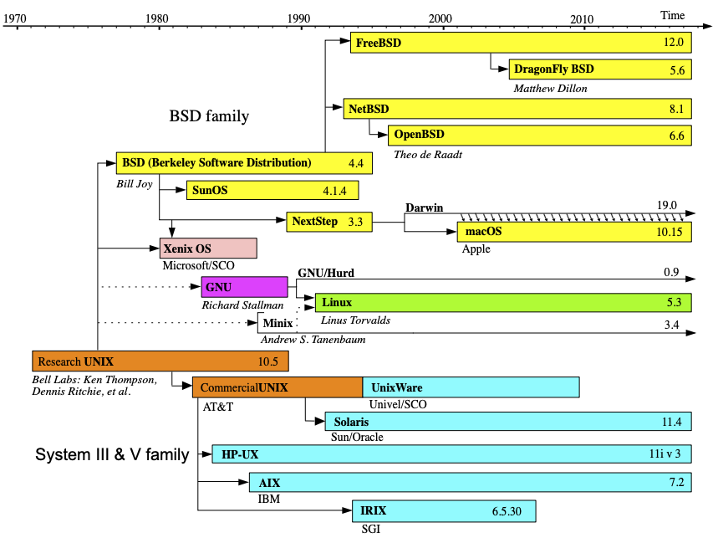
Evolution of UNIX
CMPE 142
CMPE 142
https://upload.wikimedia.org/wikipedia/commons/c/cd/Unix_timeline.en.svg

Slide 32
UNIX/Linux Interfaces
Command line
  bash command shell and scripting language
Graphical user interface
  X Window System (also called X11)
  Developed by MIT
  Gnome or KDE windowing environment
Application programming interface (API)
  POSIX standard set of API functions.
  Other OS’s (such as Windows) also have implemented POSIX to various degrees.

Slide 33
POSIX
Portable Operating System Interface
  First specified by the IEEE Computer Society in 1988 to maintain compatibility between operating systems (mostly but not only UNIX-based OS’s)
API system calls
Command-line commands and scripts
Utility programs
POSIX-certified and mostly POSIX-compliant operating systems
  See https://en.wikipedia.org/wiki/POSIX#POSIX-oriented_operating_systems

Slide 34
UNIX and Linux
Linux is derived from the GNU branch
of the UNIX operating system.
Very popular with different “distributions”.
  Ubuntu, Debian, etc.
https://upload.wikimedia.org/wikipedia/commons/c/cd/Unix_timeline.en.svg

Slide 35
UNIX and macOS
macOS is derived from the BSD (Berkeley Software Distribution) branch of UNIX.
There are only a few significant differences from Linux.
https://upload.wikimedia.org/wikipedia/commons/c/cd/Unix_timeline.en.svg

Slide 36
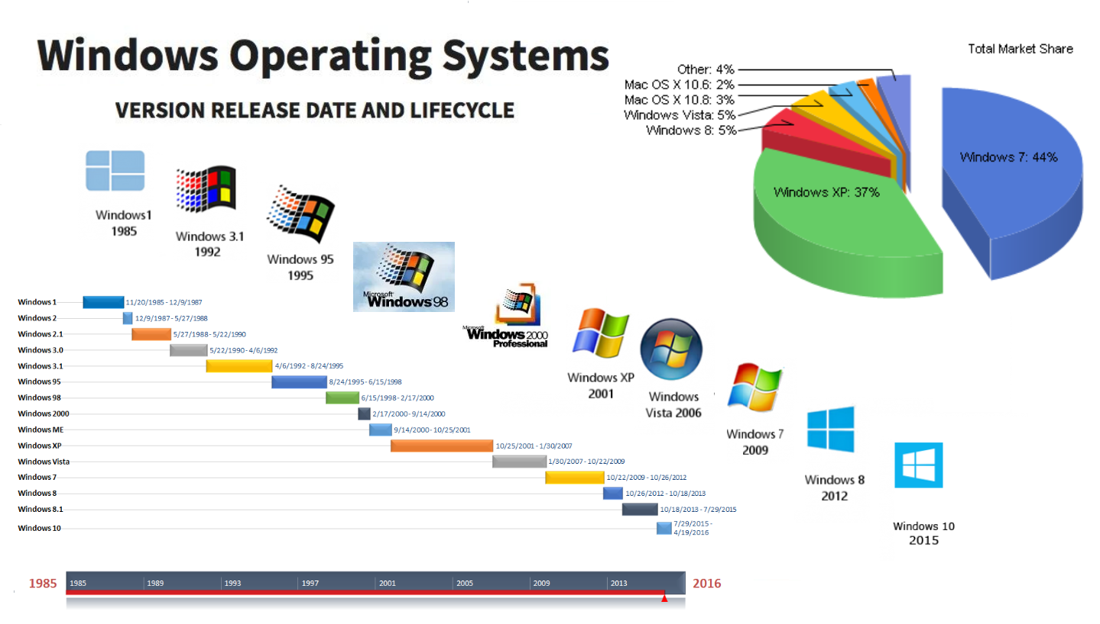
Windows 10
Windows 10 is part of a totally separate family of operating systems from Microsoft.
https://kavindi-herath.medium.com/evolution-of-windows-os-9e6a0c96a3f2

Slide 37
Linux on Windows
The Windows 10 feature, Windows Subsystem for Linux (WSL), it is possible to install a Linux distribution such as Ubuntu (recommended).
  See https://docs.microsoft.com/en-us/windows/wsl/install-win10
A bash shell window (terminal window for interpreting commands) will open.
To run GUI-based applications, you must also install and run an X Windows server:
  https://sourceforge.net/projects/xming/
  https://sourceforge.net/projects/vcxsrv/

Slide 38
Linux on Windows, cont’d
Useful tutorials:
  “Install Ubuntu on Windows 10”
  http://www.cs.sjsu.edu/~mak/tutorials/InstallUbuntuWindows.pdf
  “Configure Ubuntu for Software Development”
  http://www.cs.sjsu.edu/~mak/tutorials/ConfigureUbuntu.pdf
Demo

Slide 39
Linux on VirtualBox
VirtualBox is a hypervisor that you can install and run on macOS and on Windows 10.
  A hypervisor is a virtual machine monitor that runs a virtual machine on top of a host OS (e.g., Windows or macOS).
  You can then install and run a guest OS (such as Ubuntu) in the virtual machine created by VirtualBox.
  See https://www.virtualbox.org/
If you have a Mac and need to run Ubuntu, VirtualBox + Ubuntu is a way to do it.
  On Windows 10, it is most likely easier to use WSL.

Slide 40
Linux on VirtualBox, cont’d
Useful tutorials:
  “Install Ubuntu on VirtualBox”
  http://www.cs.sjsu.edu/~mak/tutorials/InstallUbuntuVirtualBox.pdf
  “Configure Ubuntu for Software Development”
  http://www.cs.sjsu.edu/~mak/tutorials/ConfigureUbuntu.pdf
Demo

Slide 41
The bash Shell
bash is the default shell and command language for Linux.
  shell: a command interpreter for the
  command-line interface to Linux.
Starting with the Catalina release,
macOS uses zsh instead of bash.
  For this class, you may want to make bash the default shell again on macOS.
  See “Install bash for macOS”
  http://www.cs.sjsu.edu/~mak/tutorials/InstallBashForMacOS.pdf

Slide 42
Important Command-Line Skills
Although GUI-based tools are very common nowadays, many UNIX and Linux applications still require using the command line for installation and use.
Therefore, an important survival skill is knowing how to use the bash shell.
Go through the bash tutorial:
https://linuxconfig.org/bash-scripting-tutorial-for-beginners
  bash is very powerful but unfortunately, the command language has a cryptic syntax.

Slide 43
The bash Shell, cont’d
We will use bash to demonstrate UNIX/Linux features as our example operating system.
Example programs will use POSIX calls to show how these features are implemented.

Slide 44
Assignment #1
This is an individual assignment.
If you’re on Windows 10: Install Ubuntu using the Windows Subsystem for Linux (WSL).
  Use VirtualBox only if you can’t get WSL to work.
If you’re on macOS that’s Catalina or later, replace zsh with bash as your default shell.
  Use VirtualBox if you want to use Ubuntu.
Demonstrate your command-line skills by doing the exercises in the assignment write-up.

Slide 45
Reminder: By Wednesday, February 3
Form teams.
Submit your team information into Canvas.
  team name
  team members and email addresses

