Slide 1
Data Analysis
Mark Stamp

Slide 2
Topics
Experimental design
Training set, test set, n-fold cross validation, thresholding, imbalance, ...
Quantifying success
Accuracy ⎯ False positive, false negative, true positive, true negative
ROC curves ⎯ Area under the ROC curve (AUC), partial AUC (written as AUC_{p})
Precision-Recall (PR) curves

Slide 3
Scenario
Assume that we have a proposed method for detecting malware
We want to determine how well it performs on a specific dataset
We want to quantify effectiveness
Ideally, compare to previous work
But, often difficult to directly compare
Comparisons to AV products?
Notes:
Almost nothing here is specific to the malware detection problem. The one obvious exception is the comparison to AV products.

Slide 4
Basic Assumptions
We have a set of malware samples
All from a single (metamorphic) “family”…
…or, at least all of a similar type
Broader the “family”, the more difficult
And, a representative non-family set
Often, assumed to be benign samples
More diverse, may be more difficult
Problem specifics matter...

Slide 5
Experimental Design
Want to test malware detection score
Refer to malware dataset as match set
And benign dataset is nomatch set
Partition match set into…
Training set ⎯ used to determine parameters of scoring function
Test set ⎯ reserved to test scoring function generated from training set
Note: Cannot test on the training set!
Notes:
Note that “partition” means there is no overlap between the training and test sets. Note also that we are considering the case where a model is trained only on the malware set (an HMM, for example). In some cases, we directly train a classifier (SVM, neural networks, etc.), in which case the training set must contain data from both the match and nomatch sets. In the latter case, there is no separate scoring phase.
We want models that learn, not models that “memorize”…

Slide 6
Training and Scoring
Two phases: Training and scoring
Training phase
Train a model based on the training data
Scoring phase
Score data in test set and score nomatch (benign) set
Analyze results from scoring phase
Assume it’s representative of general case

Slide 7
Scatterplot
Train a model on the training set
Apply score to test and nomatch sets
Can visualize results as a scatterplot
match scores
nomatch scores
score
test case
Notes:
We’ll be sloppy here and refer to the test dataset as the match set.

Slide 8
Experimental Design
A couple of potential problems…
How to partition the match set?
How to get most out of limited data set?
Why are these things concerns?
When we partition match set, might get biased training/test sets, and …
… more data is always “more better”
Cross validation solves these problems

Slide 9
n-Fold Cross Validation
Partition match set into n equal subsets
Denote subsets as S₁,S₂,…,S_{n}
Let training set be S₂∪ S₃∪ … ∪ S_{n}
And test set is S₁
Repeat with training set S₁∪ S₃∪ … ∪ S_{n}
And test set S₂
And so on, for each of n “folds”
Typically, n = 5 or n = 10 is used
Notes:
Again, “partition” implies that each file is in exactly 1 subset.

Slide 10
n-Fold Cross Validation
Benefits of cross validation?
Any bias in match data smoothed out
Bias likely to only affect a few of the S_{i}
Maximizes number of match scores
Usually, no shortage of nomatch data
While match data may be very limited
And it’s easy to do, so why not?
Best of all, it sounds really fancy…
Notes:
The lack of match data can be striking in medical experiments, where there is sometimes only a handful (or less) of match cases. This is often due to the expense/risk of the procedure under investigation. In the malware context, obtaining samples for the match set might require capturing the samples, and labor-intensive manual analysis.

Slide 11
Thresholding
Set a threshold after scoring phase
Ideally, we have complete separation
I.e., no “overlap” in scatterplot
Usually, that doesn’t happen
Then where to set the threshold?
In practice, thresholding is critical
At research stage, can be a distraction…
…as we discuss later
Notes:
Why is thresholding critical in practical use? You tell me…

Slide 12
Thresholding
Where to set threshold?
Left scatterplot is a lot easier than right
score
score
test case
test case

Slide 13
Quantifying Success
And how to quantify “better”?
Any ideas?
score
score
test case
test case

Slide 14
Results
Given scatterplot and a threshold
For each sample, one of 4 cases…
True positive ⎯ correctly classified as +
False positive ⎯ incorrectly classified as +
True negative ⎯ correctly classified as −
False negative ⎯ incorrectly classified as −
TP, FP, TN, FN, respectively
Append “R” to each for “rate”
Notes:
For example, TPR = TP / P, where P is the number of positive instances tested, and TNR = TN / N, where N is the number of negative instances tested.

Slide 15
Confusion Matrix
Assuming that high scores (i.e., above threshold) better match the model

Slide 16
Sensitivity and Specificity
The TPR also known as sensitivity while TNR is known as specificity
Consider a medical test
Sensitivity is percentage of sick people detected by the test (as they should be)
Specificity is percentage of healthy who are not classified as sick (as they should)
Inherent tradeoff between TPR & TNR
Everything depends on threshold!
Notes:
By changing the threshold, we can alter the balance between sensitivity and specificity.

Slide 17
Accuracy
Let P be the number of positive cases tested and N the negative cases tested
Note: P is size of test set, N nomatch set
Also, P = TP + FN and N = TN + FP
Then, Accuracy = (TP + TN) / (P + N)
Note that accuracy ranges from 0 to 1
Accuracy of 1? Ideal situation
Accuracy 0.5? Don’t give up your day job…
Notes:
If n-fold cross validation is used, then for a test set of size P and a nomatch set of size N, for the overall combined result, we would have P positive scores and nN negative scores, since each negative is scored in each fold.
Later, we discuss Precision = TP / (TP + FP) and Recall = = TP / (TP + FN), which are sometime used to measure success.
Finally, note that an accuracy of 0 is actually a very good thing, since we can just reverse the classification criteria to obtain an accuracy of 1. In general, if we have an accuracy of x < ½, then we can reverse the criteria and obtain an accuracy of 1-x > ½

Slide 18
Balanced Accuracy
Often, there is a large imbalance between test set and nomatch set
Test set often smaller than nomatch set
Define
Balanced accuracy = (TPR + TNR) / 2 = 0.5 TP/P + 0.5 TN/N
This weights errors of both types equally
We consider imbalance again later
Notes:
If there is a large imbalance, a large relative error in the smaller set has little effect on the accuracy. But since error rates are weighted equally in the balanced accuracy, a large relative error in either will have a large impact on the balanced accuracy. Also, if P equals N, the balanced accuracy is the same as the accuracy.

Slide 19
Accuracy
Accuracy tells us something…
But it depends on where threshold is set
How should we set the threshold?
Seems we are going around in circles, like a dog chasing its tail
Bottom line? We still don’t have good way to compare different techniques
Next slide, please…
Notes:
The point here is that we don’t want the results to depend on a threshold that we have no systematic way to set. This would make it difficult to compare results from different experiments.

Slide 20
ROC Curves
Receiver Operating Characteristic
Originated from electrical engineering
Now widely used in many fields
What is an ROC curve?
Plot TPR vs FPR as threshold varies thru the range of scores
Plot FPR on x-axis, TPR on y-axis
Equivalently, 1 – specificity vs sensitivity
What the … ?

Slide 21
ROC Curve
1
TPR
Suppose threshold is set at yellow line
Above yellow, classified as positive,
Below yellow is negative
In this case,
TPR = 1.0
FPR = 1.0 – TNR = 1.0 – 0.0 = 1.0
0
1
FPR
score
test case

Slide 22
ROC Curve
1
TPR
Suppose threshold set at yellow line
Above yellow, classified as positive,
Below yellow is negative
In this case,
TPR = 1.0
FPR = 1.0 – TNR = 1.0 – 0.2 = 0.8
0
1
FPR
score
test case

Slide 23
ROC Curve
1
TPR
Suppose threshold set at yellow line
Above yellow, classified as positive,
Below yellow is negative
In this case,
TPR = 1.0
FPR = 1.0 – TNR = 1.0 – 0.4 = 0.6
0
1
FPR
score
test case

Slide 24
ROC Curve
1
TPR
Suppose threshold set at yellow line
Above yellow, classified as positive,
Below yellow is negative
In this case,
TPR = 1.0
FPR = 1.0 – TNR = 1.0 – 0.6 = 0.4
0
1
FPR
score
test case

Slide 25
ROC Curve
1
TPR
Suppose threshold set at yellow line
Above yellow, classified as positive,
Below yellow is negative
In this case,
TPR = 0.8
FPR = 1.0 – TNR = 1.0 – 0.6 = 0.4
0
1
FPR
score
test case

Slide 26
ROC Curve
1
TPR
Suppose threshold set at yellow line
Above yellow, classified as positive,
Below yellow is negative
In this case,
TPR = 0.6
FPR = 1.0 – TNR = 1.0 – 0.6 = 0.4
0
1
FPR
score
test case

Slide 27
ROC Curve
1
TPR
Suppose threshold set at yellow line
Above yellow, classified as positive,
Below yellow is negative
In this case,
TPR = 0.6
FPR = 1.0 – TNR = 1.0 – 0.6 = 0.2
0
1
FPR
score
test case

Slide 28
ROC Curve
1
TPR
Suppose threshold set at yellow line
Above yellow, classified as positive,
Below yellow is negative
In this case,
TPR = 0.4
FPR = 1.0 – TNR = 1.0 – 0.6 = 0.2
0
1
FPR
score
test case

Slide 29
ROC Curve
1
TPR
Suppose threshold set at yellow line
Above yellow, classified as positive,
Below yellow is negative
In this case,
TPR = 0.4
FPR = 1.0 – TNR = 1.0 – 1.0 = 0.0
0
1
FPR
score
test case

Slide 30
ROC Curve
1
TPR
Suppose threshold set at yellow line
Above yellow, classified as positive,
Below yellow is negative
In this case,
TPR = 0.2
FPR = 1.0 – TNR = 1.0 – 0.6 = 0.0
0
1
FPR
score
test case

Slide 31
ROC Curve
1
TPR
Suppose threshold set at yellow line
Above yellow, classified as positive,
Below yellow is negative
In this case,
TPR = 0.0
FPR = 1.0 – TNR = 1.0 – 0.6 = 0.0
0
1
FPR
score
test case

Slide 32
ROC Curve
Connect the dots…
This is an ROC curve!
What good is it?
Captures info wrt all possible thresholds
Removes threshold as a factor in the analysis
What does it all mean?
1
TPR
0
1
FPR

Slide 33
ROC Curve
Random classifier?
Yellow 45 degree line
Perfect classifier?
Red (Why?)
Above 45 degree line?
Better than random
The closer to the red, the closer to ideal
1
TPR
0
1
FPR

Slide 34
Area Under the Curve (AUC)
ROC curve lives within a 1x1 square
Random classifier?
AUC ≈ 0.5
Perfect classifier (red)?
AUC = 1.0
Example curve (blue)?
AUC = 0.8
1
TPR
0
1
FPR
Notes:
In general, the area under the ROC curve (AUC) is equal to the probability that the classifier will rank a randomly chosen positive instance higher than a randomly chosen negative one (for more details, see the paper by Bradley referenced at the end of the slides).

Slide 35
Area Under the Curve (AUC)
Area under ROC curve quantifies success
0.5 ⎯ like flipping coin
1.0 ⎯ ideal detection
AUC of ROC curve
Enables us to compare different techniques
And no need to worry about threshold
1
TPR
0
1
FPR
Notes:
Of course, this doesn’t solve every possible problem… For example, the results still depend on the selection of match and nomatch sets. So, if we choose an unrealistically easy nomatch set, then the ROC results might look good, but the score could still fail miserably in practice.

Slide 36
Partial AUC
Might only consider cases where FPR < p
“Partial” AUC is AUC_{p}
Area up to FPR of p
Normalized by p
In this example,
AUC_{0.4} = 0.2 / 0.4 = 0.5
AUC_{0.2} = 0.08/0.2 = 0.4
1
TPR
0
1
FPR
Notes:
When might we use AUC_{p} instead of AUC? For example, suppose we want to compare our results to a commercial AV product. Such products tend to have very low false positive rates, at the expense of a higher false negative rate (the next few slides should make it clear why this might be desirable). So, it would be reasonable to conclude that any threshold that yields a false positive rate above, say, 0.05 is irrelevant when comparing to AV products. So, by limiting our attention to AUC_{0.5}, we would thus obtain a more reasonable comparison.

Slide 37
Imbalance Problem
Suppose we train model for given malware family
In practice, we expect to score many more non-family samples than family
Number of negative cases is large
Number of positive cases is small
So what?
Let’s consider an example

Slide 38
Imbalance Problem
In practice, we need threshold
For a given threshold, suppose sensitivity = 0.99, specificity = 0.98
Then TPR = 0.99 and FPR = 0.02
Spse 1 in 1k samples tested is malware of type our model is trained to detect
Suppose we scan, say, 100k files
What do we find?
Notes:
In actual practice, the imbalance could be much greater. That is, the ratio of actual malware can be far less than 1 in 1000, which would make the results on the next slide even more dismal.

Slide 39
Imbalance Problem
Assuming TPR = 0.99 and FPR = 0.02
And 1 in 1000 samples tested is malware
After scanning 100k files…
Detect 99 of 100 actual malware (TP)
Misclassify 1 malware as benign (FN)
Correctly classify 97902 (out of 99900) benign as benign (TN)
Misclassify 1998 benign as malware (FP)

Slide 40
Imbalance Problem
We have 97903 classified as benign
Of those, 97902 are actually benign
And 97902/97903 > 0.9999
We classified 2097 as malware
Of these, only 99 are actual malware
But 99/2097 < 0.05
Remember the “boy who cried wolf”?
This is the AV that cries wolf (a lot)…

Slide 41
Imbalance Solution?
What to do?
There is inherent tradeoff between sensitivity and specificity
Suppose we can adjust threshold so
TPR = 0.92 and FPR = 0.0003
As before…
We have 1 in 1000 is malware
And we test 100k files

Slide 42
Imbalance Solution?
Assuming TPR = 0.92 and FPR = 0.0003
And 1 in 1000 is malware
After scanning 100k files…
Detect 92 of 100 actual malware (TP)
Misclassify 8 malware as benign (FN)
Correctly classify 99870 (out of 99900) benign as benign (TN)
Misclassify 30 benign as malware (FP)

Slide 43
Imbalance Solution?
We have 99878 classified as benign
Of those, all but 8 are actually benign
And 99870/99878 > 0.9999
We classified 122 as malware
Of these, 92 are actual malware
And 92/122 > 0.75
Can adjust threshold to further reduce “crying wolf” effect

Slide 44
Imbalance Problem
A better alternative?
Instead of decreasing FPR (lower TPR)
Perform secondary testing on files that pass initial malware test
We can thus weed out most FP cases
This gives us best of both worlds!
Low FPR, few benign reported as malware
“Balance” primary and secondary work
Notes:
The secondary testing might be difficult and costly---not to mention the fact that we need to develop such a test. However, since there are relatively few FP cases, we can afford to do a more careful and costly analysis on the samples that pass the primary test. Given specific details on the time required for secondary vs primary testing, we can then adjust the threshold to balance the work vs the expected number of false positives.

Slide 45
PR Curves
Suppose nomatch set is very large relative to test set
ROC curve dominated by nomatch
But may be more interested in match set
Precision-Recall curves to the rescue!
May be preferable to ROC in some cases
Recall ⎯ match cases classified correctly
Precision ⎯ those classified as positive that actually belong to match set

Slide 46
PR Curve
Recall = TPR = TP / (TP + FN)
Correctly classified as positive / total number of actual positive cases
Precision = TP / (TP + FP)
Correctly classified positive / total number that were classified as positive
Note that TN does not appear here
So, focus in on positive (match) set

Slide 47
PR Curve
1
precision
Suppose threshold is set at yellow line
Above yellow, classified as positive,
Below yellow is negative
In this case,
recall = TPR = 1.0
precision = TP/(TP+FP) = 5/(5+5) = 0.5
0
1
recall
score
test case

Slide 48
PR Curve
1
precision
Suppose threshold set at yellow line
Above yellow, classified as positive,
Below yellow is negative
In this case,
recall = 1.0
precision = TP/(TP+FP) = 5/(5+4) = 0.5556
0
1
recall
score
test case

Slide 49
PR Curve
1
precision
Suppose threshold set at yellow line
Above yellow, classified as positive,
Below yellow is negative
In this case,
recall = 1.0
precision = TP/(TP+FP) = 5/(5+3) = 0.625
0
1
recall
score
test case

Slide 50
PR Curve
1
precision
Suppose threshold set at yellow line
Above yellow, classified as positive,
Below yellow is negative
In this case,
recall = 1.0
Precision = TP/(TP+FP) = 5/(5+2) = 0.7143
0
1
recall
score
test case

Slide 51
PR Curve
1
precision
Suppose threshold set at yellow line
Above yellow, classified as positive,
Below yellow is negative
In this case,
recall = 0.8
precision = TP/(TP+FP) = 4/(4+2) =0.6667
0
1
recall
score
test case

Slide 52
PR Curve
1
precision
Suppose threshold set at yellow line
Above yellow, classified as positive,
Below yellow is negative
In this case,
recall = 0.6
precision = TP/(TP+FP) = 3/(3+2) = 0.6
0
1
recall
score
test case

Slide 53
PR Curve
1
precision
Suppose threshold set at yellow line
Above yellow, classified as positive,
Below yellow is negative
In this case,
recall = 0.6
precision = TP/(TP+FP) = 3/(3+1) = 0.75
0
1
recall
score
test case

Slide 54
PR Curve
1
precision
Suppose threshold set at yellow line
Above yellow, classified as positive,
Below yellow is negative
In this case,
recall = 0.4
precision = TP/(TP+FP) = 2/(2+1) = 0.6667
0
1
recall
score
test case

Slide 55
PR Curve
1
precision
Suppose threshold set at yellow line
Above yellow, classified as positive,
Below yellow is negative
In this case,
recall = 0.4
precision = TP/(TP+FP) = 2/(2+0) = 1.0
0
1
recall
score
test case

Slide 56
PR Curve
1
precision
Suppose threshold set at yellow line
Above yellow, classified as positive,
Below yellow is negative
In this case,
recall = 0.2
precision = TP/(TP+FP) = 1/(1+0) = 1.0
0
1
recall
score
test case

Slide 57
PR Curve
1
precision
Suppose threshold set at yellow line
Above yellow, classified as positive,
Below yellow is negative
In this case,
recall = 0.0
precision = TP/(TP+FP) = 0/(0+0) = ?
Define 0/0 to be 1.0
0
1
recall
score
test case

Slide 58
PR Curve
Connect the dots to generate PR curve
Here, we are using linear interpolation
This slightly over-estimates AUC-PR
Good enough for government work…
1
precision
0
1
recall
Notes:
Technically, should connect dots with smooth curve, but straight lines (i.e., piecewise linear) will give a reasonable approximation.

Slide 59
AUC-PR
Area under PR curve denoted AUC-PR
Like AUC-ROC
Ranges between 0 and 1
Closer to 1 is better
Connections between ROC and PR curves?
Next slide
1
precision
0
1
recall

Slide 60
PR Curve vs ROC Curve
Similarities between PR and ROC ?
Many connections, for example…
Curve that “dominates” in ROC space also “dominates” in PR space (and vice versa)
Differences ?
PR focused on test set, not nomatch set
So, PR may be more useful when there is a large imbalance (see homework)

Slide 61
Deep Learning Issues

Slide 62
Deep Learning
In deep learning (and SVM) we train a classifier
Obtain a classifier, not a score
So, no need to score samples, set threshold, etc.
Training data split into training set and validation (test) set
Train on training, test on validation

Slide 63
Training
Usually, we train deep learning model by gradient decent
Define an objective (loss) function
Use calculus to minimize loss function
Loss is a function of training data
Train on subsets of training data
One pass thru training data is an epoch
Train for many epochs
Notes:
Loss is like a score, except that smaller loss is better, whereas larger score is better.

Slide 64
Training
When training, we measure loss and can also measure accuracy
We can do the same on validation set
Have 4 graphs (as functions of epoch)
Training accuracy
Training loss
Validation accuracy
Validation loss

Slide 65
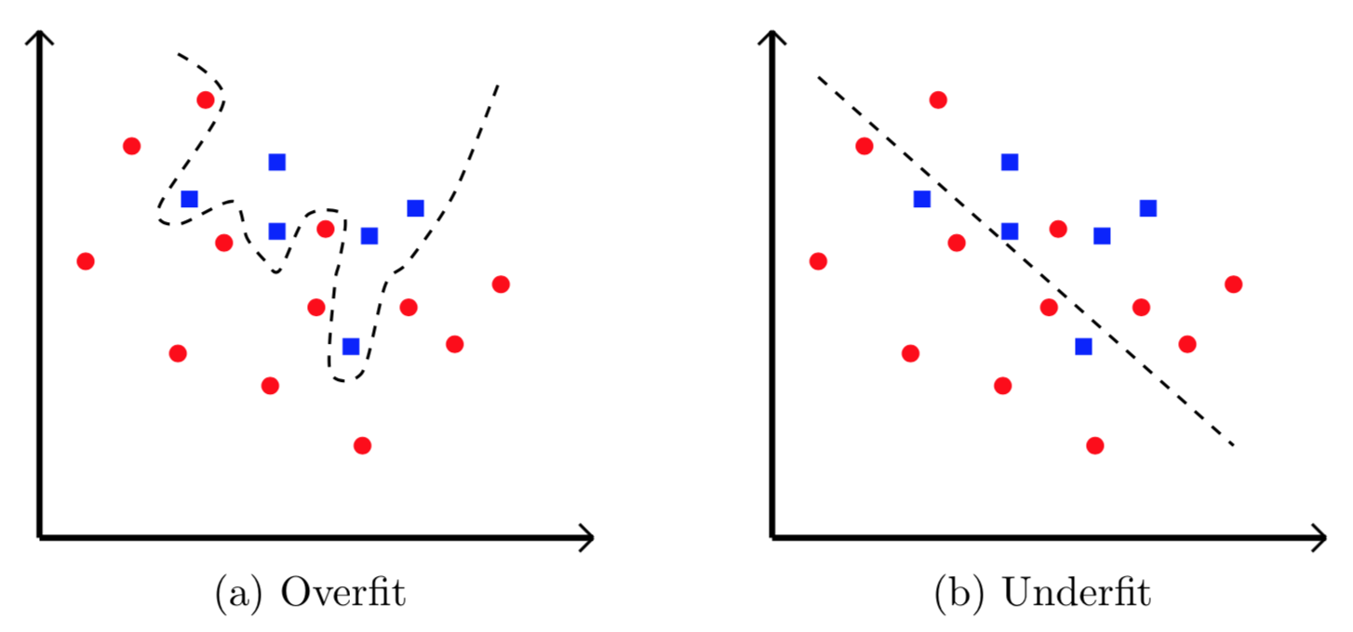
Overfitting
Issue with deep learning is overfitting
Model “memorizes”, rather than learning

Slide 66
How to Detect Overfitting?
Accuracy and loss graphs help us detect overfitting
Plot accuracy for both training and validation as function of epoch
Plot loss for both training and validation as function of epoch
What should graphs look like?
What do we see in case of overfitting?

Slide 67
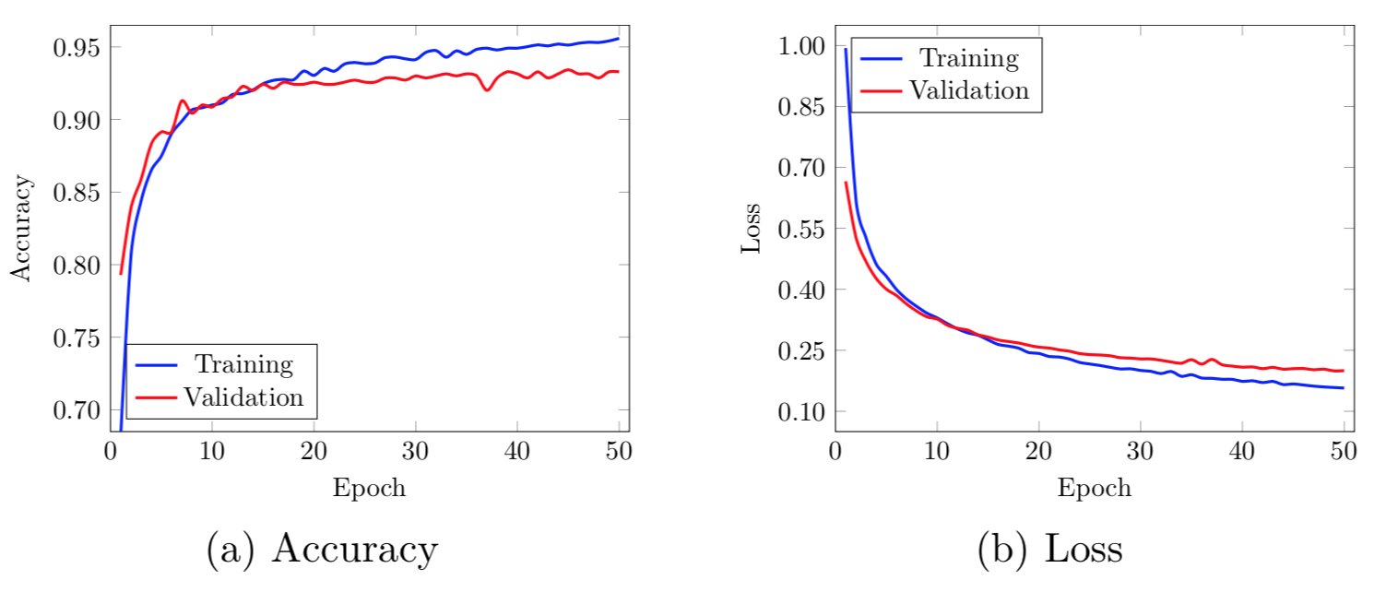
No Overfitting
This is what we like to see!

Slide 68
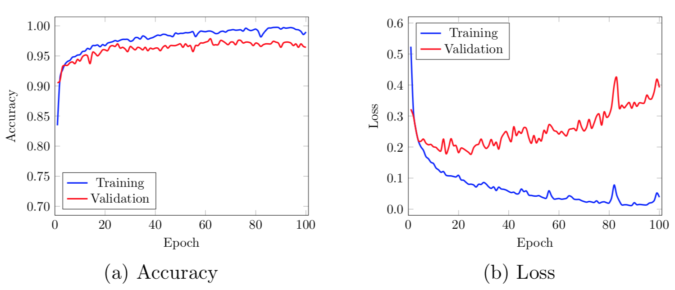
Example of Overfitting
Indication of overfitting...

Slide 69
Overfitting
How to prevent overfitting?
Prevent model from focusing too much on the “noise”
Many techniques help with overfitting
Dropouts and other regularization techniques
Other ideas?

Slide 70
Bottom Line
Design your experiments properly
Use n-fold cross validation (e.g., n = 5 or n = 10)
Generally, cross validation is a good idea
Thresholding is important in practice
But not so useful for analyzing results
Accuracy not as informative as, say, ROC analysis
Use ROC and/or PR curves and compute AUC
Sometimes, partial AUC may be better
Imbalance problem may be significant issue
Beware of overfitting, especially in DL!
Notes:
For malware, if comparing results to AV products, then partial AUC may be the most relevant measure (with a very small value of p). Also, be aware of the imbalance problem.

Slide 71
References
A.P. Bradley, The use of the area under the ROC curve in the evaluation of machine learning algorithms, Pattern Recognition, 30:1145-1159, 1997

