Slide 1


DATA 220
Mathematical Methods for Data Analysis
April 15 Class Meeting
Department of Applied Data Science
San Jose State University
Spring 2021
Instructor: Ron Mak
www.cs.sjsu.edu/~mak

Slide 2
Machine Learning
Supervised ML works with labeled data.
  regression √
  classification
Unsupervised ML works with unlabeled data.
  dimensionality reduction
    Example: principal component analysis
  clustering algorithms
    Example: k-means

Slide 3
Scikit-Learn ML Algorithms
The scikit-learn library contains the
most effective machine-learning algorithms.
  Called estimators.
  Build models for making predictions.
Python makes it easy to try different models.
  It’s hard to know in advance which model
  will work best on a particular dataset.
  Run several models and then evaluate which is best.

Slide 4
“Big Data”
Old days
  “Help, we’re drowning in too much data!”
Now
  More data = smarter ML models
    More insights
    More accurate predictions
  Data mining
    Find answers to questions you didn’t even know to ask.
    Introduced in my database classes – not enough time here.

Slide 5
Datasets Bundled with Scikit-Learn
Datasets bundled with scikit-learn
“Toy” datasets Boston house prices Iris plants Diabetes Optical recognition of handwritten digits Linnerrud Wine recognition Breast cancer Wisconsin (diagnostic) | Real-world datasets Olivetti faces 20 newsgroups text Labeled Faces in the Wild face recognition Forest cover types RCV1 Kddcup 99 California Housing
See: https://scikit-learn.org/stable/datasets/
and: https://www.openml.org
Python for Programmers
by Paul Deitel and Harvey Deitel
Pearson, 2019
ISBN 9780135231364

Slide 6
Steps for Doing Machine Learning
Acquire and load the data.
Explore the data with Pandas and visualization.
Clean and transform the data as necessary.
  Scikit-Learn requires numeric data.
Split the data for training and testing.
Create the machine learning model.
Train and test the model.
Tune the model and evaluate its accuracy.
Use the model to make predictions on live data that the model hasn’t seen before.

Slide 7
Example Supervised ML: Classification
Use the Digits dataset.
  From the MNIST database
  32-by-32 pixel images of
  handwritten digits 0 – 9
  Example image:
Use the k-Nearest Neighbors (KNN)
supervised machine learning algorithm.
  Train the machine to recognize handwritten digits.
  The training set will be labeled images.
A more powerful deep-learning algorithm for image recognition is convolutional neural networks (CNN).
Python for Programmers
by Paul Deitel and Harvey Deitel
Pearson, 2019
ISBN 978-0-13-5222433-5

Slide 8
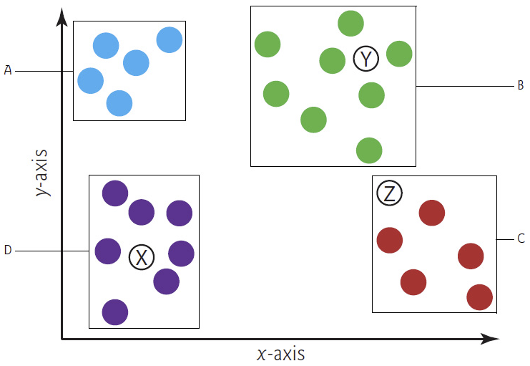
k-Nearest Neighbors Algorithm
Assume k = 3 nearest neighbors:
k is a hyperparameter
of the model (specified
in advance).
Predict that
sample Y
is in class B.
Predict that
sample Z
is in class C:
2 out of 3
of its nearest
neighbors
are in class c
Predict that
sample X
is in class D.
Choose an odd value for k.
Python for Programmers
by Paul Deitel and Harvey Deitel
Pearson, 2019
ISBN 978-0-13-5222433-5

Slide 9
Components of the Digits Dataset
Five components:
  'images': 8-by-8 two-dimensional arrays of integers, one array per digit. Each integer represents a grayscale, ranging from 0 (white) to 16 (black).
  'targets': The target digit 0 – 9 corresponding to what each image represents.
  'data': One-dimensional arrays, each containing the 64 integers flattened from the corresponding images array.
  'target_names': array([0, 1, 2, 3, 4, 5, 6, 7, 8, 9])
  'DESCR': Dataset description.

Slide 10
Explore the Digits Dataset
k-NearestNeighbors.ipynb
digits.data.shape = (1797, 64)
digits.target.shape = (1797,)
Sample digit image as a two-dimensional array:
digits.images[13] =
[[ 0. 2. 9. 15. 14. 9. 3. 0.]
[ 0. 4. 13. 8. 9. 16. 8. 0.]
[ 0. 0. 0. 6. 14. 15. 3. 0.]
[ 0. 0. 0. 11. 14. 2. 0. 0.]
[ 0. 0. 0. 2. 15. 11. 0. 0.]
[ 0. 0. 0. 0. 2. 15. 4. 0.]
[ 0. 1. 5. 6. 13. 16. 6. 0.]
[ 0. 2. 12. 12. 13. 11. 0. 0.]]
One-dimensional array representation for Scikit-Learn:
digits.data[13] =
[ 0. 2. 9. 15. 14. 9. 3. 0. 0. 4. 13. 8. 9. 16. 8. 0. 0. 0.
0. 6. 14. 15. 3. 0. 0. 0. 0. 11. 14. 2. 0. 0. 0. 0. 0. 2.
15. 11. 0. 0. 0. 0. 0. 0. 2. 15. 4. 0. 0. 1. 5. 6. 13. 16.
6. 0. 0. 2. 12. 12. 13. 11. 0. 0.]
Some target values:
digits.target[::100] = [0 4 1 7 4 8 2 2 4 4 1 9 7 3 2 1 2 5]

Slide 11
Visualize the Digits Dataset
k-NearestNeighbors.ipynb
%matplotlib inline
import matplotlib.pyplot as plt
# Arrange the images in a 4 by 6 grid.
figure, axes = plt.subplots(nrows=4, ncols=6, figsize=(6, 4))
# Display each image and its target, without the axes labels.
for item in zip(axes.ravel(), digits.images, digits.target):
axes, image, target = item
axes.imshow(image, cmap=plt.cm.gray_r)
axes.set_xticks([]) # remove x-axis tick marks
axes.set_yticks([]) # remove y-axis tick marks
axes.set_title(target)
plt.tight_layout()

Slide 12
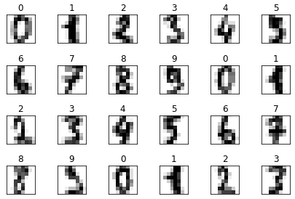
Visualize the Digits Dataset, cont’d

Slide 13
Split the Digits Dataset
k-NearestNeighbors.ipynb
from sklearn.model_selection import train_test_split
X_train, X_test, y_train, y_test = train_test_split(
digits.data, digits.target, random_state=11)
print(f'X_train.shape = {X_train.shape}')
print(f'X_test.shape = {X_test.shape}')
print()
print(f'y_train.shape = {y_train.shape}')
print(f'y_test.shape = {y_test.shape}')
Shuffles the data
before splitting.
Random seed.
X_train.shape = (1347, 64)
X_test.shape = (450, 64)
y_train.shape = (1347,)
y_test.shape = (450,)
Convention
X (upper case) for samples
y (lower case) for target values

Slide 14
Create and Train the KNN Model
k-NearestNeighbors.ipynb
from sklearn.neighbors import KNeighborsClassifier
knn = KNeighborsClassifier(n_neighbors=5)
knn.fit(X=X_train, y=y_train)
KNeighborsClassifier()
The fit() function loads the training data
and returns the estimator.
  This is a lazy estimator because it
  doesn’t do any work with the data
  until you ask it to make predictions.

Slide 15
Test the KNN Model
k-NearestNeighbors.ipynb
predicted = knn.predict(X=X_test)
expected = y_test
print('First twenty predictions:')
print(f'predicted[:20] = {predicted[:20]}')
print(f' expected[:20] = {expected[:20]}')
First twenty predictions:
predicted[:20] = [0 4 9 9 3 1 4 1 5 0 4 9 4 1 5 3 3 8 5 6]
expected[:20] = [0 4 9 9 3 1 4 1 5 0 4 9 4 1 5 3 3 8 3 6]

Slide 16
Wrong Predictions
k-NearestNeighbors.ipynb
wrong = [ (pred, exp)
for (pred, exp) in zip(predicted, expected)
if pred != exp
]
print('Wrong predictions:')
print(wrong)
Wrong predictions: [(5, 3), (8, 9), (1, 4), (4, 9),
(7, 3), (3, 8), (3, 8), (1, 8)]

Slide 17
Wrong Predictions, cont’d
k-NearestNeighbors.ipynb
print('Wrong predictions:')
print()
for data, pred, exp in zip(X_test, predicted, expected):
if pred != exp:
figure = plt.figure(figsize=(1, 1))
image = data.reshape(8, 8)
plt.imshow(image, cmap=plt.cm.gray_r)
plt.xticks([]) # remove x-axis tick marks
plt.yticks([]) # remove y-axis tick marks
plt.title(f'pred = {pred}, exp = {exp}')

Slide 18
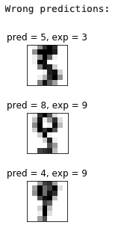
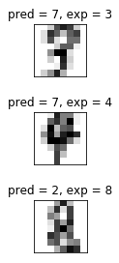
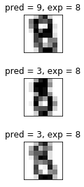

Wrong Predictions, cont’d
print(f'Prediction accuracy score = {knn.score(X_test, y_test):.2%}')
Prediction accuracy score = 97.78%

Slide 19
Confusion Matrix
k-NearestNeighbors.ipynb
from sklearn.metrics import confusion_matrix
confusion = confusion_matrix(y_true=expected, y_pred=predicted)
print('Confusion matrix:')
print(confusion)
Confusion matrix:
[[45 0 0 0 0 0 0 0 0 0]
[ 0 45 0 0 0 0 0 0 0 0]
[ 0 0 54 0 0 0 0 0 0 0]
[ 0 0 0 42 0 1 0 1 0 0]
[ 0 0 0 0 49 0 0 1 0 0]
[ 0 0 0 0 0 38 0 0 0 0]
[ 0 0 0 0 0 0 42 0 0 0]
[ 0 0 0 0 0 0 0 45 0 0]
[ 0 1 1 2 0 0 0 0 39 1]
[ 0 0 0 0 1 0 0 0 1 41]]
Rows: Classes 0 – 9
Columns: How many test samples
were classified in each class 0 – 9
Row 8:
One 8 incorrectly classified as a 1
One 8 incorrectly classified as a 2
Two 8’s incorrectly classified as 3’s
39 8’s correctly classified as 8’s
One 8 incorrectly classified as a 9

Slide 20
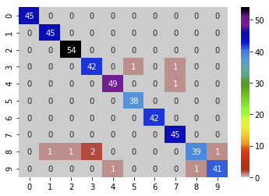
Confusion Matrix, cont’d
k-NearestNeighbors.ipynb
import pandas as pd
import seaborn as sns
confusion_df = pd.DataFrame(confusion, index=range(10),
columns=range(10))
axes = sns.heatmap(confusion_df, annot=True, cmap='nipy_spectral_r')

Slide 21
Classification Report
k-NearestNeighbors.ipynb
from sklearn.metrics import classification_report
names = [str(digit) for digit in digits.target_names]
print(classification_report(expected, predicted, target_names=names))
precision recall f1-score support
0 1.00 1.00 1.00 45
1 0.98 1.00 0.99 45
2 0.98 1.00 0.99 54
3 0.95 0.95 0.95 44
4 0.98 0.98 0.98 50
5 0.97 1.00 0.99 38
6 1.00 1.00 1.00 42
7 0.96 1.00 0.98 45
8 0.97 0.89 0.93 44
9 0.98 0.95 0.96 43
accuracy 0.98 450
macro avg 0.98 0.98 0.98 450
weighted avg 0.98 0.98 0.98 450
precision: Total number of correct
predictions for a digit divided by
the total number of predictions for
that digit.
Example: For 7: 45/47 = 0.96
recall: Total number of correct
predictions divided by the total
number that should have been
predicted as that digit.
Example: For 8: 39/44 = 0.89
f1-score: Average of precision and recall.
support: Number of samples with the
expected value.
Example: 50 samples labeled as 4
Confusion matrix:
[[45 0 0 0 0 0 0 0 0 0]
[ 0 45 0 0 0 0 0 0 0 0]
[ 0 0 54 0 0 0 0 0 0 0]
[ 0 0 0 42 0 1 0 1 0 0]
[ 0 0 0 0 49 0 0 1 0 0]
[ 0 0 0 0 0 38 0 0 0 0]
[ 0 0 0 0 0 0 42 0 0 0]
[ 0 0 0 0 0 0 0 45 0 0]
[ 0 1 1 2 0 0 0 0 39 1]
[ 0 0 0 0 1 0 0 0 1 41]]

Slide 22
Break

Slide 23
Unsupervised Machine Learning
Work with unlabeled data.
  Example: An online bookseller records large amounts of book purchase data and notice that people who buy certain books often buy other books on the same or similar topics. Unsupervised machine learning supports the development of a recommendation system.
Clustering algorithms
  Example: k-means clustering to find similarities in unlabeled data.
  Use dimensionality reduction to compress a large feature set.
We don’t know in advance
how the books will cluster.

Slide 24
Unsupervised ML: Dimensionality Reduction
Data with more than three dimensions
are difficult to visualize.
Use dimensionality reduction to reduce
the data to two or three dimensions.
  Performed by unsupervised machine learning algorithms.
  Graph the reduced dimension data and
  possibly see patterns, such as clusters of data.
  Reduce dimensions to improve training performance.
  But at the cost of potential reduced accuracy.

Slide 25
Dimensionality Reduction Algorithms
Two popular dimensionality reduction estimators.
  Analyze a dataset’s features and reduce them
  to a specified number of dimensions.
TSNE estimator
  t-distributed Stochastic Neighbor Embedding (t-SNE)
  See https://en.wikipedia.org/wiki/T-distributed_stochastic_neighbor_embedding
  TNSE from sklearn.manifold
Principal Component Analysis (PCA) estimator
  PCA from sklearn.decomposition

Slide 26
Example: Dimensionality Reduction
Reuse the Digits dataset.
  This time, ignore the target labels.
Use the TSNE estimator.
The data originally has 64 dimensions.
  The flattened 8 x 8 integer matrix of grayscale values.
DimensionalityReduction.ipynb
from sklearn.datasets import load_digits
digits = load_digits()
print('Original data shape: digits.data.shape = ' +
f'{digits.data.shape}')
Original data shape: digits.data.shape = (1797, 64)

Slide 27
Reduction via the TSNE Estimator
Use the TSNE estimator to reduce the data
to two dimensions.
  Employ a random rendering sequence.
  First train (fit) the estimator with the dataset and then
  transform the data into the number of dimensions.
  This calculation takes a while.
DimensionalityReduction.ipynb
from sklearn.manifold import TSNE
tsne = TSNE(n_components=2, random_state=11)
reduced_digits = tsne.fit_transform(digits.data)
print(f'Reduced data shape: reduced_digits.shape = {reduced_digits.shape}')
Reduced data shape: reduced_digits.shape = (1797, 2)

Slide 28
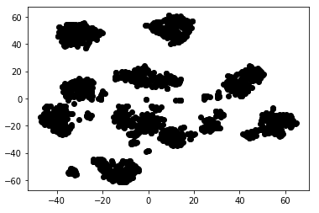
Visualize the Reduced Data
First in black and white:
DimensionalityReduction.ipynb
%matplotlib inline
import matplotlib.pyplot as plt
dots = plt.scatter(reduced_digits[:, 0], reduced_digits[:, 1], c='black')
column 0
column 1
The clustering suggests
that k-nearest neighbors
would be a good supervised
machine learning algorithm
to apply on the original data.

Slide 29
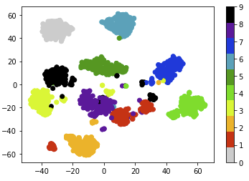
Visualize the Reduced Data, cont’d
Then in color, one color per digit:
dots = plt.scatter(reduced_digits[:, 0], reduced_digits[:, 1], c=digits.target,
cmap=plt.cm.get_cmap('nipy_spectral_r', 10))
colorbar = plt.colorbar(dots)
DimensionalityReduction.ipynb

Slide 30
Unsupervised ML: k-Means Clustering
Analyze unlabeled sample data.
Attempt to place data items in clusters
of items that appear to be related.
“k means” refers to the number of clusters
you seek to find in the data.

Slide 31
k-Means Clustering, cont’d
The k-means clustering algorithm uses distance calculations similar to k-nearest neighbors.
Each cluster is grouped around a centroid,
the cluster’s center point.
  The algorithm initially choses k centroids at random.
  Each unlabeled data sample is placed in the cluster whose centroid is the closest.
  The centroids are iteratively recalculated.
  The samples are reassigned to clusters until, for all clusters, the distances from each centroid to the samples in its cluster are minimized.

Slide 32
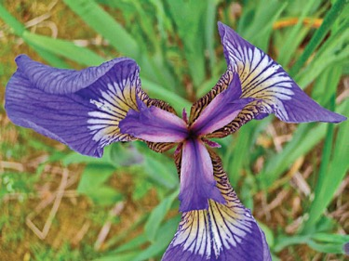
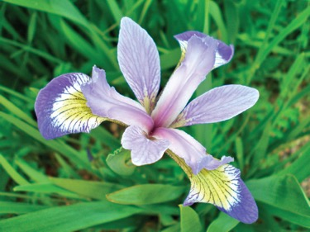
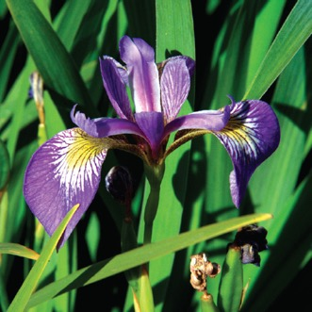
Example k-Means Clustering
The Iris dataset
  A ”toy dataset” of 150 samples.
  Descriptions of 50 samples each
  of three types of iris flowers.
    setosa
    versicolor
    virginica
  Four features
    sepal length and width
    petal length and width
setosa
versicolor
virginica
Sepals are the larger outer parts of each flower that protect
the smaller inside petals before the flower buds bloom.

Slide 33
Example k-Means Clustering, cont’d
Load and explore the dataset.
k-MeansClustering.ipynb
from sklearn.datasets import load_iris
iris = load_iris()
print(f'iris.data.shape = {iris.data.shape}')
print(f'iris.target.shape = {iris.target.shape}')
print(f'iris.target_names = {iris.target_names}')
print(f'iris.feature_names = {iris.feature_names}')
iris.data.shape = (150, 4)
iris.target.shape = (150,)
iris.target_names = ['setosa' 'versicolor' 'virginica']
iris.feature_names = ['sepal length (cm)', 'sepal width (cm)’,
'petal length (cm)', 'petal width (cm)']

Slide 34
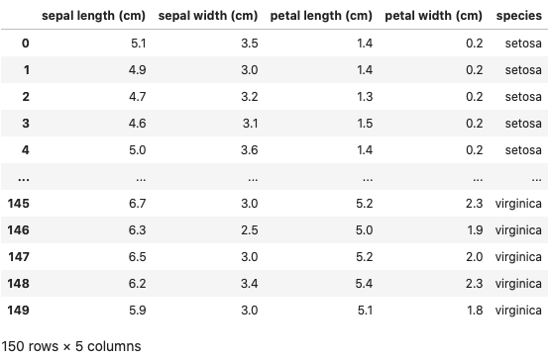
Example k-Means Clustering, cont’d
Create a Pandas dataframe
k-MeansClustering.ipynb
import pandas as pd
pd.set_option('max_columns', 5)
pd.set_option('display.width', None)
iris_df = pd.DataFrame(iris.data, columns=iris.feature_names)
iris_df['species'] = [iris.target_names[i] for i in iris.target]
iris_df
Grouped
by species

Slide 35
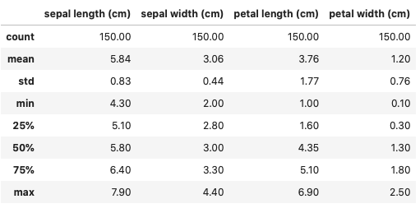

Example k-Means Clustering, cont’d
pd.set_option('precision', 2)
iris_df.describe()
iris_df['species'].describe()

Slide 36
Example k-Means Clustering, cont’d
Visualize the dataset.
  We have four features.
  We cannot plot one feature against the other three.
  Use the Seaborn pairplot() function to create a grid of graphs plotting each feature against the others.
k-MeansClustering.ipynb
%matplotlib inline
import seaborn as sns
sns.set(font_scale=1.1)
sns.set_style('whitegrid')
grid = sns.pairplot(data=iris_df, vars=iris_df.columns[0:4],
hue='species')
first 4 columns

Slide 37
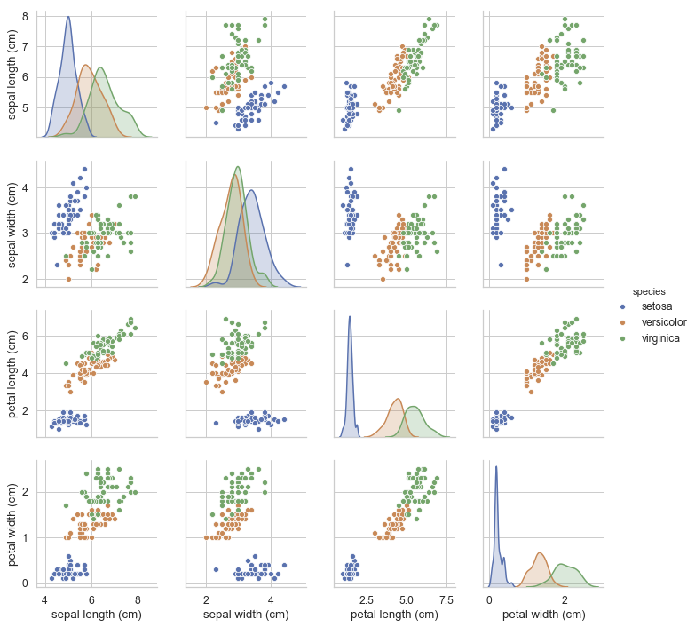
Example k-Means Clustering, cont’d
Distribution charts
along the diagonal.
Notice that the blue dots
that represent setosa
stand out from the green
and orange dots that
represent versicolor
and virginica.

Slide 38
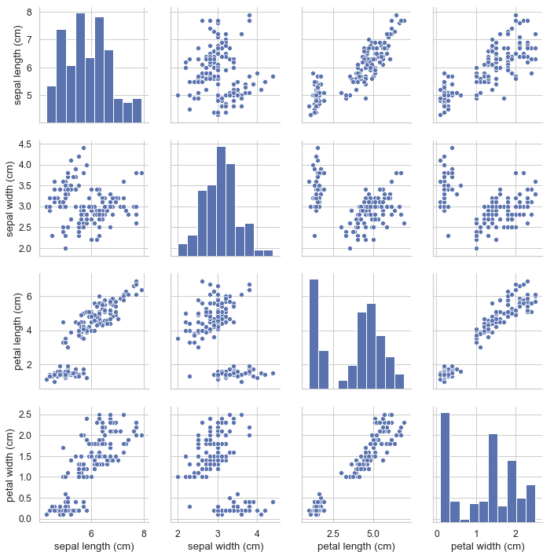
Example k-Means Clustering, cont’d
grid = sns.pairplot(data=iris_df, vars=iris_df.columns[0:4])

Slide 39
Example k-Means Clustering, cont’d
Create a k-means estimator and fit the model.
k-MeansClustering.ipynb
from sklearn.cluster import KMeans
kmeans = KMeans(n_clusters=3, random_state=11)
kmeans.fit(iris.data)
Seek 3 clusters
KMeans(n_clusters=3, random_state=11)
We normally do unsupervised machine learning with unlabeled data.
For this example, we use the iris dataset which is actually labeled data.
Therefore, we can use the labels to judge how well we classified the data.

Slide 40
Example k-Means Clustering, cont’d
Compare the k-means labels to the
Iris dataset’s target values.
print(kmeans.labels_[0:50]) # setosa
No confusion
about setosa.
[1 1 1 1 1 1 1 1 1 1 1 1 1 1 1 1 1 1 1 1 1 1 1 1 1
1 1 1 1 1 1 1 1 1 1 1 1 1 1 1 1 1 1 1 1 1 1 1 1 1]
Cluster 1
print(kmeans.labels_[50:100]) # versicolor
[0 0 2 0 0 0 0 0 0 0 0 0 0 0 0 0 0 0 0 0 0 0 0 0 0
0 0 2 0 0 0 0 0 0 0 0 0 0 0 0 0 0 0 0 0 0 0 0 0 0]
Cluster 0
print(kmeans.labels_[100:150]) # virginica
[2 0 2 2 2 2 0 2 2 2 2 2 2 0 0 2 2 2 2 0 2 0 2 0 2
2 0 0 2 2 2 2 2 0 2 2 2 2 0 2 2 2 0 2 2 2 0 2 2 0]
Cluster 2

Slide 41
Principal Component Analysis
Analyze a dataset’s features.
  Reduce them to a specified number of dimensions.
  Use the sklearn.decomposition.PCA estimator.
    Similar in functionality to the t-distributed Stochastic Neighbor Embedding (t-NSE) estimator.
from sklearn.decomposition import PCA
pca = PCA(n_components=2, random_state=11) # reduce to two components
pca.fit(iris.data)
PCA(n_components=2 random_state=11)

Slide 42
Principal Component Analysis, cont’d
Visualize the reduced data
reduced_iris = pca.transform(iris.data)
reduced_iris.shape
(150, 2)
reduced_iris_df = pd.DataFrame(reduced_iris,
columns=['Component 1', 'Component 2'])
reduced_iris_df['species'] = iris_df.species
import matplotlib.pyplot as plt
axes = sns.scatterplot(data=reduced_iris_df, hue='species', legend='brief',
x='Component 1', y='Component 2')
iris_centers = pca.transform(kmeans.cluster_centers_)
dots = plt.scatter(iris_centers[:,0], iris_centers[:,1], s=100, c='k')

Slide 43
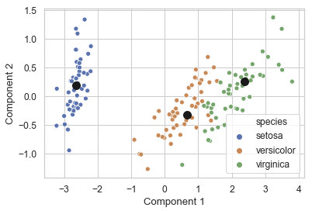
Principal Component Analysis, cont’d

Slide 44
Lab Assignment #9: ML Clustering and Classification
Identify a suitable dataset of unlabeled data
to perform k-means clustering.
  If you choose a labeled dataset, ignore the labels.
  Clean, transform, and load.
Perform similar analytical operations
as done in class for the Iris dataset.
  Did the algorithm generate meaningful clusters?
  If your dataset was labeled, how well did the clusters match the labels?

Slide 45
Lab Assignment #9, cont’d
After performing k-means clustering, you can then label each data item in your dataset according to the cluster it belongs to.
  Split the newly labeled data into
  training and testing data.
Now use the newly-labeled data to perform
k-nearest neighbor classification.
Perform similar analytical operations
as done in class for the Digits dataset.
  How well do the classifications match the clusters?

Slide 46
Lab Assignment #9, cont’d
Good sources of machine learning datasets:
  https://archive.ics.uci.edu/ml/datasets.php
  https://elitedatascience.com/datasets#classic-machine-learning
  https://en.wikipedia.org/wiki/List_of_datasets_for_machine-learning_research
    Do a text search on the word “clustering”
  Google “clustering dataset download”

Slide 47
Natural Language Processing (NLP)
Two important natural language applications:
  sentiment analysis
  language translation
Use Python’s Natural Language Toolkit (NLTK) and the TextBlob library.
A bit out of the scope of this class,
but too fun and interesting to pass up.
Only a very brief introduction!

Slide 48
Natural Language Processing, cont’d
The following NLP examples are from:
Several of the following NLP examples require first executing commands on the command line to install text processing modules.
  Windows users: Run the Anaconda Prompt as Administrator. Right click the Anaconda Prompt in the Start menu and select More > Run as administrator
Python for Programmers
by Paul Deitel and Harvey Deitel
Pearson, 2019
ISBN 978-0-13-5222433-5

Slide 49
NLP Example: TextBlob
TextBlob is an NLP text-processing library.
  Built on the NLTK.
  NLP tasks:
Tokenization—splitting text into pieces called tokens, which are meaningful units, such as words and numbers.
Parts-of-speech (POS) tagging—identifying each word’s part of speech, such as noun, verb, adjective, etc.
Noun phrase extraction—locating groups of words that represent nouns, such as “red brick factory.”
Sentiment analysis—determining whether text has positive, neutral or negative sentiment.
Inter-language translation and language detection powered by Google Translate.
Inflection—pluralizing and singularizing words. There are other aspects of inflection that are not part of TextBlob.
Spell checking and spelling correction.
Stemming—reducing words to their stems by removing prefixes or suffixes.
For example, the stem of “varieties” is “varieti.”
Lemmatization—like stemming, but produces real words based on the original words’ context.
For example, the lemmatized form of “varieties” is “variety.”
Word frequencies—determining how often each word appears in a corpus.
WordNet integration for finding word definitions, synonyms and antonyms.
Stop word elimination—removing common words, such as a, an, the, I, we, you and
to analyze the important words in a corpus.
n-grams—producing sets of consecutive words in a corpus for use in identifying words
frequently appear adjacent to one another.
Python for Programmers
by Paul Deitel and Harvey Deitel
Pearson, 2019
ISBN 978-0-13-5222433-5

Slide 50
NLP Example: TextBlob
First execute on the command line:
Tasks:
  Tokenize the text into sentences and words.
  Tag parts of speech.
  Extract noun phrases.
  Sentiment analysis with the Naive Bayes Analyzer.
    default sentiment analyzer
    Naive Bayes analyzer trained on movie reviews
  Language detection and translation.
conda install -c conda-forge textblob
ipython -m textblob.download_corpora
11_02.01-TextBlob.ipynb

Slide 51
NLP Example: Inflection
Tasks:
  Pluralization
  Singularization
11_02.08-Inflection.ipynb

Slide 52
NLP Example: Spell Checking and Correction
Tasks:
  Probable word matches of incorrectly spelled words.
  Each word match has a confidence value.
  Choose the word with the highest confidence value.
  Correct all the misspelled words in a sentence.
11_02.09-Spelling.ipynb

Slide 53
NLP Example: Stemming and Lemmatization
Tasks:
  Stemming
    Remove a prefix and/or a suffix from a word.
    The result may or may not be a real word.
  Lemmatization
    Similar to stemming but factors in
    the word’s part of speech.
    The result is a real word.
11_02.10-Stemming.ipynb

Slide 54
NLP Example: Word Frequencies
Tasks:
  Frequencies of words in text.
  Frequencies of noun phrases.
11_02.11-Frequencies.ipynb

Slide 55
NLP Example: Definitions
Tasks:
  Word definitions
  Synonyms
  Antonyms
11_02.12-Definitions.ipynb

Slide 56
NLP Example: Stop Words
Stop words
  Common words that typically
  do not provide useful information.
    Examples: a, the, by, is, at, my, before
  Often removed from text before analysis.
Tasks
  Download English stop words.
  Remove stop words from a sentence.
11_02.13-StopWords.ipynb

Slide 57
NLP Example: N-Grams
n-gram
  A sequence of n letters or words that frequently appear adjacent to one another.
  Used to predict word completions.
Tasks:
  List n-grams of three words each (trigrams).
  List n-grams of five words each.
11_02.14-N-Grams.ipynb

Slide 58
NLP Example: Word Frequency Visualizations
Tasks:
  Get word frequencies from
  the text of “Romeo and Juliet”.
  Eliminate the stop words.
  Sort the words by frequency, most to least.
  Enter the top 20 words into a Pandas dataframe.
  Create a bar chart of the top 20 words.
11_03.01-FrequencyVisualizations.ipynb

Slide 59
NLP Example: Word Clouds
First execute on the command line:
Tasks:
  Read the text of “Romeo and Juliet”.
  Load the heart-shaped image mask.
  Configure and generate the word cloud.
  Save the word cloud as an image file (.png).
  Display the word cloud image.
conda install -c conda-forge wordcloud
11_03.02-WordCloud.ipynb

Slide 60
NLP Example: Readability Assessment
First execute on the command line:
Tasks:
  Read the text of “Romeo and Juliet”.
  Use the Textatistic library to assess readability.
  Assess with five popular readability formulas:
    Flesch Reading Ease
    Flesch-Kincaid
    Gunning Fog
    Simple Measure of Gobbledygook (SMOG)
    Dale-Chall
pip install textatistic
11_04-Readability.ipynb

Slide 61
NLP Example: Named Entity Recognition
named entity recognition
  Attempt to locate and categorize items such as dates, times, quantities, places, people, things, organizations, etc.
First execute on the command line:
Tasks:
  Use the spaCy NLP Library.
  Recognize and print named entities.
conda install -c conda-forge spacy
ipython -m spacy download en
11_05-NamedEntity.ipynb

Slide 62
NLP Example: Similarity Detection
Tasks:
  Read the texts of Shakespeare’s “Romeo and Juliet” and Christopher Marlowe’s “Edward the Second”.
  Use the spaCy NLP Library to generate a similarity score from 0.0 (not similar) to 1.0 (identical).
11_06-Similarity.ipynb

