Slide 1


DATA 220
Mathematical Methods for Data Analysis
September 17 Class Meeting
Department of Applied Data Science
San Jose State University
Spring 2021
Instructor: Ron Mak
www.cs.sjsu.edu/~mak

Slide 2
Assignment #4
Go over solutions.

Slide 3
Conditional Probability
What if events A and B are not independent?
Example: What is the probability that a roll of a die produced an even number given that the
number was between 2 and 5?
  Let A = the set of even number outcomes
  Let B = the set of between 2 and 5 outcomes
  Now we look only at the
  reduced sample space
  consisting of numbers
  between 2 and 5.
5
6
4
3
2
1

Slide 4
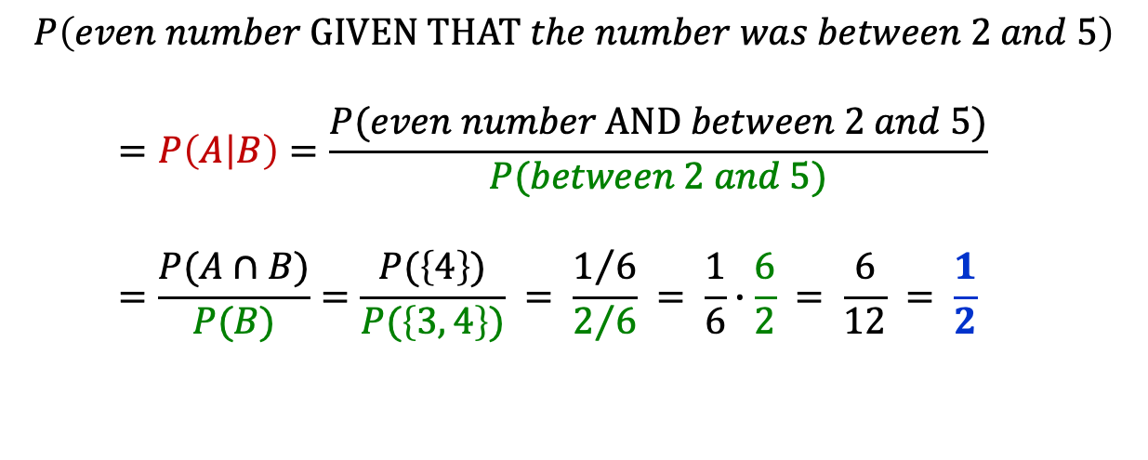
Conditional Probability, cont’d
  Let A = the set of even number
  outcomes
  Let B = the set of between 2
  and 5 outcomes
5
6
4
3
2
1
$$P\left(even number GIVEN THAT the number was between 2 and 5\right) \\ =P\left(A | B\right)=\frac{P(even number AND between 2 and 5)}{P(between 2 and 5)} \\ =\frac{P(A∩B)}{P(B)}=\frac{P(\left\{4\right\})}{P(\left\{3, 4\right\})} = \frac{1/6}{2/6} = \frac{1}{6}∙\frac{6}{2} = \frac{6}{12} = \frac{1}{2}$$

Slide 5

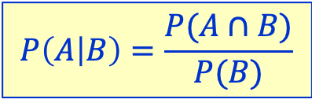
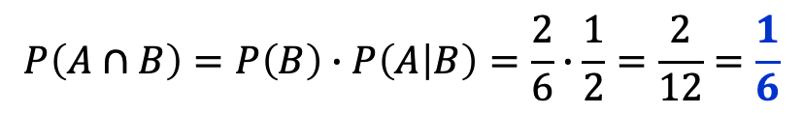
Conditional Probability, cont’d
  Let A = the set of even number
  outcomes
  Let B = the set of between 2
  and 5 outcomes
5
6
4
3
2
1
$$P\left(A∩B\right)=P\left(B\right)∙P\left(A | B\right)=\frac{2}{6}∙\frac{1}{2}=\frac{2}{12}=\frac{1}{6}$$
$$P\left(A | B\right)=\frac{P(A∩B)}{P(B)}$$
$$P\left(A∩B\right)=P\left(B\right)∙P(A|B)$$

Slide 6
Conditional Probability, cont’d
Example: A spa manufacturer has 25 spas in stock. Each spa is equipped with an on-off switch. The switches, some of which are defective, are supplied by two sources:
 | Nondefective | Defective
Source 1 | 10 | 5
Source 2 | 8 | 2
15
10
18
7
25

Slide 7
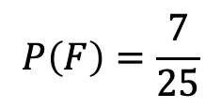
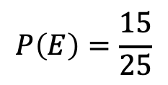
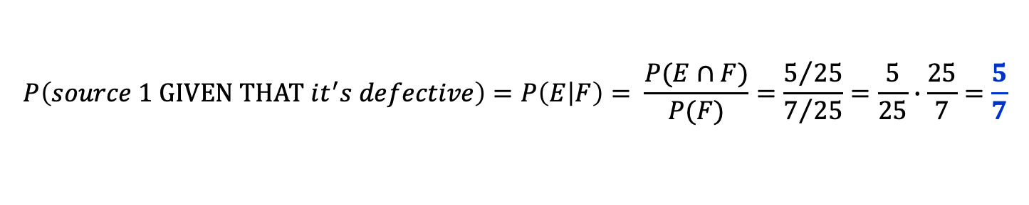
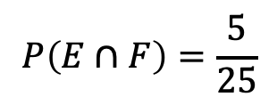
Conditional Probability, cont’d
 | Nondefective | Defective
Source 1 | 10 | 5
Source 2 | 8 | 2
A random spa is
selected for testing.
  Let E = event that spa’s switch is from Source 1
  Let F = event that the spa’s switch is defective
Testing reveals a defective switch. What is the probability the switch came from Source 1?
15
10
18
7
25
$$P\left(E\right)=\frac{15}{25}$$
$$P\left(F\right)=\frac{7}{25}$$
$$P\left(E∩F\right)=\frac{5}{25}$$
$$P\left(source 1 GIVEN THAT it^{′}s defective\right)=P\left(E | F\right)= \frac{P(E∩F)}{P(F)}=\frac{5/{25}}{7/{25}}=\frac{5}{25}∙\frac{25}{7}=\frac{5}{7}$$

Slide 8
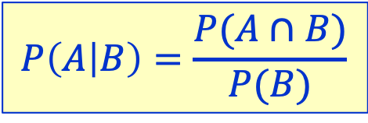
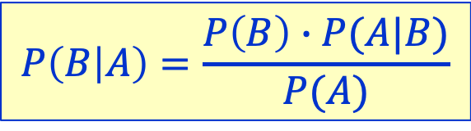




Conditional Probability Formulas
$$P\left(A | B\right)=\frac{P(A∩B)}{P(B)}$$
Recall that
Exchange the roles of A and B:
Therefore:
$$P\left(A∩B\right)=P\left(B\right)∙P(A|B)$$
$$A∩B=B∩A$$
$$P\left(B∩A\right)=P(A)∙P(B|A)$$
$$P\left(A\right)∙P\left(B | A\right)=P\left(B\right)∙P(A|B)$$
$$P\left(B | A\right)=\frac{P\left(B\right)∙P(A|B)}{P(A)}$$
Important!

Slide 9
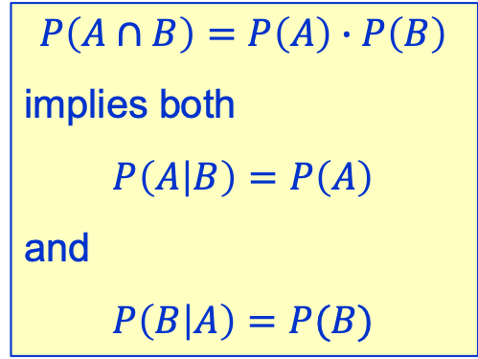
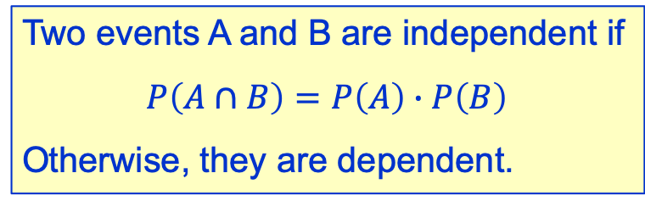
Independent vs. Dependent Events
Two events A and B are independent if
$$P\left(A∩B\right)=P\left(A\right)∙P\left(B\right)$$
Otherwise, they are dependent.
$$P\left(A∩B\right)=P\left(A\right)∙P\left(B\right)$$
implies both
$$P\left(A | B\right)=P\left(A\right)$$
and
$$P\left(B | A\right)=P(B)$$

Slide 10
Example: Bad Loan Risks
A bank’s loan officer knows that:
  5% of all loan applicants are bad risks.
  92% of all loan applicants who are bad risks are
  also rated bad risks by a credit advisory service.
  2% of all loan applicants are actually good risks but were rated bad risks by the credit advisory service.
What is the probability that a loan applicant
who was rated a bad risk by the credit service
is truly a bad risk?

Slide 11


Example: Bad Loan Risks, cont’d
  5% of all loan applicants are bad risks.
  92% of all loan applicants who are bad risks are also rated bad risks by a credit advisory service.
  2% of all loan applicants are actually good risks but are rated bad risks by the credit advisory service.
Let A be the event that the credit advisory service rates a loan applicant a bad risk.
Let B be the event that the loan applicant
is truly a bad risk.
What is P(B|A)?
$$P\left(B\right) =0.05 \\ P\left(A | B\right)=0.92 \\ P\left(A | \overline{B}\right)=0.02$$
Who is truly a bad loan risk
given a bad credit rating?
B
0.92
A
$$P\left(B\right)∙P\left(A | B\right)=\left(0.05\right)\left(0.92\right)=0.046$$
0.05
Bad
risk
Bad
rating
0.95
Good
risk
Bad
rating
0.95 = 1 – 0.05
0.02
$$P\left(\overline{B}\right)∙P\left(A | \overline{B}\right)=\left(0.95\right)\left(0.02\right)=0.019$$
$$\overline{B}$$
A

Slide 12
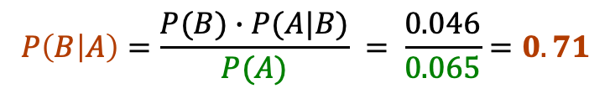
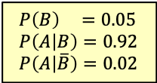
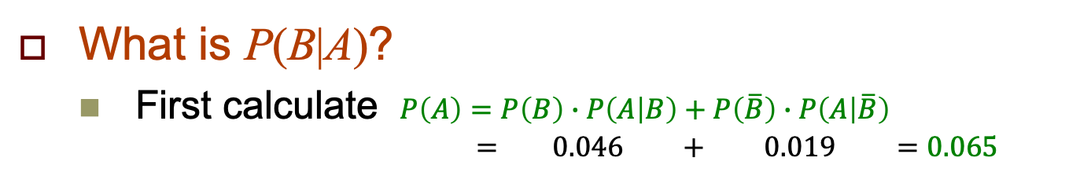

Example: Bad Loan Risks, cont’d
  5% of all loan applicants are bad risks.
  92% of all loan applicants who are bad risks are also rated bad risks by a credit advisory service.
  2% of all loan applicants are actually good risks but are rated bad risks by the credit advisory service.
$$P\left(B\right) =0.05 \\ P\left(A | B\right)=0.92 \\ P\left(A | \overline{B}\right)=0.02$$
B
0.92
A
$$P\left(B\right)∙P\left(A | B\right)=\left(0.05\right)\left(0.92\right)=0.046$$
0.05
Bad
risk
Bad
rating
0.95
Good
risk
Bad
rating
0.02
$$P\left(\overline{B}\right)∙P\left(A | \overline{B}\right)=\left(0.95\right)\left(0.02\right)=0.019$$
$$\overline{B}$$
A
What is P(B|A)?
  First calculate $P\left(A\right)=P\left(B\right)∙P\left(A | B\right)+P\left(\overline{B}\right)∙P\left(A | \overline{B}\right)$
  $= 0.046 + 0.019 =0.065$
Who is truly a bad loan risk
given a bad credit rating?
$$P\left(B | A\right)=\frac{P\left(B\right)∙P(A|B)}{P(A)}$$
(slide 8)
$$P\left(B | A\right)=\frac{P(B)∙P(A|B)}{P(A)} = \frac{0.046}{0.065}=0.71$$
The probability that a loan applicant is truly a bad loan risk GIVEN a bad risk rating by the credit advisory service is 0.71

Slide 13
Example: Disgruntled Engineers
A company does a survey to understand why
its engineers are quitting. It discovers that:
  20% dislike their work ➔ probability of quitting = 0.60
  50% feel underpaid ➔ probability of quitting = 0.40
  30% dislike their boss ➔ probability of quitting = 0.90
What is the most
likely reason that
an engineer quit?
B₁
0.60
A
$$P\left(B_{1}\right)∙P\left(A | B_{1}\right)=\left(0.20\right)\left(0.60\right)=0.12$$
0.20
Dislikes
work
Engineer
quits
0.50
B₂
0.40
A
$$P\left(B_{2}\right)∙P\left(A | B_{2}\right)=\left(0.50\right)\left(0.40\right)=0.20$$
0.30
Feels
underpaid
Engineer
quits
B₃
0.90
A
$$P\left(B_{3}\right)∙P\left(A | B_{3}\right)=\left(0.30\right)\left(0.90\right)=0.27$$
Dislikes
boss
Engineer
quits

Slide 14
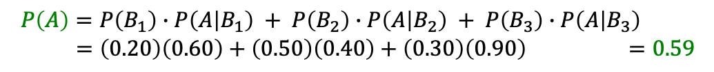
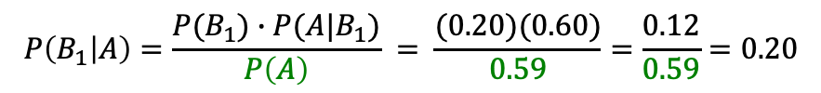

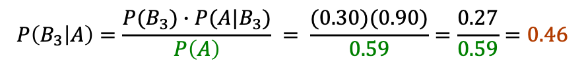
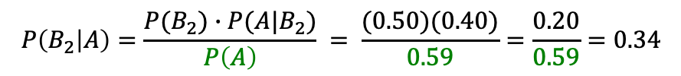
Example: Disgruntled Engineers, cont’d
B₁
0.60
A
$$P\left(B_{1}\right)∙P\left(A | B_{1}\right)=\left(0.20\right)\left(0.60\right)=0.12$$
0.20
Dislikes
work
Engineer
quits
0.50
B₂
0.40
A
$$P\left(B_{2}\right)∙P\left(A | B_{2}\right)=\left(0.50\right)\left(0.40\right)=0.20$$
Sum
0.59
0.30
Feels
underpaid
Engineer
quits
What is the most
likely reason that
an engineer quit?
B₃
0.90
A
$$P\left(B_{3}\right)∙P\left(A | B_{3}\right)=\left(0.30\right)\left(0.90\right)=0.27$$
Dislikes
boss
Engineer
quits
$$P\left(B | A\right)=\frac{P\left(B\right)∙P(A|B)}{P(A)}$$
$$P\left(A\right)=P\left(B_{1}\right)∙P\left(A | B_{1}\right) + P\left(B_{2}\right)∙P\left(A | B_{2}\right) + P\left(B_{3}\right)∙P\left(A | B_{3}\right) \\ =\left(0.20\right)\left(0.60\right)+\left(0.50\right)\left(0.40\right)+\left(0.30\right)\left(0.90\right) =0.59$$
$$P\left(B_{1} | A\right)=\frac{P(B_{1})∙P(A|B_{1})}{P\left(A\right)} = \frac{(0.20)(0.60)}{0.59}=\frac{0.12}{0.59}=0.20$$
$$P\left(B_{2} | A\right)=\frac{P(B_{2})∙P(A|B_{2})}{P\left(A\right)} = \frac{(0.50)(0.40)}{0.59}=\frac{0.20}{0.59}=0.34$$
$$P\left(B_{3} | A\right)=\frac{P(B_{3})∙P(A|B_{3})}{P\left(A\right)} = \frac{(0.30)(0.90)}{0.59}=\frac{0.27}{0.59}=0.46$$
Most likely the engineer
disliked the boss.

Slide 15
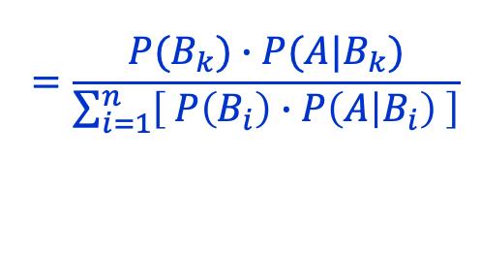
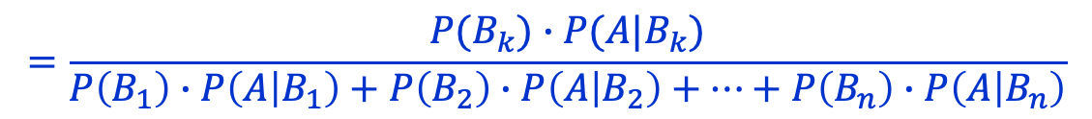
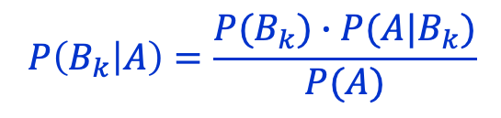
Bayes’ Theorem
If B₁, ... B_{n} are mutually exclusive events
and A is another event, then
$$P\left(B_{k} | A\right)=\frac{P(B_{k})∙P(A|B_{k})}{P(A)}$$
for a particular value of k = 1, 2, ..., or n
$$=\frac{P(B_{k})∙P(A|B_{k})}{P\left(B_{1}\right)∙P\left(A | B_{1}\right)+P\left(B_{2}\right)∙P\left(A | B_{2}\right)+⋯+P\left(B_{n}\right)∙P\left(A | B_{n}\right)}$$
$$=\frac{P(B_{k})∙P(A|B_{k})}{\sum_{i=1}^{n}{\left[ P\left(B_{i}\right)∙P\left(A | B_{i}\right) \right]}}$$

Slide 16
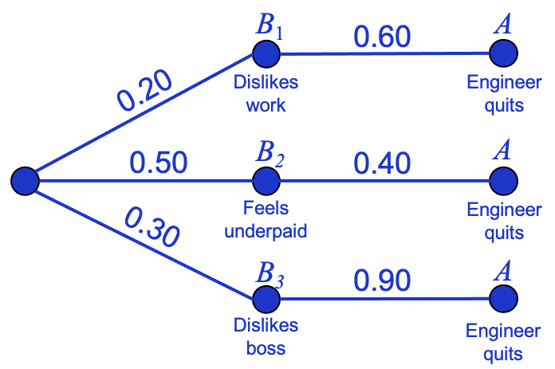
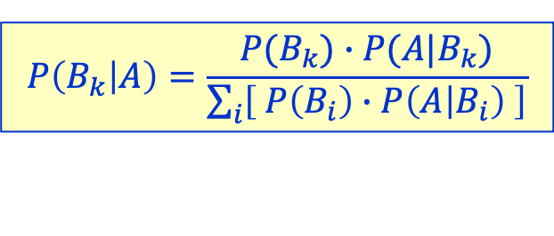
Bayes’ Theorem, cont’d
$$P\left(B_{k} | A\right)=\frac{P(B_{k})∙P(A|B_{k})}{\sum_{i}{\left[ P\left(B_{i}\right)∙P\left(A | B_{i}\right) \right]}}$$
A is an observable event.
  An engineer quits.
The probabilities P(B_{i}) are prior probabilities where i = 1, 2, ..., n
  P(dislikes work), etc., before observing the quit event A.
The problem is to find each posterior probability P(B_{k} | A) for k = 1, 2, ..., or n.
  P(dislike work | quit) after observing the quit event A.

Slide 17
Thomas Bayes
Thomas Bayes (1701-1761) was an English statistician,
philosopher, and minister. He formulated a specific case
of the theorem that bears his name. However, he did not
publish his most famous accomplishment. His friend
Richard Price edited and published Bayes’s notes after
Bayes’s death.
Bayesian statistics is based on the Bayesian interpretation
of probability, which incorporates one’s degree of belief in
an event. The degree of belief may be based on prior
knowledge of the event, previous experimental results,
or personal beliefs.

Slide 18
Thomas Bayes, cont’d
Bayesian statisticians’ interpretation of probability is
different from the frequentists’ interpretation. Recall that
the latter views probability as the limit of the relative
frequency of an event after many experimental trials.
Many frequentist statisticians viewed Bayesian statistics
unfavorably due to philosophical and practical
considerations. But with modern computational power,
the use of Bayesian statistics is increasing.
See: https://en.wikipedia.org/wiki/Thomas_Bayes
and https://en.wikipedia.org/wiki/Bayesian_statistics

Slide 19

Example: Disease Test
A classic!
A disease affects 1 out of every 1,000 people.
A test gives the correct result 90% of the time.
  90% of the time, it gives a positive result if you
  have the disease or a negative result if you don’t.
  10% of the time, it gives an incorrect result.
Your test is positive. What is the probability that you have the disease?
Are data scientists smarter than doctors?

Slide 20
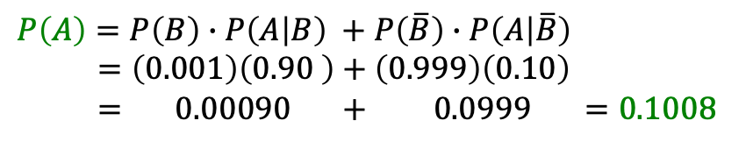
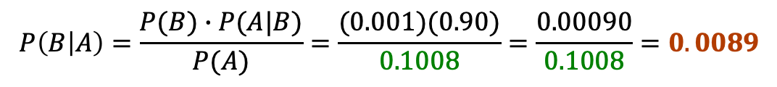
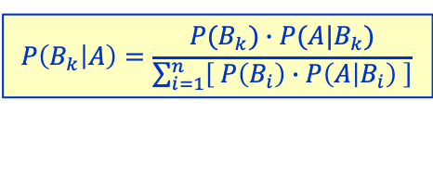
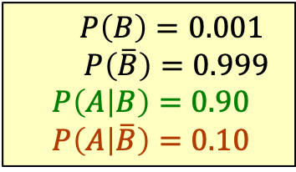
Example: Disease Test, cont’d
The disease affects 1 out of 1,000 people.
The test is correct 90% of the time and wrong 10% of the time.
Your test is positive. Do you have the disease?
$$P\left(B_{k} | A\right)=\frac{P(B_{k})∙P(A|B_{k})}{\sum_{i=1}^{n}{\left[ P\left(B_{i}\right)∙P\left(A | B_{i}\right) \right]}}$$
Let A be the event that the test is positive.
Let B be the event that you have the disease.
$$P\left(B\right)=0.001$$
$P\left(\overline{B}\right)=0.999$
$$P\left(A | B\right)=0.90$$
$$P\left(A | \overline{B}\right)=0.10$$
$$P\left(A\right)=P\left(B\right)∙P\left(A | B\right) +P\left(\overline{B}\right)∙P\left(A | \overline{B}\right) \\ =\left(0.001\right)\left(0.90 \right)+\left(0.999\right)\left(0.10\right) \\ = 0.00090 + 0.0999 =0.1008$$
$$P\left(B | A\right)=\frac{P(B)∙P(A|B)}{P(A)}=\frac{(0.001)(0.90)}{0.1008}=\frac{0.00090}{0.1008}=0.0089$$
Less than 1% of the people who test positive
actually have the disease.

Slide 21
Break

Slide 22
The Monty Hall Problem
Monty Hall hosted a popular TV game show.
You are a contestant on the show.
  Monty shows you three closed doors #1, #2, and #3.
  Behind one door is a new car, but behind each of
  the other doors is a goat.
  You pick one of the doors.
  Monty opens one of the other two doors
  and reveals a goat.
  He gives you the option to switch to the third door.
  You want to win that car! Should you stay with your original pick, or should you switch?

Slide 23
The Monty Hall Problem, cont’d
After seeing a goat behind
the door that Monty opened:
  Should you stay with the door
  you originally picked?
  Should you switch to the other
  unopened door?
  Does it make any difference
  whether you stay or switch?
This is a conditional probability problem!

Slide 24
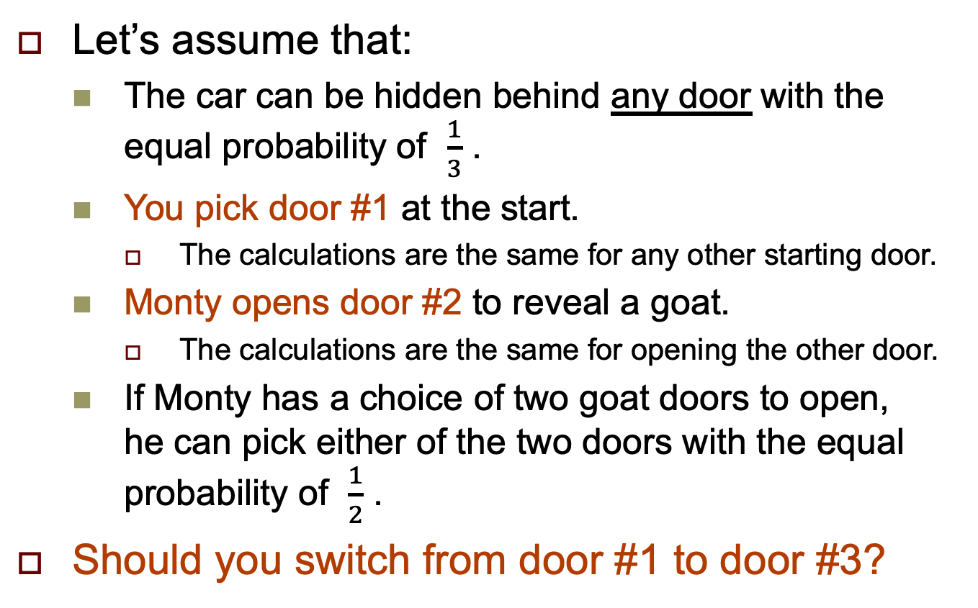
The Monty Hall Problem, cont’d
Let’s assume that:
  The car can be hidden behind any door with the
  equal probability of $\frac{1}{3}$ .
  You pick door #1 at the start.
    The calculations are the same for any other starting door.
  Monty opens door #2 to reveal a goat.
    The calculations are the same for opening the other door.
  If Monty has a choice of two goat doors to open,
  he can pick either of the two doors with the equal probability of $\frac{1}{2}$ .
Should you switch from door #1 to door #3?

Slide 25
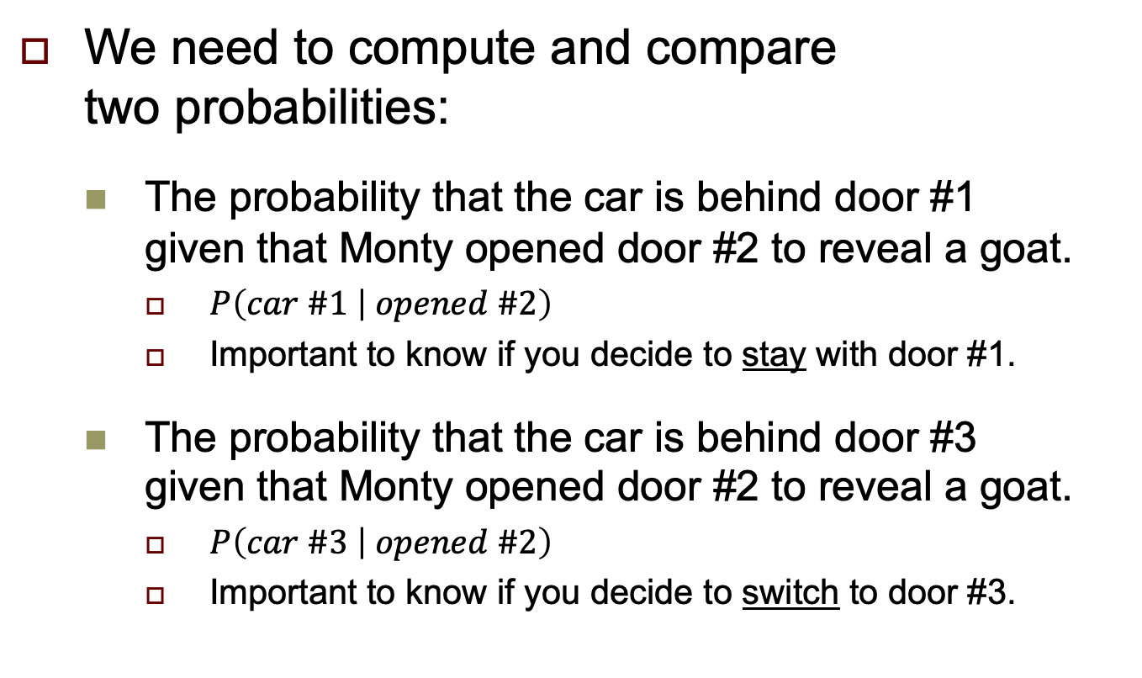
The Monty Hall Problem, cont’d
We need to compute and compare
two probabilities:
  The probability that the car is behind door #1
  given that Monty opened door #2 to reveal a goat.
    $P\left(car \#1 | opened \#2\right)$
    Important to know if you decide to stay with door #1.
  The probability that the car is behind door #3
  given that Monty opened door #2 to reveal a goat.
    $P\left(car \#3 | opened \#2\right)$
    Important to know if you decide to switch to door #3.
You picked door #1.
Monty opened door #2.

Slide 26

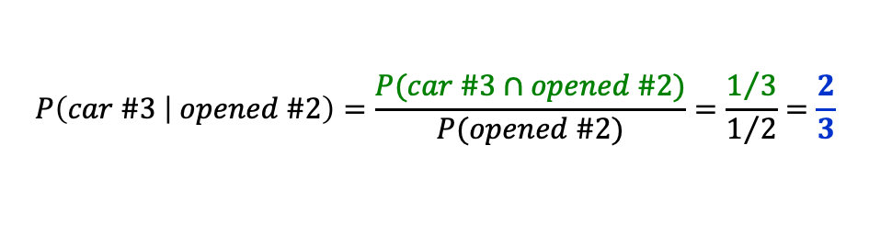
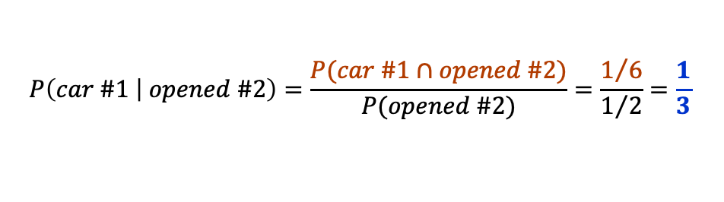

The Monty Hall Problem, cont’d
$$P\left(A | B\right)=\frac{P(A∩B)}{P(B)}$$
$$P\left(A∩B\right)=P\left(B\right)∙P(A|B)$$
$$P\left(car \#1∩opened \#2\right)=P\left(car \#1\right)∙P\left(opened \#2 | car \#1\right)= \frac{1}{3}∙\frac{1}{2}= \frac{1}{6}$$
If the car is behind #1,
Monty can pick either
door #2 or #3 to open.
$$P\left(car \#2∩opened \#2\right)=P\left(car \#2\right)∙P\left(opened \#2 | car \#2\right)=\frac{1}{3}∙0 =0$$
If the car is behind #2,
Monty will not open #2.
$$P\left(car \#3∩opened \#2\right)=P\left(car \#3\right)∙P\left(opened \#2 | car \#3\right)=\frac{1}{3}∙1 = \frac{1}{3}$$
If the car is behind #3,
Monty must open #2.
$$P\left(opened \#2\right)=P\left(car \#1 ∩opened \#2\right)+P\left(car \#2∩opened \#2\right)+P\left(car \#3∩opened \#2\right)$$
$$= \frac{1}{6} + 0 + \frac{1}{3} =\frac{1}{2}$$
$$P\left(car \#1 | opened \#2\right)=\frac{P(car \#1∩opened \#2)}{P(opened \#2)}=\frac{1/6}{1/2}=\frac{1}{3}$$
Your probability of
winning the car
is 2x higher if
you switch from
door #1 to door #3.
stay
$$P\left(car \#3 | opened \#2\right)=\frac{P(car \#3∩opened \#2)}{P(opened \#2)}=\frac{1/3}{1/2}=\frac{2}{3}$$
switch

Slide 27
The Monty Hall Problem, cont’d
A more intuitive explanation?
If you stay with your original door:
  Your likelihood of winning remains the same:
  one in three.
If you switch to the other closed door:
  One time in three, your original door was right,
  so you lose by switching.
  Two times in three, your original door was wrong,
  so you win by switching.

Slide 28
Random Variables
random variable: A numerical variable whose value depends on the outcome of a chance experiment.
  Computers use algorithms to generate
  pseudo-random values.
  True random values are often derived from measurements of natural phenomena.

Slide 29
Discrete Random Variables
A discrete random variable has a set of values that is a collection of isolated points on the number line.
  A common set of values for a discrete random variable is a subset of integers.
  In a dataset, we can treat a sequence of numerical values as discrete random values if the values don’t depend on each other.
  Example: The ages of the passengers in the
  Titanic Survival dataset.

Slide 30
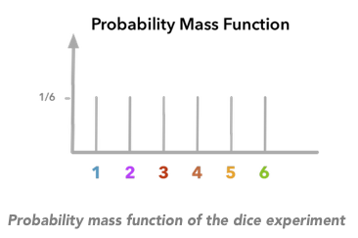
Probability Mass Function
The probability mass function gives the probability that a discrete random variable is exactly equal to some value.
Python: Various pmf() functions in scipy.stats
https://hadrienj.github.io/posts/Probability-Mass-and-Density-Functions/

Slide 31
Continuous Random Variables
A continuous random variable has a set of possible values in an entire interval of the number line.
  The values are floating-point (real) numbers.
  Example: You break a meter stick in two. The distance x from one end of the stick to where the break occurs is a continuous random value. x = 0.2 m is possible. So is x = 0.72 m. In fact, any value of x from 0 to 1 meter is possible. Therefore, x is a continuous random variable.
What if you rounded x to the nearest millimeter?

Slide 32
Probability Distributions of Random Variables
Let x be a discrete random variable associated with an experiment whose results are determined by chance.
  The outcome that occurs when the experiment is performed determines which value of x is observed.
The total probability for all outcomes is 1.
The probability distribution of x describes
how much of this total probability is placed
on each possible x value.

Slide 33
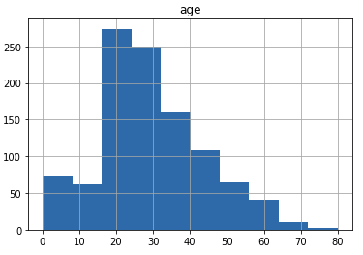
Graphs of Probability Distributions
We can graph a probability distribution.
  The x axis is the possible values of variable x.
  The y axis is the probability of each x value.
  Example: We drew a
  histogram of the
  ages of the
  Titanic passengers:

Slide 34
Graphs of Probability Distributions
There are several common probability distributions, each with a different shape
when the distributions are graphed.
  The more random values from a particular distribution are graphed, the closer the graph
  gets to the theoretical shape of the distribution.

Slide 35
Graphs of Probability Distributions, cont’d
  Example: We drew a histogram of the ages
  of the Titanic passengers:
  From the rough shape of the graph, we may infer
  that the ages have a normal distribution.

Slide 36
Graphs of Probability Distributions, cont’d
By graphing the random values of a variable, we can often determine its probability distribution.
A typical task of data analysis is to examine a sequence of values in a dataset and determine its probability distribution.
Knowing the probability distribution enables us
to apply more advanced analytical procedures
that are appropriate to that type of distribution.

Slide 37
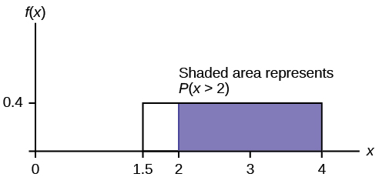
Uniform Probability Distribution
Within the interval of possible values for this continuous random variable x, every interval
of equal width has an equal probability
of being observed.
https://courses.lumenlearning.com/odessa-introstats1-1/chapter/the-uniform-distribution/

Slide 38
Normal Probability Distribution
The distribution of this continuous random variable x forms a bell curve.
https://statisticsbyjim.com/basics/normal-distribution/

Slide 39
Exponential Distribution
The values of this continuous random variable
are often concerned with the amount of time
until some specific event occurs.
  There are fewer large values and more small values.
  Examples:
    The amount of time until a customer finishes browsing
    and actually purchases something in your store.
    The length of time of a phone call.
    The amount of time you need to wait until the bus arrives.

Slide 40
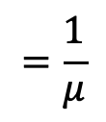
Exponential Distribution, cont’d
  Example: The length of time, in minutes,
  that a postal clerk spends with a customer:
$$=\frac{1}{μ}$$
https://courses.lumenlearning.com/introstats1/chapter/the-exponential-distribution/

Slide 41
Exponential Distribution, cont’d
  Example: The probability that a postal clerk will spend 4 to 5 minutes with a randomly selected customer:
https://courses.lumenlearning.com/introstats1/chapter/the-exponential-distribution/

Slide 42
Binomial Distribution
Properties of a binomial experiment:
  It consists of a fixed number n of trials.
  Each trial can result in only two mutually exclusive outcomes, labeled success (S) and failure (F).
  The outcomes of different trials are independent.
  The probability p that a trial results in S
  is the same for each trial.

Slide 43
Binomial Distribution, cont’d
This discrete binomial variable x is the
number of successes observed when
the experiment is performed.
  Variable x has a
  binomial distribution.
  It’s related to a
  normal distribution
  for a continuous
  random variable.
You will perform 20 trials of a
binomial experiment, where the
probability of success of each
trial is p = 0.25. What is the
probability that you’ll have
x successes from the 20 trials?
http://www.real-statistics.com/binomial-and-related-distributions/binomial-distribution/

Slide 44
Poisson Distribution
The values of this discrete random variable x with a Poisson distribution is the number of events over an interval of time or space.
  Example: The number of cars arriving at a toll booth during a given 5-minute period of time. The event is the arrival of the car. The time is the 5 minutes.
  Example: The number of plastic particles in a liter of water sampled from the ocean. The event is the discovery of a plastic particle. The space is the liter of sampled water.
The amount of time between Poisson events has an exponential distribution.

Slide 45
Poisson Distribution, cont’d
https://www.sciencedirect.com/topics/social-sciences/poisson-distribution
The graph increasingly resembles a normal curve as the number of values of x increases.

Slide 46
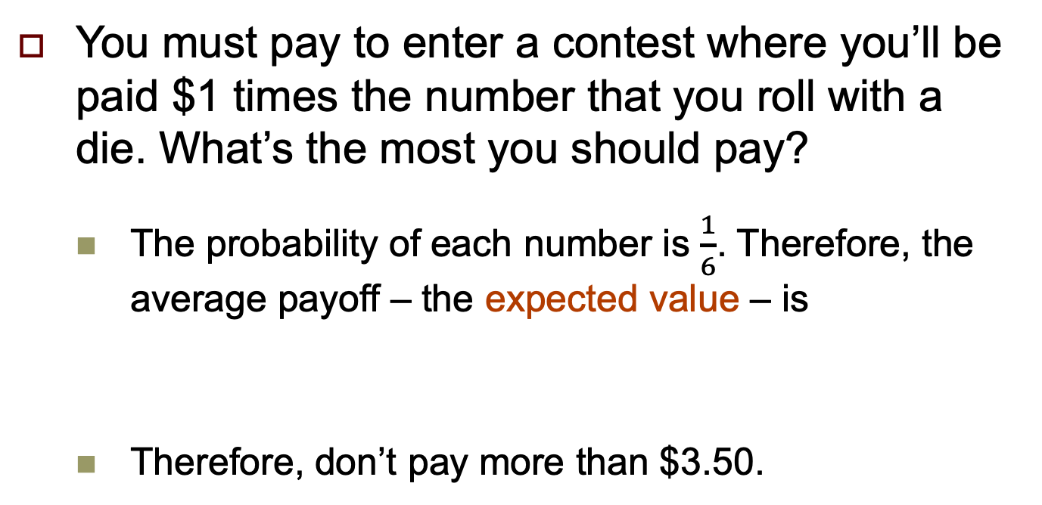
Expected Value
You must pay to enter a contest where you’ll be paid $1 times the number that you roll with a die. What’s the most you should pay?
  The probability of each number is $\frac{1}{6}$. Therefore, the average payoff – the expected value – is
  Therefore, don’t pay more than $3.50.
$$ev=\left(\frac{1}{6}∙1\right)+ \left(\frac{1}{6}∙2\right)+ \left(\frac{1}{6}∙3\right)+ \left(\frac{1}{6}∙4\right)+ \left(\frac{1}{6}∙5\right)+ \left(\frac{1}{6}∙6\right)=\frac{21}{6}=3.5$$

Slide 47
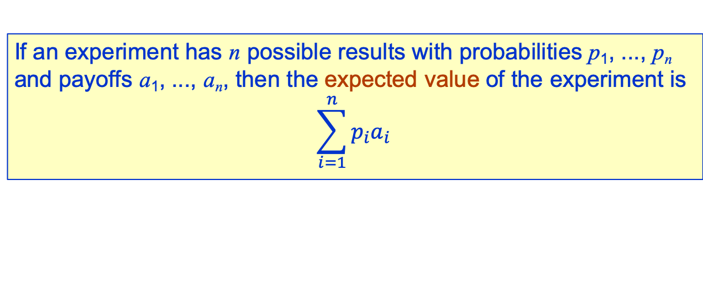
Expected Value, cont’d
If an experiment has n possible results with probabilities p₁, ..., p_{n}
and payoffs a₁, ..., a_{n}, then the expected value of the experiment is
$$\sum_{i=1}^{n}{p_{i}a_{i}}$$

Slide 48
Expected Value, cont’d
Example: A slot machine has 3 reels, each of which has the same 5 different pictures. Assume that each reel is independent of the others, and the 5 pictures on each reel have equal probabilities. The payoffs are:
  3 bells: $50
  3 of any one of the other 4 pictures: $10
  2 bells and any other picture: $2
Is it worth $1 to play this slot machine?

Slide 49
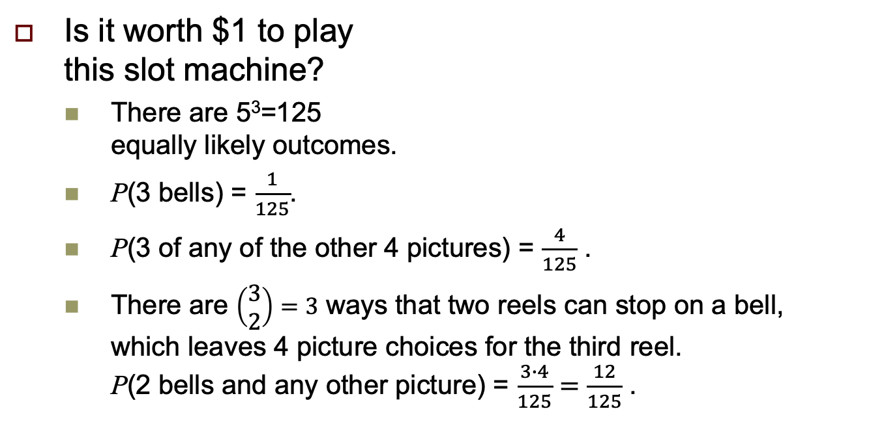
Expected Value, cont’d
Is it worth $1 to play
this slot machine?
  There are 5³=125
  equally likely outcomes.
  P(3 bells) = $\frac{1}{125}$.
  P(3 of any of the other 4 pictures) = $\frac{4}{125}$ .
  There are $\left(\begin{aligned}3 \\ 2\end{aligned}\right)=3$ ways that two reels can stop on a bell,
  which leaves 4 picture choices for the third reel.
  P(2 bells and any other picture) = $\frac{3∙4}{125}=\frac{12}{125}$ .
3 reels each with 5 pictures:
3 bells: $50
3 of any one of the other 4 pictures: $10
2 bells and any other picture: $2
$$ev=\left(\frac{1}{125}∙50\right)+\left(\frac{4}{125}∙10\right)+\left(\frac{12}{125}∙2\right)=\frac{50+40+24}{125}=\frac{114}{125}=0.912$$

Slide 50
Expected Value, cont’d
Mary, age 60, has a life-threatening illness.
Should she choose surgical procedure A or B?
  A: 40% of cases cured outright with patients living out their average life expectancy (20 more years for Mary), 20% died in surgery, 40% lived 5 more years.
  B: 20% of cases cured outright with patients living out their average life expectancy, no one died in surgery, 80% lived 5 more years.
$$ev\left(A\right)=\left(0.40∙20\right)+(0.40∙5)=10 years$$
$$ev\left(B\right)=(0.20∙20)+(0.80∙5)=8 years$$

Slide 51
Animated Graphs
Up until now, the graphs we’ve drawn with the Python packages were static (nothing moves).
Often it can be insightful to draw dynamic (animated) graphs.
  Update the graph to include new data values.
  The matplotlib.animation.FuncAnimation function repeatedly calls a function you’ve written.
  It pauses a given duration in milliseconds
  between calls to your function.

Slide 52
Demo: Animated Graph of Die Throws
If you roll a die, which face comes up is a random variable.
  It’s a uniformly distributed random variable
  that can have face values 1, 2, 3, 4, 5, or 6.
  Each value has the probability 1/6.
The more times you roll the die, the closer the frequencies of the face values become equal.
Animate the frequency (probability) distribution bar chart as the number of rolls increases.

Slide 53
Demo: Animated Graph of Die Throws
Function show_bar_chart (written for the Titanic dataset analysis) draws a bar chart of the frequency of each of the six face values.
Function update_frame generates new random face values each time it’s called.
Then it calls function show_bar_chart.
matplotlib.animation.FuncAnimation calls function update_frame for each animation frame, which occurs every 25 milliseconds (or any duration you specify).

Slide 54
Demo: Animated Graph of Die Throws, cont’d
Run the program on the command line of a terminal window (not in a Jupyter notebook):
This program requires two arguments on the command line, the number of frames (e.g., 100) and the number of die rolls per frame (e.g., 10).
  The following Python statements obtain the values
  of the first and second command-line parameters.
ipython -i RollDieDynamic.py 100 10
import sys
number_of_frames = int(sys.argv[1])
rolls_per_frame = int(sys.argv[2])

Slide 55
Assignment #5
Probability problem set:
http://www.cs.sjsu.edu/~mak/DATA220/assignments/5/Assignment5.ipynb

