Slide 1


DATA 201
Database Technologies for Data Analytics
May 8 Class Meeting
Department of Applied Data Science
San Jose State University
Spring 2025
Instructor: Ron Mak
www.cs.sjsu.edu/~mak

Slide 2
This Evening
Factless fact table
OLAP operations
  drill up, drill down
  slice, dice
  pivot
Conformed dimensions
GROUP BY ... WITH ROLLUP
Break

Slide 3
This Evening, cont’d
Stored procedures to pivot a table
Display graphs inside PyQt windows
Executive dashboard
Public key cryptography
Exciting contest!
Oral project presentations: Thursday, May 15
5:30 – 7:30 PM
At most 13 minutes each, so be concise!
Present the highlights of your application.
Final projects due: Friday, May 23

Slide 4
Survey Questions During Presentations
While each team does its oral presentation,
the rest of the class will evaluate it online.
  Rate each question Poor, OK, Good, Excellent
Survey questions
  Application and data sources
  Operation database architecture
  Analytical database architecture and ETL
  Demo
  Overall impression of the presentation

Slide 5
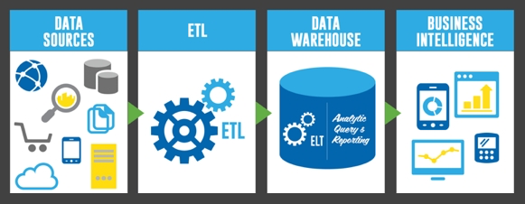
Extract, Transform, and Load (ETL)
http://uploads.webflow.com/54e3cc87305a0f0a0665f71f/5537351f5f1065d401cde83c_etl-elt-architecture.jpg

Slide 6
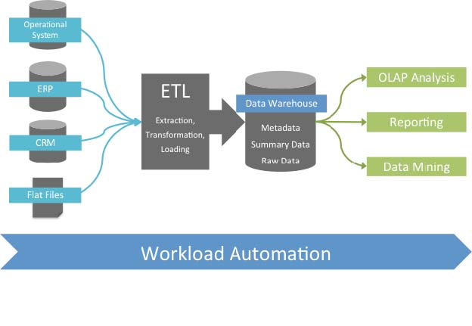
Extract, Transform, and Load (ETL), cont’d
http://www.stonebranch.com/common/images/etl-tipping-point.jpg

Slide 7
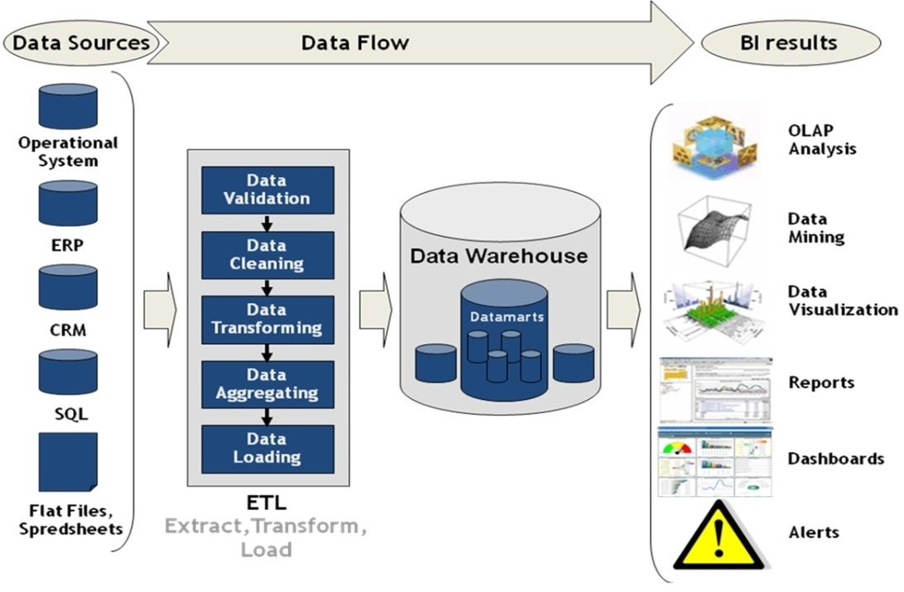
Extract, Transform, and Load (ETL), cont’d
http://superdevelop.com/wp-content/themes/shopperpress/thumbs/ETL.jpeg

Slide 8
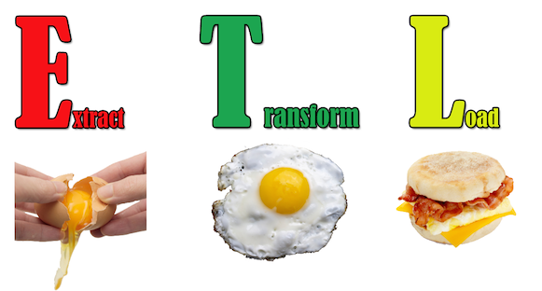
Extract, Transform, and Load (ETL), cont’d
http://edpflager.com/wp-content/uploads/2014/05/ETL.png

Slide 9
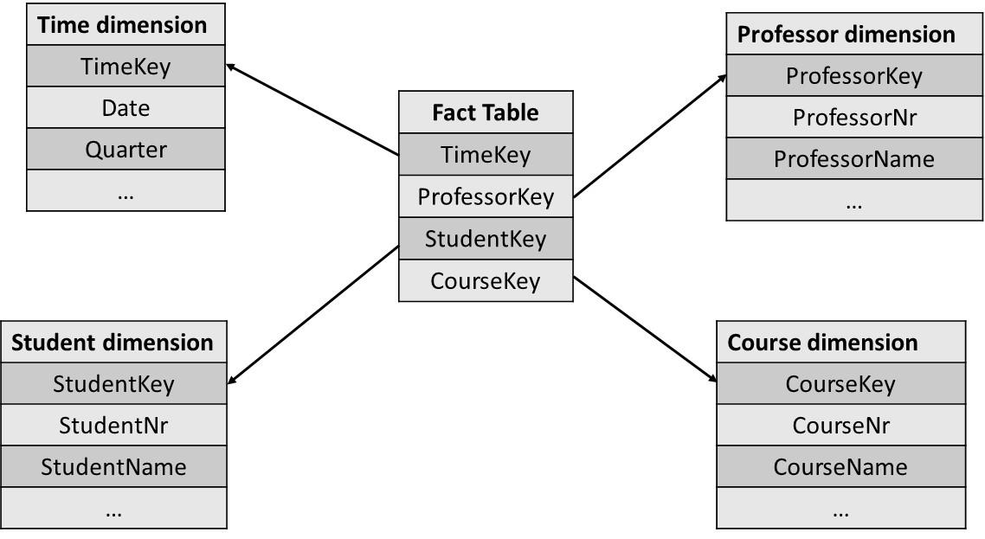
Factless Fact Table
Contains only foreign keys and no measures.
  Example:
  Example queries:
    Which professor teaches the highest number of courses?
    What is the average number of students who attend a course?
    Which course has the highest number of students?
Principles of Database Management
by Lemahieu, vanden Broucke, Baesens
Cambridge University Press, 2018
ISBN 978-1-107-18612-5

Slide 10
Online Transaction Processing (OLTP)
Online: The computer responds immediately
or very quickly.
  online ≠ internet
OLTP
  online transaction processing
  operational database = OLTP system
Update and query operational data.
Present current data
  Generate reports

Slide 11
Online Analytical Processing (OLAP)
OLAP
  online analytical processing
  Query data from data warehouses and/or
  data marts to analyze and present data.
OLAP tools support decision making.
OLAP tools are read only.

Slide 12
OLAP Operations
drill up and drill down
slice and dice
pivot

Slide 13
OLAP Drill Up and Drill Down
Drill through dimension hierarchies.
  Examples:
    Location: country → state → region → city → store
    Time: year → quarter → month → week → day → hour
Drill up
  AKA roll up
  Make the data granularity coarser.
  Aggregate the data.
Drill down
  Make the data granularity finer.

Slide 14
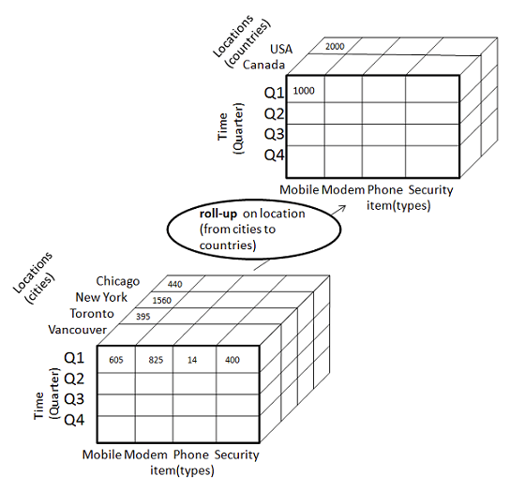
OLAP Drill Up and Drill Down, cont’d
http://www.tutorialspoint.com/dwh/dwh_olap.htm

Slide 15
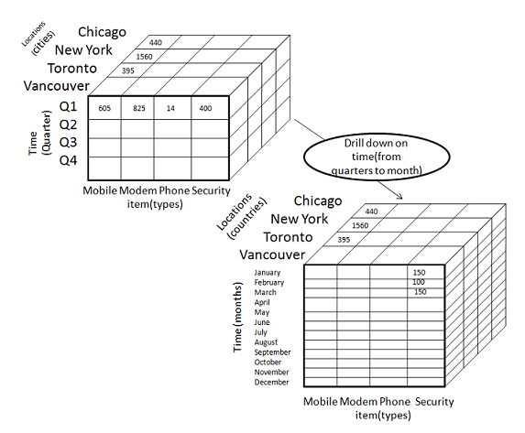
OLAP Drill Up and Drill Down, cont’d
http://www.tutorialspoint.com/dwh/dwh_olap.htm

Slide 16
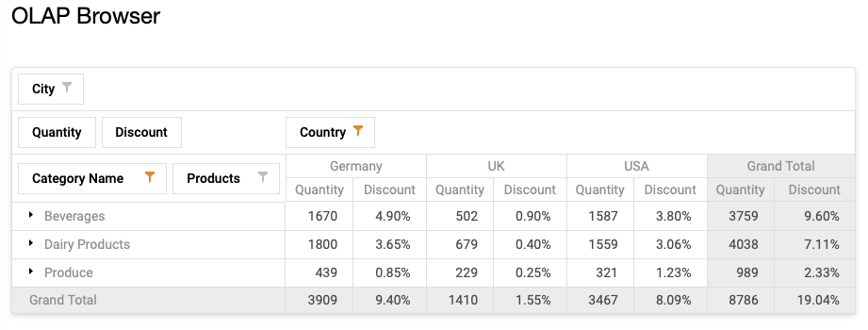
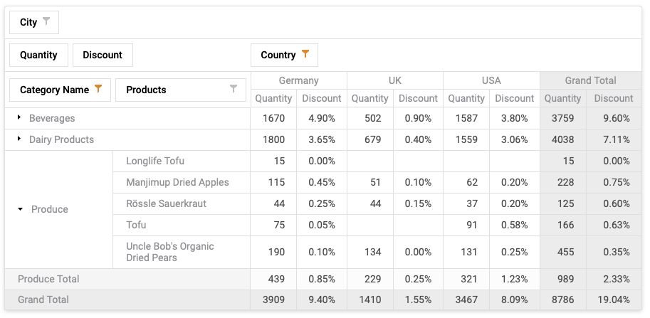
OLAP Drill Up and Drill Down, cont’d
Example commercial
OLAP tool
Drill down on
Produce
Drill up
(rollup) on
Produce
https://demos.devexpress.com/aspxpivotgriddemos/OLAP/Browser.aspx

Slide 17
Conformed Dimensions
When multiple star schemas share a common set of dimensions, the dimensions are called conformed dimensions.
Conformed dimensions enable analyses to span multiple star schemas, where the schemas share a common view of the world.
  For example, all the schemas must share
  a common view of what a customer is.
  Drill across: A OLAP operation that
  spans multiple star schemas.

Slide 18
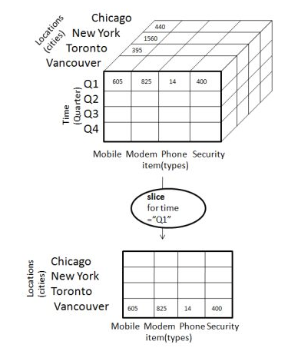
Slice and Dice
Slice: Select one value of a dimension attribute.
http://www.tutorialspoint.com/dwh/dwh_olap.htm

Slide 19
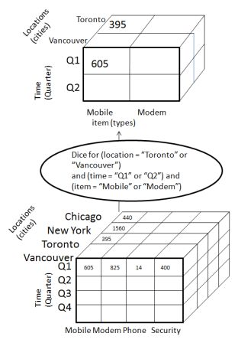
Slice and Dice
Dice: Select attribute values from two or more dimensions.
http://www.tutorialspoint.com/dwh/dwh_olap.htm

Slide 20
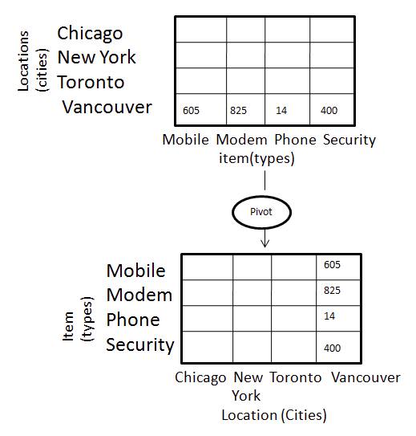
Pivot
Pivot: Reorganize query results by rotation.
Similar to a matrix transpose.
http://www.tutorialspoint.com/dwh/dwh_olap.htm

Slide 21
Implementing OLAP Operations
Straightforward to do with SQL only:
  drill up and down
  slice and dice
Best done with stored procedures:
  pivot
  (after the break)

Slide 22
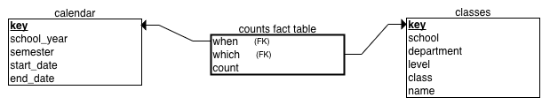
Examples of Slicing and Dicing
Dimensional model (star schema):
  Hierarchical dimension table calendar
    school year ➔ semester
  Hierarchical dimension table classes
    school ➔ department ➔ level ➔ class
  Fact table counts
    measure is the count of students
students-star.ipynb

Slide 23
SQL ROLLUP to Drill Up for Subtotals
MySQL supports rollup operations with
GROUP BY ... WITH ROLLUP
for drilling up hierarchical dimensions
to calculate subtotals and a grand total.
students-rollup.ipynb

Slide 24
Break

Slide 25
Stored Procedures to Pivot a Table
Introduces more stored procedure features:
  prepared statements
  cursors
  condition handlers
pivot.sql
exec_stmt.sql
pivot_install.ipynb
pivot_test.ipynb
pivot_explanation.ipynb

Slide 26
Display Graphs in PyQt Windows
It is possible to display Matplotlib and Seaborn graphs inside PyQt windows.
  Challenge: Automatically resize and redraw the graph whenever the user resizes the window.
PyQt also has its own functions for drawing graphs.
titanic_barchart.ui
titanic_barchart.py
titanic_barchart_main.py
TitanicSurvival.csv

Slide 27
Executive Dashboard
An executive dashboard is a good way to display important analysis results.
  Situational awareness: A decision maker
  sees at a glance what’s current and important.
Therefore, a major window of a GUI-based application can be an executive dashboard.

Slide 28
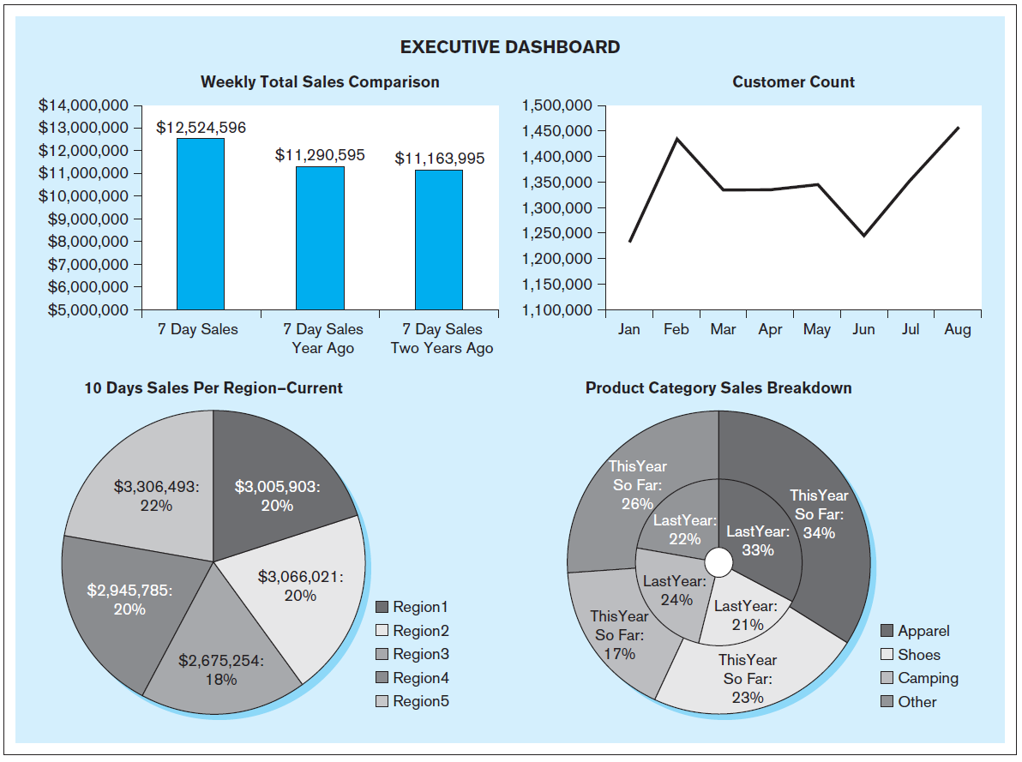
Executive Dashboard, cont’d
Database Systems
by Jukić, Vrbsky, & Nestorov
Pearson 2014
ISBN 978-0-13-257567-6

Slide 29
Bonus Lecture!
Public key cryptography
  How data transmissions are kept secret
Slides I presented several years ago to local high school teachers so that they in turn can teach their students about data security.

Slide 30



Security
Sending data such as email messages
to each other via the Internet …
… is like sending postcards
via the U.S. mail system.
Anyone can read the
message along the way!
“We plan to manufacture 7 million widgets next quarter.”
Jill
John

Slide 31

Security, cont’d
“We plan to manufacture 7 million widgets next quarter.”
Jill
John
Bart
How can we keep the nefarious Bart
from reading confidential messages that
Jill and John are sending each other?

Slide 32
The Shared Secret
Jill needs to send a message containing the confidential data 7 to John.
John and Jill can agree ahead of time to a shared secret – the number 12.
Then Jill can encrypt the data by adding 12
to the confidential data 7.
John decrypts the data by subtracting 12.
19
John
Shared
secret 12
Jill
Shared
secret 12

Slide 33
The Shared Secret, cont’d
19
John
Shared
secret 12
Jill
Shared
secret 12
X
Bart
Because Bart doesn’t know the shared secret 12, he won’t be able to decrypt the message and obtain the confidential data 7.

Slide 34
The Shared Secret, cont’d
19
John
Shared
secret 12
Jill
Shared
secret 12
But this shared secret solution has problems.
  Jill and John must arrange beforehand
  to share the secret 12.
  What if Jill doesn’t already know John?
  What if Jill wants to send the confidential data
  to all her vice presidents at the same time?
How can Jill and all her recipients share a secret?

Slide 35
Public Key Cryptography, cont’d
How can Jill and her recipients share a secret number in order to encrypt the confidential data?
A security scheme called public key cryptography was invented just for this purpose.
In this simplified introduction, let’s pretend
that multiplication is a one-way operation.
  Once you’ve multiplied two numbers, say 4x5=20,
  you can’t recover the original numbers by dividing.
  In other words, you can’t do 20÷4=5 or 20÷5=4

Slide 36
Public Key Cryptography, cont’d
Jill chooses a private key.
  Let’s suppose Jill chooses 10.
Each person to whom she wants to send confidential data also chooses a private key.
  Let’s suppose John chooses 8.
Private
key 10
Jill
John
Private
key 8

Slide 37
Public Key Cryptography, cont’d
Private
key 10
Jill
John
Private
key 8
Public
key 5
Bart
Now Jill announces a public key.
  Let’s suppose the public key is 5.
Everyone can see the public key.
  Including the nefarious Bart.

Slide 38
Public Key Cryptography, cont’d
Jill’s
public-private
key 50
John’s
public-private
key 40
Private
key 10
Jill
John
Private
key 8
Public
key 5
Now Jill can create her public-private key.
  Multiply the public key by her private key: 5x10=50.
John creates his public-private key.
  Multiply the public key by his private key: 5x8=40.

Slide 39
Public Key Cryptography, cont’d
Jill’s
public-private
key 50
John’s
public-private
key 40
Private
key 10
Jill
John
Private
key 8
Public
key 5
Remember that we’re pretending that multiplication is a one-way operation.
  We cannot discover Jill’s private key 10 by dividing her public-private key 50 by the public key 5.
  We cannot discover John’s private key 8 by dividing his public-private key 40 by the public key 5.

Slide 40
Public Key Cryptography, cont’d
Jill’s
public-private
key 50
John’s
public-private
key 40
Private
key 10
Jill
John
Private
key 8
Public
key 5
What is the goal of all this?
  To create a shared secret between Jill and John.
Jill multiplies John’s public-private key by her private key: 40x10=400
John multiplies Jill’s public-private key by his private key: 50x8=400

Slide 41
Public Key Cryptography, cont’d
Shared
secret 400
Jill’s
public-private
key 50
John’s
public-private
key 40
Shared
secret 400
Private
key 10
Jill
John
Private
key 8
Public
key 5
407
Now Jill and John have a shared secret 400.
Jill can encrypt the confidential data 7
by adding the shared secret 400 to obtain 407.
John can decrypt the confidential data 7
by subtracting the shared secret 400 from 407.

Slide 42
Public Key Cryptography, cont’d
407
John
Shared
secret 400
Jill
Shared
secret 400
X
Bart
Bart can’t decrypt the 407 because he
doesn’t know the shared secret 400.

Slide 43
Public Key Cryptography, cont’d
Public key encryption works
with multiple recipients.
Jill needs to send confidential data
to both John and his
twin brother Mark.
Each picks a private key.
Mark
Private
key 2
Private
key 10
Jill
John
Private
key 8

Slide 44
Public Key Cryptography, cont’d
Jill announces the public key 5, and everyone generates his or her public-private key.
  Jill: 5x10=50
  John: 5x8=40
  Mark: 5x2=10
Mark’s
public-private
key 10
Mark
Private
key 2
Public
key 5
Jill’s
public-private
key 50
John’s
public-private
key 40
Private
key 10
Jill
John
Private
key 8

Slide 45
Public Key Cryptography, cont’d
Jill will have a shared secret with each recipient.
  Jill and John will share 400 between them, as before.
  Jill and Mark will have a different shared secret.
    Jill: Multiply Mark’s
    public-private key by
    her private key:
    10x10=100.
    Mark: Multiply Jill’s
    public-private key by
    his private key:
    50x2=100
Mark’s
public-private
key 10
Shared secret
with Jill: 100
Mark
Private
key 2
Public
key 5
Shared secret
with Mark: 100
Jill’s
public-private
key 50
John’s
public-private
key 40
Shared secret
with Jill: 400
Shared secret
with John: 400
Private
key 10
Jill
John
Private
key 8

Slide 46
Public Key Cryptography, cont’d
Jill sends to each recipient.
  Bart can’t decrypt the messages to recover the confidential data 7 because he doesn’t know
  the shared secrets.
Shared secret
with Jill: 100
Mark
107
Shared secret
with John: 400
407
Shared secret
with Jill: 400
Jill
John
Shared secret
with Mark: 100
X
Bart

Slide 47
Cryptography in the Real World
Of course, in the real world, we can’t use simple operations like multiplication and addition to generate keys and to encrypt data.
  Multiplication and addition are
  not one-way operations.
Real-world encryption uses very large
prime numbers and modulo arithmetic.
  Not even the most powerful supercomputer
  can undo such operations.

Slide 48
The Diffie-Hellman Protocol
Public key cryptography is a key exchange protocol first published by Whitfield Diffie
and Martin Hellman in 1976.
  It was actually invented earlier in 1970 by the
  British government, but it was classified.
Whenever you visit a secure website, you are using the Diffie-Hellman protocol or a variant.
  A secure website has a URL that
  starts with https: instead of http:

Slide 49
Exciting Contest!
Each student has two chances to win
the fabulous prize.
  No programming required!
  You must be physically in class to participate!

