Slide 1


DATA 201
Database Technologies for Data Analytics
April 17 Class Meeting
Department of Applied Data Science
San Jose State University
Spring 2025
Instructor: Ron Mak
www.cs.sjsu.edu/~mak

Slide 2
This Evening
Calculate medians
Time-series analysis
  Moving averages
  Exponential smoothing
Sakila sample database
Break

Slide 3
This Evening, cont’d
Operational vs. analytical databases
Application-oriented vs. subject-oriented
Data warehouse
  data warehouse components
  business intelligence (BI)
Dimensional modeling
  star schema

Slide 4
Median
In a sorted sequence of values, the median is the value in the middle of the sequence.
  Example: If the sorted values are 2, 6, 6, 8, 13, 15, 20 then the median is 8 because it’s in the middle.
If the number of sorted values is even, then the median is the average of the two values in the middle.
  So the median might not be a value in the sequence.
  Example: If the sorted values are 2, 6, 6, 8, 13, 15, 20, 25, then the median is (8 + 13)/2 = 21/2 = 10.5

Slide 5
Median, cont’d
The median value separates the sorted values into two equal-sized partitions containing:
  values less than the median
  values greater than the median
  Example: 2, 6, 6, 8, 13, 15, 20
  Example: 2, 6, 6, 8, 13, 15, 20, 25
  10.5

Slide 6
Mean or Median?
Because the mean depends on all the values
of a sequence, it is much more sensitive to the data than the median, which depends only on the values in the middle of the sorted values.
So is the mean a better measure of
central tendency than the median?
The median is a more robust measure
when there are changes to the values.

Slide 7
Mean or Median? cont’d
Example: Compare typical household incomes in neighborhoods around Lake Washington in Seattle.
  Compare the Medina neighborhood to the Windermere neighborhood.
Use the mean: Bill Gates lives in Medina.
Would that fact make for a good comparison
of means with Windermere?
Use the median: Bill Gates’s stock holdings could triple in value, or he could go broke, but the median value of Medina won’t change.

Slide 8
Calculate the Median in SQL
First, we’ll do it in Python.
Then in SQL.
MedianPython.ipynb
MedianSQL.ipynb

Slide 9
Time-Series Analysis
Time-series analysis is a common application
of regression.
  Use the time as the independent variable x.
  Record data at regular intervals of time.
  The data values y are a function of the time.
  Calculate and plot trends of data values over time.
Different time-series trends:
  Least-squares line
  Moving average
  Exponentially smoothed

Slide 10
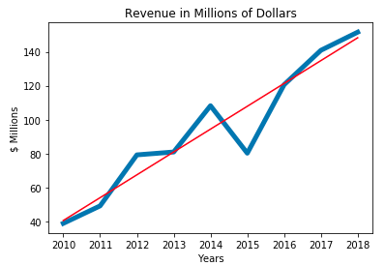
Linear Trend Over Time
A straightforward application of the
least squares regression line.
  You already know
  how to compute the
  the slope and
  y-intercept in SQL.

Slide 11
Moving Averages
The moving average y_{ma} of data values y over
the time x values that represent the time intervals:
  Each y_{ma} value of the moving average corresponding to the current x time value is the average of the current y value and the previous n-1 of the y values.
  There can be no y_{ma} moving average values corresponding to the first n-1 of the x values.
Higher values of n generate moving average plots that “smooth out” the data more.

Slide 12
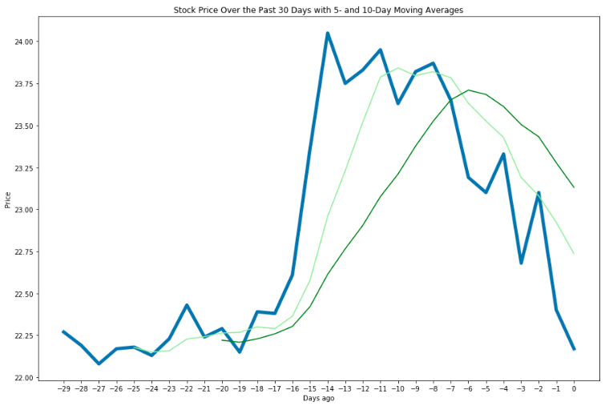
Moving Averages, cont’d
n = 5
n = 10

Slide 13
Moving Averages in Python
Python code:
  n-day moving average of stock prices
  table has two columns
    column 1: -29, -28, -27, ... -1, 0 (days ago)
    column 2: prices for each day
MovingAveragesPython.ipynb
last_prices = [] # last n prices
for i in range(len(table)):
last_prices += [table[i][1],] # append a new price
if i >= n:
last_prices.pop(0) # remove the oldest price
if i < 2:
table[i] += (None,) # no average for first n-1 days
else:
table[i] += (sum(last_prices)/3,) # moving average

Slide 14
Moving Averages in SQL
SQL code:
  n-day moving average of stock prices
  Uses SQL windowing
No average for the first n days.
SELECT days_ago, price,
IF ( ROW_NUMBER() OVER (ORDER BY days_ago) >= {n},
AVG(price) OVER (ORDER BY days_ago
ROWS BETWEEN {n - 1} PRECEDING
AND CURRENT ROW),
NULL
)
FROM recent_prices
ORDER BY days_ago
Average of the preceding n - 1 prices and the current price.
MovingAveragesSQL.ipynb

Slide 15
Exponential Smoothing
Exponential smoothing is a special form of moving average that weighs the most recent values of y differently than the earlier y values.
The smoothing is based on the value of the smoothing constant α, a fraction between
0 and 1.
The first value y_{es} of the exponentially smoothed average is simply the value of y calculated from the first value of x, the first time interval.

Slide 16
Exponential Smoothing, cont’d
Moving forward in time, for each subsequent value of x, the value of y_{es} is α times the current corresponding value of y plus 1 – α times the previous value of y_{es}.
  Therefore, if α < 0.5, the current value of y has less influence on the smoothed curve than earlier values. This dampens current fluctuations.
Smaller values of α generate more stable values of y_{es}. Larger values of α enable quicker reaction to current changes in values of y.

Slide 17
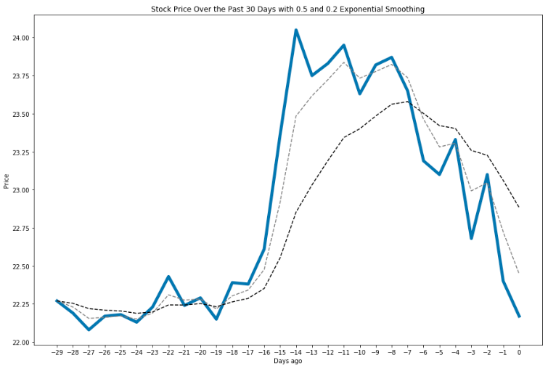
Exponential Smoothing, cont’d
α = 0.5
α = 0.2
If α < 0.5, the current value of y
has less influence on the
smoothed curve than earlier values.
This dampens current fluctuations.

Slide 18
Exponential Smoothing in Python
Python code:
  Exponential smoothing of stock prices with α = 0.2
  table has two columns
    column 1: -29, -28, -27, ... -1, 0 (days ago)
    column 2: prices for each day
ExponentialSmoothingsPython.ipynb
smoothed = None
for i in range(len(table)):
price = table[i][1]
smoothed = (0.2*price
+ (1 – 0.2)*(price if smoothed is None else smoothed))
table[i] += (smoothed,)

Slide 19
Exponential Smoothing in SQL
SQL code:
  Exponential smoothing of stock prices with α = 0.2
  Uses user-defined variable @smoothed that is initially NULL
ExponentialSmoothingsSQL.ipynb
SELECT days_ago, price,
@smoothed := (0.2*price
+ (1-0.2)*(IF (@smoothed IS NULL, price, @smoothed)))
AS smoothed
FROM recent_prices
ORDER BY days_ago

Slide 20
The Sakila Example Database
A very good example of an operational database developed by MySQL.
  Install: http://www.cs.sjsu.edu/~mak/DATA201/sakila-db/sakila.sql
  Documentation: https://dataedo.com/samples/html/Sakila/doc/Sakila_8/home.html
Movie rental database
  16 tables for movies, actors, ratings, payments, etc.
  7 views
  3 stored procedures
  3 stored functions
  4 triggers
To be used for next week’s Checkpoint #3 exam.

Slide 21
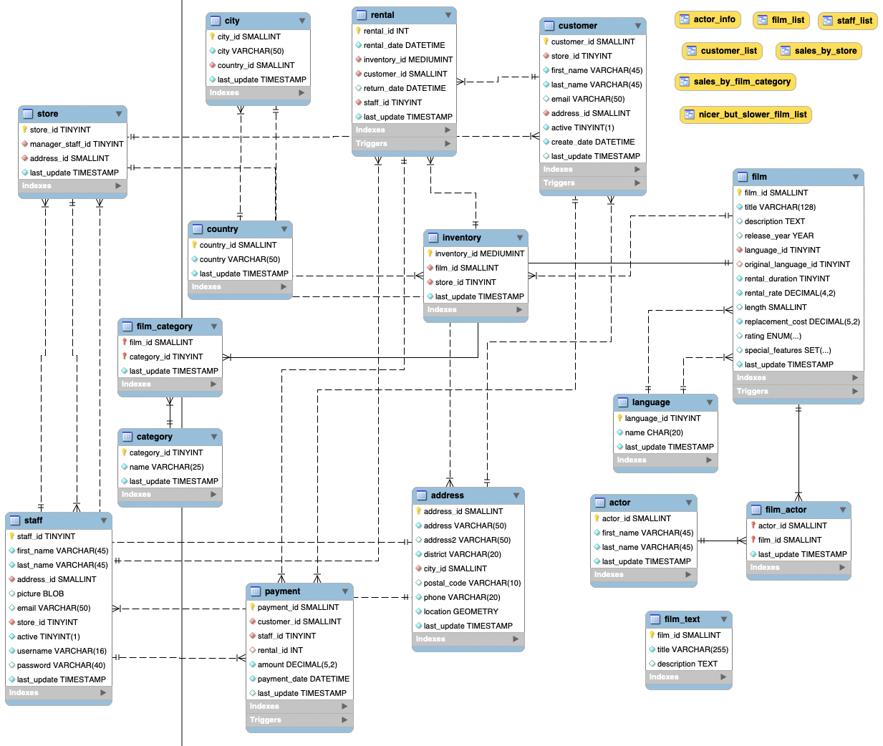
The Sakila Sample Database, cont’d

Slide 22
Break

Slide 23
The Data Deluge
90% of all the data ever created
was created in the past two years.
2.5 quintillion bytes of data per day
is being created.
  2.5 x 10¹⁸
  That’s a lot of data!
80% of the data is “dark data”
  i.e., unstructured data

Slide 24
A Transformation
collect values
Data
Often together
simply called “data”
add metadata
Information
add context
Knowledge
add insight
Wisdom

Slide 25
Operational Data
Support a company’s day-to-day operations.
  A company can have multiple
  operational data sources.
Contains operational information.
  AKA transactional information.
Example operational data:
  sales transactions
  ATM withdrawals
  results from ongoing scientific experiments
Example:
Sakila database

Slide 26
Analytical Data
Collected for decision support and data analysis.
Example analytical information:
  patterns of ATM usage during the day
  sales trends over the past year
  common results from experimental practices
Analytical information is based on
operational information.
  Extracted from the operational databases.
  Possibly augmented by third-party data sources.

Slide 27
Operational vs. Analytical Data
Create a data warehouse as a separate analytical database.
Don’t slow down the performance of the operational database by also making it
support analytical operations.
It’s often impossible to structure a single database that is optimal for both operational and analytical operations.

Slide 28
Time Horizon
Operational data
  Shorter time horizon: typically 60 to 90 days.
    Archive data after 60 to 90 days.
  Frequent queries and updates by multiple users.
    Small amounts of data retrieved from each query.
  Don’t penalize the performance of typical queries
  for the sake of an occasional atypical query.
Analytical data
  Look for patterns and trends over many years.
  Specialized queries by a few data analysts.
    Possibly large amounts of data from each query.

Slide 29
Level of Data Detail
Operational data
  Detailed data about each transaction.
  Summarized data are not stored but are
  derived attributes calculated with formulas.
  Summary data is subject to frequent changes.
Analytical data
  Summarized data is physically stored.
  Summarized data is often precomputed.
  Summarized data is historical and unchanging.

Slide 30
Data Time Representation
Operational data
  Contains the current state of affairs.
  Frequently updated.
Analytical data
  Current situation plus snapshots of the past.
  Snapshots are calculated once
  and physically stored for repeated use.

Slide 31
Data Amounts and Query Frequency
Operational data
  Frequent queries by more users.
  Small amounts of data per query.
Analytical data
  Fewer queries by fewer users.
  Can have large amounts of data per query.
Difficult to optimize for both:
  Frequent queries + small amounts of data
  Less frequent queries + large amounts of data

Slide 32
Data Updates
Operational data
  Regularly updated by end users.
  Insert, modify, and delete data.
Analytical data
  End users can only retrieve data.
  Updates by end users not allowed.

Slide 33
Data Redundancy
Operational data
  Goal is to reduce data redundancy.
  Eliminate update anomalies.
Analytical data
  Updates by end users are not allowed.
  No danger of update anomalies.
  Eliminating data redundancies is not as critical.

Slide 34
Data Audience
Operational data
  Support day-to-day operations.
  Used by all types of employees, customers, etc.
  for various tactical purposes.
Analytical data
  Used by a narrower set of users
  for decision-making purposes.

Slide 35
Data Orientation
Operational data
  Application-oriented
  Created to support an application that serves
  one or more business operations and processes.
  Enable the efficient functioning of the application
  that it supports.
Analytical data
  Subject-oriented
  Created for the analysis of one or more business subject areas such as sales, returns, cost, profit, etc.

Slide 36
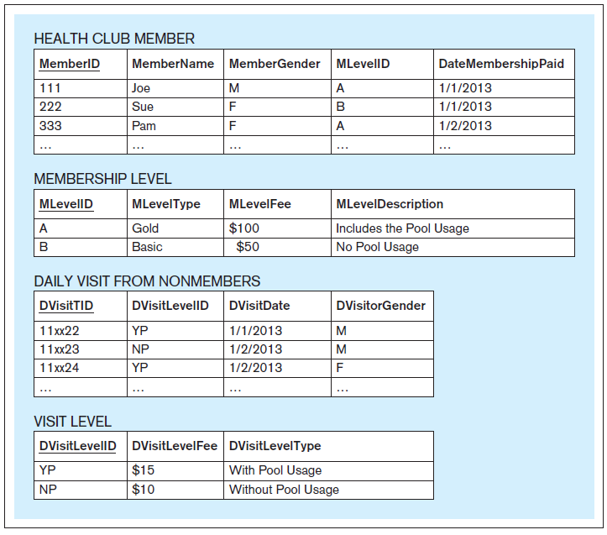
An Application-Oriented Operational Database
Support the
Visits and Payments application
of a health club.
Updated whenever a person joins or visits the club.
Database Systems
by Jukić, Vrbsky, & Nestorov
Pearson 2014
ISBN 978-0-13-257567-6

Slide 37
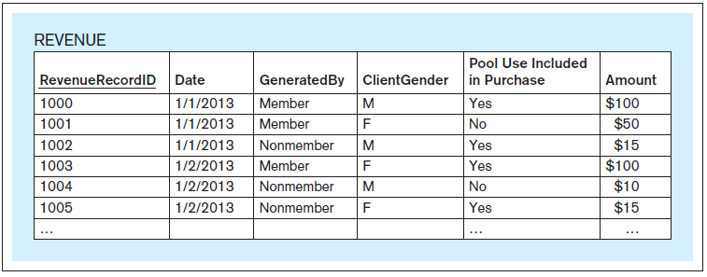
A Subject-Oriented Analytical Database
Support the analysis of the
subject of revenue
for a health club.
The data is loaded from
the operational database
on a weekly basis.
Database Systems
by Jukić, Vrbsky, & Nestorov
Pearson 2014
ISBN 978-0-13-257567-6

Slide 38
Operational vs. Analytical Data, cont’d
Operational Data | Analytical Data
Data Makeup
Typical time horizon: days/months | Typical time horizon: years
Detailed | Summarized (and/or detailed)
Current | Values over time (snapshots)
Technical Differences
Small amounts used in a process | Large amounts used in a process
High frequency of access | Low/Modest frequency of access
Can be updated | Read (and append) only
Non-redundant | Redundancy not an issue
Functional Differences
Used by all types of employees for tactical purposes | Used by fewer employees for decision making
Application oriented | Subject oriented

Slide 39
What is a Data Warehouse?
The data warehouse is a structured repository of integrated, subject-oriented, enterprise-wide, historical, and time-variant data.
The purpose of the data warehouse is
the retrieval of analytical information.
A data warehouse can store both detailed
and summarized data.

Slide 40
Structured Repository
The data warehouse is a structured repository of integrated, subject-oriented, enterprise-wide, historical, and time-variant data.
A data warehouse is a database that contains analytically useful information.
Any database is a structured repository.

Slide 41
Integrated
The data warehouse is a structured repository of integrated, subject-oriented, enterprise-wide, historical, and time-variant data.
The data warehouse integrates analytically useful data from existing operational databases in the organization.
Copy the data from the operational databases into the data warehouse.

Slide 42
Subject-Oriented
The data warehouse is a structured repository of integrated, subject-oriented, enterprise-wide, historical, and time-variant data.
Operational database
  Support a specific business operation.
Data warehouse
  Analyze specific business subject areas.

Slide 43
Enterprise-Wide
The data warehouse is a structured repository of integrated, subject-oriented, enterprise-wide, historical, and time-variant data.
The data warehouse provides an
enterprise-wide view of analytical data.
Example subject: Cost
  Bring into the data warehouse all
  analytically useful cost data.
  Possibly from individual operational databases at different business locations.

Slide 44
Historical
The data warehouse is a structured repository of integrated, subject-oriented, enterprise-wide, historical, and time-variant data.
The data warehouse has a longer time horizon than in operational databases.
  Operational database: typically, 60-90 days
  Data warehouse: typically, multiple years

Slide 45
Time-Variant
The data warehouse is a structured repository of integrated, subject-oriented, enterprise-wide, historical, and time-variant data.
The data warehouse contains slices or snapshots of data from different periods of time across its time horizon.
Example: Analyze and compare the cost for the first quarter of last year vs. the cost for the first quarter from two years ago.

Slide 46
Retrieval of Analytical Data
The data warehouse is a structured repository of integrated, subject-oriented, enterprise-wide, historical, and time-variant data.
Periodically load data from the operational databases into the data warehouse.
  Automatically append the new data
  to the existing data.
Data that has been loaded into the
data warehouse is not subject to changes.
  Users can only retrieve from a data warehouse.
  Nonvolatile, static, read-only data warehouse.

Slide 47
Detailed and/or Summarized Data
Detailed data
  AKA atomic data, transaction-level data
    Example: An ATM transaction
Summarized data
  Each record represents calculations based on multiple instances of transaction-level data.
    Example: The total amount of ATM withdrawals
    during one month for one account.
  Coarser level of detail than transaction data.
  A data warehouse that contains the data at the
  finest level of detail is the most powerful.

Slide 48
Data Warehouse Components
Source systems
Extract-transform-load (ETL) infrastructure
Data warehouse
Front-end applications
  Business Intelligence (BI) applications

Slide 49
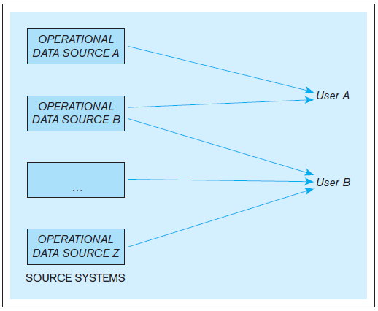
Data Warehouse Components, cont’d
Example: An organization where users use multiple operational data stores for daily operational purposes.
Database Systems
by Jukić, Vrbsky, & Nestorov
Pearson 2014
ISBN 978-0-13-257567-6

Slide 50
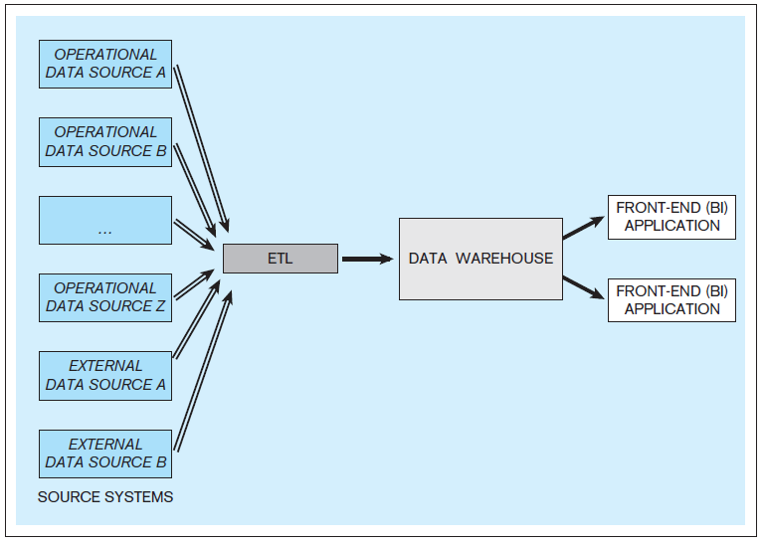
Data Warehouse Components, cont’d
Example: A data warehouse with multiple internal and external data sources.
Database Systems
by Jukić, Vrbsky, & Nestorov
Pearson 2014
ISBN 978-0-13-257567-6

Slide 51
Source Systems
Operational databases and other operational data repositories that provide analytically useful information for the data warehouse.
Therefore, each such operational data store
has two purposes:
  The original operational purpose.
  A source for the data warehouse.
Both internal and external data sources.
  Example external: third-party market research data

Slide 52
Extract-Transform-Load (ETL)
Extract analytically useful data from the operational data sources.
Transform the source data
  Make it conform to the structure of the
  subject-oriented data warehouse.
  Ensure data quality through processes such as
  data cleansing and scrubbing.
Load the transformed and quality-assured data into the target data warehouse.

Slide 53
Data Warehouse
Typically, an ETL operation occurs periodically for the target data warehouse.
  Common: Perform ETL nightly.
Active data warehouse: retrieval of data from the operational data sources is continuous.

Slide 54
Business Intelligence (BI)
A technology-driven process to analyze data and present actionable knowledge to help corporate executives, business managers and other end users make more informed business decisions.
Tools, applications and methodologies to collect data, prepare it for analysis, query the data, and create reports, dashboards, and other data visualizations.

Slide 55
Business Intelligence (BI) Applications
Front-end applications that allow users who are analysts to access the data and functions
of the data warehouse.

Slide 56
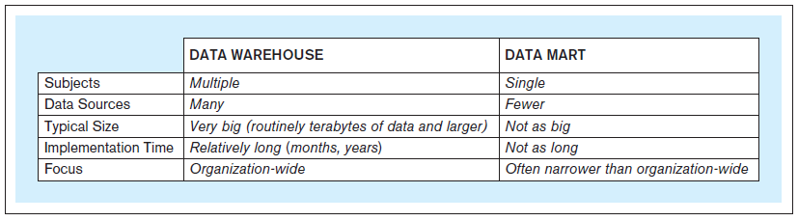
Data Marts
Same principles as a data warehouse.
More limited scope: one subject only.
Not necessarily an enterprise-wide focus.
Database Systems
by Jukić, Vrbsky, & Nestorov
Pearson 2014
ISBN 978-0-13-257567-6

Slide 57
Independent Data Marts
Standalone
Created the same way as a data warehouse.
Have their own data sources
and ETL infrastructure.

Slide 58
Dependent Data Marts
Does not have its own data sources.
Data comes from the data warehouse.
Provide users with a subset of the data.
  User get only the data they need or want
  or allowed to have access to.

Slide 59
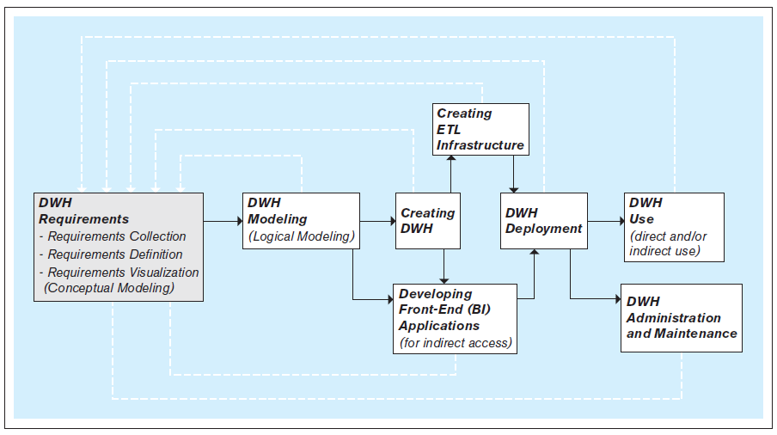
Steps to Create a Data Warehouse
An iterative process!
Database Systems
by Jukić, Vrbsky, & Nestorov
Pearson 2014
ISBN 978-0-13-257567-6

Slide 60
Create the ETL Infrastructure
The ETL infrastructure must reconcile all the differences between the multiple operational sources and the target data warehouse.
Decide how to bring in information without creating misleading duplicates.
Creating the ETL infrastructure is often
the most time- and resource-consuming part
of developing a data warehouse.

Slide 61
Develop the BI Applications
Front-end BI applications enable users to analyze the data in the data warehouse.
Typical business intelligence functions:
  Query the data.
  Perform ad hoc analyses on the fly.
  Generate reports and graphs.
  Control a dashboard, often in real time.
  Create data visualizations.
  Advanced: data mining.

Slide 62
Develop the BI Applications, cont’d
The primary goal of BI is to provide useful
business insights and actionable knowledge
for the decision makers.

Slide 63
Dimensional Modeling
A type of data model used for data warehouses and data marts.
  Subject-oriented analytical databases
The dimensional model is commonly based on the relational data model.
Two types of tables:
  dimension tables
  fact tables
Ralph Kimball
Data warehousing and dimensional modeling pioneer.

Slide 64
Star Schema
A dimensional relational schema contains dimension tables and fact tables.
  Often called a star schema.
Each dimension table contains
  a primary key
  attributes that are used for the analysis
  of the measures in the fact tables
Each fact table contains
  fact-measure attributes
  foreign keys to the dimension tables

Slide 65
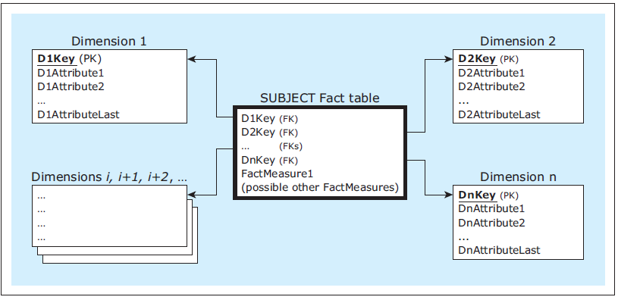
Star Schema, cont’d
A dimensional model
Database Systems
by Jukić, Vrbsky, & Nestorov
Pearson 2014
ISBN 978-0-13-257567-6

Slide 66
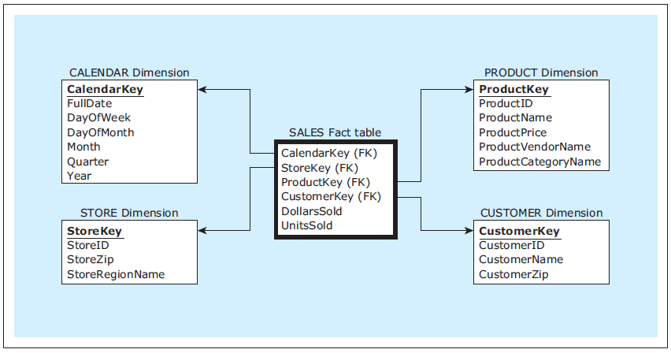
Dimensional Model Example
Nearly every star schema includes
a date- or time-related dimension.
Dimensional
model
Database Systems
by Jukić, Vrbsky, & Nestorov
Pearson 2014
ISBN 978-0-13-257567-6

Slide 67
Team Database Projects
Each project team produces:
  Operational database
  + GUI-based Python application
  Analytical database
  + GUI-based Python application
Demonstrate how well you can apply what you learned during the semester.
  Not all technologies
  have to be used.
Live demos
  Evaluated by the class via Canvas surveys
Oral presentations
Thursday, May 15
(instead of a final exam,
but must be present in class)
Class evaluations will be worth about 1/3 of the total project score.

Slide 68
Team Database Projects, cont’d
Data for the operational database
  Actual commerce or experimental data
  Dataset(s) downloaded from the web
  Artificially generated data (e.g., mockeroo)
The frontend GUI-based Python application for the operational database should demonstrate user queries and updates and display their results.

Slide 69
Team Database Projects, cont’d
Data for the analytical database
  Extracted from the operational database.
  ETL from external sources.
The frontend GUI-based Python application for the analytical database should demonstrate analytical operations and display their results.

Slide 70
Team Database Projects, cont’d
Python code (notebook or standalone)
  Use a shared server (provide access)
Written report (10 – 20 pages)
  What is the application?
  Describe your operational and analytical databases.
  What data did you use, and where did you get it?
  Include:
    ER diagram
    Relational and star schemas
    Operational and analytical queries
    User scenarios with screen shots
Projects are due
Friday, May 23

