Slide 1


DATA 201
Database Technologies for Data Analytics
March 6 Class Meeting
Department of Applied Data Science
San Jose State University
Spring 2025
Instructor: Ron Mak
www.cs.sjsu.edu/~mak

Slide 2
This Evening
Database design example
Stored procedures
Break
GUI programming with Python

Slide 3
Unofficial Field Trip
Computer History Museum in Mt. View
  http://www.computerhistory.org/
  Provide your own transportation to the museum.
Saturday, March 15, 11:30 AM
  Special free admission for my students.
    Meet in the front lobby for your free pass.
  Stay as long as you like, until closing time
  Do a self-guided tour of the Revolution exhibit.
  Experience a fully restored IBM 1401 mainframe computer from the early 1960s in operation.

Slide 4
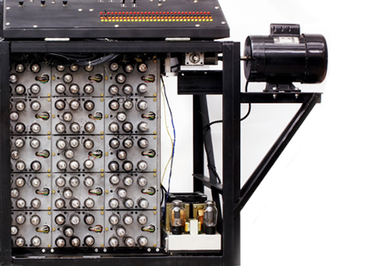
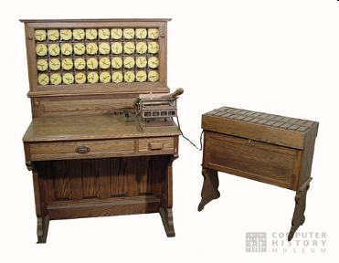
Unofficial Field Trip, cont’d
See the extensive Revolution exhibit!
  Walk through a timeline of the
  First 2000 Years of Computing History.
  Historic computer systems, data processing equipment,
  and other artifacts.
  Small theater presentations.
Hollerith
Census
Machine
Atanasoff-Berry
Computer

Slide 5
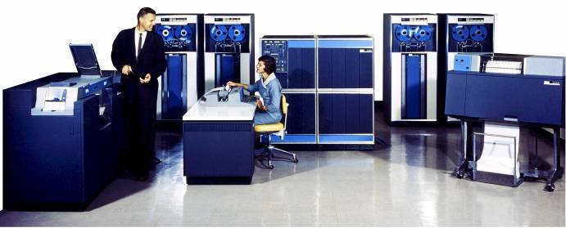
Unofficial Field Trip, cont’d
IBM 1401 computer, fully restored and operational.
  A small transistor-based mainframe computer.
  Extremely popular with small businesses
  in the late 1950s through the mid 1960s
    Maximum of 16K bytes of memory.
    800 card/minute card reader (wire brushes).
    600 line/minute line printer (impact).
    6 magnetic tape drives, no disk drives.

Slide 6
Database Design Example
Requirements
  Each salesperson has a name.
  Each customer has a name and gender.
  Each car has a car identification number (VIN), company, model, year, and price.
  Each transaction includes the month when it occurred.
  A salesperson creates transactions to sell cars.
  A transaction can include many cars, including none.
  Each sold car is included in a single transaction.
  A transaction belongs to only one customer and one salesperson.
  A customer have many transactions, but at least one.
  A customer can have transactions with different salespeople.

Slide 7
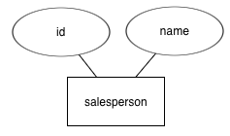
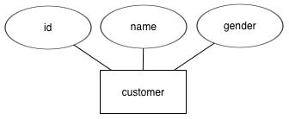
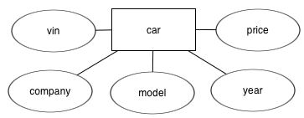
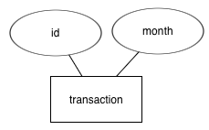
Database Design Example, cont’d
Each salesperson has a name.
Each customer has a name and gender.
Each car has a vehical identification
number (VIN), company, model,
year, and price.
Each transaction includes
the month when it occurred.

Slide 8
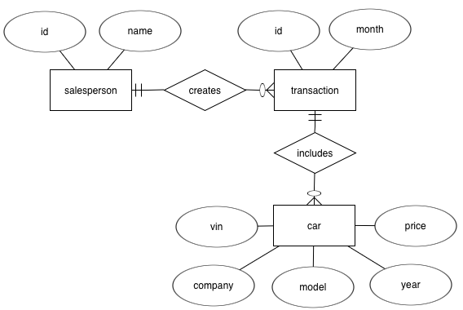
Database Design Example, cont’d
A salesperson creates transactions
to sell cars.
A transaction can include many cars,
including none.
Each sold car
is included in a
single transaction.

Slide 9
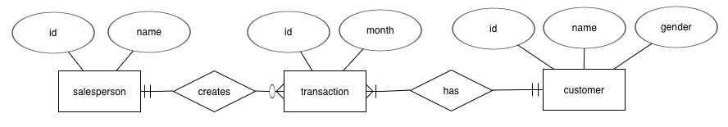
Database Design Example, cont’d
A transaction belongs to only one customer and one salesperson.
A customer have many transactions,
but at least one.
A customer can have transactions
with different salespeople.

Slide 10
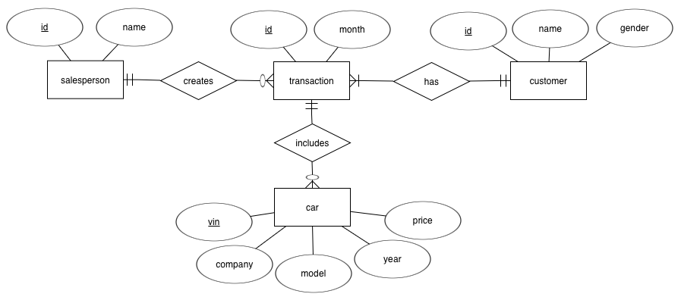
Database Design Example, cont’d
Each salesperson has a name.
Each customer has a name and gender.
Each car has a car identification number (VIN), company, model, year, and price.
Each transaction includes the month when it occurred.
A salesperson creates transactions to sell cars.
A transaction can include many cars, including none.
Each sold car is included in a single transaction.
A transaction belongs to only one customer and one salesperson.
A customer have many transactions, but at least one.
A customer can have transactions with different salespeople.

Slide 11
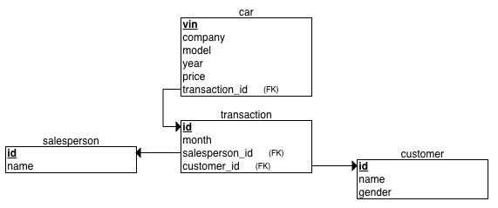
Database Design Example, cont’d
Each salesperson has a name.
Each customer has a name and gender.
Each car has a car identification number (VIN), company, model, year, and price.
Each transaction includes the month when it occurred.
A salesperson creates transactions to sell cars.
A transaction can include many cars, including none.
Each sold car is included in a single transaction.
A transaction belongs to only one customer.
A customer have many transactions, but at least one.
A customer can have transactions with different salespeople.

Slide 12
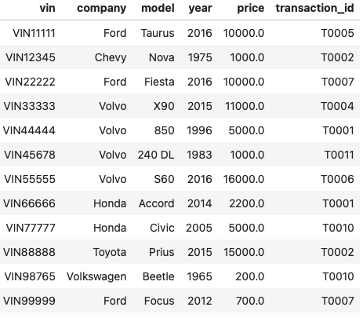
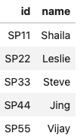
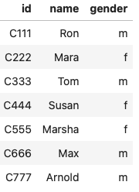
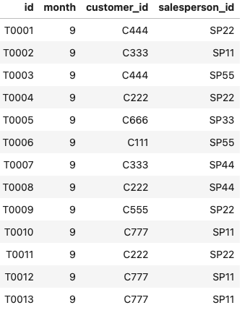
Database Design Example, cont’d
car
salesperson
customer
transaction

Slide 13
Database Design Example, cont’d
Query 1
  In the month of September, which salesperson
  sold the most cars and how many?
Query 2
  Which salespersons in September sold fewer than the average number of cars in September?
Query 3
  In September, what is the number and average price of cars sold in each group consisting of a salesperson, a car company, and a customer gender? Only consider salespersons who sold two or more cars in the group.

Slide 14
Advantages of Stored Procedures
Compiled code stored on the database server
  Less network traffic
  Faster invocation
  IN, OUT, and INOUT parameters
  Tested and shared code

Slide 15
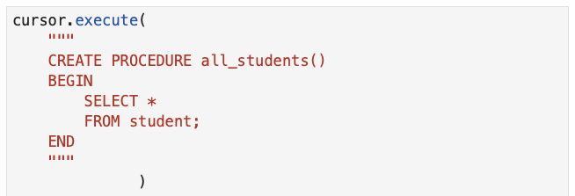
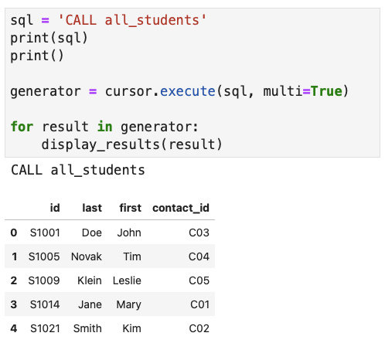
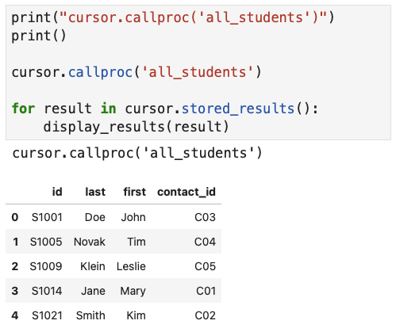
Student Stored Procedures
StudentProcsInstall.ipynb
StudentProcsCall.ipynb
SQL CALL command
Cursor method callproc()
Two ways to call the stored procedure.

Slide 16
Student Stored Procedures, cont’d
DROP PROCEDURE IF EXISTS all_students;
DROP PROCEDURE IF EXISTS id_of;
DROP PROCEDURE IF EXISTS class_codes_of;
DROP PROCEDURE IF EXISTS classmates_of;
DELIMITER $$
CREATE PROCEDURE all_students()
BEGIN
SELECT *
FROM student;
END$$
CREATE PROCEDURE id_of(IN first_name VARCHAR(32),
IN last_name VARCHAR(32),
OUT sid VARCHAR(5))
BEGIN
SELECT id INTO sid
FROM student
WHERE first = first_name
AND last = last_name;
END$$
...
DELIMITER ;
Enter on the command line in a terminal window:
# mysql -u root -p
Enter password:
Welcome to the MySQL monitor.
mysql> use school
Database changed
mysql> source StudentProcsInstall.sql
StudentProcsInstall.sql

Slide 17
More Stored Procedure Features
Local variables
  Various datatypes
Control statements
  IF, CASE, WHILE, REPEAT, LOOP
MonthProcs.sql
MonthProcsInstall.sql
MonthProcsCall.sql

Slide 18
Stored Functions
Read about them here:
https://www.mysqltutorial.org/mysql-stored-function/

Slide 19
Triggers
A trigger is a block of SQL code that automatically fires (executes) either before or after an INSERT, UPDATE, or DELETE statement is executed on a table.
Commonly used to enforce data consistency or application-specific business rules, or for logging.

Slide 20
Trigger Examples
When we hire a new employee, we want to automatically set the employee’s salary to $1 above the minimum salary of the current employees.
  Automatically calculate the new salary before inserting the employee record.
We want to log when the new employee was hired.
  Automatically write a log record after inserting the employee record.
Triggers.ipynb

Slide 21
Events
A scheduled event is a block of SQL code that automatically fires (executes) according to the event scheduler.
We can schedule the event to fire only once at a specified time or to fire periodically, starting at a specified time for specified time intervals.
Commonly used to monitor the changing contents of a database table.
Events.ipynb

Slide 22
Break

Slide 23
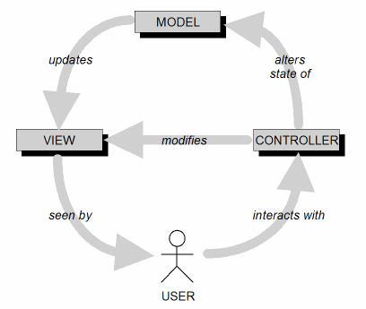
Model-View-Controller Architecture (MVC)
MVC is a software architecture for GUI applications.
Design goal: Identify which application components are model, view, or controller.
A user cannot directly modify the model.

Slide 24
MVC Model Objects
Model objects represent the persistent information maintained by your application.
The information can be kept in memory,
in files, or in a database.

Slide 25
MVC View Objects
View objects represent
user interface components.
  Input components such as text fields,
  buttons, menus, checkboxes, and
  radio buttons.
Users interact with at least one
view object.
A view object collects information from users
in a form that the model and controller objects
can use.

Slide 26
MVC Controller Objects
Controller objects coordinate the model and view objects.
Often have no physical counterpart
in the real world.
Dispatches information
from the view objects
to the model objects.
  This is how user-entered data
  can update the model.

Slide 27
Software Frameworks
A software framework consists of a set of cooperating classes.
  These classes implement the essential mechanisms
  for a particular problem domain.
  Example: PyQt is a Python software framework
  for GUI programming.
A framework imposes a structure on the
design and development of applications.
  It has classes and API that implement the structure.
  It is more than simply a library.

Slide 28
Software Frameworks, cont’d
A programmer builds an application by:
  Subclassing framework classes.
  Adding new classes that provide
  custom functionality.
Inversion of control
  The framework controls the execution flow.
  The programmer registers callback functions,
  mostly as event handlers, with the framework.
  The framework invokes the callback functions at the appropriate times, such as in response to events.
    Example event: The user clicks a button.

Slide 29
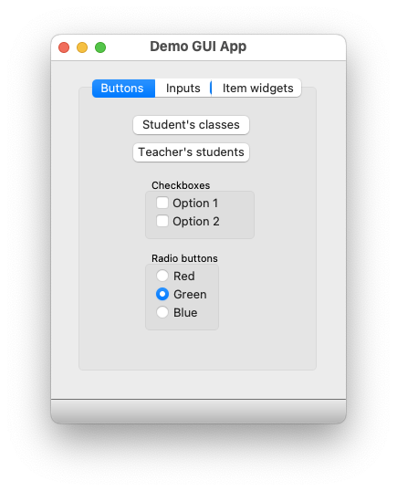
Demo PyQt 5 Widgets Application

Slide 30
Creating a GUI for Python
Install PyQt5
  PyQt6 is not compatible with later versions of Python.
Install and use Qt Designer.
  https://build-system.fman.io/qt-designer-download
  Create windows and dialogs.
  Add interactive input and display components.
Write event-driven Python code that reacts to user interactions (button clicks, menu selections, etc.) with the GUI components.
pip3 install PyQt5

Slide 31
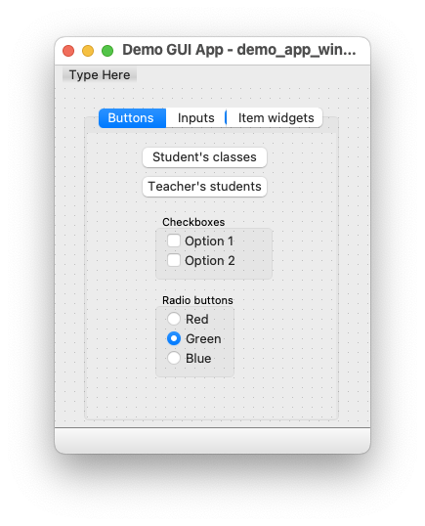
Creating a GUI for Python, cont’d
Qt Designer creates an XML .ui file for each window and dialog box that you lay out.
  Your Python program will load and render the file.
<?xml version="1.0" encoding="UTF-8"?>
<ui version="4.0">
<class>main_window</class>
<widget class="QMainWindow" name="main_window">
<property name="geometry">
<rect>
<x>0</x>
<y>0</y>
<width>323</width>
<height>398</height>
</rect>
...
demo_app_window.ui
self.ui = uic.loadUi('demo_app_window.ui')

Slide 32
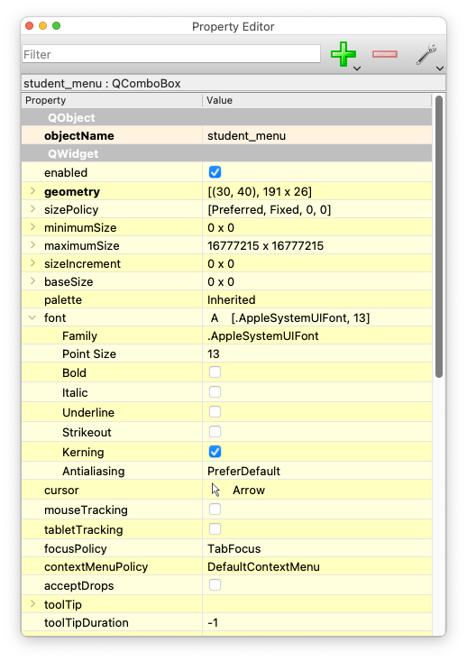
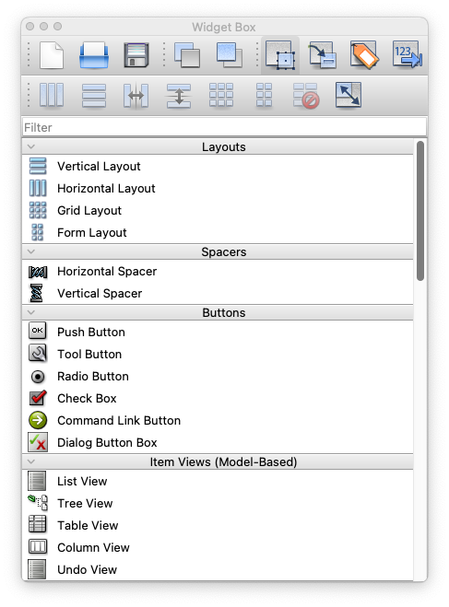
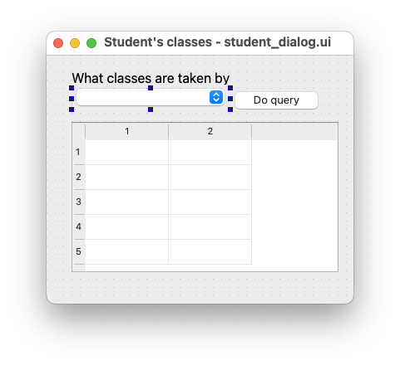
Creating a GUI for Python, cont’d
Remember the names you give to the components.
  You will refer to them in your Python code.
student_dialog.ui

Slide 33
Creating a GUI for Python, cont’d
Set the items of student_menu to the student’s
names.
student_dialog.py
def _initialize_student_menu(self):
conn = db_connection(config_file = 'school.ini')
cursor = conn.cursor()
sql = """
SELECT first, last FROM student
ORDER BY last
"""
cursor.execute(sql)
rows = cursor.fetchall()
cursor.close()
conn.close()
# Set the menu items to the students' names.
for row in rows:
name = row[0] + ' ' + row[1]
self.ui.student_menu.addItem(name, row)

Slide 34
Event-Driven Programming
Connect a Python method to a GUI event.
  Menu selection change.
  Button click
The Python methods are event handlers.
  Method _initialize_table will execute whenever the user selects a menu item.
  Method _enter_class_data will execute
  whenever the user clicks query_button.
student_dialog.py
# Student menu and query button event handlers.
self.ui.student_menu.currentIndexChanged.connect(self._initialize_table)
self.ui.query_button.clicked.connect(self._enter_class_data)

Slide 35
Event-Driven Programming, cont’d
Get first_name and last_name values from the current selection of student_menu and use them to do the query.
def _enter_class_data(self):
"""
Enter class data from the query into
the student and takes tables.
"""
name = self.ui.student_menu.currentData()
first_name = name[0]
last_name = name[1]
conn = db_connection(config_file = 'school.ini')
cursor = conn.cursor()
sql = (
f"""
SELECT class.code, class.subject
FROM student
JOIN takes
ON takes.student_id = student.id
JOIN class
ON class.code = takes.class_code
WHERE student.last = '{last_name}'
AND student.first = '{first_name}'
ORDER BY class.code
"""
)
cursor.execute(sql)
rows = cursor.fetchall()
cursor.close()
conn.close()
...
student_dialog.py

Slide 36
Event-Driven Programming, cont’d
Enter the query results into class_table,
one cell at a time.
student_dialog.py
...
# Set the class data into the table cells.
row_index = 0
for row in rows:
column_index = 0
for data in row:
item = QTableWidgetItem(str(data))
self.ui.class_table.setItem(row_index, column_index, item)
column_index += 1
row_index += 1
self._adjust_column_widths()

Slide 37
Event-Driven Programming, cont’d
SQL commands in a GUI will be issued often.
A good situation for stored procedures!
CREATE PROCEDURE teachers_names()
BEGIN
SELECT first, last FROM teacher
ORDER BY last;
END
TeacherProcsInstall.ipynb
CREATE PROCEDURE students_of(IN first VARCHAR(32),
IN last VARCHAR(32))
BEGIN
SELECT student.id, student.first, student.last,
class.subject
FROM student
JOIN takes
ON takes.student_id = student.id
JOIN class
ON class.code = takes.class_code
JOIN teacher
ON teacher.id = class.teacher_id
WHERE teacher.first = first
AND teacher.last = last
ORDER BY class.subject, student.last;
END

Slide 38
Event-Driven Programming, cont’d
teacher_dialog.py
def _initialize_teacher_menu(self):
"""
Initialize the teacher menu with teacher names from the database.
"""
conn = db_connection(config_file = 'school.ini')
cursor = conn.cursor()
sql = 'CALL teachers_names'
generator = cursor.execute(sql, multi=True)
for result in generator:
rows = cursor.fetchall()
# Set the menu items to the teachers' names.
for row in rows:
name = row[0] + ' ' + row[1]
self.ui.teacher_menu.addItem(name, row)
cursor.close()
conn.close()
Call stored procedure teacher_names.

Slide 39
Event-Driven Programming, cont’d
teacher_dialog.py
# Teacher menu event handler.
self.ui.teacher_menu.currentIndexChanged.connect(self._enter_student_data)
def _enter_student_data(self):
"""
Enter student data from the query into the student table.
"""
self.ui.student_table.clear()
col = [' ID ', ' First ', ' Last ', 'Subject']
self.ui.student_table.setHorizontalHeaderLabels(col)
name = self.ui.teacher_menu.currentData()
first_name = name[0]
last_name = name[1]
conn = db_connection(config_file = 'school.ini')
cursor = conn.cursor()
sql = f"CALL students_of('{first_name}', '{last_name}')"
generator = cursor.execute(sql, multi=True)
...

Slide 40
Event-Driven Programming, cont’d
teacher_dialog.py
...
for result in generator:
rows = cursor.fetchall()
# Set the student data into the table cells.
row_index = 0
for row in rows:
column_index = 0
for data in row:
item = QTableWidgetItem(str(data))
self.ui.student_table.setItem(row_index, column_index, item)
column_index += 1
row_index += 1
self._adjust_column_widths()
cursor.close()
conn.close()

Slide 41
PyQt Components
Each GUI component has an API (application programming interface) consisting of methods for your Python code to call.
Reference material is written for C++, but it’s easy to convert the method calls to Python: https://doc.qt.io/qt-5/qtwidgets-module.html

Slide 42
PyQt Components, cont’d
Your Python program will load and render a .ui file directly to display its components.
Call uic.loadIUi()which returns a UI object,
and then call show() on the object.
  Example:
self.ui = uic.loadUi('demo_app_window.ui')
self.ui.show()

Slide 43
Window vs. Dialog
An application consists of one or more windows (QWindow object) .
A dialog box (QDialog object) can pop up to accept user input, often in response to an event such as a mouse click or a menu item choice.
  Should have OK and CANCEL buttons.
  Disappear after the user has OK’d or CANCEL’d.

Slide 44
Assignment #7a
Team assignment.
Create a Python GUI-based database application.
  You can choose to use stored procedures.
  The prototype for your team semester project.

Slide 45
Assignment #7b
Individual assignment.
Practice creating stored procedures for
the Car Dealership database.

