Slide 1


DATA 201
Database Technologies for Data Analytics
February 27 Class Meeting
Department of Applied Data Science
San Jose State University
Spring 2025
Instructor: Ron Mak
www.cs.sjsu.edu/~mak

Slide 2
This Evening
Go over solutions to Checkpoint Exam #1
Go over solutions to Assignment #5
More about the ALTER TABLE command
UPDATE and DELETE commands
Cascading deletes and updates
Break

Slide 3
This Evening, cont’d
Windowing functions
MYSQL functions
Relational algebra
Joins: self, inner, and outer
Views and common table expressions (CTE)
Indexing
EXPLAIN

Slide 4
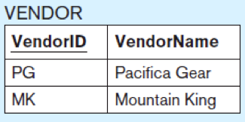
ALTER TABLE
Change the structure of
an existing table.
Add a new column.
  Example:
Drop a column.
  Example:
ALTER TABLE vendor
ADD COLUMN vendorphonenumber CHAR(11);
ALTER TABLE vendor
DROP COLUMN vendorphonenumber;
Database Systems
by Jukić, Vrbsky, & Nestorov
Pearson 2014
ISBN 978-0-13-257567-6

Slide 5
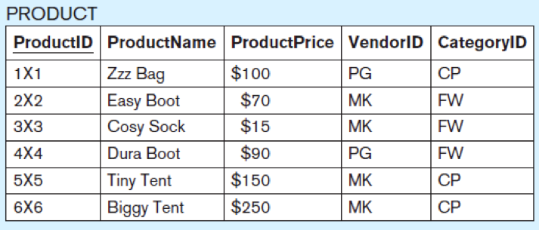
UPDATE
Database Systems
by Jukić, Vrbsky, & Nestorov
Pearson 2014
ISBN 978-0-13-257567-6
Modify data in a table.
  Examples:
UPDATE product
SET product_price = 100
WHERE product_id = '4×4'
ALTER TABLE product ADD COLUMN discount NUMERIC(3,2);
UPDATE product SET discount = 0.2
Set the value of the new discount column in all rows to 0.2.

Slide 6
DELETE
Delete rows from a table.
  Example:
Without the WHERE clause, all the table rows
will be deleted, resulting in an empty table.
  First disable “safe mode” in order to delete all rows.
DELETE FROM product
WHERE product_id = '4×4’;
SET sql_safe_updates = 0;
DELETE FROM product
Database Systems
by Jukić, Vrbsky, & Nestorov
Pearson 2014
ISBN 978-0-13-257567-6

Slide 7
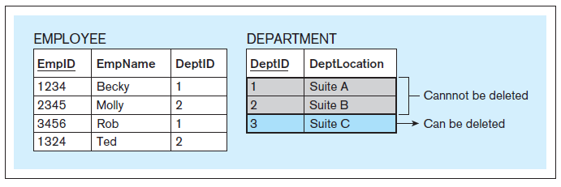
Cascading Deletes
Normally, the referential integrity constraint prevents you from deleting a row from a table if it is referred to by a row in another table.
Database Systems
by Jukić, Vrbsky, & Nestorov
Pearson 2014
ISBN 978-0-13-257567-6

Slide 8
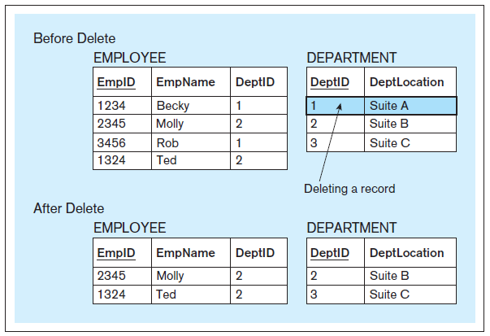
Cascading Deletes, cont’d
      CREATE TABLE employee
      ( emp_id CHAR(4),
      emp_name CHAR(20),
      deptid CHAR(2),
      PRIMARY KEY (empid),
      FOREIGN KEY (deptid) REFERENCES department
      ON DELETE CASCADE
      );
Database Systems
by Jukić, Vrbsky, & Nestorov
Pearson 2014
ISBN 978-0-13-257567-6

Slide 9
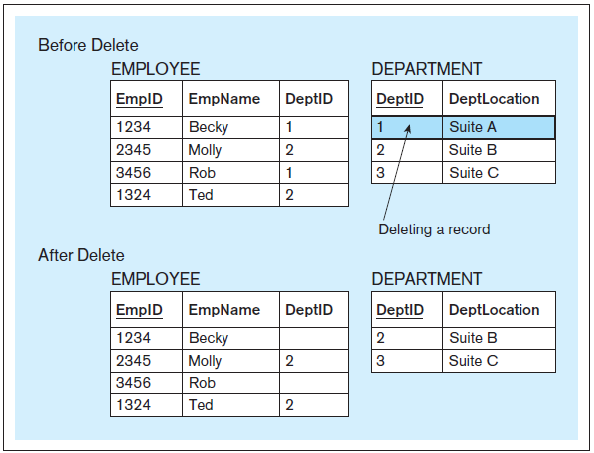
Cascading Deletes, cont’d
      CREATE TABLE employee
      ( empid CHAR(4),
      empname CHAR(20),
      deptid CHAR(2),
      PRIMARY KEY (empid),
      FOREIGN KEY (deptid) REFERENCES department
      ON DELETE SET NULL
      );
Database Systems
by Jukić, Vrbsky, & Nestorov
Pearson 2014
ISBN 978-0-13-257567-6

Slide 10
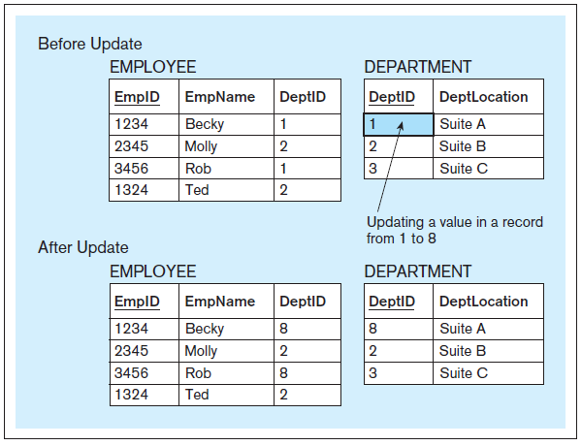
Cascading Updates
      CREATE TABLE employee
      ( empid CHAR(4),
      empname CHAR(20),
      deptid CHAR(2),
      PRIMARY KEY (empid),
      FOREIGN KEY (deptid) REFERENCES department
      ON UPDATE CASCADE
      );
Database Systems
by Jukić, Vrbsky, & Nestorov
Pearson 2014
ISBN 978-0-13-257567-6

Slide 11
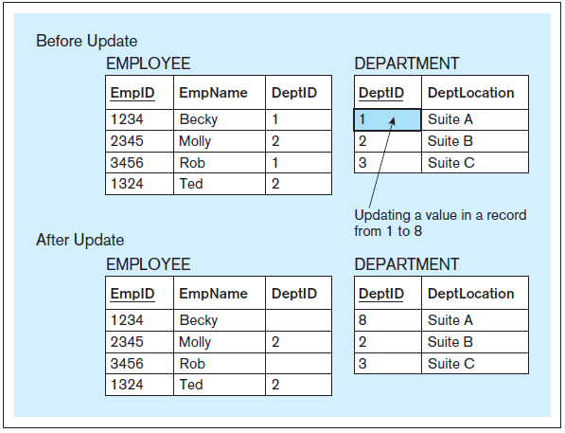
Cascading Updates
      CREATE TABLE employee
      ( empid CHAR(4),
      empname CHAR(20),
      deptid CHAR(2),
      PRIMARY KEY (empid),
      FOREIGN KEY (deptid) REFERENCES department
      ON UPDATE SET NULL
      );
Database Systems
by Jukić, Vrbsky, & Nestorov
Pearson 2014
ISBN 978-0-13-257567-6

Slide 12
Break

Slide 13
SQL Window Function
In a SELECT statement, a result field can perform an aggregate-type operation
on a set of rows related to the current row.
The aggregate result appears in
each result row of the SELECT.
The windowing function has many options.
  We’ll look some basic options for now.
  More options later with more advanced SQL analytics.

Slide 14
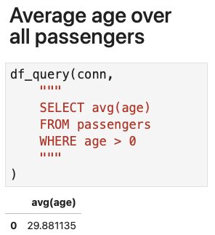
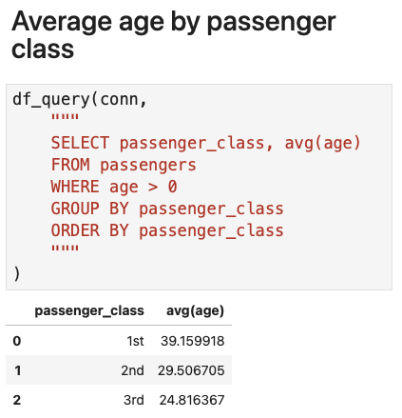
Window Function Example
Windowing.ipynb

Slide 15
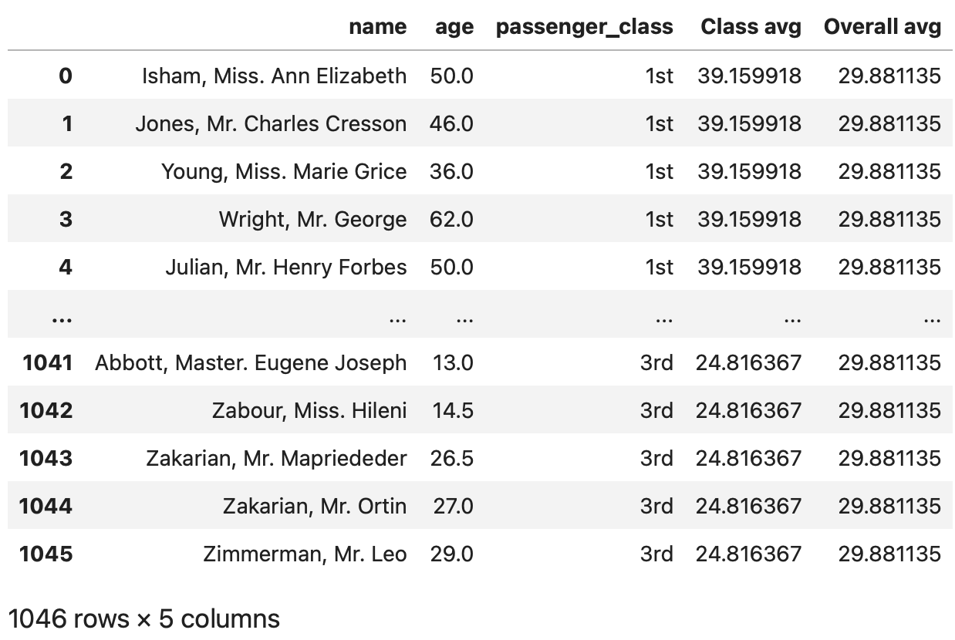

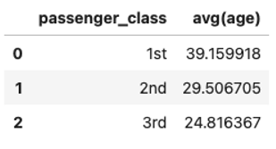
Window Function Example, cont’d
df_query(conn,
"""
SELECT name, age, passenger_class,
avg(age) OVER(PARTITION BY passenger_class) AS "Class avg",
avg(age) OVER() AS "Overall avg"
FROM passengers
WHERE age > 0
ORDER BY passenger_class
"""
)
Windowing.ipynb

Slide 16
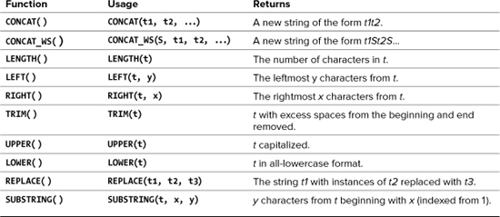
MySQL Text Functions
Also:
  One-way encryption
  Returns a 40-character string.
SHA1(string)
PHP and MySQL for
Dynamic Web Sites, 4th ed.
by Larry Ullman
Peachpit Press, 2012
ISBN 978-0-321-78407-0

Slide 17
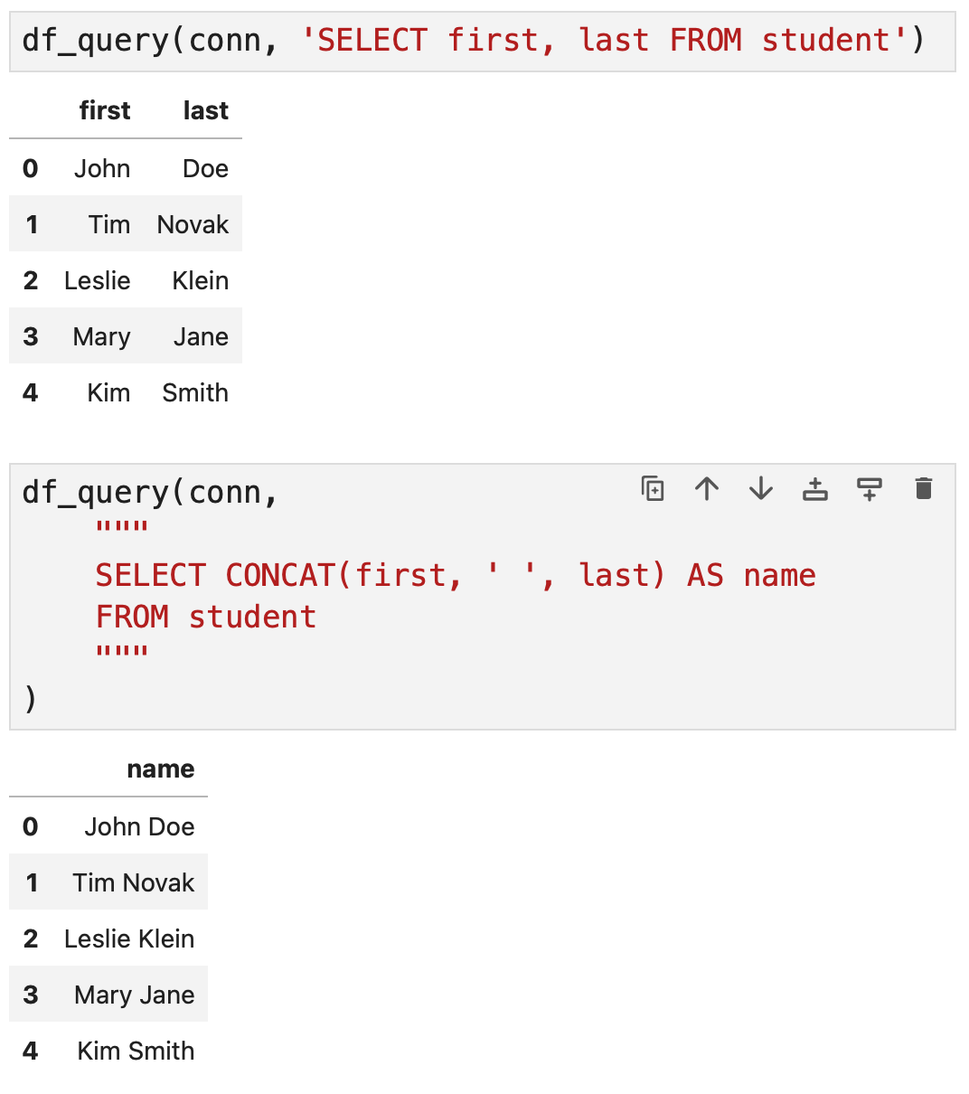
MySQL Text Functions, cont’d
StringConcat.ipynb

Slide 18
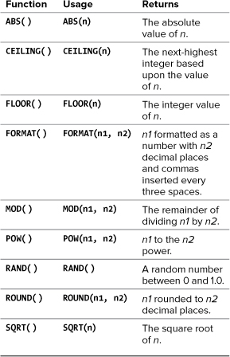
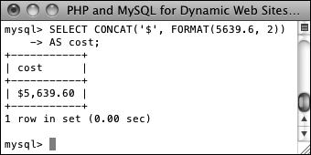
MySQL Numeric Functions
SELECT CONCAT('$', FORMAT(5639.6, 2)) AS cost
PHP and MySQL for
Dynamic Web Sites, 4th ed.
by Larry Ullman
Peachpit Press, 2012
ISBN 978-0-321-78407-0

Slide 19
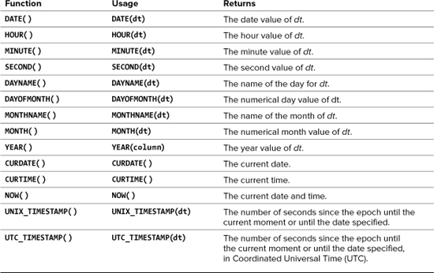
MySQL Date and Time Functions
No arguments.
PHP and MySQL for
Dynamic Web Sites, 4th ed.
by Larry Ullman
Peachpit Press, 2012
ISBN 978-0-321-78407-0

Slide 20
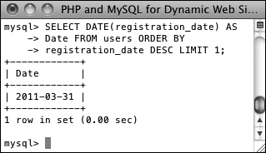
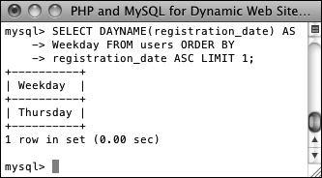
MySQL Date and Time Functions, cont’d
Data types that store both a date and time:
DATETIME and TIMESTAMP
Data type that stores just the date: DATE
Data type that stores just the year: YEAR
PHP and MySQL for
Dynamic Web Sites, 4th ed.
by Larry Ullman
Peachpit Press, 2012
ISBN 978-0-321-78407-0
SELECT DATE(registration_date) AS Date
FROM users
ORDER BY registration_date DESC
LIMIT 1;
SELECT DAYNAME(registration_date) AS Weekday
FROM users
ORDER BY registration_date ASC
LIMIT 1;

Slide 21
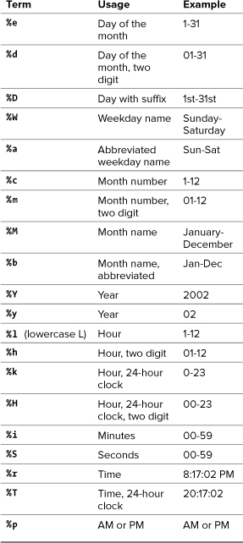
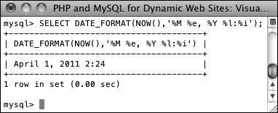
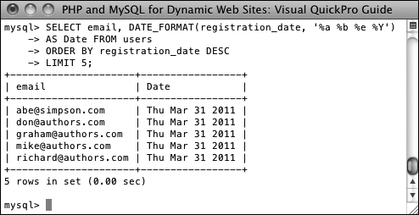
Formatting the Date and Time
Return the current date and time as Month DD, YYYY - HH:MM :
PHP and MySQL for
Dynamic Web Sites, 4th ed.
by Larry Ullman
Peachpit Press, 2012
ISBN 978-0-321-78407-0
Select the email address and date registered,
ordered by date registered, formatting the date as
Weekday (abbreviated) Month (abbreviated) Day Year,
for the last five registered users :

Slide 22
Relational Algebra
The mathematical theory behind
database operations:
  project
    which columns?
    listed after the SELECT keyword
  select
    which rows?
    WHERE and HAVING clauses
  join
    Query multiple tables at the same time.

Slide 23
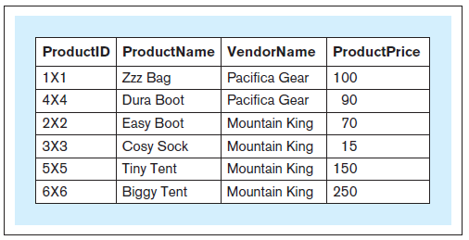
Joins
What is the id, product name, vendor name, and price of each product?
SELECT product_id, product_name,
vendor_name, product_price
FROM product
JOIN vendor
ON product.vendor_id
= vendor.vendor_id
Qualified names
Database Systems
by Jukić, Vrbsky, & Nestorov
Pearson 2014
ISBN 978-0-13-257567-6

Slide 24
Joins, cont’d
Without a join condition or a WHERE clause,
you get a Cartesian product.
Each record of one table matched
with every record from the other table.

Slide 25
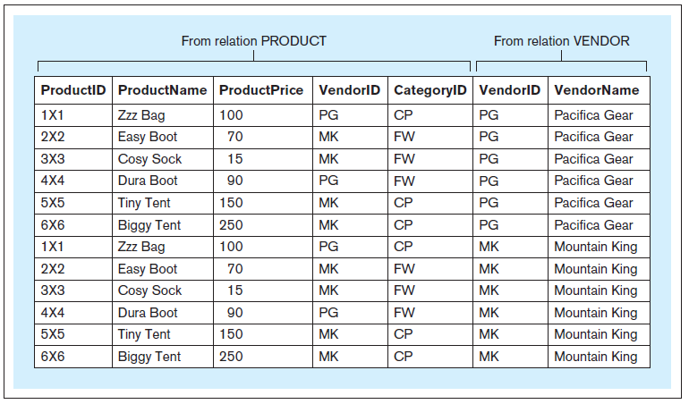
Joins, cont’d
SELECT *
FROM product
JOIN vendor
ORDER BY vendor_name DESC
Database Systems
by Jukić, Vrbsky, & Nestorov
Pearson 2014
ISBN 978-0-13-257567-6

Slide 26
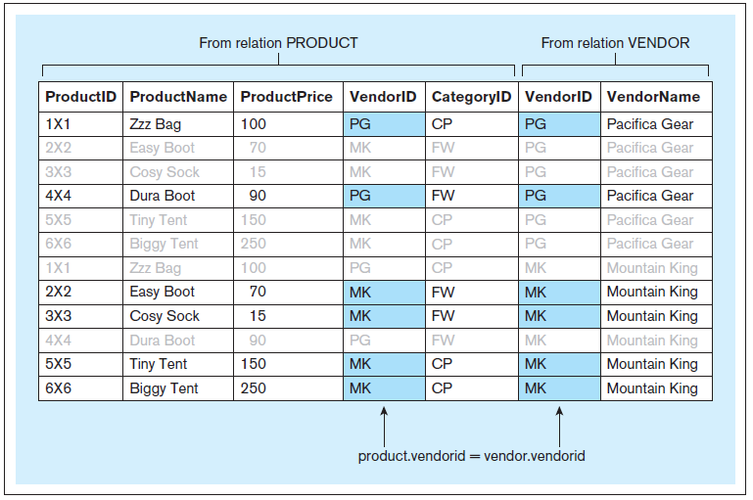
Joins, cont’d
Include the join condition.
SELECT *
FROM product
JOIN vendor
ON product.vendor_id = vendor.vendor_id
ORDER BY vendor_name DESC

Slide 27
Join Alias
Use aliases anywhere within a query instead of the full table name.
  No effect on the query itself.
  Improve legibility.
SELECT product_id, product_name,
vendor_name, product_price
FROM product
JOIN vendor
ON product.vendor_id = vendor.vendor_id
SELECT p.product_id, p.product_name,
v.vendor_name, p.product_price
FROM product p
JOIN vendor v
ON p.vendor_id = v.vendor_id
SELECT p.product_id, p.product_name,
v.vendor_name, p.product_price
FROM product p
JOIN vendor v USING (vendor_id)

Slide 28
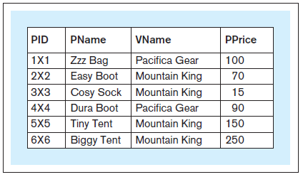
Join Alias, cont’d
Use aliases to rename columns in query results.
SELECT p.product_id pid,
p.product_name pname,
v.vendor_name vname,
p.product_price pprice
FROM product p
JOIN vendor v USING (vendor_id)
You cannot use aliased column
names in the WHERE clause.
Database Systems
by Jukić, Vrbsky, & Nestorov
Pearson 2014
ISBN 978-0-13-257567-6

Slide 29
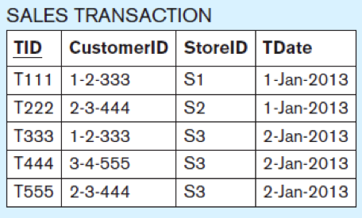
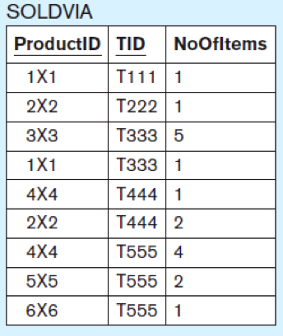
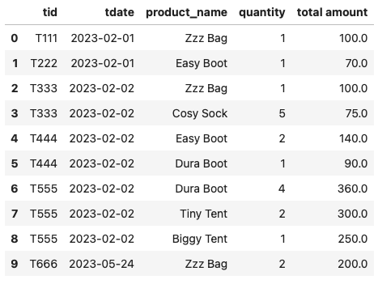
Joining Multiple Tables
SELECT t.tid, t.tdate, p.product_name,
sv.no_of_items AS quantity,
(sv.no_of_items*p.product_price) AS 'total amount'
FROM product AS p
JOIN sold_via AS sv USING (product_id)
JOIN sales_transaction AS t USING (tid)
ORDER BY t.tid
Joins.ipynb
You can use AS to introduce an alias.
Oracle does not allow AS for table aliases.
Database Systems
by Jukić, Vrbsky, & Nestorov
Pearson 2014
ISBN 978-0-13-257567-6

Slide 30
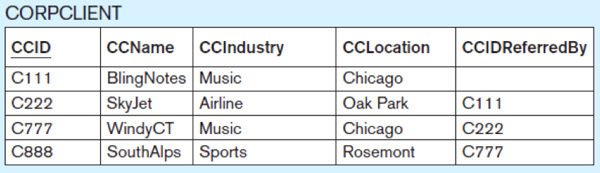
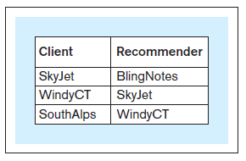
Self Join
Which corporate clients were referred by other corporate clients?
SELECT c.ccname AS client,
r.ccname AS recommender
FROM corpclient c
JOIN corpclient r
ON r.ccid = c.ccidreferredby
Joins.ipynb
The use of aliases is
mandatory for a self join.
Database Systems
by Jukić, Vrbsky, & Nestorov
Pearson 2014
ISBN 978-0-13-257567-6

Slide 31
Inner and Outer Joins
Inner join
  What we’ve been doing so far.
Outer join
  left outer join
  right outer join
  full outer join

Slide 32
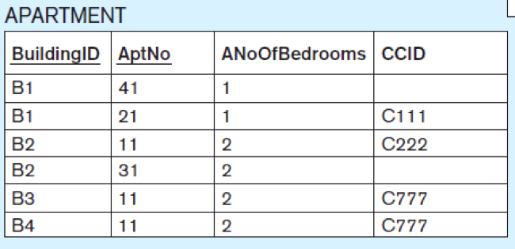
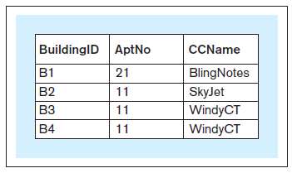
Inner Join
Which apartments are rented
by which corporate clients?
An inner join is the default so you can simply write JOIN.
SELECT buildingid, aptno, ccname
FROM apartment
INNER JOIN corpclient USING (ccid)
ORDER BY buildingid
Joins.ipynb
Retrieve only the
rows that match.
Database Systems
by Jukić, Vrbsky, & Nestorov
Pearson 2014
ISBN 978-0-13-257567-6

Slide 33
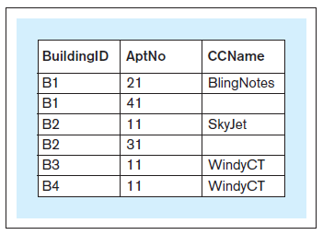
Left Outer Join
SELECT buildingid, aptno, ccname
FROM apartment
LEFT OUTER JOIN corpclient USING (ccid)
ORDER BY buildingid
Include all the rows on the left part of the relation (apartment joins corpclient)
whether or not there is a match.
Joins.ipynb
No matches.
Database Systems
by Jukić, Vrbsky, & Nestorov
Pearson 2014
ISBN 978-0-13-257567-6

Slide 34
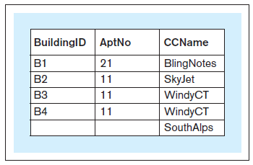
Right Outer Join
SELECT buildingid, aptno, ccname
FROM apartment
RIGHT OUTER JOIN corpclient USING (ccid)
ORDER BY buildingid
Include all the rows on the right part of the relation (apartment joins corpclient)
whether or not there is a match.
Joins.ipynb
Database Systems
by Jukić, Vrbsky, & Nestorov
Pearson 2014
ISBN 978-0-13-257567-6
No match.

Slide 35
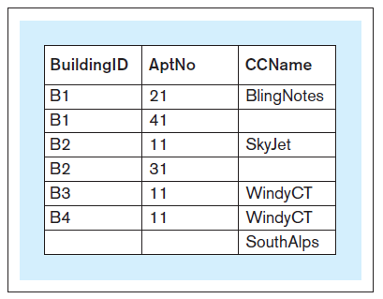
Full Outer Join
SELECT buildingid, aptno, ccname
FROM apartment
FULL OUTER JOIN corpclient USING (ccid)
ORDER BY buildingid
Include all the rows from both relations whether or not there is a match.
FULL OUTER JOIN
is not available with
MySQL.
Database Systems
by Jukić, Vrbsky, & Nestorov
Pearson 2014
ISBN 978-0-13-257567-6

Slide 36
Full Outer Join (MySQL)
Joins.ipynb
SELECT buildingid, aptno, ccname
FROM apartment
LEFT OUTER JOIN corpclient USING (ccid)
UNION
SELECT buildingid, aptno, ccname
FROM apartment
RIGHT OUTER JOIN corpclient USING (ccid)
ORDER BY buildingid
Database Systems
by Jukić, Vrbsky, & Nestorov
Pearson 2014
ISBN 978-0-13-257567-6

Slide 37
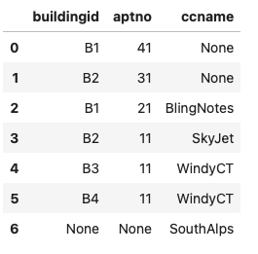
Full Outer Join (MySQL), cont’d
To use ORDER BY and/or LIMIT with a UNION, parenthesize the individual SELECT clauses and put the ORDER BY and/or LIMIT inside the parentheses.
( SELECT buildingid, aptno, ccname
FROM apartment
LEFT OUTER JOIN corpclient USING (ccid)
ORDER BY buildingid
)
UNION
( SELECT buildingid, aptno, ccname
FROM apartment
RIGHT OUTER JOIN corpclient USING (ccid)
ORDER BY buildingid
)
Joins.ipynb

Slide 38
Views
A view allows the structure of a query
to be saved in the database.
  AKA virtual table
Not an actual table – no data is saved.
Use a view like a table.
  Views can join with each other.
  Test and debug each view separately.
Whenever a view is joined, it executes its query to retrieve a result set.
  A view is analogous to a procedure
  in a programming language.

Slide 39
Views, cont’d
Which products have more than 3
items sold in all sales transactions?
Views.ipynb
CREATE VIEW products_more_than_3_sold AS
SELECT product_id, product_name, product_price
FROM product
WHERE product_id IN (SELECT product_id
FROM sold_via
GROUP BY product_id
HAVING SUM(no_of_items) > 3)

Slide 40
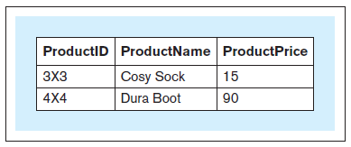
Views, cont’d
Views.ipynb
CREATE VIEW products_more_than_3_sold AS
SELECT product_id, product_name, product_price
FROM product
WHERE product_id IN (SELECT product_id
FROM sold_via
GROUP BY product_id
HAVING SUM(no_of_items) > 3)
SELECT *
FROM products_more_than_3_sold
Database Systems
by Jukić, Vrbsky, & Nestorov
Pearson 2014
ISBN 978-0-13-257567-6

Slide 41
Views, cont’d
CREATE VIEW products_in_multiple_trnsc AS
SELECT product_id, product_name, product_price
FROM product
WHERE product_id IN (SELECT product_id
FROM sold_via
GROUP BY product_id
HAVING COUNT(*) > 1)
Views.ipynb
Database Systems
by Jukić, Vrbsky, & Nestorov
Pearson 2014
ISBN 978-0-13-257567-6

Slide 42
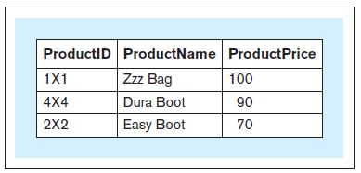
Views, cont’d
Views.ipynb
SELECT *
FROM products_in_multiple_trnsc
Dropping views
  Example:
DROP VIEW products_in_multiple_trnsc;
Database Systems
by Jukić, Vrbsky, & Nestorov
Pearson 2014
ISBN 978-0-13-257567-6

Slide 43
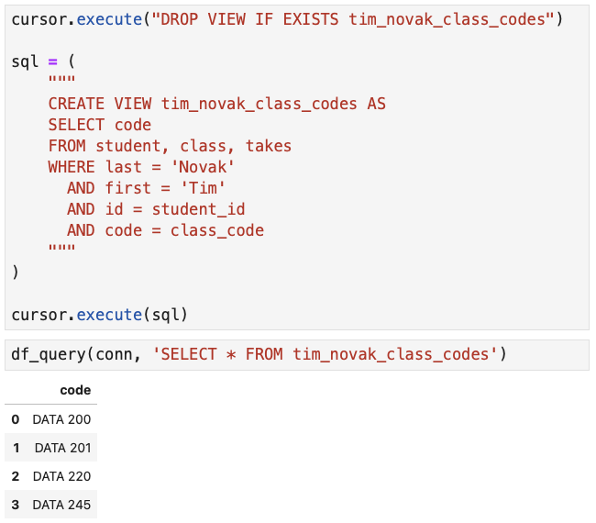
Views, cont’d
Who are the classmates of John Novak?
Views.ipynb

Slide 44
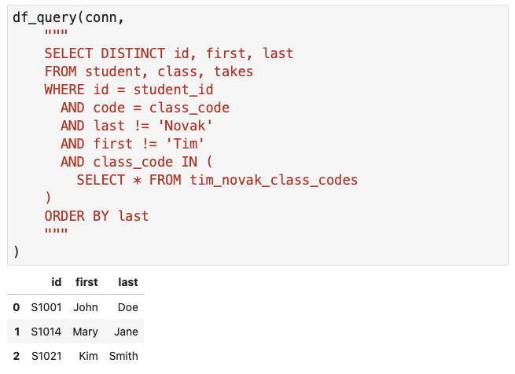
Views, cont’d
Views.ipynb

Slide 45
Common Table Expressions (CTE)
Views are useful because they are stored in the database and the views can be used by multiple queries.
But if a view’s query is only used by one other query, use a common table expression (CTE) instead.
  A CTE is not stored in the database.
  It is part of a SELECT command.
  It is “local” only to the SELECT command that uses it.

Slide 46
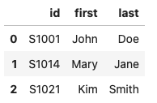
CTE, cont’d
CTE.ipynb
WITH
tim_novak_class_codes AS
(
SELECT code
FROM student, class, takes
WHERE last = 'Novak'
AND first = 'Tim'
AND id = student_id
AND code = class_code
)
SELECT DISTINCT id, first, last
FROM student, class, takes
WHERE id = student_id
AND code = class_code
AND last != 'Novak'
AND first != 'Tim'
AND class_code IN (
SELECT * FROM tim_novak_class_codes
)
ORDER BY last
CREATE VIEW tim_novak_class_codes AS
SELECT code
FROM student, class, takes
WHERE last = 'Novak'
AND first = 'Tim'
AND id = student_id
AND code = class_code
CTE
SELECT DISTINCT id, first, last
FROM student, class, takes
WHERE id = student_id
AND code = class_code
AND last != 'Novak'
AND first != 'Tim'
AND class_code IN (
SELECT * FROM tim_novak_class_codes
)
ORDER BY last
WITH ... SELECT is one statement.

Slide 47
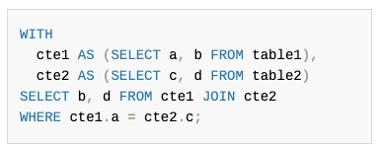
CTE, cont’d
A SELECT can be preceded by multiple CTEs, separated by commas.
  Example:
Like views, CTEs can join with each other.
  Test and debug each CTE as you add them
  one at a time.
This is a single
WITH ... SELECT statement.

Slide 48
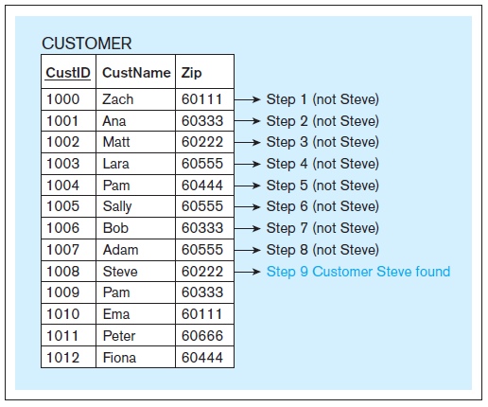
Indexing
Indexing increases the speed of retrieving table rows based on an unsorted column.
  The database
  server automatically
  indexes the primary
  key of eah table.
  Use a binary search
  instead of a linear
  search.
Database Systems
by Jukić, Vrbsky, & Nestorov
Pearson 2014
ISBN 978-0-13-257567-6
Linear search
for “Steve”.

Slide 49
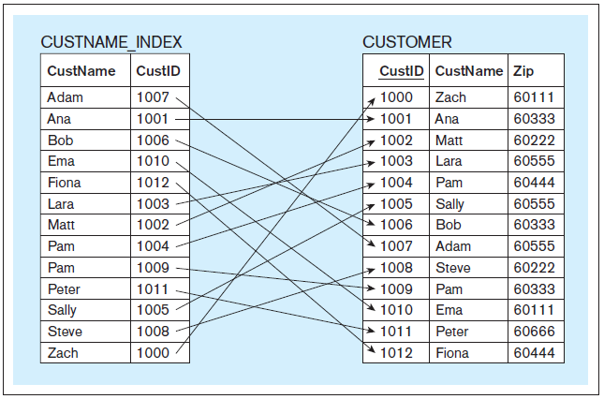
Indexing (Conceptual View)
  CREATE INDEX custname_index ON customer(custname);
Database Systems
by Jukić, Vrbsky, & Nestorov
Pearson 2014
ISBN 978-0-13-257567-6

Slide 50
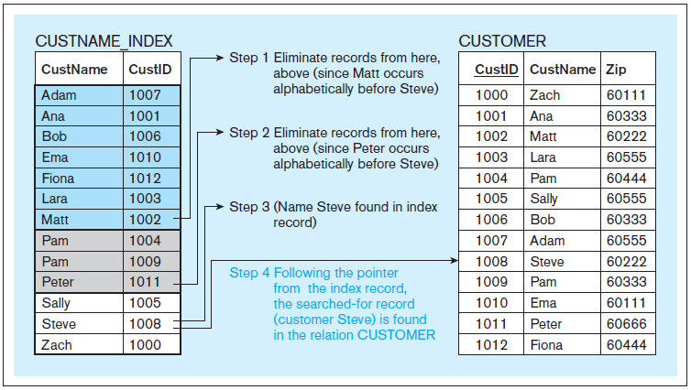
Indexing (Conceptual View), cont’d
Binary search
for “Steve”.
Database Systems
by Jukić, Vrbsky, & Nestorov
Pearson 2014
ISBN 978-0-13-257567-6

Slide 51
Indexing, cont’d
In an actual RDBMS, the index column can contain physical disk addresses.
Indexing speeds record retrieval, but it will slow record insertion, deletion, and modification.
To drop an index:
  Unfortunately, there is no DROP INDEX IF EXISTS
  and so you must first test for existence.
See https://www.mysqltutorial.org/mysql-index/mysql-create-index/
  DROP INDEX custname_index ON customer
indexes.ipynb

