Slide 1


DATA 201
Database Technologies for Data Analytics
February 20 Class Meeting
Department of Applied Data Science
San Jose State University
Spring 2025
Instructor: Ron Mak
www.cs.sjsu.edu/~mak

Slide 2
This Evening
Checkpoint exam #1
Break
SELECT command
Aggregate functions
GROUP BY and HAVING
Nested queries
SELECT IN
INSERT INTO SELECT
Cloning a table

Slide 3
SELECT
Retrieve data from database tables.
The most common SQL command.

Slide 4
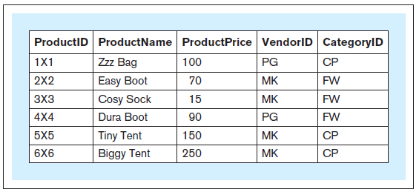
SELECT, cont’d
Retrieve the entire contents of the
product table.
SELECT * FROM product
Database Systems
by Jukić, Vrbsky, & Nestorov
Pearson 2014
ISBN 978-0-13-257567-6

Slide 5
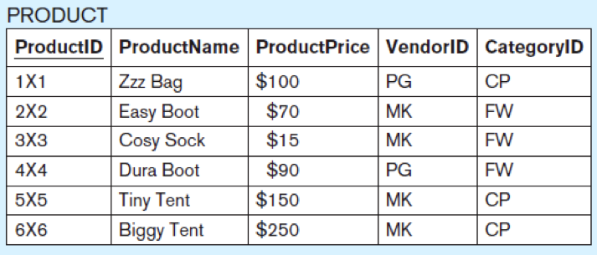
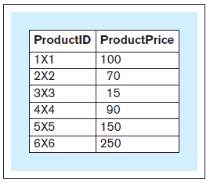
SELECT, cont’d
Retrieve only certain columns of the
product table.
Projection operation
SELECT product_id, product_price
FROM product
Database Systems
by Jukić, Vrbsky, & Nestorov
Pearson 2014
ISBN 978-0-13-257567-6

Slide 6
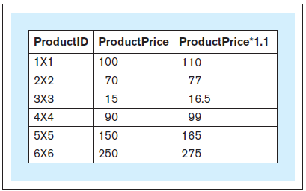
SELECT, cont’d
Calculate a column (derived attribute) from the product table.
SELECT product_id, product_price,
1.1*product_price
FROM product
Database Systems
by Jukić, Vrbsky, & Nestorov
Pearson 2014
ISBN 978-0-13-257567-6

Slide 7
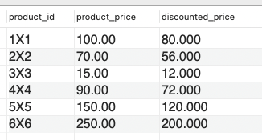
Column Aliases
Use AS to rename a column in the results.
SELECT product_id, product_price,
0.8*product_price AS discounted_price
FROM product

Slide 8
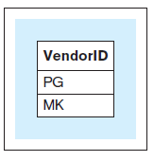
SELECT DISTINCT
Which vendor IDs are in the product table?
SELECT DISTINCT vendor_id
FROM product
Database Systems
by Jukić, Vrbsky, & Nestorov
Pearson 2014
ISBN 978-0-13-257567-6

Slide 9
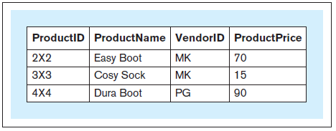
SELECT WHERE
Which products in the FW category
have price less than or equal to $110?
SELECT product_id, product_name,
vendor_id, product_price
FROM product
WHERE product_price <= 110
AND category_id = 'FW';
Database Systems
by Jukić, Vrbsky, & Nestorov
Pearson 2014
ISBN 978-0-13-257567-6

Slide 10
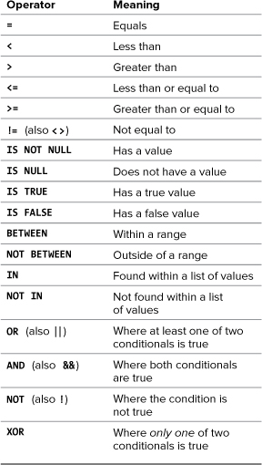
MySQL Conditional Operators
PHP and MySQL for
Dynamic Web Sites, 4th ed.
by Larry Ullman
Peachpit Press, 2012
ISBN 978-0-321-78407-0

Slide 11
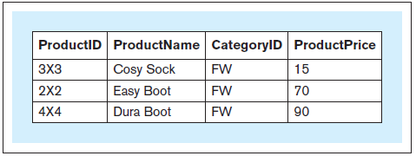
SELECT ORDER BY
Sort products by product price in the results.
SELECT product_id, product_name,
category_id, product_price
FROM product
WHERE category_id = 'FW'
ORDER BY product_price;
Database Systems
by Jukić, Vrbsky, & Nestorov
Pearson 2014
ISBN 978-0-13-257567-6

Slide 12
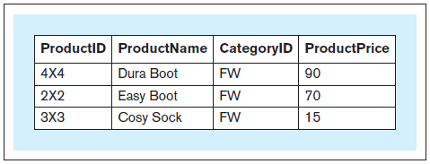
SELECT ORDER BY, cont’d
Sort products by product price
in descending order.
SELECT product_id, product_name,
category_id, product_price
FROM product
WHERE category_id = 'FW'
ORDER BY product_price DESC;
ASC
Database Systems
by Jukić, Vrbsky, & Nestorov
Pearson 2014
ISBN 978-0-13-257567-6

Slide 13
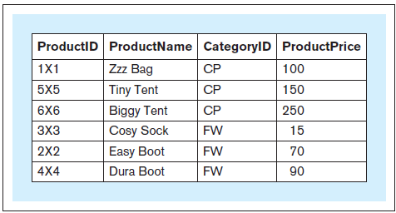
SELECT ORDER BY, cont’d
Sort products first by category ID
and then by product price.
Database Systems
by Jukić, Vrbsky, & Nestorov
Pearson 2014
ISBN 978-0-13-257567-6
SELECT product_id, product_name,
category_id, product_price
FROM product
ORDER BY category_id,
product_price;

Slide 14
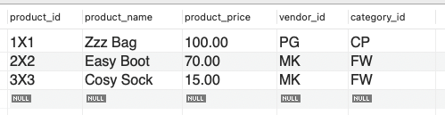
Limiting Query Results
SELECT *
FROM product
LIMIT 3
Also:
  Return n records starting
  with the i^{th} record.
  Does not improve the query execution speed,
  since MySQL still must match all the records.
  Reduces the number of returned records.
  Useful for “paging” the results.
LIMIT i, n
PHP and MySQL for
Dynamic Web Sites, 4th ed.
by Larry Ullman
Peachpit Press, 2012
ISBN 978-0-321-78407-0

Slide 15
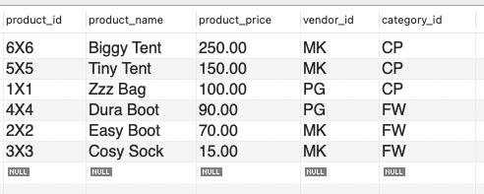

Limiting Query Results, cont’d
Which product was most expensive?
SELECT *
FROM product
ORDER BY product_price DESC
SELECT *
FROM product
ORDER BY product_price DESC
LIMIT 1

Slide 16
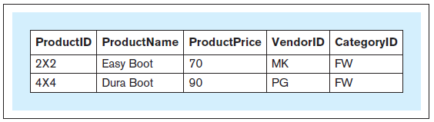
SELECT LIKE
Which products have “Boot” in their name?
SELECT *
FROM product
WHERE product_name LIKE '%Boot%'
Database Systems
by Jukić, Vrbsky, & Nestorov
Pearson 2014
ISBN 978-0-13-257567-6

Slide 17
SELECT LIKE, cont’d
String comparisons using wildcard characters:
  _ matches any single character
  % matches any zero or more characters
mysql> select * from people;
+-----+---------+---------+--------+--------+
| id | first | last | gender | salary |
+-----+---------+---------+--------+--------+
| 101 | Charles | Jones | M | 100000 |
| 103 | Mary | Adams | F | 150000 |
| 105 | Susan | Miller | F | 50000 |
| 110 | Roger | Brown | M | 75000 |
| 112 | Leslie | Adamson | F | 105000 |
+-----+---------+---------+--------+--------+
5 rows in set (0.00 sec)
mysql> select * from people
-> where last like 'Adam%';
+-----+--------+---------+--------+--------+
| id | first | last | gender | salary |
+-----+--------+---------+--------+--------+
| 103 | Mary | Adams | F | 150000 |
| 112 | Leslie | Adamson | F | 105000 |
+-----+--------+---------+--------+--------+
2 rows in set (0.02 sec)

Slide 18
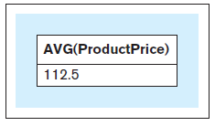
SELECT Aggregate Functions
What is the average price of all products?
SELECT AVG(product_price)
FROM product
Database Systems
by Jukić, Vrbsky, & Nestorov
Pearson 2014
ISBN 978-0-13-257567-6

Slide 19
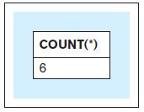
SELECT Aggregate Functions, cont’d
How many products are there?
SELECT COUNT(*)
FROM product
Database Systems
by Jukić, Vrbsky, & Nestorov
Pearson 2014
ISBN 978-0-13-257567-6

Slide 20
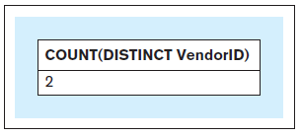
SELECT Aggregate Functions, cont’d
How many unique vendors supply the products?
SELECT COUNT(DISTINCT vendor_id)
FROM product
Database Systems
by Jukić, Vrbsky, & Nestorov
Pearson 2014
ISBN 978-0-13-257567-6

Slide 21
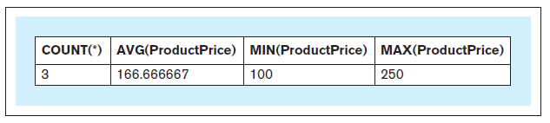
SELECT Aggregate Functions, cont’d
Aggregate functions COUNT, SUM, AVG, MIN, MAX
SELECT COUNT(*), AVG(product_price),
MIN(product_price), MAX(product_price)
FROM product
WHERE category_id = 'CP'
Database Systems
by Jukić, Vrbsky, & Nestorov
Pearson 2014
ISBN 978-0-13-257567-6

Slide 22
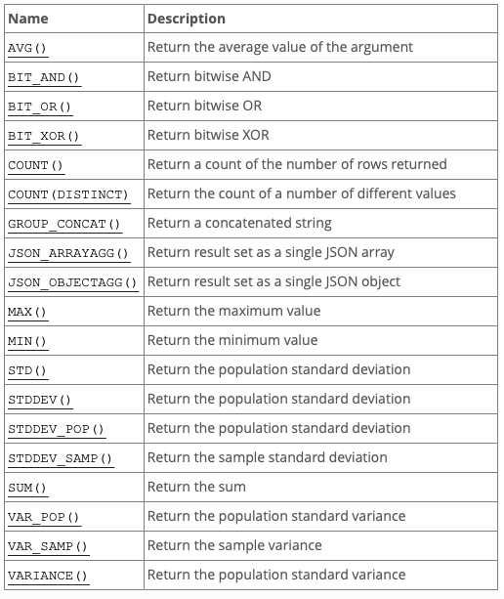
SELECT Aggregate Functions, cont’d
See https://dev.mysql.com/doc/refman/8.0/en/aggregate-functions.html

Slide 23
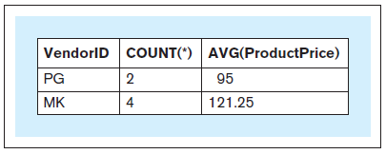
SELECT GROUP BY
What is the average price for each vendor?
SELECT vendor_id, COUNT(*), AVG(product_price)
FROM product
GROUP BY vendor_id
Database Systems
by Jukić, Vrbsky, & Nestorov
Pearson 2014
ISBN 978-0-13-257567-6

Slide 24

SELECT GROUP BY, cont’d
When a SELECT has aggregate functions,
it cannot have individual columns unless
the columns are in a GROUP BY clause.
But this is OK:
  vendor_id ➔ vendor_name
SELECT vendor_id, COUNT(*), AVG(product_price)
FROM product
GROUP BY vendor_id;
SELECT vendor_id, vendor_name, COUNT(*), AVG(product_price)
FROM product
JOIN vendor USING (vendor_id)
GROUP BY vendor_id
Why?

Slide 25
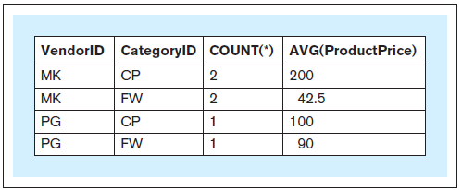
SELECT GROUP BY, cont’d
You can group by multiple columns.
Group by vendor and then by category.
SELECT vendor_id, category_id, COUNT(*), AVG(product_price)
FROM product
GROUP BY vendor_id, category_id
Database Systems
by Jukić, Vrbsky, & Nestorov
Pearson 2014
ISBN 978-0-13-257567-6

Slide 26
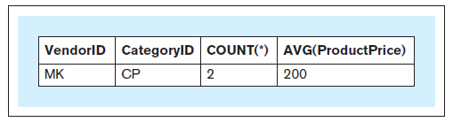
SELECT GROUP BY HAVING
Group products $50 or more by vendor and category.
Count and average price only if more than one per group.
SELECT vendor_id, category_id, COUNT(*), AVG(product_price)
FROM product
WHERE product_price >= 50
GROUP BY vendor_id, category_id
HAVING COUNT(*) > 1
Database Systems
by Jukić, Vrbsky, & Nestorov
Pearson 2014
ISBN 978-0-13-257567-6

Slide 27
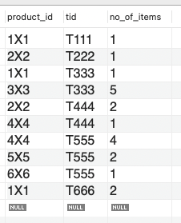
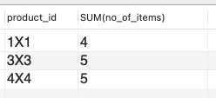
SELECT GROUP BY HAVING, cont’d
SELECT * FROM sold_via
ORDER BY tid, product_id
For products that sold more than 3 items in all sales transactions, what were the total number of items sold?
SELECT product_id, SUM(no_of_items)
FROM sold_via
GROUP BY product_id
HAVING SUM(no_of_items) > 3
The WHERE clause
applies to rows.
The HAVING clause
applies to groups.
Database Systems
by Jukić, Vrbsky, & Nestorov
Pearson 2014
ISBN 978-0-13-257567-6

Slide 28
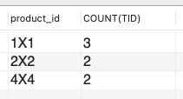
SELECT GROUP BY HAVING, cont’d
SELECT * FROM sold_via
ORDER BY tid, product_id
For each product that was sold in more than one sales
transaction, what is the number of transactions in which the product was sold?
SELECT product_id, COUNT(TID)
FROM sold_via
GROUP BY product_id
HAVING COUNT(TID) > 1
Database Systems
by Jukić, Vrbsky, & Nestorov
Pearson 2014
ISBN 978-0-13-257567-6

Slide 29
Nested Queries
An outer query makes use of the results
from a nested (inner) query.

Slide 30
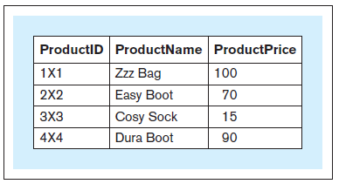
Nested Queries, cont’d
Which products sell below the average price?
SELECT product_id, product_name, product_price
FROM product
WHERE product_price < (SELECT AVG(product_price)
FROM product)
First, we need to
calculate the average.
Nested-SELECT-Sales.ipynb
Database Systems
by Jukić, Vrbsky, & Nestorov
Pearson 2014
ISBN 978-0-13-257567-6

Slide 31
Nested Queries, cont’d
Wrong:
Aggregate functions can only appear within a SELECT clause or a HAVING clause.
SELECT product_id, product_name, product_price
FROM product
WHERE product_price < AVG(product_price);
Database Systems
by Jukić, Vrbsky, & Nestorov
Pearson 2014
ISBN 978-0-13-257567-6

Slide 32
Nested Queries, cont’d
Nested SELECTs can have poor performance.
Whenever possible, replace with JOINs instead.
  See Assignment #5

Slide 33
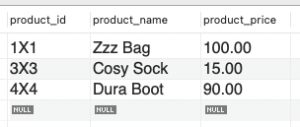
SELECT IN
SELECT * FROM sold_via
ORDER BY tid, product_id
Which products have more than 3 items sold in all sales transactions?
SELECT product_id, product_name, product_price
FROM product
WHERE product_id IN (SELECT product_id
FROM sold_via
GROUP BY product_id
HAVING SUM(no_of_items) > 3)
Database Systems
by Jukić, Vrbsky, & Nestorov
Pearson 2014
ISBN 978-0-13-257567-6

Slide 34
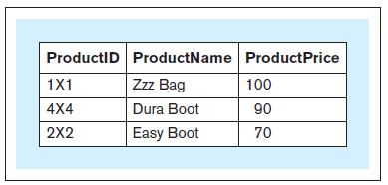
SELECT IN, cont’d
SELECT * FROM sold_via
ORDER BY tid, product_id
Which products were each sold
in more than one sales transaction?
SELECT product_id, product_name, product_price
FROM product
WHERE product_id IN (SELECT product_id
FROM sold_via
GROUP BY product_id
HAVING COUNT(*) > 1)
Database Systems
by Jukić, Vrbsky, & Nestorov
Pearson 2014
ISBN 978-0-13-257567-6

Slide 35
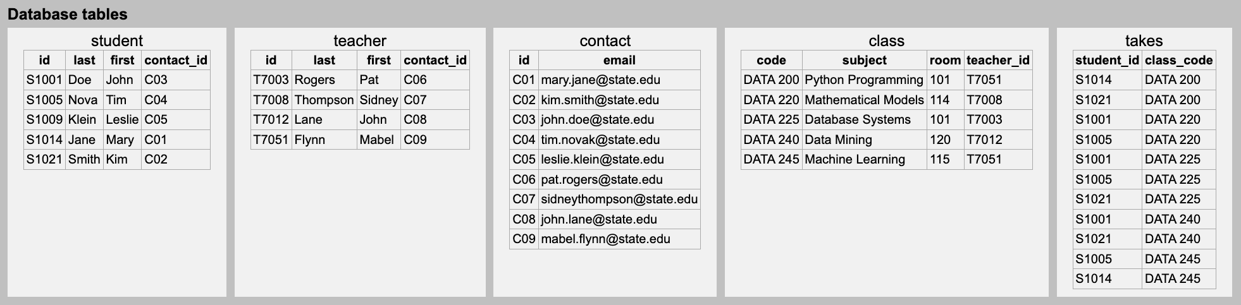
Class Problem
Who are the classmates of Tim Novak?
SELECT-IN-School.ipynb

Slide 36
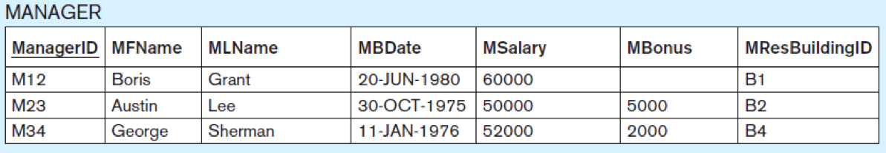
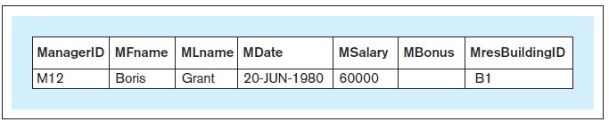
IS NULL
Which managers did not get a bonus?
SELECT *
FROM manager
WHERE mbonus IS NULL;
Database Systems
by Jukić, Vrbsky, & Nestorov
Pearson 2014
ISBN 978-0-13-257567-6

Slide 37
EXISTS
Follow WHERE EXISTS by a nested query.
The nested query is true if it retrieves any rows, else it is false.
If the nested query uses columns from the
outer query, then the inner query is a
correlated subquery.

Slide 38
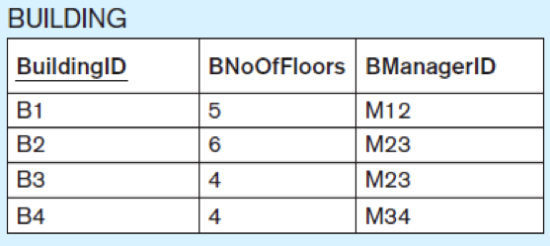
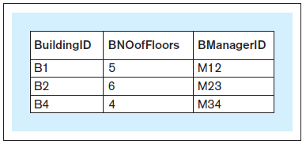
EXISTS, cont’d
Which buildings have managers living in them?
SELECT-EXISTS-Building.ipynb
SELECT *
FROM building b
WHERE EXISTS (SELECT *
FROM manager m
WHERE b.buildingid
= m.mresbuildingid);
correlated subquery

Slide 39
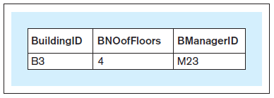
NOT
Which buildings
do not have managers living in them?
SELECT *
FROM building b
WHERE NOT EXISTS (SELECT *
FROM manager m
WHERE b.buildingid
= m.mresbuildingid);

Slide 40
INSERT INTO SELECT
Use the results
from a query
to populate
another table.
  Source:
  Titanic passengers.
INSERT-INTO-SELECT.ipynb
CREATE TABLE young_men_survivors
(
name VARCHAR(32) NOT NULL UNIQUE,
age DOUBLE NOT NULL,
class INT NOT NULL,
PRIMARY KEY(name)
)
INSERT INTO young_men_survivors
SELECT name, age,
CASE
WHEN passenger_class = '1st' THEN 1
WHEN passenger_class = '2nd' THEN 2
WHEN passenger_class = '3rd' THEN 3
ELSE 0
END AS class
FROM passengers
WHERE sex = 'male'
AND survived = 'yes'
AND age BETWEEN 21 AND 24
mysql> select * from young_men_survivors;
+---------------------------------+-----+-------+
| name | age | class |
+---------------------------------+-----+-------+
| Asplund, Mr. Johan Charles | 23 | 3 |
| Buckley, Mr. Daniel | 21 | 3 |
| Collett, Mr. Sidney C Stuart | 24 | 2 |
| Duquemin, Mr. Joseph | 24 | 3 |
| Greenfield, Mr. William Bertram | 23 | 1 |
| Jansson, Mr. Carl Olof | 21 | 3 |
| Karlsson, Mr. Einar Gervasius | 21 | 3 |
| Leeni, Mr. Fahim (Philip Zenni | 22 | 3 |
| Madsen, Mr. Fridtjof Arne | 24 | 3 |
| Midtsjo, Mr. Karl Albert | 21 | 3 |
| Oxenham, Mr. Percy Thomas | 22 | 2 |
| Snyder, Mr. John Pillsbury | 24 | 1 |
| Vartanian, Mr. David | 22 | 3 |
| Williams, Mr. Richard Norris II | 21 | 1 |
+---------------------------------+-----+-------+
This all happens on the database server,
not the client side.

Slide 41
Cloning a Table
To make a copy beta of table alpha:
  Any alpha constraints are copied as well into beta.
  You can include a WHERE clause with the SELECT
  to copy only certain rows.
If you don’t execute the INSERT statement, you’ve only copied the table structure.
  The copied table will be empty.
CREATE TABLE beta LIKE alpha;
INSERT INTO beta SELECT * FROM alpha

