Slide 1


DATA 201
Database Technologies for Data Analytics
February 6 Class Meeting
Department of Applied Data Science
San Jose State University
Spring 2025
Instructor: Ron Mak
www.cs.sjsu.edu/~mak

Slide 2
This Evening
Entity-relationship (ER) diagram
(conceptual data model)
  entities and attributes
  relationships
Use of https://erdplus.com website.
Break

Slide 3
This Evening, cont’d
Relational schema (logical data model)
MySQL database (physical data model)
Remote database server
Terra Bikes example database application

Slide 4
Conceptual Data Model
Visualize the requirements.
Build a conceptual data model.
  Example: Entity-Relationship (ER) modeling
  Draw ER diagrams.
Implementation independent:
No dependencies on the logic of a particular database management system.
  Example DBMS: Oracle, MySQL, etc.
Blueprint for the logical model.

Slide 5
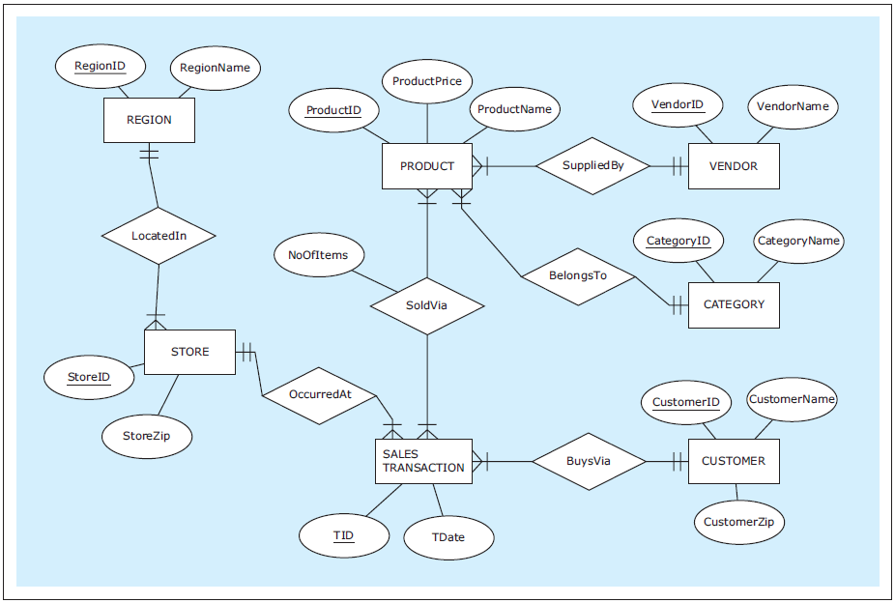
Example Conceptual Model: ER Diagram
A free online tool for drawing ER diagrams:
https://erdplus.com
  Create an account and you can save diagrams.
ZAGI Retail Company
Sales Department Database
Database Systems
by Jukić, Vrbsky, & Nestorov
Pearson 2014
ISBN 978-0-13-257567-6

Slide 6
Entities and Attributes
Entity
  Represents a real-world concept.
    Examples: customer, product, store, event, etc.
  Data that the database stores.
  Each entity represents multiple instances.
    Example: A student entity represents many students.
Attribute
  Characteristic of an entity that the database stores.
    Examples (for a customer): name, address, id, etc.
  A unique attribute of an entity has a value that is different for each instance of the entity.

Slide 7
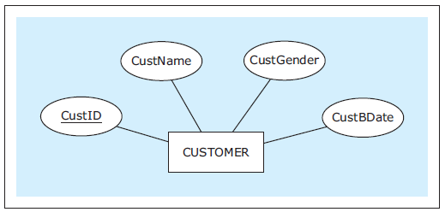
Entities and Attributes, cont’d
In an ER diagram, show an entity with a rectangle and its attributes with ovals.
  Underline the unique attribute.
Database Systems
by Jukić, Vrbsky, & Nestorov
Pearson 2014
ISBN 978-0-13-257567-6

Slide 8
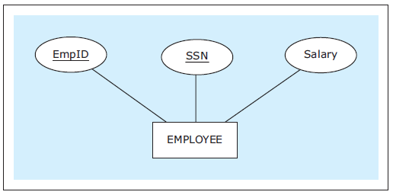
Entities and Attributes, cont’d
An entity can have multiple unique attributes.
  Each one is called a candidate key.
Database Systems
by Jukić, Vrbsky, & Nestorov
Pearson 2014
ISBN 978-0-13-257567-6

Slide 9
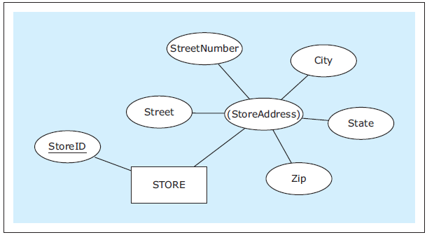
Composite Attributes
A composite attribute is composed of
several attributes.
  Parenthesize the name of the composite attribute.
Database Systems
by Jukić, Vrbsky, & Nestorov
Pearson 2014
ISBN 978-0-13-257567-6

Slide 10
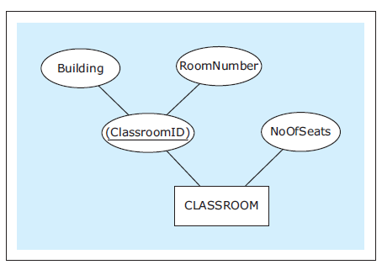
Composite Attributes, cont’d
An entity’s unique attribute can be composite.
Database Systems
by Jukić, Vrbsky, & Nestorov
Pearson 2014
ISBN 978-0-13-257567-6

Slide 11
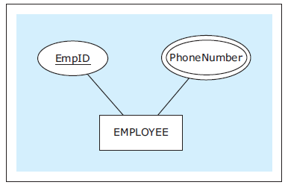
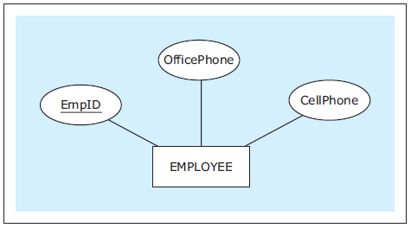
Multivalued Attributes
An entity instance can
have multiple values
for an attribute.
If the number of
values is fixed,
use separate
attributes instead.
Database Systems
by Jukić, Vrbsky, & Nestorov
Pearson 2014
ISBN 978-0-13-257567-6

Slide 12
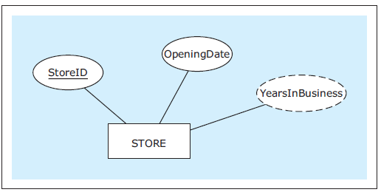
Derived Attributes
The value of a derived attribute is not stored.
  It’s calculated from the values of the other attributes and additional data such as the current date.
  Show with a dashed oval.
Database Systems
by Jukić, Vrbsky, & Nestorov
Pearson 2014
ISBN 978-0-13-257567-6

Slide 13
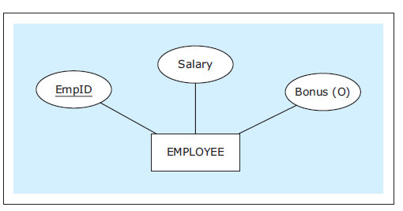
Optional Attributes
An optional attribute does not always have to have a value.
  Indicate with (O).
Database Systems
by Jukić, Vrbsky, & Nestorov
Pearson 2014
ISBN 978-0-13-257567-6

Slide 14
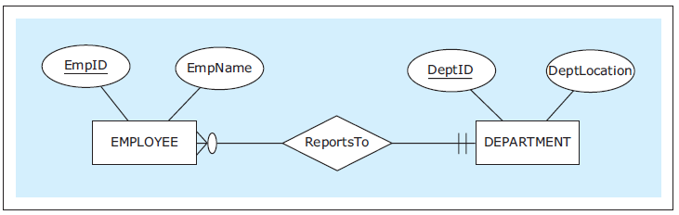
Relationships
Each entity in an ER diagram must be related
to at least one other entity.
Show a relationship with a diamond and connect the diamond to the entities that
are part of the relationship.
Database Systems
by Jukić, Vrbsky, & Nestorov
Pearson 2014
ISBN 978-0-13-257567-6

Slide 15
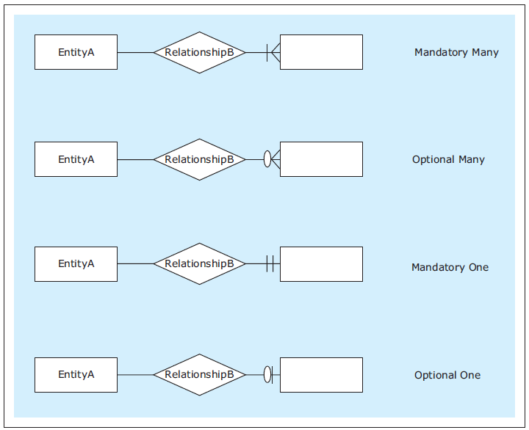
Relationship Cardinality
Show cardinality (how many instances of an entity) with symbols at the end of the relationship lines.
  Maximum symbol closest to the entity.
  Minimum symbol further away.
  Zero, one, many
Database Systems
by Jukić, Vrbsky, & Nestorov
Pearson 2014
ISBN 978-0-13-257567-6

Slide 16
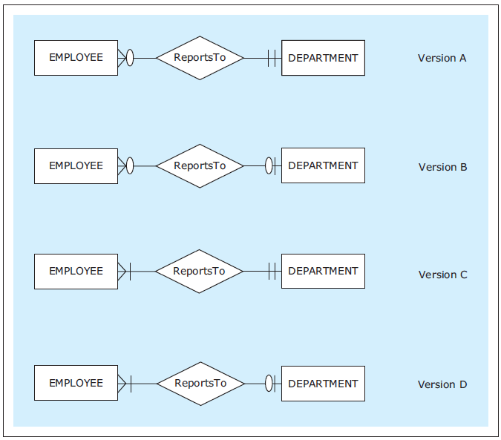
Relationship Cardinality, cont’d
Read each relationship in
either direction in this order:
  rectangle
  diamond
  cardinality
  rectangle
Database Systems
by Jukić, Vrbsky, & Nestorov
Pearson 2014
ISBN 978-0-13-257567-6

Slide 17
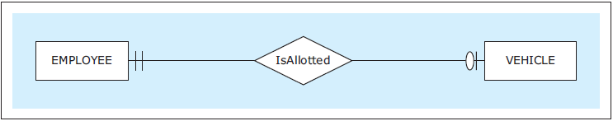
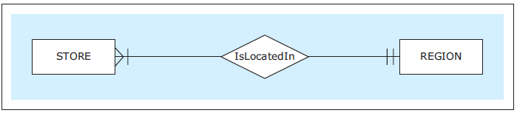
Types of Relationships
One-to-one (1:1)
One-to-many (1:M)
Each employee is allotted at most one (zero or one) vehicle.
Each vehicle is allotted to exactly one employee.
Each store is located in exactly one region.
Each region has located in it at least one (i.e., many) stores.
Database Systems
by Jukić, Vrbsky, & Nestorov
Pearson 2014
ISBN 978-0-13-257567-6

Slide 18
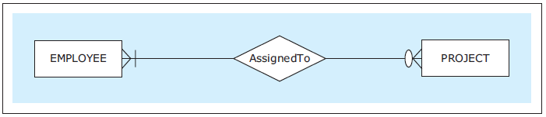
Types of Relationships, cont’d
Many-to-many (M:N)
Each employee is assigned to none or many projects.
Each project has assigned to it at least one (one or many) employee.
Database Systems
by Jukić, Vrbsky, & Nestorov
Pearson 2014
ISBN 978-0-13-257567-6

Slide 19
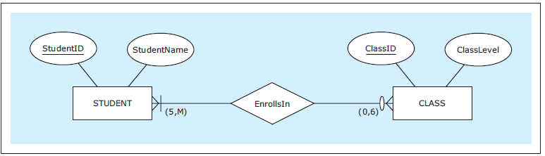
Exact Cardinalities
Indicate exact cardinalities with parenthesized minimum and maximum values.
  Example: (2, 6)
  Use M for a non-specific minimum or maximum.
Database Systems
by Jukić, Vrbsky, & Nestorov
Pearson 2014
ISBN 978-0-13-257567-6

Slide 20
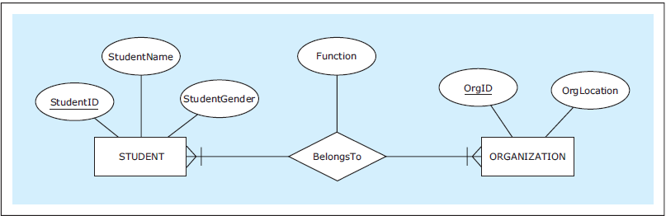
Relationship Attributes
An relationship can also have attributes.
Database Systems
by Jukić, Vrbsky, & Nestorov
Pearson 2014
ISBN 978-0-13-257567-6

Slide 21
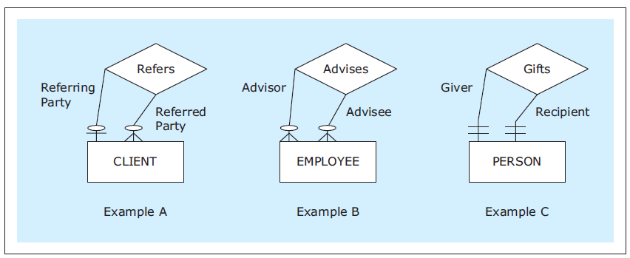
Unary Relationships
In a unary relationship, an entity is involved in a relationship with itself.
  One instance has a relationship with
  another instance of the same entity.
  You can indicate the relationship role.
Database Systems
by Jukić, Vrbsky, & Nestorov
Pearson 2014
ISBN 978-0-13-257567-6

Slide 22
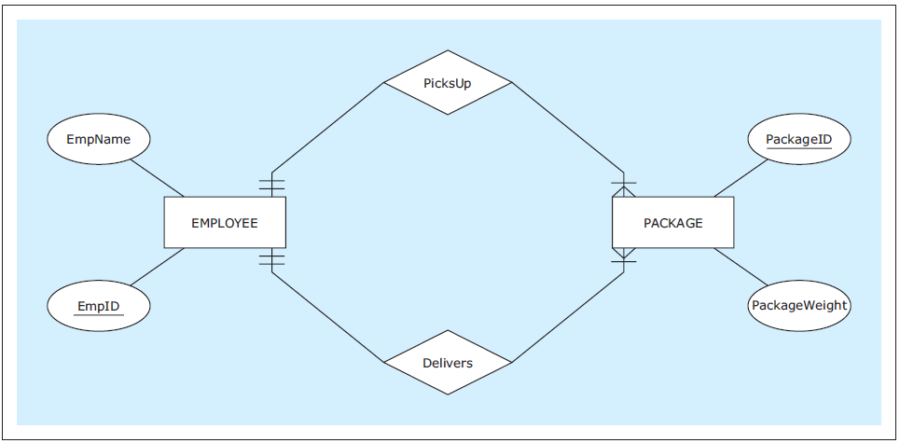
Multiple Relationships
Two entities can have multiple relationships with each other.
Database Systems
by Jukić, Vrbsky, & Nestorov
Pearson 2014
ISBN 978-0-13-257567-6

Slide 23
Weak Entities
A weak entity does not have its own
unique attribute.
  It only has a partial key.
  Underline the partial key with dashes.
Therefore, it must be associated with an
owner entity via an identifying relationship.
  Indicate the weak entity and the
  identifying relationship with double borders.
The partial key plus the owner attribute’s unique attribute uniquely identify the weak entity.

Slide 24
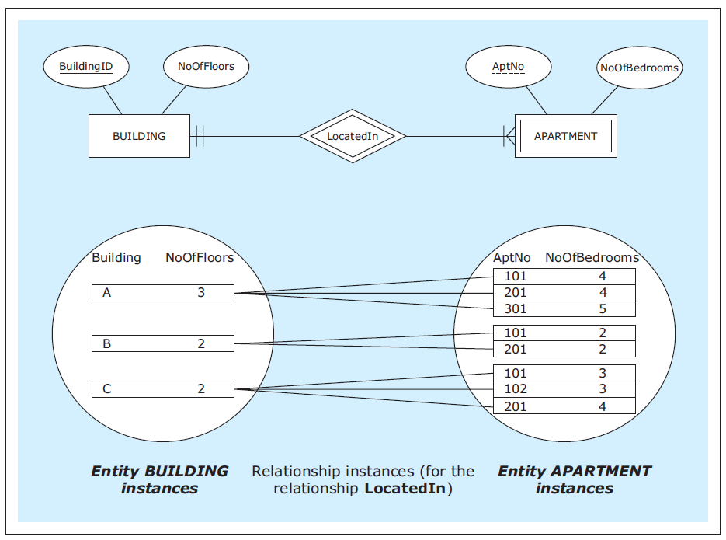
Weak Entities, cont’d
Database Systems
by Jukić, Vrbsky, & Nestorov
Pearson 2014
ISBN 978-0-13-257567-6

Slide 25
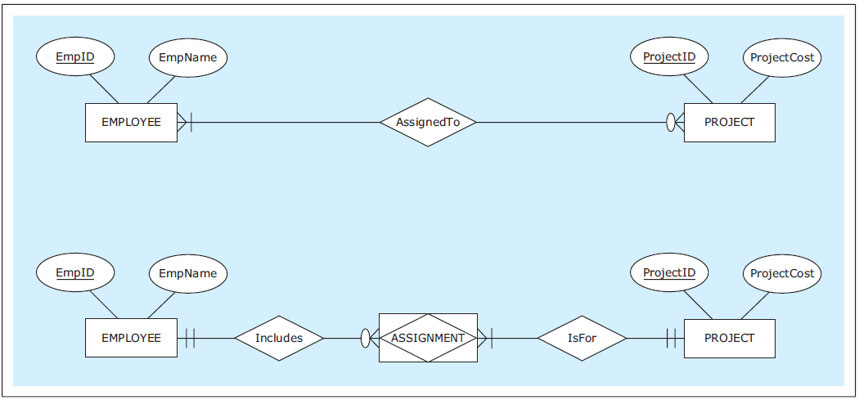
Associative Entities
An associative entity is an alternate way to depict a many-to-many (M:N) relationship.
Database Systems
by Jukić, Vrbsky, & Nestorov
Pearson 2014
ISBN 978-0-13-257567-6

Slide 26
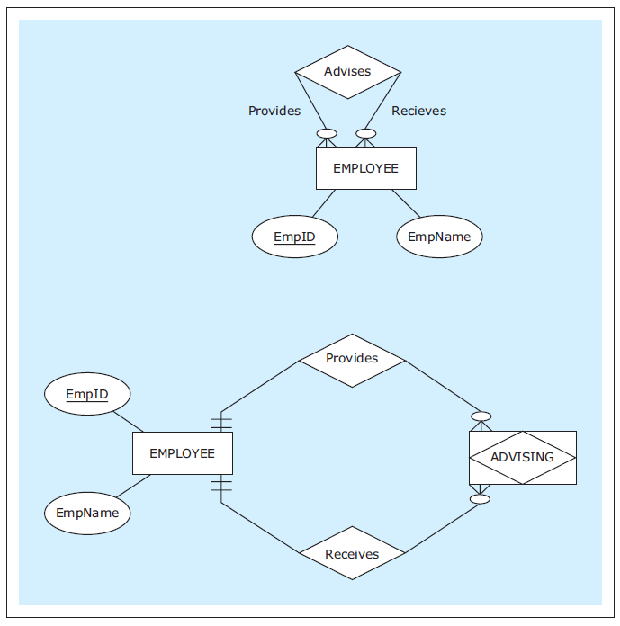
Associative Entities, cont’d
Associative entity
for a unary M:N
relationship.
Database Systems
by Jukić, Vrbsky, & Nestorov
Pearson 2014
ISBN 978-0-13-257567-6

Slide 27
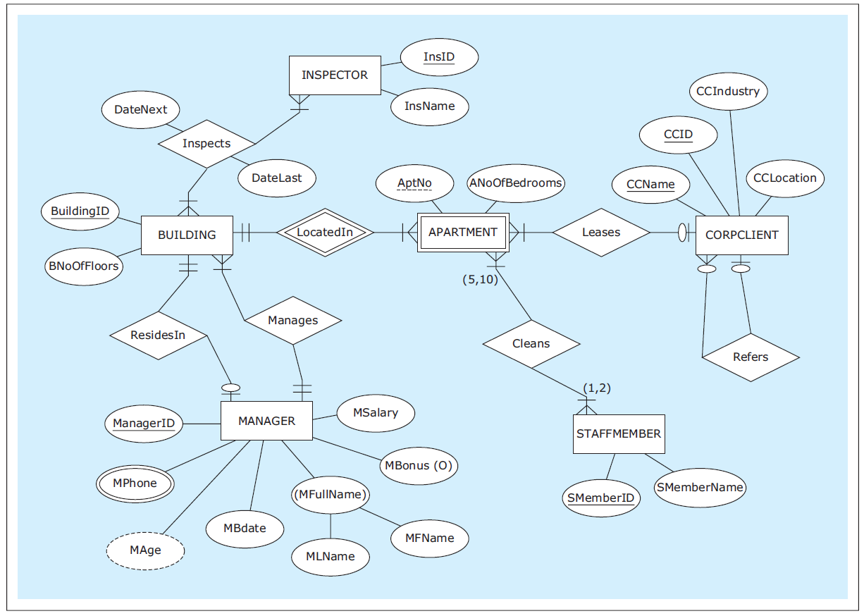
ER Diagram Example
HAFH Realty Company
Property Management Database
Database Systems
by Jukić, Vrbsky, & Nestorov
Pearson 2014
ISBN 978-0-13-257567-6

Slide 28
ERDPlus
Very capable online database design tool:
https://erdplus.com
Create an ER diagram.
  All the examples in these slides were generated using ERDPlus.
Automatic mapping to a relational schema.
Automatic export to SQL CREATE commands.
Create an account to save ER diagrams and relational schemas.
Demo

Slide 29
Break
Give ERDPlus a try!

Slide 30
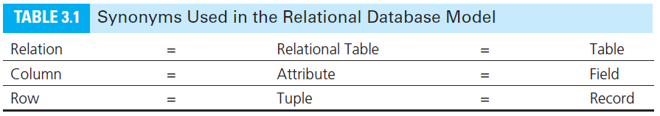
Logical Database Model
Map the ER diagram to a logical model represented as a relational schema.
Database Systems
by Jukić, Vrbsky, & Nestorov
Pearson 2014
ISBN 978-0-13-257567-6

Slide 31
Conditions for a Table to be a Relation
Each column must have a name.
  Within a table, each column name must be unique.
All values in each column must be from the same (predefined) domain (i.e., same datatype).
Within a table, each row must be unique.
Within each row, each value in each column must be single-valued.
  Multiple values of the content represented by the column are not allowed in any rows of the table.

Slide 32
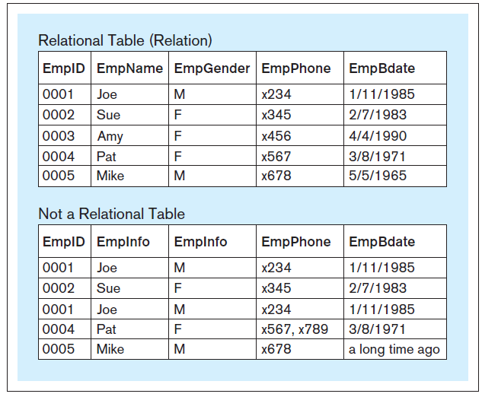
Relational vs. Non-Relational Tables
X
Database Systems
by Jukić, Vrbsky, & Nestorov
Pearson 2014
ISBN 978-0-13-257567-6

Slide 33
Additional Properties for a Relational Table
The order of columns is irrelevant.
The order of rows is irrelevant.

Slide 34
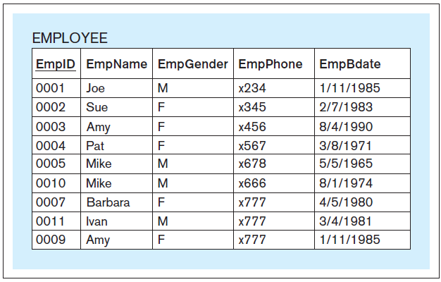
Primary Key
Each relation must have a primary key.
  A column or set of columns whose value
  uniquely identifies each row.
  Underline the primary key of the relational table.
Database Systems
by Jukić, Vrbsky, & Nestorov
Pearson 2014
ISBN 978-0-13-257567-6

Slide 35
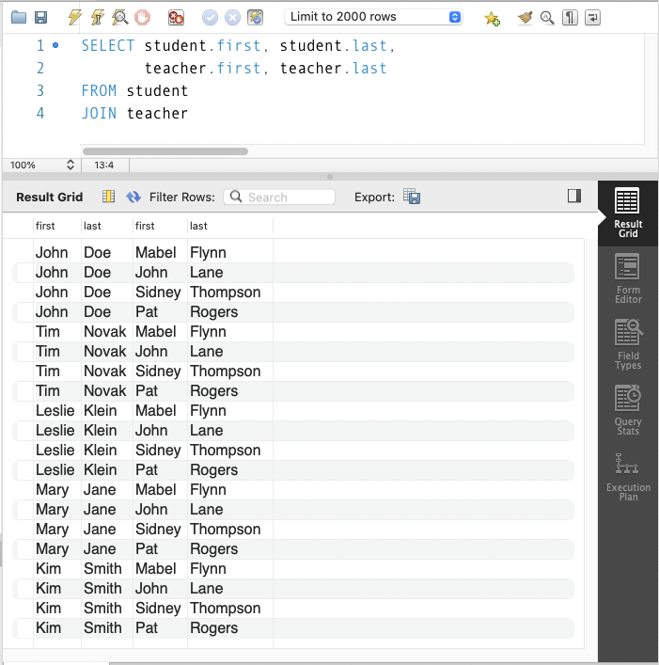
Result Set from a Query
The result set from a query may look like a relational table, but it doesn’t have to follow these rules.

Slide 36
Logical Database Model
Create the relational logical database model.
It’s usually straightforward to map
an ER diagram to a relational model.
  Create a relational schema.

Slide 37
Map Conceptual Model to Logical Model
From this ER diagram:
ZAGI Retail Company
Sales Department Database
conceptual
Database Systems
by Jukić, Vrbsky, & Nestorov
Pearson 2014
ISBN 978-0-13-257567-6

Slide 38
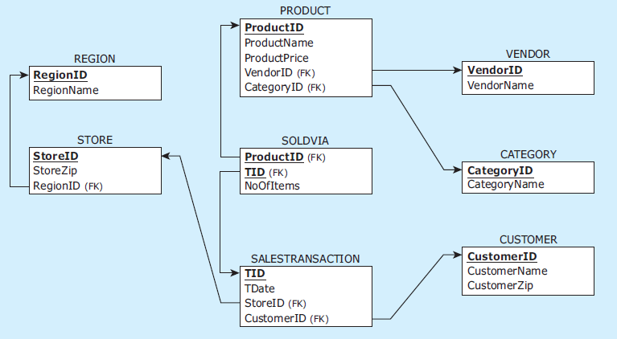
Logical Mapping as a Relational Schema
To this relational schema:
ZAGI Retail Company
Sales Department Database
logical
Database Systems
by Jukić, Vrbsky, & Nestorov
Pearson 2014
ISBN 978-0-13-257567-6

Slide 39
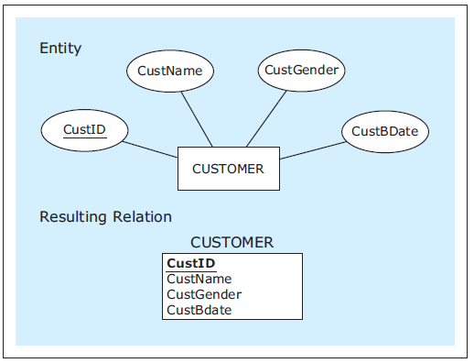
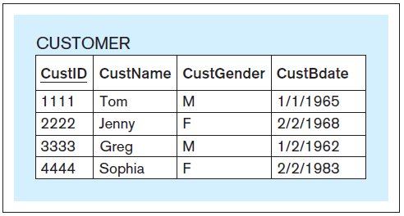
Mapping Entities
conceptual
logical
physical
Database Systems
by Jukić, Vrbsky, & Nestorov
Pearson 2014
ISBN 978-0-13-257567-6

Slide 40
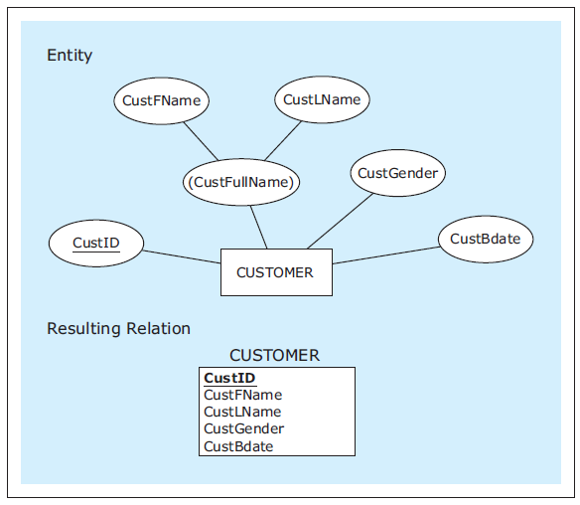
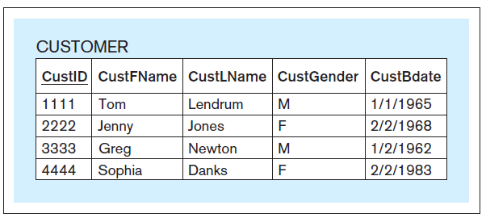
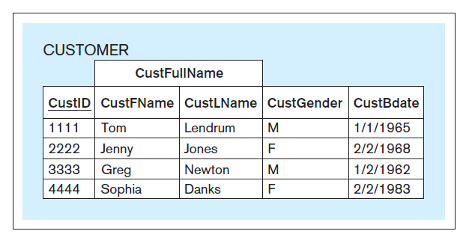
Mapping Entities, cont’d
physical
conceptual
As mapped.
logical
Entity with a composite attribute.
As seen by a front-end application.
Database Systems
by Jukić, Vrbsky, & Nestorov
Pearson 2014
ISBN 978-0-13-257567-6

Slide 41
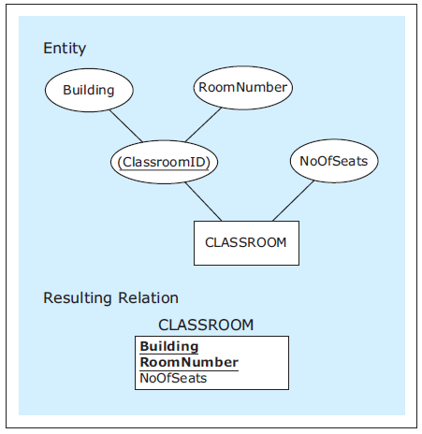
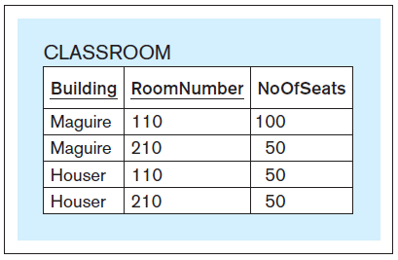
Mapping Entities, cont’d
conceptual
physical
logical
Attribute with a
composite primary key.
Two column headers underlined.
Database Systems
by Jukić, Vrbsky, & Nestorov
Pearson 2014
ISBN 978-0-13-257567-6

Slide 42
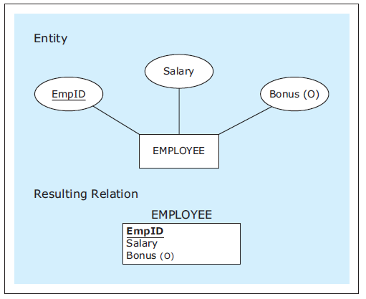
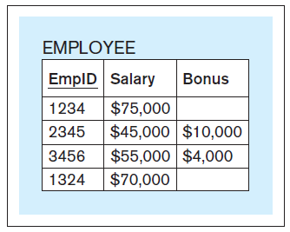
Mapping Entities, cont’d
conceptual
logical
physical
Entity with an optional attribute.
Database Systems
by Jukić, Vrbsky, & Nestorov
Pearson 2014
ISBN 978-0-13-257567-6

Slide 43
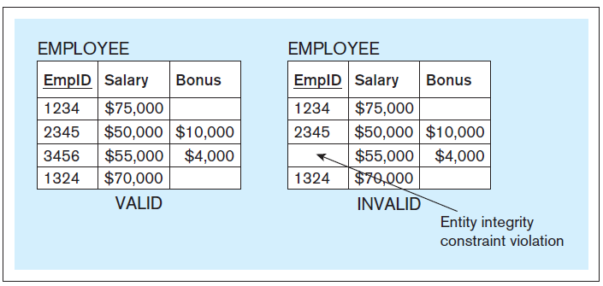
Entity Integrity Constraint
A primary key column of a relational table
cannot have null (empty) values.
The database server will enforce entity integrity.
Database Systems
by Jukić, Vrbsky, & Nestorov
Pearson 2014
ISBN 978-0-13-257567-6

Slide 44
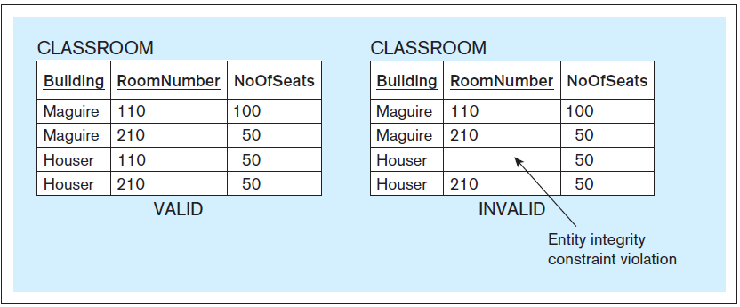
Entity Integrity Constraint, cont’d
Database Systems
by Jukić, Vrbsky, & Nestorov
Pearson 2014
ISBN 978-0-13-257567-6

Slide 45
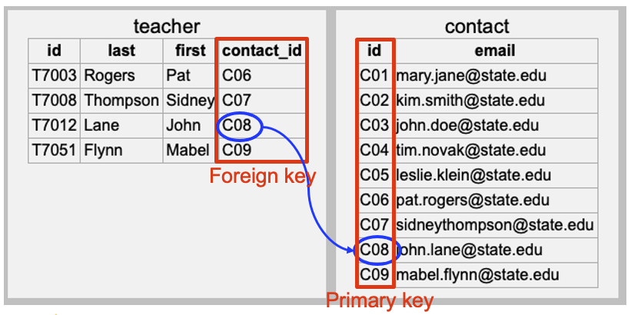
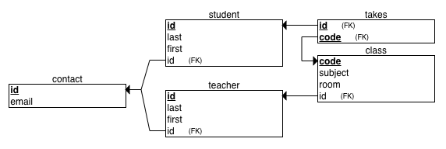
Foreign Keys
A foreign key is a column in a table that refers to a primary key column in another table.
In a relational schema, draw an arrow from the foreign key to the corresponding primary key.
CREATE TABLE teacher
(
id VARCHAR NOT NULL,
last VARCHAR NOT NULL,
first VARCHAR NOT NULL,
contact_id VARCHAR NOT NULL,
PRIMARY KEY (id),
FOREIGN KEY (contact_id) REFERENCES contact(id)
)

Slide 46
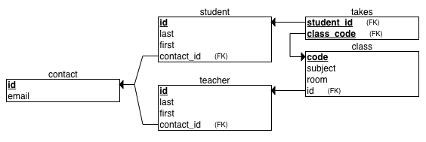
Foreign Keys
A foreign key is a column in a table that refers to a primary key column in another table.
In a relational schema, draw an arrow from the foreign key to the corresponding primary key.
CREATE TABLE teacher
(
id VARCHAR NOT NULL,
last VARCHAR NOT NULL,
first VARCHAR NOT NULL,
contact_id VARCHAR NOT NULL,
PRIMARY KEY (id),
FOREIGN KEY (contact_id) REFERENCES contact(id)
)

Slide 47
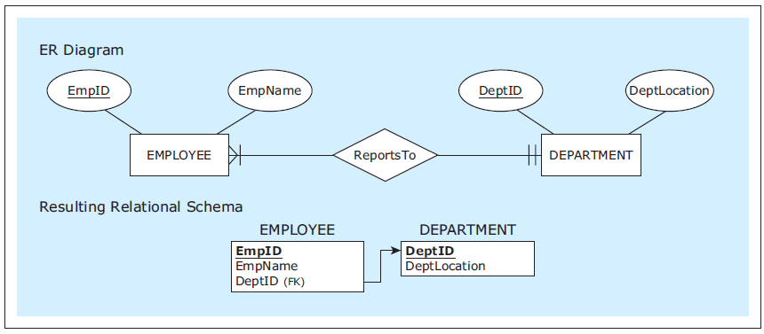
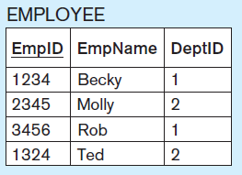
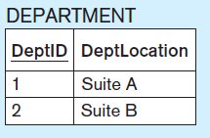
Mapping 1:M Relationships
Mandatory
participation
on both sides.
In a 1:M relationship,
the foreign key is
always on the M side.
The foreign key on the M side
of the 1:M relationship
(EMPLOYEE) corresponds to
the primary key on the 1 side
(DEPARTMENT).
Database Systems
by Jukić, Vrbsky, & Nestorov
Pearson 2014
ISBN 978-0-13-257567-6

Slide 48
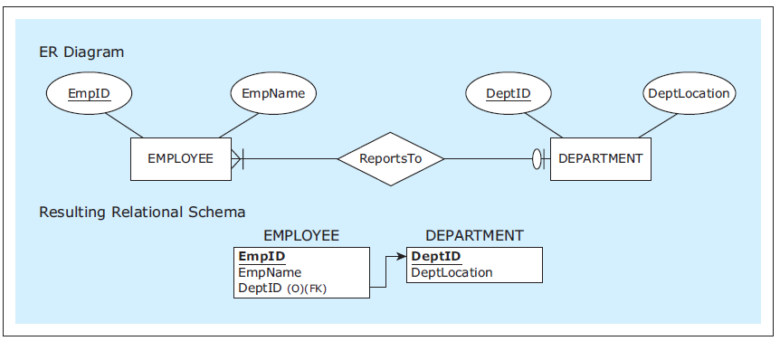
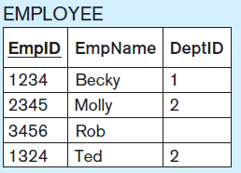
Mapping 1:M Relationships, cont’d
Optional participation
on the 1 side.
Database Systems
by Jukić, Vrbsky, & Nestorov
Pearson 2014
ISBN 978-0-13-257567-6

Slide 49
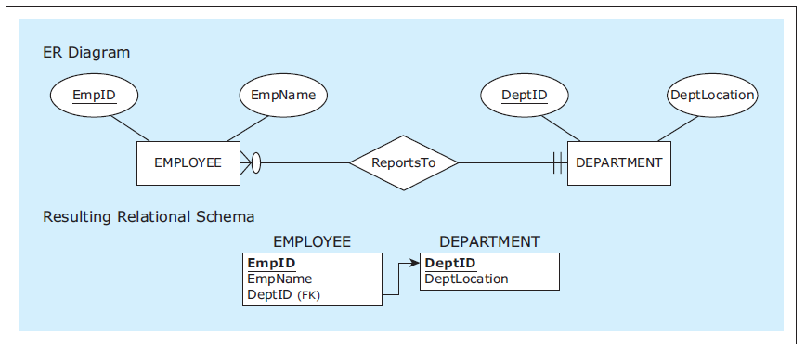
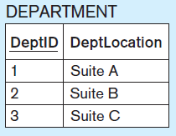
Mapping 1:M Relationships, cont’d
Optional participation
on the M side.
Database Systems
by Jukić, Vrbsky, & Nestorov
Pearson 2014
ISBN 978-0-13-257567-6

Slide 50
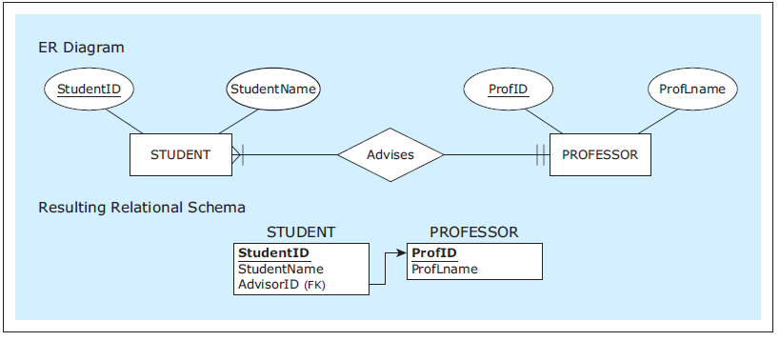


Mapping 1:M Relationships, cont’d
Rename a foreign key
to better reflect the
role of a relationship.
Database Systems
by Jukić, Vrbsky, & Nestorov
Pearson 2014
ISBN 978-0-13-257567-6

Slide 51




Mapping M:N Relationships
Use the
linking table
BELONGSTO
with two
foreign keys.
AKA:
bridge relation
or join table.
A M:N relationship
requires a
linking table.
Database Systems
by Jukić, Vrbsky, & Nestorov
Pearson 2014
ISBN 978-0-13-257567-6

Slide 52



Mapping M:N Relationships, cont’d
Optional
participation
on both sides.
Database Systems
by Jukić, Vrbsky, & Nestorov
Pearson 2014
ISBN 978-0-13-257567-6

Slide 53


Mapping M:N Relationships, cont’d
Relationship
with an
attribute.
Database Systems
by Jukić, Vrbsky, & Nestorov
Pearson 2014
ISBN 978-0-13-257567-6

Slide 54
Mapping 1:1 Relationships
Map 1:1 relationships similarly
to 1:M relationships.
One table will have a foreign key pointing to
the primary key of the other table.
It can be an arbitrary choice of which table
has the foreign key.
  Make the choice that is most intuitive or efficient.

Slide 55


Mapping 1:1 Relationships, cont’d
Table VEHICLE has the foreign key.
Database Systems
by Jukić, Vrbsky, & Nestorov
Pearson 2014
ISBN 978-0-13-257567-6

Slide 56

Referential Integrity Constraint
The value of a foreign key must either:
  Match one of the values
  of the primary key in the table being referred to.
  Be null.
The database server
will enforce referential integrity.
Database Systems
by Jukić, Vrbsky, & Nestorov
Pearson 2014
ISBN 978-0-13-257567-6

Slide 57
Physical Database Model
The physical model is the actual
database implementation.
Map the logical model (relational schema)
to relational database tables.
SQL commands to create, delete, modify,
and query database structures.
  ERDPlus will export CREATE commands.

Slide 58
Mapping Example: ER Diagram
From this ER diagram (conceptual model):
ZAGI Retail Company
Sales Department Database
Database Systems
by Jukić, Vrbsky, & Nestorov
Pearson 2014
ISBN 978-0-13-257567-6

Slide 59
Mapping Example: Relational Schema
To this relational schema (logical model):
ZAGI Retail Company
Sales Department Database
Database Systems
by Jukić, Vrbsky, & Nestorov
Pearson 2014
ISBN 978-0-13-257567-6

Slide 60

Mapping Example: Database Tables
To this database (physical model ):
ZAGI Retail Company
Sales Department Database
ZAGIsales.sql
Database Systems
by Jukić, Vrbsky, & Nestorov
Pearson 2014
ISBN 978-0-13-257567-6

Slide 61
ERDPlus Demo
Create the ER diagram for a simple database.
Map it to a relational schema.
Generate the SQL CREATE commands to recreate the database.
Demo

Slide 62
Relational Database Constraints
A constraint is a rule that a relational database must satisfy in order to be valid.
Two types of constraints:
  implicit constraints
  user-defined constraints

Slide 63
Implicit RDB Constraints
Each relation (table) in a relational schema must have a unique name.
For each relation:
  Each column name must be unique.
  Each row must be unique.
  Each column of each row must be single-valued.
  Domain constraint: All values in a column must be from the same predefined domain (i.e., datatype)
  The column order is irrelevant.
  The row order is irrelevant.

Slide 64
Implicit RDB Constraints, cont’d
Primary key constraint: Each relation must have a primary key (a column or set of columns) whose value is unique for each row.
Entity integrity constraint: No primary key column can have a null value.
Referential integrity constraint: In each row containing a foreign key, either the value of the foreign key must match one of the values of the primary key of the table being referred to, or the foreign key is null.

Slide 65
User-Defined RDB Constraints
Optional attributes
Mandatory foreign key
  Example: Each employee must report to a department.
Exact cardinalities
  Example: A student can take at most 5 classes.
Business rules
  Usually enforced by front-end applications.
  Example: Each organization must have both
  male and female students.

Slide 66




User-Defined RDB Constraints, cont’d
Database Systems
by Jukić, Vrbsky, & Nestorov
Pearson 2014
ISBN 978-0-13-257567-6

Slide 67
ER Modeling and Relational Modeling
Why not skip ER modeling and go directly to logical modeling (creating relational schemas)?
ER modeling is better for
visualizing requirements.
Certain concepts can be visualized graphically only in an ER diagram.
A conceptual model (ER diagram) is better for communication and documentation.

Slide 68
Remote Database Server
Remote database server
  http://www.cs.sjsu.edu/~mak/DATA201/SchoolServer.pdf
  The host is IES-ADS-ClassDB.sjsu.edu
Each project team has a database and a team user on the remote server.
  Example: For a team named “Super Coders”, the database is named supercoders_db, the user is named supercoders_user, and the team was emailed file supercoders.ini that contains the team user’s password.
  Also connect with MySQL Workbench.

Slide 69
Terra Bikes
DATA 225 team project, Fall 2023
  DATA 225 Database Systems for Analytics
  DATA 201 has 90% the same course content
First install the Python GUI package PyQt5:
The database is on the school server, so if you’re off-campus, you need to be on VPN.
Start the application on the command line:
TerraBikes.zip
pip3 install PyQt5
ipython TerraBikes.py

Slide 70
Terra Bikes, cont’d
You can log in as three different users:
  The common password is welcome1234
  The manager sees the Dashboards where data analytics and graphs are displayed.
PowerPoint slides during presentation:
Report:
User role | Username
Customer | jcaughan7
Employee | HayyimM3
Manager | HyDu19
Some operations may cause the app to crash. Just restart it and don’t do that operation again!
SQL_Weavers.pptx
SQL_Weavers - TerraBikes Application Report

Slide 71
Assignment #3: Data Modeling
Use the online ERDPlus tools at https://erdplus.com to create an ER diagram (conceptual model).
Map the ER diagram to a relational schema (logical model).
Export SQL CREATE commands to create the database (physical model).
Use MySQL Workbench to create an EER (extended entity-relationship) diagram.

Slide 72

Assignment #3, cont’d
MySQL Workbench can
“reverse engineer” a schema
(database) and generate
an EER diagram.
https://medium.com/@tushar0618/how-to-create-er-diagram-of-a-database-in-mysql-workbench-209fbf63fd03

