Slide 1


DATA 201
Database Technologies for Data Analytics
January 30 Class Meeting
Department of Applied Data Science
San Jose State University
Spring 2025
Instructor: Ron Mak
www.cs.sjsu.edu/~mak

Slide 2
This Evening
More about traditional vs. SQL-92 syntax
SQL, Python, and MySQL Workbench skills
  connect to a database
  fetch and insert records
  query results in a dataframe
  dynamic query generation
  create a table
  extract, transform, and load (ETL) CSV data
  export/import (dump/restore) a database
  create a user
  mysql command

Slide 3
This Evening, cont’d
Break
Introduction to database design
  database systems and client-server architecture
  development steps
  requirements
  entity-relationship (ER) diagrams
  conceptual database model
  logical database model
  physical database model
  one-to-one, one-to-many, many-to-many relationships

Slide 4
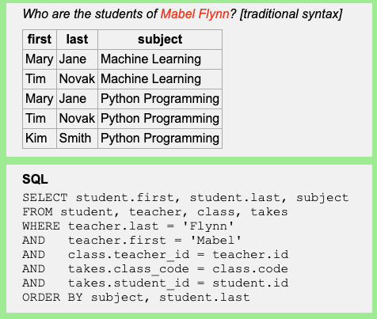
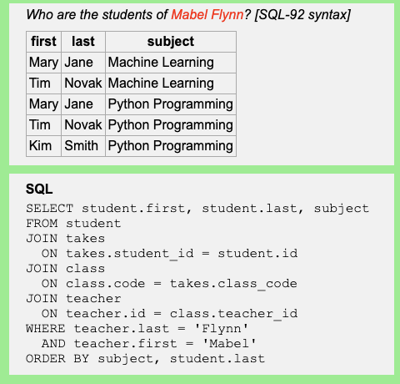
Reminder: Traditional vs. SQL-92 Syntax
Traditional syntax
SQL-92 syntax
Implicit joins.
Explicit joins.
SQL-92 syntax is now preferred.

Slide 5
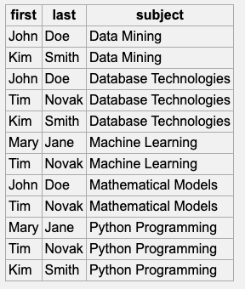
Traditional vs. SQL-92 Syntax, cont’d
Traditional syntax is more prone to programming errors.
SELECT student.first, student.last, subject
FROM student, teacher, class, takes
WHERE teacher.last = 'Flynn'
AND teacher.first = 'Mabel'
AND class.teacher_id = teacher.id
AND takes.class_code = class.code
AND takes.student_id = student.id
ORDER BY subject, student.last
Oops! You accidentally omitted a WHERE condition.

Slide 6
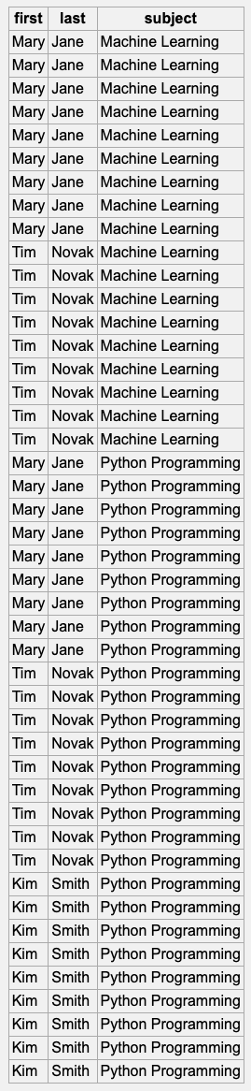
Traditional vs. SQL-92 Syntax, cont’d
Another common programming error with traditional syntax.
SELECT student.first, student.last, subject
FROM student, teacher, class, takes, contact
WHERE teacher.last = 'Flynn'
AND teacher.first = 'Mabel'
AND class.teacher_id = teacher.id
AND takes.class_code = class.code
AND takes.student_id = student.id
ORDER BY subject, student.last
Oops! You accidentally included an extra table to join.

Slide 7
Today’s Notebooks and Files
Connect to a database
Fetch records from a database using a cursor
01-School.ipynb
school.ini
sakila-remote.ini
02-FetchAll.ipynb
03-FetchOne.ipynb
04-FetchMany.ipynb

Slide 8
Today’s Notebooks and Files, cont’d
Query results and Pandas dataframes
Dynamically generated query string
Create a database table
05-MabelFlynnStudents-df.ipynb
06-StudentsOf.ipynb
07-CreateTable.ipynb

Slide 9
Today’s Notebooks and Files, cont’d
Insert rows into a table
CSV files
08-Insert.ipynb
09-Insert-tuple.ipynb
10-Insert-dictionary.ipynb
11-CSV-read.ipynb
12-CSV-insert.ipynb

Slide 10
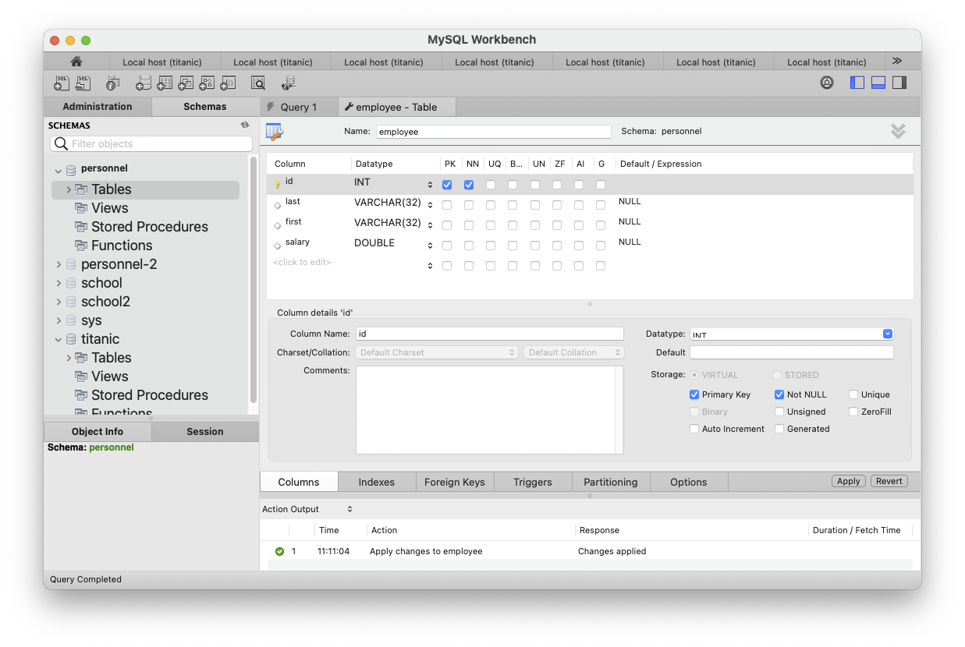
Create Table with MySQL Workbench
You can use MySQL Workbench to create a new database (schema) and a table.
Make sure personnel
is the current schema.
Then right-click Tables
and select "Create Table ..."
PK: primary key
NN: non-null

Slide 11
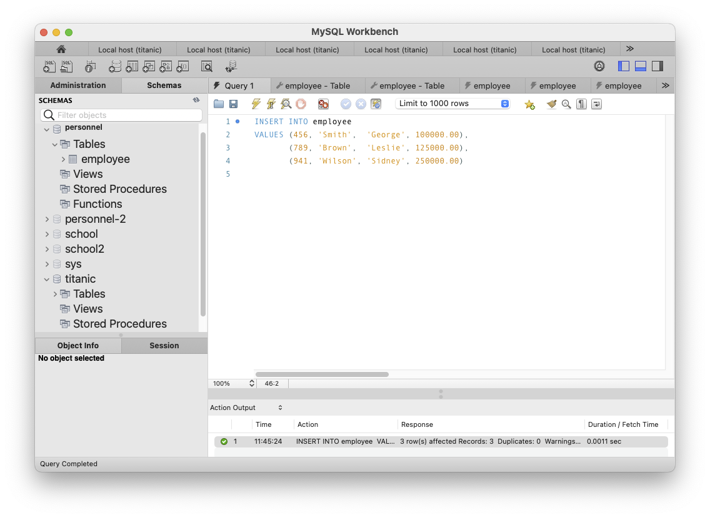
Insert Rows with MySQL Workbench
INSERT INTO employee
VALUES (456, 'Smith', 'George', 100000.00),
(789, 'Brown', 'Leslie', 125000.00),
(941, 'Wilson', 'Sidney', 250000.00)

Slide 12
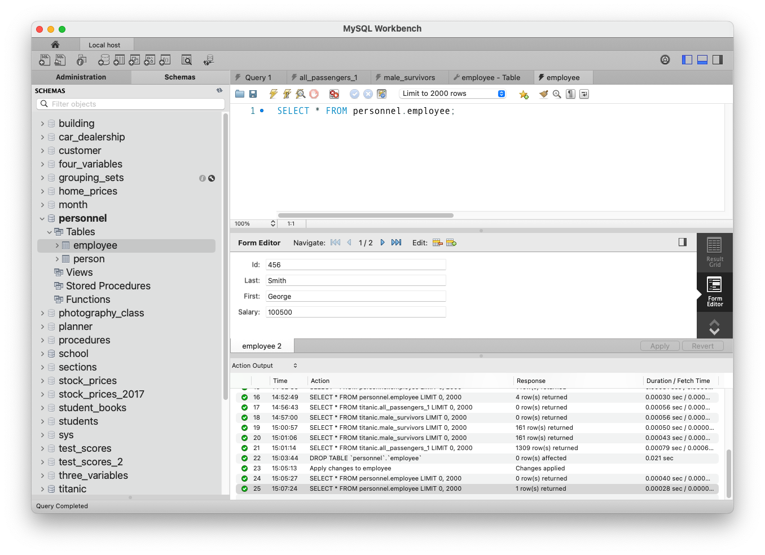
Insert Rows with MySQL Workbench, cont’d

Slide 13
CSV Files
Text files containing comma-separated values (CSV) are a popular format to download data.
  A textbook example is TitanicSurvival.csv
"","survived","sex","age","passengerClass"
"Allen, Miss. Elisabeth Walton","yes","female",29,"1st"
"Allison, Master. Hudson Trevor","yes","male",0.916700006,"1st"
"Allison, Miss. Helen Loraine","no","female",2,"1st"
"Allison, Mr. Hudson Joshua Crei","no","male",30,"1st"
"Allison, Mrs. Hudson J C (Bessi","no","female",25,"1st"
"Anderson, Mr. Harry","yes","male",48,"1st"
"Andrews, Miss. Kornelia Theodos","yes","female",63,"1st"
"Andrews, Mr. Thomas Jr","no","male",39,"1st"
"Appleton, Mrs. Edward Dale (Cha","yes","female",53,"1st"
"Artagaveytia, Mr. Ramon","no","male",71,"1st"
"Astor, Col. John Jacob","no","male",47,"1st"
"Astor, Mrs. John Jacob (Madelei","yes","female",18,"1st"
"Aubart, Mme. Leontine Pauline","yes","female",24,"1st"
"Barber, Miss. Ellen Nellie","yes","female",26,"1st"
"Barkworth, Mr. Algernon Henry W","yes","male",80,"1st"
"Baumann, Mr. John D","no","male",NA,"1st"
"Baxter, Mr. Quigg Edmond","no","male",24,"1st"
...

Slide 14
Extract, Transform, and Load CSV Data
There are multiple ways to ETL a CSV file.
  ETL: extract, transform, load
Transformation: We may want to clean the data:
  Replace the passenger classes "1st", "2nd", and "3rd" with integers 1, 2, and 3, respectively.
  Replace each "NA" for a missing age with 0.
"Yousif, Mr. Wazli","no","male",NA,"3rd"
"Yousseff, Mr. Gerious","no","male",NA,"3rd"
"Zabour, Miss. Hileni","no","female",14.5,"3rd"
"Zabour, Miss. Thamine","no","female",NA,"3rd"

Slide 15
Three Ways to ETL a CSV File
Use Python + SQL code.
  Python code reads and transforms the CSV data.
  SQL code embedded in the Python code inserts the transformed code into the database tables.
  A very flexible way to do ETL.
Execute SQL’s LOAD DATA command.
  Less control over data transformations.
  Load only one table at a time.
MySQL Workbench’s Table Data Import Wizard.
  Simplest but least flexible.

Slide 16
Today’s Notebooks and Files, cont’d
CSV files
  ETL CSV Data #1
11-CSV-read.ipynb
12-CSV-ETL.ipynb

Slide 17
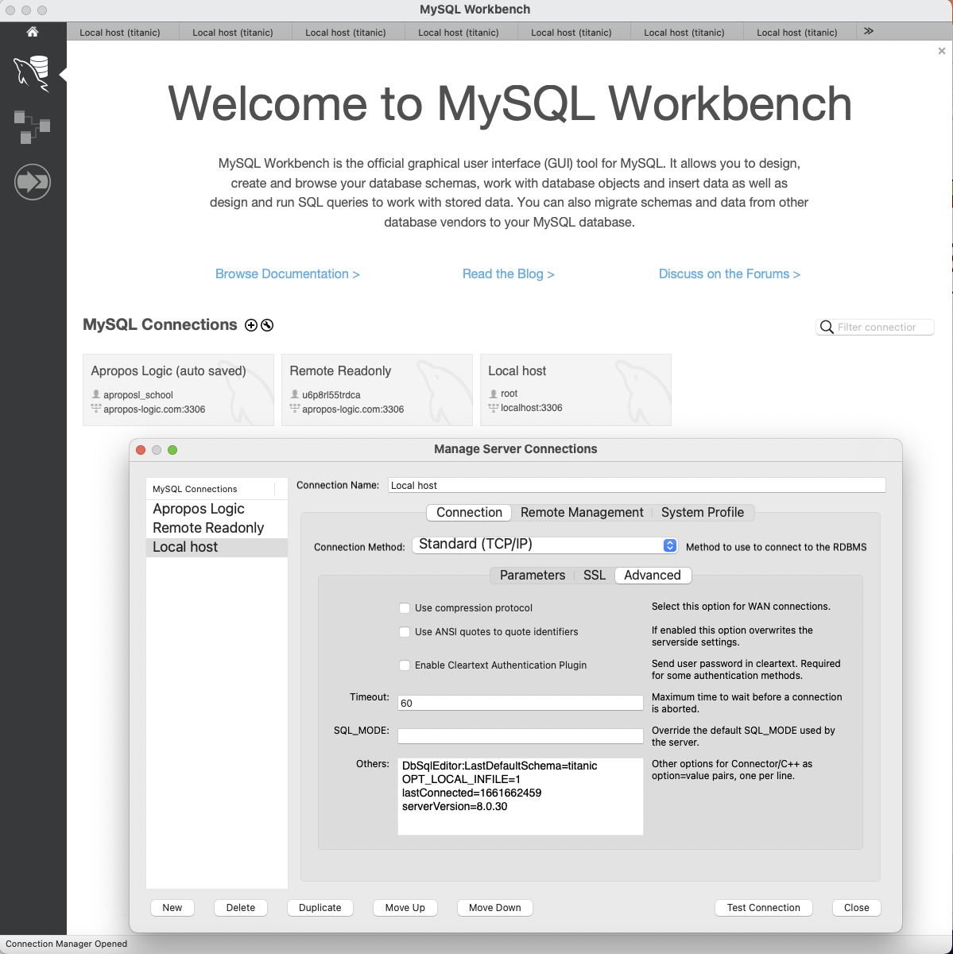
ETL CSV Data #2
Right-click to edit.
Select Advanced
Add OPT_LOCAL_INFILE=1

Slide 18
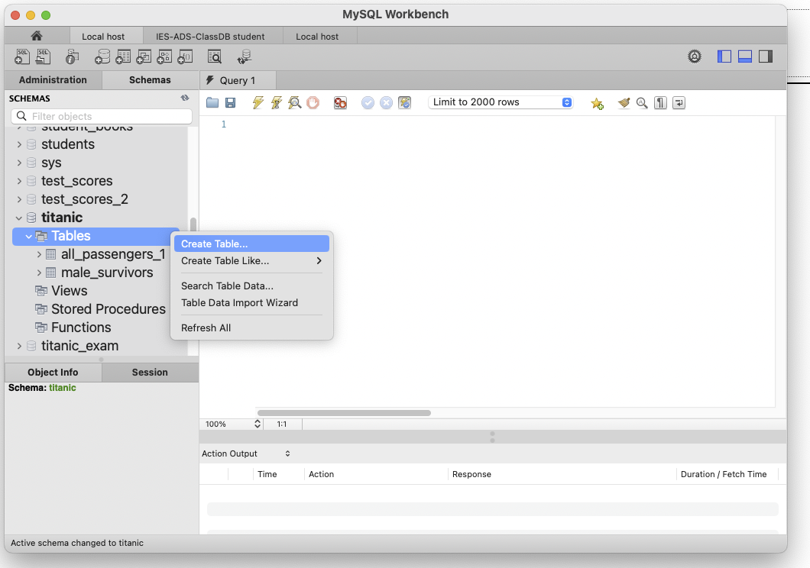
ETL CSV Data #2, cont’d

Slide 19
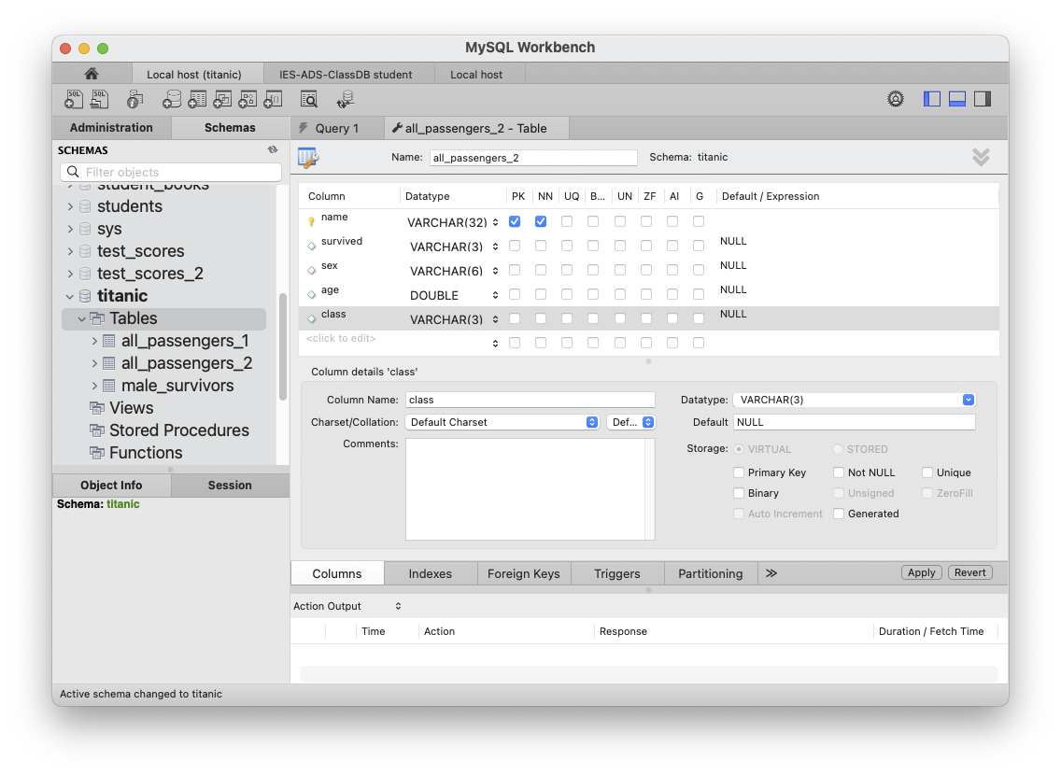
ETL CSV Data #2, cont’d

Slide 20
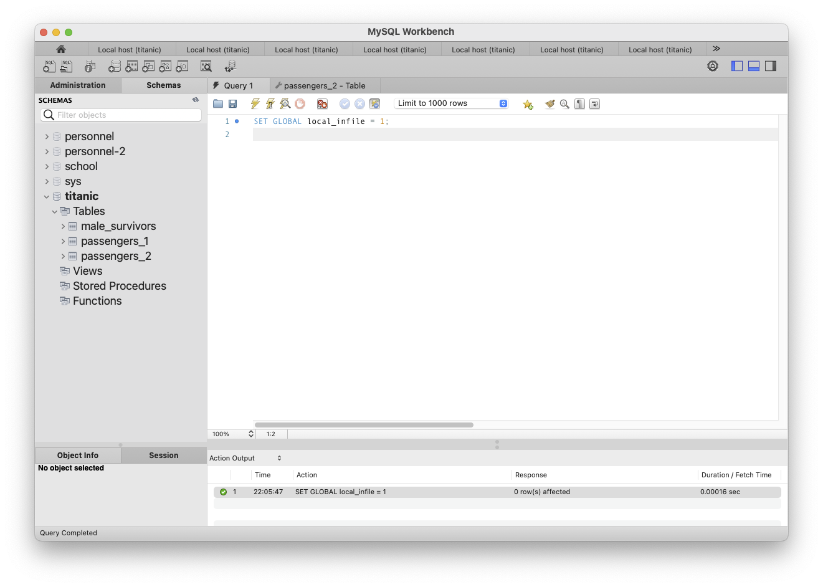
Load CSV Data #2, cont’d
SET GLOBAL local_infile = 1

Slide 21
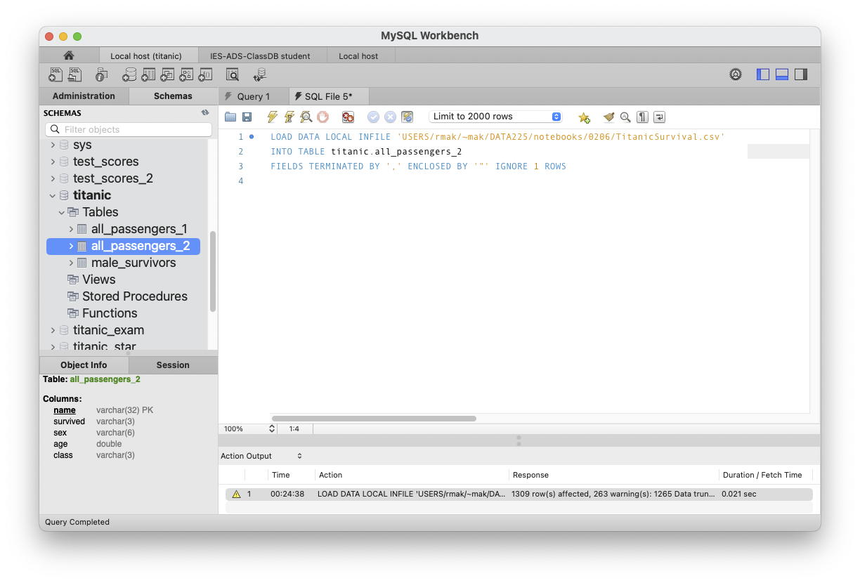
ETL CSV Data #2, cont’d
LOAD DATA LOCAL INFILE 'USERS/rmak/~mak/DATA201/notebooks/0130/TitanicSurvival.csv'
INTO TABLE titanic.all_passengers_2
FIELDS TERMINATED BY ',' ENCLOSED BY '"' IGNORE 1 ROWS
Because we declared field age to
have datatype double, the 263 rows
with NA for age had age set to 0.
Many LOAD DATA options: https://dev.mysql.com/doc/refman/8.4/en/load-data.html

Slide 22
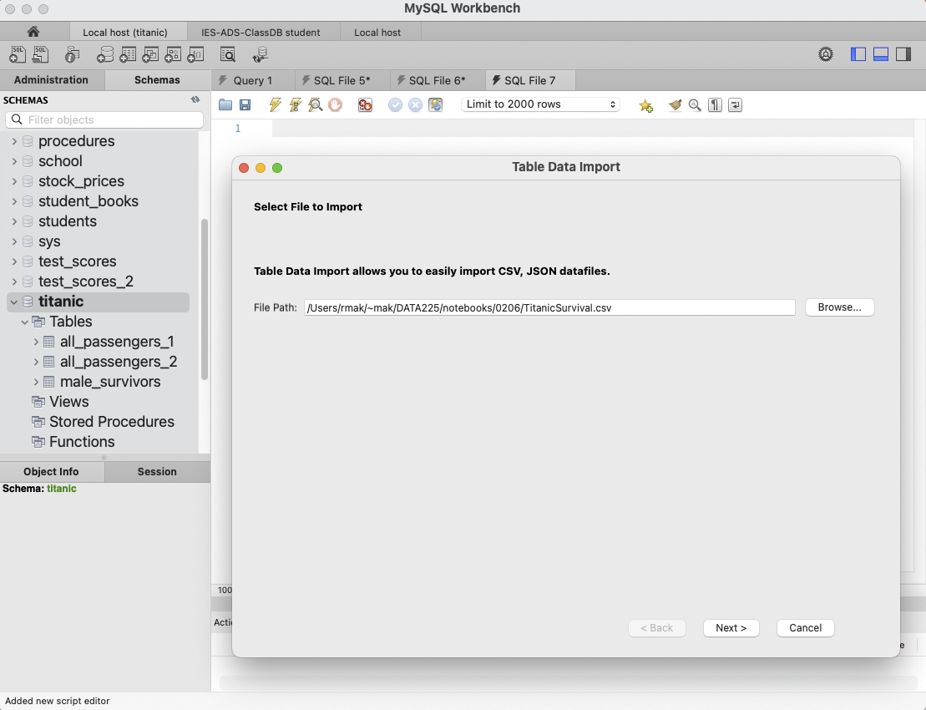
ETL CSV Data #3
Right-click titanic and select
Table Data Import Wizard

Slide 23
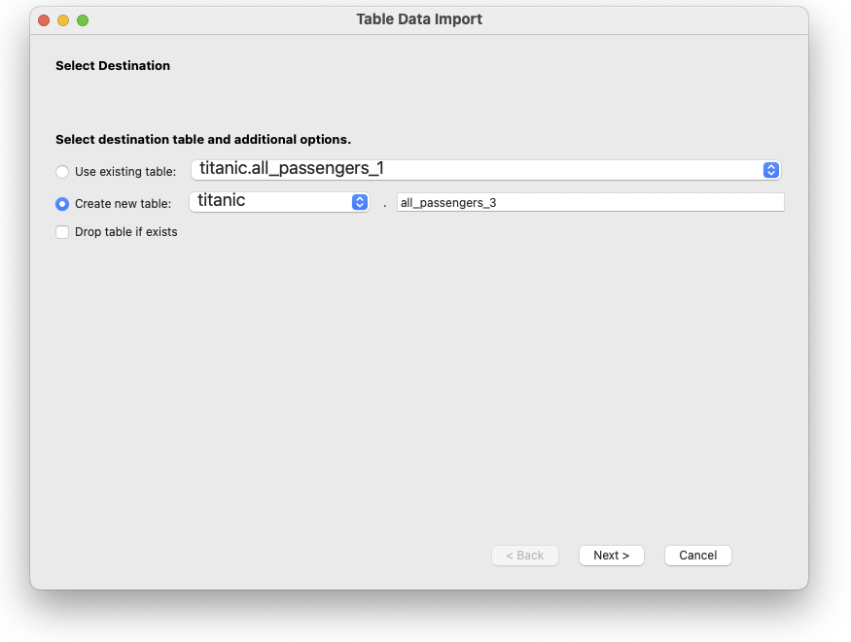
ETL CSV Data #3, cont’d

Slide 24
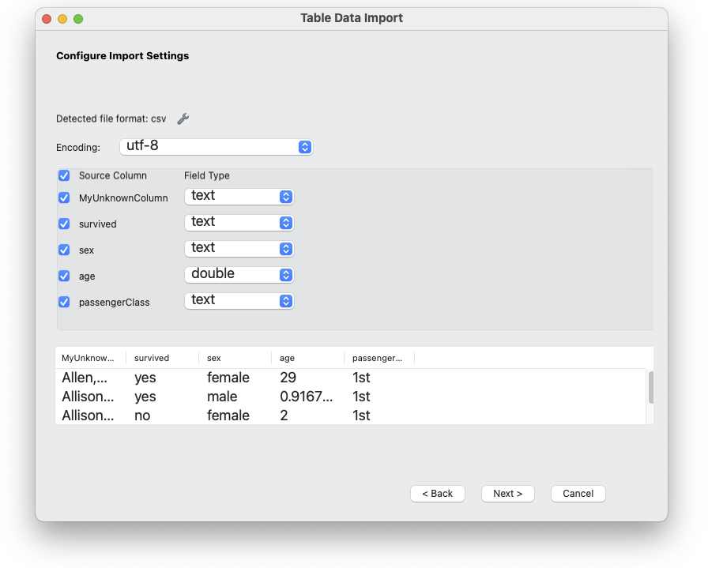
ETL CSV Data #3, cont’d

Slide 25
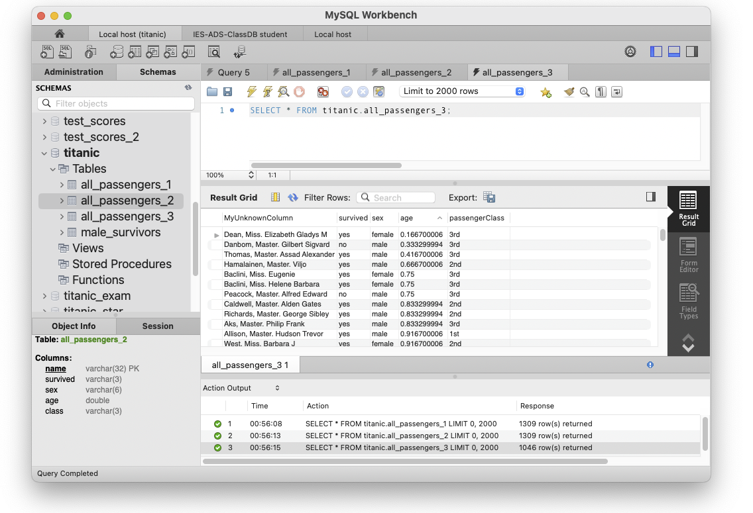
ETL CSV Data #3, cont’d
Apparently, the import wizard silently skipped the rows where age was NA. since we specified that age is double.

Slide 26
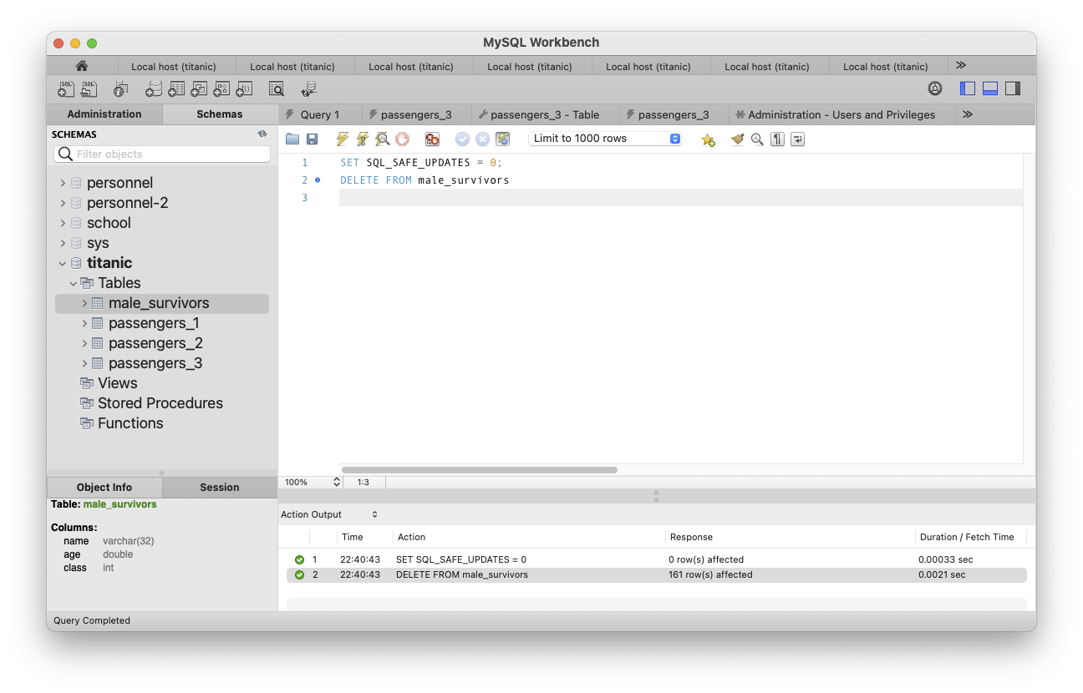
Delete Rows from a Table
SET SQL_SAFE_UPDATES = 0;
DELETE FROM male_survivors

Slide 27
Delete Rows from a Table, cont'd
You can delete only certain rows from a table:
SET SQL_SAFE_UPDATES = 0;
DELETE FROM all_passengers_2
WHERE age > 10

Slide 28
Delete Databases and Tables
The database world has its own vocabulary.
To delete (remove) a table:
To delete a database (AKA schema):
DROP TABLE employee
DROP TABLE IF EXISTS employee
DROP DATABASE school
DROP SCHEMA school
DROP DATABASE IF EXISTS school
DROP SCHEMA IF EXISTS school

Slide 29
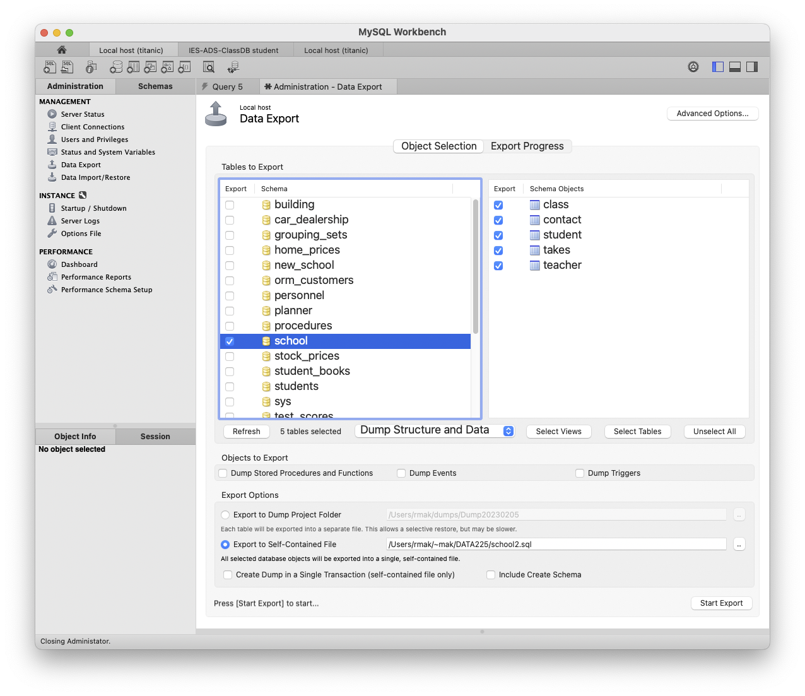
Export (Dump/Backup) a Database

Slide 30
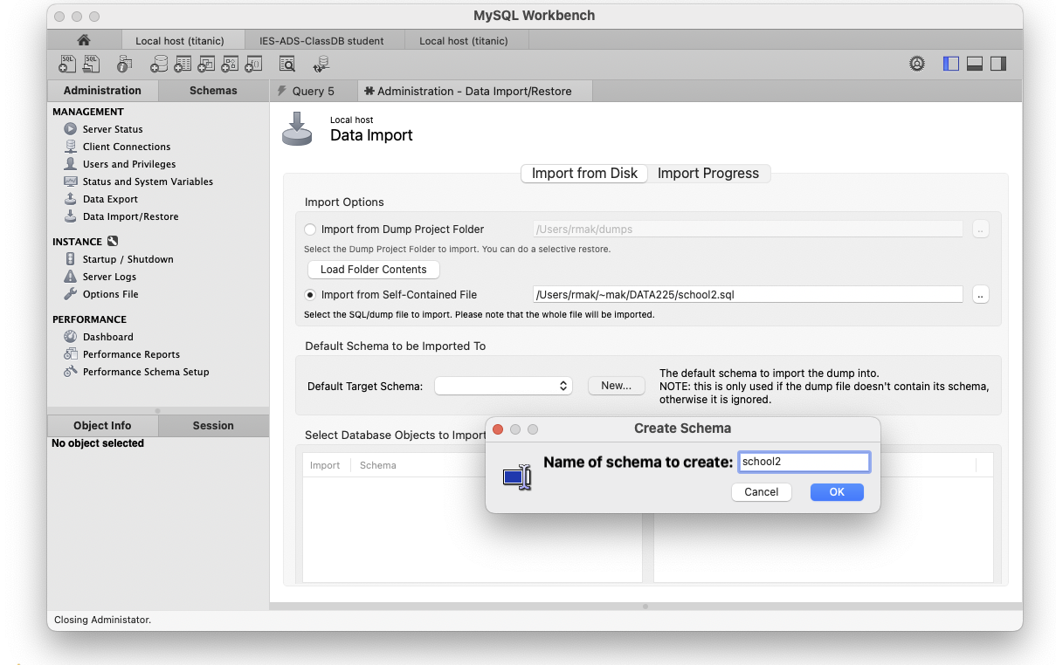
Import (Restore) a Database
This is how team members
can exchange databases.

Slide 31
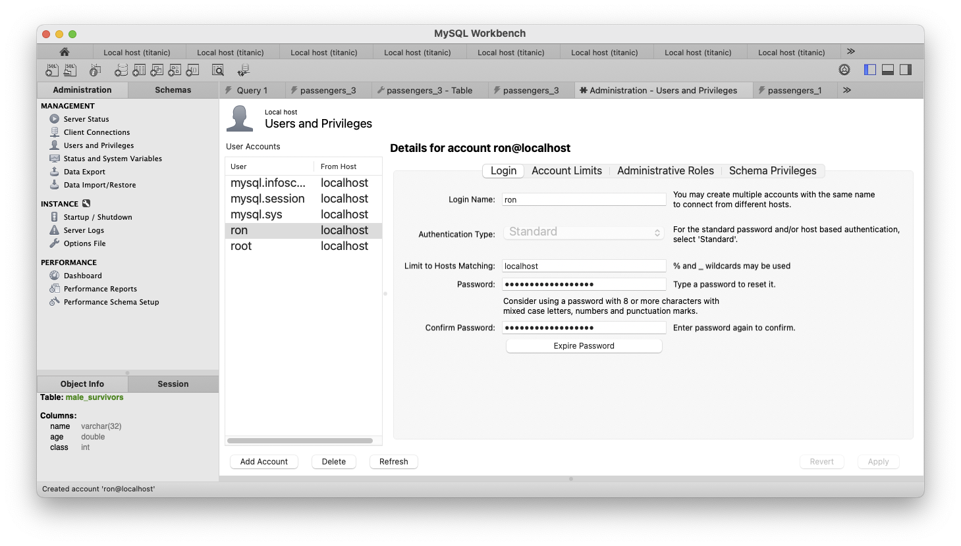
Create a User
Create a new user (account)
to the database server.
Then grant access privileges
to individual databases (schemas).

Slide 32
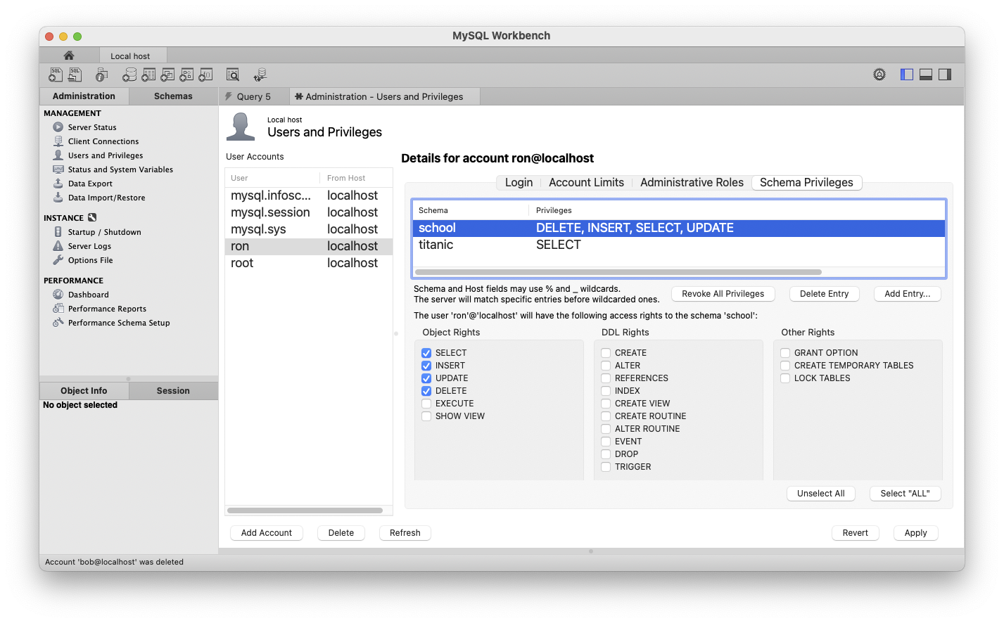
Create a User, cont’d

Slide 33
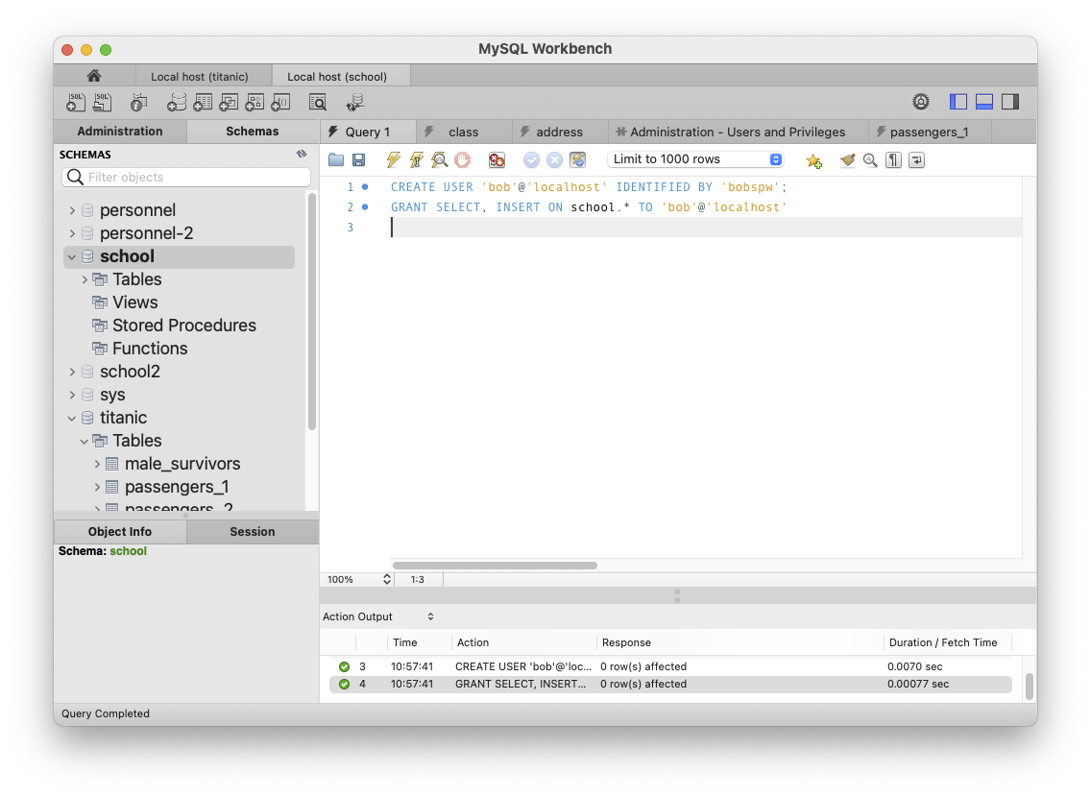
Create a User, cont’d
Create a user using SQL:
CREATE USER 'bob'@'localhost' IDENTIFIED BY 'bobspw';
GRANT SELECT, INSERT ON school.* TO 'bob'@'localhost'
Create a new user
to the database server.
Then grant access privileges
to individual databases.

Slide 34
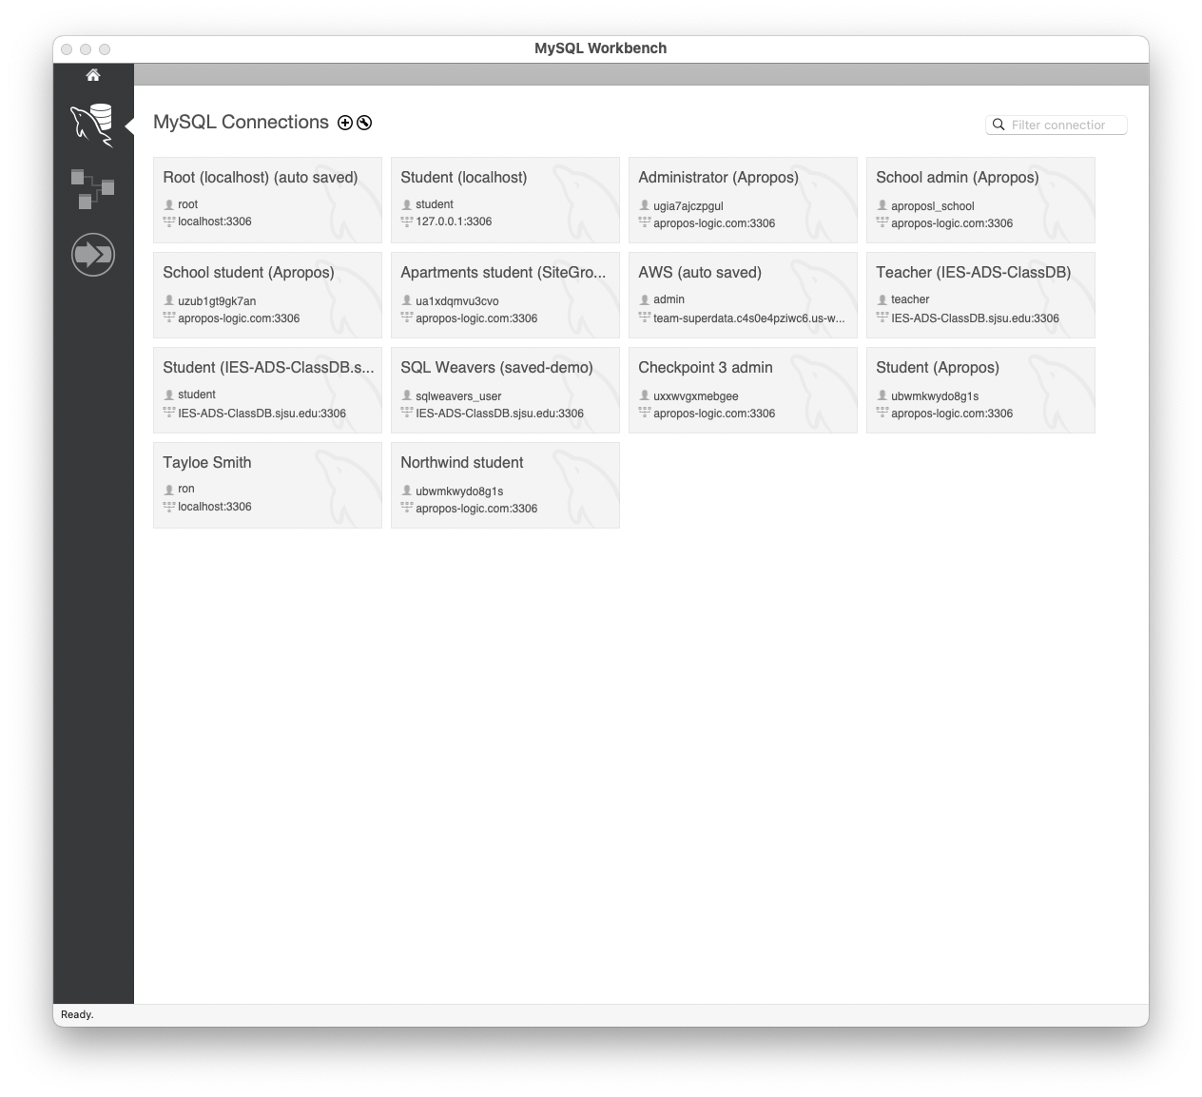
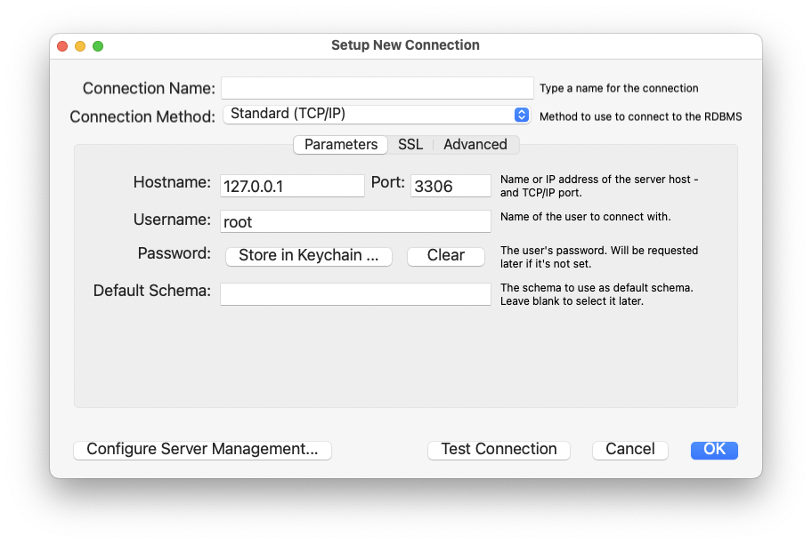
Create a User, cont’d
You can create a connection for the user.

Slide 35
The mysql Command in a Terminal Window
(base) ~/~mak/DATA201: mysql -u ron -p
Enter password:
Welcome to the MySQL monitor. Commands end with ; or \g.
Your MySQL connection id is 35
Server version: 8.0.30 MySQL Community Server - GPL
mysql> show databases;
+--------------------+
| Database |
+--------------------+
| information_schema |
| performance_schema |
| school |
| titanic |
+--------------------+
4 rows in set (0.00 sec)
mysql> use school
Database changed
mysql>
User ron can only see the
databases that he can access.

Slide 36
The mysql Command, cont’d
mysql> show tables;
+------------------+
| Tables_in_school |
+------------------+
| class |
| contact |
| student |
| takes |
| teacher |
+------------------+
mysql> SELECT first, last
-> FROM teacher
-> JOIN class
-> ON class.teacher_id = teacher.id
-> WHERE subject = 'Data Mining';
+-------+------+
| first | last |
+-------+------+
| John | Lane |
+-------+------+
1 row in set (0.01 sec)
mysql>

Slide 37
The mysql Command, cont’d
To run the LOAD command:
mysql> SET GLOBAL local_infile = 1;
Query OK, 0 rows affected (0.00 sec)
mysql> use titanic
Database changed
mysql> LOAD DATA LOCAL INFILE 'TitanicSurvival.csv'
-> INTO TABLE titanic.all_passengers_2
-> FIELDS TERMINATED BY ',' ENCLOSED BY '"' IGNORE 1 ROWS;
Query OK, 1309 rows affected, 263 warnings (0.01 sec)
Records: 1309 Deleted: 0 Skipped: 0 Warnings: 263
mysql> quit
Bye
(base) ~/~mak/DATA201:

Slide 38
Break

Slide 39
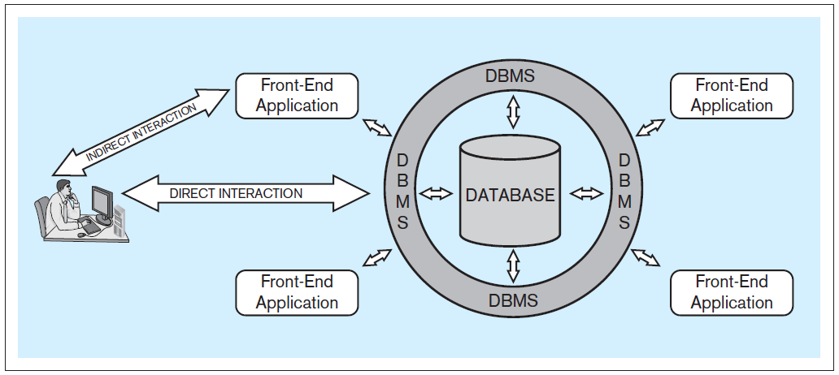
Database System Architecture
Database system: A computer-based system that enables efficient interaction between users and information stored in a database.
Database Systems
by Jukić, Vrbsky, & Nestorov
Pearson 2014
ISBN 978-0-13-257567-6

Slide 40
Client-Server Architecture
Local machine
localhost
network
MySQL
database server
Python
database
application
"""
SELECT *
FROM teacher
"""
Databases
results
"""
SELECT *
FROM teacher
"""
Port 3306
MySQL
Workbench
"""
SELECT *
FROM teacher
"""
results
results
Terminal
running
mysql
client app
"""
SELECT *
FROM teacher
"""
Web apps
"""
SELECT *
FROM teacher
"""
Web
Browser
Apache
web server
results
Remote machine
IES-ADS-ClassDB.sjsu.edu

Slide 41
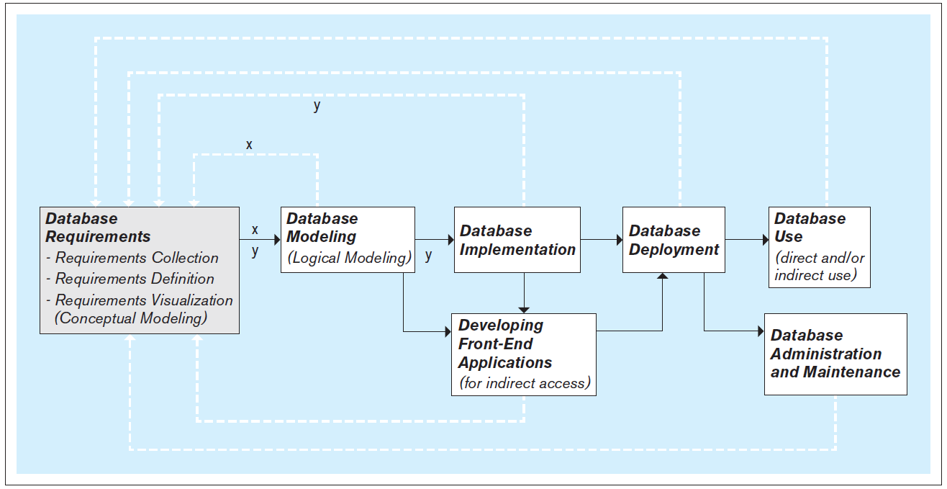
Steps to Develop a Database
It’s an iterative process!
Database Systems
by Jukić, Vrbsky, & Nestorov
Pearson 2014
ISBN 978-0-13-257567-6

Slide 42
Database Requirements
First and most critical step:
Collect, define, and visualize the requirements.
What data will the database hold and how?
What will be the capabilities and functionalities of the database?
Reliability, performance, and security issues?
Use the requirements to model and implement the database and to create the front-end applications.

Slide 43
Conceptual Database Model
Visualize the requirements.
Build a conceptual data model.
  Example: Entity-relationship (ER) modeling
  Draw ER diagrams.
Implementation independent:
No dependencies on the logic of a particular database management system.
  Example DBMS: Oracle, IBM DB2, MySQL, etc.
Blueprint for the logical model.

Slide 44
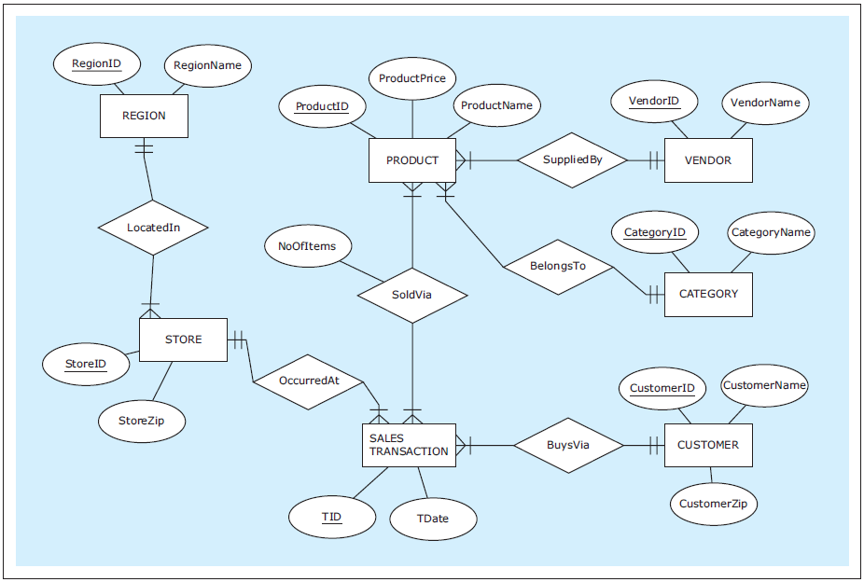
Example Conceptual Model: ER Diagram
Conceptual
model
Draw ER diagrams using the free tool at https://erdplus.com
Database Systems
by Jukić, Vrbsky, & Nestorov
Pearson 2014
ISBN 978-0-13-257567-6

Slide 45
Logical Database Model
Create the relational logical database model.
It’s usually straightforward to map
an ER diagram to a relational model.

Slide 46
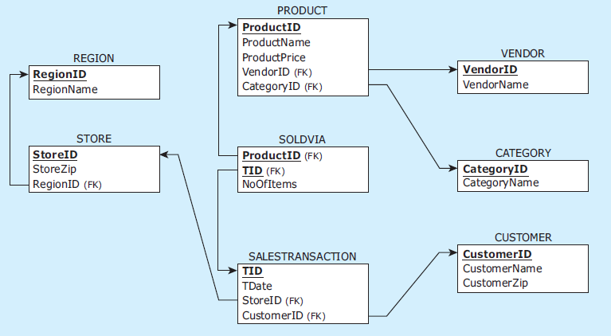
Example Logical Model: Map ER Diagrams to Tables
Logical
model
Database Systems
by Jukić, Vrbsky, & Nestorov
Pearson 2014
ISBN 978-0-13-257567-6

Slide 47
Physical Database Model
The physical model is the actual
database implementation.
Use relational DBMS (RDBMS) software.
SQL commands to create, delete, modify, and query database structures.

Slide 48
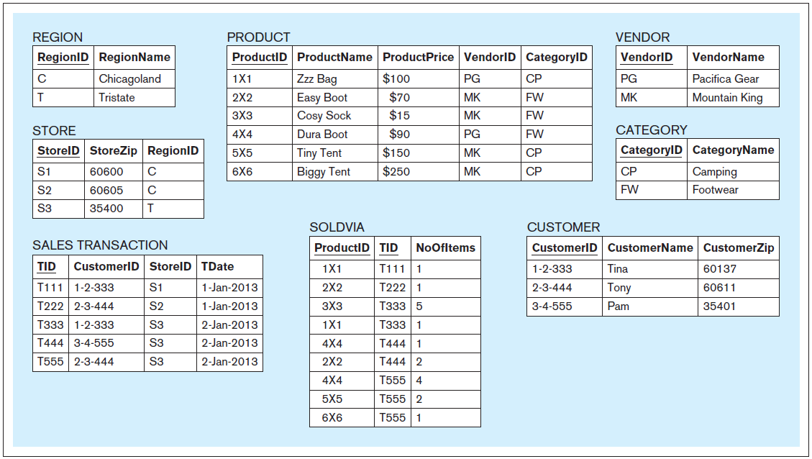
Example Physical Model
Physical
model
Database Systems
by Jukić, Vrbsky, & Nestorov
Pearson 2014
ISBN 978-0-13-257567-6

Slide 49
Front-End Application Development
End users generally do not access the database directly.
Front-end applications
  Access the database directly.
  Provide end users with safe application-oriented interfaces to query and manipulate the data.
  Fulfill the end user’s requirements.

Slide 50
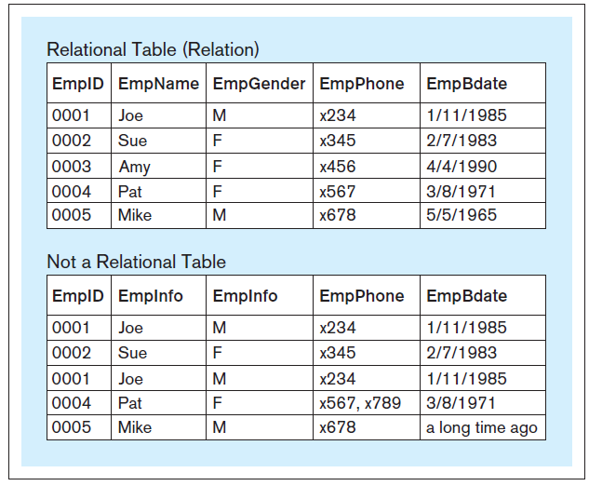
Table Structure in a Relational Database
Within a table of a relational database:
  Each column must have a unique name.
  All the values in each column must have the same datatype (e.g., all integers, all text, etc.)
  Each row must be unique.
  Within each row, each
  value in each column
  must be single-valued.
  Row order and column
  order are irrelevant.
X
A table in a relational database
is also called a “relation”.
Database Systems
by Jukić, Vrbsky, & Nestorov
Pearson 2014
ISBN 978-0-13-257567-6

Slide 51
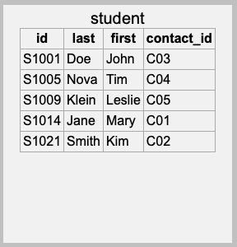
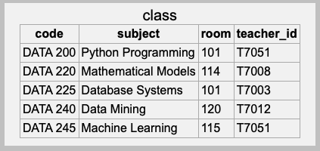
Primary Key
Each table must have a primary key.
  A column or set of columns whose value
  uniquely identifies each row.
Primary key
Primary key

Slide 52
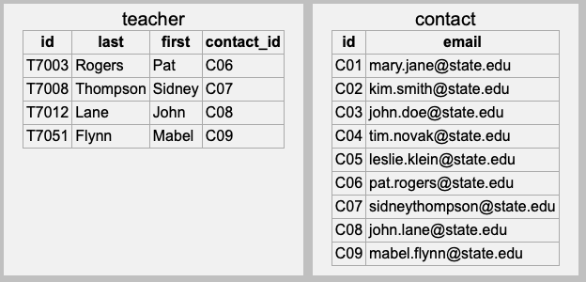
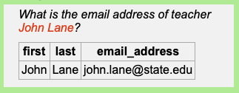
Foreign Keys
A table can have one or more columns of foreign keys that each refers to another table.
  A foreign key value is equal to the primary key value
  of a row in the other table.
This is how the database
solves an address query!
Foreign key
Primary key

Slide 53
One-to-One (1:1) Relationship
This is known as a one-to-one relationship.
  Also written 1:1.
  One row of the first table relates to one row
  of the second table.
Foreign key
Primary key

Slide 54
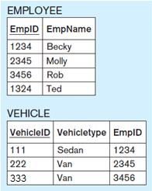
One-to-One Relationship, cont’d
In a 1:1 relationship, either table can have the foreign key to the other table.
A table can have multiple foreign key columns that each relates to a different other table.
Table VEHICLE
has the foreign key.
Molly has Van 222.
Database Systems
by Jukić, Vrbsky, & Nestorov
Pearson 2014
ISBN 978-0-13-257567-6

Slide 55
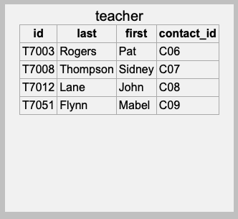
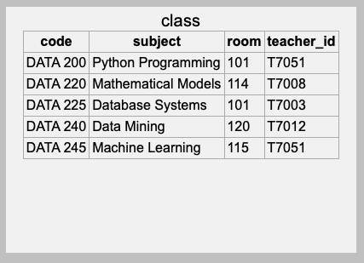
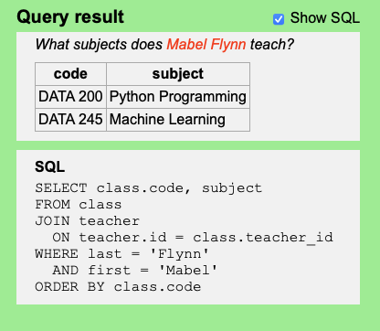
One-to-Many (1:M) Relationship
In a one-to-many relationship, one row of a table can be related to many rows of another table.
  Here, “many” means “zero, one, or more”.
Foreign key
One teacher can teach
many classes.

Slide 56
One-to-Many (1:M) Relationship, cont’d
In a one-to-many relationship, the foreign key must be in the table on the “many” side.
In the example below, why can’t the teacher table
contain the foreign key to the class table?
Foreign key
One teacher can teach
many classes.

Slide 57
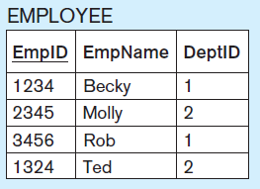
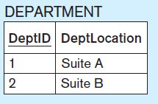
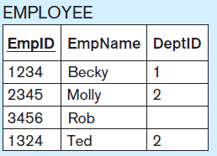
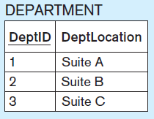
One-to-Many (1:M) Relationship, cont’d
Each department (1) can have
many employees (M).
Optional participation on the 1 side.
Rob does not belong to any department.
Optional participation on the M side.
(Can you see it?)
Department 3 has no employees.

Slide 58
Many-to-Many (M:N) Relationship
In a many-to-many relationship, one row of the first table can be related to many rows of the second table. Conversely, one row of the second table can be related to many rows of the first table.
  Remember that “many” means “zero, one, or more”.
Our example school database allows one student (from the student table) to take many classes (from the class table). Also, one class can be taken by many students.

Slide 59
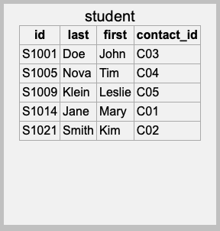
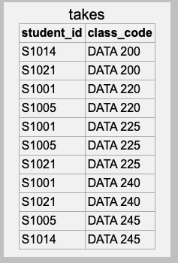
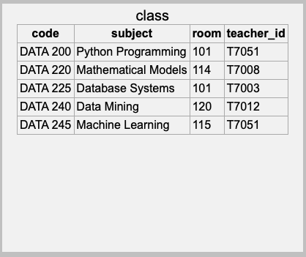
Many-to-Many (M:N) Relationship, cont’d
A M:N relationship requires an intermediary linking table.
  The linking table has two foreign key columns,
  one for each table of the relationship.
The two foreign key columns
of the linking table together also
constitute the linking table’s
primary key.
Linking table

Slide 60
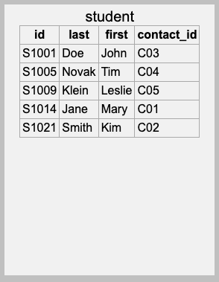
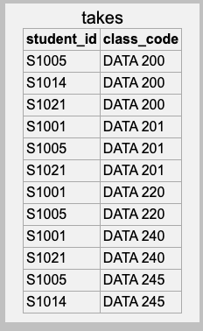
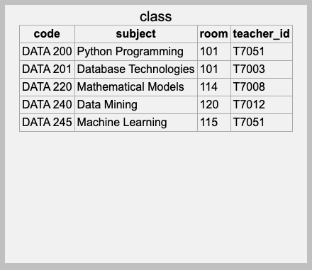
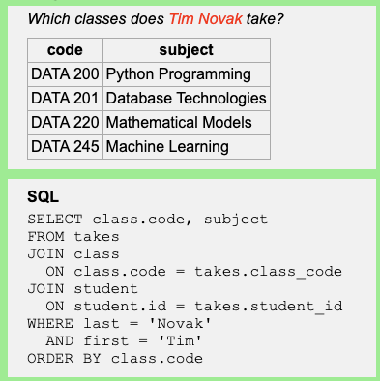
Many-to-Many (M:N) Relationship, cont’d
One student takes
many classes.

Slide 61
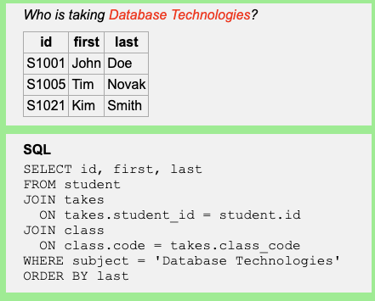
Many-to-Many (M:N) Relationship, cont’d
One class is taken
by many students.

Slide 62



Many-to-Many (M:N) Relationship, cont’d
To which organizations
does each student belong?
1111/Robin belongs to
O11/Student Hall/Charity and
to O41/Damen Hall/Sport.
Linking table
Who belongs to each
organization?
O11/Student Hall/Charity has 1111/Robin, 2222/Pat, and 3333/Jami belonging to it.
Optional participation on both sides.
Abby does not belong to any organization.
O50/Damen Hall/Politics has no student members.

Slide 63



Many-to-Many (M:N) Relationship, cont’d
Relationship with an attribute.
Column BELONGSTO.Function
1111/Robin belongs to O11/Student Hall/Charity as its President
and to O41/Damen Hall/Sport as a Member.
O11/Student Hall/Charity has 1111/Robin belonging to it as its President,
2222/Pat as its V.P., and 3333/Jami as a Member.

Slide 64
Assignment #2
Design and create database tables.
ETL from CSV files.
Perform queries.
Team assignment

