Slide 1


DATA 201
Database Technologies for Data Analytics
January 23 Class Meeting
Department of Applied Data Science
San Jose State University
Spring 2025
Instructor: Ron Mak
www.cs.sjsu.edu/~mak

Slide 2
Contact Info
ron.mak@sjsu.edu
Office hours
  Tu Th 4:30 – 5:30 PM in Clark Hall CL 325
Website
  Faculty webpage: http://www.cs.sjsu.edu/~mak/
  Class webpage: http://www.cs.sjsu.edu/~mak/DATA201/
  Syllabus
  Lecture notes
  Example code
  Assignments

Slide 3

Short Bio
Lecturer at San Jose State University since Spring 2008
  Department of Computer Science
  Department of Applied Data Science
  Department of Computer Engineering
  Engineering Extended Studies
Formerly
  Senior Scientist at the NASA Ames
  Research Center and JPL
  Research Staff Member
  IBM Research
  Software Strategist
  Lawrence Livermore National Lab
  Software developer, project lead,
  engineering manager, etc. at various Silicon Valley companies
http://www.cs.sjsu.edu/~mak/
Mission Control, Jet Propulsion Laboratory (JPL)
NASA Mars Exploration Rover Mission

Slide 4
Course Objectives
The primary goal of this class is to learn the fundamental technologies of databases for
performing data analytics.
Develop a significant data analytics application by the end of the semester.
You will gain important data management and project development skills that are valued by employers.

Slide 5
Course Objectives, cont’d
You will understand practical aspects of
data modeling, relational databases, SQL,
and object-relational mapping.
You will understand how to design and deploy operational databases for transactions and analytical databases for data analysis.
You will learn how to develop front-end standalone, notebook, and GUI-based Python applications with a back-end database.

Slide 6
Course Objectives, cont’d
You will learn how to extract, transform, and load (the ETL process) large datasets into a database.
  Design normalized tables with proper relationships.
  Perform “data wrangling”.
  Clean defective or missing data values.
You will also get an introduction to dimensional data modeling, data warehousing, and OLAP (online analytical processing).
  Subject of the new DATA 226 class.

Slide 7
Course Objectives, cont’d
Not course objectives:
  Deep expertise in any one topic
    It’s up to you do further research as necessary
    for your projects.
  Database theory
  Implementation of database management system (DBMS)
  Database administration (DBA) beyond the basics

Slide 8
Course Syllabus
See the syllabus for:
  course learning outcomes
  recommended books
  useful websites
  software to install
  team project
  exams and grading
  course schedule

Slide 9
Project Teams
Assignments will be done by
small project teams.
Form your own teams of 4 members each.
Choose your team members wisely!
  It’s important to gain experience working with others on a team project.
  Be sure you’ll be able to meet and communicate
  with each other and work together well.
  No moving from team to team.

Slide 10
Project Teams, cont’d
Each team member will receive the same score on each team assignment and team project.
Submit your team information to Canvas
(under “Assignments/Miscellaneous”)
by Wednesday, January 29 at 8:00 PM:
  Your team name.
  A list of team members, student IDs,
  and email addresses.
  cc all team members in an email to ron.mak@sjsu.edu
Only one student per team needs to submit and email team information.

Slide 11
Team Semester Project
A significant Python application that accesses
a database to perform data analytics
  GUI-based
  more details about the project during the semester
Possible data sources
  actual experimental data
  data downloaded from the internet
  fake but realistic data created by data generation tools such as mockeroo

Slide 12
Team Semester Project, cont’d
Each project team will give an oral presentation and demo at the end of the semester.
  The rest of the class will participate in grading the oral presentation.
Written report

Slide 13
Individual Responsibilities
  You are personally responsible for participating
  and contributing to your team’s work, and for
  understanding each part of the work for every
  assignment whether or not you worked on that part.

Slide 14
Postmortem Assessment Report
At the end of the semester, each student will individually turn in a short (one page) report:
  A brief description of what you learned in the course.
  An assessment of your personal accomplishments
  for your project team.
  An assessment of each of your project team members.
This report will be seen only by the instructor.
  Assessments by your team members can move your class grade up or down.

Slide 15
Final Individual Class Grade
Your final class grade will be adjusted
up or down depending on your
level and quality of participation,
as determined by project tracking tools
and your teammates’ postmortem reports.
30% checkpoint
exams 1, 2, 3
30% assignments
40% project
This class is CR/NC.
You must score at least 75% for CR.
During the semester, keep track of your progress in Canvas.

Slide 16
Participation is Important!
Can move your final grade up or down,
especially in borderline cases.
Participation in your team.
  As reported by team members during the semester.
  As reported by the postmortem assessment reports.

Slide 17
What is Data?
Recorded facts that are accessible.
Facts can appear in different formats.
  text
  numbers
  figures
  graphs
  images
  audio/video recordings

Slide 18
Structured vs. Unstructured Data
Structured data is highly organized and formatted in a way to make it easy to access and search.
Unstructured data is everything else!
  Printed and written text
  Social media data (e.g., tweets)
  Audio, video, satellite imagery
  etc.
There’s a lot more
unstructured data
than structured data
in the world.

Slide 19
What is Information?
We access the data for some particular purpose.
  To learn something about the data.
  To make a decision based on what we learned.
We obtain useful information from a collection
of data by performing some activity, such as
  Search through the data.
  Process the data.
  Manipulate the data in some form or fashion.

Slide 20
What is a Database?
A structured collection of related data
stored on the computer.
Multiple people and programs can access
the data in a database simultaneously.
The database is a shared repository of data
in a format that is usable by multiple programs.
Tools to manage and manipulate the data.

Slide 21
Database Management System (DBMS)
A software system to create and maintain databases.
Enable programs and users to store, insert, update, retrieve, and delete data in databases.
Provide an application programming interface (API) for applications to access databases.
  We will use the Python database APIs.
Tools to manage the databases.

Slide 22
Types of DBMS
Relational
  It’s the most popular type of database in use today.
  We will primarily use the MySQL
  relational DBMS in this class.
  Others include IBM DB2, Oracle, ...
NoSQL
Object-oriented
Network
Hierarchical

Slide 23
Two Primary Use Cases of Databases
Operational database
Analytical database

Slide 24
Operational Database
Keep track of transactions and other data
when they arrive.
  Examples:
    Record sales as they occur
    Record scientific data from ongoing experiments
  Ad hoc lookups and updates by users
  Usually store only the most recent data
  OLTP: Online Transactional Processing
Most common use case
  Especially for commerce.

Slide 25
Analytical Database
Analyze stored data
  Examples:
    Compare this quarter’s sales vs. last quarter’s sales.
    Analyze the trend of results from a series of experiments performed over time.
  Accessed by data analysts
  OLAP: Online Analytical Processing
  Data mining
Large volumes of data
  Can store archived and historical data
  Data warehouse

Slide 26
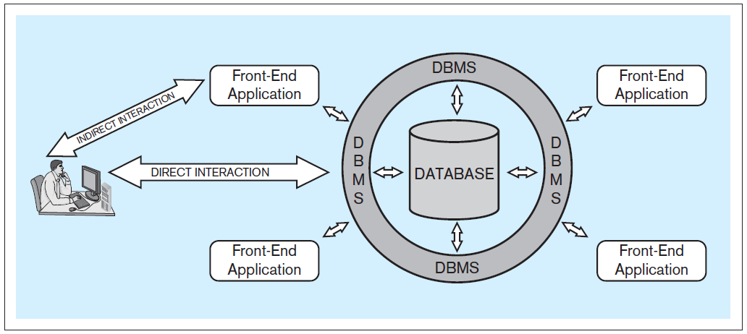
Database Application Architecture
A user can interact directly with a DBMS.
But more likely, the user interacts with a front-end application (such as a Python program) which in turn interacts directly with the DBMS.
Database Systems
by Jukić, Vrbsky, & Nestorov
Pearson 2014
ISBN 978-0-13-257567-6

Slide 27
Multiple Simultaneous Users
A DBMS can handle multiple simultaneous users and maintain data integrity.
  The DBMS prevents users and their applications from stepping on each other and corrupting the data.
Database Systems
by Jukić, Vrbsky, & Nestorov
Pearson 2014
ISBN 978-0-13-257567-6

Slide 28
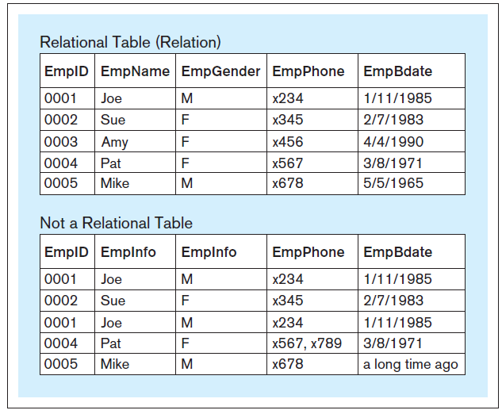
Table Structure in a Relational Database
Within a table of a relational database:
  Each column must have a unique name.
  All the values in each column must have the
  same datatype (e.g., all integers, all text, etc.)
  Each row must be unique.
  Within each row, each
  value in each column
  must be single-valued.
  Row order and column
  order are irrelevant.
A table in a relational database
is also called a “relation”.
Why not?
Database Systems
by Jukić, Vrbsky, & Nestorov
Pearson 2014
ISBN 978-0-13-257567-6

Slide 29
Introduction to Database Queries
Introduction to Database Queries
web-based application:
https://www.apropos-logic.com/dbclass/
I created this website with JavaScript,
PHP, SQL, HTML, CSS, and AJAX programming
(but not Python!).

Slide 30
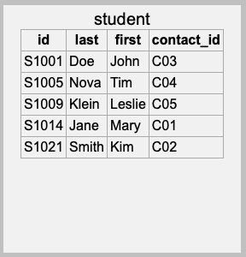
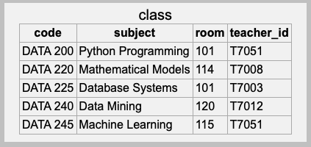
Primary Key
Each table must have a primary key.
  A column or set of columns whose value
  uniquely identifies each row.
Primary key
Primary key
Intro 1

Slide 31
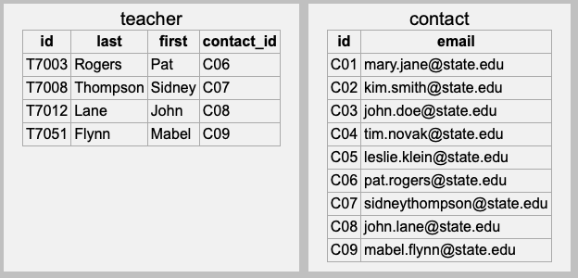
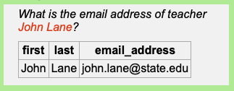
Foreign Keys
A table can have one or more columns of foreign keys that each refers to another table.
  A foreign key value is equal to the primary key value
  of a row in the other table.
Intro 2
This is how the database
solves an address query!
Foreign key
This is an example of a join of two tables.
Primary key

Slide 32
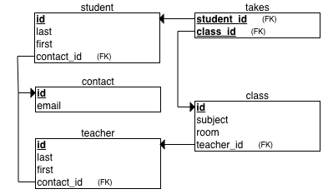
Primary Keys and Foreign Keys
Primary keys and foreign keys maintain the relationships among the tables of a database.
  They often are used by matching their values
  to perform a join of two tables.
  Joins can involve other table fields other than
  the primary and foreign keys.

Slide 33
Break

Slide 34
Introduction to SQL
SQL (Structured Query Language) is the industry-standard language to program a relational database. It consists of:
  Data Definition Language (DDL)
    Create and modify the tables.
  Data Manipulation Language (DML)
    Insert, modify, delete, and retrieve data.
  Data Control Language (DCL)
    Facilitate data access control.
  Transaction Control Language (TCL)
    Manage database transactions.

Slide 35
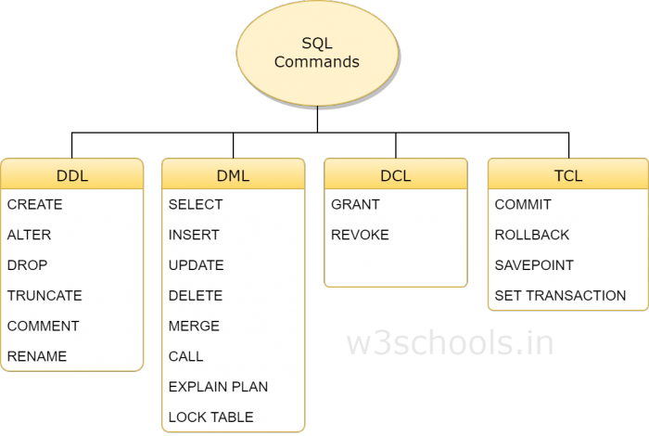
Introduction to SQL, cont’d
DDL: Data Definition Language
DML: Data Manipulation Language
DCL: Data Control Language
TCL: Transaction Control Language
We’ll start tonight with the SELECT command.
Then the INSERT, UPDATE, DELETE, CREATE, ALTER, and DROP commands.
Later, the GRANT, REVOKE, COMMIT, and ROLLBACK commands.
https://www.w3schools.in/mysql/ddl-dml-dcl/

Slide 36
The SQL Language
SQL (Structured Query Language) is unlike languages like Python, Java, or C++.
  You don’t explicitly specify the steps of an algorithm to access the database tables.
You specify what you want done, not how.
  The database server uses its SQL interpreter and the query optimizer to figure out the best way to accomplish the query.

Slide 37
SQL Syntax
SQL keywords are not case sensitive.
  For clarity and consistency, we will use all caps
  for SQL keywords (such as SELECT).
Table and column names
may be case sensitive.
  It depends on your computer’s operating system.
  The safest and most portable strategy is to use
  all lowercase for table and column names.

Slide 38
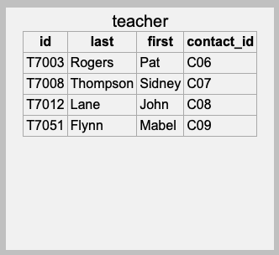
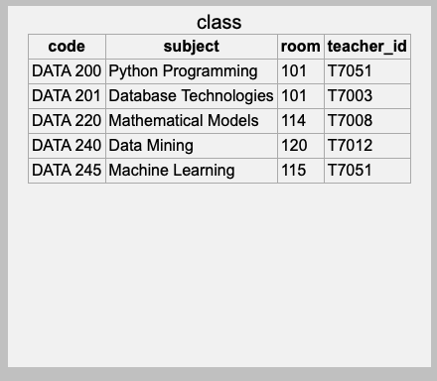
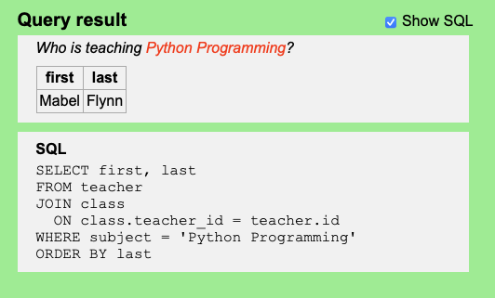
SQL Syntax, cont’d
An SQL statement can be written as
one long line of text.
  The first one or two words of a statement
  are the command keywords.
  For legibility reasons, SQL statements are
  usually written as multiple lines of text.
  Example:
In this SQL statement, the command keyword is SELECT. Other keywords in the statement are FROM, JOIN, ON, WHERE, ORDER, and BY.

Slide 39
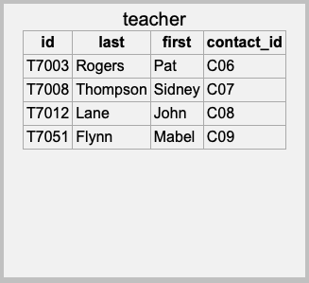
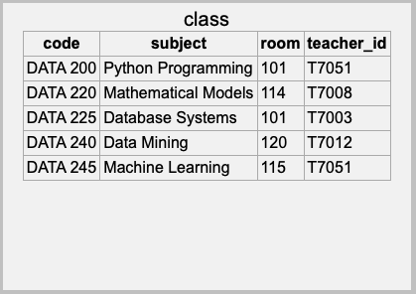
Table Join
To solve this query, we performed a join
of two tables, teacher and class.
The matching criteria is not limited to the primary and foreign keys.
Which column values to return.
Which tables to join.
Join condition.
Selection criteria.

Slide 40
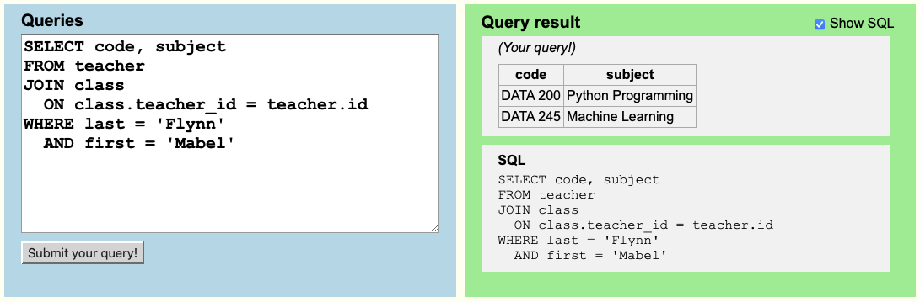
Write Your SQL Code
The Introduction to Database Queries web app allows you to type your own SQL code, execute it, and see what results you get.

Slide 41
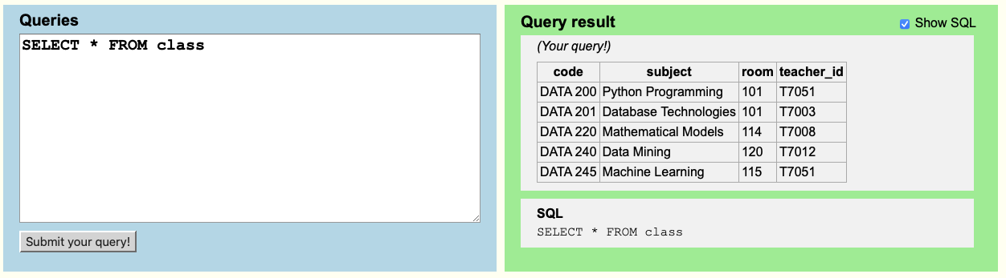
Display an Entire Table
All columns
Since there is no
selection criteria
(no WHERE clause),
all the rows are retrieved.

Slide 42
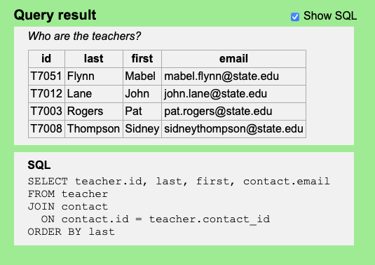
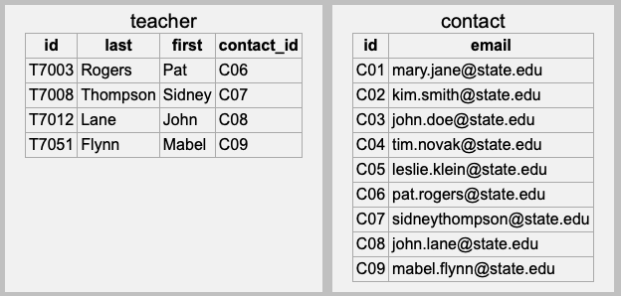
How a Query Works #1
Match each and every teacher with an email address. There is no WHERE clause with selection criteria.
We can always qualify a field name
with a table name even if it’s not
necessary. Doing so can make
things clearer:
teacher.contact_id
contact.id
Tables teacher and contact
each has a column named
id, so we must write
teacher.id to disambiguate.

Slide 43
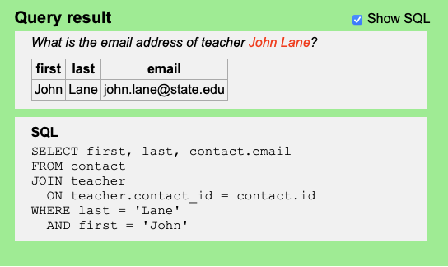
How a Query Works #2
Match a specific teacher with an email address. The WHERE clause provides selection criteria.
Match the last and first names
to select the correct row in the
teacher table.
From the selected teacher row,
match teacher.contact_id
to contact.id.

Slide 44
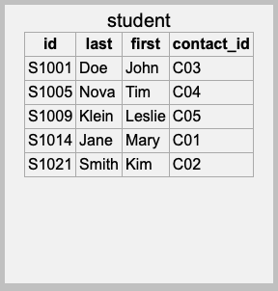
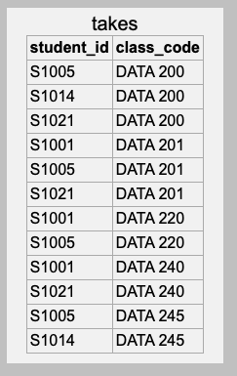
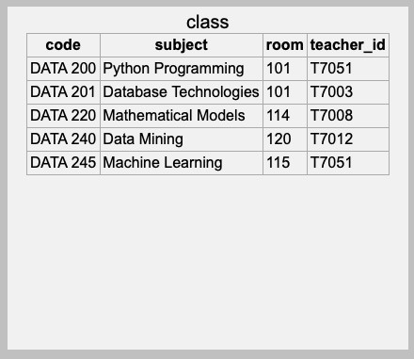
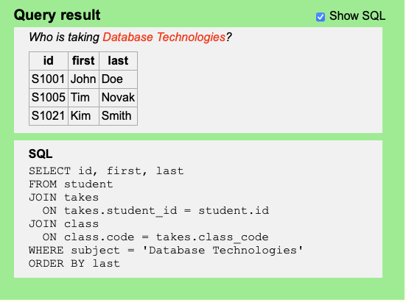
How a Query Works #3

Slide 45
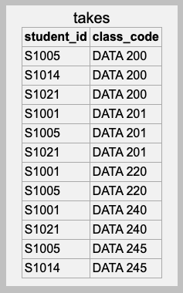
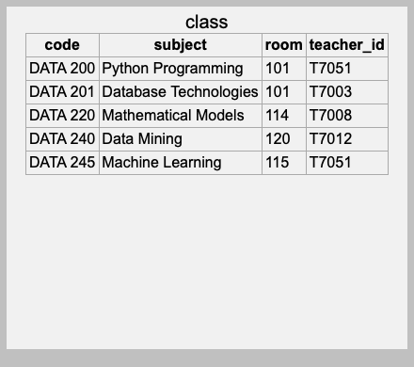
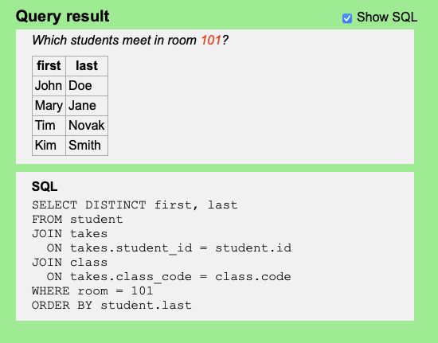
How a Query Works #4
Tim Novak and Kim Smith
will each show up twice!
That’s why we use
SELECT DISTINCT.

Slide 46
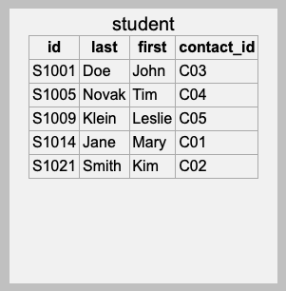
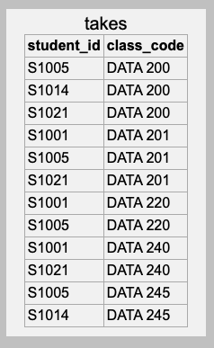
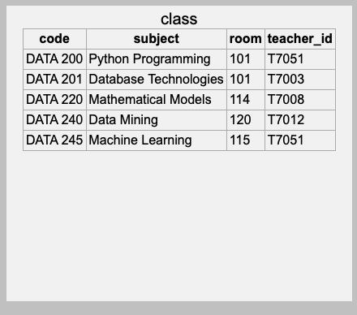
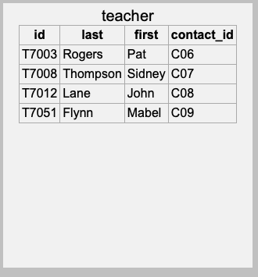
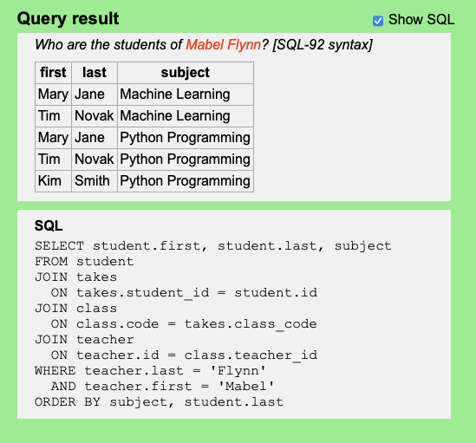
How a Query Works #5
Tim Novak and Mary Jane each matches twice!
Why don’t we need to use
SELECT DISTINCT this time?
ORDER BY subject, student.last
Sort the results first by subject,
then by the students’ last name.

Slide 47
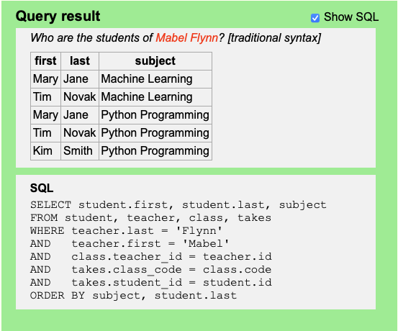
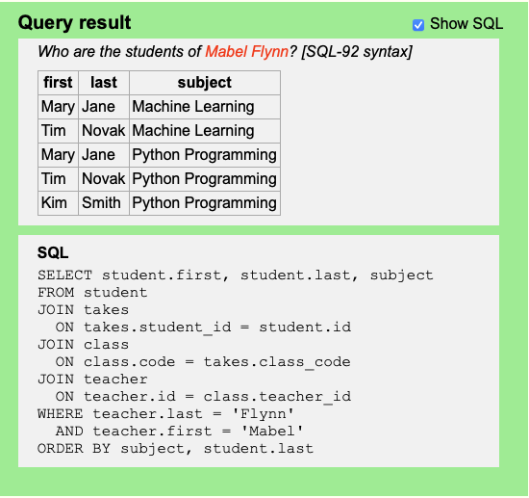
Traditional vs. Modern SQL Syntax
Traditional syntax
  Lists all the tables to be joined in the FROM clause.
  The WHERE clause includes all the join conditions and selection criteria.
  More prone to errors by programmers.
Modern SQL-92 syntax
  Each table JOIN listed explicitly with the corresponding join condition.
  Forces programmers to be more careful and make fewer errors.
Still used by many textbooks and old database programmers.
Better to use going forward!

Slide 48
Assignment #1: Install Software
Do this assignment individually.
  Due Thursday, January 30 at 5:30 PM
Your platform can be Windows or macOS.
Install Python.
Install the MySQL DBMS.
  The installation should include MySQL Workbench
  and the MySQL Connector/Python.
  Use password seekrit for the root password
See “Software to Install”
in the syllabus for some
installation instructions.

Slide 49
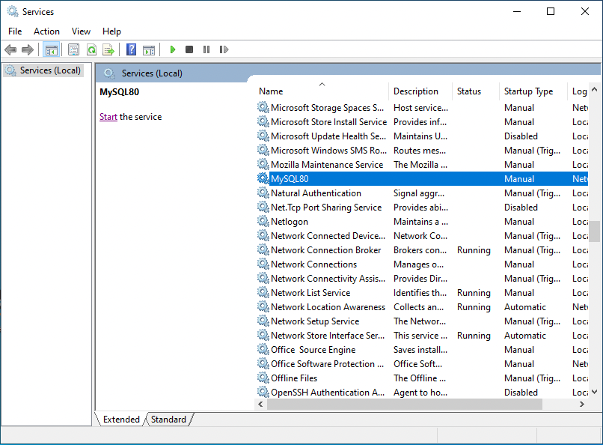
Assignment #1, cont’d
Start the MySQL DBMS on Windows.
  In the bottom left of your screen, enter and run services.msc.
  Find MySQL80
  and start it.

Slide 50
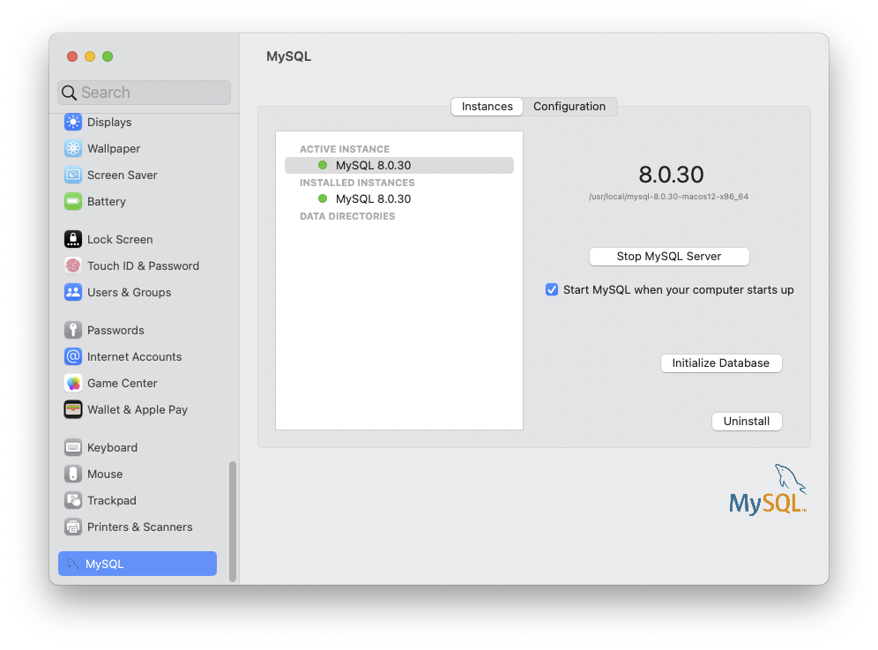
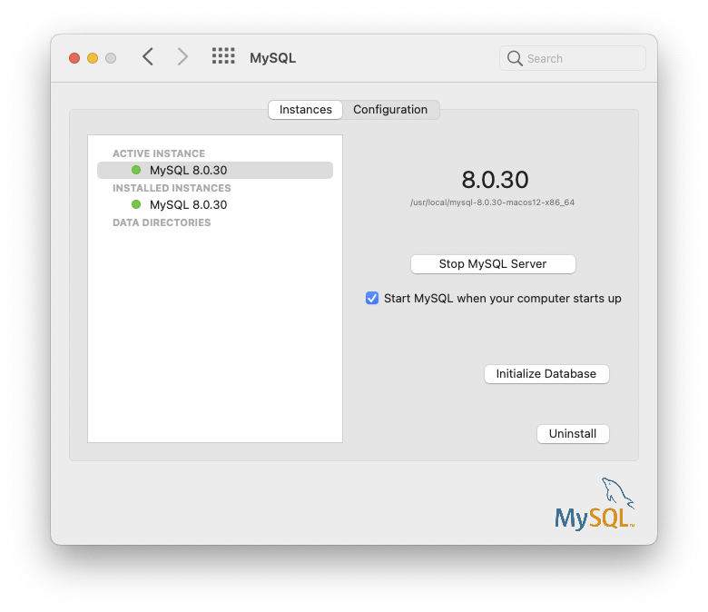
Assignment #1, cont’d
Start the MySQL DBMS
on the Mac.
  Open System Settings.
  Open MySQL and start it.

Slide 51
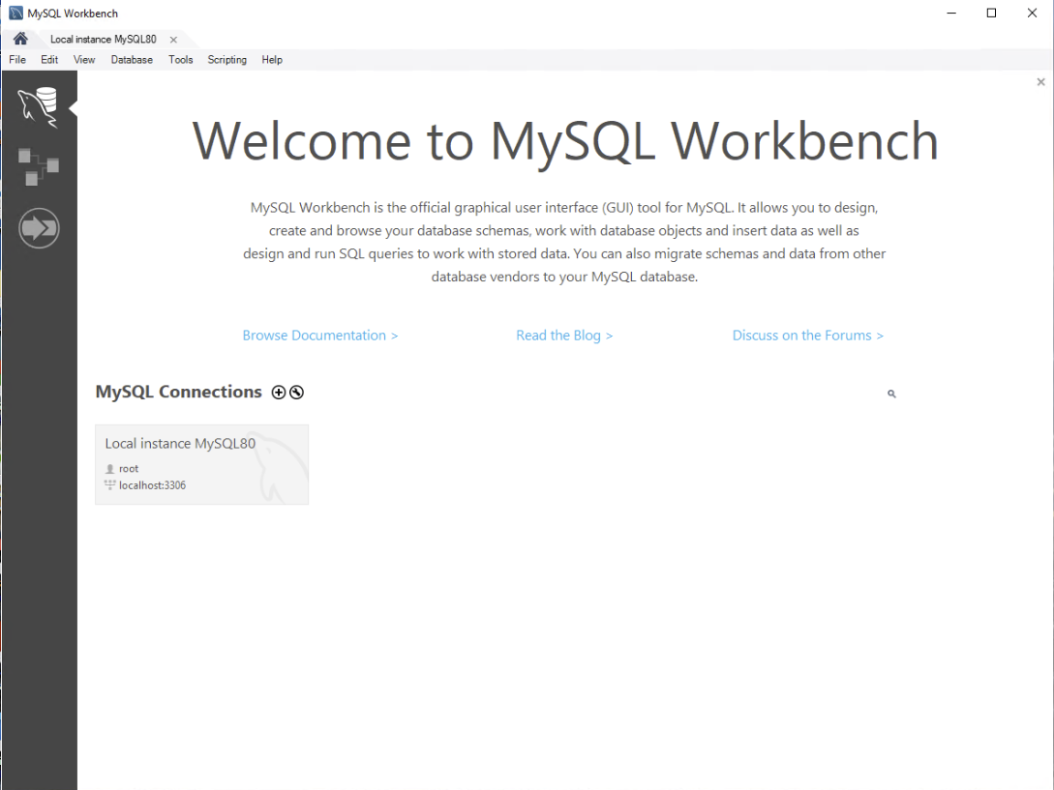
Assignment #1, cont’d
Install and start the MySQL Workbench tool.
  Click on the
  Local instance
  tab.

Slide 52
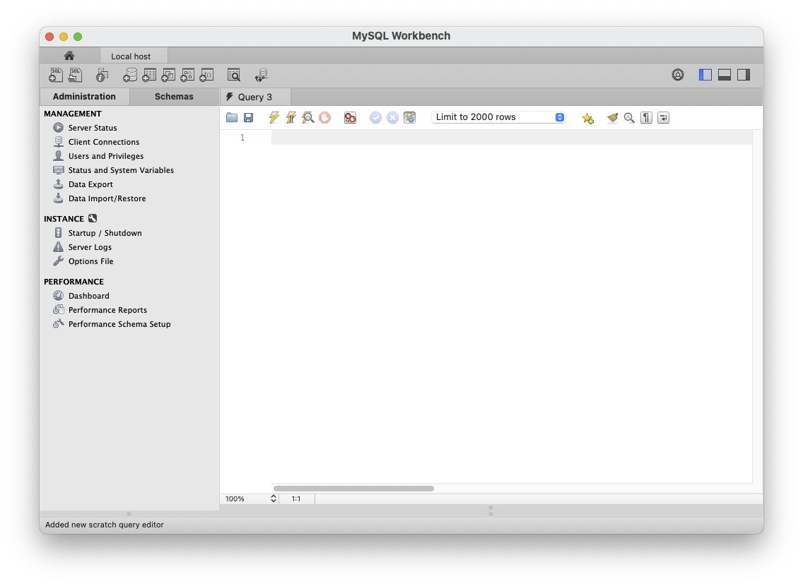
Assignment #1, cont’d
Click on Data Import/Restore

Slide 53
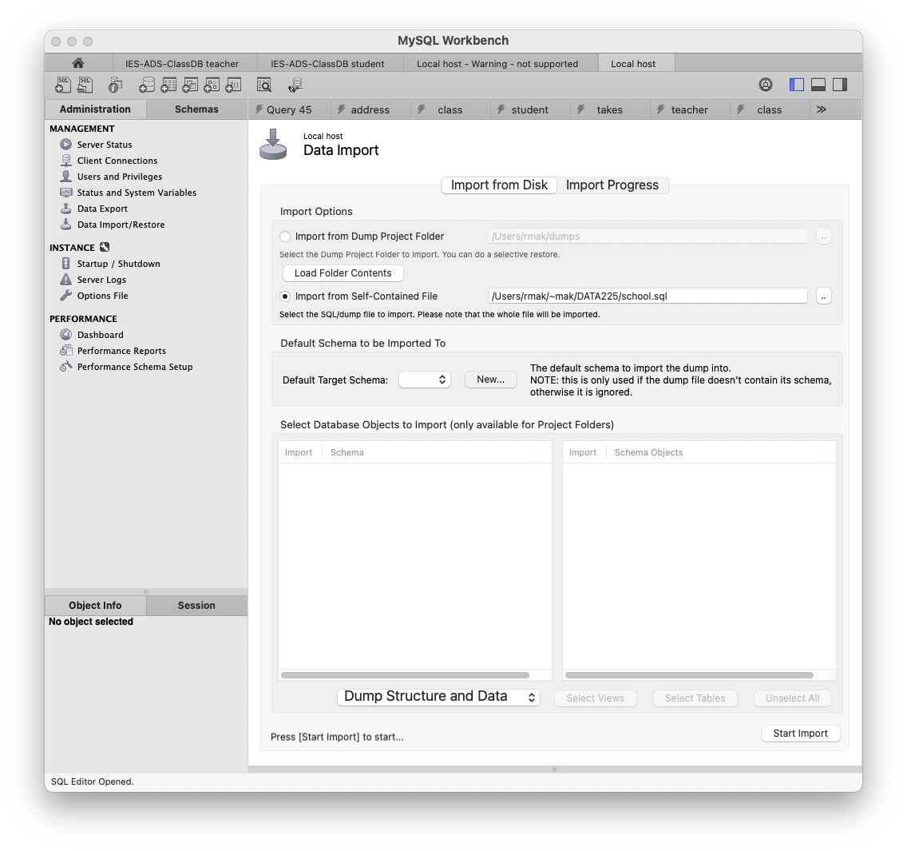
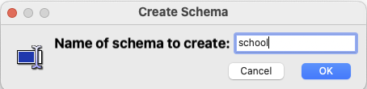
Assignment #1, cont’d
Load file
school.sql
into a new
schema
(database)
named
school.

Slide 54
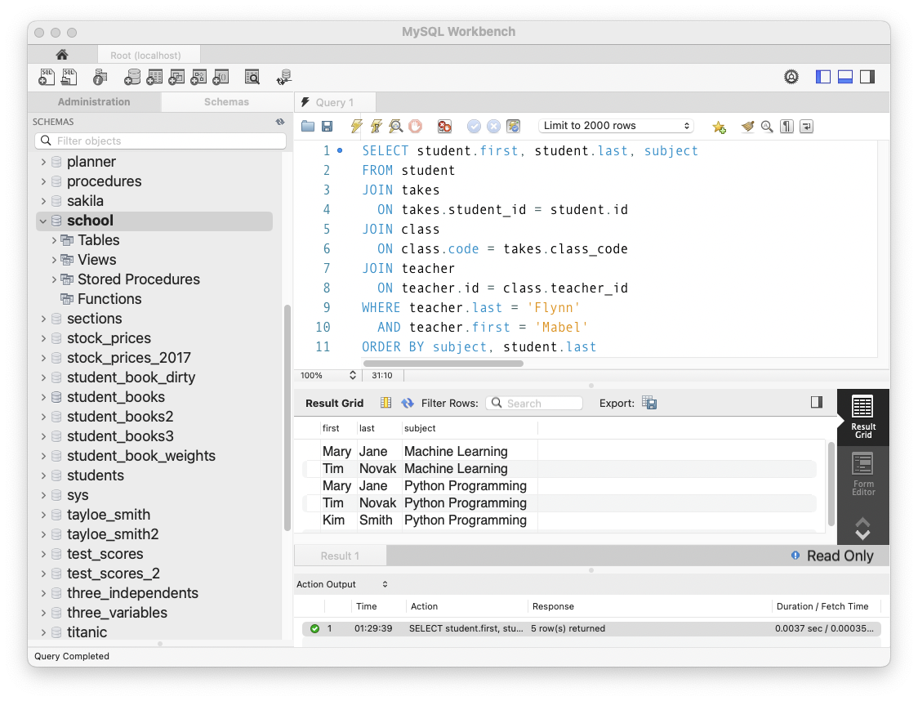
Assignment #1, cont’d
Go to the Schemas tab.
  Click the
  refresh button.
  Double-click on
  the school
  schema to make
  it the default.
  Type a query.
  Click the
  execute button.

Slide 55
Assignment #1, cont’d
Install the MySQL Connector/Python which enables a Python program to connect to a database and access its data.
You will be able to run a standalone Python program that connects to a database and queries its data.
You will also be able to run Python code in a notebook that connects to a database and queries its data.

Slide 56
Assignment #1, cont’d
What to submit for Assignment #1:
  A screenshot of MySQL Workbench that shows
    the school schema listed among the schemas
    an SQL query (make up one or copy one from the “Introduction to SQL Queries” website)
    the results of the query
  A screenshot or text file of executing Assignment1.py of the standalone Connection program in a terminal.
  A screenshot of the last three cells and their output from the notebook Assignment1.ipynb.

Slide 57
Reminder: By Wednesday, January 29
Form project teams.
Submit your team information to Canvas.
  team name
  team members and email addresses
  cc all team members in an email to ron.mak@sjsu.edu
Application demo

