Slide 1


DATA 200
Computational Programming for Analytics
May 9 Class Meeting
Department of Applied Data Science
San Jose State University
Spring 2024
Instructor: Ron Mak
www.cs.sjsu.edu/~mak

Slide 2
This Evening
Go over Quiz 0402 and Assignment #13
Generator expressions
Lambda expressions
Insertion sorting
The Quicksort algorithm
  “The most elegant algorithm in computer science.”
Break
Introduction to GUI programming with PyQt

Slide 3
This Evening, cont’d
Recursion
  reverse a list
  Towers of Hanoi
  binary search
Quiz

Slide 4
Creating a GUI for Python
Install and use Qt Designer.
  See https://www.pythonguis.com/installation/install-qt-designer-standalone/
  Latest version is 6.6.2.
  Create windows and dialogs.
  Add interactive input and display components.
  Works for Windows and Mac OS platforms.
Write event-driven Python code that reacts to user interactions with the GUI components.
  “Reversal of control”

Slide 5
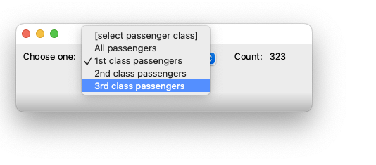
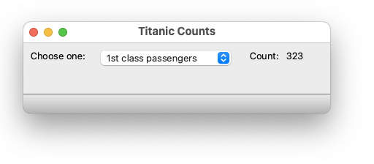
Example: “Titanic Counts” Application
An event occurs when the user chooses an item (which passenger class, or all passengers) from the drop-down menu.
In response, the event handler connected to the menu updates the passenger count.

Slide 6
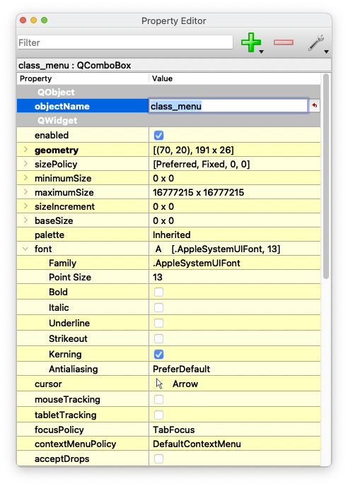
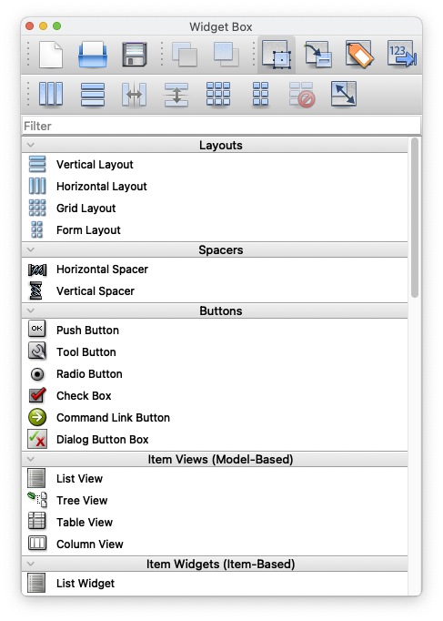
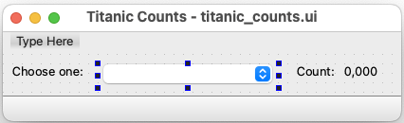
Use Qt Designer to Create the GUI
Remember the
names, such as
class_menu,
that you give to
the widgets.

Slide 7
Use Qt Designer to Create the GUI, cont’d
You can create windows and dialog boxes.
“Widgets” include labels, checkboxes, radio buttons, push buttons, menus, type-in text fields, tabbed panels, etc.
The output of Qt Designer is a .ui file that contains the GUI that you created:
  The names and layout of all the components.
Your Python application reads the .ui file and renders (displays) the components.

Slide 8
“Titanic Counts” Application, cont’d
titanic_counts.py
class TitanicCounts(QWindow):
def __init__(self):
"""
Load the UI and initialize its components.
"""
super().__init__()
self._passenger_df = pd.read_csv('TitanicSurvival.csv')
self.ui = uic.loadUi('titanic_counts.ui')
self._initialize_class_menu()
self.ui.count_text.setText('')
# Connect the event handler to the menu.
self.ui.class_menu.currentIndexChanged.connect(
self._update_count)
self.ui.show();

Slide 9
“Titanic Counts” Application, cont’d
titanic_counts.py
def _initialize_class_menu(self):
self.ui.class_menu.addItem('[select passenger class]', '')
self.ui.class_menu.addItem('All passengers', 'all')
self.ui.class_menu.addItem('1st class passengers', '1st')
self.ui.class_menu.addItem('2nd class passengers', '2nd')
self.ui.class_menu.addItem('3rd class passengers', '3rd')

Slide 10
“Titanic Counts” Application, cont’d
titanic_counts.py
def _update_count(self):
klass = self.ui.class_menu.currentData()
# Determine which passenger class.
if klass == '':
self.ui.count_text.setText('')
return
elif klass == 'all':
df = self._passenger_df
else:
df = self._passenger_df[
self._passenger_df.passengerClass == klass
]
row_count = len(df.index)
self.ui.count_text.setText(f'{row_count:,d}')

Slide 11
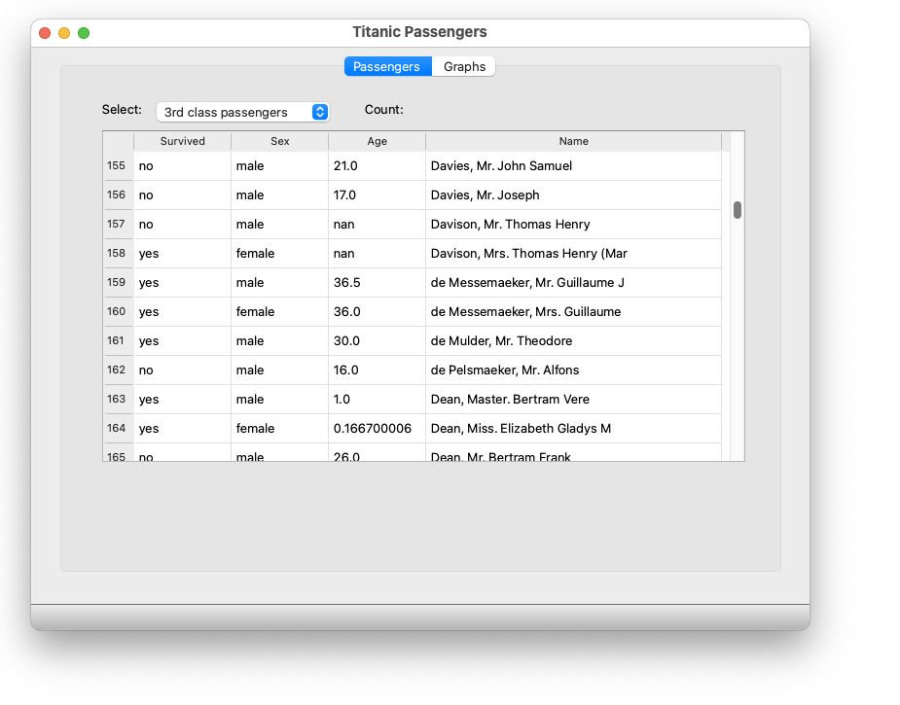
Example: “Titanic Passengers” Application

Slide 12
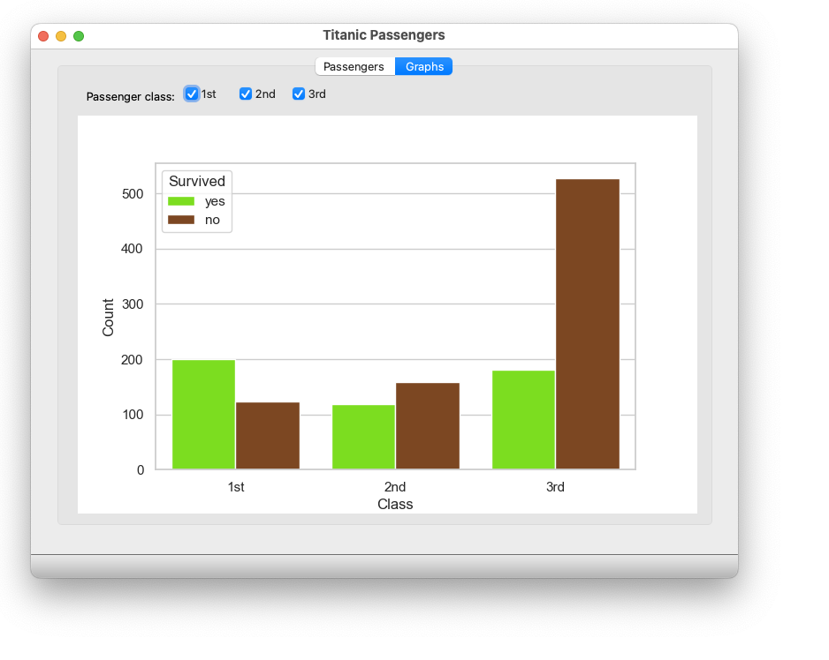
“Titanic Passengers” Application, cont’d

