Slide 1


CS 46B: Introduction to Data Structures
July 28 Class Meeting
Department of Computer Science
San Jose State University
Summer 2015
Instructor: Ron Mak
www.cs.sjsu.edu/~mak

Slide 2
Quizzes for July 30
Quiz 21 July 30 17.1
Quiz 22 July 30 17.2
Quiz 23 July 30 17.3

Slide 3
Hash Tables
Consider an array or an array list.
To access a value, you use an integer index.
  The array “maps” the index to a data value
  stored in the array.
We can consider the
index value to be the
“key” to obtaining the
corresponding data value.
  Key 2 maps to value 42.
2
0
12
“key”
1
5
2
42
3
91
4
0
5
57

Slide 4
Hash Tables, cont’d
As long as the index value is within range,
there is a strict one-to-one correspondence
between an index value and a stored data value.
2
0
12
“key”
1
5
2
42
3
91
4
0
5
57

Slide 5
Hash Tables, cont’d
A hash table also stores data values.
  Use a key to obtain the corresponding data value.
The key does not have to be an integer value.
  For example, the key could be a string.
Every Java object has a hash code.
  The hash code can serve as the key.

Slide 6
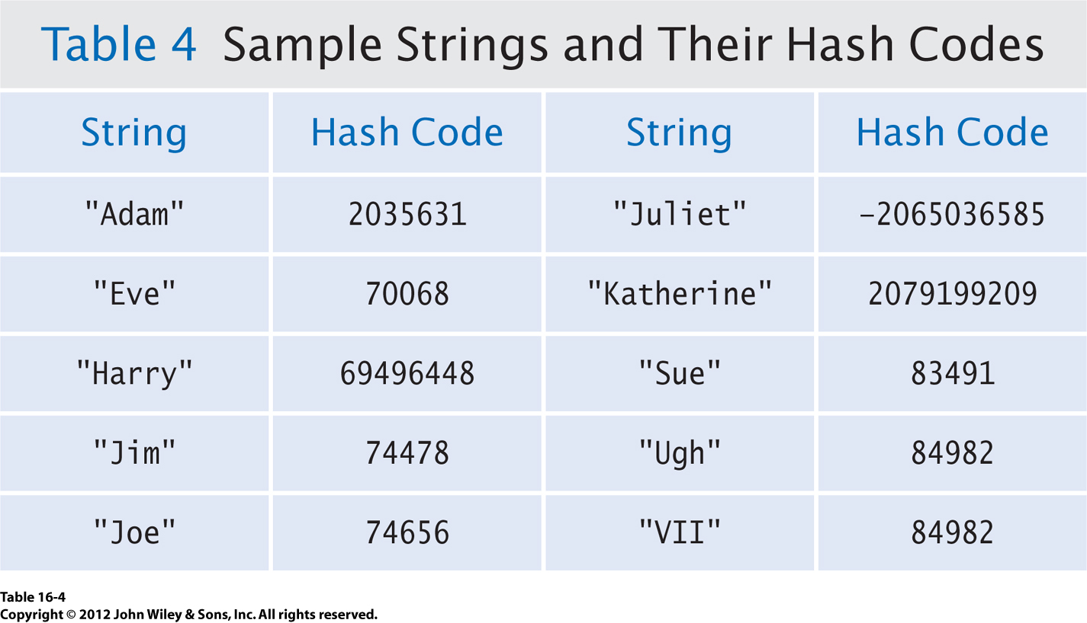
Hash Codes
Hash codes
are not
necessarily
unique.
This is a “collision”.
Every Java object (not just strings)
has a hash code.

Slide 7
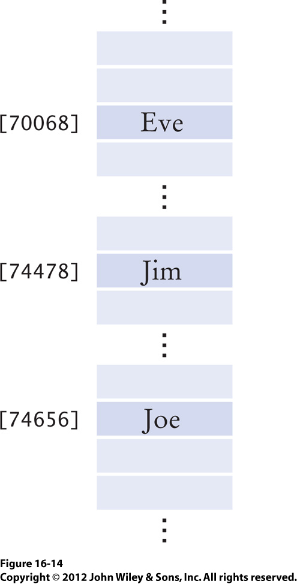
Hash Codes, cont’d
Use an object’s hash code
as a key.
To check whether or not a value is in the hash table, just use its hash code to index into the array.
But you would need a very large array to accommodate the very large index (key) values.

Slide 8
Hash Codes, cont’d
We must use a smaller array and “compress” the hash code to become valid array index.
  Use the remainder operation as our hash function:
But with the compressed hash code,
collisions are more likely.
  Different objects will generate the same index value.
h = obj.hashCode();
if (h < 0) h = -h;
index = h%arrayLength;

Slide 9
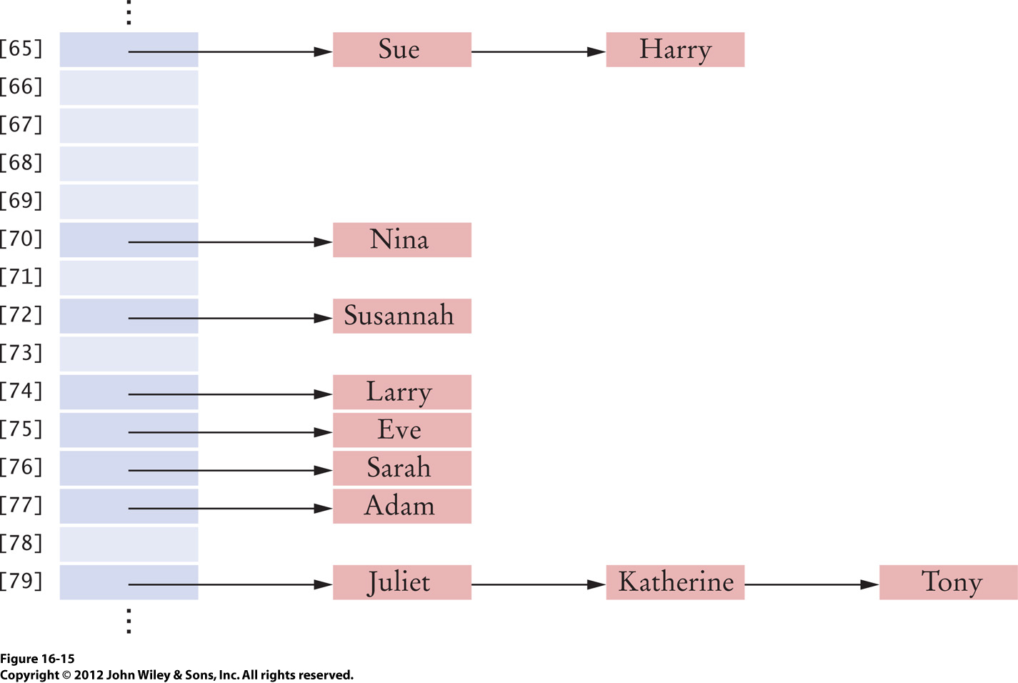
Collision Resolution: Separate Chaining
All objects
(such as “Sue”
and “Harry”)
with the same
key go into the
same “bucket”.
Each bucket is a linked list of objects
that have the same key.

Slide 10
Hash Function
We need an ideal hash function to map
each data record into a distinct table cell.
It can be very difficult to find
such a hash function.
The more data we put into a hash table,
the more collisions occur.

Slide 11
Find an Element in a Hash Table
Compute the key.
  Compute the element’s
  hash code.
  Compress the
  hash code.
Search the bucket indexed by the key.
  Iterate through the elements of the bucket.
  Check each element for a match.
If a match is found, the element is in the table.
Otherwise, it is not.
Call the equal() method.

Slide 12
Add an Element to a Hash Table
Compute the element’s key.
Search the bucket indexed by the key.
If there is a match, exit.
Otherwise, add the element to the bucket.
Where in the bucket’s linked list
should you add the new element?
  Head? Tail? Somewhere in the middle the list? Why?

Slide 13
Remove an Element from a Hash Table
Compute the element’s key.
Search the bucket indexed by the key.
If there is no match, exit.
Otherwise, remove the element
from the bucket.

Slide 14
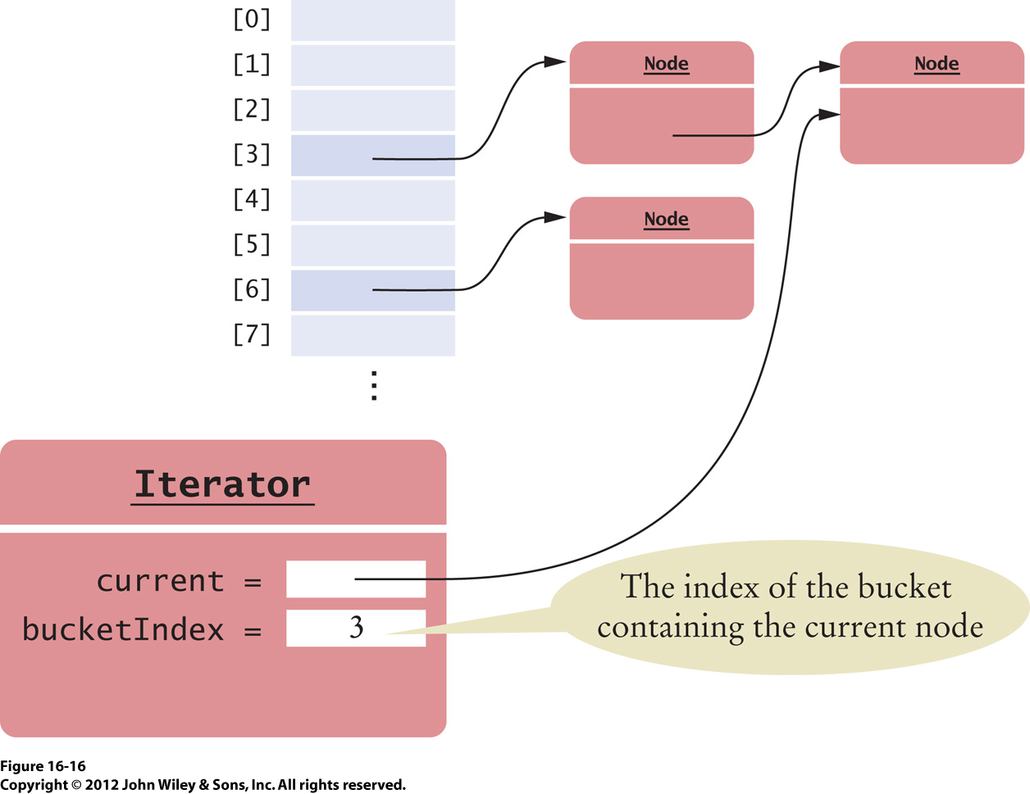
Iterate over a Hash Table
An iterator keeps track of the bucket index
and the current element in the collision chain.
After all the elements
of a chain have been
visited, bucketIndex
must advance past
empty buckets.

Slide 15
Load Factor
The load factor λ of a hash table is the ratio of
the number of elements in the table
to the table length.
  λ = n/L where n is the number of elements
  and L is the table length.
The higher the load factor, the more collisions.
If λ is higher than a given threshold, move the elements to a larger table (“rehash”).
  Java’s built-in hash table has a threshold of 0.75

Slide 16
Hash Table Performance
Computing a hash key takes constant time.
On average, each bucket should contain
λ elements.
Searching a bucket (linked list) bounded by length λ for an element takes O(1) time.
Rehashing should occur infrequently.
  Amortize the cost of rehashing
  over all add and remove operations.
Adding and removing and element takes
O(1)+ time.

Slide 17
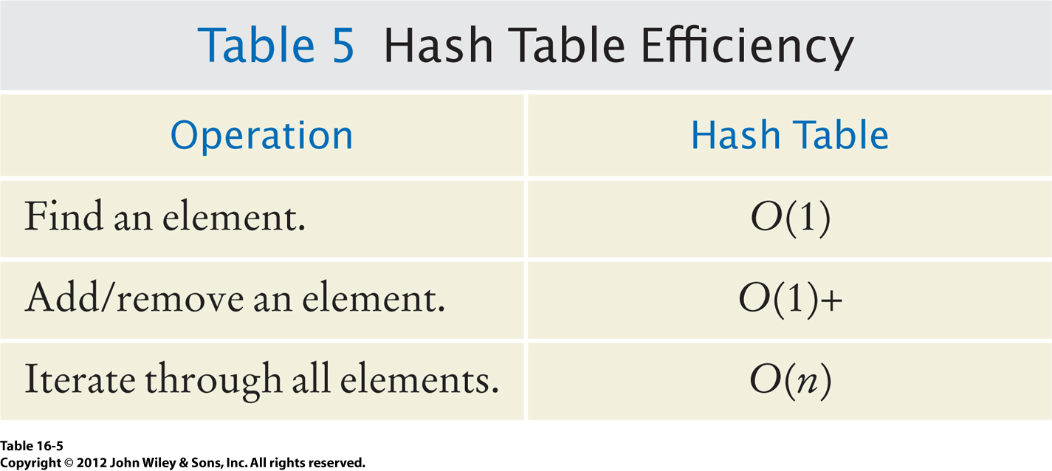
Hash Table Performance, cont’d

Slide 18
Collision Resolution: Linear Probing
Does not use linked lists.
When a collision occurs,
try a different table cell.

Slide 19
Collision Resolution: Linear Probing, cont’d
Insertion
  If a cell is filled, look for the next empty cell.
Search
  Start searching at the home cell, keep looking at the next cell until you find the matching key is found.
  If you encounter an empty cell, there is no key match.
Deletion
  Empty cells will prematurely terminate a search.
  Leave deleted items in the hash table but
  mark them as deleted.

Slide 20
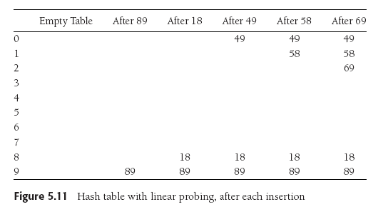
Collision Resolution: Linear Probing, cont’d
Suppose the table length is 10, the keys are integer values, and the hash function is the key value modulo 10.
  We want to insert values 89, 18, 49, 58, and 69.
Linear probing causes
primary clustering.
Data Structures and Algorithms in Java, 3rd ed.
by Mark Allen Weiss
Pearson Education, Inc., 2012
ISBN 0-13-257627-9

Slide 21
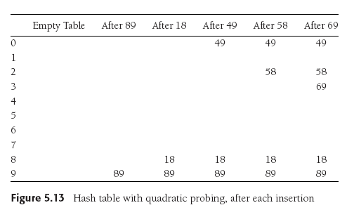
Collision Resolution: Quadratic Probing
The first probe is 1 cell away from the home cell.
The i^{th} probe is i² cells away from the home cell.
49 collides with 89:
the next empty cell
is 1 away.
58 collides with 18:
the next cell is filled.
Try 2² = 4 cells away
from the home cell.
Same for 69.
Data Structures and Algorithms in Java, 3rd ed.
by Mark Allen Weiss
Pearson Education, Inc., 2012
ISBN 0-13-257627-9

Slide 22
Built-in Java Support for Hashing
Java’s built-in HashSet and HashMap
use separate chaining hashing.
Each Java object has a built-in hash code defined by the Object class
(the base class of all Java classes)
  public int hashCode()
  public boolean equals()
A hash code should “spread around” values.
  You can override the built-in hashCode() method.
  You can override the built-in equal() method.

Slide 23
Built-in Java Support for Hashing, cont’d
Equal objects must produce
the same hash code.
Unequal objects need not produce
distinct hash codes.
A hash function can use an object’s hash code to produce a key suitable for a particular hash table.

Slide 24
Example Hash Code for String
static final int HASH_MULTIPLIER = 31;
int h = 0;
for (int i = 0; i < s.length(); i++) {
h = HASH_MULTIPLIER*h + s.charAt(i);
}

Slide 25
Break

Slide 26
Tree
A tree is a hierarchical data structure.
A tree is a collection of nodes:
  One node is the root node.
A node contains data and has pointers
(possibly null) to other nodes, its children.
  The pointers are directed edges.
  Each child node can itself be the root of a subtree.
  A leaf node is a node that has no children.
Each node other than the root node has
exactly one parent node.

Slide 27
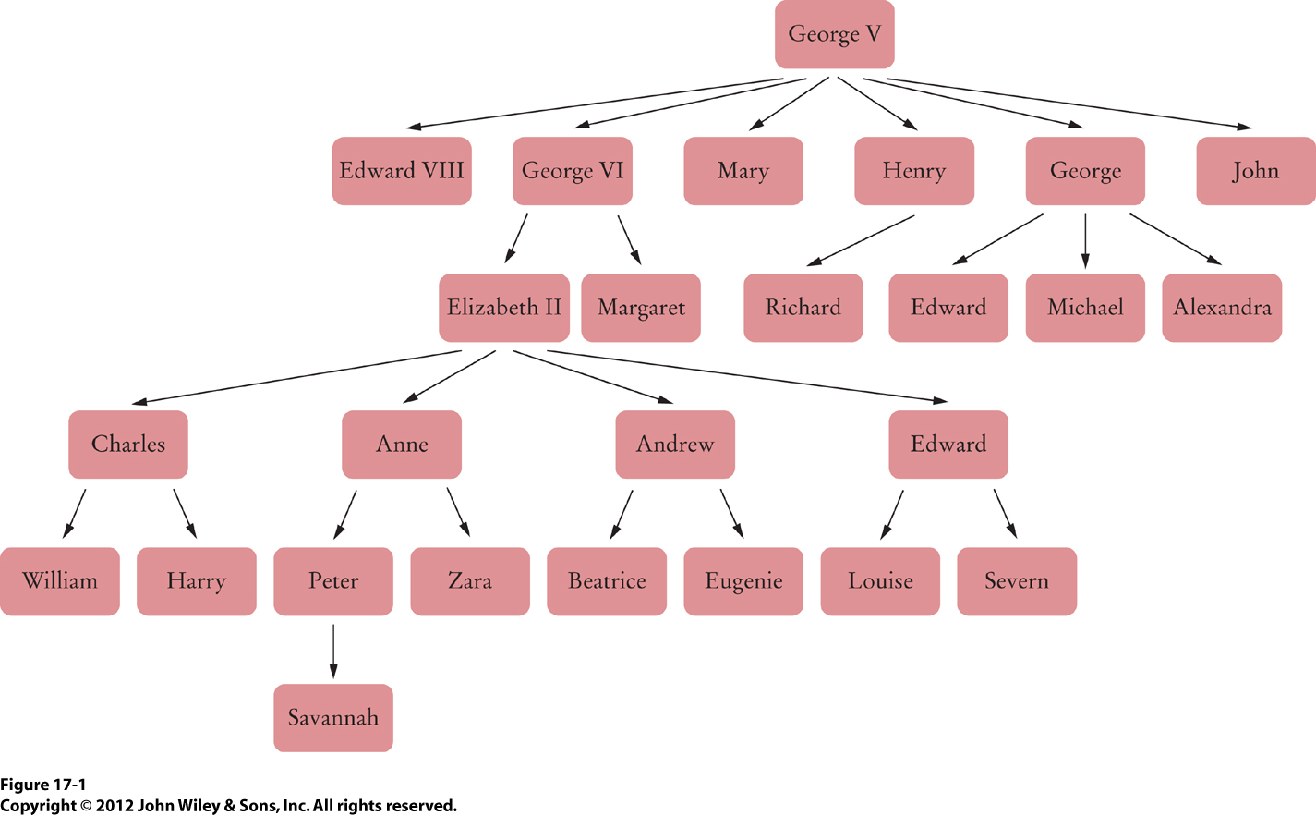
Example Tree

Slide 28
Tree Terms
The path from node n₁ to node n_{k} is the sequence of nodes in the tree from n₁ to n_{k}.
  What is the path from A to Q? From E to P?
The length of a path is the number of its edges.
  What is the length of the path from A to Q?
Data Structures and Algorithms in Java, 3rd ed.
by Mark Allen Weiss
Pearson Education, Inc., 2012

Slide 29
Tree Terms, cont’d
The size of a tree is the number of its nodes.
  What is the size of this tree?
  Of the subtree rooted at E?
The depth of a node is the length of the path
from the root to that node.
  What is the depth of node J? Of the root node?
Data Structures and Algorithms in Java, 3rd ed.
by Mark Allen Weiss
Pearson Education, Inc., 2012

Slide 30
Tree Terms, cont’d
The height of a node is the length of the longest path from the node to a leaf node.
  What is the height of node E? Of the root node?
Depth of a tree = depth of its deepest node = height of the tree
Data Structures and Algorithms in Java, 3rd ed.
by Mark Allen Weiss
Pearson Education, Inc., 2012

Slide 31
Tree Terms, cont’d
The height of a node is the length of the longest path from the node to a leaf node.
  What is the height of node E? Of the root node?
NOTE: Your textbook prefers an alternate definition for height: The number of nodes on the longest path from the node to a leaf node.
Data Structures and Algorithms in Java, 3rd ed.
by Mark Allen Weiss
Pearson Education, Inc., 2012

Slide 32
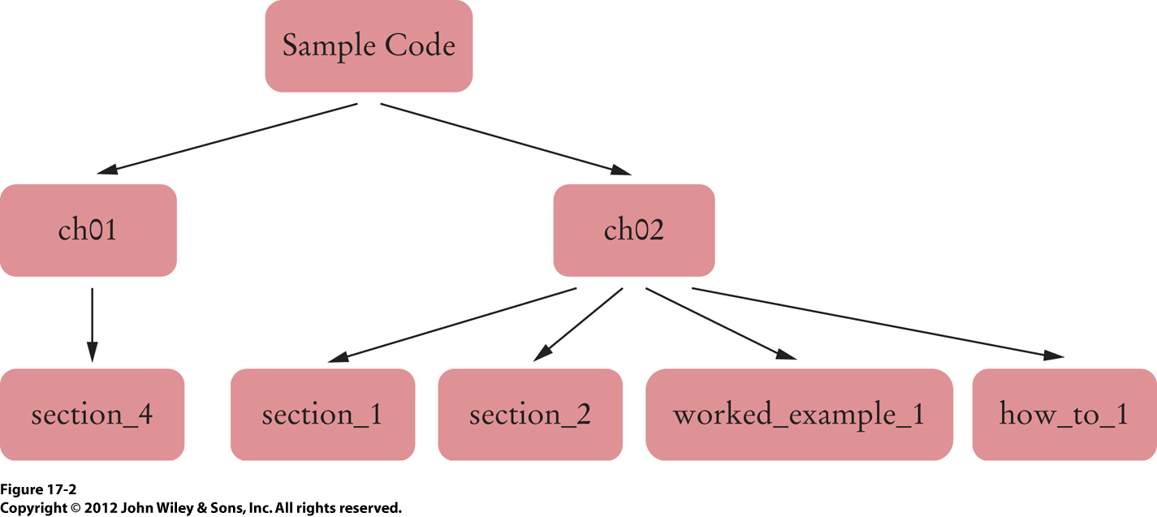
Hierarchical Data Example
File system directory

Slide 33
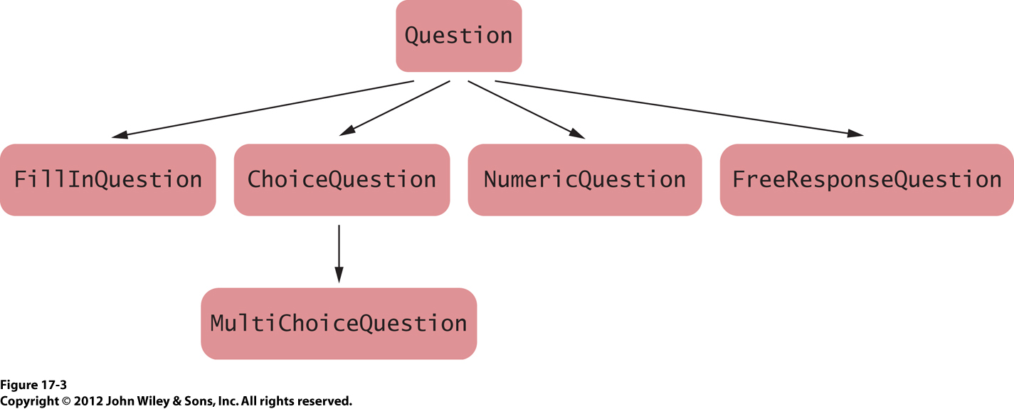
Hierarchical Data Example
Inheritance

Slide 34
Tree Implementation
public class Tree
{
private Node root;
class Node
{
public Object data;
public List<Node> children;
}
public Tree(Object rootData)
{
root = new Node();
root.data = rootData;
root.children = new ArrayList<Node>();
}
public void addSubtree(Tree subtree)
{
root.children.add(subtree.root);
}
. . .
}

Slide 35
Binary Tree
Each node has at most 2 children.
  Order is significant.
  Which child should be the left child.
  Which child should be the right child.
Many important applications!

Slide 36
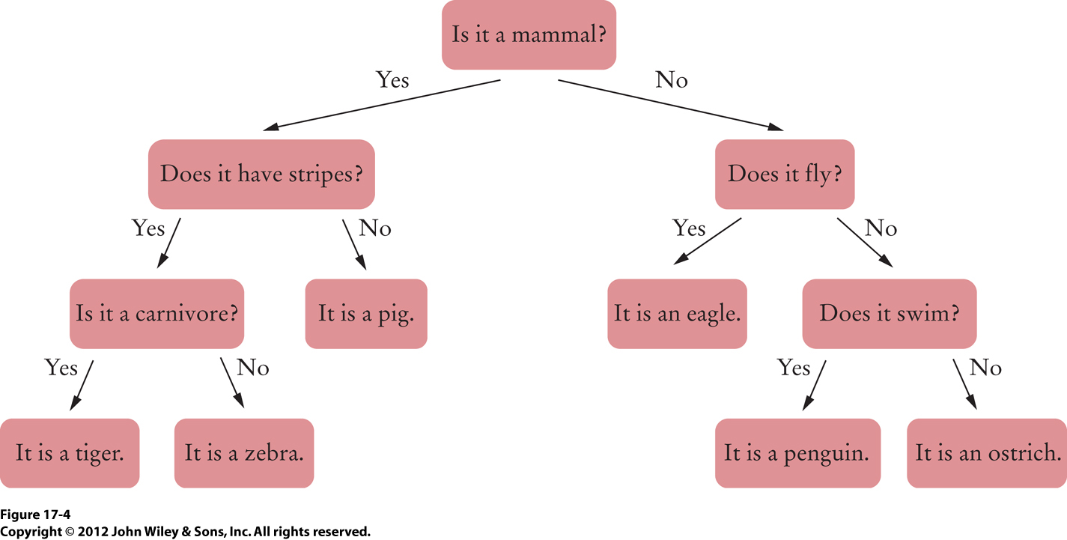
Binary Tree Example
Decision tree
  Left child: Yes
  Right child: No
This tree happens to be full:
Each node is either a leaf
or it has two children.

Slide 37
Binary Tree Implementation
public class BinaryTree
{
private Node root;
public BinaryTree() { root = null; } // An empty tree
public BinaryTree (Object rootData, BinaryTree left,
BinaryTree right)
{
root = new Node();
root.data = rootData;
root.left = left.root;
root.right = right.root;
}
class Node
{
public Object data;
public Node left;
public Node right;
}
. . .
}

