Slide 1


CS 46B: Introduction to Data Structures
June 25 Class Meeting
Department of Computer Science
San Jose State University
Summer 2015
Instructor: Ron Mak
www.cs.sjsu.edu/~mak

Slide 2
Midterm Solution: Question 1
public class Frequency
{
public static void main(String args[])
{
if (args.length < 2) {
System.out.println("*** Invalid arguments.");
System.exit(-1);
}
String filePath = args[0];
String searchWord = args[1];
int count = 0;
Scanner in = null;
try {
in = new Scanner(new File(filePath));
in.useDelimiter("[^A-Za-z]");

Slide 3
Midterm Solution: Question 1, cont’d
try {
in = new Scanner(new File(filePath));
in.useDelimiter("[^A-Za-z]");
while (in.hasNext()) {
if (searchWord.equalsIgnoreCase(in.next())) ++count;
}
System.out.printf("The word \"%s\" appears %d times in file %s\n",
searchWord, count, filePath);
}
catch (FileNotFoundException ex) {
System.out.println("*** File not found: " + filePath);
}
finally {
if (in != null) in.close();
}
}
}

Slide 4
Midterm Solution: Question 2a
public class Name implements Comparable
{
private String name;
private String first;
private String last;
public String getName() { return name; }
public Name(String name)
{
this.name = name;
String parts[] = name.split(" ");
this.first = parts[0];
this.last = parts[1];
}
public int compareTo(Object other)
{
Name otherName = (Name) other;
return this.last.compareTo(otherName.last);
}

Slide 5
Midterm Solution: Questions 2b and 2c
public int compareTo(Object other)
{
Name otherName = (Name) other;
return -this.last.compareTo(otherName.last);
}
public int compareTo(Object other)
{
Name otherName = (Name) other;
return this.name.length() - otherName.name.length();
}

Slide 6
Midterm Solution: Question 3
public static void main(String args[])
{
Scanner in = null;
try {
in = new Scanner(new File(INPUT_FILE_NAME));
(new Graph(in)).printGraph();
}
catch (FileNotFoundException ex) {
System.out.println("*** File not found: " + INPUT_FILE_NAME);
}
finally {
if (in != null) in.close();
}
}

Slide 7
Midterm Solution: Question 3, cont’d
private void printGraph()
{
System.out.printf("%-12s %-5s\n\n", "LANGUAGE", "SHARE");
in.nextLine();
while (in.hasNextLine()) {
Scanner line = new Scanner(in.nextLine());
line.useDelimiter("[,%]");
line.next();
String language = line.next();
float share = line.nextFloat();
long count = Math.round(share);
System.out.printf("%-12s %5.2f%% ", language, share);
for (int i = 1; i <= count; i++) System.out.print("*");
System.out.println();
line.close();
}
}

Slide 8
Midterm Solution: Question 4a
public interface Vocal
{
void vocalize();
}
public class Bird extends Animal implements Vocal
{
public void move()
{
System.out.println("Flap, flap!");
}
}
Because class Bird implements interface Vocal, it must implement method vocalize().

Slide 9
Midterm Solution: Question 4b
public class Mammal extends Animal implements Vocal
{
public void vocalize()
{
System.out.println("Grrr!");
}
}
public class Dog extends Mammal
{
public void vocalize()
{
super.vocalize();
System.out.println("Arf!");
}
}

Slide 10
Midterm Solution: Question 4c
Mammal m = new Dog();
m.move();
Vocal v = new Dog();
v.vocalize();
try {
v.move();
}
catch (ClassCastException ex) {
System.out.println("Can't move!");
}
You cannot call move() on variable v
since the type of v is Vocal.
Try-catch is for catching runtime errors and
doesn’t prevent compile-time errors.

Slide 11
Midterm Solution: Question 5a
Possible classes (look for nouns):
  University
  Department
  Klass
  Classroom
  Calendar
  TimeOfDay
  Student
  WaitingList
Why the funny spelling?

Slide 12
Midterm Solution: Question 5a, cont’d
Department
  Responsibilities
    maintain list of classes
    schedule classes
    open classes for registration by students
  Collaborators
    Klass
    Classroom
    Calendar
    TimeOfDay
    Students

Slide 13
Midterm Solution: Question 5a, cont’d
Klass
  Responsibilities
    maintain list of students
    maintain waiting list
  Collaborators
    Student
    WaitingList

Slide 14
Midterm Solution: Question 5a, cont’d
Student
  Responsibilities
    register for classes
  Collaborators
    Klass

Slide 15
Midterm Solution: Question 5a, cont’d
WaitingList
  Responsibilities
    maintain list of students
  Collaborators
    Student

Slide 16
Midterm Solution: Question 5b
Department aggregates Klass
  one department has many classes
Klass aggregates WaitingList
  each class has one waiting list
WaitingList aggregates Student
  one waiting list has zero, one, or more students

Slide 17
Quizzes
Do quizzes 7, 8, and 9 by next 9:00 AM next Tuesday, June 30.
These cover Chapter 13, sections 13.1 – 13.4
and Worked Example 13.1

Slide 18
Break

Slide 19
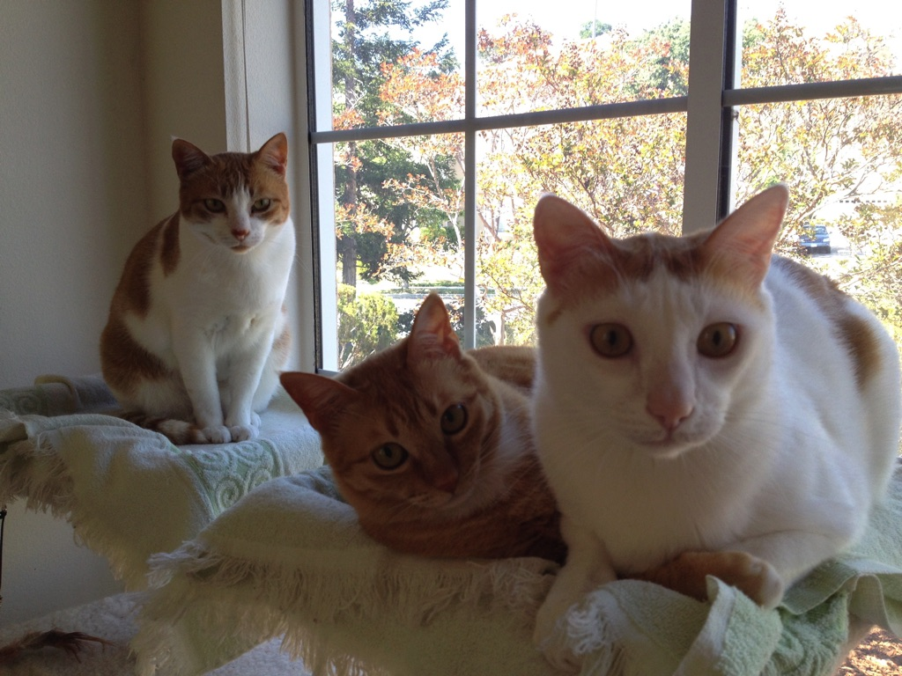
Recursion
Oh, no! Not recursion!
Recursion requires a whole new way of thinking.
Recursion is a required skill for all programmers.

Slide 20
How to Think Recursively
Does this problem contain a
simpler but similar case of the problem?
Can I solve the overall problem
if I can solve the simpler case?
Is there a simplest case that has
an immediate and obvious solution?
  This is called the base case.

Slide 21
Factorials: The Classic Recursion Problem
5! = 5 x 4 x 3 x 2 x 1
= 5 x 4!
Therefore, we can solve 5! if we can solve 4!
  4! is a simpler but similar case of the problem.
We can solve 4! = 4 x 3! if we can solve 3!
We can solve 3! = 3 x 2! if we can solve 2!
We can solve 2! = 2 x 1! if we can solve 1!
But by definition, 1! = 1

Slide 22
Factorials, cont’d
But by definition, 1! = 1
  That’s the simplest case (base case) with an
  immediate and obvious solution.
Therefore, 2! = 2 x 1! = 2 x 1 = 2
Therefore, 3! = 3 x 2! = 3 x 2 = 6
Therefore, 4! = 4 x 3! = 4 x 6 = 24
Therefore, 5! = 5 x 4! = 5 x 24 = 120

Slide 23
Factorials, cont’d
Solve n! recursively:
What’s the base case?
  1! = 1
What’s the simpler but similar case?
  (n-1)!
  Note that n-1 is closer to the base case of 1.
Factorial.java
private int fact(int n)
{
if (n <= 1) return 1;
else return n*fact(n-1);
}

Slide 24
Recursive Multiplication
Solve i x j recursively.
Base case:
  i equals 0: product = 0
  i equals 1: product = j
Simpler but similar case:
  If we can solve the problem for i-1
  (which is closer to 0 and 1),
  then i x j is [(i-1) x j] + j

Slide 25
Recursive Multiplication, cont’d
Multiplier.java
private long multiply(int i, int j)
{
switch (i) {
case 0: return 0;
case 1: return j;
default: return j + multiply(i-1, j);
}
}

Slide 26
Iterative Fibonacci
Fibonacci sequence: 1 1 2 3 5 8 13 21 34 55
  f_{n} = f_{n-2} + f_{n-1}
  f₁ = 1
  f₂ = 1
An iterative
solution:
private long fibonacci(int n)
{
if (n <= 2) return 1;
else {
long older = 1;
long old = 1;
long next = 1;
for (int i = 3; i <= n; i++) {
next = older + old;
older = old;
old = next;
}
return next;
}
}
Fibonacci.java

Slide 27
Recursive Fibonacci
  According to the definition:
    f_{n} = f_{n-2} + f_{n-1}
    f₁ = 1
    f₂ = 1
FibonacciRecursive.java
private long fibonacci(int n)
{
if (n <= 2) return 1;
else return fibonacci(n-2) + fibonacci(n-1);
}

Slide 28
Recursive Fibonacci, cont’d
Why does the recursive solution take a long time when n is large?
Let’s trace the recursive calls:
private long fibonacci(int n)
{
System.out.printf("Called fibonaaci(%d)\n", n);
long f;
if (n <= 2) f = 1;
else f = fibonacci(n-2) + fibonacci(n-1);
System.out.printf("Returning fibonacci(%d) = %d\n", n, f);
return f;
}
FibonacciTrace.java

Slide 29
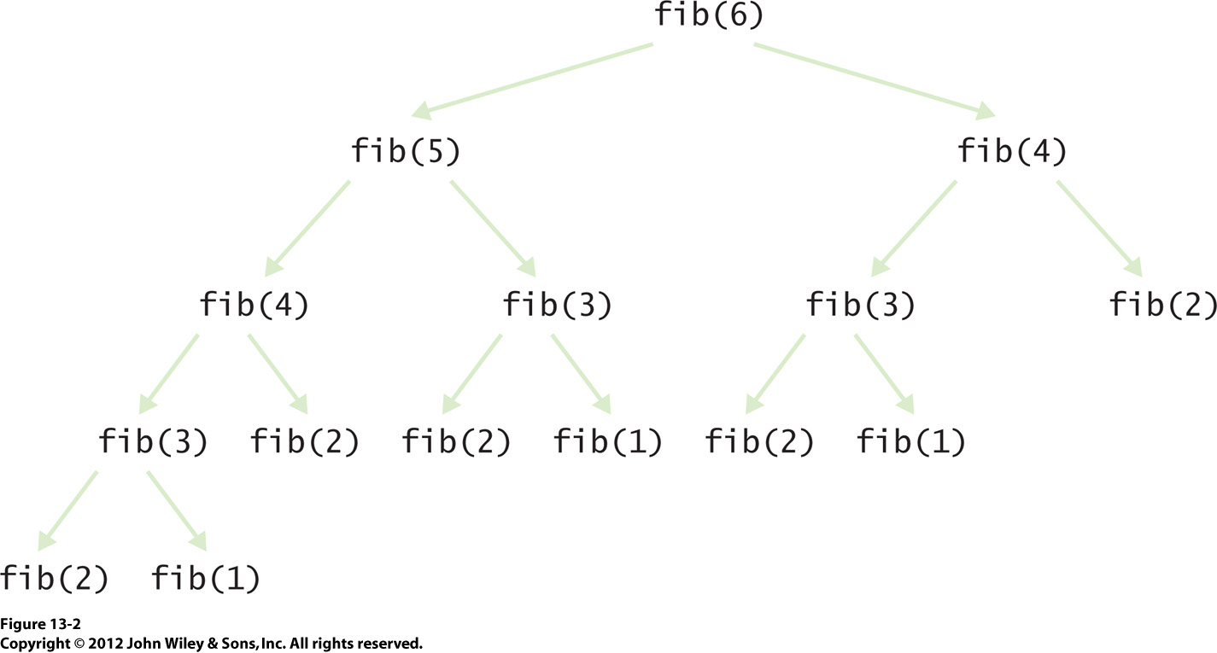
Recursive Fibonacci, cont’d

Slide 30
Member of
Given a list of n integers, is x in the list?
Base case
  The list is empty: x is not in the list.
Simpler but similar case:
  Either x is equal to the first element in the list,
  or x is in the rest of the list.
  The rest of the list is one shorter,
  so it’s closer to the base case.

Slide 31
Member of, cont’d
private boolean memberOf(int x, ArrayList<Integer> list)
{
if (list.size() == 0) return false;
else {
int first = list.get(0);
list.remove(0);
return (x == first) || memberOf(x, list);
}
}
Member.java
Unfortunately, this version of memberOf() destroys its list parameter.

Slide 32
Member of, cont’d
private boolean memberOf2(int x, ArrayList<Integer> list)
{
if (list.size() == 0) return false;
else {
int first = list.get(0);
list.remove(0);
return (x == first) || memberOf2(x, list);
}
}
private boolean memberOf(int x, ArrayList<Integer> list)
{
ArrayList<Integer> temp = (ArrayList<Integer>) list.clone();
return memberOf2(x, temp);
}
This version doesn’t harm its list parameter.

Slide 33
Unique
Given a list of n integers in a list, remove all the duplicate values so that what remains is a list of unique values.
Base case
  The list is empty or it contains only one value:
  Just return the list (it’s empty or it has a single unique value).
Simpler but similar case:
  Take out the first value. Make the rest of the list unique. Then if the value we took out is not in the rest of the list, put it back. Otherwise, leave it out.

Slide 34
Unique, cont’d
private ArrayList<Integer> unique(ArrayList<Integer> list)
{
if (list.size() <= 1) return list;
else {
int first = list.get(0);
list.remove(0);
ArrayList<Integer> ulist = unique(list); // rest of list
if (memberOf(first, ulist)) return ulist;
else {
ulist.add(0, first); // put back the first element
return ulist;
}
}
}
Unique.java

Slide 35
Reverse
Reverse the values of a list of n integers.
Base case
  The list is empty or it contains only one value:
  Just return the list.
Simpler but similar case:
  Take out the first value of the list. Reverse the rest of the list. Append the removed value to the end of the reversed rest of the list.

Slide 36
Reverse, cont’d
private ArrayList<Integer> reverse(ArrayList<Integer> list)
{
if (list.size() <= 1) return list;
else {
int first = list.get(0);
list.remove(0); // remove first element
reverse(list).add(first); // append it to the end
return list;
}
}
Reverse.java

Slide 37
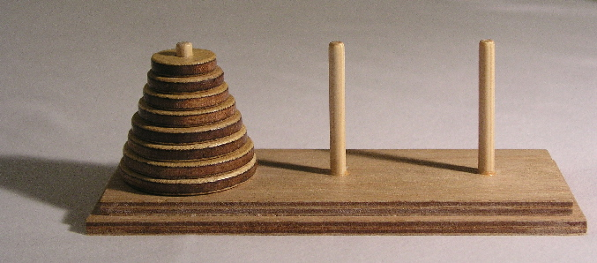
Towers of Hanoi
Goal: Move the stack of disks from the source pin
to the destination pin.
  You can move only one disk at a time.
  You cannot put a larger disk on top of a smaller disk.
  Use the third pin for temporary disk storage.

Slide 38
Towers of Hanoi, cont’d
Label the pins A, B, and C.
  A: source
  B: temporary
  C: destination
Base case: n = 1 disk
  Move disk from A to C (source ➔ destination)
Simpler but similar case: n-1 disks
  Solve for n-1 disks (source ➔ temp)
  Move disk from A to C (source ➔ destination)
  Solve for n-1 disks (temp ➔ destination

Slide 39
Towers of Hanoi, cont’d
private static final char A = 'A'; // initial source
private static final char B = 'B'; // initial temp
private static final char C = 'C'; // initial destination
private static int count = 0;
private static void move(char from, char to)
{
System.out.printf("%2d: Move disk from %c to %c.\n",
++count, from, to);
}
public static void main(String args[])
{
int n = 6;
System.out.printf("Solve for %d disks:\n\n", n);
solve(n, A, B, C);
}
Hanoi1.java

Slide 40
Towers of Hanoi, cont’d
Solve n disks (source = A, destination = C)
  Solve for n-1 disks (source ➔ temp)
  Move disk from A to C (source ➔ destination)
  Solve for n-1 disks (temp ➔ destination)
Hanoi.java
private static void solve(int n, char source,
char temp, char destination)
{
if (n > 0) {
solve(n-1, source, destination, temp);
move(source, destination);
solve(n-1, temp, source, destination);
}
}

Slide 41
Homework 5: Write Recursive Methods
Method read() reads and prints a text file line by line. Its parameter is a text Scanner object. Input will be the text file GettysburgAddress.txt.
  Codecheck URL: http://codecheck.it/codecheck/files/15062509419psp5nux3kfu2ypvk7t9da0fw
Note: DNS problems with http://codecheck.it For the next 48 hours,
replace with http://130.211.187.232 For example:
http://130.211.187.232/codecheck/files/15062509419psp5nux3kfu2ypvk7t9da0fw

Slide 42
Homework 5, cont’d
Method allSame() has a string parameter and returns true if all the characters of the string are the same, and false otherwise.
  Codecheck URL: http://codecheck.it/codecheck/files/15062509333k18e6dph2n9pejrc4o49s8ax

Slide 43
Homework 5, cont’d
Method count() has two parameters, a character and a string. It returns the number of occurrences the character is in the string (case sensitive comparisons).
  Codecheck URL: http://codecheck.it/codecheck/files/150625093862ongmlhoag9dokoccytmfrhy

Slide 44
Homework 5, cont’d
Method append() has two parameters that are array lists of integers. It returns an array list that is the second array list appended to the end of the first array list.
  Codecheck URL: http://codecheck.it/codecheck/files/1506250936devech3xgnds2e8b833tkb4qz

Slide 45
Homework 5, cont’d
All your methods must be recursive.
  You may be surprised by how short they are.
Canvas: Homework 5 Final
Due: Monday, June 29 at 11:59 PM

