Slide 1


CS 46B: Introduction to Data Structures
June 16 Class Meeting
Department of Computer Science
San Jose State University
Summer 2015
Instructor: Ron Mak
www.cs.sjsu.edu/~mak

Slide 2
What Makes a Software Application Good?
It does what it’s supposed to do.
It’s well-designed.
  reliable
  robust
  flexible
  object-oriented architecture?
  uses design patterns?
It’s easy to modify and maintain.
  Things are always changing!

Slide 3
How Do You Achieve “Good Design”?
Sorry, there is no magic formula.
Learning lots of object-oriented tools and techniques alone won’t give you good design.
For a nontrivial application,
good design won’t simply “happen”.

Slide 4
How Do You Achieve “Good Design”? cont’d
Good design is a destination reached
after a journey.
Every programmer must take this trip
for every application.
The journey can be longer
for less-experienced programmers.
  false starts
  meandering
  wrong paths
  backtracking

Slide 5
It’s an Iterative Process
Achieving good design is an iterative process.
As you’re developing the application,
you will revisit your design several times.
Even the very best programmers
can’t come up with the perfect good design
the first time every time.
The journey to good design requires that
you make corrections, refinements,
and other improvements along the way.

Slide 6
It’s an Iterative Process, cont’d
The journeys will become shorter
as you become more experienced.
Practice, practice, practice.
Learn object-oriented tools and techniques.
More practice, practice, practice.

Slide 7
A Poor Design is Not Necessarily a Failure ...
... if it soon leads to a better design.
  Don’t paralyze yourself trying to come up with a perfect design right from the start.
Goal: Recognize a poor design early during development and start to improve it iteratively
as soon as possible.
Even better: Try not to start
with a really bad design.
  You will learn quickly how not to do a bad design!

Slide 8
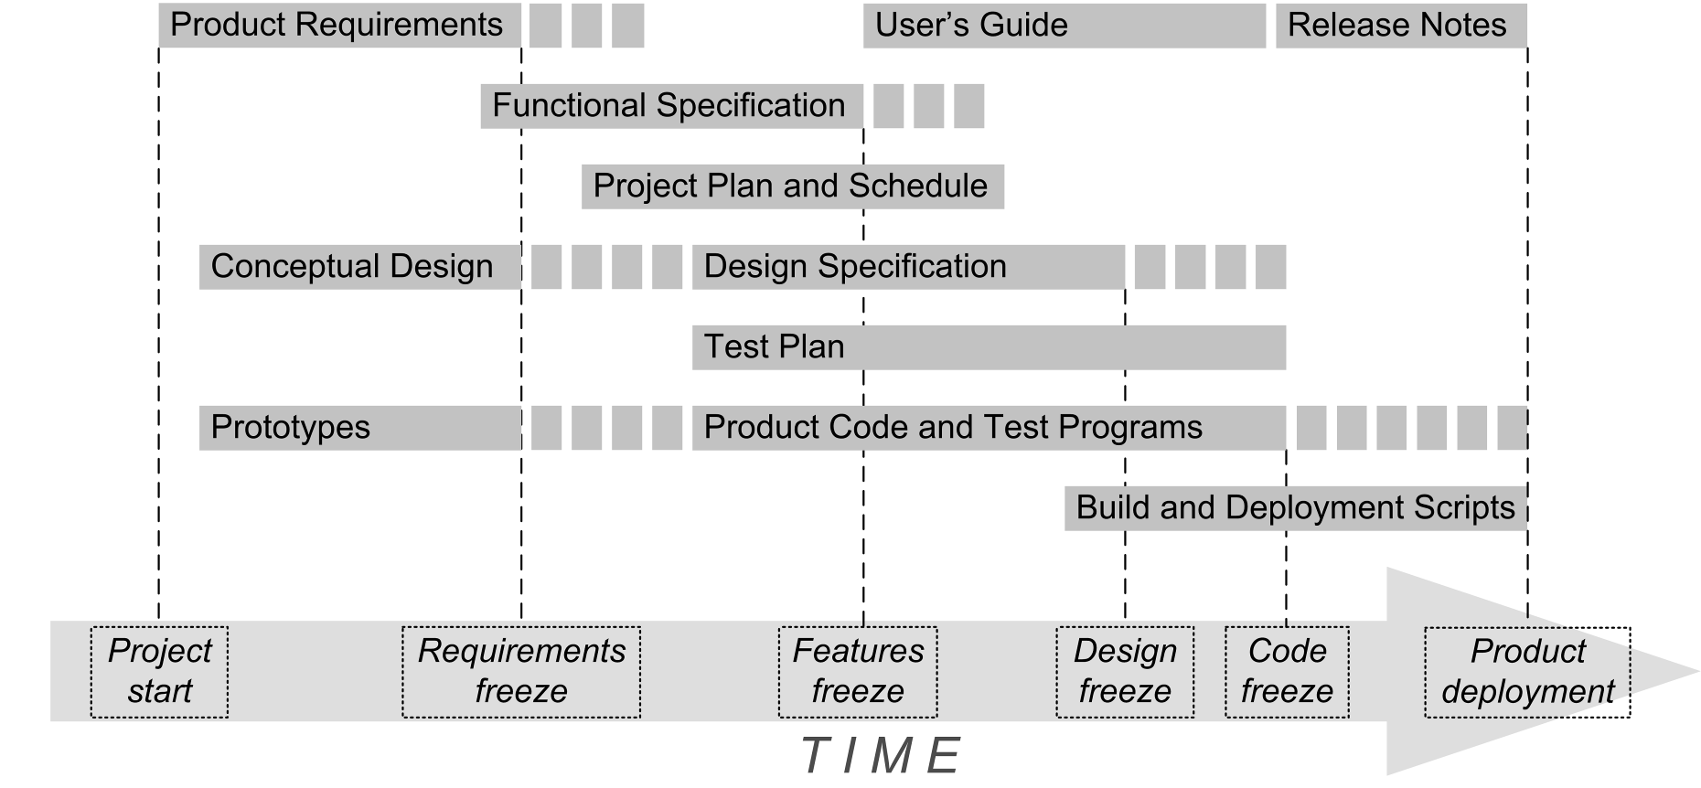
Application Development Big Picture

Slide 9
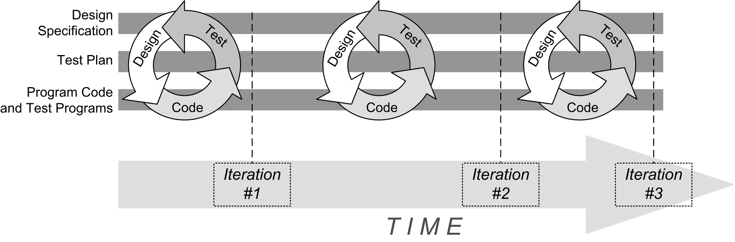
Iterative Development

Slide 10

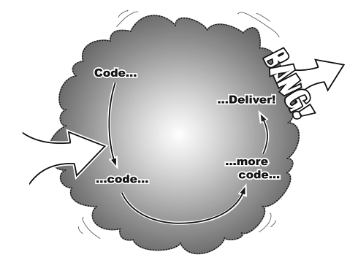
Incremental Development
Goal
Start
Each iteration adds functionality to
code that already works.
No Big Bang!
Head First Object-Oriented Analysis & Design
by Brett McLaughlin & Gary Pollice
O’Reilly, 2006.

Slide 11
Where Do Classes Come From?
Textual analysis
  Look for nouns and verbs
  in your requirements specification.
    Nouns ➔ classes
    Verbs ➔ methods
  Not all nouns and verbs may be appropriate!
Class names should be nouns in the singular form, such as Inventory, Product, LineItem, Customer.

Slide 12
Where Do Classes Come From? cont’d
How will the methods support the behaviors
that your requirements describe?
Focus on concepts, not implementation.

Slide 13
Categories of Classes
Things
  Examples: Inventory, LineItem
Agents
  Represent doers of tasks.
  Names often end in “er” or “or”
  Examples: Scanner, Paginator

Slide 14
Categories of Classes, cont’d
Events and transactions
  Model records of activities that describe what happened in the past or what needs to be done later
  Example: Purchase remembers when an item was bought, the amount, and for how much.
Users and roles
  Stand-in for the actual users of the application.
  Common in systems that are used by more than one person or where one person needs to perform distinct tasks.
  Examples: Administrator, Reviewer

Slide 15
Categories of Classes, cont’d
System
  Model a subsystem or the overall system being built.
  Typical methods: initialize, shutdown, read input
System interfaces and devices
  Interfaces to the host operating system,
  file system, etc.
Foundation
  Typically the built-in classes.
  Examples: String, Date

Slide 16
Class Responsibilities
Responsibilities correspond to verbs
in the requirements.
Each responsibility should be owned by
one and only one class.
  Who does what?
Common mistakes:
  Assign a responsibility to an inappropriate class.
  Assign too many responsibilities to a class.
  Ideally, each class should have
  a single primary responsibility.

Slide 17
Class Responsibilities Example
class Automobile
  start()
  stop()
  changeTires()
  drive()
  wash()
  displayOilLevel()
  checkOil()
class Automobile
  start()
  stop()
  displayOilLevel()
class Driver
  drive()
class CarWash
  wash()
class Mechanic
  changeTires()
  checkOil()
Too many responsibilities!
A cohesive class does
one thing really well and
does not try to be something else.

Slide 18
Class Relationships: Dependency
Class C depends on class D:
  Some method of C manipulates objects of D
  Example: Mailbox objects manipulate Message objects.
Dependency is asymmetric.
  The Message class is not aware
  of the existence of the Mailbox class.
  Therefore, Message objects
  do not depend on Mailbox objects.

Slide 19
Class Relationships: Dependency, cont’d
Loose coupling
  Minimize the number of dependency relationships.
  An important way for a design to handle changes.

Slide 20
Class Relationships: Aggregation
Class C aggregates class A:
  Objects of class C contains objects of class A
  over a period of time.
A special case of dependency.
  The “has a” relationship.
  Example: An Invoice object
  has a list of LineItem objects.

Slide 21
Class Relationships: Aggregation, cont’d
Multiplicity
  1:1 – Example: Each Person object
  has a single StreetAddress object.
  1:n – Example: Each Invoice object
  has an array of multiple LineItem objects.

Slide 22
Class Relationships: Inheritance
Class C inherits from superclass S.
  The “is a” relationship.
All class C objects are special cases
of class S objects.
Class S is the superclass of class C.
Class C is a subclass of class S.
An object of class C is an object of class S.

Slide 23
Aggregation vs. Inheritance
Aggregation
  A Mailbox object has a Message object.
Inheritance
  A ForwardedMessage object is a Message object.

Slide 24
The CRC Technique
Classes-Responsibilities-Collaborators
An effective technique to discover classes, responsibilities, and relationships.
CRC card is an index card that
  Describes one class.
  Lists the class’s responsibilities.
  Lists other classes with which it must collaborate
  to fulfill its responsibilities.

Slide 25
The CRC Technique, cont’d
Mailbox
Responsibilities | Relationships
Manage passcode | MessageQueue
Manage greeting
Create new message
Example: class Mailbox

Slide 26
The CRC Technique, cont’d
Write the class name on each index card.
Distribute the responsibilities
among the classes.
Find out their relationships and
list all dependencies of each classes.
Don't write the methods or instance fields.
  Just write the responsibilities at a high level.

Slide 27
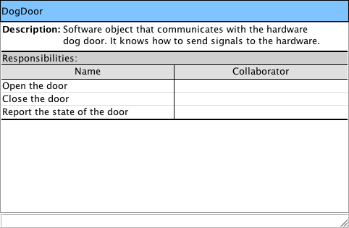
Example CRC Card
Class name
Optional
Responsibilities of this class
Classes this class works with to perform its responsibilities
Head First Object-Oriented Analysis & Design
by Brett McLaughlin & Gary Pollice
O’Reilly, 2006.

Slide 28
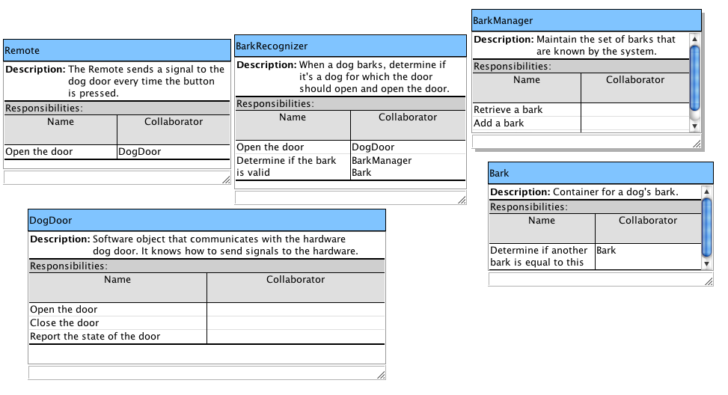
More Example CRC Cards
Head First Object-Oriented Analysis & Design
by Brett McLaughlin & Gary Pollice
O’Reilly, 2006.

Slide 29
Break

Slide 30
Assignment #4
Print a personnel report for a company.
The company consists of several departments.
Each department has a manager.
Each manager has zero or more workers.
Each employee (manager or worker) has an integer employee id and a home address.
A home address consists of a street address,
a city, and a state.

Slide 31
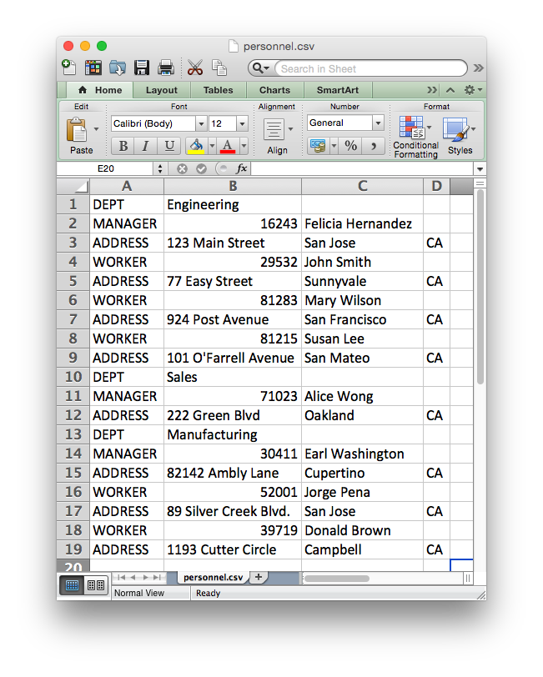
Assignment #4, cont’d
Input is a CSV text file personnel.csv generated from the Excel spreadsheet personnel.xlsx.
Column A contains row tags DEPT, MANAGER, WORKER, or ADDRESS.

Slide 32
Assignment #4, cont’d
Each DEPT row has the department name in column B.
Each MANAGER or a WORKER row has the employee id in column B and the employee name in column C.

Slide 33
Assignment #4, cont’d
Each employee’s row is followed by that employee’s home ADDRESS: street in column B, city in column C, and state in column D.
Each manager is followed by his or her workers.

Slide 34
Assignment #4 Draft
Create classes Department, Employee, Manager, Worker, and Address.
Each class should have
private instance variables.
Each instance variable should have a
public accessor method.
If necessary, each instance variable should have a public mutator method.

Slide 35
Assignment #4 Draft, cont’d
Override each class’s toString() method.
  Each method should return the name of the class followed by each instance variable’s value in the form [variable=value]
    Example:
  Append :Manager or :Worker to indicate whether an employee is a manager or a worker
    Examples:
Address[street=123 Main Street][city=San Jose][state=CA]
Employee[id=16243][name=Felicia Hernandez]:Manager
Employee[id=29532][name=John Smith]:Worker

Slide 36
Assignment #4 Draft, cont’d
Read the CSV file and create the appropriate object for each input line.
The constructor for each class should have one parameter that is the input line.
  Example:
The constructor should read the comma-separated values from the line to set the values of the object’s instance variables.
public Address(String line) { ... }

Slide 37
Assignment #4 Draft, cont’d
Generate the output text file personnel.out by printing each object right after it is created:
Department[name=Engineering]
Employee[id=16243][name=Felicia Hernandez]:Manager
Address[street=123 Main Street][city=San Jose][state=CA]
Employee[id=29532][name=John Smith]:Worker
Address[street=77 Easy Street][city=Sunnyvale][state=CA]
Employee[id=81283][name=Mary Wilson]:Worker
Address[street=924 Post Avenue][city=San Francisco][state=CA]
Employee[id=81215][name=Susan Lee]:Worker
Address[street=101 O'Farrell Avenue][city=San Mateo][state=CA]
Department[name=Sales]
Employee[id=71023][name=Alice Wong]:Manager
Address[street=222 Green Blvd][city=Oakland][state=CA]
Department[name=Manufacturing]
Employee[id=30411][name=Earl Washington]:Manager
Address[street=82142 Ambly Lane][city=Cupertino][state=CA]
Employee[id=52001][name=Jorge Pena]:Worker
Address[street=89 Silver Creek Blvd.][city=San Jose][state=CA]
Employee[id=39719][name=Donald Brown]:Worker
Address[street=1193 Cutter Circle][city=Campbell][state=CA]

Slide 38
Assignment #4 Draft, cont’d
private void readData()
{
while (in.hasNextLine()) {
String line = in.nextLine();
String tag = line.split(",")[0];
if (tag.equals("ADDRESS")) {
Address addr = new Address(line);
out.println(addr);
}
else if (tag.equals("DEPT")) {
Department dept = new Department(line);
out.println(dept);
}
else if (tag.equals("MANAGER")) {
Manager mgr = new Manager(line);
out.println(mgr);
}
else if (tag.equals("WORKER")) {
Worker wrkr = new Worker(line);
out.println(wrkr);
}
}
}
You are given this
readData() method.
You need to make it
work to generate the
output report.

Slide 39
Assignment #4 Draft, cont’d
Due Thursday, June 18 at 11:59 PM
Codecheck URL: http://codecheck.it/codecheck/files/1506161025v35hsxjohx9p5kstpwzzcrui
Canvas: Homework 4 Draft

Slide 40
Assignment #4 Draft, cont’d
Spreadsheet: http://www.cs.sjsu.edu/~mak/CS46B/assignments/4/personnel.xlsx
CSV file: http://www.cs.sjsu.edu/~mak/CS46B/assignments/4/personnel.csv
Output file: http://www.cs.sjsu.edu/~mak/CS46B/assignments/4/draft/personnel.out

Slide 41
Assignment #4 Final
Modify class Department so that each of its objects aggregates its Manager object.
Modify class Manager so that each of its objects aggregates its Worker objects.
Each employee object should have an address.
Create class Company that aggregates its departments.
  Modify the readData() method to return a reference to a Company object.

Slide 42
Assignment #4 Final, cont’d
Generate the final output file personnel.out by starting with the Company object.
Iterate over the Company object’s
Department objects.
Process each Department object’s
Manager object.
Iterate over each Manager object’s
Worker objects.
Print each employee’s address underneath
the employee’s name.

Slide 43
Assignment #4 Final, cont’d
DEPARTMENT MANAGER WORKERS
Engineering Felicia Hernandez
123 Main Street
San Jose, CA
John Smith
77 Easy Street
Sunnyvale, CA
Mary Wilson
924 Post Avenue
San Francisco, CA
Susan Lee
101 O'Farrell Avenue
San Mateo, CA
Sales Alice Wong
222 Green Blvd
Oakland, CA
Manufacturing Earl Washington
82142 Ambly Lane
Cupertino, CA
Jorge Pena
89 Silver Creek Blvd.
San Jose, CA
Donald Brown
1193 Cutter Circle
Campbell, CA

Slide 44
Assignment #4 Final
Due Monday, June 22 at 11:59 PM.
Codecheck URL: http://codecheck.it/codecheck/files/15061610396cizpfg4jtpj27n5lnnq7w5qo
Canvas: Homework 4 Final

Slide 45
Assignment #4 Final, cont’d
Spreadsheet: http://www.cs.sjsu.edu/~mak/CS46B/assignments/4/personnel.xlsx
CSV file: http://www.cs.sjsu.edu/~mak/CS46B/assignments/4/personnel.csv
Output file: http://www.cs.sjsu.edu/~mak/CS46B/assignments/4/final/personnel.out

