Slide 1
CS 235: User Interface Design May 7 Class Meeting
Department of Computer Science San Jose State University Spring 2015 Instructor: Ron Mak
www.cs.sjsu.edu/~mak

Slide 2
Unofficial Field Trip
Computer History Museum in Mt. View
http://www.computerhistory.org/
Saturday, May 9, 11:30 – closing time
Special free admission.
Do a self-guided tour of the new Revolution exhibit.
See a life-size working model of Charles Babbage’s Difference Engine in operation, a hand-cranked mechanical computer designed in the early 1800s.
Experience a fully restored IBM 1401 mainframe computer from the early 1960s in operation.
General info: http://en.wikipedia.org/wiki/IBM_1401
My summer seminar: http://www.cs.sjsu.edu/~mak/1401/
Restoration: http://ed-thelen.org/1401Project/1401RestorationPage.html
Extra credit
fun quiz!

Slide 3
Introduction to Information Dashboards
A form of communication.
Present information on a computer screen to help monitor what’s going on.
Part of business intelligence (BI).
Not about cute gauges (skeuomorphs) or fancy artwork, but about informed design.
There are too many examples of poorly designed dashboards!

Slide 4
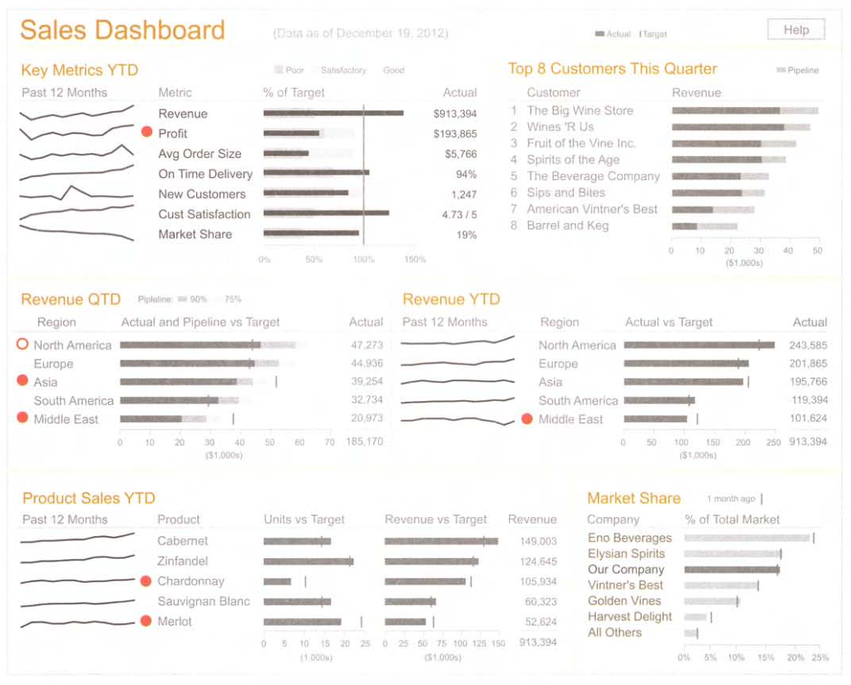
Example: Well Designed Dashboard
Information Dashboard Design, 2nd ed.
by Stephen Few
Analytics Press, 2013

Slide 5
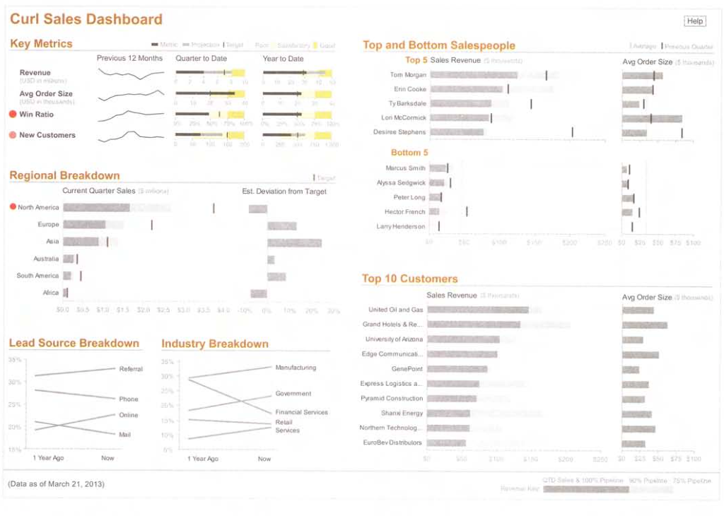
Example: Well Designed Dashboard, cont’d
Information Dashboard Design, 2nd ed.
by Stephen Few
Analytics Press, 2013

Slide 6
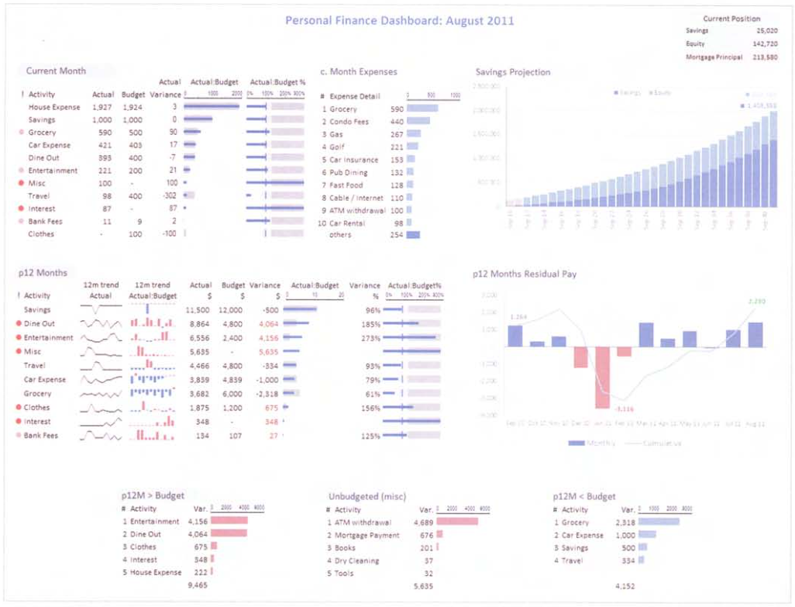
Example: Well Designed Dashboard, cont’d
Information Dashboard Design, 2nd ed.
by Stephen Few
Analytics Press, 2013

Slide 7
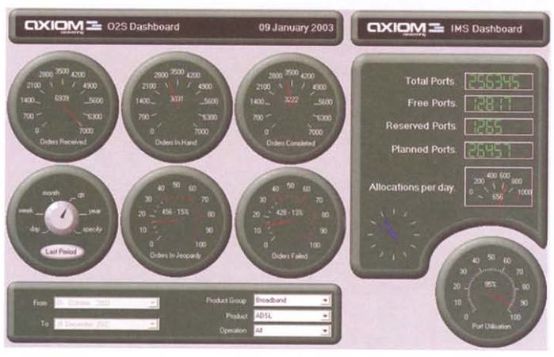
Example: Poorly Designed Dashboard
Information Dashboard Design, 2nd ed.
by Stephen Few
Analytics Press, 2013

Slide 8
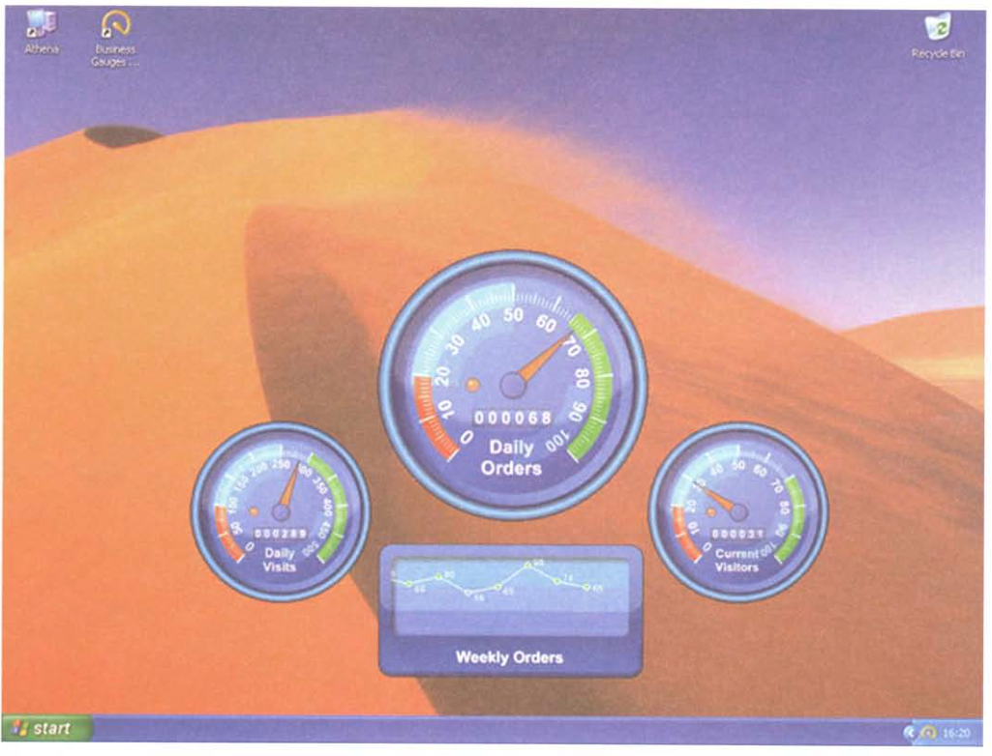
Example: Poorly Designed Dashboard, cont’d
Information Dashboard Design, 2nd ed.
by Stephen Few
Analytics Press, 2013

Slide 9
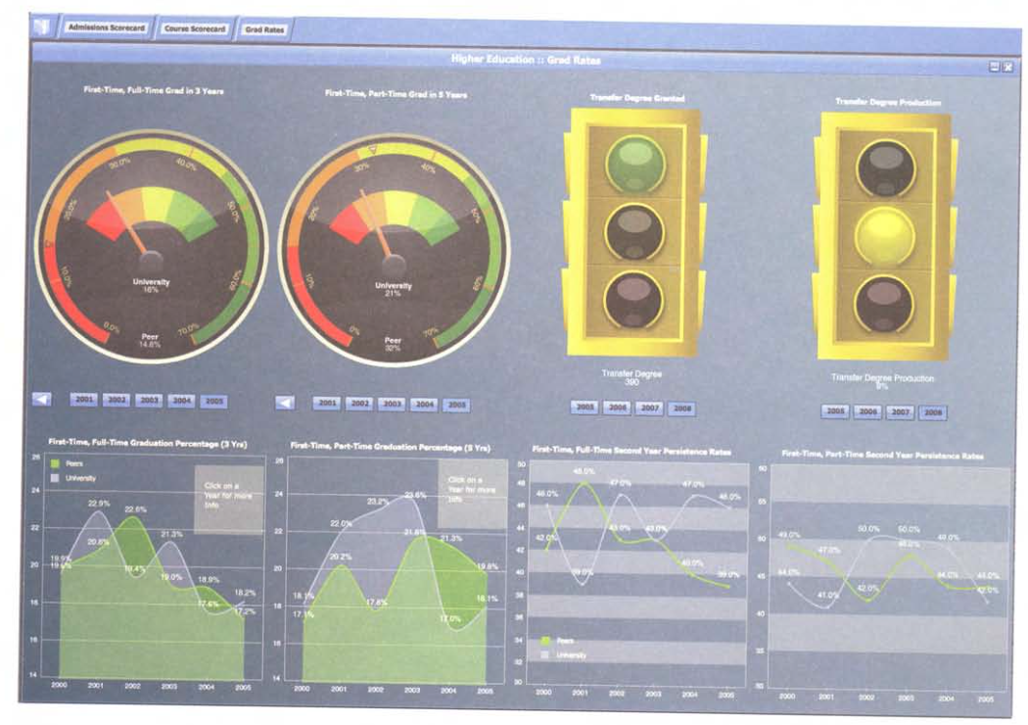
Example: Poorly Designed Dashboard, cont’d
Information Dashboard Design, 2nd ed.
by Stephen Few
Analytics Press, 2013

Slide 10
What is a Dashboard?
A visual display …
… of the most important information needed to achieve one or more objectives …
… that has been consolidated on a single computer screen …
… so that it can be monitored at a glance.

Slide 11
Visual Display
A visual display of the most important information needed to achieve one or more objectives
that has been consolidated on a single computer screen so that it can be monitored at a glance.
Combination of text and graphics.
Emphasis on graphics.
Graphical presentations can communicate more effectively and comprehensively than text alone.
If designed expertly.
To design well, you must understand concepts of visual perception.

Slide 12
Information to Achieve Objectives
A visual display of the most important information needed to achieve one or more objectives
that has been consolidated on a single computer screen so that it can be monitored at a glance.
A dashboard should achieve at least one objective.
Access a collection of facts from diverse sources that are not otherwise related.
Use whatever information needed to achieve the objective(s).
Can be a set of KPIs or any other facts.
KPI = Key Performance Indicator

Slide 13
Fits on a Single Computer Screen
A visual display of the most important information needed to achieve one or more objectives
that has been consolidated on a single computer screen so that it can be monitored at a glance.
Seen all at once, at a glance.
It’s not a dashboard if scrolling is required.
Have the most important information readily and easily available.
The viewer can quickly absorb what’s needed to know.
The information need not necessarily be updated in real time.
Sometimes only a snapshot is needed.

Slide 14
Monitor Information at a Glance
A visual display of the most important information needed to achieve one or more objectives
that has been consolidated on a single computer screen so that it can be monitored at a glance.
A dashboard provides an overview.
Quickly point out that something deserves attention and may require action.
Not required to provide all the details.
The viewer should be able to navigate to the details.
Primary job: Tell the viewer at a glance that he or she needs to act.

Slide 15
How a Dashboard Presents Information
Presents information using small, concise, direct, and clear display media.
Clearly states the messages without taking up much space.
Fit all information on a single screen.
Avoids cute or absurd skeuomorphs.
Car dashboard gauges, traffic lights, etc.

Slide 16
Dashboards are Customized
A dashboard is
a type of display
a form of presentation
Not a multi-chart display for user interaction.
No adding or removing charts, filtering data, etc.
The screen should look the same from day to day without alteration.
Except for changes in the data.
Why?

Slide 17
What a Dashboard is Not
Not a display for data exploration and analysis.
Make the viewer aware of something that must be explored or analyzed.
Navigate to a different screen to explore or analyze.
Not a portal.
The purpose of a dashboard is to monitor important information.
The purpose of a portal is to enable a user to access often needed information to accomplish certain tasks.

Slide 18
What a Dashboard is Not, cont’d
Not a scorecard.
A scorecard is part of a system of data and activities for managing and improving an organization’s performance.
A dashboard can be part of this system.
Not a report to look up specific facts.
Looking up facts is not performance monitoring.
Looking up facts requires controls for accessing and filtering data.
A dashboard displays a defined set of information.

Slide 19
Situational Awareness
To do your job well, you must have an awareness of what’s going on.
Require a set of facts that present an overview of the current situation.
The facts must be readily available and easy and efficient to perceive.

Slide 20
Three Levels of Situational Awareness
Perception of the elements of the environment.
Comprehension of the current situation.
Projection of future status.
Knowledge in a vacuum is meaningless.
Achieving objectives requires the successful application of knowledge in contextually appropriate ways.

Slide 21
Four Stages of Performance Monitoring
Update high-level situational awareness.
Identify and focus on particular items that need attention.
Update awareness of this item in greater detail.
Determine whether action is required.
Access any additional information required to act, to determine an appropriate response.
Respond.

Slide 22
Three Stages of Decision Making
Frame the problem to be solved.
Collect relevant information leading to a decision.
Reflect and review.

Slide 23
Dashboard Solutions
Dashboards offer a unique solution to the problem of information overload.
Dashboards are cognitive tools that improve your “span of control” over a lot of information.
Dashboards are becoming an increasingly common form of business communication.
We must become experts on dashboard creation.

Slide 24
Dashboard Design Mistakes
Exceed the boundaries of a single screen.
Supply inadequate context for the data.
Display excessive detail or precision.
Express measures indirectly.
Choose inappropriate display media.
Introduce meaningless variety.
Use poorly designed display media.

Slide 25
Dashboard Design Mistakes, cont’d
Encode quantities inaccurately.
Arrange information poorly.
Highlight important information ineffectively.
Clutter the display with visual effects.
Misuse or overuse color.
Design an unattractive visual display.

Slide 26
More Than a Single Screen
Limited working memory.
Lose context after scrolling or navigating.
A primary benefit of a dashboard is to show everything needed all at once.
Can lead to “Aha!” insights.
Don’t fragment the data onto separate screens or require the viewer to scroll.

Slide 27
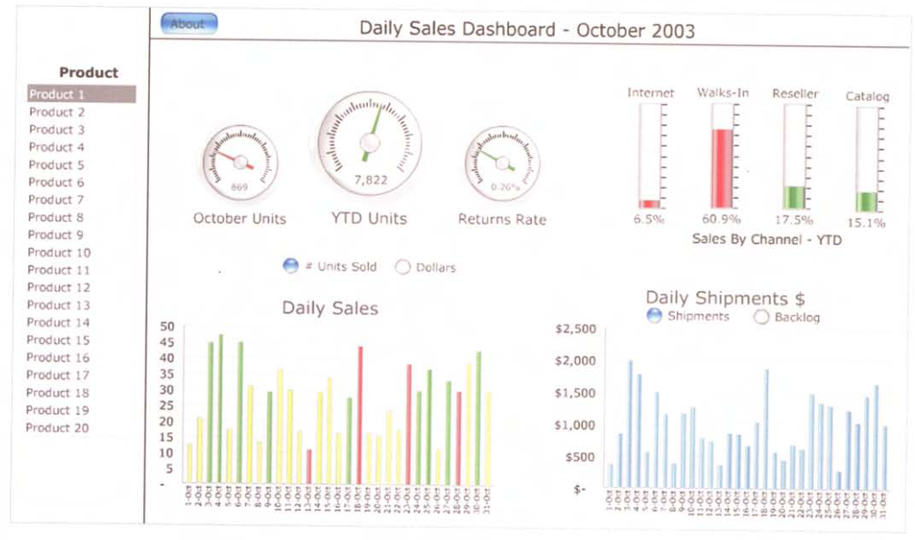
More Than a Single Screen, cont’d
Information Dashboard Design, 2nd ed.
by Stephen Few
Analytics Press, 2013

Slide 28
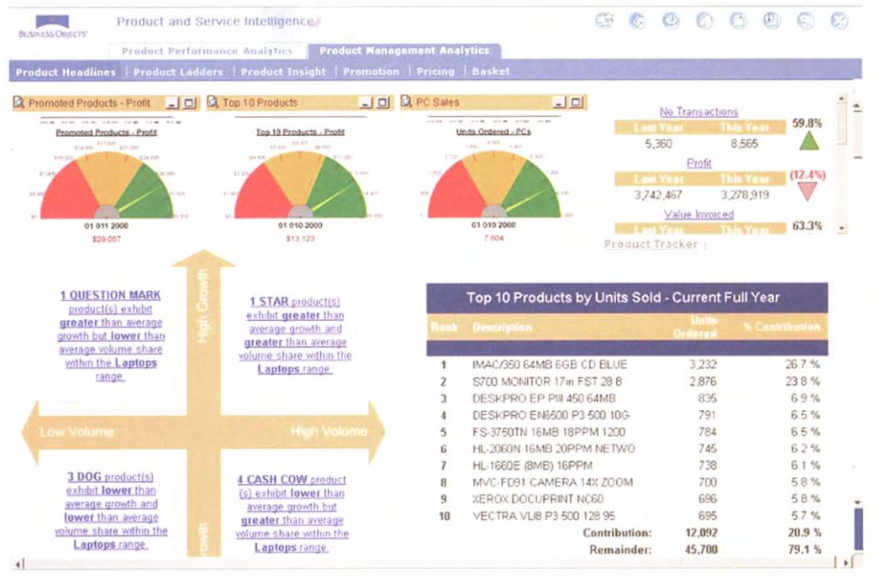
More Than a Single Screen, cont’d
Information Dashboard Design, 2nd ed.
by Stephen Few
Analytics Press, 2013

Slide 29
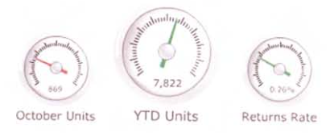
Inadequate Context for Data
Supply the right context for data in order to enlighten and inspire action.
Example: The following display shows data but without context.
Compared to what?
Are the numbers good or bad?
Information Dashboard Design, 2nd ed.
by Stephen Few
Analytics Press, 2013

Slide 30
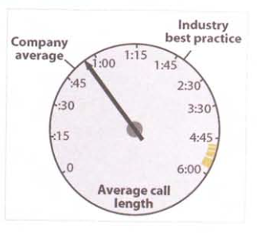
Inadequate Context for Data, cont’d
An improvement:
Prominently display primary information and subdue the supporting context.
Don’t let the context get in the way of quickly scanning for the key data points.
Information Dashboard Design, 2nd ed.
by Stephen Few
Analytics Press, 2013

Slide 31
Excessive Detail or Precision
Present only high-level information.
Too much detail or precision slows scanning.
Every unnecessary piece of information results in time wasted as the view needs to filter out what’s important.

Slide 32
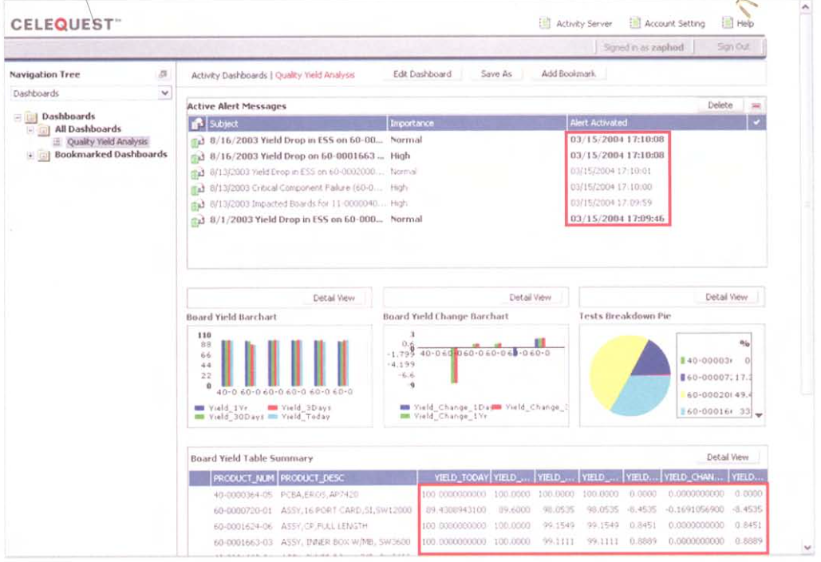
Excessive Detail or Precision, cont’d
Information Dashboard Design, 2nd ed.
by Stephen Few
Analytics Press, 2013

Slide 33
Express Measures Indirectly
What is being measured? What are the units?
A measure is deficient if it isn’t the one that most clearly and efficiently communicates the message that the viewer needs.
The data may be accurate but not the best choice to convey the intended message.

Slide 34
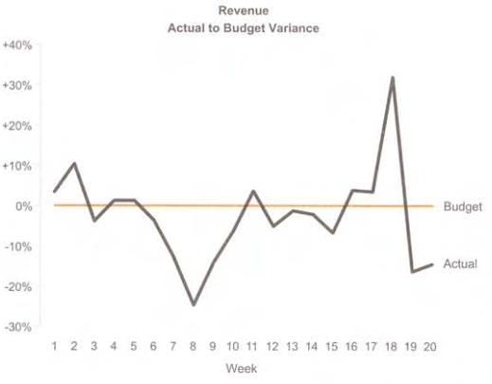
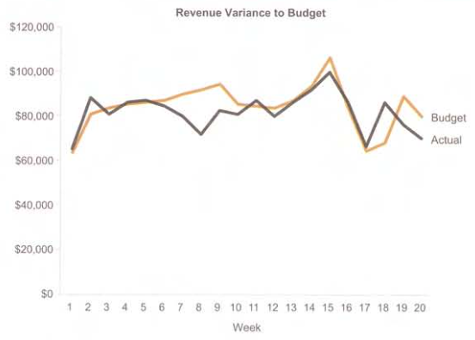
Expressing Measures Indirectly, cont’d
Information Dashboard Design, 2nd ed.
by Stephen Few
Analytics Press, 2013

Slide 35
Inappropriate Display Media
Choosing inappropriate display media is one of the most common design mistakes.
Examples:
Using a graph when a table of numbers is better.
Using a pie chart when a bar chart is better.

Slide 36
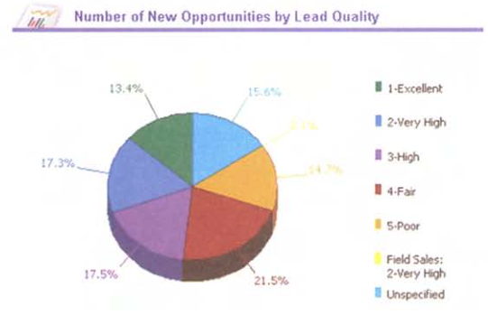
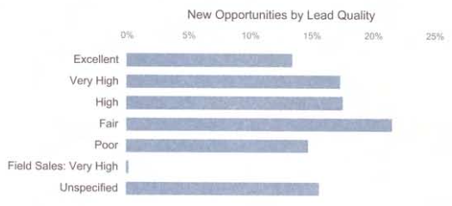
Inappropriate Display Media, cont’d
Information Dashboard Design, 2nd ed.
by Stephen Few
Analytics Press, 2013

Slide 37
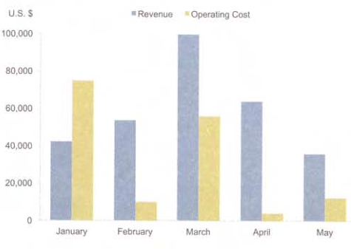
Inappropriate Display Media, cont’d
Information Dashboard Design, 2nd ed.
by Stephen Few
Analytics Press, 2013

Slide 38
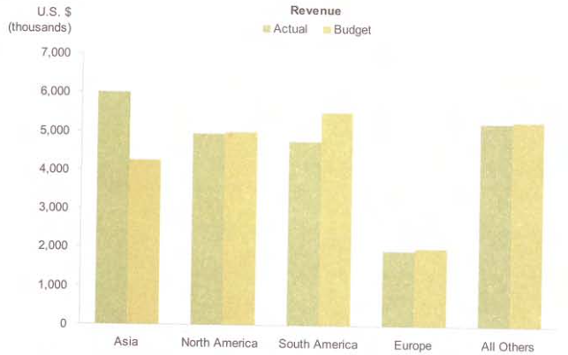
Inappropriate Display Media, cont’d
Information Dashboard Design, 2nd ed.
by Stephen Few
Analytics Press, 2013

Slide 39
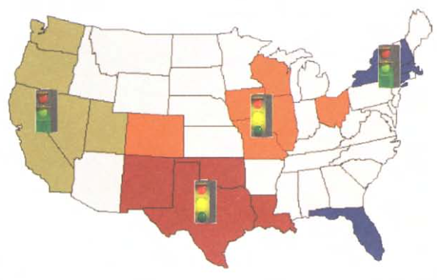
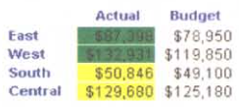
Inappropriate Display Media, cont’d
Information Dashboard Design, 2nd ed.
by Stephen Few
Analytics Press, 2013

Slide 40
Meaningless Variety in Display Media
Arbitrary variety will aggravate viewers.
Don’t force users to work harder than necessary.
Viewers will not get “bored” by consistent media.
Consistent media enables viewers to use the same perceptual strategy to interpret all the data.
Saves time and energy.

Slide 41
Meaningless Variety in Display Media, cont’d
Information Dashboard Design, 2nd ed.
by Stephen Few
Analytics Press, 2013

Slide 42
Poorly Designed Display Media
Be wary of pie charts.
Avoid overuse of skeuomorphs.
Avoid 3-D bar charts.

Slide 43
Poorly Designed Display Media, cont’d
Information Dashboard Design, 2nd ed.
by Stephen Few
Analytics Press, 2013

Slide 44
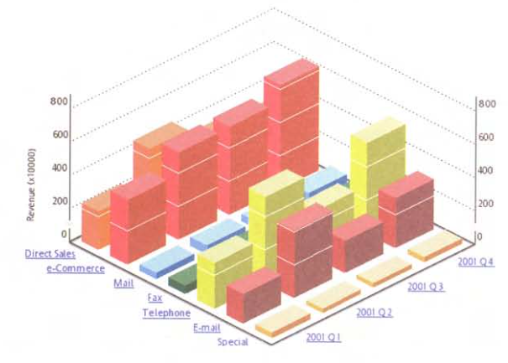
Poorly Designed Display Media, cont’d
Information Dashboard Design, 2nd ed.
by Stephen Few
Analytics Press, 2013

Slide 45
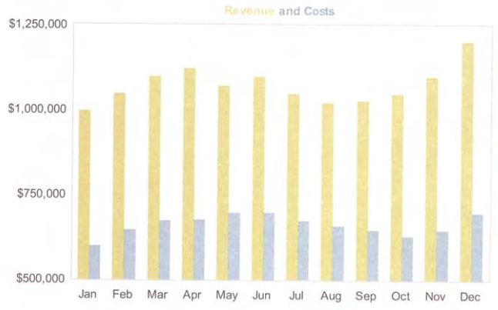
Encoding Data Inaccurately
Don’t display data inaccurately or misleadingly.
Information Dashboard Design, 2nd ed.
by Stephen Few
Analytics Press, 2013

Slide 46
Arranging Data Poorly
Don’t simply make the dashboard look good.
Arrange the information appropriately.
The most important information should be prominent.
Information that needs attention should stand out.
Data that should be compared should be arranged and visually designed to encourage comparisons.

Slide 47
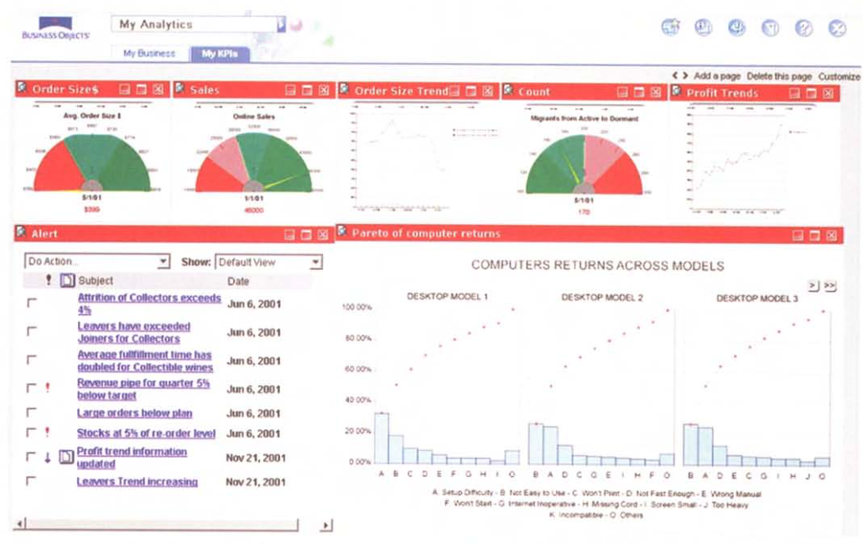
Arranging Data Poorly, cont’d
Wasted
screen space.
Should be
next to the
order size gauge.
Can we compare
the two line graphs?
Is this the most
important data?
Information Dashboard Design, 2nd ed.
by Stephen Few
Analytics Press, 2013

Slide 48
Highlighting Important Information Poorly
A dashboard should draw our eyes immediately to the most important information.
If everything is visually prominent, nothing will stand out.
If everything shouts for attention, nothing will be heard.

Slide 49
Highlighting Important Information Poorly, cont’d
Information Dashboard Design, 2nd ed.
by Stephen Few
Analytics Press, 2013

Slide 50
Cluttering with Visual Effects
An abundance of useless embellishments is a common dashboard problem.
Fancy artwork soon becomes weary.
Viewers must get past the decorations to obtain the information.

Slide 51
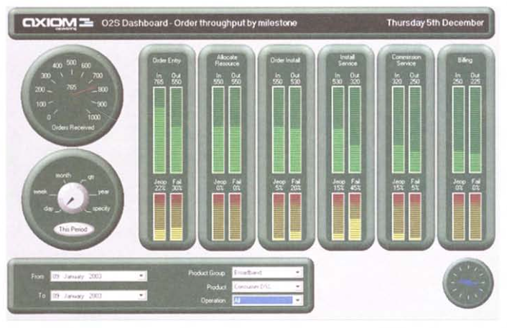
Cluttering with Visual Effects, cont’d
Information Dashboard Design, 2nd ed.
by Stephen Few
Analytics Press, 2013

Slide 52
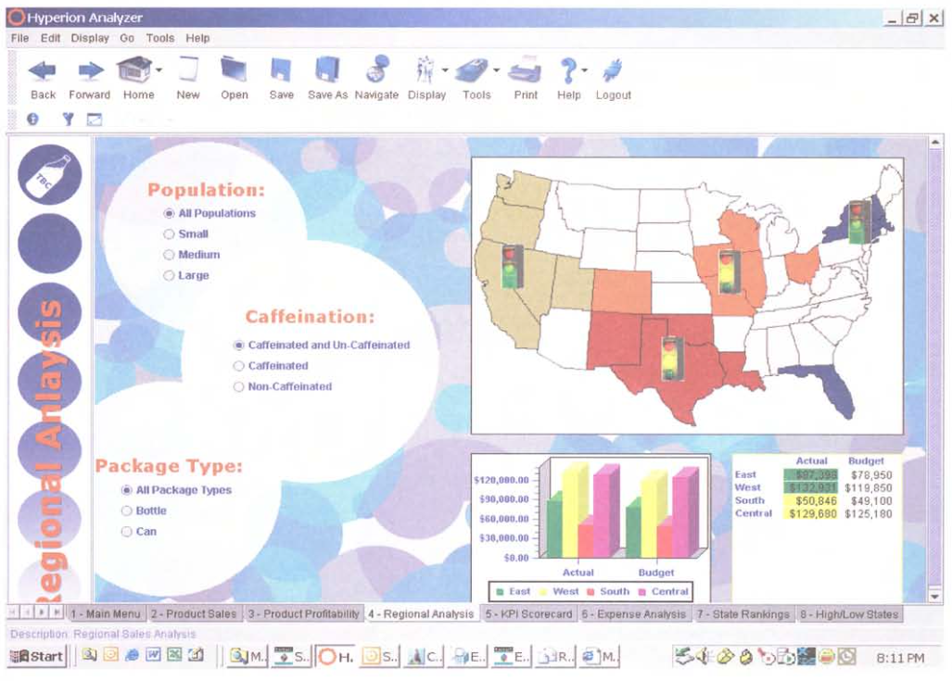
Cluttering with Visual Effects, cont’d
Information Dashboard Design, 2nd ed.
by Stephen Few
Analytics Press, 2013

Slide 53
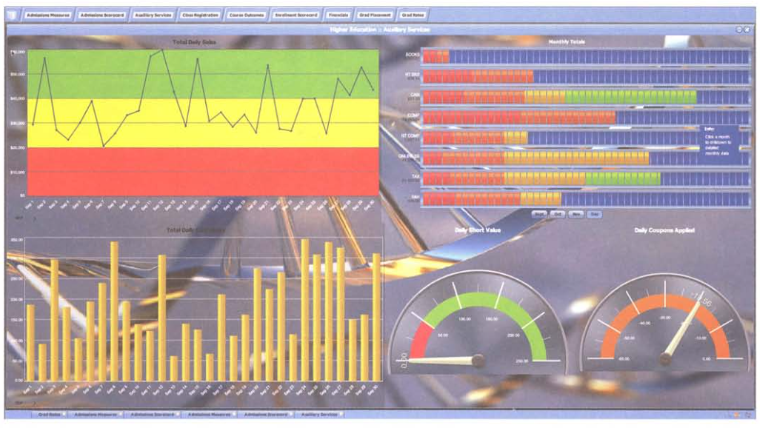
Cluttering with Visual Effects, cont’d
Information Dashboard Design, 2nd ed.
by Stephen Few
Analytics Press, 2013

Slide 54
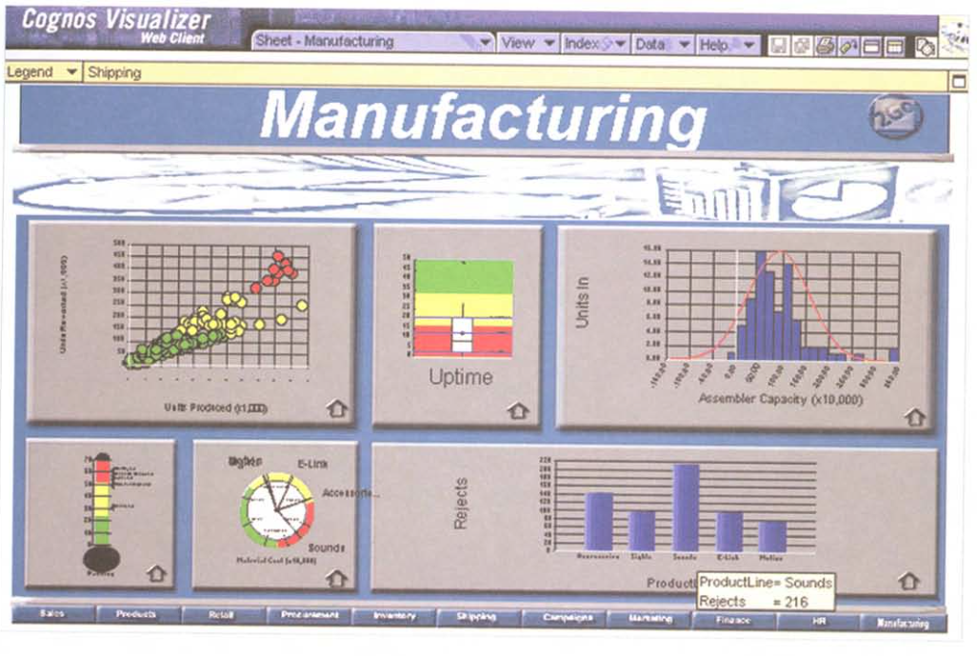
Unattractive Visual Display
Information Dashboard Design, 2nd ed.
by Stephen Few
Analytics Press, 2013
Don’t make ugly dashboards!

Slide 55
Data-Ink Ratio
Maximize the data-ink ratio (within reason).
Every bit of ink on a graphic requires a reason.
Nearly always, the reason should be that the ink presents new information.
Keep it simple!
Eliminate chart junk!

Slide 56
Dashboard Design: Goals and Steps
Reduce the non-data pixels.
Eliminate all unnecessary non-data pixels.
De-emphasize and regularize the non-data pixels that remain.
Enhance the data pixels.
Eliminate all unnecessary data pixels.
Highlight the most important data pixels that remain.

Slide 57
Data-Ink Ratio, cont’d
Can you separate the data ink from the non-data ink?
The non-data ink
is highlighted in red.
Information Dashboard Design, 2nd ed.
by Stephen Few
Analytics Press, 2013

Slide 58
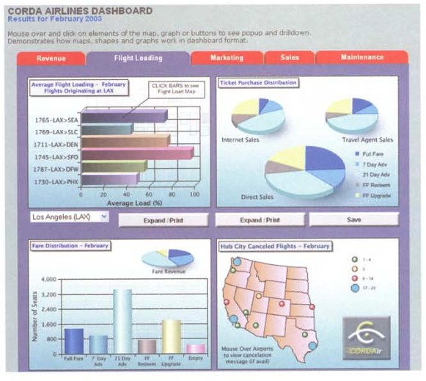
Data-Ink Ratio, cont’d
Too high percentage of non-data pixels:
Information Dashboard Design, 2nd ed.
by Stephen Few
Analytics Press, 2013

Slide 59
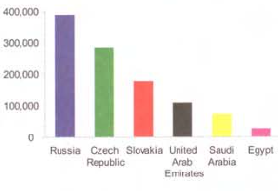
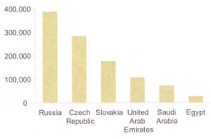
Data-Ink Ratio, cont’d
Colors that don’t encode any meaning:
Information Dashboard Design, 2nd ed.
by Stephen Few
Analytics Press, 2013

Slide 60
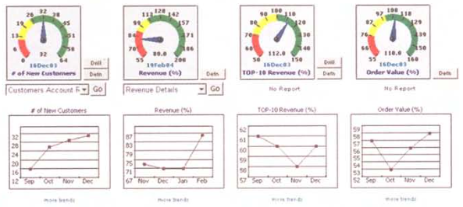
Data-Ink Ratio, cont’d
Unnecessary borders fragment the display.
Information Dashboard Design, 2nd ed.
by Stephen Few
Analytics Press, 2013

Slide 61
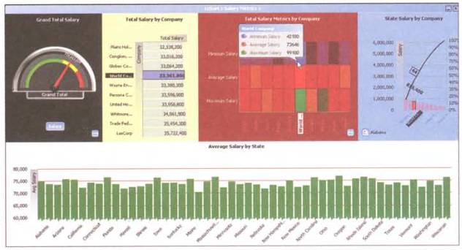
Data-Ink Ratio, cont’d
Unnecessary and distracting fill colors.
Information Dashboard Design, 2nd ed.
by Stephen Few
Analytics Press, 2013

Slide 62
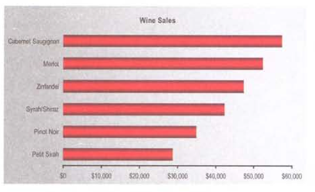
Data-Ink Ratio, cont’d
Distracting use of color gradients.
Information Dashboard Design, 2nd ed.
by Stephen Few
Analytics Press, 2013

Slide 63
Data-Ink Ratio, cont’d
Unnecessary grid lines in graphs.
Information Dashboard Design, 2nd ed.
by Stephen Few
Analytics Press, 2013

Slide 64
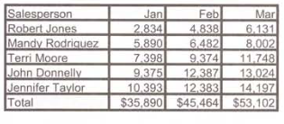
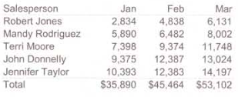
Data-Ink Ratio, cont’d
Unnecessary grid lines in tables.
Information Dashboard Design, 2nd ed.
by Stephen Few
Analytics Press, 2013

Slide 65
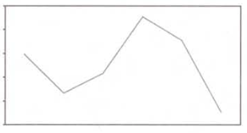
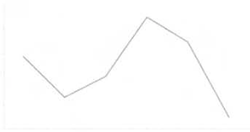
Data-Ink Ratio, cont’d
Complete borders instead of x- and y-axes.
Information Dashboard Design, 2nd ed.
by Stephen Few
Analytics Press, 2013

Slide 66
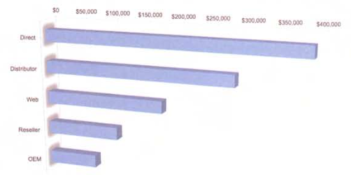
Data-Ink Ratio, cont’d
Avoid 3-D
Information Dashboard Design, 2nd ed.
by Stephen Few
Analytics Press, 2013

Slide 67
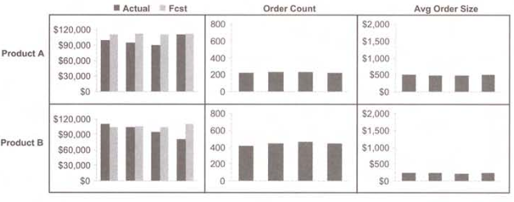
Data-Ink Ratio, cont’d
Make separator lines lighter.
Information Dashboard Design, 2nd ed.
by Stephen Few
Analytics Press, 2013

Slide 68
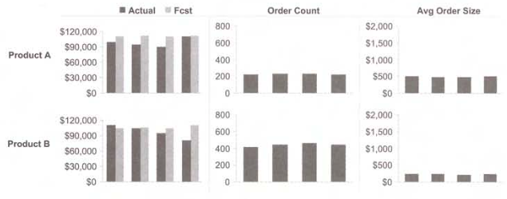
Data-Ink Ratio, cont’d
Make separator lines lighter, cont’d.
Information Dashboard Design, 2nd ed.
by Stephen Few
Analytics Press, 2013

Slide 69
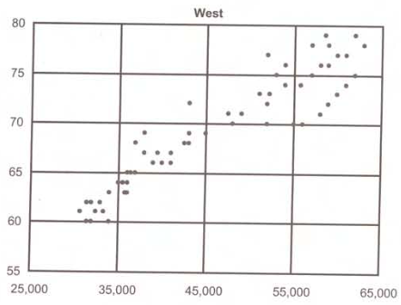
Data-Ink Ratio, cont’d
Make grid lines lighter.
Information Dashboard Design, 2nd ed.
by Stephen Few
Analytics Press, 2013

Slide 70
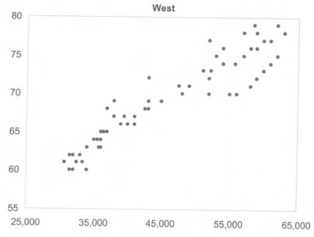
Data-Ink Ratio, cont’d
Make grid lines lighter, cont’d.
Information Dashboard Design, 2nd ed.
by Stephen Few
Analytics Press, 2013

Slide 71
Data-Ink Ratio, cont’d
Mute the shading used to delineate table rows.
Information Dashboard Design, 2nd ed.
by Stephen Few
Analytics Press, 2013

Slide 72
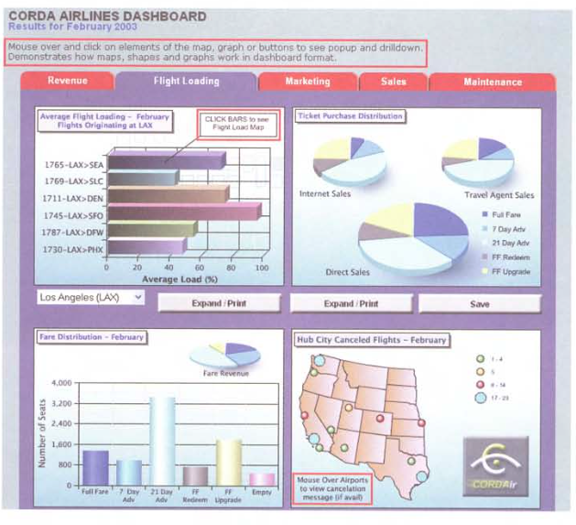
Data-Ink Ratio, cont’d
Dashboards should not need instructions.
Information Dashboard Design, 2nd ed.
by Stephen Few
Analytics Press, 2013

Slide 73
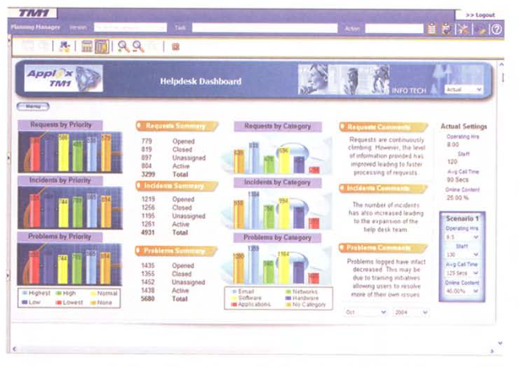
Data-Ink Ratio, cont’d
Chart junk!
Information Dashboard Design, 2nd ed.
by Stephen Few
Analytics Press, 2013

Slide 74
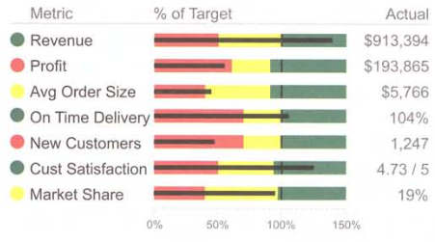
Data-Ink Ratio, cont’d
Overuse of color.
Information Dashboard Design, 2nd ed.
by Stephen Few
Analytics Press, 2013

Slide 75
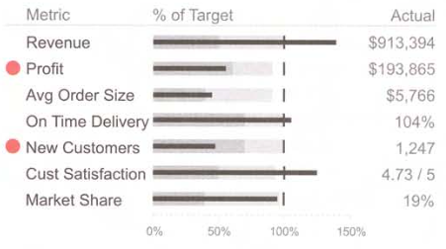
Data-Ink Ratio, cont’d
Overuse of color, cont’d.
Now the important
items stand out.
Information Dashboard Design, 2nd ed.
by Stephen Few
Analytics Press, 2013

