Slide 1
CS 235: User Interface Design April 14 Class Meeting
Department of Computer Science San Jose State University Spring 2015 Instructor: Ron Mak
www.cs.sjsu.edu/~mak

Slide 2
Some Sources of Data for Visualization
Google “datasets for data visualization”
http://archive.ics.uci.edu/ml/
http://www.kdnuggets.com/datasets/index.html
https://www.kaggle.com/competitions
http://www.visualizing.org/data/browse
http://datavisualization.ch/datasets/
http://www.idvbook.com/teaching-aid/data-sets/
http://blog.visual.ly/data-sources/
https://www.google.com/publicdata/directory

Slide 3
Data Visualization
False: We have too much information.
Data represents a wealth of potential.
True: We don’t know how to make the best use of the data.
Today’s software tools can assist us in doing data analysis.
The tools’ effectiveness depend on how skilled we are in using them.

Slide 4
What is Data Analysis?
Analysis: Take things apart to understand them.
Data analysis: Make sense of data.
Meanings reside in data.
Take the data apart to understand relationships among the parts.
How does this part relate to that part?
Are they similar or different?
How are they changing?
Does one part’s change cause another part to change?

Slide 5
Data Analysis Tools
Wrong:
Correct:
Data Analysis
Tool
Data
Decisions
Data Analysis
Tool
Data Visualization
Data
Decisions

Slide 6
Data Analysis Tools, cont’d
Tableau Public
Create data visualizations for the web.
Choose from a palette of visual widgets.
Free: http://www.tableausoftware.com/products/public
D3.js
Javascript library for manipulating documents based on data.
HTML, SVG, and CSS
Allows great control over the visual result.
Free: https://github.com/mbostock/d3/releases/download/v3.4.13/d3.zip

Slide 7
Data Analysis Tools, cont’d
Highcharts
Javascript library to create interactive web charts.
Free: http://www.highcharts.com/products/highcharts

Slide 8
Why Analyze Data?
Understand and manage what’s happening now.
Causes
Descriptive analytics
Predict what is likely to happen in the future.
Create opportunities
Prevent problems
Determine what actions will cause this future.
Predictive analytics
Help with decision-making.
Prescriptive analytics

Slide 9
Becoming Acquainted with a Data Set
Ways to become acquainted with a data set for the first time.
See the paper: http://www.perceptualedge.com/articles/visual_business_intelligence/exploratory_vistas.pdf

Slide 10
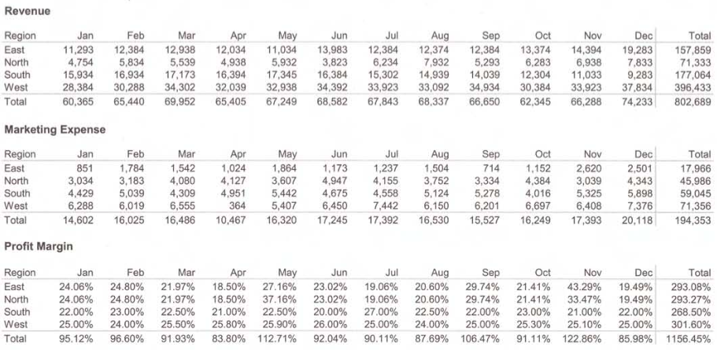
Tables vs. Graphs
These tables give us the data we need:
The precise amount of sales revenue, marketing expense, and profit for a specific region during a specific month.
Now You See It
by Stephen Few
Analytics Press, 2009

Slide 11
Tables vs. Graphs, cont’d
We need graphs to understand the relationships within and among sales revenues, marketing expenses, and profits.
Graphs tell a story or provide a narrative.
Well-designed visualizations make the stories visible and bring them to life.

Slide 12
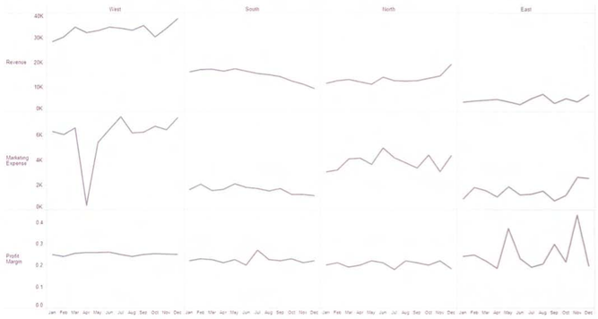
Tables vs. Graphs, cont’d
Line graphs that focus on change over time:
Despite low revenue, the east region
generated the highest profit margins
in the spring and winter. The spikes
correspond to increases in marketing
expenses in the spring and winter.
Now You See It
by Stephen Few
Analytics Press, 2009

Slide 13
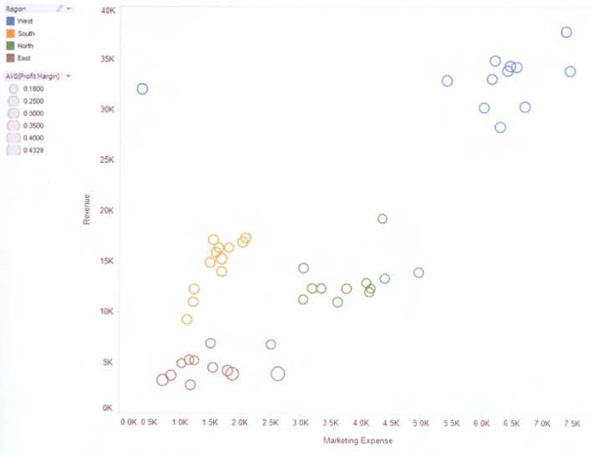
Tables vs. Graphs, cont’d
Scatter plot of correlations between revenues, profits, and marketing expenses by region.
Extremely low
marketing
expenses in April
in the west.
Strong correlation between
marketing expenses and
revenues in the south.
May and November
peaks in eastern profits.
Now You See It
by Stephen Few
Analytics Press, 2009

Slide 14
What is Data Visualization?
Data visualization
Information visualization
Scientific visualization
Information visualization
Computer-generated interactive representations of abstract data in order to foster understanding.
Example: sales, revenue, expense data
Scientific visualization
Visual representations of scientific data that are usually physical in nature.
Example: an MRI scan

Slide 15
A Brief History of Data Visualization
Now You See It
by Stephen Few
Analytics Press, 2009

Slide 16
A Brief History of Data Visualization, cont’d
2nd century CE
Egypt: Tabular arrangements of astronomical data.
17th century
René Descartes invents the two-dimensional graph.
18th century
Scottish social scientist William Playfair invents the bar graph, the line graph to represent change over time, and the pie chart.

Slide 17
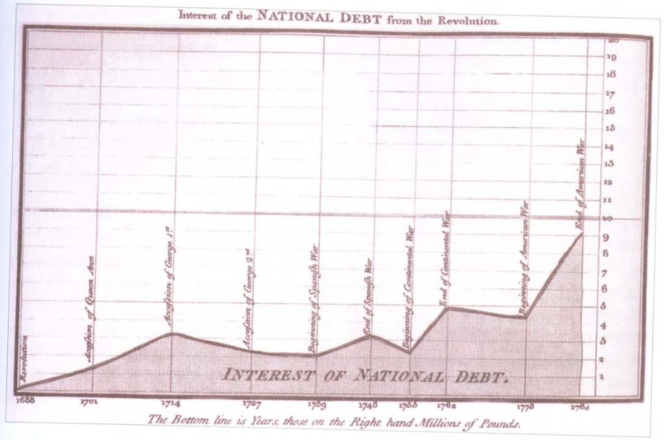
A Brief History of Data Visualization, cont’d
An original graph by William Playfair:

Slide 18
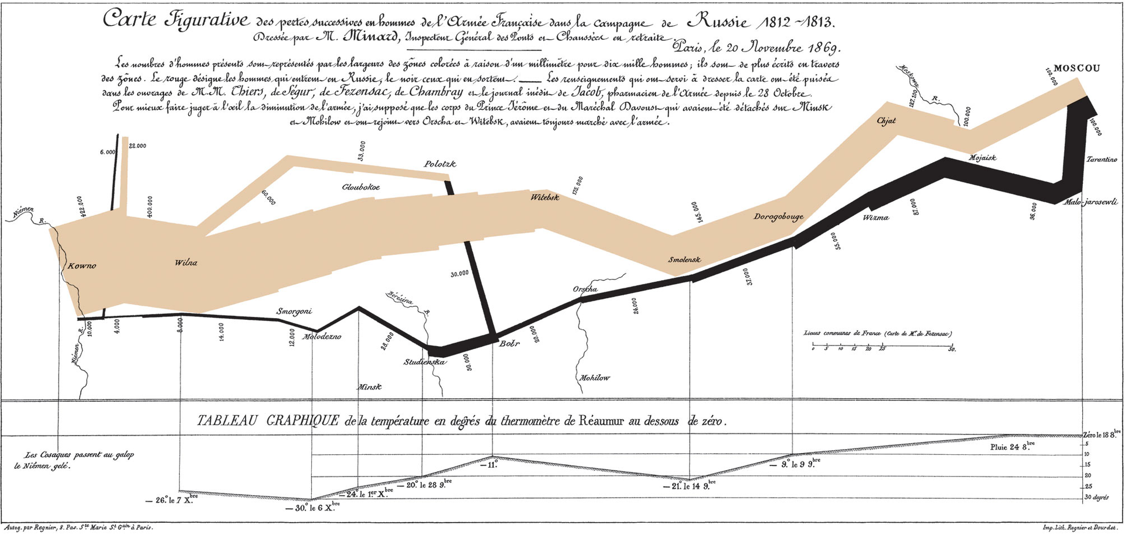
A Brief History of Data Visualization, cont’d
http://en.wikipedia.org/wiki/Charles_Joseph_Minard#mediaviewer/File:Minard.png
1869
Graph by Charles Minard of Napolean’s French troops during the Russian Campaign, 1812-1813

Slide 19
A Brief History of Data Visualization, cont’d
1967
Jacques Bertin publishes Sémiologie Graphique (Semiology of Graphics)
Introduced the concept of visual language.
Argued that visual perception operated according to rules that could be followed to clearly, accurately, and efficiently express information in a visual format.
1977
Princeton statistics professor John Tukey publishes Exploratory Data Analysis.
A new approach to statistics.

Slide 20
A Brief History of Data Visualization, cont’d
1983
Data visualization expert Edward Tufte publishes The Visual Display of Quantitative Information.
Effective ways to display data visually.
1984
Apple introduces the Macintosh computer.
1985
Statistician William Campbell at Bell Labs publishes The Elements of Graphing Data.
Refined and extended the use of visualization.

Slide 21
A Brief History of Data Visualization, cont’d
1986
National Science Foundation (NSF) sponsors “Panel on Graphics, Image Processing and Workstations”.
1987
Report Visualization in Scientific Computing
1990
First IEEE Visualization Conference

Slide 22
What is Data Visualization? cont’d
Data Visualization
Activities | Exploration Sense-making | Communication
Technologies | Information visualization Scientific visualization | Graphical presentation
Immediate goal | Understanding
End goal | Good decisions

Slide 23
Traits of Meaningful Data
High volume
More information increases the chance we’ll find what we need or see something interesting.
Historical
Make sense of the present by seeing patterns from the past.
Consistent
Keep the data consistent despite changes over time.
Adjust the data as necessary to current definitions.

Slide 24
Traits of Meaningful Data, cont’d
Multivariate
The more variables we have when trying to make sense of data, the richer the opportunities for discovery.
Atomic
Able to drill down to the lowest level of detail.
Don’t omit details when storing data.
Clean
“Garbage in, garbage out”.
Information that is accurate, complete, and error-free.

Slide 25
Traits of Meaningful Data, cont’d
Clear
Not cryptic.
Expressed in familiar terms.
Dimensionally structured
Dimensions and measures (facts).
Dimensions are categorical data.
Examples: departments, regions, products, time
Measures are quantitative data.
Examples: sales, profits, revenue, expenses

Slide 26
Traits of Meaningful Data, cont’d
Richly segmented
Segmented into meaningful groups
Examples: geographic regions, product categories
Known pedigree
How did the data come to be.
Where did it came from.
How was it calculated.

Slide 27
Visual Perception
Our eyes are drawn to familiar patterns.
We see what we know and expect.
Can you see
the dolphin?
Now You See It
by Stephen Few
Analytics Press, 2009

Slide 28
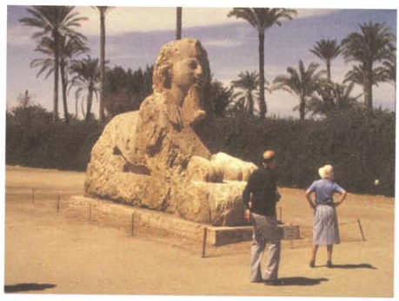
Visual Perception, cont’d
Memory plays an important role in cognition.
Working memory is extremely limited.
Now You See It
by Stephen Few
Analytics Press, 2009

Slide 29
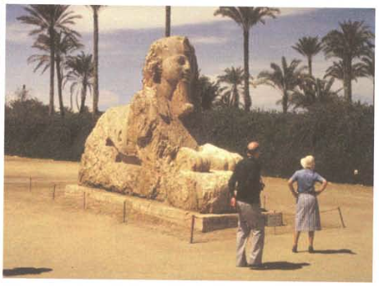
Visual Perception, cont’d
Working memory is extremely limited, cont’d.
What changed?
Now You See It
by Stephen Few
Analytics Press, 2009

Slide 30
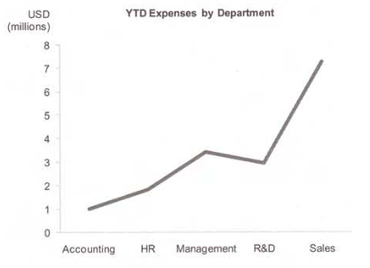
Make Abstract Data Visible
What is wrong with this graph?
It doesn’t make sense
to encode the values
as a line.
The departments are
independent of each
other and have no
particular order.
Now You See It
by Stephen Few
Analytics Press, 2009

Slide 31
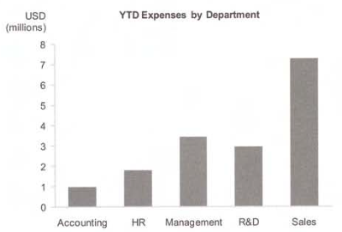
Make Abstract Data Visible, cont’d
A more reasonable graph:
Now You See It
by Stephen Few
Analytics Press, 2009

Slide 32
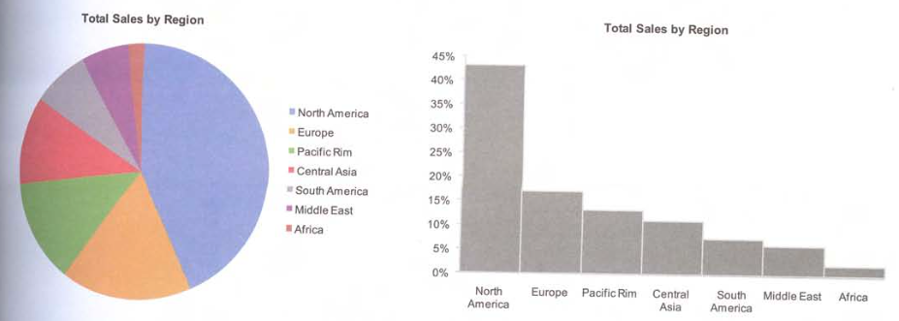
Make Abstract Data Visible, cont’d
Which graph best allows you to rank and compare the top sales regions?
Now You See It
by Stephen Few
Analytics Press, 2009

Slide 33
Pre-Attentive Attributes
Attributes of visual images that we perceive pre-attentively—prior to conscious awareness.
length
width
orientation
size
shape
curvature
enclosure
spatial grouping
blur
hue
color intensity
2-D position
direction of motion

Slide 34
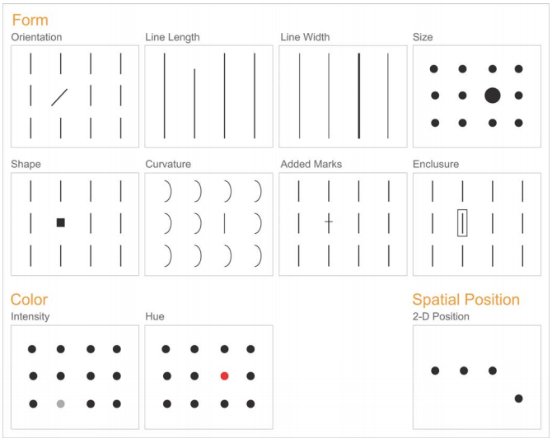
Pre-Attentive Attributes, cont’d
http://jthsinstructionaltechnology.blogspot.com/2012/10/infographics-explained-and-why-you.html

Slide 35
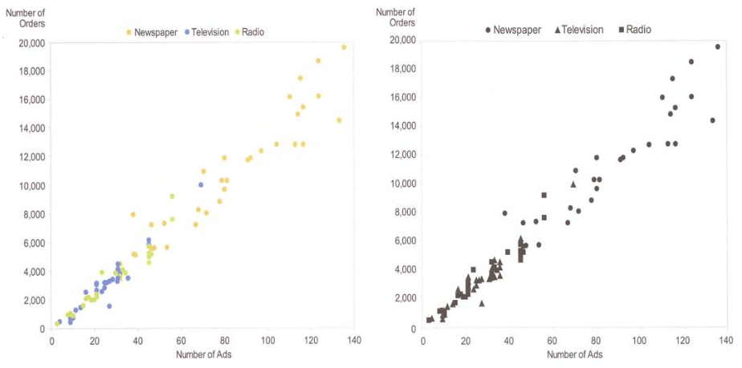
Use of Pre-Attentive Attributes
Now You See It
by Stephen Few
Analytics Press, 2009

Slide 36
Use of Pre-Attentive Attributes, cont’d
Sales revenue by region:
Add profits by region:
Now You See It
by Stephen Few
Analytics Press, 2009

Slide 37
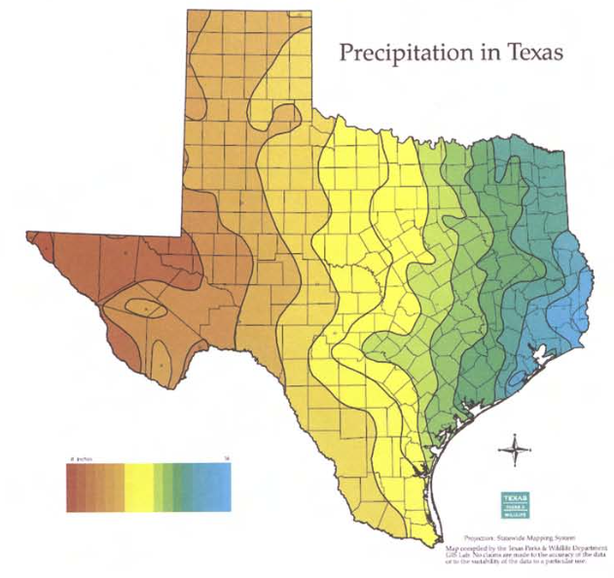
Use of Pre-Attentive Attributes, cont’d
Heat map:
Now You See It
by Stephen Few
Analytics Press, 2009

Slide 38
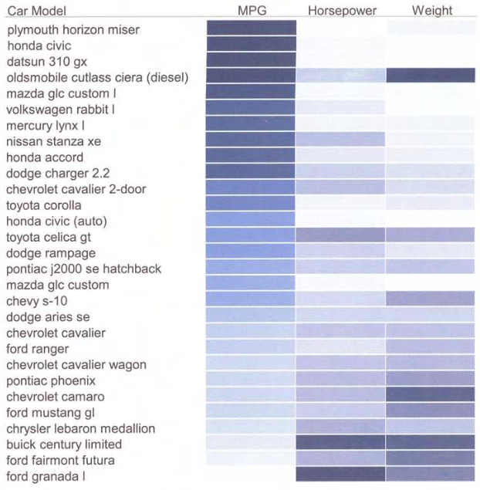
Use of Pre-Attentive Attributes, cont’d
Heat map:
Now You See It
by Stephen Few
Analytics Press, 2009

Slide 39
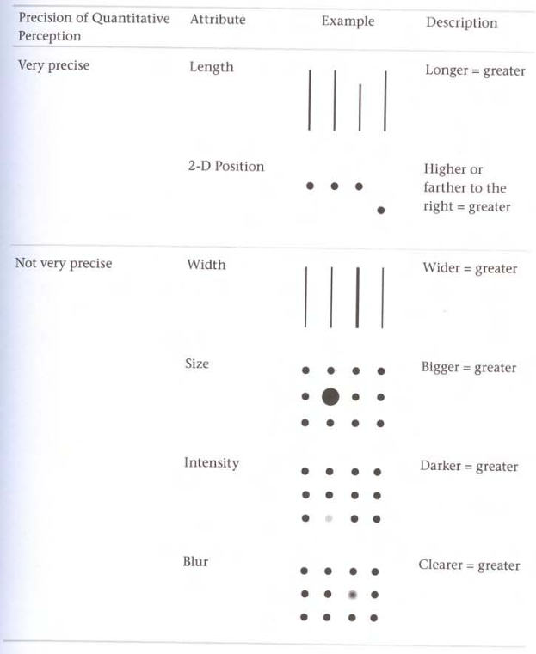
Quantitative Perceptions
Now You See It
by Stephen Few
Analytics Press, 2009

Slide 40
Prerequisites for a Successful Data Analyst
Interested
You must care about the data.
Sense that what you do is important and valuable.
Curious
Enjoy figuring things out.
Wonder how things work or why they happen.
Crave information.
Self-motivated
Don’t need to be told what to do.

Slide 41
Prerequisites, cont’d
Open-minded and flexible
Willingness to accept what you find.
Willingness to discover that you are wrong.
Imaginative
Creativity to navigate unknown territories.
Repeatedly ask “what if I try this?”
Skeptical
Never be entirely sure of the data or the methods.
Be willing to look from a different perspective.

Slide 42
Prerequisites, cont’d
Aware of what’s worthwhile
Have priorities.
Not all data is equally valuable.
Methodical
Repeat known successful processes until the goal is reached.
Capable of spotting patterns
Discern patterns of meaning within visual representations of data.
Spot meaningful patterns and ignore the rest.

Slide 43
Prerequisites, cont’d
Analytical
Recognize the individual parts of something complex and how the parts relate to one another.
Synthetical
Look at pieces and see how they may fit together.
See the big picture.
Familiar with data
Understand the rules and meanings of data.
Skilled in the practices of data analysis

