Slide 1


CS 235: User Interface Design
February 12 Class Meeting
Department of Computer Science
San Jose State University
Spring 2015
Instructor: Ron Mak
www.cs.sjsu.edu/~mak

Slide 2
Your Application Prototype
Each team should build a working prototype
of its application.
  Concentrate on designing a good user interface.
  Use UI design patterns.
The prototype doesn’t have to really work.
  “Fake it” enough so that looks realistic.
  Hard-code the interactions.
  OK for some execution paths not to work at all.
Make at least two of your use cases “work”.
  Concentrate on designing a good user experience.

Slide 3
Your Application Prototype, cont’d
Bob Nicholson’s favorite wireframe tool:
  Balsamic Mockups
  https://balsamiq.com
You will perform usability testing
with your application prototypes.
  Determine how good your UI and UX designs are.
We will study how to perform usability testing
starting next week.

Slide 4
Organization Design Patterns
Feature, Search, and Browse
News Stream
Picture Manager
Dashboard
Canvas + Palette
Wizard
Settings Editor
Alternate Views
Multiple Workspaces
Multilevel Help

Slide 5
Navigation Design Patterns
Clear Entry Points
Hub and Spoke
Fully Connected
Multilevel
Sequential
Pyramid
Pan and Zoom
Modal Dialog
Escape Hatch
Bookmark

Slide 6
Page Layout Design Patterns
Visual Framework
Center Stage
Grid of Equals
Tiled Sections
Module Tabs
Collapsible Panel
Movable Panels
Left-right Alignment
Responsive Enabling
Self-adjusting Layout

Slide 7
List Design Patterns
Two-panel Selector
One-Window Drilldown
List Inlay
Thumbnail Grid
Carousel
Striped Rows
Pagination
Jump to Item
Alphabet Scroller
Cascading Lists
Tree Table
New-Item Row

Slide 8
Action Controls
Buttons
Menu bars
Pop-up menus
Drop-down menus
Toolbars
Links
Action panels
Hover tools
Double-clicking
Keyboard actions
Drag-and-drop
Typed commands

Slide 9
Action Design Patterns
Ways to present action.
Indicate progress of actions.
Give users a sense of closure.
Allow users to preview actions.
Allow users to cancel actions.
Allow users to undo actions.
_

Slide 10
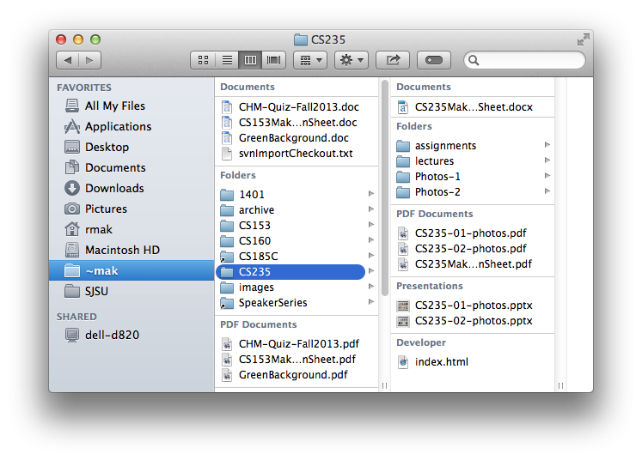
Action: Button Groups
What
  Group related actions
  Multiple groups for
  multiple sets of actions
When
  Many possible actions
  Related sets of actions
Why
  Gestalt principles
  Actions that can take place in a given context
  Button clusters easy to pick out among in a complex layout

Slide 11
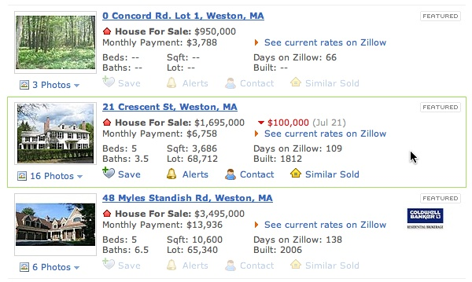
Action: Hover Tools
What
  Place controls next to the item they act upon
  Hide or disable the controls until the user hovers the mouse over the item
When
  Many possible actions
  Keep user interface as uncluttered as possible
Why
  Show or enable only relevant controls
Designing Interfaces, 2nd ed.
by Jenifer Tidwell
O’Reilly Media, 2011

Slide 12
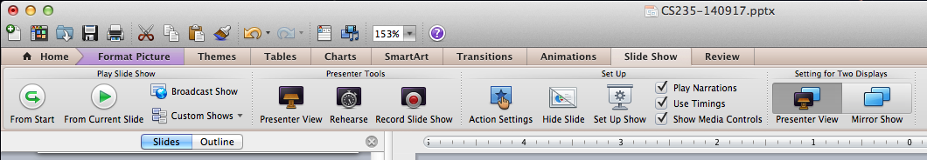
Action: Action Panel
What
  A panel of related controls that is richly organized
  and always visible
When
  The controls need to be visible always
  Sufficient space to display the controls
Why
  Users will always know what actions are available

Slide 13
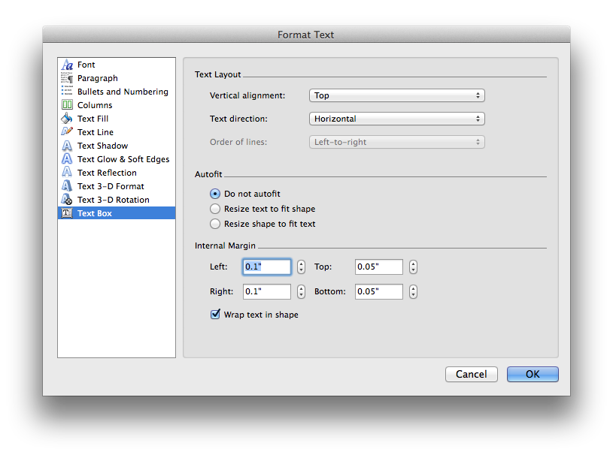
Action: Prominent “Done” Button
What
  Place the button that
  completes an action
  prominently at the
  end of the visual flow
When
  Whenever you need a
  Done, Submit, OK, or
  Continue button
Why
  Give the user a sense of closure
  The user knows that an action was done

Slide 14
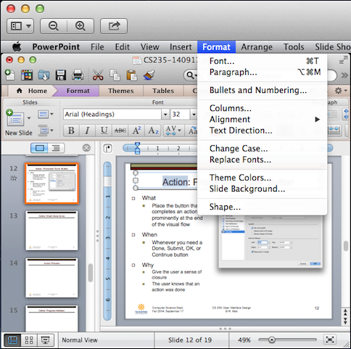
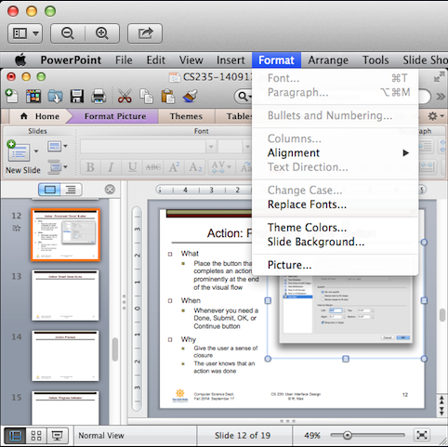
Action: Smart Menu Items
What
  Dynamically
  change or
  disable
  menu items
When
  Different
  actions for
  different
  contexts
Why
  Only show actions that are
  relevant for a given context,
  such as a user selection

Slide 15
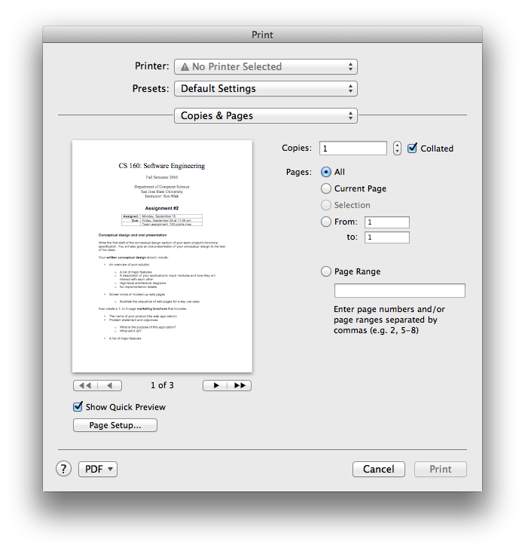
Action: Preview
What
  Show a preview or summary of the results of a pending action
When
  The user is about to perform an action that will produce results
Why
  Assure the user that the results will be correct
  Help prevent errors

Slide 16
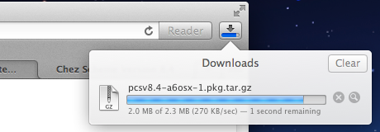
Action: Progress Indicator
What
  Show how much
  progress a time-
  consuming action
  has made
When
  A time-consuming action runs in the background
Why
  Assure the user that progress is being made
  Indicate how much work remains

Slide 17
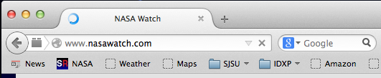
Action: Cancelability
What
  Provide a way to
  cancel a time-
  consuming action
When
  A time-consuming action
  runs in the background
Why
  Users change their minds
  A user wants to terminate
  a time-consuming action

Slide 18
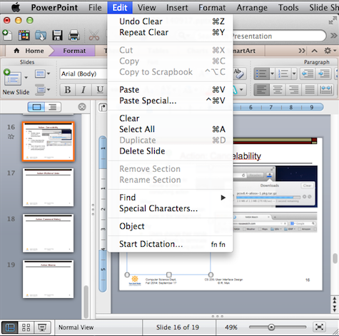
Action: Multilevel Undo
What
  Allow the user to reverse a sequence of actions
When
  A highly interactive interface with many
  user actions
Why
  Provide an interface that is safe to explore
  Users are confident that errors aren’t permanent
  No need to “checkpoint” data and revert to an earlier version

Slide 19
Actions Generally Undoable
Text entry
Drawing changes
Layout changes
Creation, deletion, or rearrangement of items
Cut, copy, or paste operations
File operations: create, delete, rename
Database operations

Slide 20
Actions Generally Not Undoable
Navigation between pages or windows
Mouse or text cursor movements
Scrollbar position
Window or panel positions and sizes
Changes made in a modal dialog box

Slide 21
Principles of Getting Input from Users
Make sure the user understands
what’s asked for and why.
  If possible, don’t ask.
Give the user a list of options.
Give meaningful and sensible error messages.
  Be forgiving.
Be aware of users’ mental models.
The choice of input controls determine the user’s expectations of what is asked for.
Do lots of usability testing.

Slide 22

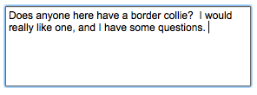

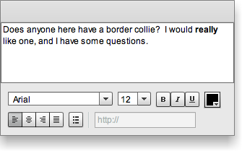
Text Input Controls
Single-line text
Multiline text
Structured text
Text editor
Designing Interfaces, 2nd ed.
by Jenifer Tidwell
O’Reilly Media, 2011

Slide 23




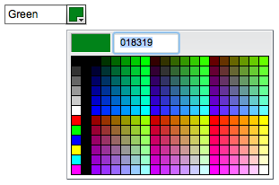
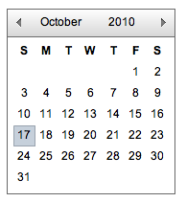
Choice Controls
Checkbox
Spinner
Radio buttons
Slider
Toggle buttons
Dropdown chooser
Calendar chooser
Designing Interfaces, 2nd ed.
by Jenifer Tidwell
O’Reilly Media, 2011

Slide 24
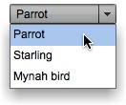
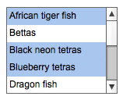
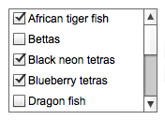
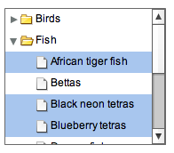
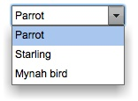
Controls for List Item Selection
Dropdown list
Multiple selection list
Checkbox list
Combo box
Multiple selection tree
Designing Interfaces, 2nd ed.
by Jenifer Tidwell
O’Reilly Media, 2011

Slide 25
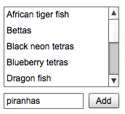
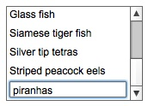
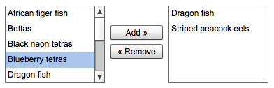
Controls for Creating Lists
List with new-item row
List with add button
List builder
Designing Interfaces, 2nd ed.
by Jenifer Tidwell
O’Reilly Media, 2011

Slide 26
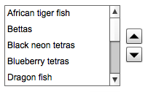
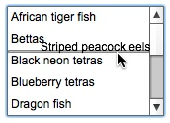
Controls for Sorting Lists
List with up-down buttons
List with internal
drag-and-drop
Designing Interfaces, 2nd ed.
by Jenifer Tidwell
O’Reilly Media, 2011

Slide 27
User Input Design Patterns
Allow users to select from choices.
Allow users to input text.
_

Slide 28

Input: Forgiving Format
What
  An input text field that allows a variety of input formats and syntax
When
  The user needs to enter information that can be typed in a variety of ways
Why
  Users are unpredictable
  Friendlier for users
Designing Interfaces, 2nd ed.
by Jenifer Tidwell
O’Reilly Media, 2011

Slide 29

Input: Structured Format
What
  A set of text input fields that reflect the structure of the requested data
When
  Input data must have a fixed structure
Why
  Provide a clue to users
  Reduce data entry errors
Credit card number:
Designing Interfaces, 2nd ed.
by Jenifer Tidwell
O’Reilly Media, 2011

Slide 30

Input: Fill-in-the-Blanks
What
  A sentence or phrase with one or more “blanks”
  for the user to fill in
When
  User input is in several related parts
Why
  Self-explanatory interface
  Hints to the user
Designing Interfaces, 2nd ed.
by Jenifer Tidwell
O’Reilly Media, 2011

Slide 31
Input: Tips and Hints
What
  Explanatory text that provides tips or hints about the desired input
When
  A form with a variety of input fields
Why
  Tell users what input
  is desired
  Users don’t need to consult documentation

Slide 32
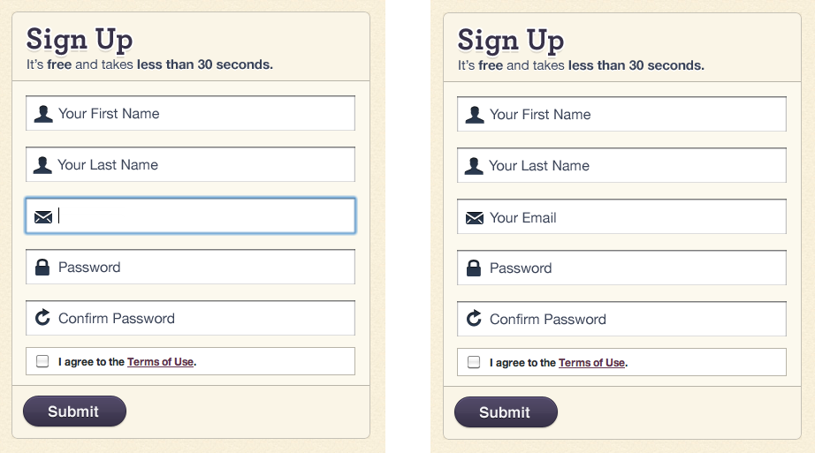
Input: Prompting Text Field
What
  Text input fields
  pre-filled with
  user prompts
When
  A form with
  a variety of
  input fields
Why
  Tell users what
  input is desired
  Users don’t need to consult documentation
Designing Interfaces, 2nd ed.
by Jenifer Tidwell
O’Reilly Media, 2011

Slide 33
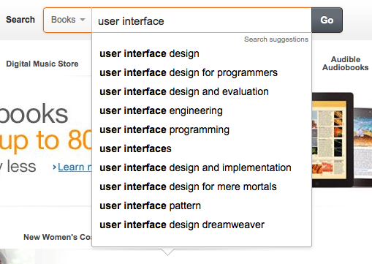
Input: Auto-Completion
What
  Anticipate possible
  input data based on
  what the user has
  already typed
When
  A list of possible ways
  to complete the input
Why
  User-friendly time saver
  Users don’t have to remember long input
  Users can reuse previous input

Slide 34
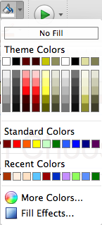
Input: Dropdown Chooser
What
  A dropdown menu with a variety
  of items
  Different ways to display the items
When
  The user must choose from a set
  of items
Why
  Users are already familiar with dropdown menus
  Compact way to present menu items
  Display menu items only when needed

Slide 35
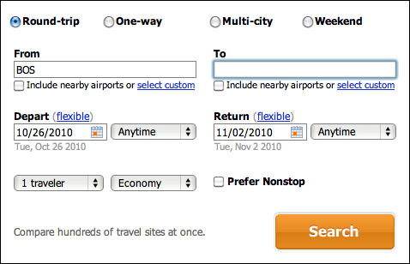
Input: Good Defaults
What
  Pre-fill input fields
  with likely user input
When
  Reasonable guesses of what the user will enter
Why
  User-friendly time-saver
  Less knowledge required by the user
Designing Interfaces, 2nd ed.
by Jenifer Tidwell
O’Reilly Media, 2011

Slide 36
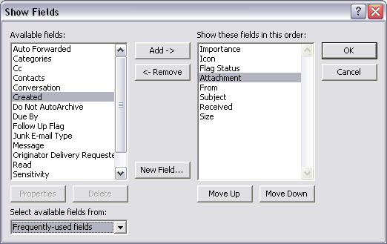
Input: List Builder
What
  Source and
  destination lists
  Add and Remove
  buttons, or drag-and-
  drop between the lists
When
  The user must create
  a list using items from
  another list
Why
  The user can see the available choices for the destination list
  Clear what the destination list will be
Designing Interfaces, 2nd ed.
by Jenifer Tidwell
O’Reilly Media, 2011

Slide 37
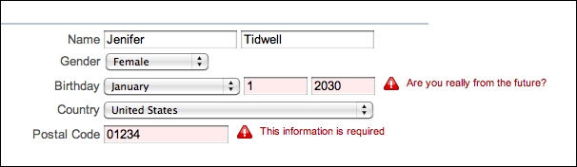
Input: Same-Page Error Messages
What
  Display error messages on the same page
  Display error messages next to the erroneous input
When
  User might enter bad input
Why
  Immediate feedback near the erroneous input
Designing Interfaces, 2nd ed.
by Jenifer Tidwell
O’Reilly Media, 2011

