Slide 1


CS 174: Web Programming
December 7 Class Meeting
Department of Computer Science
San Jose State University
Fall 2015
Instructor: Ron Mak
www.cs.sjsu.edu/~mak

Slide 2
Project Hand-Ins (Zip File)
A brief (under 5 pages) report describing:
  What the app does.
  Its architecture and the technologies that you used.
  Any special features or challenges.
Database dump.
  Indicate the name of the database and the username and password to use.
Source files.
Screen shots.
Any PowerPoint slides
Due Wednesday, December 9
at 11:59 PM
CS 174 Final Project, team name

Slide 3
Postmortem Reports
Due Monday, May 18 at 11:59 PM
  A few paragraphs.
  Word document or just an email message
  Individual and private.
What did you learn in this class?
What were your accomplishments
on your project team?
How well did each of your teammates do?

Slide 4
Final Exam
Section 2: Tue., Dec. 15, 9:45-noon, DH 450
Section 4: Wed., Dec. 16, 12:15-2:30, DH 450
Similar to the midterm
  Open book and notes
  Open laptop (bring!)
  Open Internet
It will cover the entire semester.
  Including today’s lecture.

Slide 5
Final Exam, cont’d
Understand the web development tools.
  How and when to use them.
  How they all fit together to build an application.
Understand concepts such as:
  regular expressions
  object-relational mapping (ORM)
  model-view-controller (MVC)
  internationalization (I18N) and localization (L10N)
  SEO, AJAX, XML
  frameworks
Do you know how
to build a complete
web application?

Slide 6
Usability Testing
Watch this video (at the bottom of the web page): http://www.sensible.com/rsme.html

Slide 7
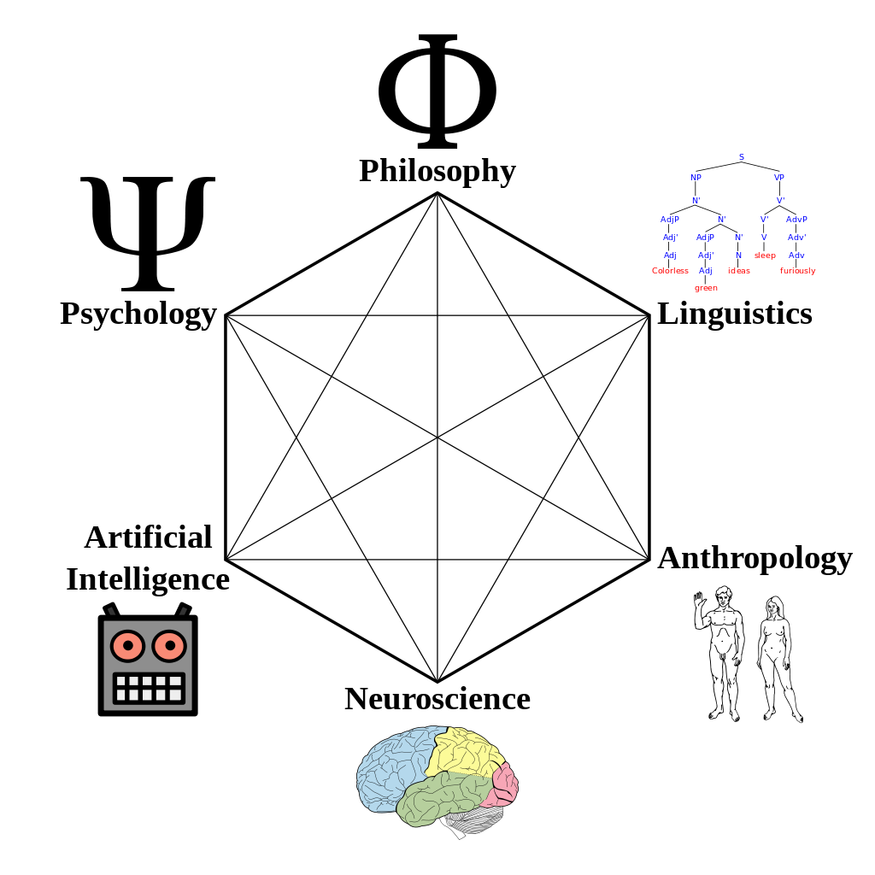
Cognitive Science
The interdisciplinary study of the mind, intelligence, and behavior.
How does the mind
process information?
  perception
  language
  memory
  reasoning
  emotion
http://en.wikipedia.org/wiki/Cognitive_science

Slide 8
Perception Can be Biased
What we see is actually an “alternate reality”.
Heavily biased by:
  The past: our experience
  The present: the current context
  The future: our goals
  _

Slide 9

Bias by Experience: Priming
Suppose you own an insurance company.
There is a small complex of office buildings that you want to insure, so you get an outline map of the buildings:
Designing with the Mind in Mind, 2nd ed.
by Jeff Johnson
Morgan Kaufmann, 2014

Slide 10
Bias by Experience: Priming, cont’d
Suppose you own an insurance company.
You want to design a large sign to advertise your life insurance policies:
Designing with the Mind in Mind, 2nd ed.
by Jeff Johnson
Morgan Kaufmann, 2014

Slide 11
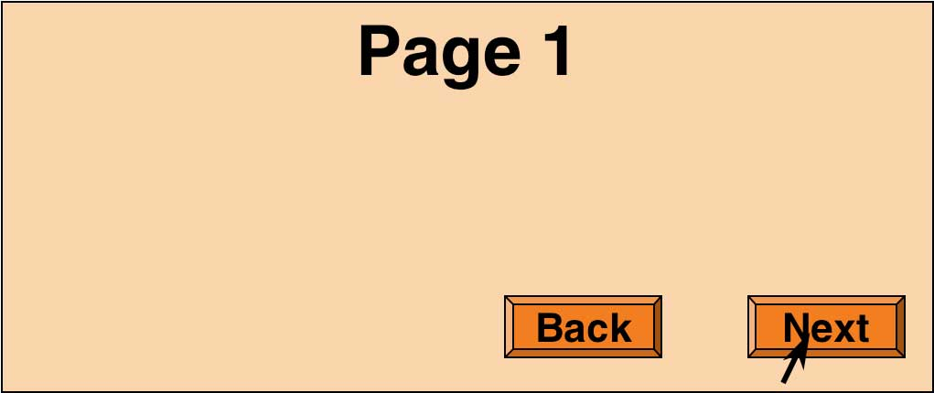



Bias by Experience: Familiar Patterns
We expect
and desire
consistency.
Designing with the Mind in Mind, 2nd ed.
by Jeff Johnson
Morgan Kaufmann, 2014

Slide 12
Bias by Experience: Context
What is the meaning?
Fold napkins.
Polish silverware.
Wash dishes.
French napkins.
Polish silverware.
German dishes.

Slide 13
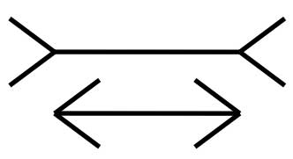

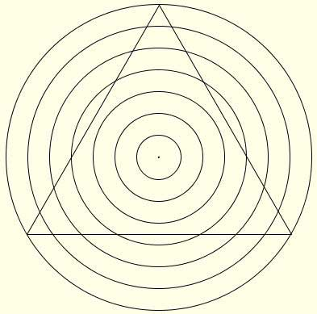
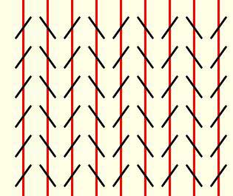
Bias by Experience: Context, cont’d
Designing with the Mind in Mind, 2nd ed.
by Jeff Johnson
Morgan Kaufmann, 2014

Slide 14
Perception Biased by Goals
Our goals influence where we look.
Our goals sensitize us to what we see.
You’re on the home page of the
University of Canterbury.
You want information about financial support
for postgraduate students in the
computer science department.
How would you find it?

Slide 15
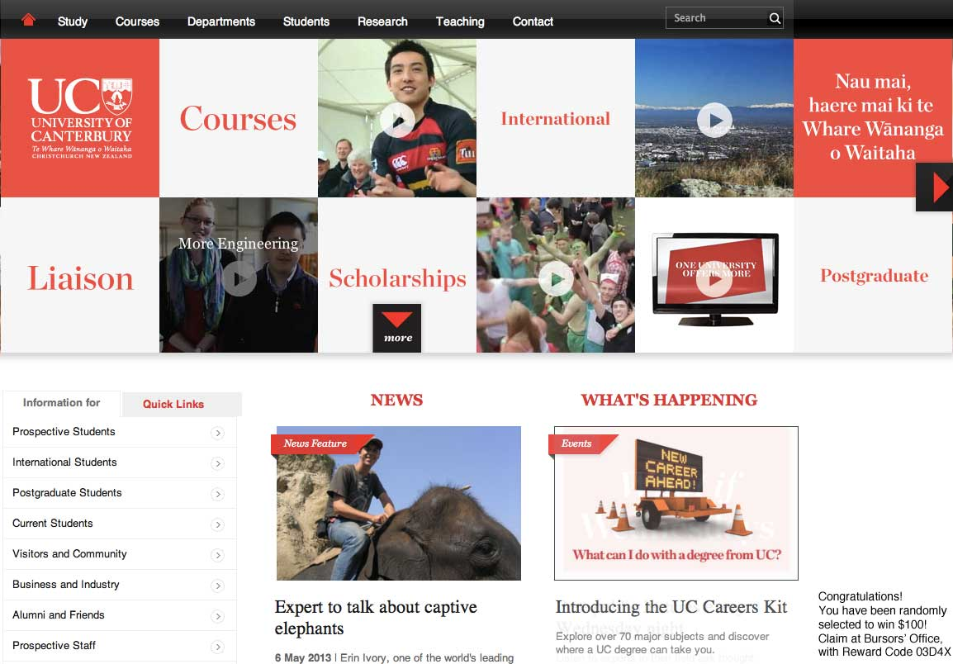
Perception Biased by Goals, cont’d
Did you notice this?
Designing with the
Mind in Mind, 2nd ed.
by Jeff Johnson
Morgan Kaufmann, 2014

Slide 16
Perception and UI Design
Take biased perception into account!
Avoid ambiguity.
  Make sure all users interpret your design in the same way.
Be consistent.
  Place controls in consistent locations.
  Use consistent shapes, colors, fonts, etc.
Understand goals.
  Different users may have different goals.
  Ensure your UI clearly directs users to the right goal.

Slide 17
Perception Video
https://www.youtube.com/watch?v=9Il_D3Xt9W0

Slide 18
Long-Term Memory
Perceptions enter through our visual, auditory, olfactory, gustatory, and tactile sensory systems.
Long-term memory is recorded in our brains
by changes in the neurons that are
involved in a neural activity pattern.

Slide 19
Long-Term Memory: Recognition vs. Recall
Recognition
  New perceptions similar to previous ones
  reactivate the same pattern of neurons.
Recall
  Other brain activity causes a pattern of neurons
  to reactivate.

Slide 20
Recognition is Easy
Recognition = perception + long-term memory
Recognition is often very fast.
  Recognize threats
  Recognize faces

Slide 21
Recall is Hard
Our brains did not evolve to recall facts well.
  We all hated to memorize facts in school.
Modern memory aids include:
  PowerPoint slides
  Account books
  Address books
  Calendars
  Alarm clocks

Slide 22

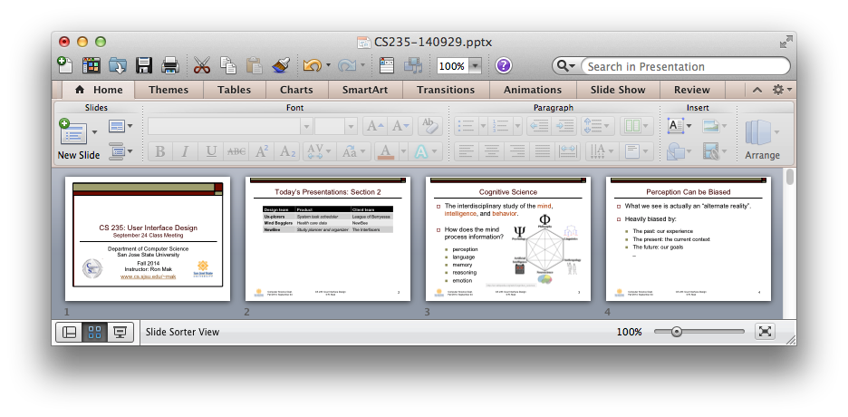
Recognition and UI Design
Docked icons convey function via recognition.
PowerPoint thumbnails provide an overview
of a presentation based on recognition.

Slide 23
Working Memory Analogy
Long-term memory is a
dark warehouse full of stuff.
Doors and windows represent
our perceptual senses.
Working memory consists of whatever
is lit up by a few searchlights.
The searchlights move to shine on
different objects as our attention
(what we are aware of now) shifts.

Slide 24
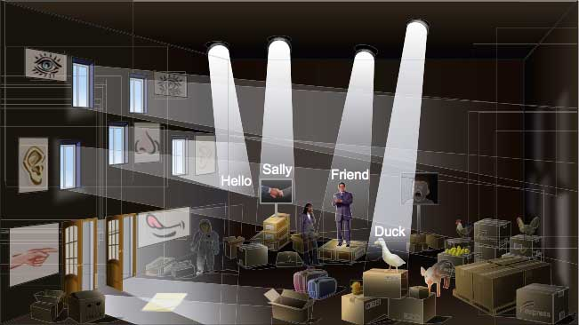
Working Memory Analogy, cont’d
Working memory is
not a memory store!
Designing with the Mind in Mind, 2nd ed.
by Jeff Johnson
Morgan Kaufmann, 2014

Slide 25
Attention and Working Memory
Attention is highly focused and selective.
  Objects and events related to our current goals.
  Movement near or toward us.
  Threats, faces, food, sex.
Capacity of attention
  Old theory: 7 plus or minus 2
  Actual average capacity: 4 plus or minus 1
Volatility of working memory
  Easy to forget goals and details.

Slide 26
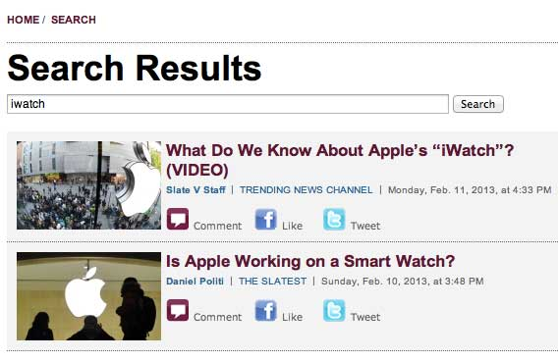
Working Memory and UI Design
Remind users what their search terms were.
Designing with the Mind in Mind, 2nd ed.
by Jeff Johnson
Morgan Kaufmann, 2014

Slide 27
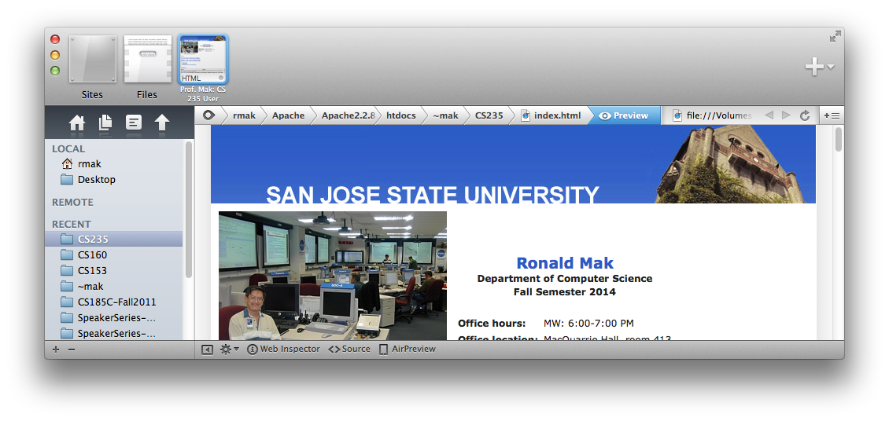
Working Memory and UI Design, cont’d
Leave breadcrumbs behind

Slide 28
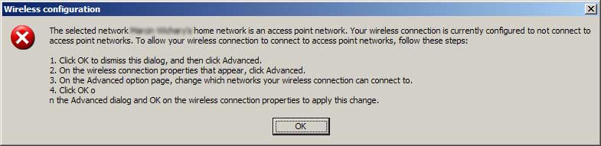
Working Memory and UI Design, cont’d
Don’t force the user to memorize instructions.
Designing with the Mind in Mind, 2nd ed.
by Jeff Johnson
Morgan Kaufmann, 2014

Slide 29
Long-Term Memory
Long-term memory is a memory store
(a dark warehouse).
Error-prone
  Not an accurate, high-resolution recording.
Weighted by emotions
Retroactively alterable
_

Slide 30
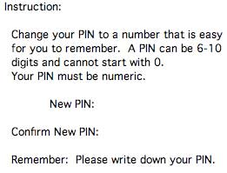
Long-Term Memory and UI Design
Do not burden long-term memory.
Example: Don’t make it impossible to create
an easy-to-remember PIN.
Designing with the Mind in Mind, 2nd ed.
by Jeff Johnson
Morgan Kaufmann, 2014

Slide 31
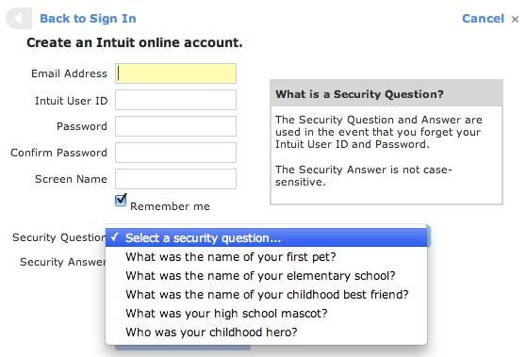
Long-Term Memory and UI Design, cont’d
Example: Users may have a hard time
to come up with unique and memorable answers
to standard
authentication
questions.
Designing with the Mind in Mind, 2nd ed.
by Jeff Johnson
Morgan Kaufmann, 2014

Slide 32
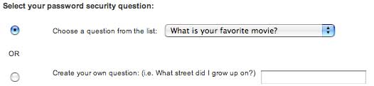
Long-Term Memory and UI Design, cont’d
Solution: Let the users pick their own questions.
Designing with the Mind in Mind, 2nd ed.
by Jeff Johnson
Morgan Kaufmann, 2014

Slide 33
Attention and Goals
We focus on our goals and pay little attention
to things not related to our goals.
Attention blindness
  When we are occupied with a task or goal, we can fail to notice objects and events that we would otherwise notice.
Change blindness
  When our attention is focused,
  we fail to notice change.

Slide 34
Attention and Change Blindness Videos
https://www.youtube.com/watch?v=IGQmdoK_ZfY&index=2&list=PLB228A1652CD49370

