Slide 1
CS 174: Web Programming November 16 Class Meeting
Department of Computer Science San Jose State University Fall 2015 Instructor: Ron Mak
www.cs.sjsu.edu/~mak

Slide 2
Unofficial Field Trip
Computer History Museum in Mt. View
http://www.computerhistory.org/
Provide your own transportation to the museum.
Saturday, November 21, 11:30 – closing time
Special free admission.
Do a self-guided tour of the Revolution exhibit.
See a life-size working model of Charles Babbage’s Difference Engine in operation, a hand-cranked mechanical computer designed in the early 1800s.
Experience a fully restored IBM 1401 mainframe computer from the early 1960s in operation.

Slide 3
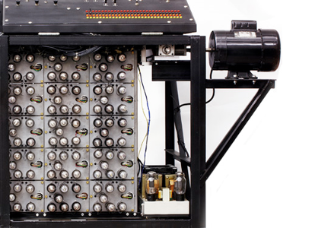
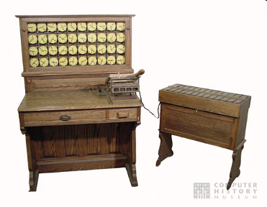
Unofficial Field Trip, cont’d
See the extensive Revolution exhibits!
Walk through a timeline of the First 2000 Years of Computing History.
Historic computer systems, data processing equipment, and other artifacts.
Small theater presentations.
Hollerith
Census
Machine
Atanasoff-Berry
Computer

Slide 4
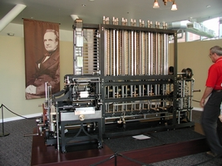
Unofficial Field Trip, cont’d
Babbage Difference Engine, fully operational
Hand-cranked mechanical computer.
Computed polynomial functions.
Designed by Charles Babbage in the early to mid 1800s.
Arguably the world’s first computer scientist, lived 1791-1871.
He wasn’t able to build it because he lost his funding.
Live demo at 1:30
His plans survived and this working model was built.
Includes a working printer!
http://www.computerhistory.org/babbage/

Slide 5
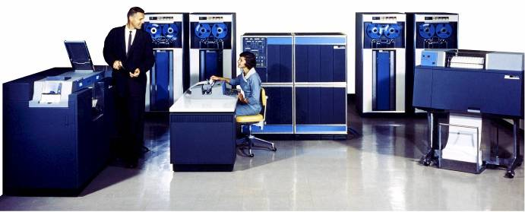
Unofficial Field Trip, cont’d
IBM 1401 computer, fully restored and operational.
A small transistor-based mainframe computer.
Extremely popular with small businesses in the late 1950s through the mid 1960s
Maximum of 16K bytes of memory.
800 card/minute card reader (wire brushes).
600 line/minute line printer (impact).
6 magnetic tape drives, no disk drives.

Slide 6
Unofficial Field Trip, cont’d
Information on the IBM 1401:
General info: http://en.wikipedia.org/wiki/IBM_1401
My summer seminar: http://www.cs.sjsu.edu/~mak/1401/
Restoration: http://ed-thelen.org/1401Project/1401RestorationPage.html

Slide 7
Unofficial Field Trip, cont’d
There will be extra credit if you participate in the visit to the Computer History Museum.
Complete a Canvas quiz.
Acceptable answers are to be found among the museum exhibits and presentations.
Each correct answer adds one point to your midterm score.

Slide 8
Internationalization and Localization
Internationalization (I18N) makes an application usable in multiple locales.
Localization (L10N) adds support for a particular locale to an internationalized application.
A locale consists of settings that describe text formatting and language conventions in a particular area of the world.
It’s more than just language translation!

Slide 9
Locale Settings
What language for messages
English, French, German, Spanish, Chinese, etc.
How to format dates and times
Order of month, day, year
Names of the months and of the days of the week
12-hour or 24-hour clock
How to format numbers
Currency symbol
Group separator, decimal point, negative indicator
How to sort text (collation sequence)

Slide 10
Developing Apps for I18N
Adapt to a user’s locale.
Dynamically determine:
What language to display all text, such as labels and messages
What format to display numbers, dates, and times
How to sort text

Slide 11
PHP Support for I18N
The intl extension is bundled with PHP versions 5.3.0 and later.
If necessary, download from http://pecl.php.net/package/intl
Mac users should see also http://darraghenright.tumblr.com/post/22027208929/installing-intl-package-on-osx-lion
Windows users should see also http://stackoverflow.com/questions/1451468/intl-extension-installing-php-intl-dll

Slide 12
Locale ID
A locale ID has several parts separated by underscores.
Two-letter language code as determined by the ISO 639-1 standard: http://en.wikipedia.org/wiki/List_of_ISO_639-1_codes
Optional country code as determed by the ISO 3166 standard: http://en.wikipedia.org/wiki/ISO_3166-1_alpha-2
Examples:
en_US: American English
en_GB: British English

Slide 13
Determine a User’s Locale
Determine a user’s locale in order to dynamically localize your web application.
Do that on the server with PHP code.
i18n/locale.php
<?php
if (isset($_SERVER['HTTP_ACCEPT_LANGUAGE'])) {
$localeToUse =
Locale::acceptFromHttp($_SERVER['HTTP_ACCEPT_LANGUAGE']);
}
else {
$localeToUse = Locale::getDefault();
}
print $localeToUse;
?>

Slide 14
Localize Text Messages
Pass the chosen word or phrase to a MessageFormatter object for formatting.
First parameter: the locale to use.
Second parameter: the string to format.

Slide 15
Localize Text Messages, cont’d
i18n/counter.php
<?php
$template = "{0, spellout}";
$locales = array('en_GB', 'fr_FR', 'de_DE', 'zh_CN');
print "<table border='1'>\n";
print " <tr>\n";
print " <th></th>\n";
foreach ($locales as $locale) {
print " <th>$locale</th>\n";
}
print " </tr>\n";

Slide 16
Localize Text Messages, cont’d
i18n/counter.php
for ($i = 0; $i <= 21; $i++) {
print " <tr>\n";
print " <td>$i</td>\n";
foreach ($locales as $locale) {
$msgMF = new MessageFormatter($locale, $template);
$msg = $msgMF->format(array($i));
print " <td>$msg</td>\n";
}
print " </tr>\n";
}
print "</table>\n";
?>

Slide 17
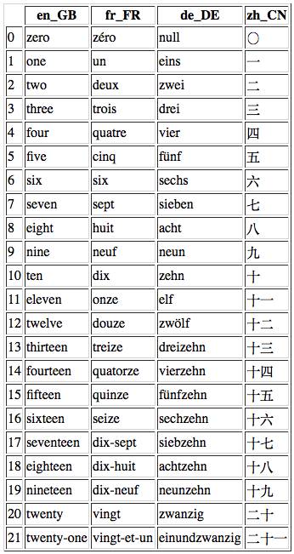
Localize Text Messages, cont’d
Output:

Slide 18
Localize Text Messages, cont’d
The constructor of class MessageFormatter takes two parameters:
the locale
the string to format
The string can contain ICU parameters.
ICU = International Components for Unicode
Example: {0, spellout}
See http://userguide.icu-project.org/formatparse/messages

Slide 19
Localize Text Messages, cont’d
Maintain a message catalog of words and phrases in the different languages.
Retrieve the appropriate word or phrase.
Pass the chosen word or phrase to a MessageFormatter object for formatting.

Slide 20
Localize Text Messages, cont’d
$messages = array();
$messages['en_US'] =
array('FAVORITE' => 'favorite',
'FRIES' => 'french fries',
'CANDY' => 'candy',
'CHIPS' => 'potato chips',
'EGGPLANT' => 'eggplant');
$messages['en_GB'] =
array('FAVORITE' => 'favourite',
'FRIES' => 'chips',
'CANDY' => 'sweets',
'CHIPS' => 'crisps',
'EGGPLANT' => 'aubergine');
$locales = array('en_US', 'en_GB');
$sentence = 'My {0} food is {1}.’;
i18n/text1.php

Slide 21
Localize Text Messages, cont’d
i18n/text1.php
$favoriteMF =
new MessageFormatter($locale, $messages[$locale]['FAVORITE']);
$favorite = $favoriteMF->format(array());
$candyMF =
new MessageFormatter($locale, $messages[$locale]['CANDY']);
$candy = $candyMF->format(array());
$sentenceMF =
new MessageFormatter($locale, $sentence);
$text = $sentenceMF->format(array($favorite, $candy));
Output:

Slide 22
Localize Dates and Times
Use a MessageFormatter object.
Use a date or time argument type.
Optionally specify short, medium, or long style.
i18n/dates1.php
date_default_timezone_set('America/Los_Angeles');
$when = new DateTime();
$message = "It is {0,time,short} on {0,date,medium}.";
$fmt = new MessageFormatter('en_US', $message);
print $fmt->format(array($when)) . "\n";
Output:
It is 4:25 AM on Apr 23, 2015.

Slide 23
Localize Dates and Times, cont’d
Use an IntlDateFormatter object to specify the individual parts of a date or time.

Slide 24
Localize Dates and Times, cont’d
date_default_timezone_set('America/Los_Angeles');
$fmt = new IntlDateFormatter('en_US', IntlDateFormatter::FULL,
IntlDateFormatter::FULL,
'America/Los_Angeles');
$when = new DateTime();
$parts = array('tm_sec' => 56,
'tm_min' => 34,
'tm_hour' => 12,
'tm_mday' => 23,
'tm_mon' => 3, /* 0 = January */
'tm_year' => 115); /* 0 = 1900 */
print $fmt->format($when) . "<br>\n";
print $fmt->format($parts);
Date type
Time type
i18n/dates2.php
Output:
Sunday, November 15, 2015 11:23:50 PM Pacific Standard Time
Thursday, April 23, 2015 12:34:56 PM Pacific Daylight Time

Slide 25
Localize Dates and Times, cont’d
IntlDateFormatter::formatObject() helper method.
i18n/dates3.php
date_default_timezone_set('America/Los_Angeles');
$when = new DateTime('now', new DateTimeZone('America/Los_Angeles'));
print IntlDateFormatter::formatObject($when, 'eeee dd MMMM y',
'es_ES') . "<br>\n";
print IntlDateFormatter::formatObject($when, IntlDateFormatter::FULL,
'fr_FR') . "<br>\n";
$formats = array(IntlDateFormatter::FULL, IntlDateFormatter::SHORT);
print IntlDateFormatter::formatObject($when, $formats, 'de_DE');
Output:
domingo 15 noviembre 2015
dimanche 15 novembre 2015 23:33:17 heure normale du Pacifique
Sonntag, 15. November 2015 23:33

Slide 26
Example Date and Time Formatting Codes
Type | Character | Description | Example
hour | h | 12-hour clock (1-12) | 7
hour | H | 24 hour clock (0-23) | 18
minute | m | minute (0-59) | 22
second | s | second (0-59) | 49
day | d | day | 12
day | EEEE | day of week (name) | Friday
month | MMMM | month name | April
year | y | year (4 digits) | 2015
other | G | era (BC or AD) | AD

Slide 27
Localize Numbers
Use a MessageFormatter object to format numbers according to a locale.
i18n/numbers.php
$x = 5327;
$y = 98;
$message = '{0,number}/{1,number} = {2,number}';
$args = array($x, $y, $x/$y);
$us = new MessageFormatter('en_US',$message);
$fr = new MessageFormatter('fr_FR',$message);
print $us->format($args) . "<br>\n";
print $fr->format($args);
Output:
5,327/98 = 54.357
5 327/98 = 54,357

Slide 28
Localize Currency
Use a MessageFormatter object to format currency according to a locale.
i18n/currency1.php
$income = 5549.3;
$debit = -25.95;
$fmt = new MessageFormatter('en_US',
'{0,number,currency} in and ' .
'{1,number,currency} out');
print $fmt->format(array($income,$debit));
Output:
$5,549.30 in and ($25.95) out

Slide 29
Localize Currency, cont’d
Use a NumberFormatter object for more specific formatting of currency.
i18n/currency2.php
$income = 5549.3;
$debit = -25.95;
$fmt = new NumberFormatter('en_US', NumberFormatter::CURRENCY);
print $fmt->formatCurrency($income, 'USD') . ' in and ' .
$fmt->formatCurrency($debit, 'EUR') . " out";
ISO 4217 currency codes: http://www.xe.com/iso4217.php
Output:
$5,549.30 in and (€25.95) out

Slide 30
Localize Currency, cont’d
i18n/currency3.php
$amounts = array(array(152.9, 'USD'),
array(328, 'ISK'),
array(-100, 'JPY'),
array(500.53, 'EUR'),
);
$fmt = new NumberFormatter('en_US', NumberFormatter::CURRENCY);
$fmt->setAttribute(NumberFormatter::PADDING_POSITION,
NumberFormatter::PAD_AFTER_PREFIX);
$fmt->setAttribute(NumberFormatter::FORMAT_WIDTH, 15);
$fmt->setTextAttribute(NumberFormatter::PADDING_CHARACTER, ' ');
foreach ($amounts as $amount) {
print $fmt->formatCurrency($amount[0], $amount[1]) . "<br>\n";
}
Output:
$ 152.90
Ikr 328
(¥ 100)
€ 500.53

Slide 31
Locale-Aware Sorting
Use a Collator object to sort text according to the collating sequence of a locale.
$words = array('Малина', 'Клубника', 'Огурец');
$collator = new Collator('ru_RU');
$collator->sort($words);
foreach ($words as $word) {
print $word . "<br>\n";
}
i18n/sorting.php
Output:
Клубника
Малина
Огурец

