Slide 1



CS 160 and CMPE/SE 131
Software Engineering
March 22 Class Meeting
Department of Computer Science
Department of Computer Engineering
San José State University
Spring 2016
Instructor: Ron Mak
www.cs.sjsu.edu/~mak

Slide 2
Assignment #5
Initial draft of your Design Document.
Document the design of your application.
  MVC architecture
  UML package and class diagrams
  UML sequence diagram
Document the design of your database.
  Conceptual model: entity-relationship (ER) diagram
  Logical model: relational schema

Slide 3
Bug Tracking
AKA defect tracking or issue tracking
A central place to store application bugs found:
  During development and testing
  After deployment
Store, categorize, prioritize, and assign bugs
to developers to fix.
Look up bugs in the bug database.
Keep track of the status of each bug.
Generate bug reports.

Slide 4
Bugzilla
A leading web-based bug-tracking tool.
  See http://www.bugzilla.org/about/
Features
  Track bugs and code changes
  Communicate with teammates
  Submit and review patches
  Manage quality assurance (QA)
Free Bugzilla hosting
  http://www.bugheaven.com/index.php/Free

Slide 5
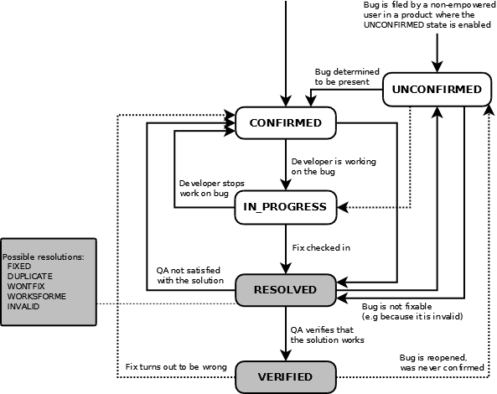
Lifecycle of a Bugzilla Bug
http://bugzilla.readthedocs.org/en/latest/_images/bzLifecycle.png

Slide 6
Managing Expectations
Estimation
  How long will tasks take, or
  how many resources will they consume.
  Should be an unbiased, analytical process.
  The goal is accuracy, not to seek a particular result.
Project planning
  A biased, goal-seeking process.
  The goal is to achieve specific outcomes
  (i.e., to hit a target).

Slide 7
Managing Expectations, cont’d
Estimates form the foundation for project plans.
But plans don’t have to be
the same as estimates.
Combining estimating and planning activities leads to bad estimates and poor plans.
A large gap between estimates
and planning targets results in
a high risk project.

Slide 8
Estimates, Targets, and Commitments
A typical scene from an all-too-familiar play:
  Product manager: We need to demo these features at a trade show in 3 months. [target]
  How long will it take?
  Project lead: I estimate it will us take 5 months.
  Manager: Wrong answer! Try again.
  Lead: OK, in 3 months, we can have the highest priority features done. [commitment]
Moral: When you’re asked for an estimate, determine whether you’re really being told to make a commitment to meet a target.

Slide 9
Primary Purpose of Software Estimation
Determine whether a project’s targets are realistic enough to allow the project to be controlled to meet them.
Good estimates are usually possible if the
initial targets and the initial estimates
are within 20% of each other.

Slide 10
“Good” Estimates
Estimates don’t need to be perfectly accurate as much as they need to be useful.
  “A good estimate is an estimate that provides a
  clear enough view of the project reality to allow
  the project leadership to make good decisions
  about how to control the project to hit its targets.”
  Steve McConnell, Software Estimation

Slide 11
Time Unit Inflation of Estimates
Time unit inflation:
hours → days → weeks → months → years
  “It should take me two hours to do this.”
  Reality: It will take two days.

Slide 12
Estimation Techniques
Complex mathematical formulas
  Best for the very largest projects.
  Done by professional estimators.
History and analogy
  How long did similar tasks take in the past?
Expert opinions
  But do you have similar skills as the experts?

Slide 13
Estimation Techniques, cont’d
Off-the-cuff “guesstimates”
  Based on personal experience.
  The smaller the task,
  the more accurate the estimate.

Slide 14
Project Schedules
Once estimates are put into a schedule,
they become commitments.
However, schedules can change (i.e., slip) ...
up to a point!

Slide 15
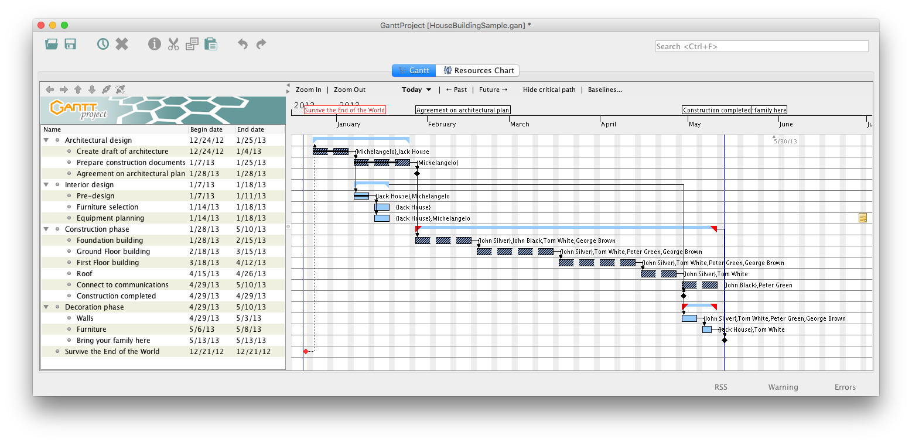
Example Project Schedule: Gantt Chart
Critical path

Slide 16
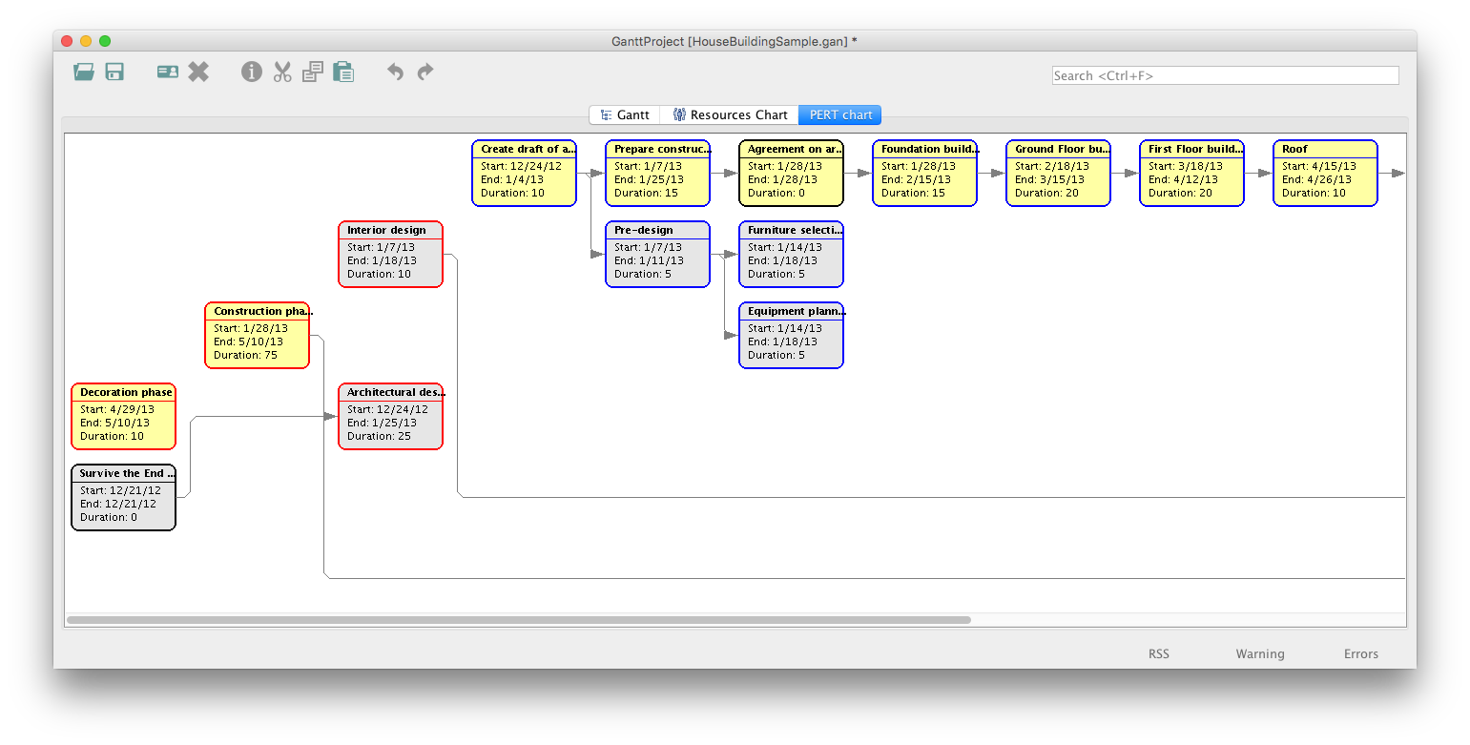
Example Project Schedule: PERT Chart

Slide 17
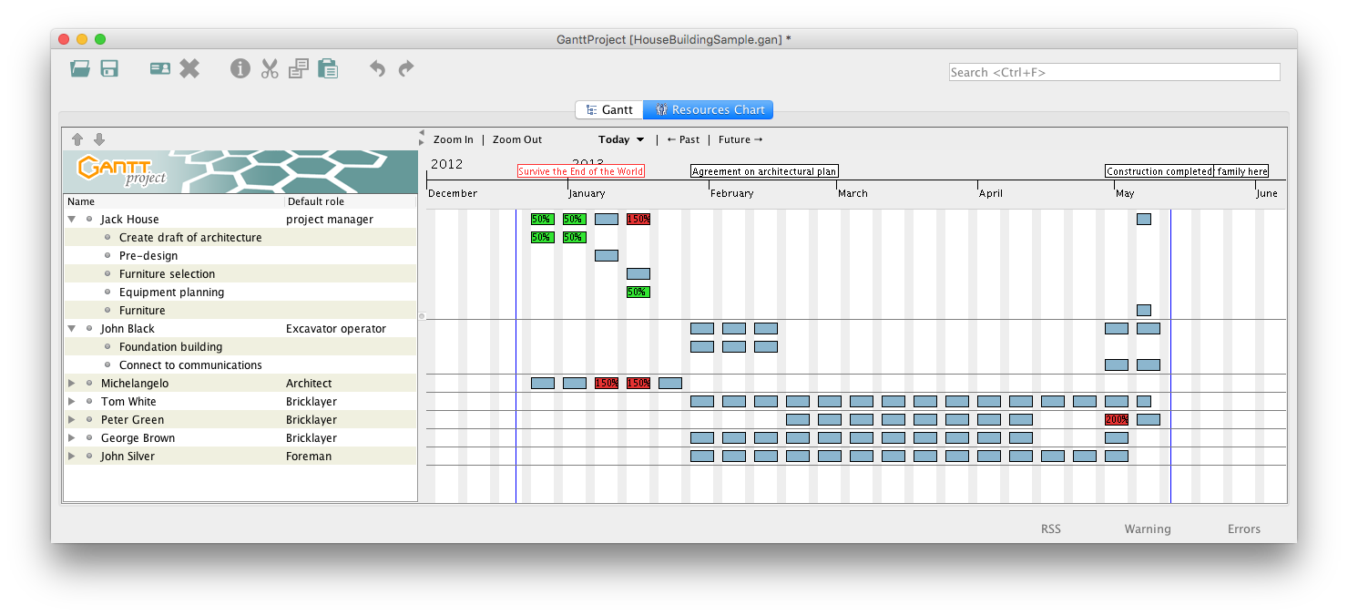
Example Project Schedule: Resources Chart

