Slide 1



CS 160 and CMPE/SE 131
Software Engineering
March 15 Class Meeting
Department of Computer Science
Department of Computer Engineering
San José State University
Spring 2016
Instructor: Ron Mak
www.cs.sjsu.edu/~mak

Slide 2
Assignment #5
Initial draft of your Design Document.
Document the design of your application.
  MVC architecture
  UML package and class diagrams
  UML sequence diagram
Document the design of your database.
  Conceptual model: entity-relationship (ER) diagram
  Logical model: relational schema

Slide 3
SQL
Structured Query Language (SQL)
  An industry standard
  But has many proprietary extensions
Language for managing data in a
relational database.
  Create and drop (delete) databases
  Create, alter, and drop tables of a database
  Retrieve, insert, update, and delete data
  in the tables.

Slide 4
SQL Query Examples
What is the class code of the
Java programming class?
Class
Code | Teacher_id | Subject | Room
908 | 7008 | Data structures | 114
926 | 7003 | Java programming | 101
931 | 7051 | Compilers | 222
951 | 7012 | Software engineering | 210
974 | 7012 | Operating systems | 109
Desired fields
SELECT code
FROM class
WHERE subject = 'Java programming'
+------+
| code |
+------+
| 926 |
+------+
Source tables
Selection criteria

Slide 5
SQL Query Examples, cont’d
Who is teaching Java programming?
Teacher
Class
Id | Last | First
7003 | Rogers | Tom
7008 | Thompson | Art
7012 | Lane | John
7051 | Flynn | Mabel
Code | Teacher_id | Subject | Room
908 | 7008 | Data structures | 114
926 | 7003 | Java programming | 101
931 | 7051 | Compilers | 222
951 | 7012 | Software engineering | 210
974 | 7012 | Operating systems | 109
SELECT first, last
FROM teacher, class
WHERE id = teacher_id
AND subject = 'Java programming'
+-------+--------+
| first | last |
+-------+--------+
| Tom | Rogers |
+-------+--------+
Selecting from multiple tables
is called a join.

Slide 6
SQL Query Examples, cont’d
What subjects does John Lane teach?
Teacher
Class
Id | Last | First
7003 | Rogers | Tom
7008 | Thompson | Art
7012 | Lane | John
7051 | Flynn | Mabel
Code | Teacher_id | Subject | Room
908 | 7008 | Data structures | 114
926 | 7003 | Java programming | 101
931 | 7051 | Compilers | 222
951 | 7012 | Software engineering | 210
974 | 7012 | Operating systems | 109
SELECT code, subject
FROM teacher, class
WHERE last = 'Lane' AND first = 'John'
AND id = teacher_id
+------+----------------------+
| code | subject |
+------+----------------------+
| 951 | Software engineering |
| 974 | Operating systems |
+------+----------------------+

Slide 7
SQL Query Examples, cont’d
Who is taking Java programming?
Student_Class
Student_id | Class_code
1001 | 926
1001 | 951
1001 | 908
1005 | 974
1005 | 908
1014 | 931
1021 | 926
1021 | 974
1021 | 931
SELECT id, last, first
FROM student, class, student_class
WHERE subject = 'Java programming'
AND code = class_code AND id = student_id
+------+-------+-------+
| id | last | first |
+------+-------+-------+
| 1001 | Doe | John |
| 1021 | Smith | Kim |
+------+-------+-------+
Class
Student
Code | Teacher_id | Subject | Room
908 | 7008 | Data structures | 114
926 | 7003 | Java programming | 101
931 | 7051 | Compilers | 222
951 | 7012 | Software engineering | 210
974 | 7012 | Operating systems | 109
Id | Last | First
1001 | Doe | John
1005 | Novak | Tim
1009 | Klein | Leslie
1014 | Jane | Mary
1021 | Smith | Kim

Slide 8
SQL Query Examples, cont’d
What classes is John Doe taking?
Student_Class
Student_id | Class_code
1001 | 926
1001 | 951
1001 | 908
1005 | 974
1005 | 908
1014 | 931
1021 | 926
1021 | 974
1021 | 931
SELECT code, subject
FROM student, class, student_class
WHERE last = 'Doe' AND first = 'John'
AND id = student_id AND code = class_code
+------+----------------------+
| code | subject |
+------+----------------------+
| 908 | Data structures |
| 926 | Java programming |
| 951 | Software engineering |
+------+----------------------+
Student
Class
Id | Last | First
1001 | Doe | John
1005 | Novak | Tim
1009 | Klein | Leslie
1014 | Jane | Mary
1021 | Smith | Kim
Code | Teacher_id | Subject | Room
908 | 7008 | Data structures | 114
926 | 7003 | Java programming | 101
931 | 7051 | Compilers | 222
951 | 7012 | Software engineering | 210
974 | 7012 | Operating systems | 109

Slide 9
SQL Query Examples, cont’d
Who are John Lane’s students?
Student_Class
SELECT student.first, student.last, subject
FROM student, teacher, class, student_class
WHERE teacher.last = 'Lane' AND teacher.first = 'John'
AND teacher_id = teacher.id
AND code = class_code AND student.id = student_id
ORDER BY subject, student.last
+-------+-------+----------------------+
| first | last | subject |
+-------+-------+----------------------+
| Tim | Novak | Operating systems |
| Kim | Smith | Operating systems |
| John | Doe | Software engineering |
+-------+-------+----------------------+
Student_id | Class_code
1001 | 926
1001 | 951
1001 | 908
1005 | 974
1005 | 908
1014 | 931
1021 | 926
1021 | 974
1021 | 931
Teacher
Class
Student
Id | Last | First
7003 | Rogers | Tom
7008 | Thompson | Art
7012 | Lane | John
7051 | Flynn | Mabel
Code | Teacher_id | Subject | Room
908 | 7008 | Data structures | 114
926 | 7003 | Java programming | 101
931 | 7051 | Compilers | 222
951 | 7012 | Software engineering | 210
974 | 7012 | Operating systems | 109
Id | Last | First
1001 | Doe | John
1005 | Novak | Tim
1009 | Klein | Leslie
1014 | Jane | Mary
1021 | Smith | Kim

Slide 10
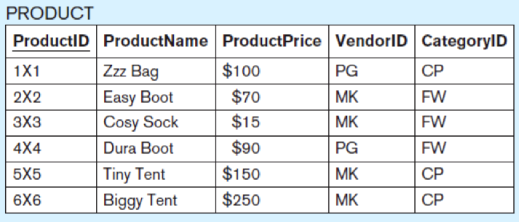
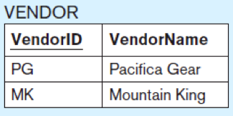
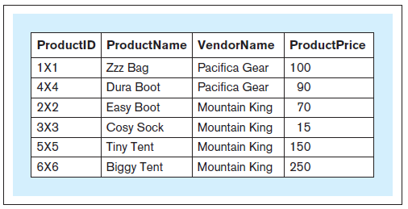
More about Joins
What is the id, name, vendor, and price
of each product?
SELECT productid, productname,
vendorname, productprice
FROM product, vendor
WHERE product.vendorid
= vendor.vendorid;
Qualified names
Database Systems
by Jukić, Vrbsky, & Nestorov
Pearson 2014
ISBN 978-0-13-257567-6

Slide 11
More about Joins, cont’d
Without a join condition, you get a
Cartesian product.
Each record of one table matched
with every record from the other table.

Slide 12
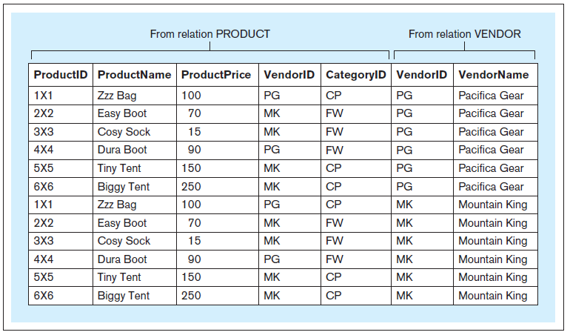
More about Joins, cont’d
SELECT *
FROM product, vendor;
Database Systems
by Jukić, Vrbsky, & Nestorov
Pearson 2014
ISBN 978-0-13-257567-6

Slide 13
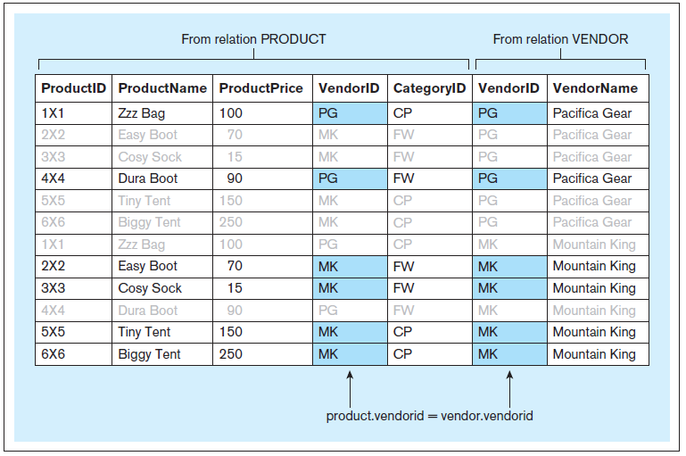
More about Joins, cont’d
Include the join condition
WHERE product.vendorid = vendor.vendorid

Slide 14
Database Record Insert, Update, and Delete
There are SQL statements to insert, update, and delete records.
  INSERT INTO teacher (id, last, first)
  VALUES (7088, 'Mak', 'Ron'),
  (7090, 'Wilson', 'Brian')
  UPDATE teacher
  SET first = 'Ronald'
  WHERE first = 'Ron'
  DELETE FROM teacher
  WHERE id = 7090
This can update
multiple records!

Slide 15
SQL to Add Rows
Add rows to
the Class table:
Code | Teacher_id | Subject | Room
908 | 7008 | Data structures | 114
926 | 7003 | Java programming | 101
931 | 7051 | Compilers | 222
951 | 7012 | Software engineering | 210
974 | 7012 | Operating systems | 109
INSERT INTO class (code, teacher_id, subject, room)
VALUES (908, 7008, 'Data structures', 114),
(926, 7003, 'Java programming', 101),
(931, 7051, 'Compilers', 222),
(951, 7012, 'Software engineering', 210),
(978, 7012, 'Operating systems', 109);

Slide 16
SQL to Create and Drop a Database
Examples to create:
Examples to drop:
CREATE DATABASE school3;
CREATE DATABASE IF NOT EXISTS school3;
DROP DATABASE school3;
DROP DATABASE IF EXISTS school3;

Slide 17
SQL to Create a Table
First we create a new database
and connect to it:
Create the Class table:
Code | Teacher_id | Subject | Room
908 | 7008 | Data structures | 114
926 | 7003 | Java programming | 101
931 | 7051 | Compilers | 222
951 | 7012 | Software engineering | 210
974 | 7012 | Operating systems | 109
CREATE DATABASE school3;
USE school3;
CREATE TABLE class
(
code INT PRIMARY KEY,
teacher_id INT NOT NULL,
subject VARCHAR(32) NOT NULL,
room INT NOT NULL
);

Slide 18
SQL Script create_school.sql
DROP DATABASE IF EXISTS school3;
CREATE DATABASE school3;
USE school3;
CREATE TABLE class
(
code INT PRIMARY KEY,
teacher_id INT NOT NULL,
subject VARCHAR(32) NOT NULL,
room INT NOT NULL,
);
INSERT INTO class (code, teacher_id, subject, room)
VALUES (908, 7008, 'Data structures', 114),
(926, 7003, 'Java programming', 101),
(931, 7051, 'Compilers', 222),
(951, 7012, 'Software engineering', 210),
  (978, 7012, 'Operating systems', 109);

Slide 19
SQL Script create_school.sql, cont’d
CREATE TABLE contact_info
(
id INT PRIMARY KEY,
email_address VARCHAR(32) NOT NULL
);
INSERT INTO contact_info (id, email_address)
VALUES (1, 'mjane@sjsu.edu'),
(2, 'ksmith@sjsu.edu'),
(3, 'jdoe@sjsu.edu'),
(4, 'tnovak@sjsu.edu'),
(5, 'lklein@sjsu.edu'),
(6, 'trogers@sjsu.edu'),
(7, 'athompson@sjsu.edu'),
(8, 'jlane@sjsu.edu'),
(9, 'mflynn@sjsu.edu');

Slide 20
SQL Script create_school.sql, cont’d
CREATE TABLE teacher
(
id INT PRIMARY KEY,
last VARCHAR(32) NOT NULL,
first VARCHAR(32) NOT NULL,
contact_id INT REFERENCES contact_info(id)
);
INSERT INTO teacher (id, last, first, contact_id)
VALUES (7003, 'Rogers', 'Tom', 6),
(7008, 'Thompson', 'Art', 7),
(7012, 'Lane', 'John’, 8),
(7051, 'Flynn', 'Mabel', 9);

Slide 21
Database Connection Pool
Opening and closing a database connection
are slow operations.
  A running web application may have many simultaneous threads each making data requests, and each request needs a connection.
Solution: Create a pool of open connections.
  When a data request needs a connection,
  it gets an open connection from the pool.
  When the request is done, it returns the open connection to the pool for another request to use.
  The pool can grow and shrink based on usage.

Slide 22
Database Connection Pool, cont’d
OPEN CONNECTIONS
Application threads
Connection pool
Database
Rails supports database connection pools.
See online tutorials and documentation:
  https://devcenter.heroku.com/articles/concurrency-and-database-connections
  http://api.rubyonrails.org/classes/ActiveRecord/ConnectionAdapters/ConnectionPool.html

Slide 23
Data Access Layer
Databases and SQL are extremely powerful.
Let the database do what it’s good at doing,
and let Ruby do what it’s good at doing.
  For example, don’t write Ruby code to sort the retrieved records – let the database do that!

Slide 24
Data Access Layer, cont’d
Add a data access layer
to your server-side architecture.
The data access layer contains all the database API calls and manages the database connection pool.
Keep the rest of your application
loosely-coupled from the database code.
With active records and object-relational mapping, the rest of your application deals only with objects, not result sets.

Slide 25
Multilayered Server-Side Architecture
SERVER SIDE
Presentation Layer
View Objects
Application Layer
Controller Objects
Data Access Layer
Fetch and Store Model Objects
Database

Slide 26
Midterm on Thursday
Open book, notes, laptop, Internet.
No communication or sharing with anyone else during the exam!
It will cover everything we’ve done so far:
  lectures
  assignments
Be familiar with the books, especially the blue Rails Crash Course book.
Be able to use ERDPlus to draw ER diagrams and relational schemas.

Slide 27
Example Midterm Questions
Briefly describe the contents of each of the following:
  Requirements specification
  Software prototype
  Conceptual design
  Design document

Slide 28
Example Midterm Questions, cont’d
Consider the use case where a user moves
a file from one directory into another within the file system. Suppose you implemented it with
a graphical user interface (GUI) based on the model-view-controller (MVC) architecture. The user does the file move by dragging the image
of a document on the screen with the mouse from one folder image into another.
  Identify the model, the view, and the controller objects.
  Draw a UML sequence diagram of the interaction described by this use case.

Slide 29
Example Midterm Questions, cont’d
Model
  File system components
  Physical files and directories that exist on disk
View
  GUI objects
  Folders and documents as shown on the screen

Slide 30
Example Midterm Questions, cont’d
Controller
  The interface (“bridge”) between
  the GUI and the file system.
  The code that translates the GUI actions to operations on the underlying file system.

Slide 31
Example Midterm Questions, cont’d
Source
Folder
Destination
Folder
GUI-FS
Bridge
File
System
User
select document
confirm selection
start drag
send source folder and source document info
detach document
from source folder
send move command
with source file path and
destination directory path
send destination
folder info
end drag
display document in destination folder
confirm file move
confirm file move

Slide 32
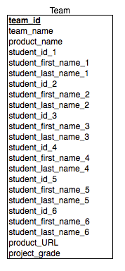
Example Midterm Questions, cont’d
Suppose a teaching assistant for this Software Engineering class wanted to build a relational database to keep track of the project teams.
His first attempt at the database consists of a single table, as shown in the relational schema.

Slide 33
Example Midterm Questions, cont’d
For each of the following queries, either write the SQL statement to perform the query based on this database, or explain why the query would be difficult to do.
  What are the name and URL of team Alpha’s product?
    SELECT product_name, product_URL
    FROM team
    WHERE team_name = ‘Alpha’

Slide 34
Example Midterm Questions, cont’d
  Who’s on team Beta?
  Which team is Mary Jones on
  and what is her project grade?
    Difficult (tedious, at least) to do because of the
    repeated student fields. Each first name/last
    name pair would need to be listed separately
    in the SELECT clause.
    Also difficult to do because the test for
    Mary Jones would have to be duplicated
    for each student in the row and then
    OR’d together.

Slide 35
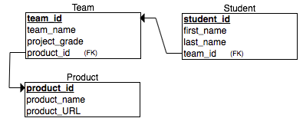
Example Midterm Questions, cont’d
Normalize to 2NF the project team database. Remember that each student on a particular project team will receive the same project grade.

