Slide 1
CS 160 and CMPE/SE 131 Software Engineering March 8 Class Meeting
Department of Computer Science Department of Computer Engineering San José State University Spring 2016 Instructor: Ron Mak
www.cs.sjsu.edu/~mak

Slide 2
Free IDE for Ruby and Rails
RubyMine https://www.jetbrains.com/student/

Slide 3
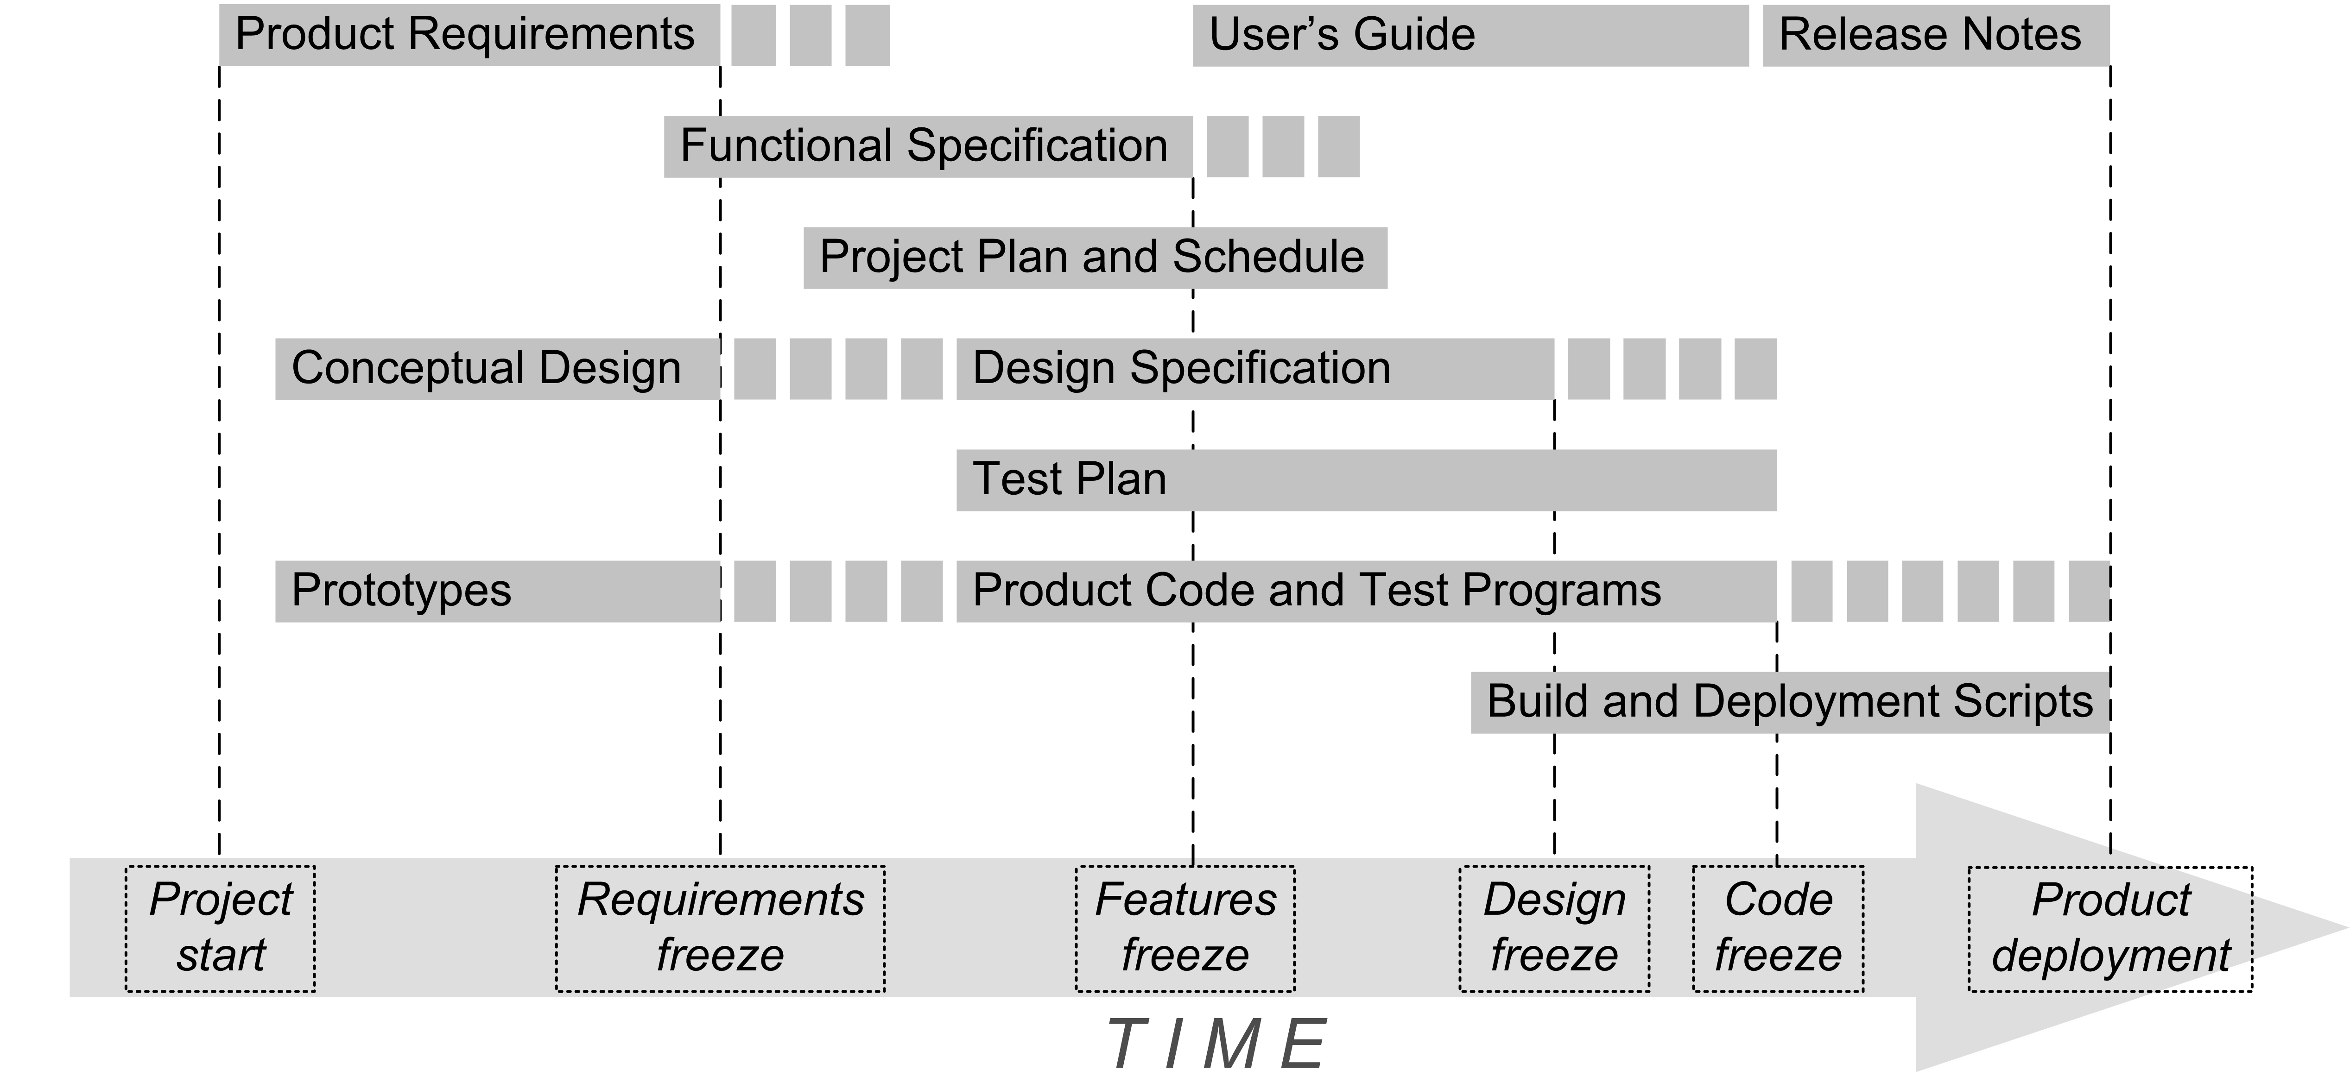
System Design
The system design model is a key part of your Design Specification document.
√
√
√
YOU ARE HERE!
√

Slide 4
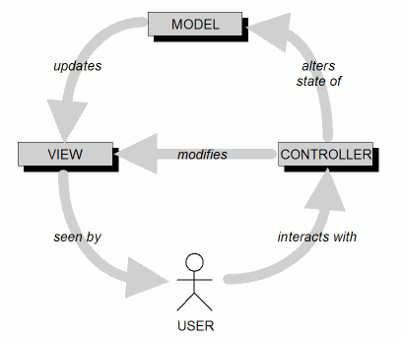
Analysis
Identifying the three types of objects of a MVC application architecture is part of analysis.

Slide 5
MVC Implementation: Loose Coupling
Keep the implementations of the three objects types separate.
Each type of objects does not depend on how the other types are implemented.
Your application is more robust (resilient to change).

Slide 6
Use Case Diagram: Bank ATM System
Model objects
operator
customer
bank account
cash
View objects
display
options (withdraw cash, deposit check, etc.)
messages
Controller objects
Start up controller (“Start up ATM” use case)
User verification controller (“Log in customer” use case)
Withdrawal controller (“Withdraw cash” use case)
Start up
ATM
Shut down
ATM
Operator
Log in
customer
Log out
customer
Withdraw
cash
Customer
Display
balance
Bank

Slide 7
Example Dynamic Model: ATM Cash Withdrawal
“Withdraw cash”
Display
Keypad
Bank
Account
Customer
select
notify
display confirmation
T
I
M
E
enter amount
notify
notify
display bank ads
verify
accept
notify
dispense cash
UML Sequence Diagram

Slide 8
Example: Customer Withdraws Cash from ATM
swipe bank card
Card accepted
enter PIN
Logged in
enter withdrawal amount
Reading
bank ads
get cash
Has cash
leave
UML Statechart Diagram Customer’s Perspective

Slide 9
Object Model Associations
Draw a line between two classes in a UML class diagram to show a relationship.
Clarify the object model by making relationships explicit.
Discover constraints associated with relationships.
An association can have a name.
You can show roles and multiplicities at each end.
Do not overdo showing associations.
Team
member
1
writes
*
Use
case
author
artifact

Slide 10
Aggregations and Compositions
An aggregation is an “ownership” or “has a” association.
Although there is a strong association between the object and its owner, the object can exist on its own.
An object can change owners or have several owners.
A composition is a “made up of” association.
The constituent objects generally would not exist alone.
This is the strongest association.
Student
Book
Page
Shelf
composition
aggregation

Slide 11
Generalization
Generalization is a special association that consolidates common attributes or behavior among classes.
Subclasses inherit attributes and behavior from their superclasses.
Person
superclass
Instructor
Student
subclasses

Slide 12
Attributes
An attribute is a property of an object.
An association with another object is not an attribute.
Attributes are the least stable part of an object model.
Attributes often change or are discovered late.
At the beginning, it’s not necessary for attributes to describe fine details.
Student
Class name
gender : {male, female}
id : String
year : integer
Attributes
Methods will go here

Slide 13
Cohesion
front end
intermediate tier
back end
Parser
Processor
Symbol
Table
Scanner
Parse
Tree
Executor
Code
Generator
Token
Goal: High cohesion
A subsystem with high cohesion contains objects that are related to each other and perform similar tasks.
A subsystem with low cohesion contains unrelated objects.

Slide 14
Tradeoff between Coupling and Cohesion
Increase cohesion by decomposing the system into smaller subsystems. (Good)
More subsystems ➔ more interfaces which increases coupling. (Bad)
Use the 7 ± 2 heuristic.
No more than 7 ± 2 subsystems at any one level of abstraction.
No more than 7 ± 2 services in any one subsystem.

Slide 15
Services
A service is a set of related operations that share a common purpose.
A subsystem is characterized by the services it provides to the other subsystems.
The provided services form the subsystem interface.

Slide 16
Services, cont’d
Later, during object design, the subsystem interface is the basis for the application programmer interface (API).
The Façade Design Pattern can encapsulate a subsystem with a simple, unified interface.

Slide 17
Translator Front End Services
front end
FrontEnd
readSourceLine() : String
generateParseTree() : Node
handleSyntaxError()
Façade
Parser
Scanner
Token

Slide 18
Layering
A layer is a group of subsystems that provide related services.
Yet another dimension along which to slice your application to deal with complexity.

Slide 19
Layering, cont’d
A hierarchical decomposition of a system creates an ordered set of layers.
Subsystems in one layer may use services in a lower layer.
Closed architecture: Each layer can access only the layer immediately below it.
Open architecture: Each layer can also access layers at deeper levels.
Do not confuse
“open architecture”
with “open source”.

Slide 20
Translator Front End Layering
Is this an
open or closed
architecture?
front end
Parser
Java
C++
XML
Parser layer
JavaParser
CppParser
XmlParser
Statement layer
StmtParser
StmtParser
StmtParser
Expression layer
ExprParser
ExprParser
ExprParser

Slide 21
Model-View-Controller

Slide 22
Data Independence
Goal: Loose coupling between applications and the data repository.
Manage complexity.
Manage change.
Applications should not need to know:
Where the data is stored (location of the repository)
How it is stored (file formats and organizations, etc.)
Access mechanisms

Slide 23
Back-End Data Repository Issues
Redundancy and inconsistency
Multiple copies of data (good for backup)
Different versions that don’t match (bad)
Consistent updates and deletions
Access
How to access data
Timeliness
Disparity
Data stored in multiple and scattered locations
Data stored in different formats and media

Slide 24
Back-End Data Repository Issues, cont’d
Concurrency
Handle multiple clients accessing and updating the data simultaneously.
Security
Prevent unauthorized accesses and updates.
Integrity
Data values must meet constraints .
Example: Minimum and maximum value ranges
Data values must agree with each other.
Example: Medical records for a male patient should not include pregnancy data.

Slide 25
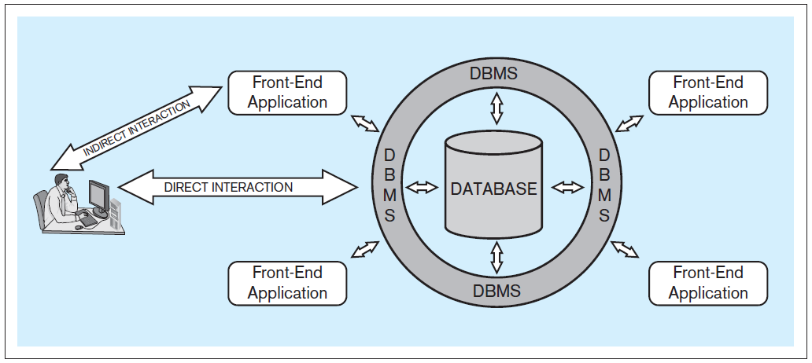
Database System Architecture
Database system: A computer-based system that enables efficient interaction between users and information stored in a database.
Database Systems
by Jukić, Vrbsky, & Nestorov
Pearson 2014
ISBN 978-0-13-257567-6

Slide 26
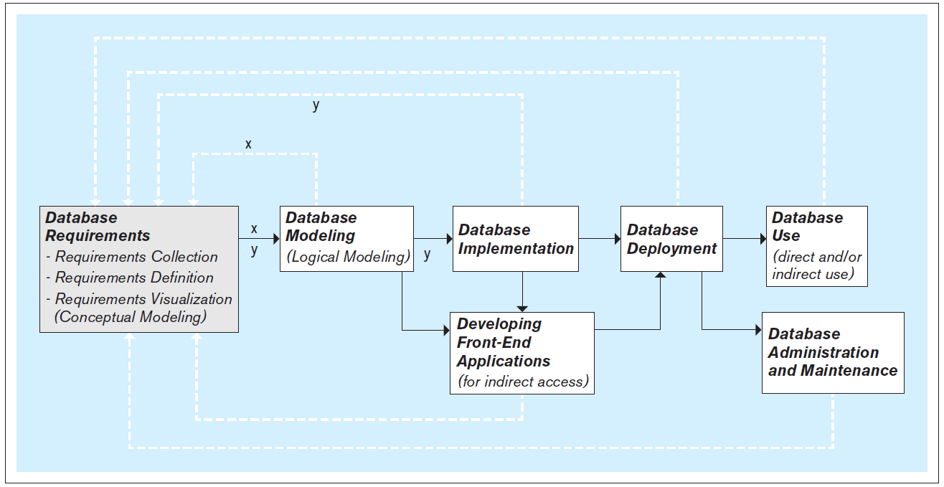
Steps to Develop a Database
It’s an iterative process!
Database Systems
by Jukić, Vrbsky, & Nestorov
Pearson 2014
ISBN 978-0-13-257567-6

Slide 27
Database Requirements
First and most critical step: Collect, define, and visualize requirements.
What data will the database hold and how?
What will be the capabilities and functionalities of the database?
Use the requirements to model and implement the database and to create the front-end applications.

Slide 28
Data Modeling
A data model is a diagram that shows what data an application works with and how the data is used.
Model data that will be persisted (written to and read from a data repository).
In the Model-View-Controller architecture, generally only the model objects are persisted.
For databases, objects are called entities.
Model entities and their relationships to each other.
Similar to classes and their relationships.

Slide 29
Conceptual Database Model
Visualize the requirements.
Use a conceptual data modeling technique.
Example: Entity-relationship (ER) modeling
Implementation independent: No dependencies on the logic of a particular database management system (DBMS).
Example DBMS: Oracle, MySQL, etc.
Blueprint for the logical model.

Slide 30
Logical Database Model
Create the relational database model as the logical model.
It’s usually straightforward to map an ER model to a relational model.

Slide 31
Physical Database Model
The physical model is the actual database implementation.
Use relational DBMS (RDBMS) software.
Structured Query Language (SQL) commands to create, delete, modify, and query database structures.

Slide 32
Conceptual DB Model: Entities and Attributes
Entity
Represents a real-world concept.
Examples: customer, product, store, event, etc.
Data that the database stores.
Attribute
Characteristic of an entity that the database stores.
Examples (for a customer): name, address, id, etc.
A unique attribute of an entity has a value that is different for each entity instance.

Slide 33
Conceptual Data Model Example
Student, teacher, class, and contact info entities and their attributes.
Student
id
first name
last name
contact info
Teacher
id
first name
last name
contact info
Class
class code
subject name
classroom number
which teacher
Contact info
id
email address

Slide 34
Conceptual Data Model Example, cont’d
Sample queries (derived from use cases)
What teachers does this student have?
What classes does this teacher teach?
Who is the teacher of this class?
Which students are in this class?
Which students are in each of the classes taught by this teacher?

Slide 35
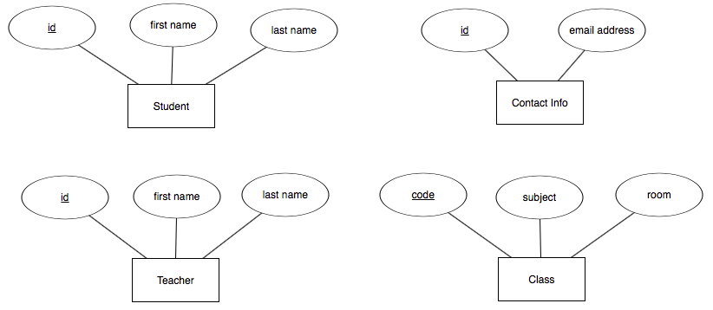
Entities and Attributes, cont’d
In an ER diagram (ERD), show an entity with a rectangle and its attributes with ovals.
Underline the unique attribute.

Slide 36
Relationships
Each entity in an ER diagram must be related to at least one other entity.
Show a relationship with a diamond and connect the diamond to the entities that are part of the relationship.
Database Systems
by Jukić, Vrbsky, & Nestorov
Pearson 2014
ISBN 978-0-13-257567-6

Slide 37
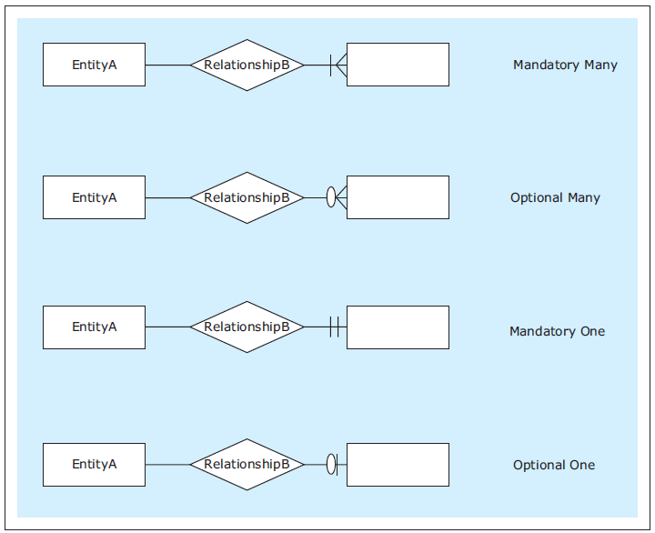
Relationship Cardinality
Show cardinality (how many instances of an entity) with symbols at the end of the relationship lines.
Maximum symbol closest to the entity.
Minimum symbol further away.
Zero, one, many
Database Systems
by Jukić, Vrbsky, & Nestorov
Pearson 2014
ISBN 978-0-13-257567-6

Slide 38
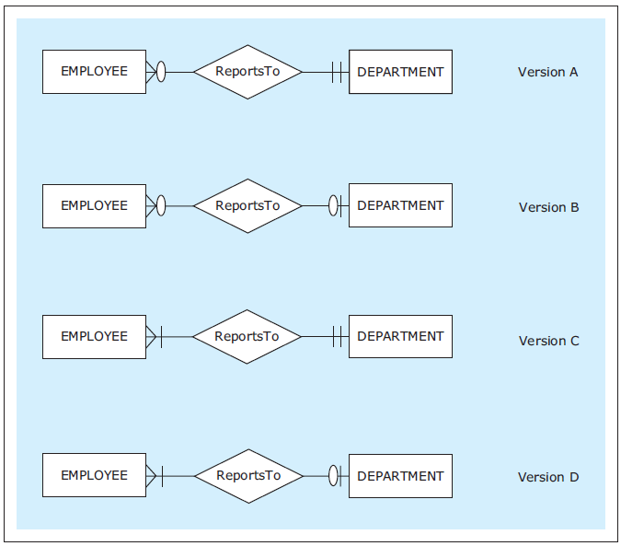
Relationship Cardinality, cont’d
Read each relationship in both directions in this order:
rectangle
diamond
cardinality
rectangle
Database Systems
by Jukić, Vrbsky, & Nestorov
Pearson 2014
ISBN 978-0-13-257567-6

Slide 39
Free Design Drawing Tool for Database Design
ERDPlus: https://erdplus.com/#/

Slide 40
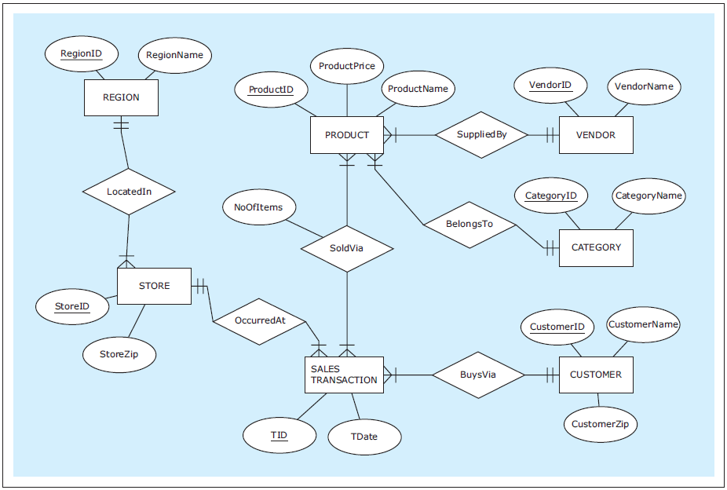
An Example ER Diagram
Database Systems
by Jukić, Vrbsky, & Nestorov
Pearson 2014
ISBN 978-0-13-257567-6

Slide 41
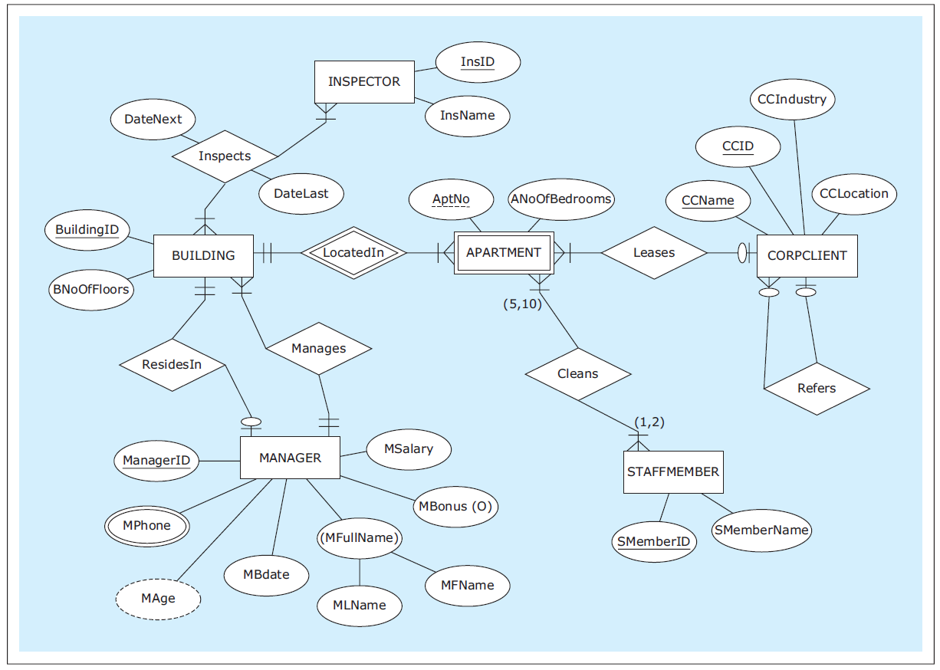
Another Example ER Diagram
Database Systems
by Jukić, Vrbsky, & Nestorov
Pearson 2014
ISBN 978-0-13-257567-6

