Slide 1
CS/SE 157B Database Management Systems II March 6 Class Meeting
Department of Computer Science San Jose State University Spring 2018 Instructor: Ron Mak
www.cs.sjsu.edu/~mak

Slide 2
Final Project
Put your emphasis on data management.
How do you manage the data that are you use?
Data models:
Operational tables
Analytical tables
Data operations:
Queries and updates of the operational tables.
Your ETL process.
Queries of the analytical tables for data analysis.
You can use actual downloaded data or
fake data created by data generation tools.
Example: https://www.mockaroo.com/

Slide 3
Final Project, cont’d
User application that invokes the data operations.
Web-based or desktop-based.
PHP, Java, etc.
Fancy GUI or data visualization not necessary.
How well did you use the technologies that you learned during the semester?
RDBM, DW, XML, data virtualization, NoSQL
node.js, Express, MongoDB, RESTful web services
Not all technologies have to be used.

Slide 4
Final Project, cont’d
Written report
What is the application?
What data did you use, and where did you get it?
Overview of your data models (in words).
ER diagram
Relational schemas
Star schemas
ETL process
Operational and analytical queries
Example user actions and screen shots of results.

Slide 5
Detailed vs. Aggregated Fact Tables
In a detailed fact table, each row contains data about a single fact.
In an aggregated fact table, each row contains a summary of multiple facts.
Such as a sum (aggregation) of all sales of a product in a particular store during a single day.

Slide 6
Granularity of the Fact Table
Fine level of granularity: Detailed fact table.
Courser level of granularity: Aggregated fact table.
Finer granularity: More analysis power.
Courser granularity: Faster queries.

Slide 7
Granularity of the Fact Table, cont’d
Granularity can also depend on how the data is collected and loaded into the fact table.
Example: Load only daily sales.
But then you lose the ability to analyze sales by the hour.
A solution: Keep both fine-grained and aggregated tables and have them share the dimension tables.

Slide 8
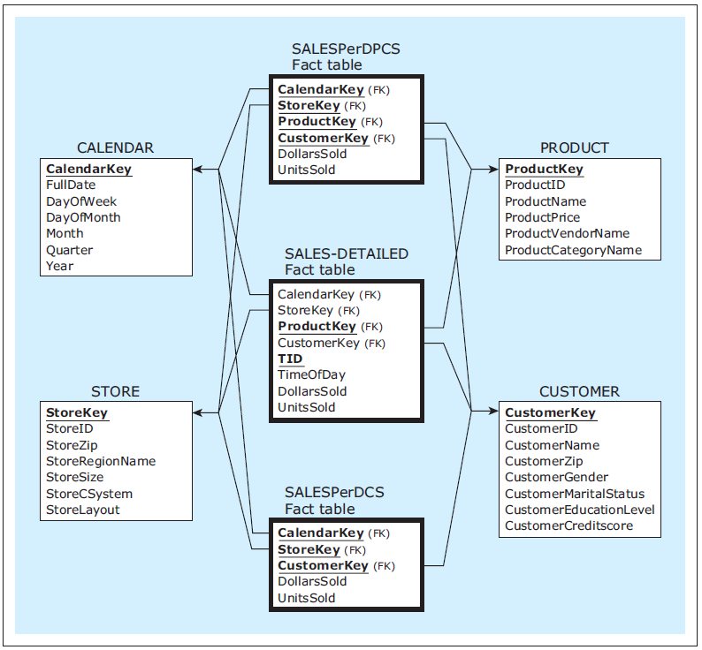
Granularity of the Fact Table, cont’d
Database Systems
by Jukić, Vrbsky, & Nestorov
Pearson 2014
ISBN 978-0-13-257567-6

Slide 9
Granularity of the Fact Table, cont’d
Good DW design involves deciding which aggregates are worth storing as tables.
The base fact tables contain data at the finest level of granularity required for full analysis.
Facts can be pre-summarized in aggregate tables at granularity levels that are determined to be optimal for certain analysis procedures.

Slide 10
Slowly Changing Dimensions
In a typical dimension of a star schema, either:
The values of a dimension’s attributes do not change or change extremely rarely.
Examples: store address, customer gender
OR: The values of a dimension’s attributes change occasionally and sporadically over time.
Example: customer address
Three approaches to handling slowly changing dimensions: Type 1, Type 2, and Type 3.

Slide 11
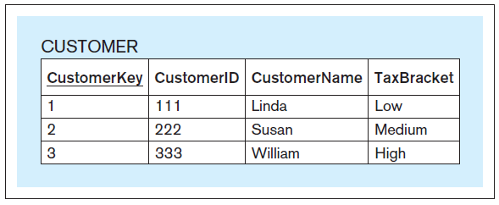
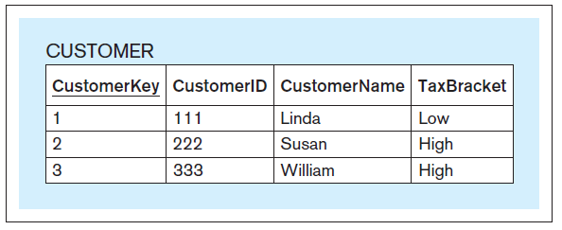
Slowly Changing Dimensions: Type 1
Simply change the value in the dimension table’s record.
Often used to correct errors.
Database Systems
by Jukić, Vrbsky, & Nestorov
Pearson 2014
ISBN 978-0-13-257567-6

Slide 12
Slowly Changing Dimensions: Type 2
Preserve history by creating an additional row with the new value.
Often used with timestamps.
Database Systems
by Jukić, Vrbsky, & Nestorov
Pearson 2014
ISBN 978-0-13-257567-6
Now you see why this analytical
table uses the separate
surrogate key CustomerKey
rather than the operational
table’s primary key CustomerID.

Slide 13
Slowly Changing Dimensions: Type 3
Create “previous” and “current” columns.
Only a fixed number of changes is possible.
Record only a limited history.
Database Systems
by Jukić, Vrbsky, & Nestorov
Pearson 2014
ISBN 978-0-13-257567-6

Slide 14
Snowflakes
Dimension tables can be unnormalized.
Fewer tables = faster joins = faster queries.
Update anomalies are not a concern.
Dimension tables are slowly changing.
Updates happen rarely if at all.
An undesirable snowflake results from unnecessarily normalizing dimension tables.

Slide 15
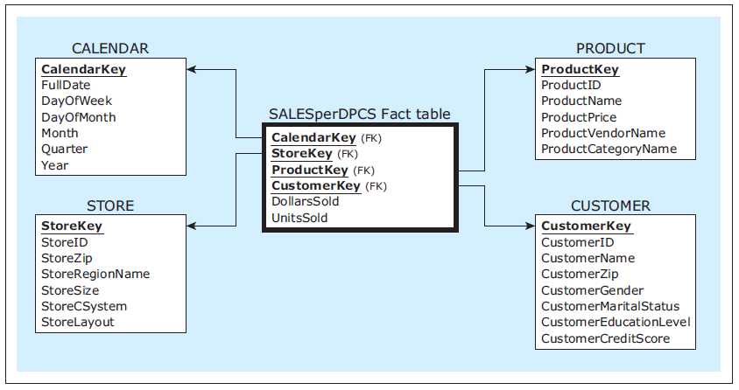
Snowflakes, cont’d
Unnormalized dimension tables.
Database Systems
by Jukić, Vrbsky, & Nestorov
Pearson 2014
ISBN 978-0-13-257567-6

Slide 16
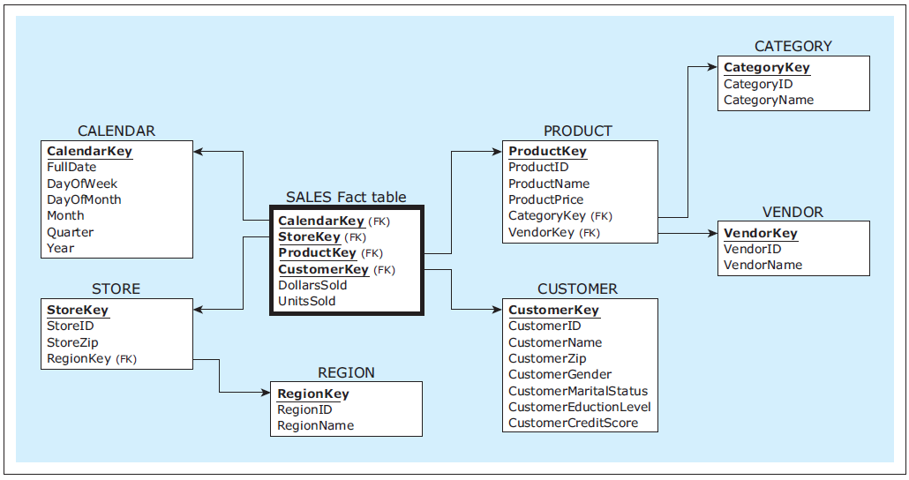
Snowflakes, cont’d
X
X
Avoid creating a snowflake!
Database Systems
by Jukić, Vrbsky, & Nestorov
Pearson 2014
ISBN 978-0-13-257567-6

Slide 17
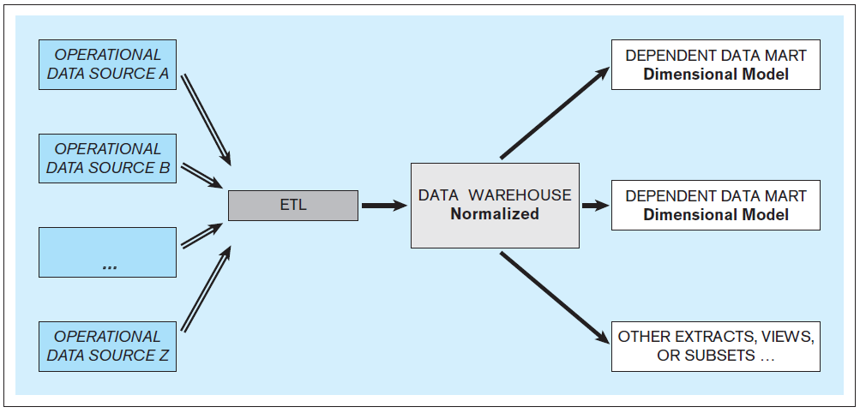
DW Architecture: Bill Inmon Approach
Normalized Data Warehouse
Database Systems
by Jukić, Vrbsky, & Nestorov
Pearson 2014
ISBN 978-0-13-257567-6

Slide 18
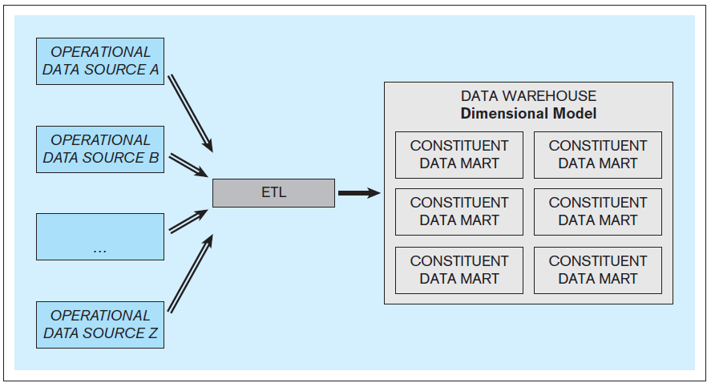
DW Architecture: Ralph Kimball Approach
Dimensionally Modeled Data Warehouse
Database Systems
by Jukić, Vrbsky, & Nestorov
Pearson 2014
ISBN 978-0-13-257567-6

Slide 19
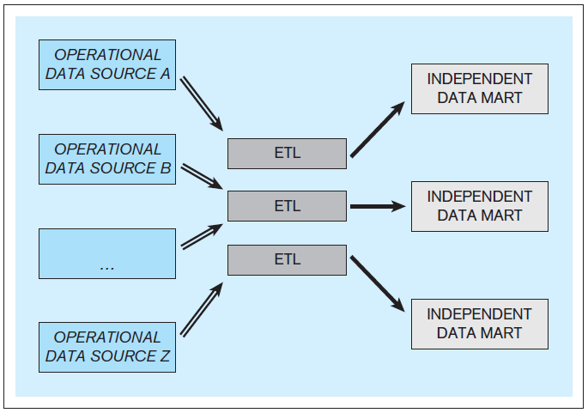
DW Architecture: Independent Data Marts
Inferior – Do not use!
Database Systems
by Jukić, Vrbsky, & Nestorov
Pearson 2014
ISBN 978-0-13-257567-6

Slide 20
Online Transaction Processing (OLTP)
Online: The computer responds immediately or very quickly.
online ≠ Internet
OLTP: online transaction processing
Use the operational database for OLTP.
Update and query operational data.
Present data
Generate reports

Slide 21
Online Analytical Processing (OLAP)
Query data from data warehouses and/or data marts to analyze and present data.
OLAP: online analytical processing
Use the analytical database for OLAP.
OLAP tools
Support decision making.
Read only.

Slide 22
OLAP Operations
Drill up and drill down
Slice and dice
Pivot

Slide 23
OLAP Drill Up and Drill Down
Drill through dimension hierarchies.
Examples:
Location: country → state → region → city → store
Time: year → quarter → month → week → day → hour
Drill up
AKA roll up.
Aggregate the data.
Make the data granularity coarser.
Drill down
Make the data granularity finer.

Slide 24
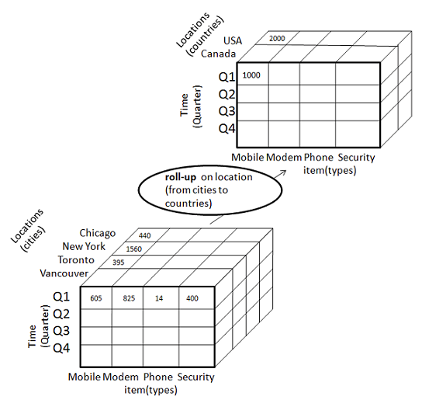
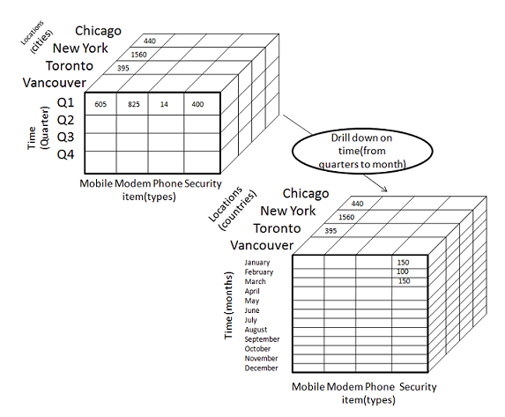
OLAP Drill Up and Drill Down, cont’d
OLAP cubes
http://www.tutorialspoint.com/dwh/dwh_olap.htm

Slide 25
OLAP Drill Up and Drill Down, cont’d
https://en.wikipedia.org/wiki/OLAP_cube
German: Schutz = protection
Ausrüstung = gear, equipment
Bergsteigen = mountaineering
Insekt = insect
Sonne = sun
Erste Hilfe = first aid

Slide 26
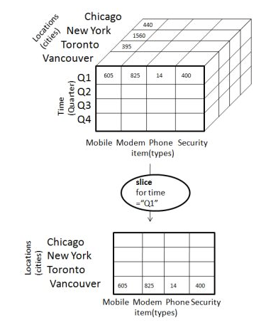
OLAP Slice
Slice: Select one value of a dimension attribute.
http://www.tutorialspoint.com/dwh/dwh_olap.htm
https://en.wikipedia.org/wiki/OLAP_cube

Slide 27
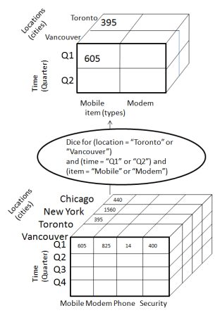
OLAP Dice
Dice: Select (not necessarily consecutive) attribute values from two or more dimensions.
http://www.tutorialspoint.com/dwh/dwh_olap.htm
https://en.wikipedia.org/wiki/OLAP_cube

Slide 28
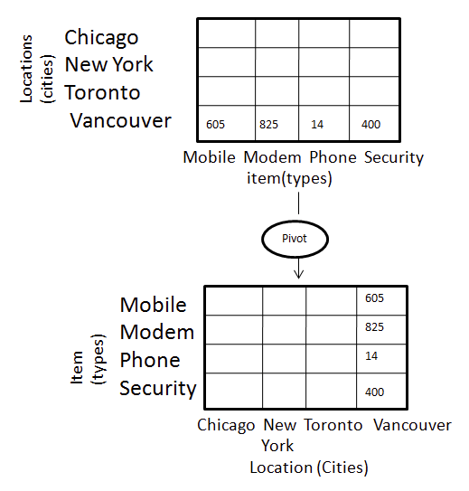
Pivot
Pivot: Reorganize query results by rotation.
http://www.tutorialspoint.com/dwh/dwh_olap.htm
https://en.wikipedia.org/wiki/OLAP_cube

Slide 29
Conformed Dimensions
When multiple star schemas share a common set of dimensions, the dimensions are called conformed dimensions.
Conformed dimensions enable analyses to span multiple star schemas, where the schemas share a common view of the world.
For example, all the schemas must share a common view of what a customer is.
Drill across: A OLAP operation that spans multiple star schemas.

Slide 30
OLAP/BI Tools
Users can query fact and dimension tables by using simple point-and-click query-building applications.
Based on user actions, the tool generates and executes the SQL code on the data warehouse or data mart.
SQL code to drill up or down, slice or dice, or pivot.
Example OLAP/BI tools
IBM Cognos, Oracle BI, TIBCO Spotfire, Tableau

Slide 31
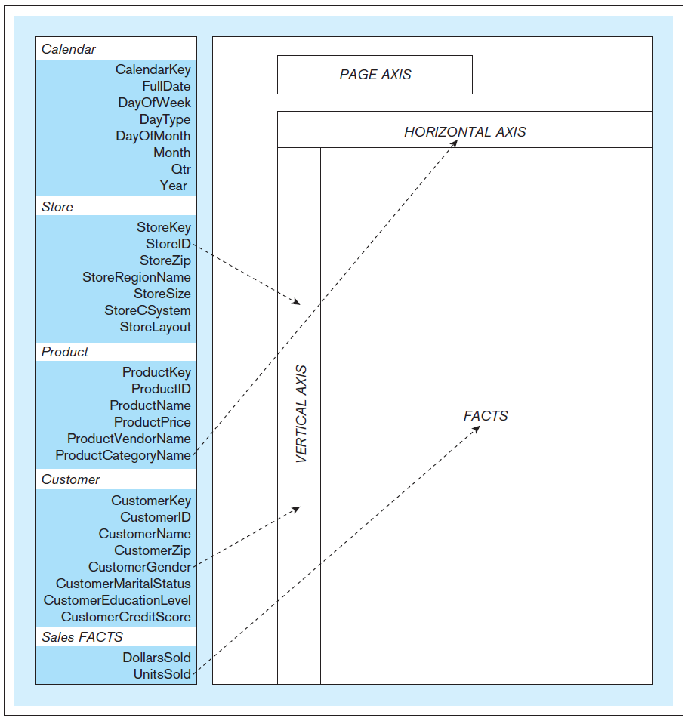
OLAP/BI Tools, cont’d
Typical OLAP
tool layout
Database Systems
by Jukić, Vrbsky, & Nestorov
Pearson 2014
ISBN 978-0-13-257567-6

Slide 32
OLAP/BI Tool Demos
RadarSoft: http://olaponline.radar-soft.com/Demos/HtmlOLAPGrid.aspx
Telerik: http://demos.telerik.com/aspnet-ajax/pivotgrid/examples/olap/defaultcs.aspx
See also: http://www.softwareadvice.com/bi/?more=true#more

Slide 33
Assignment #4
Team assignment.
Perform OLAP operations on your dimensional model from Assignment #3.
For each of the following operations, write and execute SQL queries using your sample data:
drill up
drill down
slice
dice

Slide 34
Assignment #4, cont’d
For each OLAP operation, show the query, and “before” and “after” query output.
Example: Do a query that shows quarterly results. Then for a drill down, do a query that shows monthly results. For a drill up, do a query that aggregates and shows yearly results.
Submit a zip file into Canvas containing:
Dump of your dimensional model.
SQL queries and text files containing the results.
Due Wednesday, March 22.

Slide 35
Guest Lecture on Thursday!
Topic: Content Management and WordPress
Lecturer: Bob Nicholson
Longtime friend
Professional web designer
Enterprise software expert
Senior positions at Silicon Valley companies

Slide 36
Next Week
Complete data warehousing
Review for the midterm
Midterm Thursday, March 15

Slide 37
March 20 and 22
Semi-structured data and XML
Oxygen XML Editor
XPath and XQuery
FLWOR expressions
Moved up from after Spring Break

Slide 38
After Spring Break (March 26-30)
April 3 and 5
NoSQL databases and web applications
MongoDB
Documents and collections
CAP theorem vs. ACID
April 10 and 12
The Express server-side framework
Database CRUD actions and HTTP verbs
The REST API and RESTful web services

