Slide 1
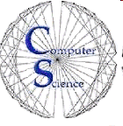
CS 154 Formal Languages and Computability January 28 Class Meeting
Department of Computer Science San Jose State University Spring 2016 Instructor: Ron Mak
www.cs.sjsu.edu/~mak

Slide 2
Basic Info
Office hours
TuTh 4:30 – 5:30 PM
MH 413
Class website
http://www.cs.sjsu.edu/~mak/
Green sheet
Assignments
Lecture notes

Slide 3
Grading
Your final class grade will be based on the class curve.
Weights:
50% assignments
15% midterm #1
15% midterm #2
20% final

Slide 4
Add Codes?
Hand in a filled-out paper Add Code form.
Email me a copy of your transcript with the prerequisite courses highlighted.
I will provide add codes to qualified students.
Up to the enrollment limit.
Graduating seniors have priority (email me a copy of your card).

Slide 5
Goals of the Course
Understand the fundamental capabilities and ultimate limitations of computation.
Appreciate the rich antecedents and foundational theories of modern computing.

Slide 6
Every Science has its Theory
Physics
Newton’s Laws
Einstein’s Theory of Relativity
Chemistry
Structure and property of substances
Reactions that change substances
Biology
Cell theory
Evolution

Slide 7
After all, it is Computer Science
This class will be about some of the foundational theories of computer science.
Science is also about experimentation.
Try things and see what happens.
Learn from the experimental results.

Slide 8
Computer Theory
AKA computation theory
Form several abstract mathematical models.
Describe types of computers.
Describe parts of computers.
With varying degrees of accuracy!
Mathematical logic is a key component.
Formal systems
Theorems and proofs

Slide 9
Computer Theory, cont’d
How is computer science theory different from:
Circuits and switching theory (computer logic)
Computer architecture
Data structures and algorithms
Operating systems and compilers
Artificial intelligence
etc.
These topics deal with computers and software that currently exist and how to optimize them.

Slide 10
Some Bold Assertions
The abstract models in computer theory deal with:
Computers and software that currently exist
Computers and software that will exist
Computers and software that we can only imagine
We are not concerned with optimization.
Rather, we are concerned with the question of possibility.
What computers and software can and cannot do.

Slide 11
Take roll!

Slide 12
A Historical Perspective
Computer theory originally formed from seemingly unrelated branches of knowledge.
A small series of contemporaneous discoveries came together.
The discoverers were very dissimilar people.
They were separately motivated.

Slide 13
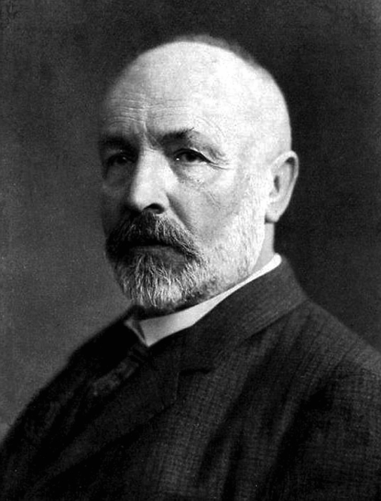
Georg Cantor
German, 1845-1918
Theory of Sets
Union, intersection, etc.
Discovered contradictions in what seemed to be rigorously proven mathematical theorems.
Example: Infinity comes in different sizes.
Cantor’s Paradox: A set that is larger than the universal set.
Left an unresolved cloud over mathematics.

Slide 14
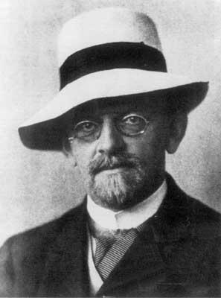
David Hilbert
German, 1862-1943
Wanted to eliminate paradoxes by making all mathematics to be like Euclidean Geometry.
Precise definitions
Explicit axioms
Rigorous proofs
Wanted to develop algorithms for solving all mathematical problems of any kind in some finite number of steps.

Slide 15
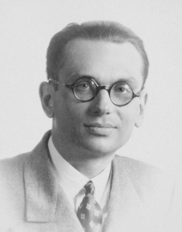
Kurt Gödel
Austrian-American, 1906-1978
Showed that no algorithm can provide proofs for all true mathematical statements.
Proved that not all true statements have proofs.
Incompleteness Theorems (1931) In all but the most trivial mathematical systems:
There are some true statements without any possible proof.
It is possible to “prove” some false statements.

Slide 16
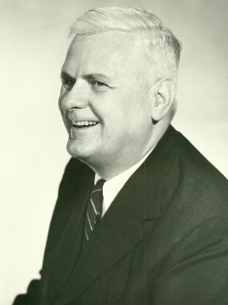
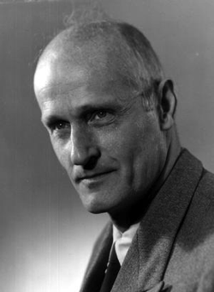
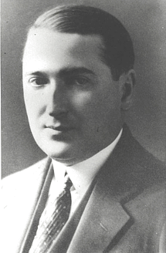
Alonzo Church, Stephen Kleene, Emil Post
Church (American, 1903-1995)
Kleene (American, 1909-1994)
Post (Polish-American, 1897-1954)
Church proposed the first general definition of an algorithm (1936).
Church and his student Kleene, and Post working separately, proved that there are problems that no algorithm can solve (1936).

Slide 17
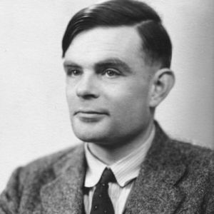
Alan Turing
British, 1912-1954
Developed the concept of a theoretical “universal-algorithm machine” (1936).
Studied what was possible for this machine to do.
Discovered that some tasks that this omnipotent machine was expected to be able to perform were in fact impossible for the machine.

Slide 18
Early to Mid 1930s
Much theoretical work on
Algorithms
What was solvable and what was not
Long before the development of electronic computers as we know them today!

Slide 19
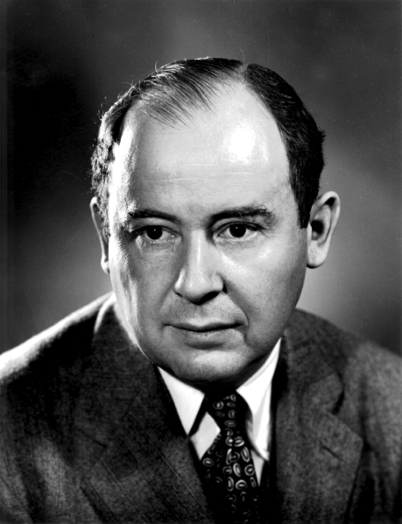
John von Neumann
Hungarian-American, 1903-1957
Von Neumann computer architecture
Concept of a stored-program computer
A program determined which hard-wired operations to perform and in what order.
His goal was to build a real-life model of an earlier theoretical machine, such as Turing’s universal-algorithm machine.

Slide 20
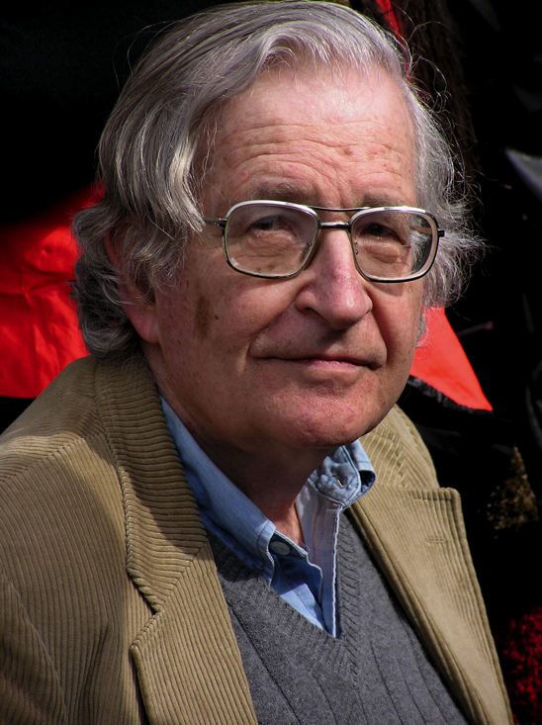
Noam Chomsky
American, born 1928
Linguist and political activist
Created mathematical models for the description of languages (1956).
Pioneered the study of programming languages.
Why are programming languages easy for a computer to understand but human languages are very difficult?

Slide 21
Overview of the Course
We will begin with the study of languages.
In a very formal way, hence the term formal languages.
Which sentences belong to a language, and which ones don’t?
We will design small machines called automata.
An automaton designed for a particular language will “execute” when given a sentence as input and decide whether or not the sentence belongs to the language.
plural
singular

Slide 22
Overview of the Course, cont’d
Our first languages will be very simple, and so will be their automata.
For example, an automaton may have very limited memory.
What operations can we perform on sentences from a language and have the result be in the language?
As the languages we study become more sophisticated, so will their automata.

Slide 23
Overview of the Course, cont’d
The automata are the models that will enable us to study computation.
Can we design an automaton that can execute any algorithm that a modern computer can?
How complex would this automaton have to be?
What are the implications if the automaton cannot execute an algorithm?
Are there algorithms that are inherently very hard to execute? That are impossible to execute by any computer?

Slide 24
The Language Game
Our study of formal languages starts out like a game.
As with any other game, it has rules.
The rules determine what sentences belong to the language.
The goal of the game is simple: Given an arbitrary sentence, determine if it belongs to the language.

Slide 25
Example: The English Language
The rules of the English language are its grammar rules.
The grammar rules determine whether or not a given sentence belongs to the English language. Is the sentence “proper English”?
Which are proper English sentences?
The dog chased the cat.
My hearing ran the water.
Table fourteen chair happy.

Slide 26
Some Basic Terms
English is much too complex a language.
Let’s instead start with some basic terms.
Let Σ represent a nonempty set of symbols called an alphabet.
We can construct finite strings of symbols from the alphabet.
sigma

Slide 27
String Examples
Let alphabet Σ = {a, b}.
Then abab and aaabbba are strings on Σ.
If we write it means that the string named w has the value abaaa.
w = abaaa
By convention, we use lowercase letters a, b, c, …
for elements in Σ and u, v, w, ... for string names.

Slide 28
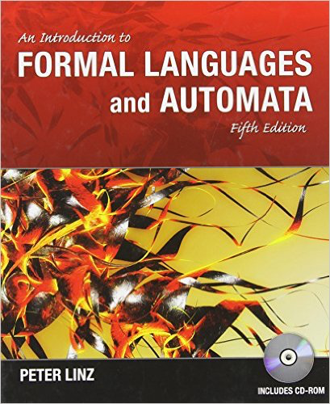
Required Textbook
An Introduction to Formal Languages
and Automata, 5th edition
Peter Linz Jones & Bartlett Learning
2012 978-1-4496-1552-9

Slide 29
Software to Install Locally
JFLAP
Java Formal Language and Automata Package
http://www.jflap.org
JavaCC
Java Compiler Compiler
https://javacc.java.net
There may be other software packages announced during the semester.

