Slide 1


CS 153
Concepts of Compiler Design
November 21 Class Meeting
Department of Computer Science
San Jose State University
Fall 2024
Instructor: Ron Mak
www.cs.sjsu.edu/~mak

Slide 2
Next Few Weeks
Tuesday, Nov. 26: Lab day
  Help with your compiler projects
Thursday, Nov. 28: Thanksgiving (no class)
Tuesday, Dec. 3: Oral project presentations
Thursday, Dec. 5: Oral project presentations
Tuesday, Dec. 17: Final exam
Friday, Dec. 20: Compiler projects due

Slide 3
Surveys During the Oral Presentations
Rate each of the following as
Poor, OK, Good, or Excellent:
  programming language
  grammar
  Jasmin object code generation
  sample program(s)
  compilation and execution of sample program(s)
  How was the presentation overall?

Slide 4
Recap
Classic Pascal as our source language.
  Popular teaching language of the 80s.
  Procedural, not object-oriented.
  Designed to be easy to parse.
Interpreter: immediate execution
  Interactive symbolic debugger
Converter: Pascal ➔ Java
  Why reinvent the compiler wheel?
Compiler: Pascal ➔ Jasmin assembly language
  Assemble and run on the Java Virtual Machine (JVM)
Demo

Slide 5
A GUI-Based Debugger
It is straightforward (though not trivial)
to create a GUI-based debugger.
It would be part of a complete
integrated development environment (IDE).
  Different windows for editing, executing, monitoring,
  input and output, etc.
  Buttons to invoke debugger operations.
  Animate the execution of a program.
Similar to Eclipse.
  (But not quite as good.)

Slide 6
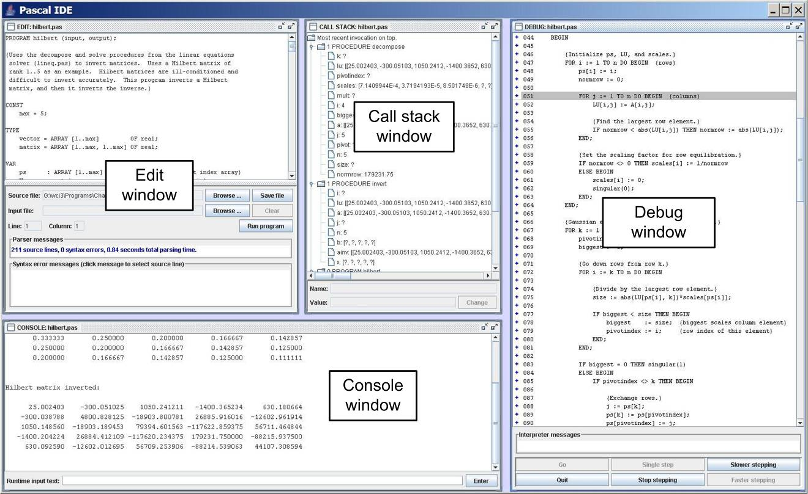
Integrated Development Environment (IDE)
A graphical user interface (GUI) that integrates:
  Edit window
  Debug window
  Call stack window
  Console window
Implemented with the Java Foundation Classes (Swing).
Uses multithreaded programming.
“Wrap a GUI” around the command-line debugger.

Slide 7
The Basic Idea Behind the IDE
Run the Pascal command-line debugger
in one process.
Run the IDE GUI code in another process.
The user manually performs an action on the IDE GUI (e.g., click the “Single step” button).
  The IDE sends the appropriate command-line command to the debugger.
  The debugger reads the command from its
  standard input just as if the user had typed it
  on the command line.

Slide 8
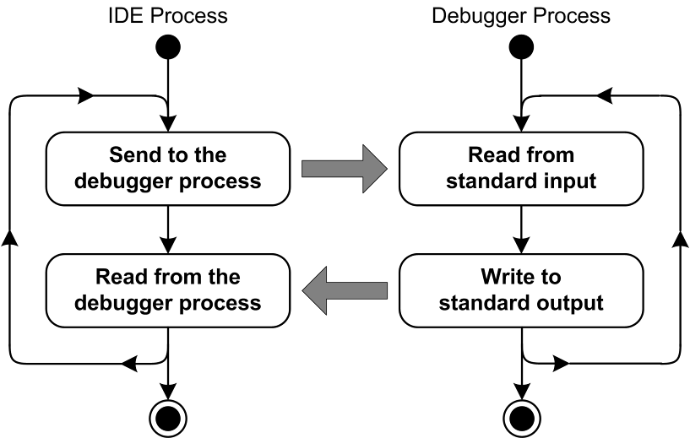
Interprocess Communication
The IDE process sends debugger commands to the debugger process.
  The IDE writes the commands to its standard output.
  The debugger reads
  the commands via its
  standard input.
The debugger process sends status information or program output to the IDE process.
  The debugger writes to its standard output.
  The IDE reads the debugger’s output via its standard input.
The debugger running in the debugger process believes that it’s reading debugger commands typed on the command line and that it’s writing results to the console.

Slide 9
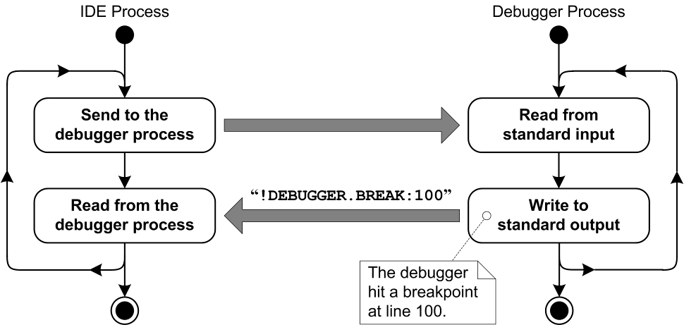
Interprocess Communication, cont’d

Slide 10
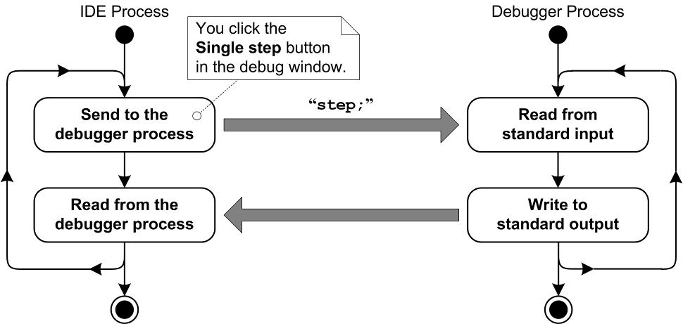
Interprocess Communication, cont’d

Slide 11
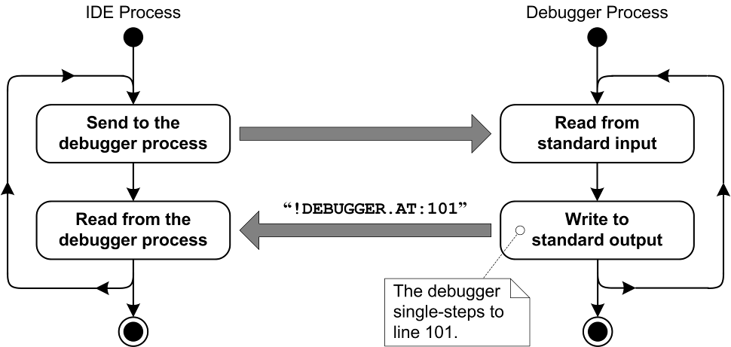
Interprocess Communication, cont’d
Demo

Slide 12
Compiler Construction Case Study
Construct a compiler for a C-like language.
It’s a cross-compiler.
  Runs on the Mac or on Windows.
  Generates Autocoder assembly object code for the IBM 1401.
    Restored and operational at the Computer History Museum.
  Assemble and run the program on the IBM 1401.
Every compiler has unique challenges
due to the target machine’s architecture
and instruction set.

Slide 13
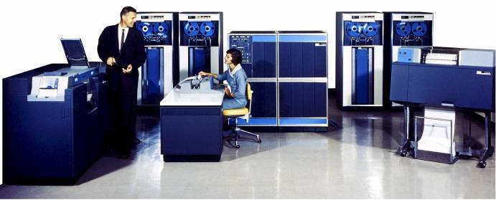
At the Computer History Museum
IBM 1401 computer, fully restored and operational.
  A small transistor-based mainframe computer.
  Extremely popular with small businesses
  in the late 1950s through the mid 1960s
    Maximum of 16K bytes of memory.
    800 card/minute card reader (wire brushes).
    600 line/minute line printer (impact).
    6 magnetic tape drives, no disk drives.

Slide 14
Challenges
The IBM 1401 computer was designed and released in the late 1950s.
Simple but ancient machine architecture.
  Up to 16K of memory.
  Character-based: one character per byte.
  Variable-length words.
  Addresses point to the low-order byte of words.
  The high-order byte has a “word mark” bit set.
  Two address registers, A and B.

Slide 15
Character-Based
Each byte represents a single character
(letter, digit, special character)
  6 bits for the character (64 “Hollerith” characters)
  1 bit for the work mark
  1 parity bit
BCD: binary-coded decimal
  Each byte can contain a single decimal digit 0 – 9
  Numbers can be arbitrarily long.
    Addressed at the low end. Word mark at the high end.
  Integer arithmetic only.
    Floating-point done with library routines.

Slide 16
Instruction Set
Operations are performed on operands in memory that are addressed by the A and B registers.
Let [A] and [B] represent the memory locations addressed by the A and B registers, respectively. Example:
  Add instruction: A ALPHA,BETA
    Load the address of ALPHA into the A register.
    Load the address of BETA into the B register.
    [B] ⬅ [B] + [A]: i.e., BETA = BETA + ALPHA

Slide 17
Temporary Variables
There is no runtime stack.
Perform arithmetic operations with
temporary variables.
  Example: w = 3*x + y - z
  Evaluate as
t1 = 3*x
t2 = t1 + y
w = t2 - z

Slide 18
Temporary Variables, cont’d
Temporaries can be different sizes depending on the results of operations.
  Example: The length of a sum of two operands
  is 1 + the length of the longer operand.
The compiler shouldn’t keep generating more temporaries for the Autocoder object code
while parsing different expressions.

Slide 19
Temp Pool
Maintain a pool of temporary variables.
If a temporary of a certain length is needed:
  First check the temp pool. If a temporary of the desired length is available, take it out of the pool
  and use it.
  If one is not available, create a new temporary
  of the desired length.
  When a temporary is no longer needed,
  put it into the pool.

Slide 20
Multiplication
The hardware performs multiplication by repeated additions.
  Requires a temporary of byte size equal to the
  sum of the number of digits of the multiplicand
  and the multiplier plus 1.
Load the multiplier into the high-order bytes of the temporary.

Slide 21
Multiplication, cont’d
The multiply instruction
  Automatically puts the address of the multiplicand into the A register.
  Automatically puts the address of the temporary
  into the B register.
After executing the M instruction:
  The product is in in the low-order bytes of the temporary.
  The multiplier is destroyed.

Slide 22
Multiplication, cont’d
In the c1401 language:
001 // c1401 multiplication demo
002
003 #include "includes/printf.s"
004
005 int mplier#3; // size 3 digits
006 int mcand#5; // size 5 digits
007 int prodct#9; // size 9 digits
008
009 void main()
010 {
011 mplier = 123;
012 mcand = 98765;
013 prodct = mplier * mcand;
014
015 printf("mplier is %3d%n", mplier);
016 printf(" mcand is %5d%n", mcand);
017 printf("prodct is %8d%n", prodct);
018 }

Slide 23
Multiplication, cont’d
MAIN SBR MAINX&3
* 009 v3=123;
ZA &123,MPLIER
* 010 v5=12345;
ZA &98765,MCAND
* 011 v9=v3*v5;
ZA &0,T01001
ZA MPLIER,T01001-6
M MCAND,T01001
ZA T01001,PRODCT
...
MPLIER DCW #3
MCAND DCW #5
PRODCT DCW #9
*
T01001 DCW #9
MPLIER
1
2
3
A
MCAND
9
8
7
6
5
B
0
0
0
0
0
0
0
0
0
T01001
1
2
3
0
0
0
0
0
0
T01001
0
1
2
1
4
8
0
9
5
T01001
0
1
2
1
4
8
0
9
5
PRODCT
Generated Autocoder assembly code
Demo

Slide 24
Scoping
The C language allows nested scopes.
  Override global variable x by local variable x.
One solution:
Don’t allow variable names to be reused.
Another solution:
Randomly rename all variables.
  Example: Source program variables x and y can become assembly variables V1253 and V9284.

Slide 25
Index Registers
The IBM 1401 has three index registers, X1, X2, and X3 which hold integer values.
An address can be indexed.
  Example subtract instruction: S ALPHA,X1,BETA
    A ⬅ address of ALPHA
    A ⬅ A + X1
    B ⬅ address of BETA
    [B] ⬅ [B] – [A]
    BETA = BETA – ALPHA[X1]

Slide 26
Recursion
Create a software stack.
  Use one of the index registers such as X2 as the pointer to the base of the stack frame.
  Then index each local variable of a recursive function by X2.
Recursive functions will therefore execute slower due to indexing its local variables.
  Make recursion an option for a function in the C language.
recursive int function foo()

Slide 27
Dynamic Memory Allocation
Maintain a heap at the far end of memory.
  Use one of the index registers such as X3
  to point to the heap limit.
  Allocate new memory at the end of the heap
  and then adjust X3.
No automatic garbage collection
  Use “mark” and “release”.
  Mark the current value of X3 by saving it.
  Release memory by restoring X3 to a saved value.

