Slide 1


CS 153
Concepts of Compiler Design
November 7 Class Meeting
Department of Computer Science
San Jose State University
Fall 2024
Instructor: Ron Mak
www.cs.sjsu.edu/~mak

Slide 2
Schedule for Oral Project Presentations
Oral presentations Thursday, December 5.
Present what you have working up to the date of your presentation.
  Tell about your
  source language
  Show highlights of your grammar (.g4 file and
  syntax diagrams)
  Compile and run least
  one sample program.
  Q and A
The rest of the class will evaluate your presentation.
Up to 20 minutes
per presentation
Compiler projects due
Friday, December 20

Slide 3
Presentation Evaluations
During each team’s oral presentation, the rest of the class will evaluate it in a Canvas survey.
Evaluation topics
(each rated Excellent, Good, OK, Poor):
  Programming language
  Grammar
  Sample program
  Jasmin code generation
  Compilation and execution
  How was the presentation overall
Class evaluations will be worth about 1/3 of the total project score.

Slide 4
Jasmin Code: WHILE Statement
L001:
getstatic TestWhile/i I
iconst_5
if_icmple L003
iconst_0
goto L004
L003:
iconst_1
L004:
ifeq L002
getstatic java/lang/System/out Ljava/io/PrintStream;
...
getstatic TestWhile/i I
iconst_1
iadd
putstatic TestWhile/i I
goto L001
L002:
program TestWhile();
var
i, j : integer;
begin
i := 1;
while i <= 5 do begin
writeln('i = ', i);
i := i + 1
end
end.

Slide 5
Jasmin Code: IF Statement
getstatic TestIf/i I
getstatic TestIf/j I
if_icmpeq L002
iconst_0
goto L003
L002:
iconst_1
L003:
ifeq L004
ldc 3.140000104904175
putstatic TestIf/x F
goto L001
L004:
iconst_5
ineg
i2f
putstatic TestIf/x F
L001:
program TestIf;
var
i, j : integer;
x : real;
begin
i := 1;
j := 2;
IF i = j THEN x := 3.14
ELSE x := -5;
end.

Slide 6
Jasmin Code: FOR Statement
.method private static proc(I)V
.var 1 is i I
.var 0 is limit I
iconst_1
istore_1
L001:
iload_1
iload_0
if_icmpgt L002
getstatic java/lang/System/out Ljava/io/PrintStream;
...
iload_1
iconst_1
iadd
istore_1
goto L001
L002:
...
return
.limit locals 2
.limit stack 6
.end method
procedure proc(limit : integer);
var
i : integer;
begin
for i := 1 to limit do writeln('i = ', i);
writeln;
end;

Slide 7
Jasmin Code: CASE Statement
getstatic TestCase/i I
iconst_1
iadd
lookupswitch
-8: L003
1: L002
4: L004
5: L004
7: L004
default: L001
L002:
getstatic TestCase/i I
putstatic TestCase/j I
goto L001
L003:
bipush 8
getstatic TestCase/i I
imul
putstatic TestCase/j I
goto L001
L004:
sipush 574
getstatic TestCase/i I
imul
putstatic TestCase/j I
goto L001
L001:
PROGRAM TestCase;
VAR
i, j : integer;
BEGIN
CASE i+1 OF
1: j := i;
-8: j := 8*i;
5, 7, 4: j := 574*i;
END;
END.

Slide 8
Jasmin Code: Procedure Call
getstatic TestProcedure/i I
getstatic TestProcedure/j I
getstatic TestProcedure/i I
i2f
getstatic TestProcedure/x F
fdiv
getstatic TestProcedure/i I
getstatic TestProcedure/j I
imul
i2f
invokestatic TestProcedure/gamma(IIFF)V
PROGRAM TestProcedure(input, output);
VAR
i, j : integer;
x : real;
PROCEDURE gamma(i, n : integer; x, r : real);
BEGIN
END;
BEGIN
gamma(i, j, i/x, i*j);
END.

Slide 9
Runtime Memory Management
In the “Pascal Virtual Machine” all local data is kept on the runtime stack.
  All memory for the parameters and variables declared locally by a routine is allocated in the routine’s stack frame.
PROGRAM main1
FUNCTION func2
FUNCTION func3
PROCEDURE proc2
PROCEDURE proc3
SF: proc2
SF: func3
AR: proc3
SF: func2
SF: proc3
3
SF: proc2
2
1
SF: main1
RUNTIME
DISPLAY
RUNTIME STACK
main1
➔ proc2
➔ proc3
➔ func2
➔ func3
➔ proc2
  The memory is later automatically deallocated when the stack frame is popped off the stack.
Recall: Resource Acquisition is Initialization (RAII)

Slide 10
Runtime Memory Management, cont’d
What about dynamically allocated data?
Memory for dynamically allocated data
is kept in the heap.

Slide 11
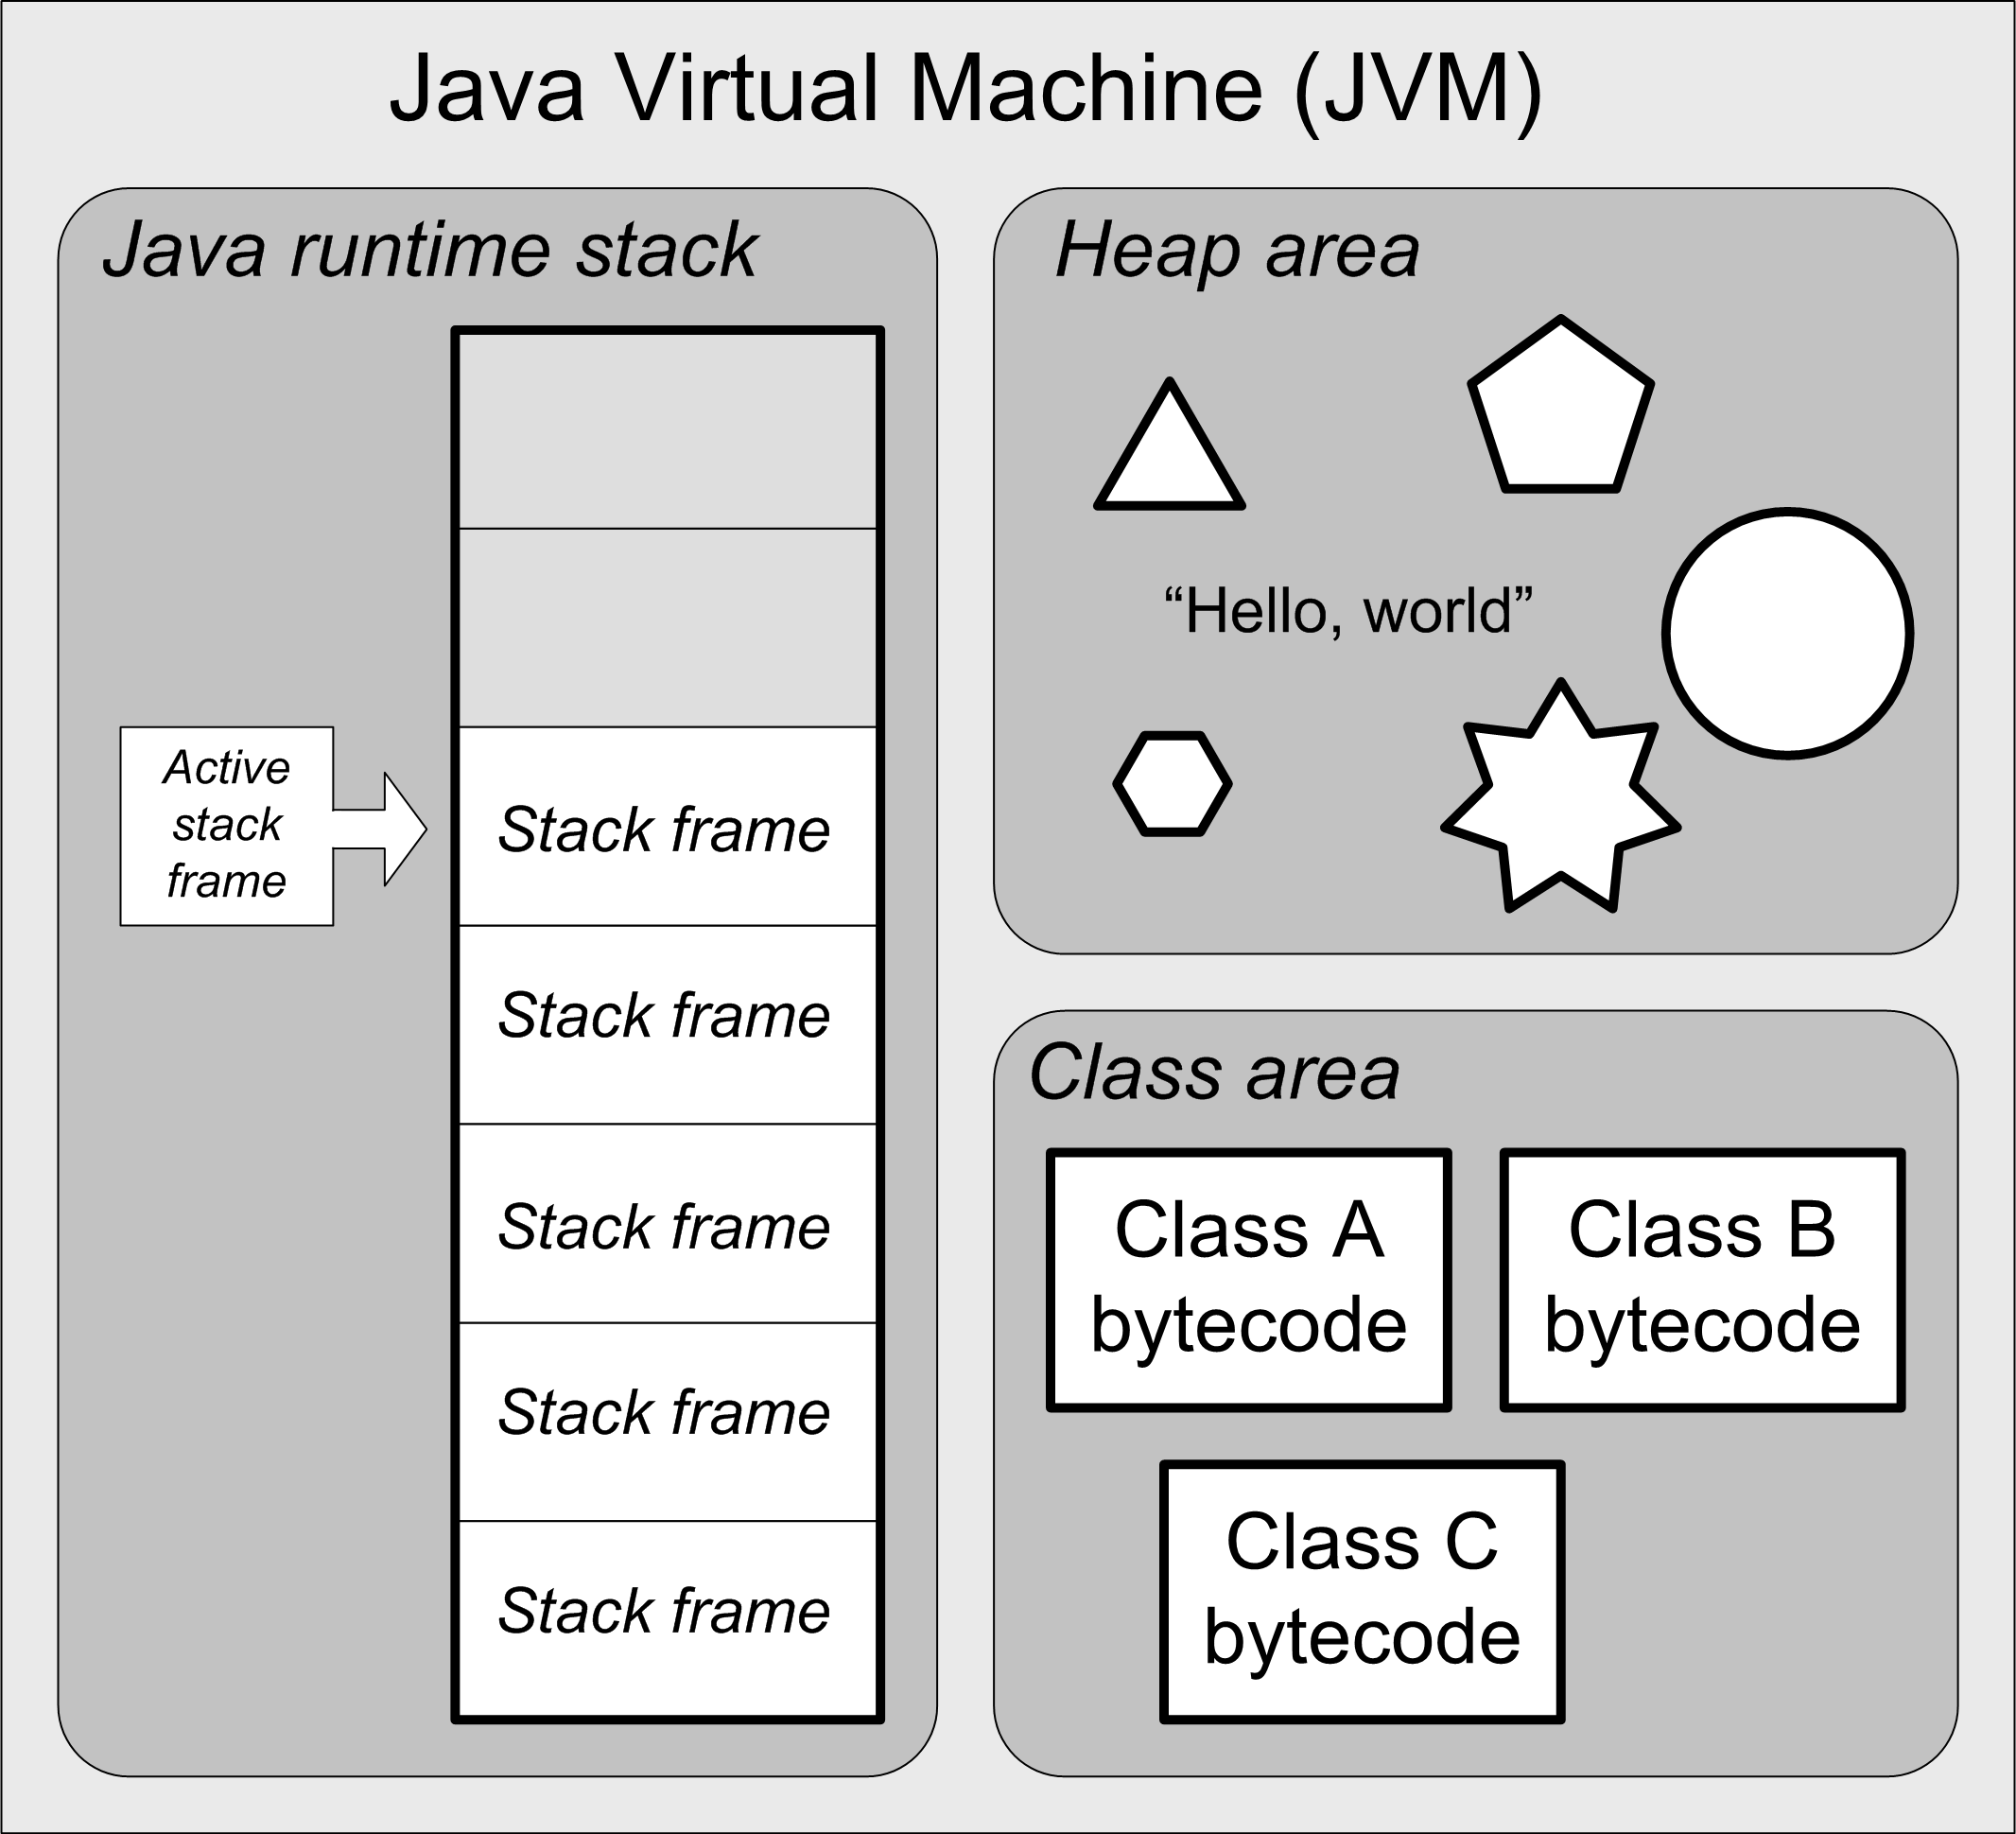
Recall the JVM Architecture ...

Slide 12
Runtime Memory Management, cont’d
Runtime memory can be divided into four partitions:
  Static memory
    executable code
    statically-allocated data
  Runtime stack
    activation records that contain locally-scoped data
  Heap
    dynamically-allocated data
    such as Java objects
  Free memory
Heap
Heap limit
Free memory
Top of stack
Runtime stack
Statically-allocated data
Executable code
Avoid: Heap-stack collision
(Out of memory error)

Slide 13
Runtime Heap Management
Handled by language-specific runtime routines.
Pascal, C, and C++
  Call new or malloc to allocate memory.
  Call delete or free to de-allocate.
Java and the JVM
  Call new to allocate memory.
  Automatic garbage collection.
New C++ “smart pointers” can
do automatic deletes when
pointer variables go out of scope.

Slide 14
Runtime Heap Management, cont’d
Keep track of all allocated blocks of memory
and all free blocks.
Free blocks are “holes” caused by freeing some of the dynamically allocated objects.

Slide 15
Runtime Heap Management, cont’d
When a new object needs to be allocated dynamically, where in the heap should
you put it?
  You can allocate it at the end of the heap,
  and thereby expand the size of the heap.
  You can find a hole within the heap
  that’s big enough for the object.

Slide 16
Runtime Heap Management, cont’d
What’s the optimal memory allocation strategy?
  Find the smallest possible hole
  that the object will fit in.
  Or randomly pick any hole that’s big enough.

Slide 17
Runtime Heap Management, cont’d
Should you periodically compact the heap
to get rid of holes and thereby
reduce the size of the heap?
If an allocated object moves due to compaction,
how do you update references (pointers)
to the object?

Slide 18
Garbage Collection
Return the memory occupied by an object (“garbage”) to unallocated status …
  … when there are no longer any references to the object and therefore it is inaccessible.
  That memory becomes a freed block (a hole).
Invented by computer scientist John McCarthy in 1959 to automatically manage runtime memory for his language Lisp.

Slide 19
Garbage Collection Algorithms
Reference counts
Mark and sweep
Stop and copy
Generational
... plus others

Slide 20
Automatic Garbage Collection
Automatic garbage collection is great
for us programmers, because we don’t
have to think about it and write code
to free unused objects.
But it can slow runtime performance unpredictably.
  Don’t write mission-critical real-time applications
  in a language that has automatic garbage collection, unless you can programmatically turn GC off when necessary.

Slide 21
Garbage Collection: Reference Counts
Include a counter with each block
of allocated memory.
  Increment the counter each time
  a pointer is set to point to the block.
  Decrement the counter whenever a pointer
  to the block is set to null (or to point elsewhere).
  Deallocate the block when the counter reaches 0.
Problem: Cyclic graphs
  The reference counts
  never become 0.

Slide 22
Garbage Collection: Mark and Sweep
A type of tracing garbage collection.
  Trace which objects are reachable by a chain of references from pointers within stack frames.
Periodically make a pass over the heap to
mark all reachable objects.
  Various marking algorithms.
  This can happen concurrently with program execution.
Make a second pass to sweep (deallocate) objects that are not marked.

Slide 23
Garbage Collection: Stop and Copy
Partition the heap into two halves.
  Allocate memory only in one half at a time.
When an allocation fails to find a sufficiently large block of free memory …
  Stop program execution.
  Copy all allocated blocks to the other half of the heap,
  thereby compacting it.
  Update all references to objects in the
  allocated blocks.
    How do you update pointer values?
  Resume program execution.

Slide 24
Generational Garbage Collection: Theory
Most objects are short-lived.
Long-lived objects are likely to last
until the program terminates.

Slide 25
Generational Garbage Collection: Practice
Partition the heap into a new generation area and an old generation area.
  Allocate new objects in the new generation area.
  Keep track of how long an object lives.
  Once an object lives past a predetermined threshold of time, migrate it to the old generation area.
The old generation area stays fairly compacted.
The new generation area needs compacting infrequently.

Slide 26
Aggressive Heap Management
Aggressive heap management means doing garbage collection frequently, even when
it’s not necessary.
  There’s still adequate free space remaining
  in the heap area.
Keep the heap compacted as much as possible.
  Improve reference locality.
  Optimize the use of physical memory
  when multiple programs are running.
  Reduce virtual memory paging.

Slide 27
Aggressive Heap Management: Tradeoff
GC operations slow program performance.
But paging to disk can be
orders of magnitude slower.

Slide 28
Recall ...
Suppose your computer ran at human speeds.
Access a value in a hardware register:
  1 CPU cycle: 1 second
Then the time to retrieve one byte from:
  SRAM
  (cache memory)
    5 seconds
  DRAM
  (main memory)
    2 minutes
  Flash drive
    1 day
  Hard drive
    2 months
  Magnetic tape
    1,000 years
The high cost of paging!

Slide 29
Change Java’s Heap Size
Typical default heap size: 256 MB.
Command-line options:
  -Xms: set an initial heap size
  -Xmx: set a maximum heap size
  -Xss: set the thread stack size
  -Xmn: set the size of the new generation area
  (the remainder goes to the old generation area)
Example:
  Increase the heap size to 1 GB to run myprog
java –Xmx1024m myprog

Slide 30
Garbage Collection Research
Entire books have been written about
garbage collection.
It’s still an area with opportunities for research.
You can become famous by inventing
a better GC algorithm!
Maybe some form of adaptive GC
using machine learning?
  Train the GC algorithm on the types of programs
  that you typically run.

Slide 31
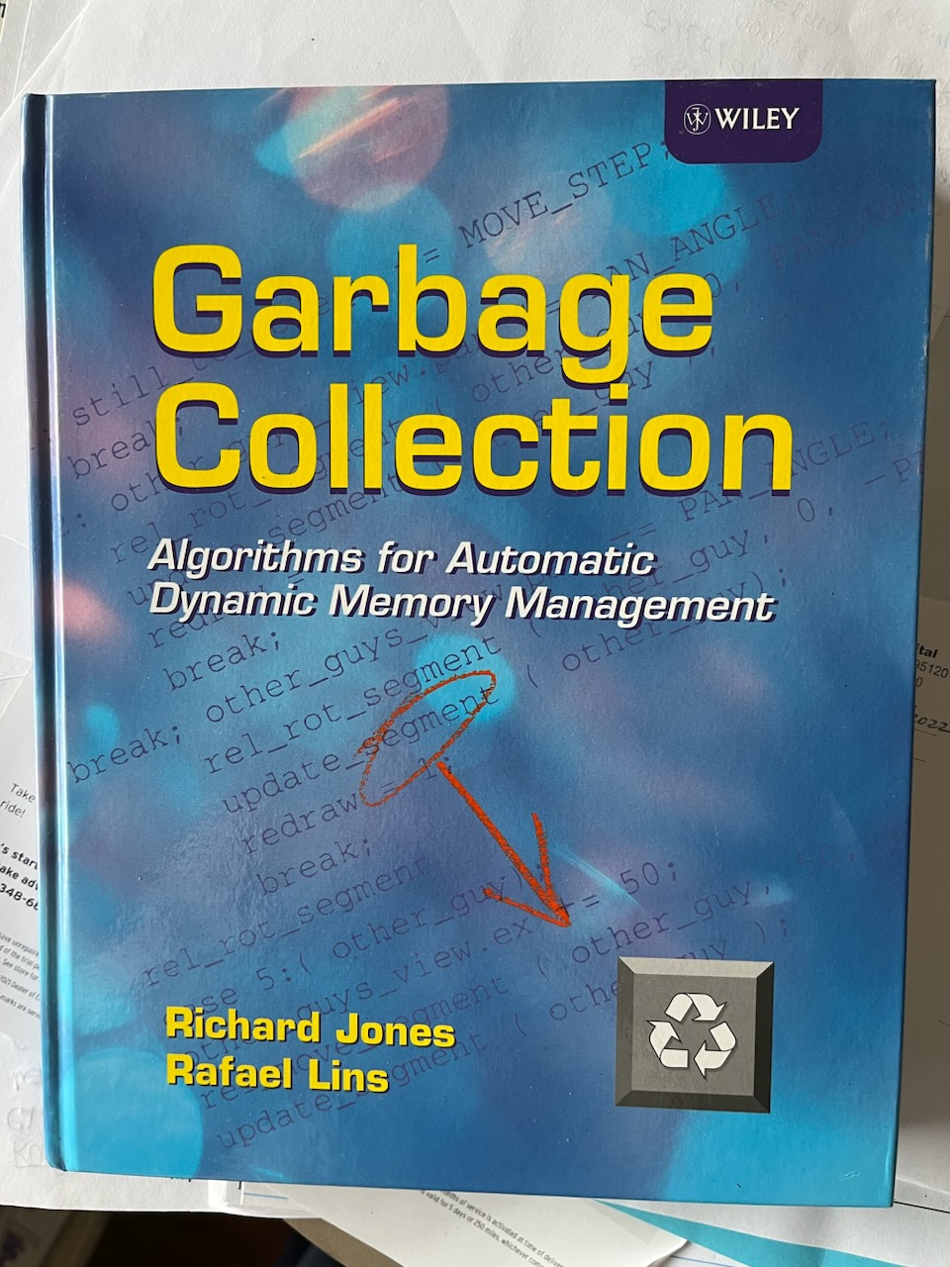
Book on Garbage Collection

