Slide 1


CS 153
Concepts of Compiler Design
October 29 Class Meeting
Department of Computer Science
San Jose State University
Fall 2024
Instructor: Ron Mak
www.cs.sjsu.edu/~mak

Slide 2
A Free Compiler Book!
A more “traditional” compiler textbook first published in 1979:
http://www.cs.sjsu.edu/~mak/CS153/UnderstandingAndWritingCompilers.pdf
  A bit dated, but still useful.

Slide 3
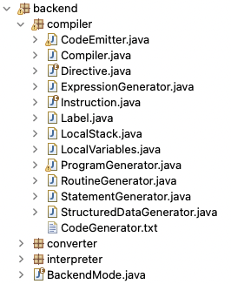
What’s in the Compiler Back End?
BackendMode.java
package backend;
public enum BackendMode
{
EXECUTOR, CONVERTER, COMPILER
}

Slide 4
Backend Compiler Classes
Label
  Generate statement labels in the form Lindex
  where index is a counter.
  The first generated label is L001.
Directive
  An enumeration class of assembler directives: .class, .method, .field, .var, .limit, etc.
iload 4
istore 7
L023:
iload 4
iconst_1
iadd
istore 4
goto L021
L022:

Slide 5
Backend Compiler Classes, cont’d
LocalVariables
  Maintain use of the local variables array in the
  stack frame of a procedure or function.
  Reserve slots for use by the local variables and parameters.
  Search for unused slots to reserve.
  Release slots that are no longer used.
  Count how many slots are used so that an accurate .limit locals directive can be emitted.
.limit locals 13
.limit stack 8

Slide 6
Backend Compiler Classes, cont’d
LocalStack
  Maintain use of the operand stack in the
  stack frame of a procedure or function.
  As Jasmin code is being emitted, keep track of the size of the stack when that code is later executed.
  Methods increase and decrease monitor the stack size.
  Return the maximum size of the stack so that an accurate .limit stack directive can be emitted.
.limit locals 13
.limit stack 8

Slide 7
Backend Compiler Classes, cont’d
Instruction
  Jasmin instructions that can be emitted.
  Net stack usage for each instruction
Instruction.java
// Load value or address
ILOAD_0(1), ILOAD_1(1), ILOAD_2(1), ILOAD_3(1),
DLOAD_0(2), DLOAD_1(2), DLOAD_2(2), DLOAD_3(2),
ALOAD_0(1), ALOAD_1(1), ALOAD_2(1), ALOAD_3(1),
LLOAD_0(2), LLOAD_1(2), LLOAD_2(2), LLOAD_3(2),
ILOAD(1), DLOAD(2), ALOAD(1),
GETSTATIC(1), GETFIELD(0),
// Store value or address
ISTORE_0(-1), ISTORE_1(-1), ISTORE_2(-1), ISTORE_3(-1),
DSTORE_0(-2), DSTORE_1(-2), DSTORE_2(-2), DSTORE_3(-2),
ASTORE_0(-1), ASTORE_1(-1), ASTORE_2(-1), ASTORE_3(-1),
LSTORE_0(-2), LSTORE_1(-2), LSTORE_2(-2), LSTORE_3(-2),
ISTORE(-1), DSTORE(-2), ASTORE(-1),
PUTSTATIC(-1), PUTFIELD(-2),

Slide 8
Backend Compiler Classes, cont’d
CodeEmitter
  LocalVariables and LocalStack fields.
  Emit Jasmin instructions, labels, and directives
  in the proper format.
  Emit comments and blank lines.
  Overloaded emit and emitDirective functions.
  Emit code sequences to load and store variable values and constants. Check for:
    Local vs. program variables
    Regular vs. shortcut instructions
  Emit code for array elements and record fields.

Slide 9
Backend Compiler Classes, cont’d
CodeEmitter, cont’d
  Miscellaneous code emitters:
    Type checking and casting
    Function return values
  Utilities
    Datatype names
    String conversion
    etc.

Slide 10
Backend Compiler Classes, cont’d
/**
* Emit a 0-operand instruction.
* @param instruction the operation code.
*/
public void emit(Instruction instruction)
{
objectFile.println("\t" + instruction.toString());
objectFile.flush();
localStack.increase(instruction.stackUse);
++count;
}
/**
* Emit a 1-operand instruction.
* @param instruction the operation code.
* @param operand the operand text.
*/
public void emit(Instruction instruction, String operand)
{
objectFile.println("\t" + instruction.toString() + "\t" + operand);
objectFile.flush();
localStack.increase(instruction.stackUse);
++count;
}
CodeEmitter.java
Many overloaded versions
of method emit().
iload 5
iload 4
iconst_1
isub
if_icmpgt L046

Slide 11
Backend Compiler Classes, cont’d
CodeEmitter.java
/**
* Emit a load of an integer constant value.
* @param value the constant value.
*/
public void emitLoadConstant(int value)
{
switch (value)
{
case -1: emit(ICONST_M1); break;
case 0: emit(ICONST_0); break;
case 1: emit(ICONST_1); break;
case 2: emit(ICONST_2); break;
case 3: emit(ICONST_3); break;
case 4: emit(ICONST_4); break;
case 5: emit(ICONST_5); break;
default:
{
if ( (-128 <= value)
&& (value <= 127)) emit(BIPUSH, value);
else if ( (-32768 <= value)
&& (value <= 32767)) emit(SIPUSH, value);
else emit(LDC, value);
}
}
}
Shortcut
instructions

Slide 12
Backend Compiler Classes, cont’d
CodeEmitter.java
/**
* Emit a load of a real constant value.
* @param value the constant value.
*/
public void emitLoadConstant(double value)
{
if (value == 0.0f) emit(FCONST_0);
else if (value == 1.0f) emit(FCONST_1);
else if (value == 2.0f) emit(FCONST_2);
else emit(LDC, value);
}
Shortcut
instructions

Slide 13
Backend Compiler Classes, cont’d
/**
* Emit a load instruction for a local variable.
* @param type the variable's data type.
* @param index the variable's index into the local variables array.
*/
public void emitLoadLocal(Typespec type, int index)
{
Form form = null
if (type != null)
{
type = type.baseType();
form = type.getForm();
}
if ( (type == Predefined.integerType)
|| (type == Predefined.booleanType)
|| (type == Predefined.charType)
|| (form == ENUMERATION))
{
switch (index)
{
case 0: emit(ILOAD_0); break;
case 1: emit(ILOAD_1); break;
case 2: emit(ILOAD_2); break;
case 3: emit(ILOAD_3); break;
default: emit(ILOAD, index);
}
}
...
}
Shortcut
instructions
CodeEmitter.java

Slide 14
Backend Compiler Classes, cont’d
/**
* Emit code to load the value of a variable, which can be
* a program variable, a local variable, a constant, or a VAR parameter.
* @param variableId the variable's symbol table entry.
*/
public void emitLoadValue(SymtabEntry variableId)
{
Typespec type = variableId.getType().baseType();
Kind kind = variableId.getKind();
int nestingLevel = variableId.getSymtab().getNestingLevel();
if (kind == CONSTANT)
{ ... }
else if (kind == ENUMERATION_CONSTANT)
{ ... }
// Program variable.
else if (nestingLevel == 1)
{
String variableName = variableId.getName();
String name = programName + "/" + variableName;
emit(GETSTATIC, name, typeDescriptor(type));
}
// Local variable.
else
{
int slot = variableId.getSlotNumber();
emitLoadLocal(type, slot);
}
}
Program variables
vs.
Local variables
CodeEmitter.java

Slide 15
Backend Compiler Classes, cont’d
CodeEmitter.java
localStack.increase(instruction.stackUse);
Instruction.java
// Objects and arrays
NEW(1), NEWARRAY(0), ANEWARRAY(0), MULTIANEWARRAY(0),
IALOAD(-1), DALOAD(0), BALOAD(-1), CALOAD(-1), AALOAD(-1),
IASTORE(-3), DASTORE(-4), BASTORE(-3), CASTORE(-3), AASTORE(-3),
Why 1 for NEW but 0 for NEWARRAY, ANEWARRAY, and MULTIANEWARRAY?
new java/util/Scanner
iconst_2
iconst_3
iconst_4
multianewarray [[[I 3
iconst_5
newarray float
StructuredDataGenerator.java
emitter.emit(MULTIANEWARRAY,
emitter.typeDescriptor(targetEntry.getType()),
Integer.toString(dimensionCount));
localStack.decrease(dimensionCount - 1);

Slide 16
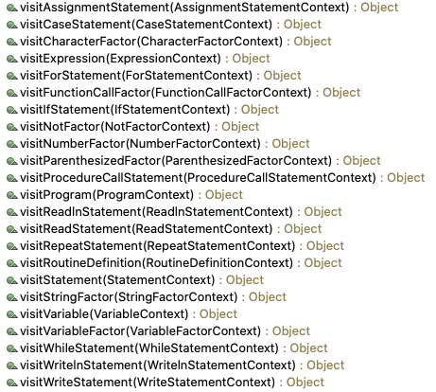
Visit Methods in Class Compiler
Most of the work is delegated
to helper classes:
ProgramGenerator
StructuredDataGenerator
StatementGenerator
ExpressionGenerator

Slide 17
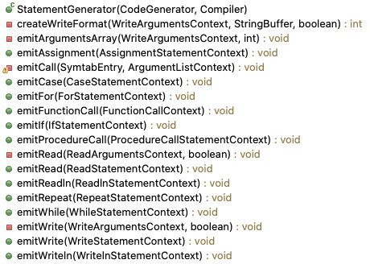
Class StatementGenerator

Slide 18
Backend Compiler Classes, cont’d
public void emitIf(PascalParser.IfStatementContext ctx)
{
PascalParser.TrueStatementContext trueCtx = ctx.trueStatement();
PascalParser.FalseStatementContext falseCtx = ctx.falseStatement();
Label loopExitLabel = new Label();
// Generate code for the boolean expression.
compiler.visit(ctx.expression());
// Generate code for a THEN statement only.
if (falseCtx == null)
{
emitter.emit(IFEQ, loopExitLabel);
compiler.visit(trueCtx);
}
// Generate code for a THEN statement and an ELSE statement.
else
{
Label falseLabel = new Label();
emitter.emit(IFEQ, falseLabel);
compiler.visit(trueCtx);
emitter.emit(GOTO, loopExitLabel);
emitter.emitLabel(falseLabel);
compiler.visit(falseCtx);
}
emitter.emitLabel(loopExitLabel);
}
StatementGenerator.java

Slide 19
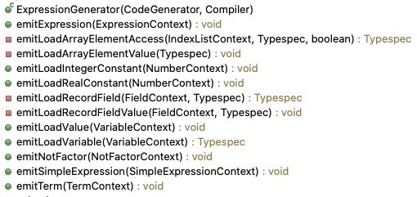
Class ExpressionGenerator

Slide 20
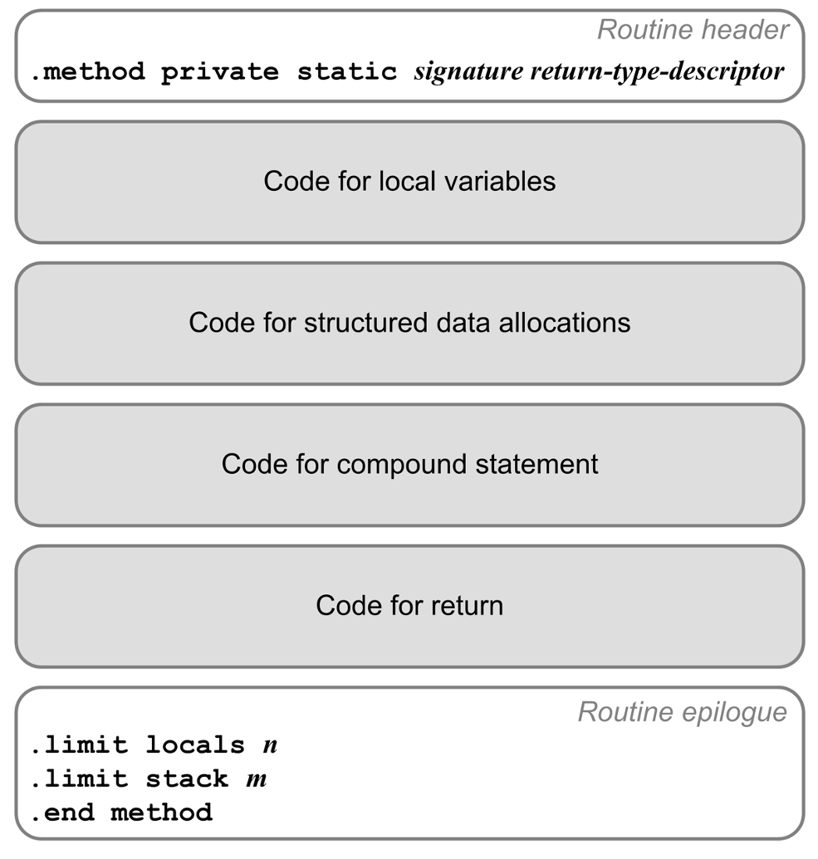

Class StructuredDataGenerator

Slide 21
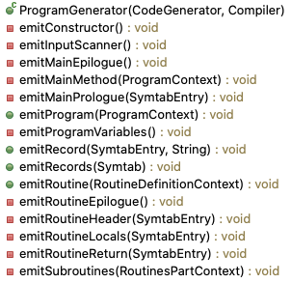
Class ProgramGenerator

Slide 22
Class ProgramGenerator, cont’d
public void emitProgram(PascalParser.ProgramContext ctx)
{
programEntry = ctx.programHeader().programIdentifier().entry;
Symtab programSymtab = programEntry.getRoutineSymtab();
emitRecords(programSymtab);
emitter.emitDirective(CLASS_PUBLIC, emitter.getProgramName());
emitter.emitDirective(SUPER, "java/lang/Object");
emitProgramVariables();
emitInputScanner();
emitConstructor(emitter);
PascalParser.RoutinesPartContext routinesCtx =
ctx.block().declarations().routinesPart();
if (routinesCtx != null)
{
RoutineGenerator routineGenerator = new RoutineGenerator(compiler);
routineGenerator.emitRoutines(routinesCtx);
}
emitMainMethod(ctx);
emitter.closeObjectFile();
}
ProgramGenerator.java

Slide 23
Class ProgramGenerator, cont’d
private void emitMainMethod(PascalParser.ProgramContext ctx)
{
LocalStack localStack = new LocalStack();
LocalVariables localVariables = new LocalVariables(5);
emitter.setLocalVariables(localVariables);
emitter.setLocalStack(localStack);
emitter.emitLine();
emitter.emitComment("MAIN");
emitter.emitDirective(METHOD_PUBLIC_STATIC,
"main([Ljava/lang/String;)V");
emitMainPrologue(programEntry);
// Emit code to allocate any arrays, records, and strings.
StructuredDataGenerator structureCode =
new StructuredDataGenerator(compiler);
structureCode.emitData(programEntry);
// Emit code for the compound statement.
emitter.emitLine();
compiler.visit(ctx.block().compoundStatement());
emitMainEpilogue();
}
ProgramGenerator.java

Slide 24
Class ProgramGenerator, cont’d
ProgramGenerator.java
private void emitMainEpilogue()
{
LocalVariables localVariables = emitter.getLocalVariables();
LocalStack localStack = emitter.getLocalStack();
// Print the execution time.
emitter.emitLine();
emitter.emit(INVOKESTATIC, "java/time/Instant/now()Ljava/time/Instant;");
localStack.increase(1);
emitter.emit(ASTORE_2);
emitter.emit(ALOAD_1);
emitter.emit(ALOAD_2);
emitter.emit(INVOKESTATIC,
"java/time/Duration/between(Ljava/time/temporal/Temporal;" +
"Ljava/time/temporal/Temporal;)Ljava/time/Duration;");
localStack.decrease(1);
emitter.emit(INVOKEVIRTUAL, "java/time/Duration/toMillis()J");
localStack.increase(1);
emitter. emit(LSTORE_3);
...

Slide 25
Class ProgramGenerator, cont’d
...
emitter.emit(GETSTATIC, "java/lang/System/out Ljava/io/PrintStream;");
emitter.emit(LDC, "\"\\n[%,d milliseconds execution time.]\\n\"");
emitter.emit(ICONST_1);
emitter.emit(ANEWARRAY, "java/lang/Object");
emitter.emit(DUP);
emitter.emit(ICONST_0);
emitter.emit(LLOAD_3);
emitter.emit(INVOKESTATIC, "java/lang/Long/valueOf(J)Ljava/lang/Long;");
emitter.emit(AASTORE);
emitter.emit(INVOKEVIRTUAL, "java/io/PrintStream/printf(Ljava/lang/String;" +
"[Ljava/lang/Object;)Ljava/io/PrintStream;");
localStack.decrease(2);
emitter.emit(POP);
emitter.emitLine();
emitter.emit(RETURN);
emitter.emitLine();
emitter.emitDirective(LIMIT_LOCALS, localVariables.count());
emitter.emitDirective(LIMIT_STACK, localStack.capacity());
emitter.emitDirective(END_METHOD);
emitter.close(); // the object file
}
ProgramGenerator.java

Slide 26
Class ProgramGenerator, cont’d
RoutineGenerator.java
public void emitRoutine(SymtabEntry routineEntry)
{
LocalStack localStack = new LocalStack();
emitter.setLocalStack(localStack);
emitRoutineHeader(routineEntry);
emitRoutineLocals(routineEntry);
// Generate code to allocate any arrays, records, and strings.
StructuredDataGenerator structuredCode =
new StructuredDataGenerator(compiler);
structuredCode.emitData(routineEntry);
// Emit code for the compound statement.
PascalParser.CompoundStatementContext stmtCtx =
(PascalParser.CompoundStatementContext) routineEntry.getExecutable();
compiler.visit(stmtCtx);
emitRoutineReturn(routineEntry);
emitRoutineEpilogue();
}

Slide 27
Class ProgramGenerator, cont’d
RoutineGenerator.java
private void emitRoutineReturn(SymtabEntry routineEntry)
{
emitter.emitLine();
// Function: Return the value in the implied function variable.
if (routineEntry.getKind() == FUNCTION)
{
Typespec type = routineEntry.getType();
// Get the slot number of the function variable.
String varName = routineEntry.getName();
SymtabEntry varEntry = routineEntry.getRoutineSymtab().lookup(varName);
emitter.emitLoadLocal(type, varEntry.getSlotNumber());
emitter.emitReturnValue(type);
}
// Procedure: Just return.
else emitter.emit(RETURN);
}

Slide 28
Project Presentations
Show what you have working
up to the day of your presentation.
  Up to 20 minutes per team.
  What is your source language?
  Is your language for a particular application domain?
  Show your grammar. Anything special?
  Show one or more sample programs
  written in your source language.
  Compile and run your sample program(s).
  Discussion and Q&A from the rest of the class.

Slide 29
Project Presentations, cont’d
During each presentation, the rest of the class will fill out a survey to evaluate your presentation.
The presentation part of your project grade
will be based significantly on the survey results.
The survey questions will be posted
before the presentations.

Slide 30
Project Presentation Schedule
Project presentations Dec. 5.
Compiler projects due
Friday, December 20
DEMO: MicroGame
A project from my CMPE 152 class
(same as CS 153 except in C++)

