Slide 1


CS 153
Concepts of Compiler Design
October 17 Class Meeting
Department of Computer Science
San Jose State University
Fall 2024
Instructor: Ron Mak
www.cs.sjsu.edu/~mak

Slide 2
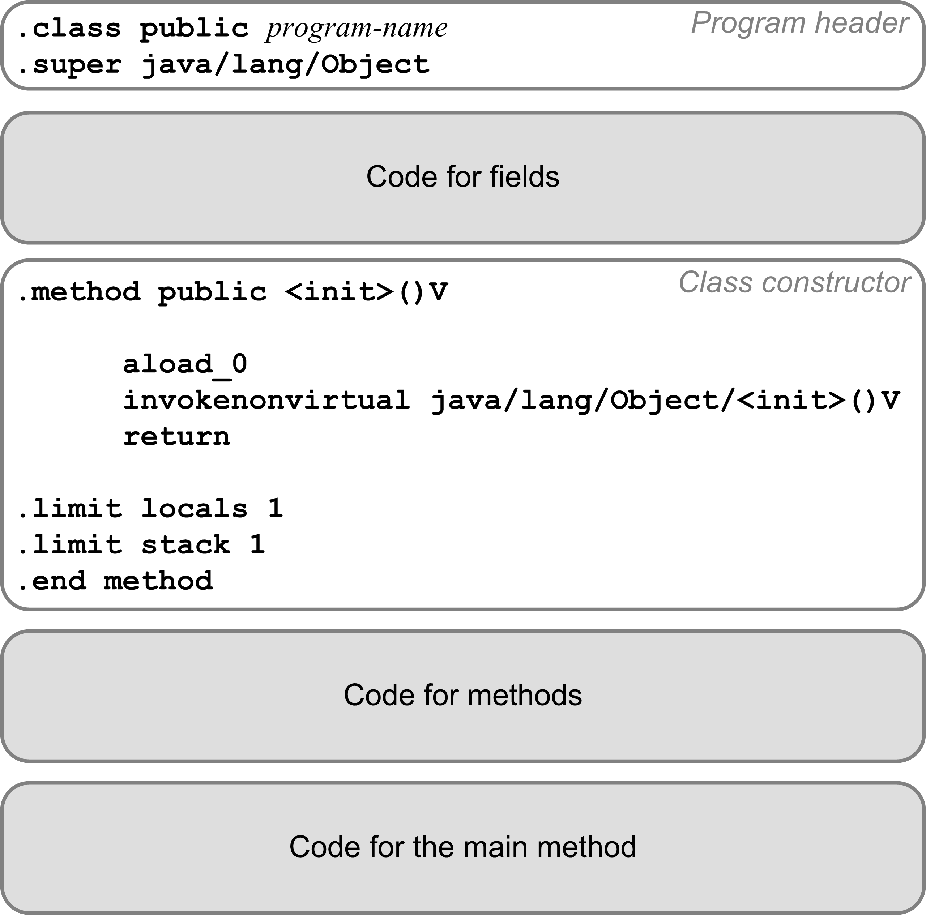
Code for Procedures and Functions

Slide 3
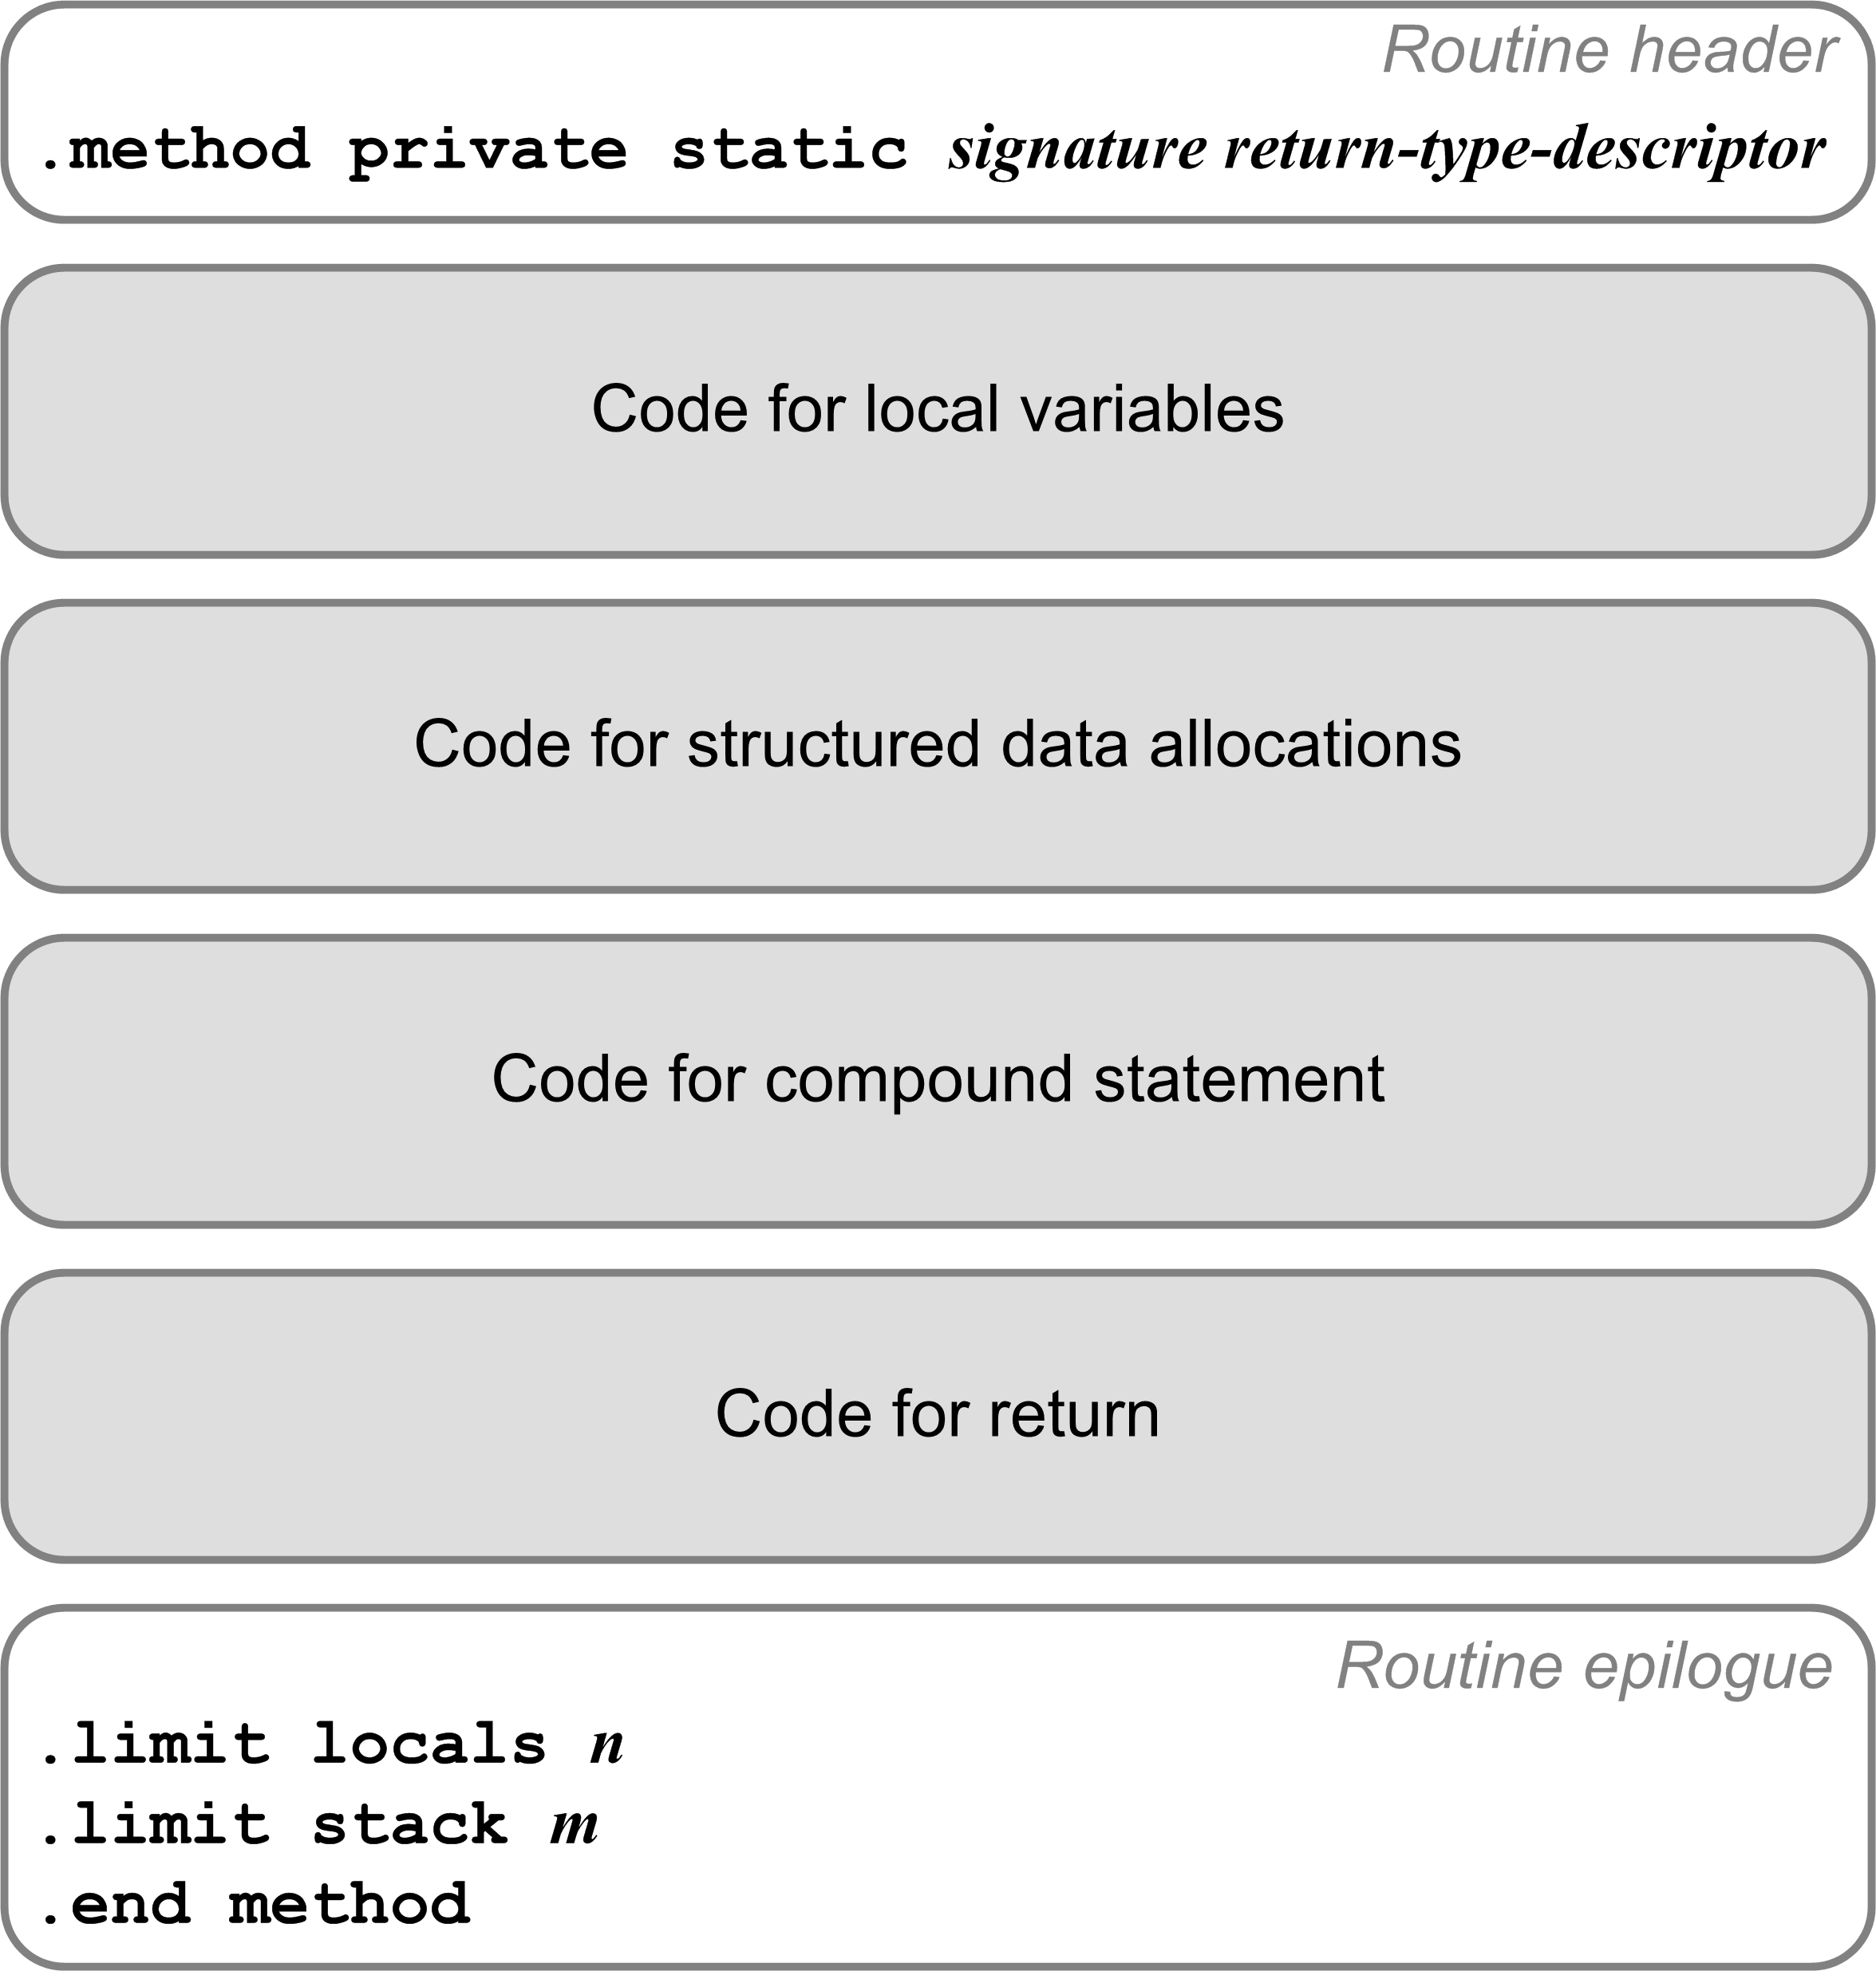
Code for Procedures and Functions
Each a private static method.
Method signature:
  Routine’s name
  Type descriptors of the formal parameters and return value.
Example:
TYPE
arr = ARRAY [1..5] OF real;
FUNCTION func(i, j : integer;
x, y : real;
p : boolean;
ch : char;
vector : arr;
length : integer)
: real;
Compiles to:
.method private static func(IIFFZC[FI)F

Slide 4
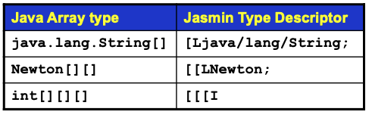
Compiling Local Variables
TYPE
arr = ARRAY [1..5] OF real;
FUNCTION func(i, j : integer;
x, y : real;
p : boolean;
ch : char;
vector : arr;
length : integer)
: real;
VAR
n : integer;
z : real;
w : arr;
Compiles to:
.method private static func(IIFFZC[FI)F
.var 5 is ch C
.var 0 is i I
.var 1 is j I
.var 7 is length I
.var 8 is n I
.var 4 is p Z
.var 6 is vector [F
.var 10 is w [F
.var 2 is x F
.var 3 is y F
.var 9 is z F
.var 11 is func F
Add a local variables array slot number
to each variable’s symbol table entry.

Slide 5
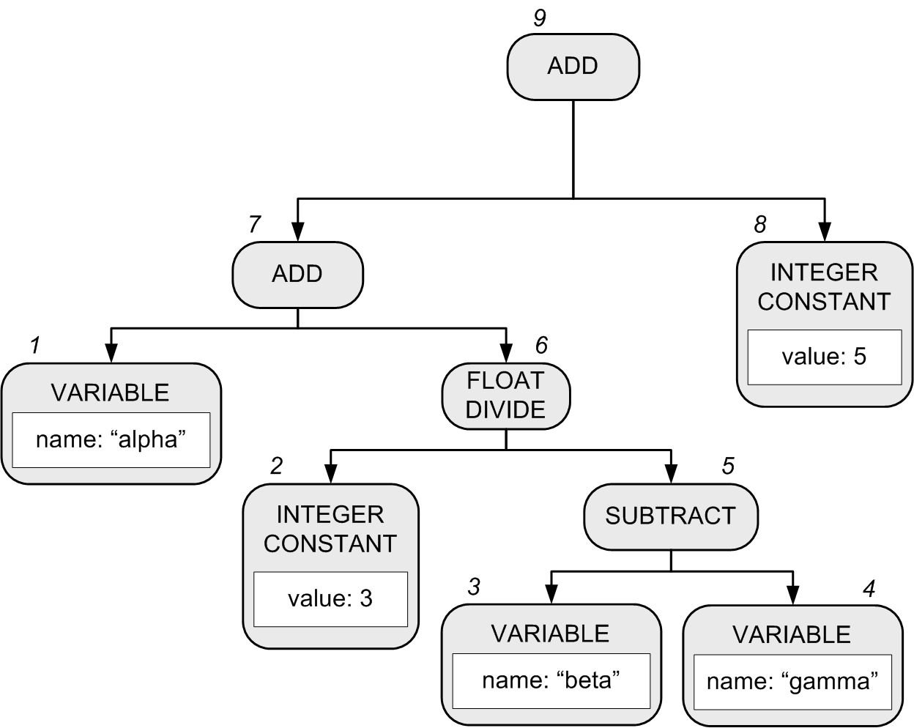
Generating Code for Expressions
alpha + 3/(beta - gamma) + 5
Recall that in our Pascal interpreter, the expression executor visits the nodes of the expression parse tree in order to execute the expression.
  Pascal’s operator precedence rules are encoded in the structure of the parse tree.
Notes:
START HERE.

Slide 6
Generating Code for Expressions
A compiler’s expression code generator also must visit the tree nodes to generate code for the expression.
  Yet another set of visit methods, in backend class Compiler.
  Assume that alpha, beta, and gamma are local real variables
  alpha ➔ local variable slot #0
  beta ➔ local variable slot #1
  gamma ➔ local variable slot #2
1 fload_0
2 ldc 3.0
3 fload_1
4 fload_2
5 fsub
6 fdiv
7 fadd
8 ldc 5.0
9 fadd
alpha + 3/(beta - gamma) + 5

Slide 7
Classes Containing Visit Methods
Semantic checking (front end)
  frontend.Semantics
Execution (backend interpreter)
  backend.interpreter.Executor
Conversion (backend language convertor)
  backend.converter.Converter
Compiler (backend compiler)
  backend.compiler.Compiler
The visit methods all visit
the same parse tree!
Pass 2
Pass 3
Pass 3
Pass 3

Slide 8
Compare Integer Values
Jasmin has a set of instructions each of which
pop off the top two integer values from the operand stack, compare them, and then branch if the comparison is true.
Instruction | Action
if_icmpeq label | Branch to label if [TOS-1] == [TOS]
if_icmpne label | Branch to label if [TOS-1] != [TOS]
if_icmpgt label | Branch to label if [TOS-1] > [TOS]
if_icmpge label | Branch to label if [TOS-1] >= [TOS]
if_icmplt label | Branch to label if [TOS-1] < [TOS]
if_icmple label | Branch to label if [TOS-1] <= [TOS]

Slide 9
Compare Integer Values, cont’d
Instruction | Action
if_icmpeq label | Branch to label if [TOS-1] == [TOS]
if_icmpne label | Branch to label if [TOS-1] != [TOS]
if_icmpgt label | Branch to label if [TOS-1] > [TOS]
if_icmpge label | Branch to label if [TOS-1] >= [TOS]
if_icmplt label | Branch to label if [TOS-1] < [TOS]
if_icmple label | Branch to label if [TOS-1] <= [TOS]
The two values are popped off
the operand stack.
  [TOS] is the value at the top of the stack.
  [TOS-1] is the value just under the one
  at the top of the stack.

Slide 10
Compare Integer Values, cont’d
You can also pop off only the single integer value at the top of the operand stack, compare it to 0, and then branch if the comparison is true.
The top value is popped off the stack.
Instruction | Action
ifeq label | Branch to label if [TOS] == 0
ifne label | Branch to label if [TOS] != 0
ifgt label | Branch to label if [TOS] > 0
ifge label | Branch to label if [TOS] >= 0
iflt label | Branch to label if [TOS] < 0
ifle label | Branch to label if [TOS] <= 0

Slide 11
Compare Values of Other Datatypes
Instructions lcmp, fcmp, and dcmp compare two long, float, or double values at the top of the operand stack.
  Each pops off the top two values, compares them, and then pushes the integer value -1, 0, or 1 back onto the operand stack.
    If [TOS-1] < [TOS], push -1.
    If [TOS-1] == [TOS], push 0.
    If [TOS-1] > [TOS], push 1.
Then use instructions iflt, ifeq, or ifgt
to test for the -1, 0, or 1.

Slide 12
Assignment Statement Code Template
The code template for an assignment statement to a local variable <variable> := <expression>
code for
<expression>
xstore n
Where x is i, l, f, or d depending on the datatype of the computed value of <expression>.
You can generate a shortcut store instruction such as istore_3 (3 is a slot number) whenever possible.

Slide 13
Load and Store Tips
Write special code emitters for loading (pushing) values onto the operand stack.
If loading constants:
  Determine whether you can emit a shortcut instruction.

Slide 14
Load and Store Tips, cont’d
To load (push) a variable’s value:
  Determine whether it’s a program variable
  (emit a getstatic instruction with the field name and data type descriptor) or a local variable (emit an appropriate load instruction with the slot number).
  Determine whether you can emit a shortcut instruction for a local variable.
Similarly, write special code emitters to store (pop) a value off the operand stack into a program variable or into a local variable’s slot.

Slide 15
What Would James Gosling Do?
What Jasmin code should you generate for this Pascal program?
CodeTest.pas
PROGRAM CodeTest;
FUNCTION test : real;
VAR
alpha, beta, gamma : real;
thirty, forty, fifty : integer;
BEGIN
alpha := 0;
beta := 10;
gamma := 20;
thirty := 30;
forty := 40;
fifty := 50;
IF forty = fifty
THEN test := alpha + 3/(beta - gamma) + 5
ELSE test := alpha + thirty/(beta - gamma) + fifty;
END;
BEGIN
writeln(test())
END.

Slide 16
What Would James Gosling Do, cont’d
What Jasmin code should you generate?
CodeTest.java
public class CodeGen
{
private static double test()
{
double alpha = 0; //* slot #0
double beta = 10; //* slot #2
double gamma = 20; //* slot #4
int thirty = 30; //* slot #6
int forty = 40; //* slot #7
int fifty = 50; //* slot #8
if (forty == fifty)
{
return alpha + 3/(beta - gamma) + 5;
}
else
{
return alpha + thirty/(beta - gamma) + fifty;
}
}
}

Slide 17
What Would James Gosling Do, cont’d
If you have a construct in your source language and you don’t know what Jasmin code to generate for it:
  Write the equivalent construct in Java.
  Compile the Java into a .class file.
  Run the jasper disassembler to get an idea
  of what code you should generate.

Slide 18
What Would James Gosling Do, cont’d
CodeTest.pas
PROGRAM CodeTest;
FUNCTION test : real;
VAR
alpha, beta, gamma : real;
thirty, forty, fifty : integer;
BEGIN
alpha := 0;
beta := 10;
gamma := 20;
thirty := 30;
forty := 40;
fifty := 50;
IF forty = fifty
THEN test := alpha + 3/(beta - gamma) + 5
ELSE test := alpha + thirty/(beta - gamma) + fifty;
END;
BEGIN
writeln(test())
END.
CodeTest.java
public class CodeTest
{
private static double test()
{
double alpha = 0; //* slot #0
double beta = 10; //* slot #2
double gamma = 20; //* slot #4
int thirty = 30; //* slot #6
int forty = 40; //* slot #7
int fifty = 50; //* slot #8
if (forty == fifty)
{
return alpha + 3/(beta - gamma) + 5;
}
else
{
return alpha + thirty/(beta - gamma) + fifty;
}
}
public static void main(String args[])
{
System.out.println(test());
}
}

Slide 19
Jasper
Use the Jasper disassembler: http://www.angelfire.com/tx4/cus/jasper/
It claims to disassemble .class files into Jasmin files suitable for the Jasmin assembler.
  Jasper is a Java program.
Google “Java byte code viewer”
for other disassemblers.
  Java comes with javap, but its output cannot be assembled by the Jasmin assembler.

Slide 20
Jasper, cont’d
.method private static test()D
.limit stack 8
.limit locals 9
.var 0 is alpha D from LABEL0x2 to LABEL0x3c
.var 2 is beta D from LABEL0x6 to LABEL0x3c
.var 4 is gamma D from LABEL0xb to LABEL0x3c
.var 6 is thirty I from LABEL0xf to LABEL0x3c
.var 7 is forty I from LABEL0x13 to LABEL0x3c
.var 8 is fifty I from LABEL0x17 to LABEL0x3c
.line 5
dconst_0
dstore_0
.line 6
LABEL0x2:
ldc2_w 10.0
dstore_2
.line 7
LABEL0x6:
ldc2_w 20.0
dstore 4
.line 8
LABEL0xb:
bipush 30
istore 6
.line 9
LABEL0xf:
bipush 40
istore 7
.line 10
LABEL0x13:
bipush 50
istore 8
private static double test()
{
double alpha = 0; //* slot #0
double beta = 10; //* slot #2
double gamma = 20; //* slot #4
int thirty = 30; //* slot #6
int forty = 40; //* slot #7
int fifty = 50; //* slot #8
if (forty == fifty)
{
return alpha + 3/(beta - gamma) + 5;
}
else
{
return alpha + thirty/(beta - gamma) + fifty;
}
}

Slide 21
Jasper, cont’d
.line 12
LABEL0x17:
iload 7
iload 8
if_icmpne LABEL0x2d
.line 14
dload_0
ldc2_w 3.0
dload_2
dload 4
dsub
ddiv
dadd
ldc2_w 5.0
dadd
dreturn
.line 18
LABEL0x2d:
dload_0
iload 6
i2d
dload_2
dload 4
dsub
ddiv
dadd
iload 8
i2d
dadd
dreturn
LABEL0x3c:
.end method
private static double test()
{
double alpha = 0; //* slot #0
double beta = 10; //* slot #2
double gamma = 20; //* slot #4
int thirty = 30; //* slot #6
int forty = 40; //* slot #7
int fifty = 50; //* slot #8
if (forty == fifty)
{
return alpha + 3/(beta - gamma) + 5;
}
else
{
return alpha + thirty/(beta - gamma) + fifty;
}
}

Slide 22
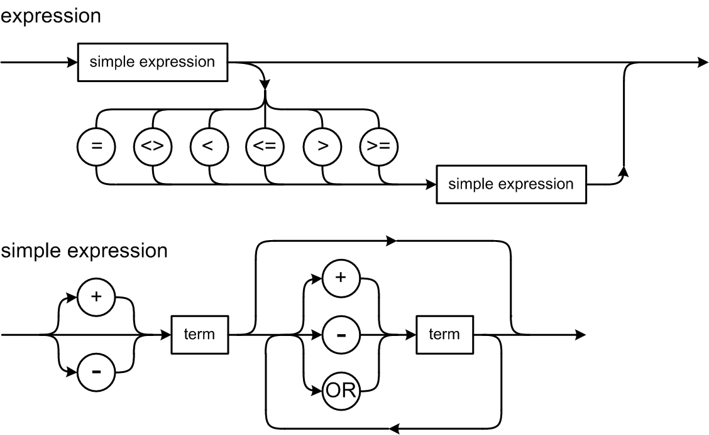
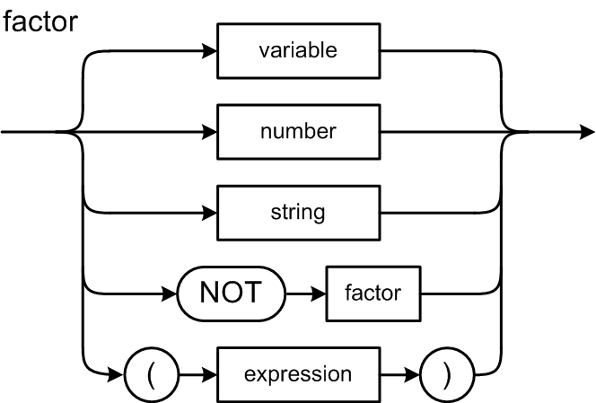
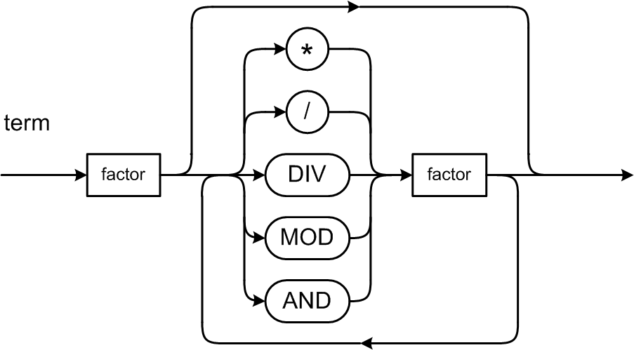
Expression Syntax Diagrams
What code should we generate for a relational expression?

Slide 23
Relational Expressions
Suppose i and j are local integer variables, and that:
  i ➔ slot #0
  j ➔ slot #1
0 represents false and
1 represents true.
For the expression i < j leave either 0 or 1
on top of the operand stack:
This is a hack that is
easy but inefficient.
The code in red
are the only parts
that change based
on the expression.
iload_0 ; push the value of i (slot #0)
iload_1 ; push the value of j (slot #1)
if_icmplt L003 ; branch if i < j
iconst_0 ; push false
goto L004 ; go to next statement
L003:
iconst_1 ; push true
L004:
Your code generator
also needs to emit labels.

Slide 24
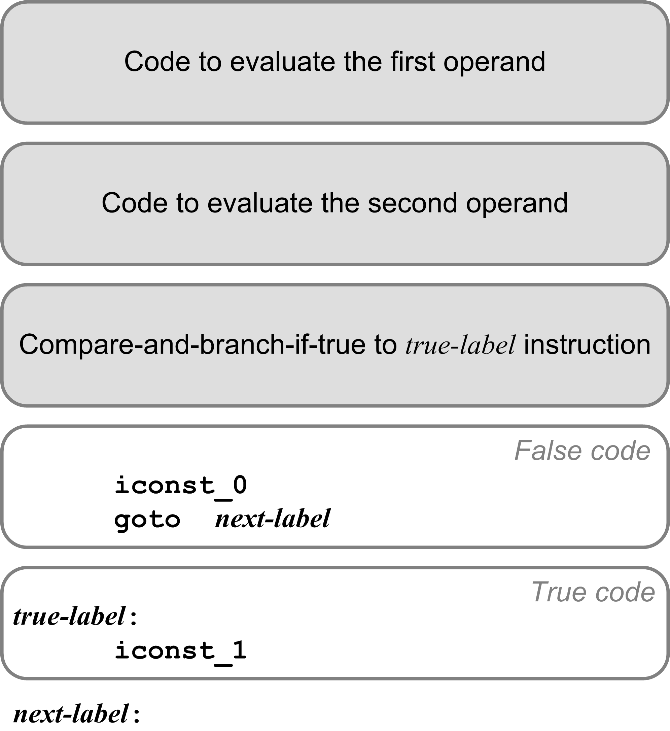
Relational Expression Code Template
iload_0
iload_1
if_icmplt L003
iconst_0
goto L004
L003:
iconst_1
L004:

Slide 25
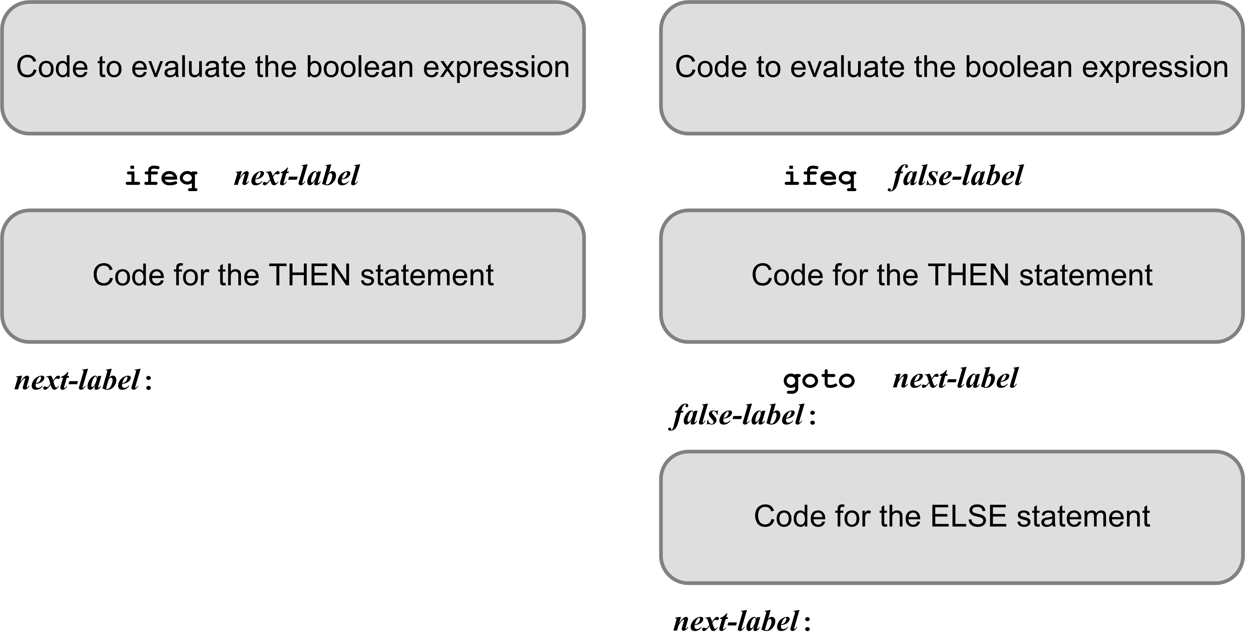
IF Statement Code Templates
The code that evaluates the boolean expression leaves either 0 (false) or 1 (true) on top of the operand stack.
  ifeq branches if [TOS] is 0
  (the expression is false)

Slide 26
Example: IF Statement
getstatic iftest/i I
getstatic iftest/j I
if_icmplt L002
iconst_0
goto L003
L002:
iconst_1
L003:
ifeq L001
sipush 300
putstatic iftest/t I
L001:
getstatic iftest/i I
getstatic iftest/j I
if_icmpeq L005
iconst_0
goto L006
L005:
iconst_1
L006:
ifeq L007
sipush 200
putstatic iftest/t I
goto L004
L007:
sipush 200
ineg
putstatic iftest/f I
L004:
PROGRAM IfTest;
VAR
i, j, t, f : integer;
BEGIN {IF statements}
...
IF i < j THEN t := 300;
IF i = j THEN t := 200
ELSE f := -200;
...
END.
Variables i, j, t, f
are program variables
and so the Jasmin code
uses their fully qualified
names.

Slide 27
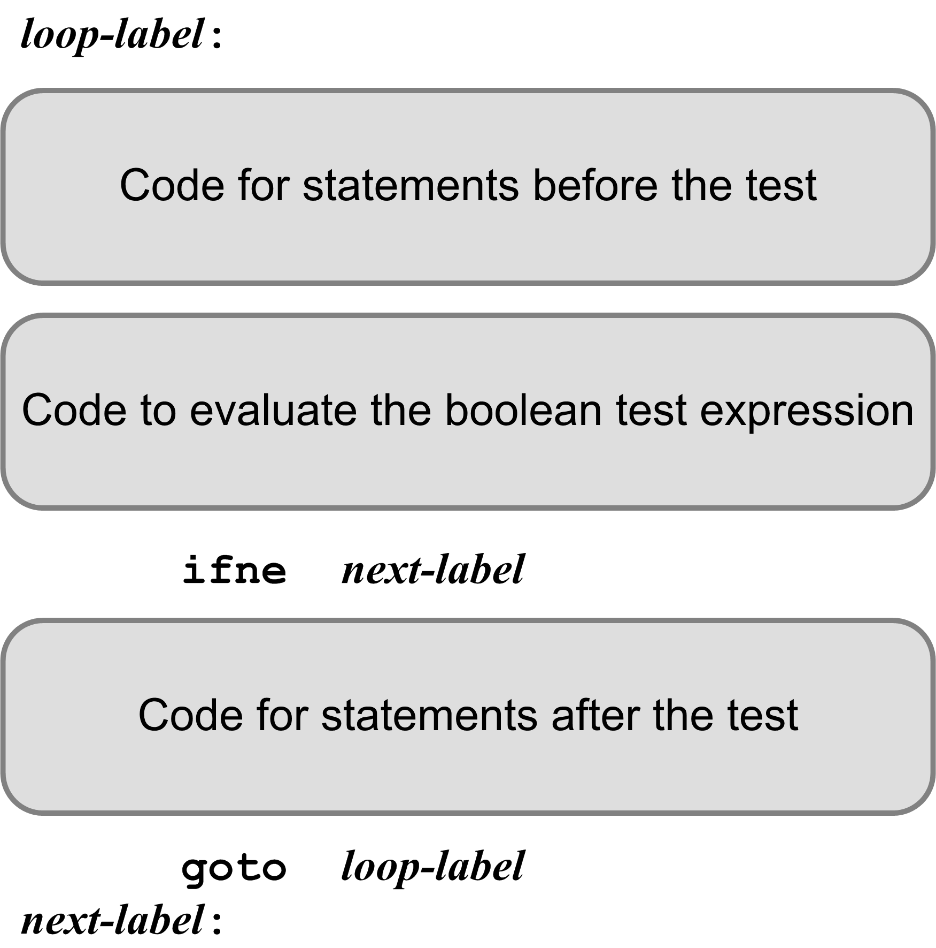
Looping Statement Code Template
The code that evaluates the boolean expression leaves either
0 (false) or 1 (true) on top of the operand stack.
  ifne branches if [TOS] is not 0
  (the expression value is true)
There may or may not be any code before or after the test.

Slide 28
Example: Newton’s Square Root Function
#3
#0
iconst_0
istore_1 ; i := 0
fload_0
fstore_2 ; root := x
L000:
fload_0 ; x
fload_2 ; root
fdiv ; /
fload_2 ; root
fadd ; +
fconst_2 ; 2.0
fdiv ; /
fstore_2 ; ==> root
iinc 1 1 ; i := i + 1;
iload_1 ; i
bipush 10 ; 10
if_icmpgt L001 ; if i > 10 goto L001
iconst_0 ; false
goto L002
L001:
iconst_1 ; true
L002:
ifne L003 ; if true goto L003
goto L000
L003:
fload_2
fstore_3
fload_3
freturn ; return root
FUNCTION sqrt(x : real) : real;
VAR
i : integer;
root : real;
BEGIN
i := 0;
root := x;
REPEAT
root := (x/root + root)/2;
i := i + 1;
UNTIL i > 10;
sqrt := root;
END;
#1
Local
variables
#2
These are local variables
and so the Jasmin code
uses their slot numbers.

Slide 29
Example: FOR Statement
PROGRAM ForTest;
VAR
j, k, n : integer;
BEGIN {FOR statements}
...
FOR k := j TO 5 DO BEGIN
n := k;
END;
...
END.
getstatic fortest/j I
putstatic fortest/k I
L001:
getstatic fortest/k I
iconst_5
if_icmpgt L003
iconst_0
goto L004
L003:
iconst_1
L004:
ifne L002
getstatic fortest/k I
putstatic fortest/n I
getstatic fortest/k I
iconst_1
iadd
putstatic fortest/k I
goto L001
L002:
Program
variables
This is code
emitted for a
general > test.
It can be much
improved!

Slide 30
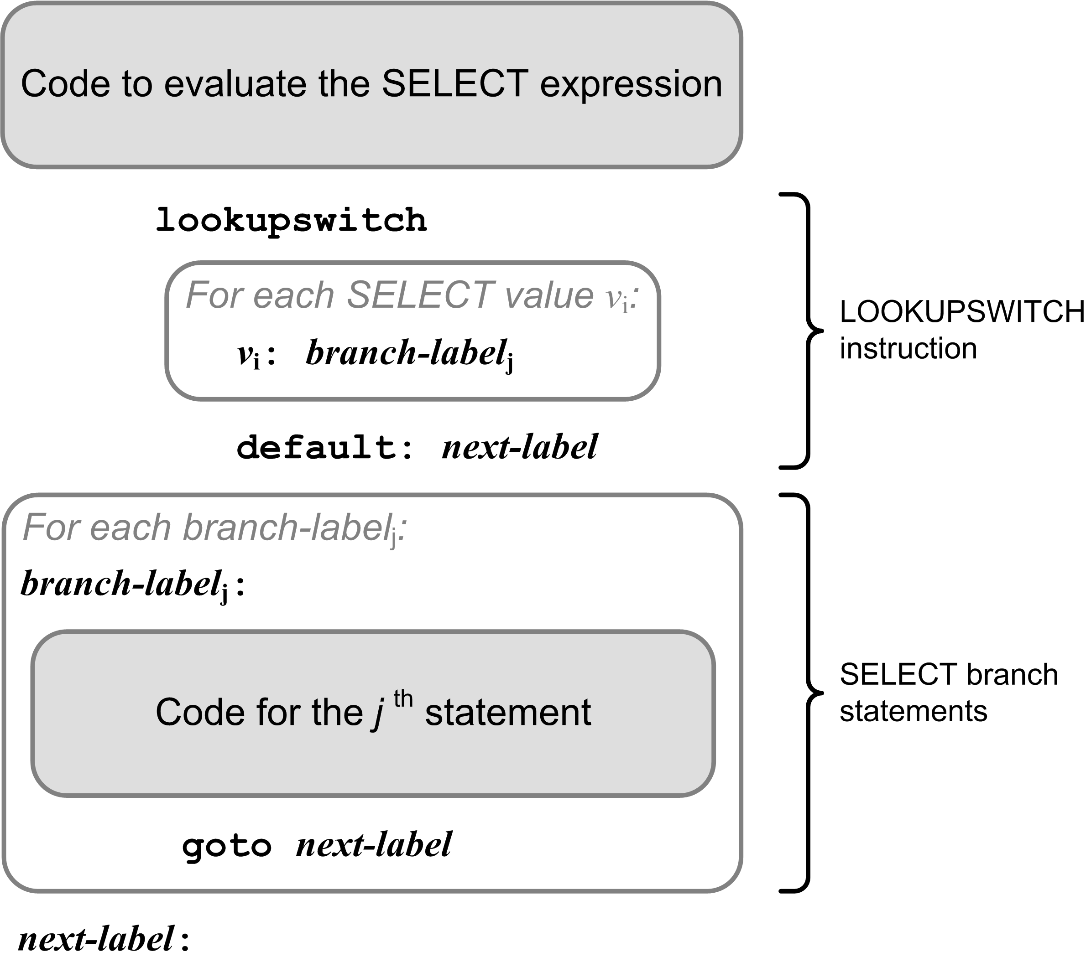
Select Template

Slide 31
Example: CASE Statement
#0
#1
Local
variables
iload_0 ; i
lookupswitch
100: L010
105: L010
200: L020
256: L020
282: L020
default: L099
L010:
sipush 1000
istore_1 ; j := 1000
goto L099
L020:
sipush 2000
istore_1 ; j := 2000
goto L099
L099:
VAR i, j : integer;
...
CASE i OF
100,105: j := 1000;
200,256,282: j := 2000;
END

Slide 32
Pascal Procedures and Functions
Analogous to Java methods (functions).
Two major simplifications for our Pascal compiler:
  Standard Pascal is not object-oriented.
  Therefore, Pascal procedures and functions are more like the private static methods of a Java class.
Java does not have nested methods.
  The JVM does not easily implement nested methods.
  Therefore, we will compile only top level (level 1)
  Pascal procedures and functions.

Slide 33
Procedures and Functions, cont’d
A Pascal program:
The roughly equivalent Java class:
  Fields and methods are
  private static.
PROGRAM ADDER;
VAR
i, j, sum : integer;
FUNCTION add(n1, n2 : integer) : integer;
VAR
s : integer;
BEGIN
s := i + j + n1 + n2;
add := s;
END;
BEGIN
i := 10;
j := 20;
sum := add(i, j);
writeln('Sum = ', sum)
END.
public class Adder
{
private static int i, j, sum;
private static int add(int n1, int n2)
{
int s = i + j + n1 + n2;
return s;
}
public static void main(String args[])
{
i = 10;
j = 20;
sum = add(i, j);
System.out.println("Sum = " + sum);
}
}

Slide 34
Code for a Pascal Function (Static Method)
PROGRAM Adder;
VAR
i, j, sum : integer;
FUNCTION add(n1, n2 : integer) : integer;
VAR
s : integer;
BEGIN
s := i + j + n1 + n2;
add := s;
END;
BEGIN
i := 10;
j := 20;
sum := add(i, j);
writeln('Sum = ', sum)
END.
.method private static add(II)I
.var 0 is n1 I
.var 1 is n2 I
.var 2 is s I
.var 3 is add I
getstatic Adder/i I
getstatic Adder/j I
iadd
iload_0
iadd
iload_1
iadd
istore_2
iload_2
istore_3
iload_3
ireturn
.limit locals 4
.limit stack 2
.end method
Local parameters are
automatically assigned
slot numbers starting at 0.
#3
#0
#1
Local parameters
and variables
#2
Push the return value
onto the caller’s
operand stack.

Slide 35
Code to Call a Function (Static Method)
PROGRAM ADDER;
VAR
i, j, sum : integer;
FUNCTION add(n1, n2 : integer) : integer;
VAR
s : integer;
BEGIN
s := i + j + n1 + n2;
add := s;
END;
BEGIN
i := 10;
j := 20;
sum := add(i, j);
writeln('Sum = ', sum)
END.
.method public static main([Ljava/lang/String;)V
bipush 10
putstatic Adder/i I
bipush 20
putstatic Adder/j I
getstatic Adder/i I
getstatic Adder/j I
invokestatic Adder/add(II)I
putstatic Adder/sum I
...
Program variables
A function call leaves its
return value on top of the
operand stack of the caller.
Use putstatic with a fully qualified field
name and type signature to pop a value off the
operand stack and store it into a static field.
Use invokestatic with a fully-qualified
method name and a type signature
to call a static method.

Slide 36
Code for a Pascal Main Program
PROGRAM Adder;
VAR
i, j, sum : integer;
FUNCTION add(n1, n2 : integer) : integer;
VAR
s : integer;
BEGIN
s := i + j + n1 + n2;
add := s;
END;
BEGIN
i := 10;
j := 20;
sum := add(i, j);
writeln('Sum = ', sum)
END.
.class public super Adder
.super java/lang/Object
.private field static i I
.private field static j I
.private field static sum I
.method public <init>()V
aload_0
invokenonvirtual java/lang/Object/<init>()V
return
.limit stack 1
.limit locals 1
.end method
...
Program variables
Private static
class fields.
Void method.
No parameters.
Each Jasmin class must have a
constructor named <init>.
  The local variable in slot #0 contains the value of “this”.
  Each constructor must call the superclass constructor.

