Slide 1


CS 153: Concepts of Compiler Design
September 19 Class Meeting
Department of Computer Science
San Jose State University
Fall 2024
Instructor: Ron Mak
www.cs.sjsu.edu/~mak

Slide 2
Labeled Production Rules
Add a # label to each rule option and
rerun ANTLR to generate a new parser:
ExprLabeled.g4
grammar ExprLabeled;
program: statement+ ;
statement : expr NEWLINE # print
| IDENTIFER '=' expr NEWLINE # assign
| NEWLINE # empty
;
expr : expr ('*'|'/') expr # mulDiv
| expr ('+'|'-') expr # addSub
| INTEGER # int
| IDENTIFER # id
| '(' expr ')' # parens
;
These are labels,
not comments!

Slide 3
Pcl
Pcl (“pickle”) is a tiny subset of Pascal.
  The subset will grow to be nearly full Pascal
  over the next few weeks (and assignments).
We will use ANTLR 4 to generate parsers
and lexers for Pcl.
  Our first grammar will be named Pcl4 because
  you’re going to use it for Assignment #4.

Slide 4
An Initial Grammar for Pcl
Pcl4.g4
grammar Pcl4;
@header {
package intermediate.antlr4;
}
program : programHeader block '.' ;
programHeader : PROGRAM IDENTIFIER programParameters? ';' ;
programParameters : '(' IDENTIFIER ( ',' IDENTIFIER )* ')' ;
block : declarations compoundStatement ;
declarations : ;
statement : compoundStatement
| assignmentStatement
| repeatStatement
| writeStatement
| writelnStatement
| emptyStatement
;
We want the ANTLR-generated code to be in package intermediate.antlr4.
We’re not quite ready to do declarations yet.

Slide 5
A Grammar for Pcl, cont’d
Pcl4.g4
statement : compoundStatement
| assignmentStatement
| repeatStatement
| writeStatement
| writelnStatement
| emptyStatement
;
compoundStatement : BEGIN statementList END ;
emptyStatement : ;
statementList : statement ( ';' statement )* ;
assignmentStatement : lhs ':=' rhs ;
repeatStatement : REPEAT statementList UNTIL expression ;
lhs : variable ;
rhs : expression ;
writeStatement : WRITE writeArgumentsOn ;
writelnStatement : WRITELN writeArgumentsLn? ;
You will add to these options.
Why are labels unnecessary here?

Slide 6
A Grammar for Pcl, cont’d
Pcl4.g4
expression
: simpleExpression (relOp simpleExpression)? ;
simpleExpression
: sign? term (addOp term)* ;
term
: factor (mulOp factor)* ;
factor
: variable # variableExpression
| number # numberExpression
| characterConstant # characterFactor
| stringConstant # stringFactor
| NOT factor # notFactor
| '(' expression ')' # parenthesizedExpression
;
variable : IDENTIFIER ;
Now we decompose an expression.

Slide 7
A Grammar for Pcl, cont’d
Pcl4.g4
relOp : '=' | '<>' | '<' | '<=' | '>' | '>=' ;
addOp : '+' | '-' | OR ;
mulOp : '*' | '/' | DIV | MOD | AND ;
writeArgumentsOn : '(' writeArgumentListOn ')' ;
writeArgumentListOn : writeArgumentList ;
writeArgumentsLn : '(' writeArgumentListLn ')' ;
writeArgumentListLn : writeArgumentList ;
writeArgumentList : writeArgument (',' writeArgument)* ;
writeArgument : expression (':' fieldWidth)? ;
fieldWidth : sign? integerConstant (':' decimalPlaces)? ;
decimalPlaces : integerConstant ;
fragment A : ('a' | 'A') ;
fragment B : ('b' | 'B') ;
fragment C : ('c' | 'C') ;
...
fragment Z : ('z' | 'Z') ;
Why these fragments?

Slide 8
A Grammar for Pcl, cont’d
PROGRAM : P R O G R A M ;
CONST : C O N S T ;
TYPE : T Y P E ;
ARRAY : A R R A Y ;
OF : O F ;
RECORD : R E C O R D ;
VAR : V A R ;
BEGIN : B E G I N ;
END : E N D ;
DIV : D I V ;
MOD : M O D ;
AND : A N D ;
OR : O R ;
NOT : N O T ;
IF : I F ;
THEN : T H E N ;
ELSE : E L S E ;
CASE : C A S E ;
REPEAT : R E P E A T ;
UNTIL : U N T I L ;
...
PROCEDURE : P R O C E D U R E ;
FUNCTION : F U N C T I O N ;
Pcl4.g4
What’s going on here?

Slide 9
A Grammar for Pcl, cont’d
Pcl4.g4
IDENTIFIER : [a-zA-Z][a-zA-Z0-9]* ;
INTEGER : [0-9]+ ;
REAL : INTEGER '.' INTEGER
| INTEGER ('e' | 'E') ('+' | '-')? INTEGER
| INTEGER '.' INTEGER ('e' | 'E') ('+' | '-')? INTEGER
;
NEWLINE : '\r'? '\n' -> skip ;
WS : [ \t]+ -> skip ;
QUOTE : '\'' ;
CHARACTER : QUOTE CHARACTER_CHAR QUOTE ;
STRING : QUOTE STRING_CHAR* QUOTE ;
fragment CHARACTER_CHAR : ~('\'') // any non-quote character
;
fragment STRING_CHAR : QUOTE QUOTE // two consecutive quotes
| ~('\'') // any non-quote character
;

Slide 10
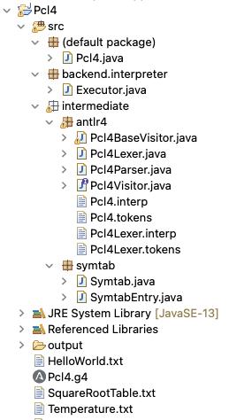
Pcl4 Package Structure
ANTLR-generated classes
are in package
intermediate.antlr4.
We now also have packages
intermediate.symtab
and backend.interpreter.

Slide 11
The Pcl4 Visitor Interface
Pcl4Visitor.java
// Generated from Pcl4.g4 by ANTLR 4.13.2
package intermediate.antlr4;
import org.antlr.v4.runtime.tree.ParseTreeVisitor;
public interface Pcl4Visitor<T> extends ParseTreeVisitor<T>
{
  T visitProgram(Pcl4Parser.ProgramContext ctx);
  T visitProgramHeader(Pcl4Parser.ProgramHeaderContext ctx);
  T visitProgramParameters(Pcl4Parser.ProgramParametersContext ctx);
  T visitBlock(Pcl4Parser.BlockContext ctx);
  T visitDeclarations(Pcl4Parser.DeclarationsContext ctx);
  T visitStatement(Pcl4Parser.StatementContext ctx);
  T visitCompoundStatement(Pcl4Parser.CompoundStatementContext ctx);
  T visitEmptyStatement(Pcl4Parser.EmptyStatementContext ctx);
  T visitStatementList(Pcl4Parser.StatementListContext ctx);
  T visitAssignmentStatement(Pcl4Parser.AssignmentStatementContext ctx);
  T visitRepeatStatement(Pcl4Parser.RepeatStatementContext ctx);
...
}
You can think of context ctx as a pointer to a node. Each visit method is for a particular context type.

Slide 12
The Pcl4 Base Visitor Class
Pcl4BaseVisitor.java
// Generated from Pcl4.g4 by ANTLR 4.13.2
package intermediate.antlr4;
import org.antlr.v4.runtime.tree.AbstractParseTreeVisitor;
public class Pcl4BaseVisitor<T> extends AbstractParseTreeVisitor<T>
implements Pcl4Visitor<T>
{
  @Override public T visitProgram(Pcl4Parser.ProgramContext ctx)
  {
return visitChildren(ctx);
}
  @Override public T visitProgramHeader(Pcl4Parser.ProgramHeaderContext ctx)
  {
return visitChildren(ctx);
}
...
}
The default implementation for each visit method is simply to go visit the node’s children.

Slide 13
Class Executor
Executor.java
package backend.interpreter;
import org.antlr.v4.runtime.ParserRuleContext;
import intermediate.antlr4.*;
import intermediate.symtab.*;
public class Executor extends Pcl4BaseVisitor<Object>
{
private Symtab symtab = new Symtab();
@Override
public Object visitProgram(Pcl4Parser.ProgramContext ctx)
{
return visit(ctx.block().compoundStatement());
}
@Override
public Object visitAssignmentStatement(Pcl4Parser.AssignmentStatementContext ctx)
{
String variableName = ctx.lhs().variable().getText();
Double value = (Double) visit(ctx.rhs());
assign(variableName, value);
return null;
}
...
We write this class to override the default visit* methods.
When we walk the parse tree by calling visit(ctx) or visitChildren(ctx), the appropriate visit* method is called using polymorphism and the context type of ctx.
Complete this class!

Slide 14
Assignment #4: Pcl4 Grammar
Add more Pascal statements
to the Pcl4 grammar:
  WHILE
  FOR
  IF
  CASE
Use ANTLR to generate a new lexer
and a new parser for Pcl4.

Slide 15
Assignment #4, cont’d
Verify the correctness of your grammar:
  Generate syntax diagrams.
  Generate graphical parse trees
  from sample source files:
    HelloWorld.txt
    Temperature.txt
    SquareRootTable.txt
    TestWhile.txt
    TestIf.txt
    TestFor.txt
    TestCase.txt

Slide 16
Assignment #4, cont’d
Complete the Executor.java skeleton in the back end.
  Reuse any code for the executor in Assignment #3 (preferably your own code, but you can use the suggested solution’s code).
Execute and generate output from all the sample source files.
Team assignment due Thursday, Oct. 3.

Slide 17
Parsing Declarations
The declarations of a programming language are often the most challenging to parse.
Declarations syntax can be difficult.
Declarations often include recursive definitions.
You must keep of track of diverse information.
Many new items to enter into the symbol table.

Slide 18
Pascal Declarations
Classic Pascal declarations consist of 5 parts,
each optional, but always in this order:
  Label declarations
  Constant definitions
  Type definitions
  Variable declarations
  Procedure and function declarations
We will examine 2, 3, and 4 next.
  We’ll do procedures and functions
  in a couple of weeks.

Slide 19
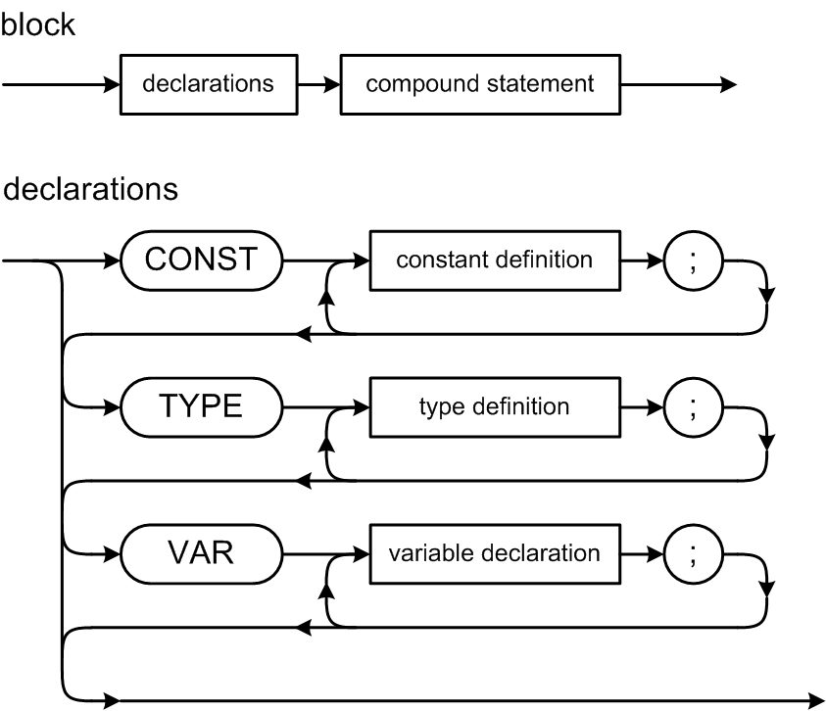
Pascal Declarations
The CONST, TYPE, and VAR parts are optional, but they must come in this order.
Note that constants and types are defined, but variables are declared.
Collectively, you refer to all of them as declarations.

Slide 20
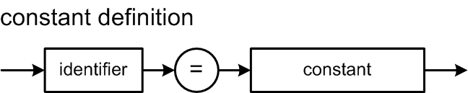
Pascal Constant Definitions
Example constant definition part:
CONST
factor = 8;
epsilon = 1.0e-6;
ch = 'x';
limit = -epsilon;
message = 'Press the OK button to confirm your selection.';
Classic Pascal only allows a constant value
after the = sign.
  No constant expressions.

Slide 21
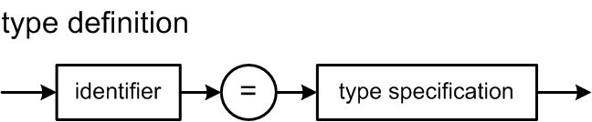
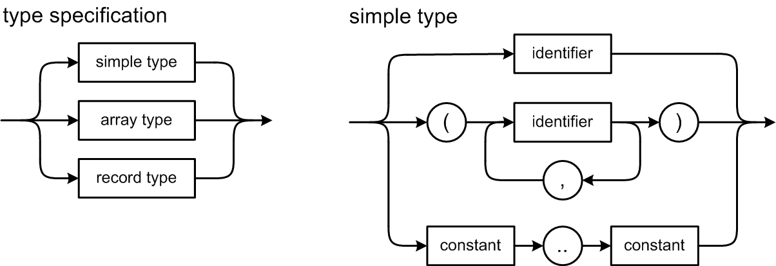
Pascal Type Definitions
A Pascal simple type can be:
  scalar (integer, real, boolean, char)
  enumeration
  subrange
Not reserved
words!

Slide 22
Pascal Simple Type Definitions
Examples of subrange and enumeration type definitions:
CONST
factor = 8;
TYPE
range1 = 0..factor; {subrange of integer (factor is constant)}
range2 = 'a'..'q'; {subrange of char}
range3 = range1; {type identifier}
grades = (A, B, C, D, F); {enumeration}
passing = A..D; {subrange of enumeration}
week = (monday, tuesday, wednesday, thursday,
friday, saturday, sunday);
weekday = monday..friday;
weekend = saturday..sunday;

Slide 23
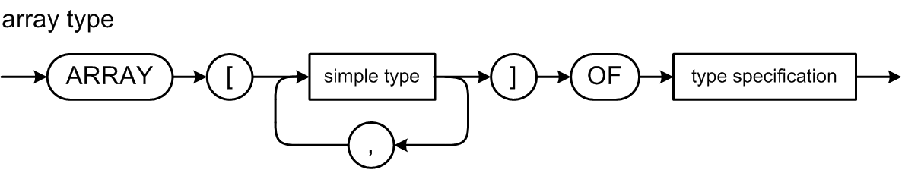
Pascal Array Type Definitions
index type
element type
An array type specification has
an index type and an element type.
The index type must be a simple type
(subrange or enumeration).
The element type can be any type.
  Including another array type (multidimensional arrays).

Slide 24
Pascal Array Type Definitions
Examples of array definitions.
CONST
c = 5;
e = 10;
TYPE
ar1 = ARRAY [grades] OF integer;
ar2 = ARRAY [(alpha, beta, gamma)] OF range2;
ar3 = ARRAY [weekday] OF ar2;
ar4 = ARRAY [range3] OF (foo, bar, baz);
ar5 = ARRAY [range1, range2, c..e] OF enum2;
ar6 = ARRAY [range1] OF ARRAY [range2] OF ARRAY[c..e] OF enum2;
ar7 = ARRAY [range1] OF ARRAY [range2, c..e] of enum2;
ar8 = ARRAY [range1, range2] OF ARRAY [c..e] of enum2;
Type definitions ar5, ar6, ar7, and ar8 above are
equivalent ways to define a multidimensional array.

Slide 25
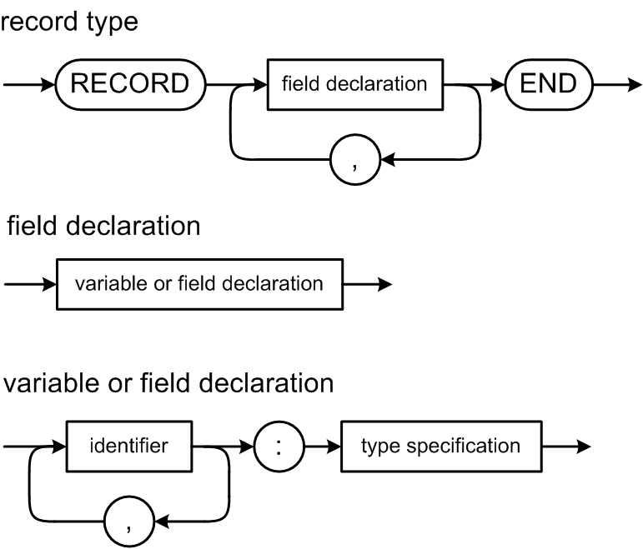
Pascal Record Type Definitions
A record field can be any type.
  Including another record type (nested records).

Slide 26
Pascal Record Type Definitions
Examples of record definitions:
TYPE
rec1 = RECORD
i : integer;
r : real;
b1, b2 : boolean;
c : char
END;
rec2 = RECORD
ten : integer;
r : rec1;
a1, a2, a3 : ARRAY [range3] OF range2;
END;
Classic Pascal is not object-oriented. A record type contains only fields, not procedures or functions.

Slide 27
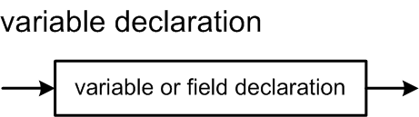
Pascal Variable Declarations
Variable declarations are syntactically similar
to record field declarations:
Examples:
VAR
var1 : integer;
var2, var3 : range2;
var4 : ar2
var5 : rec1;
direction : (north, south, east, west);
Types can be named or unnamed.

Slide 28
Declarations and the Symbol Table
Identifiers from Pascal declarations that
we will enter into a symbol table, names of:
  constants
  types
  enumeration values
  record fields
  variables
Information from parsing type specifications:
  simple types
  array types
  record types
Notes:
START HERE.

Slide 29
Scope and the Symbol Table Stack
The scope of an identifier is the part of the source program where that identifier can be used.
  Everywhere in the program where the
  declaration of the identifier is in effect.
A program creates a scope whenever it has identifiers that can only be used in a certain part of the program.
  Example: Local variables of a function.
Scope is closely related to nesting levels and the symbol table stack.

Slide 30
Scope and the Symbol Table Stack, cont’d
Global scope
  Nesting level 0:
  At the bottom of the symbol table stack.
  All predefined global identifiers such as
  integer, real, boolean, char.
Program scope
  Nesting level 1:
  One up from the bottom of the stack.
  All identifiers declared at the “top level”
  of a program (not in a procedure or function).

Slide 31
Scope and the Symbol Table Stack, cont’d
Record definitions, procedures, and functions
each has a scope.
Scopes in a Pascal program are nested.
  An identifier can be redefined within a nested scope.
  Within the nested scope, the definition in the nested scope overrides the definition in an outer scope.
  Example: A function can have a local variable x which overrides a program variable x.
Each scope must have its own symbol table.

Slide 32
Scope and the Symbol Table Stack, cont’d
As the parser parses a program from top to bottom, it enters and exits nested scopes.
Whenever the parser enters a scope,
it must push that scope’s symbol table
onto the symbol table stack.
Whenever the parser exits a scope,
it must pop that scope’s symbol table
off the stack.
Note that this is about parsing, not runtime execution!

Slide 33
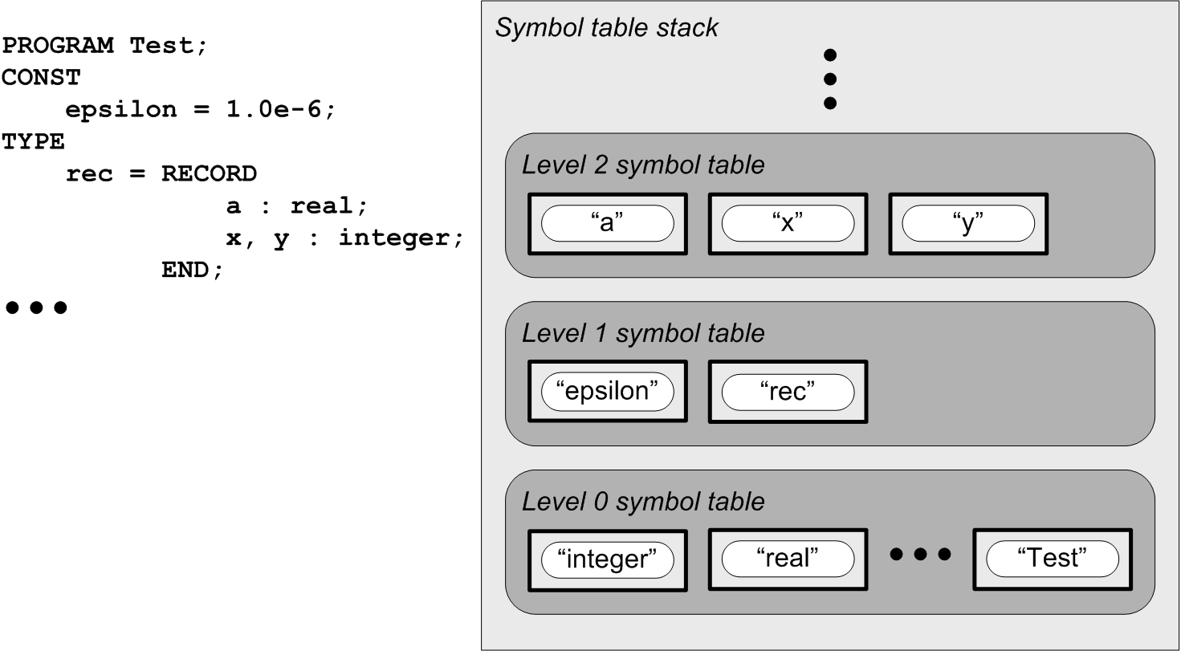
Scope and the Symbol Table Stack, cont’d
Scope example:
Record’s symbol table
Parser is here!
Program’s symbol table
Note that the program name
Test is defined in the global
scope at level 0.
Global symbol table

