Slide 1


CS 153: Concepts of Compiler Design
September 3 Class Meeting
Department of Computer Science
San Jose State University
Fall 2024
Instructor: Ron Mak
www.cs.sjsu.edu/~mak
Notes:
.

Slide 2
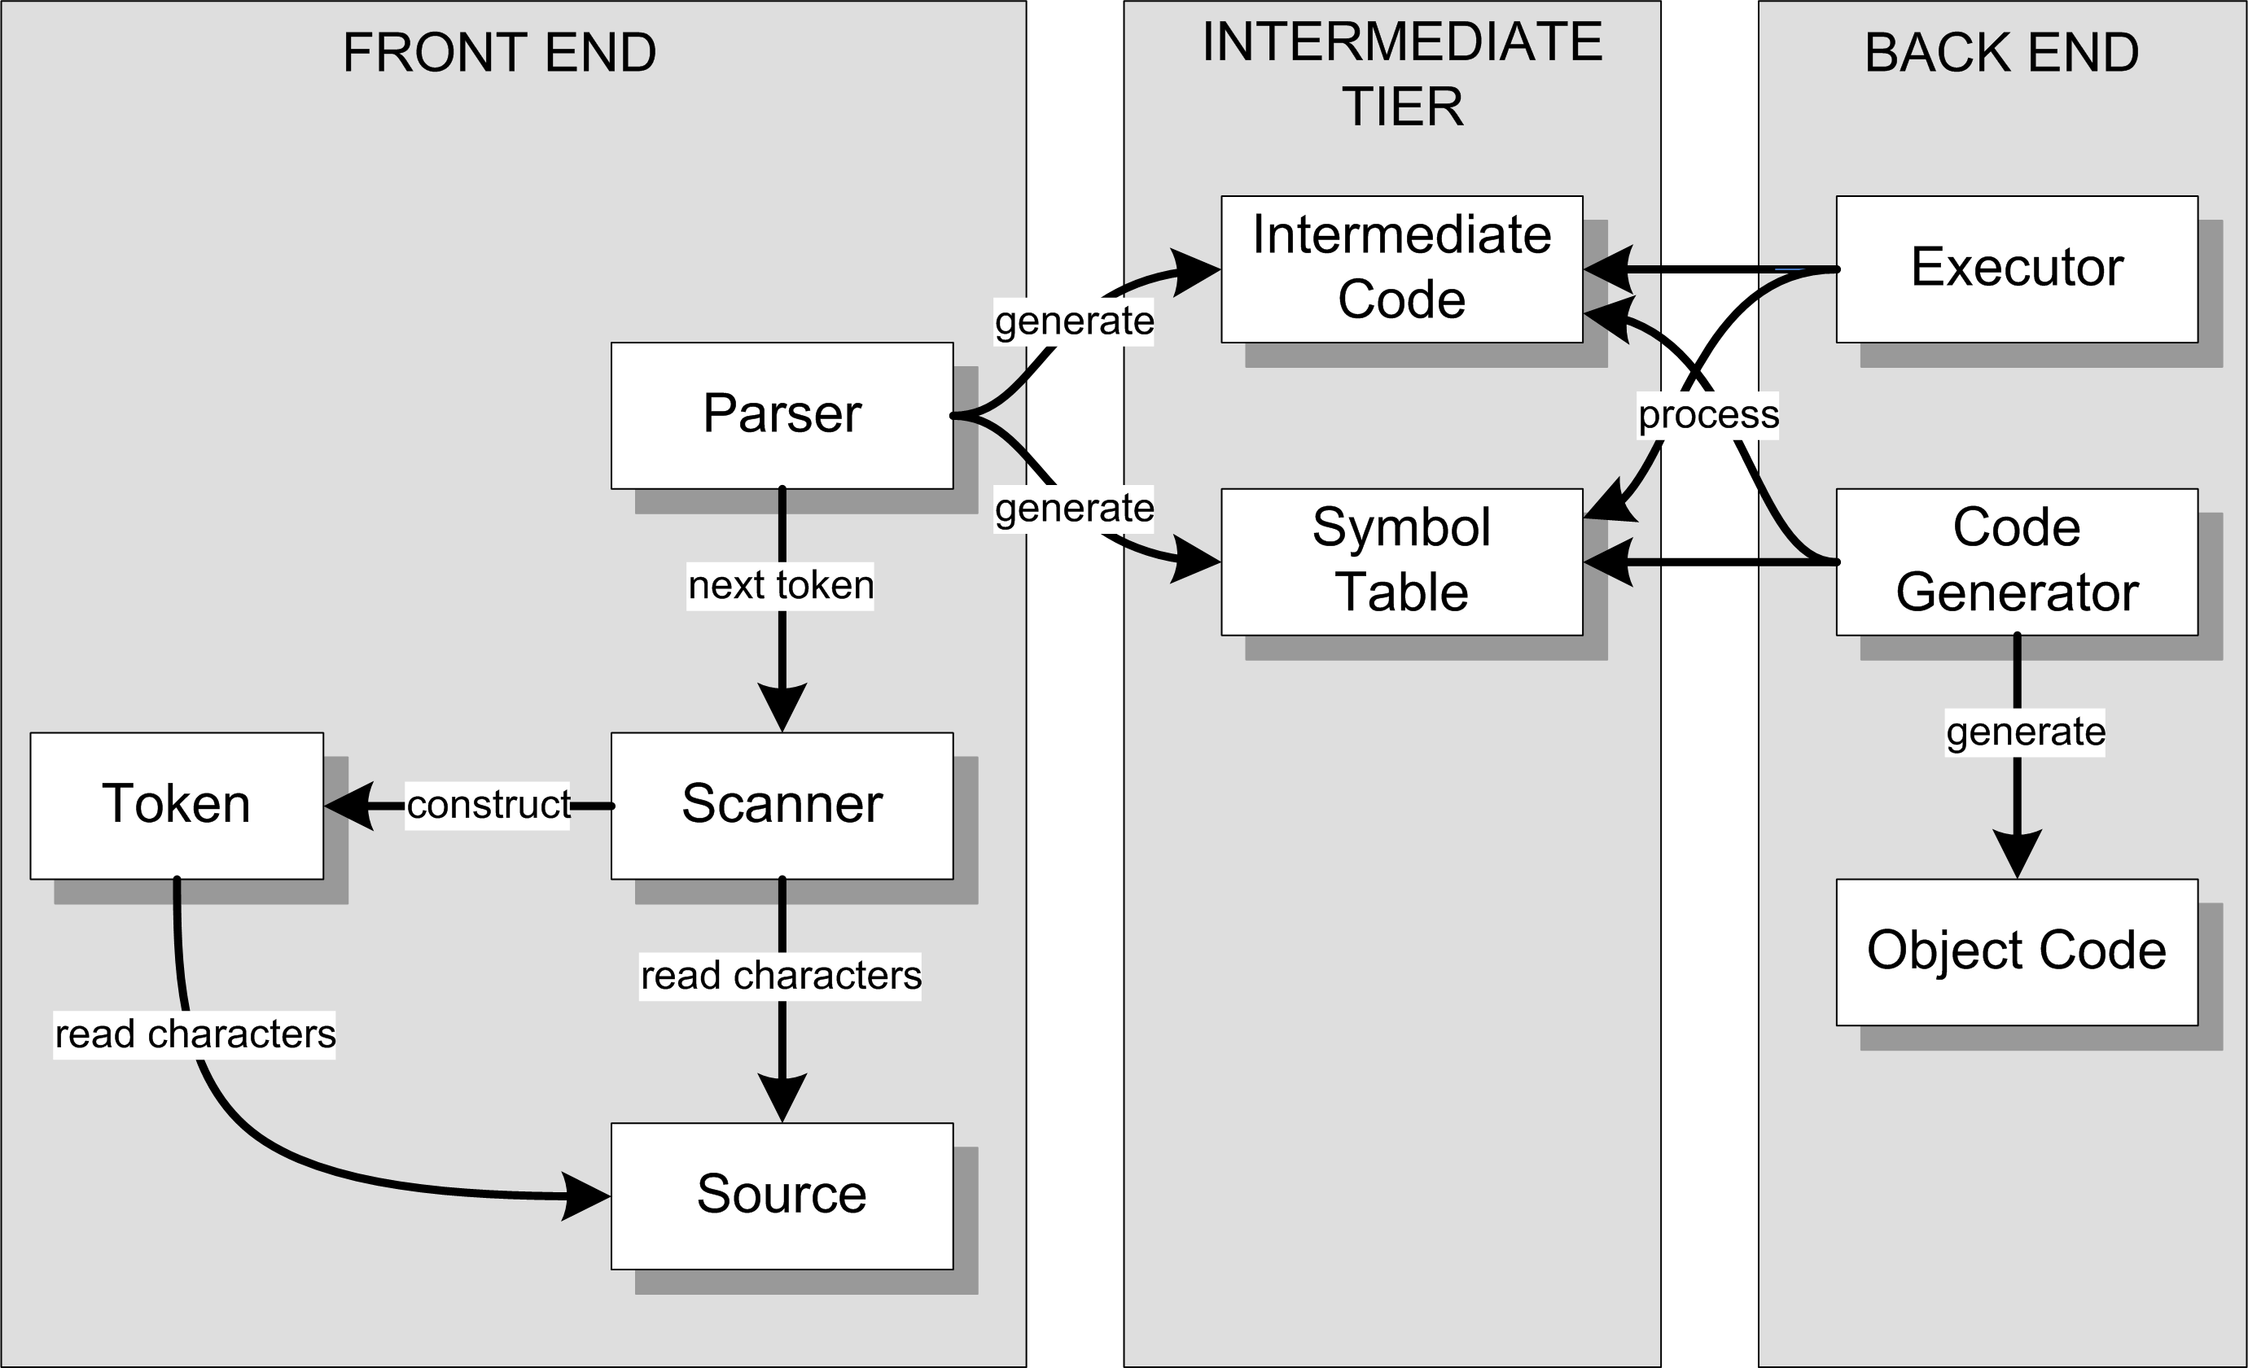
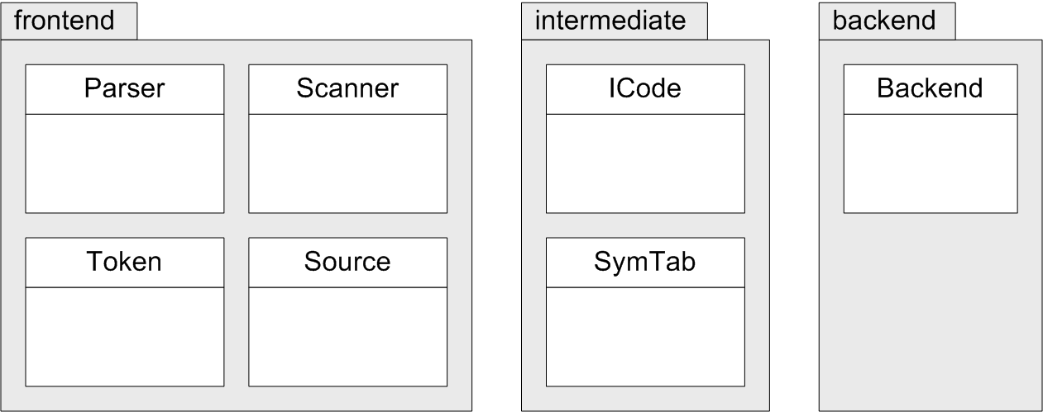
Three Java Packages
FROM:
The parser in the front end
analyzes the text of the
source program based
on the source language’s
grammar (syntax rules)
and builds the intermediate
code (parse trees) and the
symbol tables in the
intermediate tier.
TO:

Slide 3
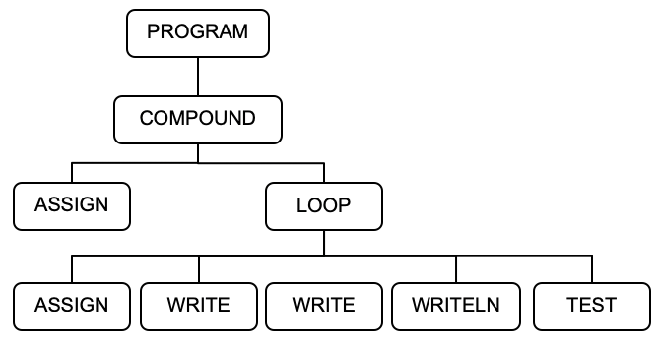
Example: HelloWorld.txt
PROGRAM HelloWorld;
BEGIN
i := 0;
REPEAT
i := i + 1;
write('#'); write(i);
writeln(': Hello, world!')
UNTIL i = 5
END.
<PROGRAM HelloWorld>
<COMPOUND line 3>
<ASSIGN line 4>
<VARIABLE i />
<INTEGER_CONSTANT 0 />
</ASSIGN>
<LOOP line 6>
<ASSIGN line 7>
<VARIABLE i />
<ADD>
<VARIABLE i />
<INTEGER_CONSTANT 1 />
</ADD>
</ASSIGN>
<WRITE line 8>
<STRING_CONSTANT '#' />
</WRITE>
<WRITE line 8>
<VARIABLE i />
</WRITE>
<WRITELN line 9>
<STRING_CONSTANT ': Hello, world!' />
</WRITELN>
<TEST line 10>
<EQ>
<VARIABLE i />
<INTEGER_CONSTANT 5 />
</EQ>
</TEST>
</LOOP>
</COMPOUND>
</PROGRAM>
HelloWorld.txt
java Simple -parse HelloWorld.txt

Slide 4
The parseProgram() Method
Parser.java
public Node parseProgram()
{
Node programNode = new Node(Node.NodeType.PROGRAM);
currentToken = scanner.nextToken(); // first token!
if (currentToken.type == Token.TokenType.PROGRAM)
{
currentToken = scanner.nextToken(); // consume PROGRAM
}
else syntaxError("Expecting PROGRAM");
if (currentToken.type == IDENTIFIER)
{
String programName = currentToken.text;
symtab.enter(programName);
programNode.text = programName;
currentToken = scanner.nextToken(); // consume program name
}
else syntaxError("Expecting program name");
PROGRAM HelloWorld;
BEGIN
i := 0;
REPEAT
i := i + 1;
write('#'); write(i);
writeln(': Hello, world!');
UNTIL i = 5;
END.
HelloWorld.txt
package frontend

Slide 5
The parseProgram() Method, cont’d
Parser.java
if (currentToken.type == SEMICOLON)
{
currentToken = scanner.nextToken(); // consume ;
}
else syntaxError("Missing ;");
if (currentToken.type != BEGIN) syntaxError("Expecting BEGIN");
// The PROGRAM node adopts the COMPOUND tree.
programNode.adopt(parseCompoundStatement());
if (currentToken.type != PERIOD) syntaxError("Expecting .");
return programNode;
}
PROGRAM
COMPOUND
PROGRAM HelloWorld;
BEGIN
i := 0;
REPEAT
i := i + 1;
write('#'); write(i);
writeln(': Hello, world!');
UNTIL i = 5;
END.
HelloWorld.txt
ASSIGN
LOOP
ASSIGN
WRITE
WRITE
WRITELN
TEST

Slide 6
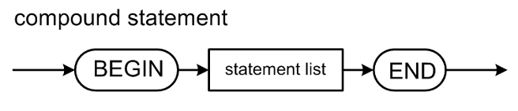
The parseCompoundStatement() Method
Parser.java
private Node parseCompoundStatement()
{
Node compoundNode = new Node(COMPOUND);
compoundNode.lineNumber = currentToken.lineNumber;
currentToken = scanner.nextToken(); // consume BEGIN
parseStatementList(compoundNode, END);
if (currentToken.type == END)
{
currentToken = scanner.nextToken(); // consume END
}
else syntaxError("Expecting END");
return compoundNode;
}
Parent node
Terminal token
PROGRAM
PROGRAM HelloWorld;
BEGIN
i := 0;
REPEAT
i := i + 1;
write('#'); write(i);
writeln(': Hello, world!');
UNTIL i = 5;
END.
COMPOUND
HelloWorld.txt
ASSIGN
LOOP
ASSIGN
WRITE
WRITE
WRITELN
TEST

Slide 7
Statement Starter Tokens
private static HashSet<Token.TokenType> statementStarters;
...
static
{
statementStarters = new HashSet<Token.TokenType>();
...
// Tokens that can start a statement.
statementStarters.add(BEGIN);
statementStarters.add(IDENTIFIER);
statementStarters.add(REPEAT);
...
}
PROGRAM HelloWorld;
BEGIN
i := 0;
REPEAT
i := i + 1;
write('#'); write(i);
writeln(': Hello, world!');
UNTIL i = 5;
END.
Parser.java
HelloWorld.txt

Slide 8
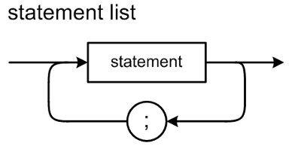
The parseStatementList() Method
private void parseStatementList(Node parentNode, Token.TokenType terminalType)
{
while ( (currentToken.type != terminalType)
&& (currentToken.type != END_OF_FILE))
{
Node stmtNode = parseStatement();
if (stmtNode != null) parentNode.adopt(stmtNode);
// A semicolon separates statements.
if (currentToken.type == SEMICOLON)
{
while (currentToken.type == SEMICOLON)
{
currentToken = scanner.nextToken(); // consume ;
}
}
else if (statementStarters.contains(currentToken.type))
{
syntaxError("Missing ;");
}
}
}
Adopt the statement subtree.
Do we see the start of the next statement
without having seen a semicolon?
HelloWorld.txt
PROGRAM HelloWorld;
BEGIN
i := 0;
REPEAT
i := i + 1;
write('#'); write(i);
writeln(': Hello, world!’);
UNTIL i = 5;
END.
Parser.java

Slide 9
The parseStatement() Method
private Node parseStatement()
{
Node stmtNode = null;
int savedLineNumber = currentToken.lineNumber;
lineNumber = savedLineNumber;
switch (currentToken.type)
{
case IDENTIFIER :
{
String text = currentToken.getText().toLowerCase();
stmtNode =
(text.equals("write")) ? parseWriteStatement()
: (text.equals("writeln")) ? parseWritelnStatement()
: parseAssignmentStatement();
break;
}
case BEGIN : stmtNode = parseCompoundStatement(); break;
case REPEAT : stmtNode = parseRepeatStatement(); break;
case SEMICOLON : stmtNode = null; break; // empty statement
default : syntaxError("Unexpected token");
}
if (stmtNode != null) stmtNode.lineNumber = savedLineNumber;
return stmtNode;
}
The current token is the token that starts the statement.
Parser.java

Slide 10
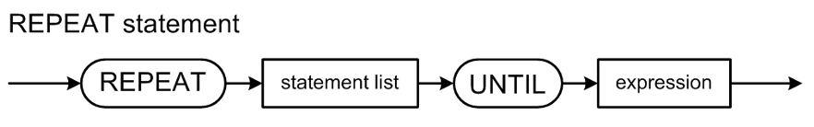
The parseRepeatStatement() Method
Parser.java
private Node parseRepeatStatement()
{
// The current token should now be REPEAT.
// Create a LOOP node.
Node loopNode = new Node(LOOP);
currentToken = scanner.nextToken(); // consume REPEAT
parseStatementList(loopNode, UNTIL);
if (currentToken.type == UNTIL)
{
// Create a TEST node. It adopts the test expression node.
Node testNode = new Node(TEST);
lineNumber = currentToken.lineNumber;
testNode.lineNumber = lineNumber;
currentToken = scanner.nextToken(); // consume UNTIL
testNode.adopt(parseExpression());
// The LOOP node adopts the TEST node as its final child.
loopNode.adopt(testNode);
}
else syntaxError("Expecting UNTIL");
return loopNode;
}
Parent node
Terminal token
HelloWorld.txt
PROGRAM HelloWorld;
BEGIN
i := 0;
REPEAT
i := i + 1;
write('#'); write(i);
writeln(': Hello, world!');
UNTIL i = 5;
END.

Slide 11
Handling Syntax Errors
Handling syntax errors well is a major challenge for compiler writers!
  Example: HelloErrors-1.txt
    Good error messages that pinpoint the errors in the source.
  Example: HelloErrors-2.txt
    What went wrong?
Demo

Slide 12
Three Java Packages
FROM:
The parser in the front end
analyzes the text of the
source program based
on the source language’s
grammar (syntax rules)
and builds the intermediate
code (parse trees) and the
symbol tables in the
intermediate tier.
TO:

Slide 13
The Symbol Table: Basic Concepts
Purpose
  To store information about certain tokens during the
  translation process (i.e., parsing and scanning)
What information to store?
  Anything that’s useful!
  For an identifier:
    name
    data type
    kind (variable name, type name, function name, etc.)

Slide 14
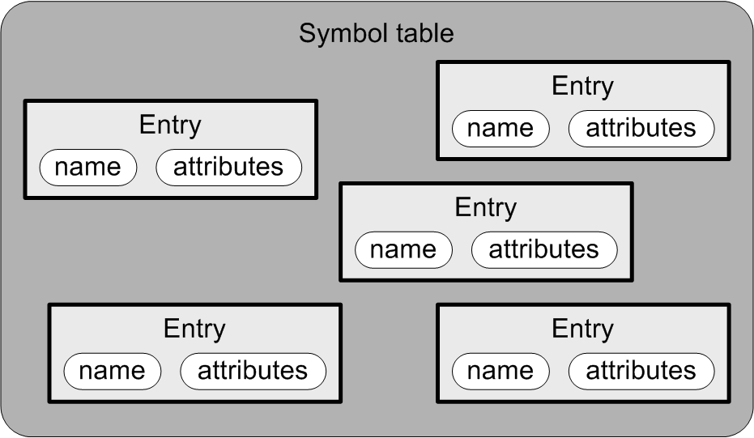
The Symbol Table: Conceptual Design
Goal: The symbol table
should be source language
independent.
Each entry in the symbol table has
  a name
  attributes

Slide 15
The Symbol Table: Basic Operations
Enter new information.
Look up existing information.
Update existing information.
The parser performs these operations whenever it gets an identifier token
from the scanner.

Slide 16
What Needs a Symbol Table?
A Pascal program
  Identifiers for constant, type, variable,
  procedure, and function names.
A Pascal procedure or function
  Identifiers for constant, type, variable,
  procedure, and function names.
  Identifiers for formal parameter names.
A Pascal record type
  Identifiers for field names.

Slide 17
Symbol Table Entries
package intermediate
SymtabEntry.java
public class SymtabEntry
{
private String name;
private Double value;
public SymtabEntry(String name)
{
this.name = name;
this.value = 0.0;
}
public String getName() { return name; }
public Double getValue() { return value; }
public void setValue(Double value) { this.value = value; }
}
For now, we’ll store all numeric values
as datatype Double.

Slide 18
The Symbol Table
package intermediate
Symtab.java
public class Symtab
{
private HashMap<String, SymtabEntry> contents = new HashMap<>();
public SymtabEntry enter(String name)
{
SymtabEntry entry = new SymtabEntry(name);
contents.put(name, entry);
return entry;
}
public SymtabEntry lookup(String name) { return contents.get(name); }
}
Return null if the name is not
contained in the HashMap.

Slide 19
A Hack!
So far, we have not parsed any
variable declarations.
The hack:
  When a variable appears on the left-hand side (LHS) of an assignment statement (i.e., it’s the target of the assignment) and it’s not already in the symbol table, enter it into the symbol table.
  When a variable appears in the right-hand side (RHS), check to see if it’s in the symbol table.
    The variable is undeclared if it isn’t in the symbol table.
celsius := (fahrenheit - 32)/1.8

Slide 20
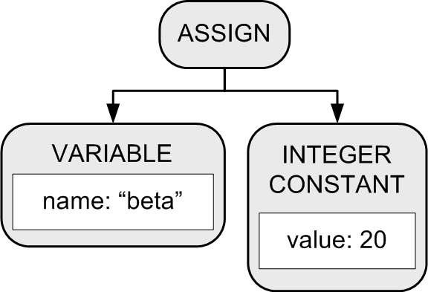
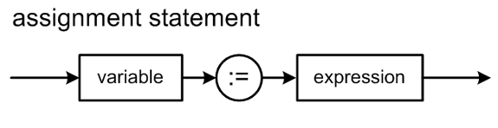
The parseAssignmentStatement() Method
celsius := (fahrenheit - 32)/1.8
Parser.java
private Node parseAssignmentStatement()
{
// The current token should now be the left-hand-side variable name.
Node assignmentNode = new Node(ASSIGN);
// Enter the variable name into the symbol table
// if it isn't already in there.
String variableName = currentToken.text;
SymtabEntry variableId = symtab.lookup(variableName.toLowerCase());
if (variableId == null) variableId = symtab.enter(variableName.toLowerCase());
// The assignment node adopts the variable node as its first child.
Node lhsNode = new Node(VARIABLE);
lhsNode.text = variableName;
lhsNode.entry = variableId;
assignmentNode.adopt(lhsNode);
currentToken = scanner.nextToken(); // consume the LHS variable;
Why lower case?
package frontend

Slide 21
parseAssignmentStatement(), cont’d
celsius := (fahrenheit - 32)/1.8
Parser.java
if (currentToken.type == COLON_EQUALS)
{
currentToken = scanner.nextToken(); // consume :=
}
else syntaxError("Missing :=");
// The assignment node adopts the expression node as its second child.
Node rhsNode = parseExpression();
assignmentNode.adopt(rhsNode);
return assignmentNode;
}

Slide 22
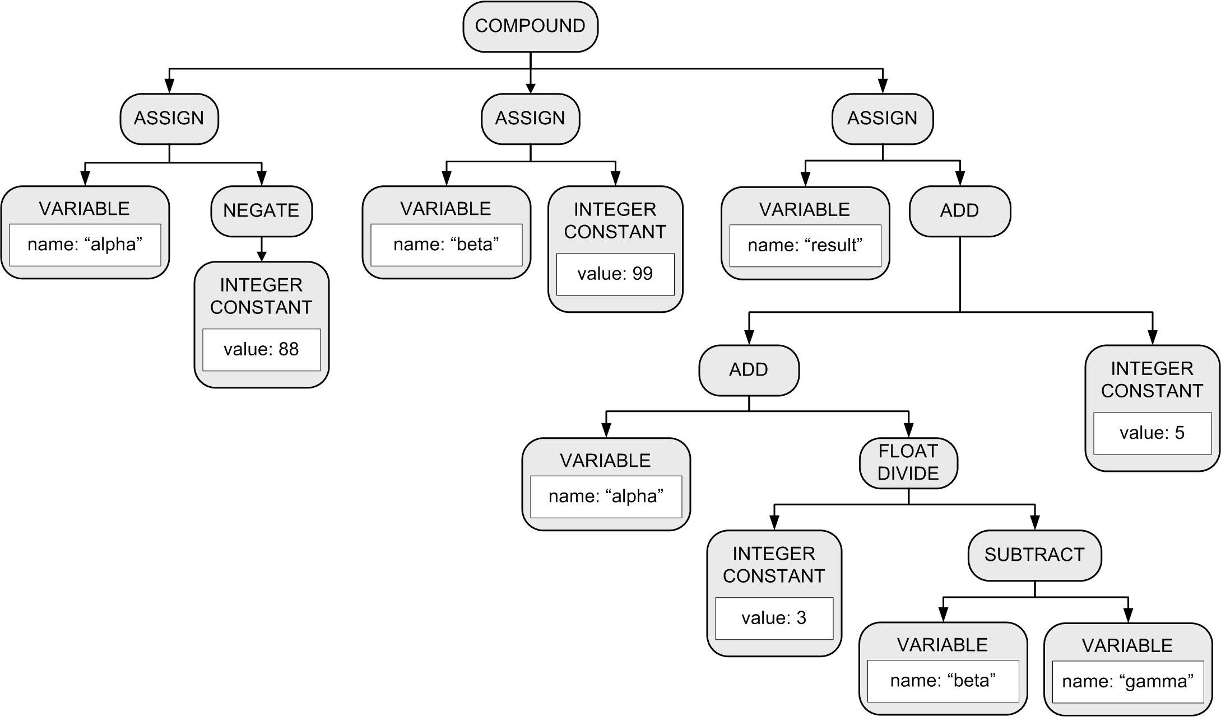
Parse Tree with Expressions
BEGIN
alpha := -88;
beta := 99;
result := alpha + 3/(beta – gamma) + 5
END

Slide 23
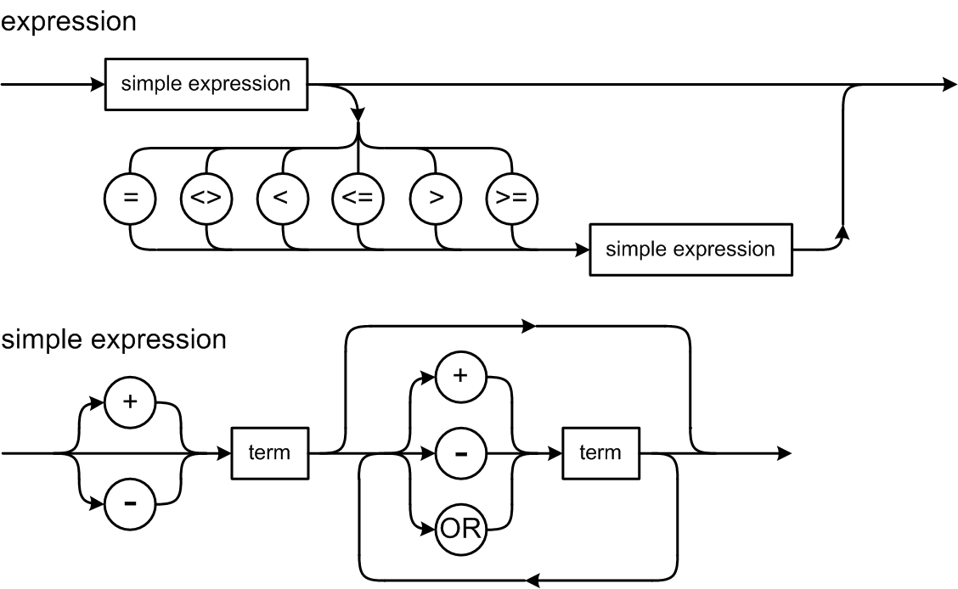
Pascal Expression Syntax Diagrams

Slide 24
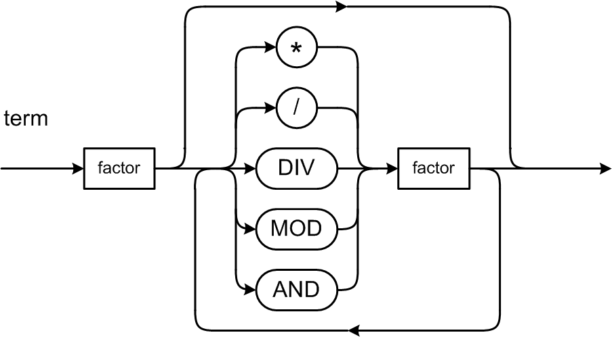
Expression Syntax Diagrams, cont’d

Slide 25
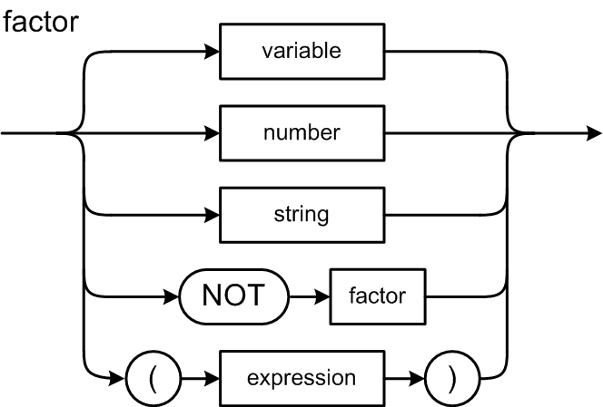
Expression Syntax Diagrams, cont’d

Slide 26
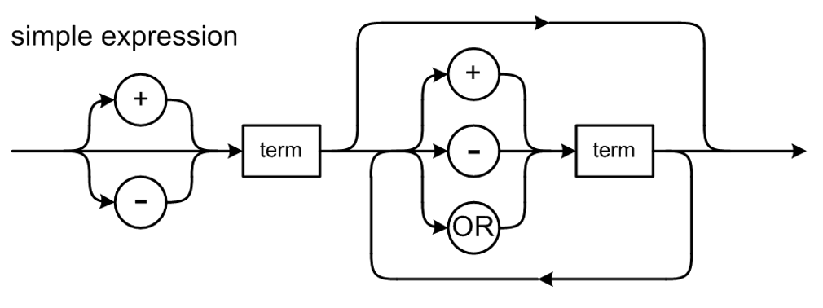
The parseSimpleExpression() Method
private Node parseSimpleExpression()
{
// The current token should now be an identifier or a number.
// The simple expression's root node.
Node simpExprNode = parseTerm();
// Keep parsing more terms as long as the current token
// is a + or - operator.
while (simpleExpressionOperators.contains(currentToken.type))
{
Node opNode = currentToken.type == PLUS ? new Node(ADD)
: new Node(SUBTRACT);
// consume the operator.
currentToken = scanner.nextToken();
// The add or subtract node adopts the first term node as its
// first child and the next term node as its second child.
// Then it becomes the simple expression's root node.
opNode.adopt(simpExprNode);
opNode.adopt(parseTerm());
simpExprNode = opNode;
}
return simpExprNode;
}
What is missing?
celsius := (fahrenheit - 32)/1.8
Parser.java

Slide 27
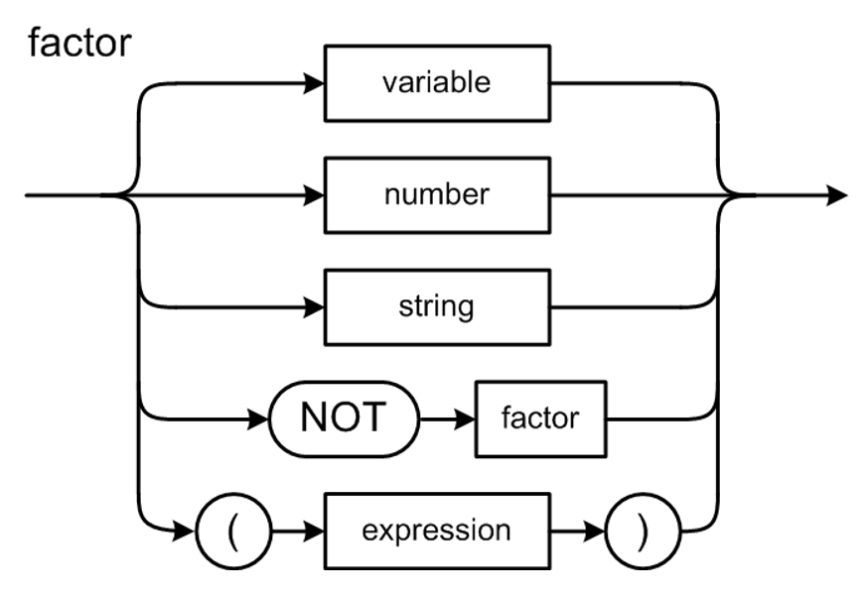
The parseFactor() Method
Parser.java
private Node parseFactor()
{
// The current token should now be an identifier or a number or (
if (currentToken.type == IDENTIFIER) return parseVariable();
else if (currentToken.type == INTEGER) return parseIntegerConstant();
else if (currentToken.type == REAL) return parseRealConstant();
else if (currentToken.type == LPAREN)
{
currentToken = scanner.nextToken(); // consume (
Node exprNode = parseExpression();
if (currentToken.type == RPAREN)
{
currentToken = scanner.nextToken(); // consume )
}
else syntaxError("Expecting )");
return exprNode;
}
else syntaxError("Unexpected token");
return null;
}
celsius := (fahrenheit - 32)/1.8

Slide 28
The parseVariable() Method
celsius := (fahrenheit - 32)/1.8
Parser.java
private Node parseVariable()
{
// The current token should now be an identifier.
// Has the variable been "declared"?
String variableName = currentToken.text;
SymtabEntry variableId = symtab.lookup(variableName.toLowerCase());
if (variableId == null) semanticError("Undeclared identifier");
Node node = new Node(VARIABLE);
node.text = variableName;
currentToken = scanner.nextToken(); // consume the identifier
return node;
}

Slide 29
Simple Interpreter
Now that we have a basic parse tree and a rudimentary symbol table, we can start the backend tier.
Recall the the backend components only work with the intermediate tier components.

Slide 30
Review: Conceptual Design
Interpreter
Compiler or
converter
Can an interpreter’s backend executor
run a Pascal program using only
the parse tree and the symbol table?

Slide 31
What is “Run Time”?
Run time is when the interpreter is executing the source program (e.g., the Pascal program).
  This can be confusing because
  the interpreter itself is running.
  Adjective: runtime or run-time
During run time, the execution of the source program is under the control of the interpreter.
  The executor in the interpreter’s back end relies solely on the parse tree and the symbol table in the intermediate tier (which were built by the parser in the front end).

Slide 32
Use of the Parse Tree at Run Time
The parse tree represents the statements
of the source program.
During run time, the executor “visits” (accesses)
the nodes of the tree.
  The executor performs certain operations
  depending on the type of node that it’s visiting.
  During a node visit, the executor can also visit
  the children of the node.

Slide 33
Use of the Symbol Table at Run Time
Each VARIABLE parse tree node contains a link to the variable’s symbol table entry.
Therefore, during the visit of an ASSIGN node, the value of the right-hand-side expression can be stored into the left-hand-side variable’s symbol table entry.
  The value of the RHS expression is obtained by visiting the nodes of the expression subtree.
  If there is a VARIABLE node in the expression subtree, the value of the variable is obtained
  from its symbol table entry.

Slide 34
Another Hack!
Storing values calculated during run time
into variables’ symbol table entries is a temporary hack we’ll use for now.
  This will fail miserably if we have recursion.
We’ll see later where we should actually store calculated runtime values for variables.

Slide 35
Visiting Parse Tree Nodes During Run Time
Class Executor in the backend package contains numerous visit methods for the
types of tree nodes:
  visitProgram()
  visitStatement()
  visitCompound()
  visitAssign()
  visitLoop()
  visitTest()
  visitExpression()
  etc.
We write visit*() methods
because we'll soon see that
the ANTLR compiler-compiler
tool generates similar visit*()
methods for us.
java Simple -execute HelloWorld.txt
Demo

