Slide 1
CS 153: Concepts of Compiler Design August 28 Class Meeting
Department of Computer Science San Jose State University Fall 2024 Instructor: Ron Mak
www.cs.sjsu.edu/~mak

Slide 2
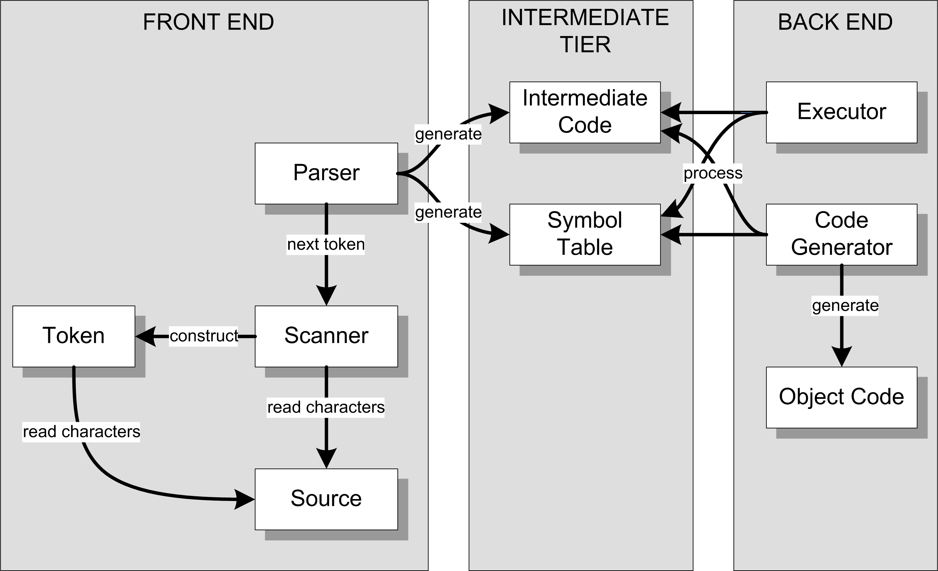
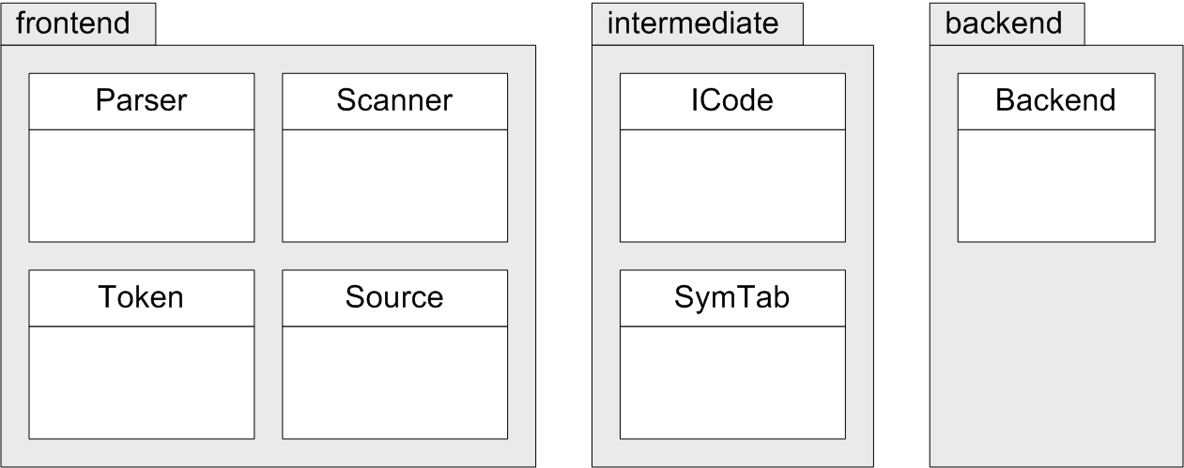
Three Java Packages
FROM:
TO:

Slide 3
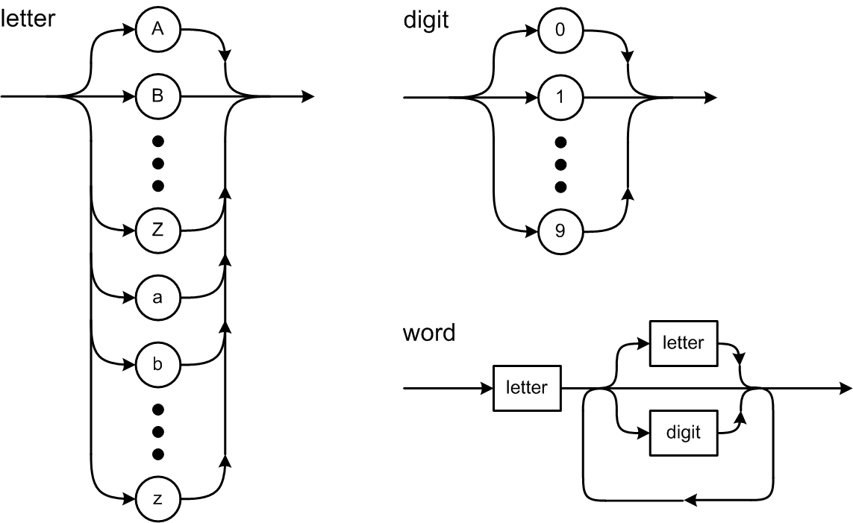
Pascal Token Syntax Diagrams

Slide 4
Test the Scanner
Simple.java
main()
testScanner()
Source.java
currentChar()
nextChar()
Scanner.java
nextToken()
package frontend
Keep track of the current input character
and read the next character upon demand.
The scanner extracts the first character
of the next token. That first character
determines what type of token is next.

Slide 5
Test the Scanner, cont’d
Token.java
reservedWords table
word()
identifier
reserved word
number()
integer
real
string()
specialSymbol()
Distinguishes reserved words
from identifiers.
Each of these static Token member
functions is called by the scanner
to create a token of the appropriate
type and to extract the remaining
characters of the token.
package frontend

Slide 6
Assignment #2: Scanner
Make the scanner more complete:
Reserved words:
Special symbols:
. , : := ; + - * / ( ) = <> < <= > >= .. ' [ ] ^
String and character literals.
Pascal is not case-sensitive.
BEGIN begin Begin BeGiN
are all the same reserved word!
Team assignment

Slide 7
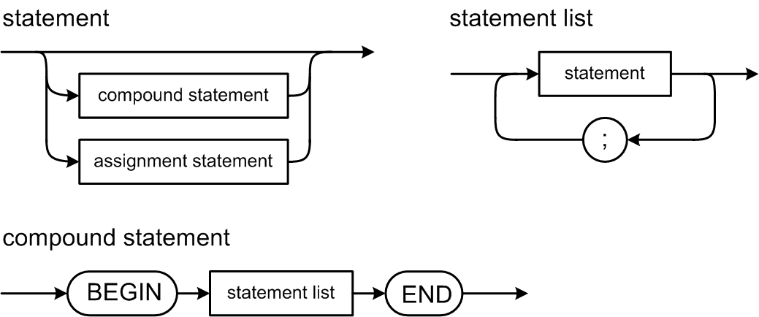
Pascal Statement Syntax Diagrams

Slide 8
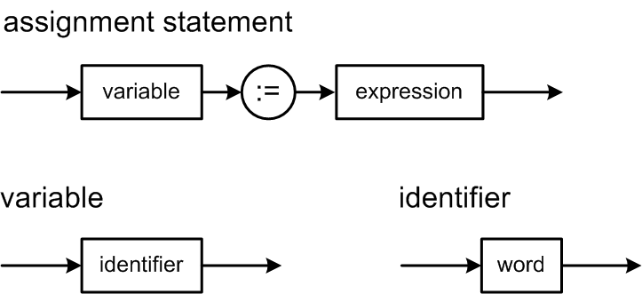
Pascal Statement Syntax Diagrams, cont'd
For now,
greatly simplified!

Slide 9
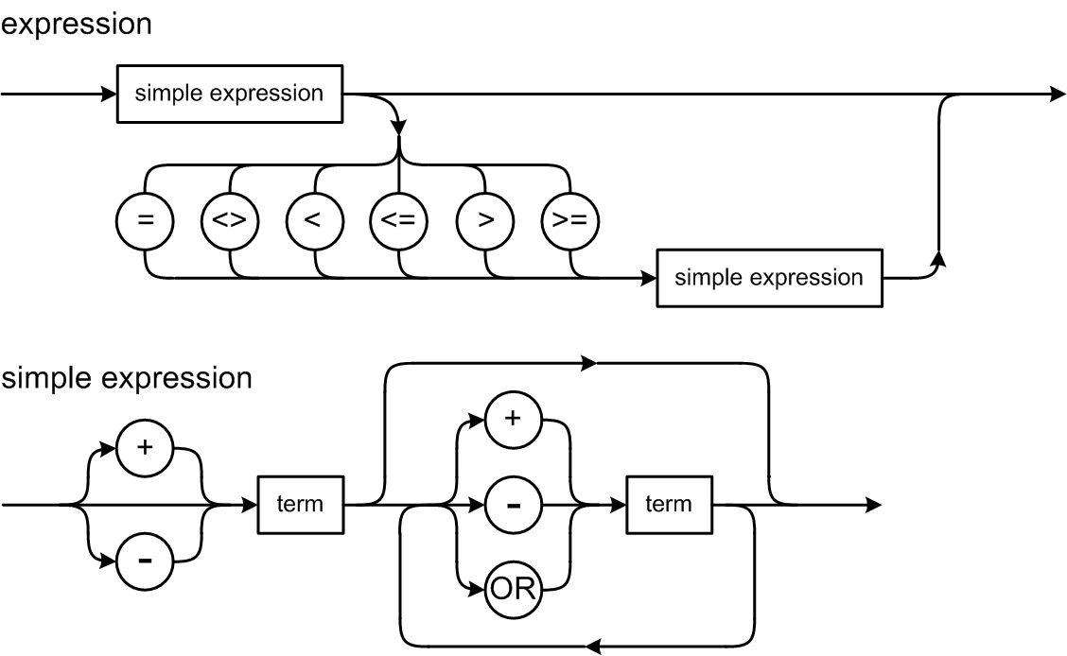
Pascal Expression Syntax Diagrams

Slide 10
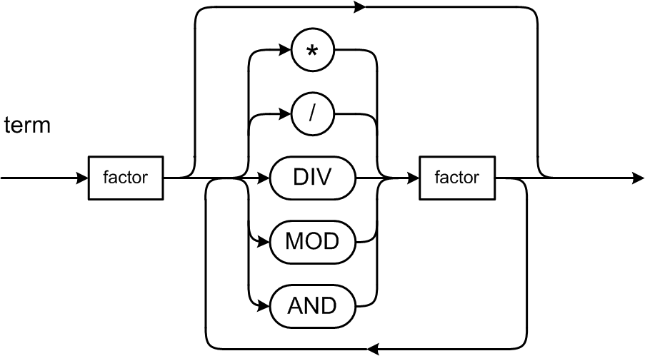
Expression Syntax Diagrams, cont’d

Slide 11
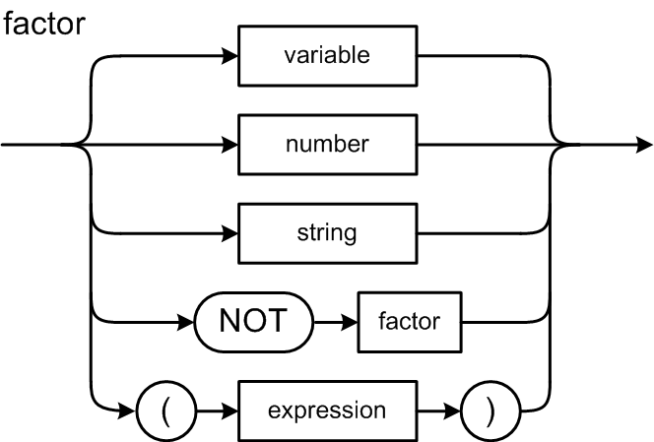
Expression Syntax Diagrams, cont’d

Slide 12
Pascal’s Operator Precedence Rules
Level | Operators
1 (factor: highest) | NOT
2 (term) | multiplicative: * / DIV MOD AND
3 (simple expression) | additive: + - OR
4 (expression: lowest) | relational: = <> < <= > >=
If there are no parentheses:
Higher level operators execute before the lower level ones.
Operators at the same level execute from left to right.
Because the factor syntax diagram defines parenthesized expressions, parenthesized expressions always execute first, from the most deeply nested outwards.

Slide 13
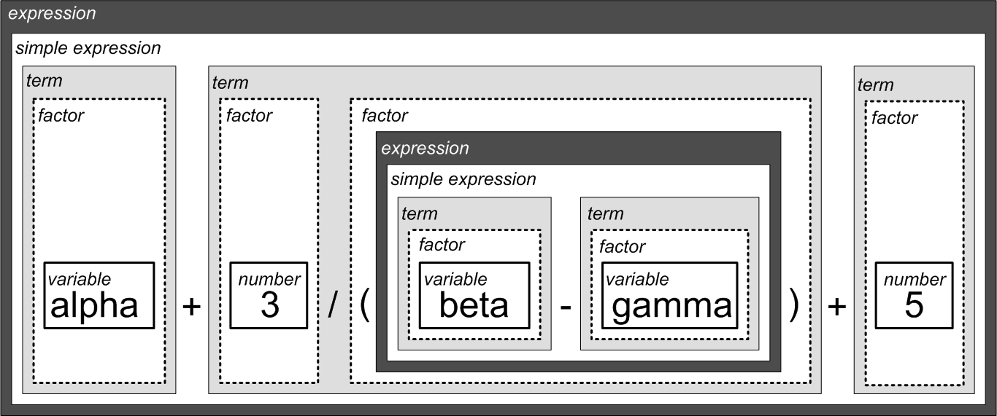
Example Decomposition
alpha + 3/(beta – gamma) + 5

Slide 14
Pascal Control Statements
Looping statements
REPEAT UNTIL
WHILE DO
FOR TO
FOR DOWNTO
Conditional statements
IF THEN
IF THEN ELSE
CASE OF

Slide 15
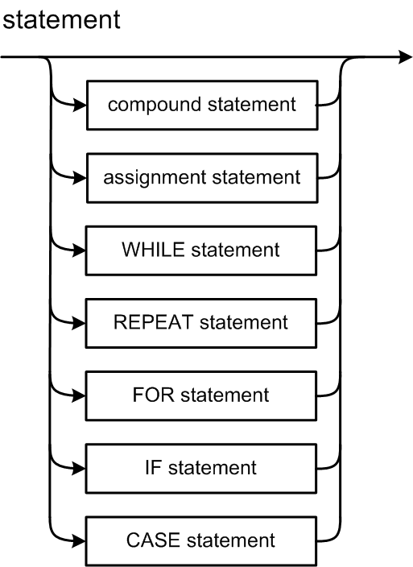
Statement Syntax Diagram

Slide 16
REPEAT Statement Syntax Diagram
See: http://primepuzzle.com/tp2/syntax-diagrams.html
REPEAT
i := i + 1;
write('#'); write(i);
writeln(': Hello, world!');
UNTIL i = 5;

Slide 17
Three Java Packages
FROM:
TO:

Slide 18
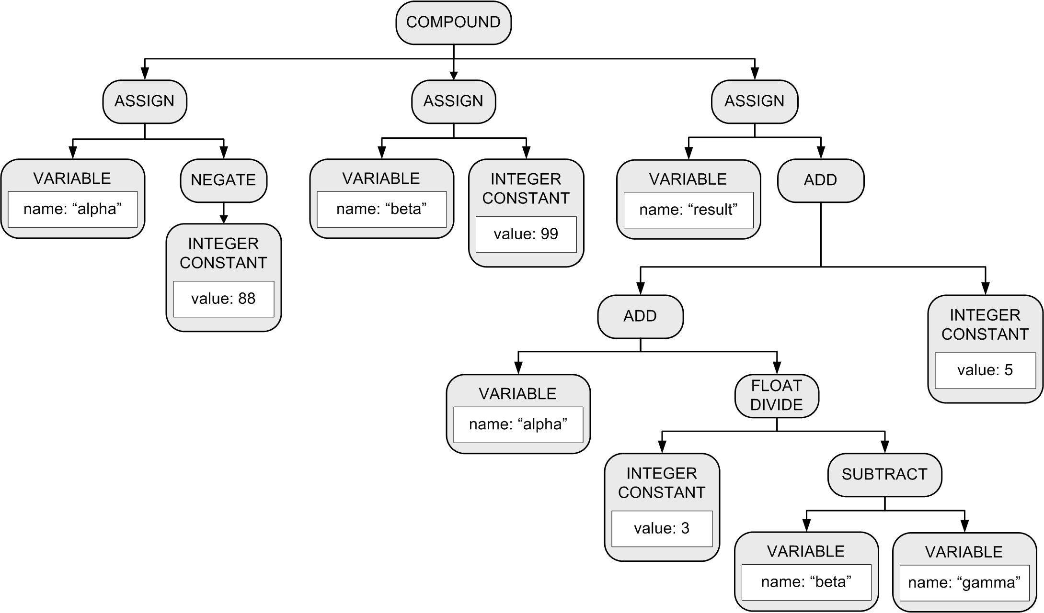
Parse Tree: Conceptual Design
More accurately called an
abstract syntax tree (AST).
BEGIN
alpha := -88;
beta := 99;
result := alpha + 3/(beta – gamma) + 5
END

Slide 19
Parse Tree: Basic Tree Operations
Create a new node.
Create a copy of a node.
Set and get the root node of a parse tree.
Set and get an attribute value in a node.
Add a child node to a node.
Get the list of a node’s child nodes.
Get a node’s parent node.

Slide 20
Test the Simple Parser
Parser.java
parseProgram()
parseStatement()
parseAssignmentStatement()
parseCompoundStatement()
parseRepeatStatement()
parseWriteStatement()
parseWritelnStatement()
parseExpression()
parseSimpleExpression()
parseTerm()
parseFactor()
parseVariable()
parseIntegerConstant()
parseRealConstant()
parseStringConstant()
package frontend
Many individual parser
member functions!

Slide 21
Building a Parse Tree
Each parse*() member function builds a new subtree and returns the subtree’s root node.
The caller of the parse*() function adopts the new subtree’s root node as a child of the subtree that the caller itself is building.
The caller then returns the root node of the subtree that it built to its caller.
This process continues until the entire source has been parsed and we have the entire parse tree.

Slide 22
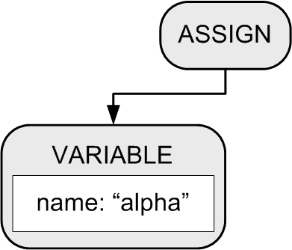
Building a Parse Tree
Example:
BEGIN
alpha := 10;
beta := 20
END
Function parseCompoundStatement() method creates a COMPOUND node.
2. Function parseAssignmentStatement() creates an ASSIGN node and a VARIABLE node, which the ASSIGN node adopts as its first child.

Slide 23
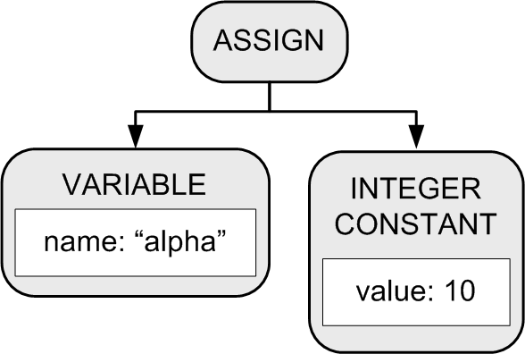
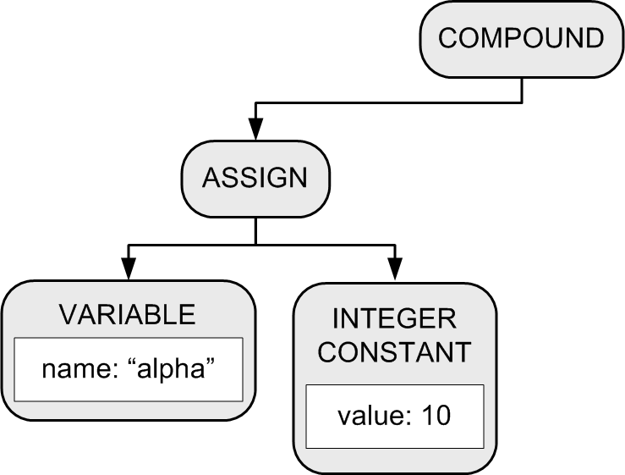
Building a Parse Tree
3. Function parseExpression() creates an INTEGER CONSTANT node which the ASSIGN node adopts as its second child.
BEGIN
alpha := 10;
beta := 20
END
4. The COMPOUND node adopts the ASSIGN node as its first child.

Slide 24
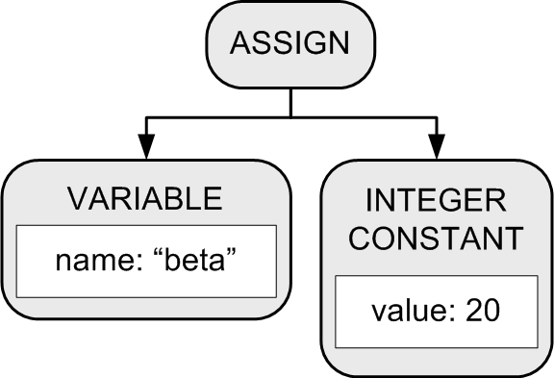
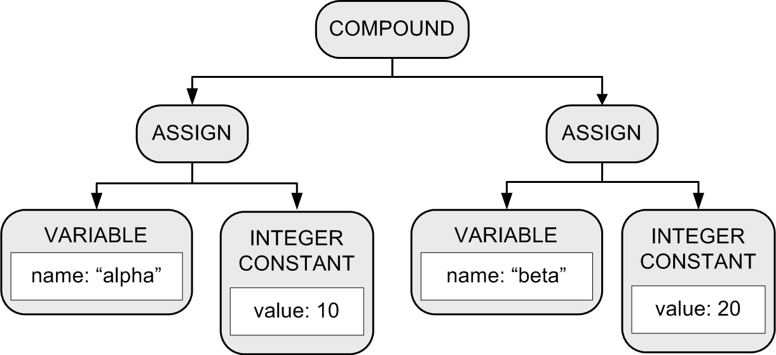
Building a Parse Tree
Another set of calls to functions parseAssignmentStatement() and parseExpression() builds another assignment statement subtree.
6. The COMPOUND node
adopts the subtree
as its second child.
BEGIN
alpha := 10;
beta := 20
END

Slide 25
Parse Tree Node
Node.java
adopt()
package intermediate

Slide 26
Types of Parse Tree Nodes
Node.java
public enum NodeType
{
PROGRAM, COMPOUND, ASSIGN, LOOP, TEST, WRITE, WRITELN,
ADD, SUBTRACT, MULTIPLY, DIVIDE, EQ, LT,
VARIABLE, INTEGER_CONSTANT, REAL_CONSTANT, STRING_CONSTANT
}

Slide 27
Printing Parse Trees
Utility class ParseTreePrinter prints parse trees.
Prints in an XML format.
package intermediate
<COMPOUND line="11">
<ASSIGN line="12">
<VARIABLE id="alpha" level="0" />
<INTEGER_CONSTANT value="10" />
</ASSIGN>
<ASSIGN line="13">
<VARIABLE id="beta" level="0" />
<INTEGER_CONSTANT value="20" />
</ASSIGN>
</COMPOUND>

Slide 28
Example: HelloWorld5.txt
PROGRAM HelloWorld5;
BEGIN
i := 0;
REPEAT
i := i + 1;
write('#'); write(i);
writeln(': Hello, world!');
UNTIL i = 5;
END.
<PROGRAM HelloWorld>
<COMPOUND line 3>
<ASSIGN line 4>
<VARIABLE i />
<INTEGER_CONSTANT 0 />
</ASSIGN>
<LOOP line 6>
<ASSIGN line 7>
<VARIABLE i />
<ADD>
<VARIABLE i />
<INTEGER_CONSTANT 1 />
</ADD>
</ASSIGN>
<WRITE line 8>
<STRING_CONSTANT '#' />
</WRITE>
<WRITE line 8>
<VARIABLE i />
</WRITE>
<WRITELN line 9>
<STRING_CONSTANT ': Hello, world!' />
</WRITELN>
<TEST line 10>
<EQ>
<VARIABLE i />
<INTEGER_CONSTANT 5 />
</EQ>
</TEST>
</LOOP>
</COMPOUND>
</PROGRAM>
PROGRAM
COMPOUND
ASSIGN
LOOP
ASSIGN
WRITE
WRITE
WRITELN
TEST
java Simple -parse HelloWorld5.txt
Demo

