Slide 1


CS 153: Concepts of Compiler Design
August 27 Class Meeting
Department of Computer Science
San Jose State University
Fall 2024
Instructor: Ron Mak
www.cs.sjsu.edu/~mak

Slide 2
Review: It’s All about Translation
Interpreter
  Translate a source program written in a high-level language to actions (i.e., execute the program, perhaps with an interactive debugger).
Converter
  Translate a source program written in a high-level language to an equivalent program written in a different high-level language (e.g., Pascal ➔ Java).
Compiler
  Translate a source program written in a high-level language to an equivalent program in a low-level language (assembly language or machine code).
This is the order that we’ll study them.

Slide 3
Overview of the Compilation Process
hello.pas
hello.java
Translation:
Pascal compiler
(you will write this in Java)
Java compiler
javac hello.java ...
assembly language
object program
hello.j
Translation:
Jasmin assembler
(provided for you)
binary
object program
hello.class
Hello.class
Java linker & loader
(provided for you)
Java linker & loader
java Hello ...
Execution:
Java Virtual Machine
(provided for you)
Java Virtual Machine

Slide 4
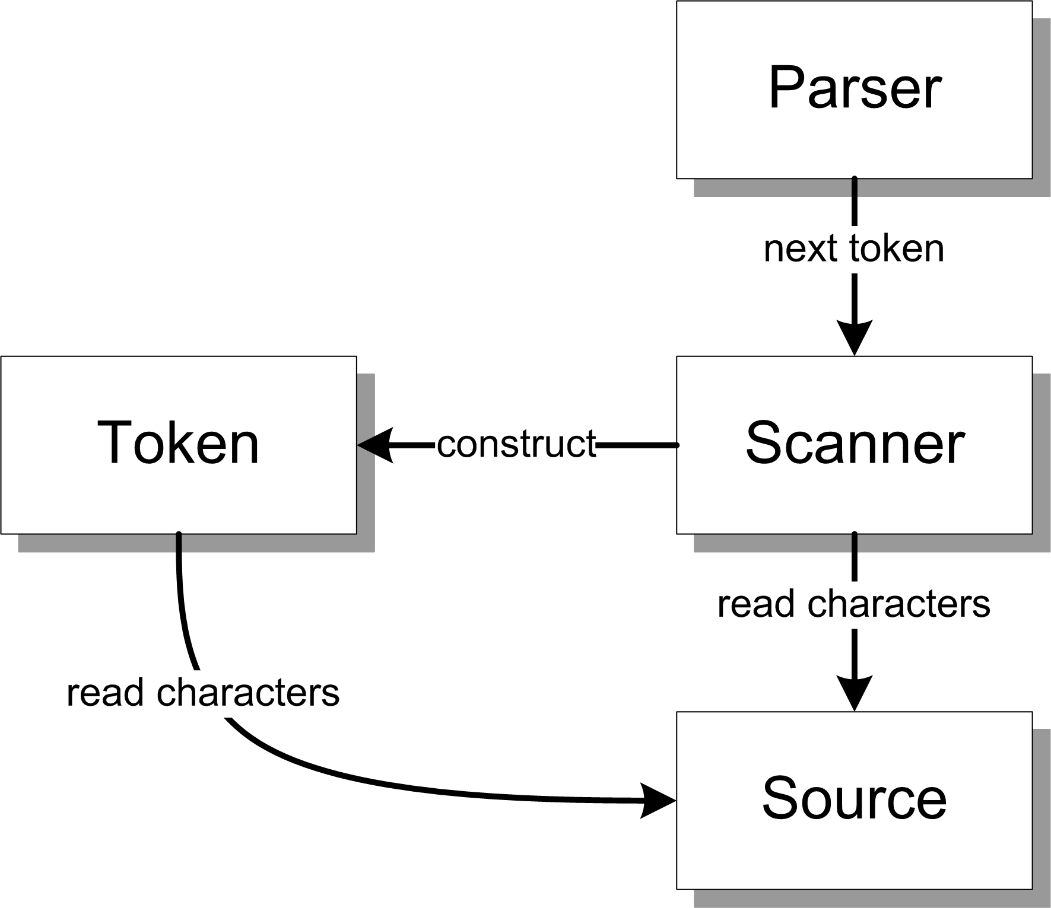
Conceptual Design (Version 1)
Parser
  Controls the translation process.
  Repeatedly asks the scanner
  for the next token.
Scanner
  Repeatedly reads characters
  from the source to construct
  tokens for the parser.
Token
  A source language element
    identifier (e.g., variable name)
    reserved word (IF, FOR, etc.)
    number
    special symbol (+ - * / = etc.)
  Also reads from the source
Source
  The source program in a text file

Slide 5
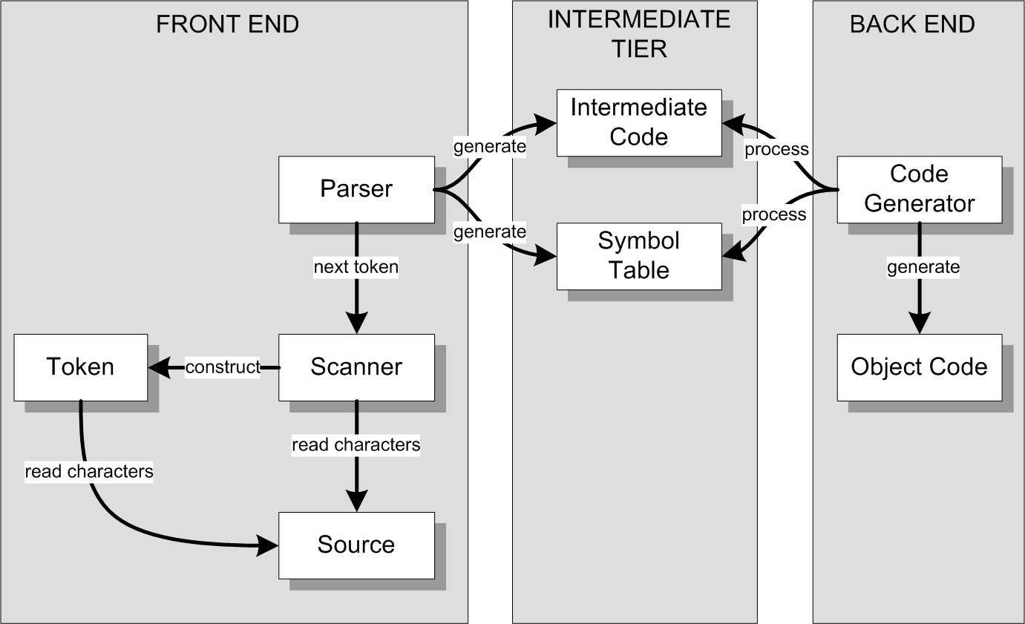
Conceptual Design (Version 2)
We can architect a compiler with three major parts:
Compiler:
Generates code in a
low-level language
such as assembly or machine code.

Slide 6
Conceptual Design (Version 2, cont’d)
We can architect a converter with the same parts:
Converter:
Generates code in
another high-level
language.
We’ll need a different
code generator than
the one in a compiler.

Slide 7
Major Parts of a Compiler or a Converter
Front end
  Parser, Scanner, Source, Token
Intermediate tier
  Intermediate code (“icode”)
    “Predigested” form of the
    source code that the back end
    can process efficiently.
    Example: parse trees
    AKA intermediate representation (IR)
  Symbol table (“symtab”)
    Stores information about the symbols (such as the identifiers) contained in the source program.
Back end
  Code generator
    Processes the icode and the symtab in order to generate the object code
      Compiler: assembly or machine code
      Converter: another high-level language
Only the front end needs to be source language-specific.
The intermediate tier and
the back end can be source
language-independent!

Slide 8
What about Interpreters?
An interpreter executes (or: runs) a source program instead of generating object code.
It executes a source program using
the intermediate code and the symbol table.

Slide 9
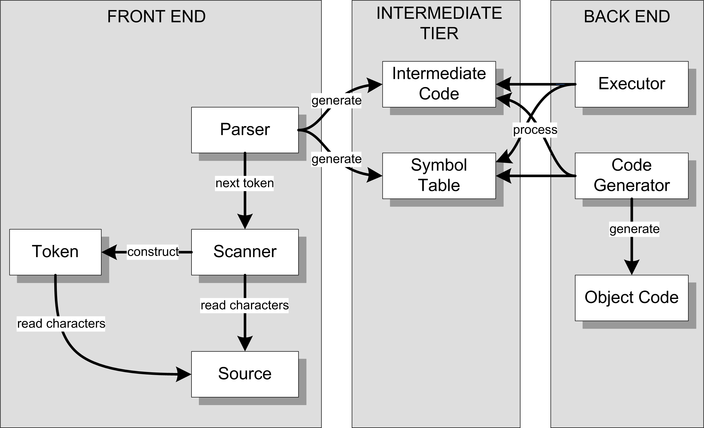
Conceptual Design (Version 3)
Interpreter
Compiler or
converter
A compiler, converter, and interpreter can all use the same front end and intermediate tier.

Slide 10
Comparing Compilers and Interpreters
A compiler generates object code,
but an interpreter does not.
Executing the source program from object code
can be several orders of magnitude faster than executing the program by interpreting the intermediate code and the symbol table.
But an interpreter requires less effort to get a source program to execute.
➔ Faster turnaround time

Slide 11
Comparing Compilers and Interpreters, cont’d
An interpreter maintains control
of the source program’s execution.
Interpreters often come with interactive
source-level debuggers that allow you
to refer to source program elements,
such as variable names.
  AKA symbolic debugger
  Set breakpoints, single-step, etc.
Demo

Slide 12
Comparing Compilers and Interpreters, cont’d
Therefore ...
  Interpreters are useful during program development.
  Compilers are useful to deploy released programs
  in a production environment.
In this course, you will ...
  Complete an interpreter for the Pascal language.
  Complete an interactive symbolic debugger.
  Complete a Pascal ➔ Java converter.
  Develop a compiler for a language of your choice.
  You can invent your own programming language!

Slide 13
Take roll!

Slide 14
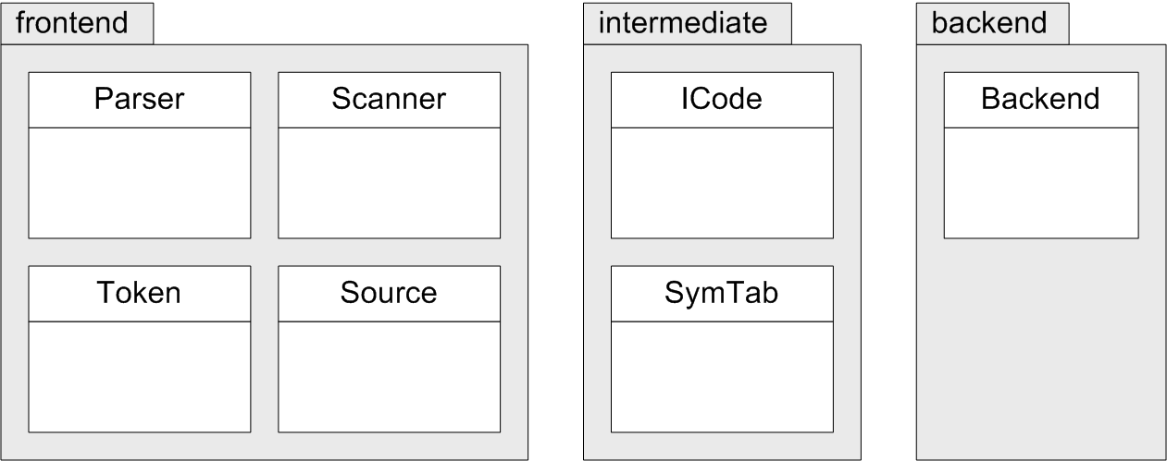
Three Java Packages
FROM:
TO:
Package
Class
UML package and
class diagrams.

Slide 15
Pascal Tokens
Identifiers, numbers, and strings
  alpha 123 -123.45e12 'Hello, world!'
Reserved words
  PROGRAM BEGIN END WHILE FOR
  REPEAT UNTIL IF THEN ELSE CASE
Special symbols
  . , : ; := + - * / ( )
  = < <= <> >= > { }
Miscellaneous
  END_OF_FILE, ERROR
More tokens
to come!

Slide 16
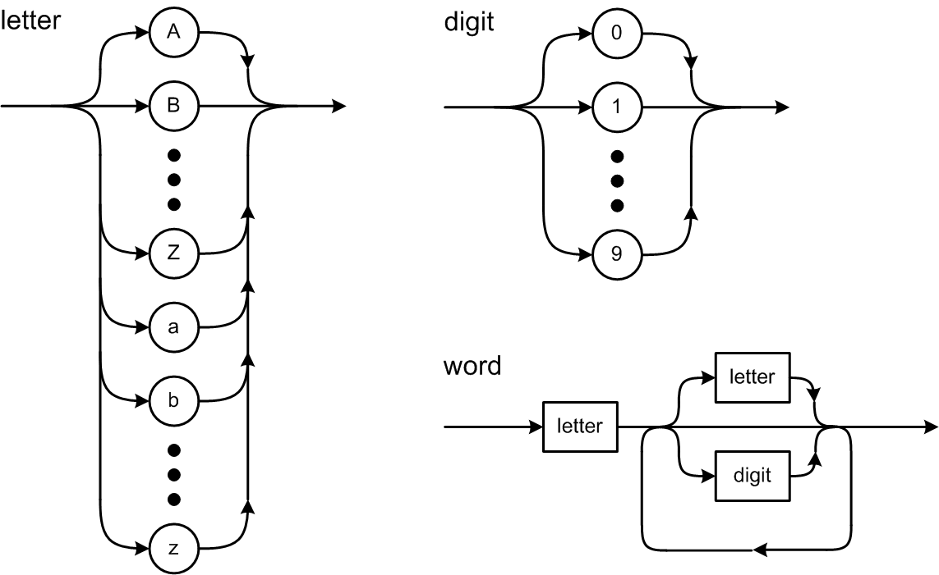
Syntax Diagrams

Slide 17
The Scanner Extracts Tokens
It’s the scanner’s job to extract tokens
from the input source file.
Whenever the parser wants the next token,
it asks the scanner to extract and return it.

Slide 18
How to Scan for Tokens
Suppose the source line contains
IF (index >= 10) THEN
The scanner skips over the leading blanks.
The current character is I, so the next token must be a word.
The word token is extracted by reading source characters up to but not including the first character that is not valid for a word, which in this case is a blank. The blank becomes the current character. The scanner determines that the word is a reserved word.

Slide 19
How to Scan for Tokens, cont’d
The scanner skips over any blanks between tokens. The current character is (. The next token must be a special symbol.
After extracting the special symbol token, the current character is i. The next token must be a word.
After extracting the word token, the current character is a blank. The scanner determines that the word is an identifier.

Slide 20
How to Scan for Tokens, cont’d
Skip the blank. The current character is >.
Extract the special symbol token. The current character is a blank.
Skip the blank. The current character is 1, so the next token must be a number.
After extracting the number token, the current character is ).

Slide 21
How to Scan for Tokens, cont’d
Extract the special symbol token. The current character is a blank.
Skip the blank. The current character is T, so the next token must be a word.
Extract the word token and determine that it’s a reserved word.
The current character is \n, so the scanner is done with this line.

Slide 22
Basic Scanning Algorithm
Skip any blanks until the current character is nonblank.
  In Pascal, a comment and the end-of-line character
  each should be treated as a blank.
The current (nonblank) character determines what the next token is and becomes that token’s first character.
Extract the rest of the next token by copying successive characters up to but not including the first character that does not belong to that token.

Slide 23
Basic Scanning Algorithm, cont’d
Extracting a token consumes all the source characters that constitute the token.
  After extracting a token, the current character is the
  next character after the last character of that token.

Slide 24
Test the Scanner
Simple.java
  main()
  testScanner()
Source.java
  currentChar()
  nextChar()
Scanner.java
  nextToken()
package frontend
Keep track of the current input character
and read the next character upon demand.
The scanner extracts the first character
of the next token. That first character
determines what type of token is next.

Slide 25
Test the Scanner, cont’d
Token.java
  reservedWords table
  word()
    identifier
    reserved word
  number()
    integer
    real
  string()
  specialSymbol()
Distinguishes reserved words
from identifiers.
Each of these static Token methods
is called by the scanner to create a
token of the appropriate type and
to extract the remaining characters
of the token.
package frontend
Demo

Slide 26
Current Character vs. Next Character
Suppose the source line contains ABCDE
and we’ve already read the first character.
currentChar() | A
nextChar() | B
nextChar() | C
nextChar() | D
currentChar() | D
currentChar() | D
nextChar() | E
nextChar() | eol

Slide 27
Consume Characters and Tokens
To consume the current input character, use it (such as by appending it to the text of the current token) and then read the next character.
To consume the current token, process it
and then extract the next token.
What happens if you
forget to consume
the current input character
or the current token?

Slide 28
Reminder: By Wednesday, August 28
Form teams.
Submit your team information into Canvas.
  team name
  team member names, student IDs, and email addresses

