Slide 1
CS 153 Concepts of Compiler Design November 20 Class Meeting
Department of Computer Science San Jose State University Fall 2023 Instructor: Ron Mak
www.cs.sjsu.edu/~mak

Slide 2
Compiler Construction Formalities
Some formal terms for concepts that we covered during the semester:
syntax-directed translation
attribute grammars
LL(1) parser
LR(0) parser and other bottom-up parsers
FIRST and FOLLOW sets
Data-flow analysis for code optimization
Alternate intermediate representations
JavaCC

Slide 3
Syntax-Directed Translation
Syntax-directed translation is done by attaching rules or program fragments to the production rules of a grammar.
Examples:
calc.l
[0-9]+\.?|[0-9]*\.[0-9]+ { sscanf(yytext, "%lf", &yylval); return NUMBER; }
calc.y
exprlist: /* empty list */
| exprlist '\n'
| exprlist expr '\n' {printf("\t= %lf\n", $2);}
;

Slide 4
Attribute Grammars
An attribute grammar attaches attribute definitions to the production rules.
If the intermediate representation is parse trees, then these attributes are fields added to the tree nodes.
Example:
Pascal.g4
variable locals [ Typespec type = null, SymtabEntry entry = null ]
: variableIdentifier modifier* ;

Slide 5
LL(1) Parser
An LL(1) parser scans its input from left to right and constructs a leftmost derivation with 1 lookahead symbol.
For top-down recursive descent parsers.
By looking ahead one token at the beginning of a statement, our top-down recursive descent parser for Pascal can determine what statement it will parse next.

Slide 6
LL(1) Parser, cont’d
A leftmost derivation of the statement by an LL(1) parser:
IF a = b THEN c := d ELSE e := f
<if_statement> ➔ IF <expression> THEN <statement> ELSE <statement>
➔ IF a = b THEN <statement> ELSE <statement>
➔ IF a = b THEN c := d ELSE <statement>
➔ IF a = b THEN c := d ELSE e := f

Slide 7
LR(0) Parser
An LR(0) parser scans its input from left to right and constructs a rightmost derivation with 0 lookahead symbols.
For bottom-up parsers.

Slide 8
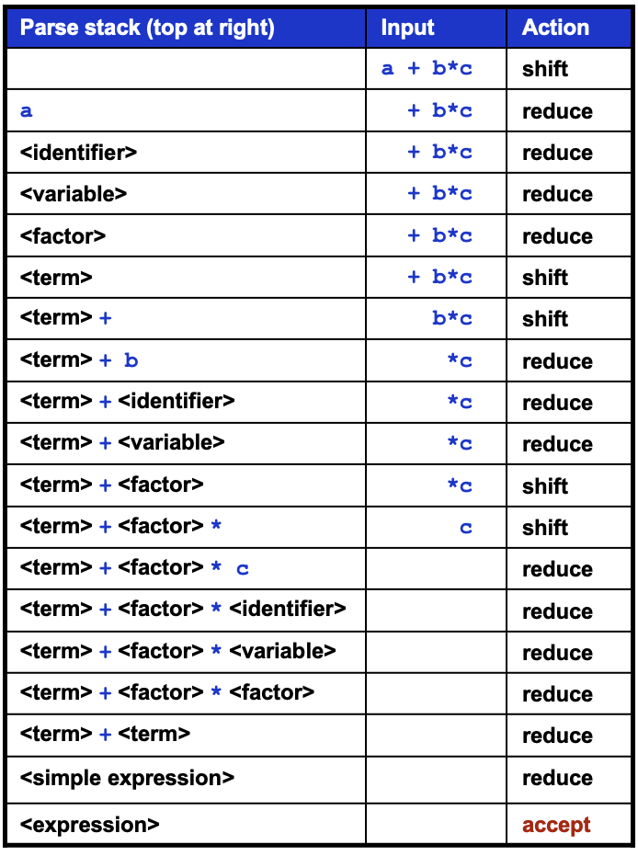
LR(0) Parser, cont’d
Read the parse from bottom to top:
No lookahead.
Process what’s on top of the parse stack.
<expression> ➔ <simple expression>
➔ <term> + <term>
➔ <term> + <factor>*<factor>
➔ <term> + <factor>*<variable>
➔ <term> + <factor>*<identifier>
➔ <term> + <factor>*c
➔ <term> + <variable>*c
➔ <term> + <identifier>*c
➔ <term> + b*c
➔ <factor> + b*c
➔ <variable> + b*c
➔ <identifier> + b*c
➔ a + b*c

Slide 9
Other Types of Parsers
SLR(1)
Simple LR(1) with one symbol of lookahead.
An extension of LR(0) that is powerful enough to handle almost all practical language structures.
SLR(k)
Generalized SLR(1) with $k≥1$
LALR(1)
“Look ahead” LR(1)
Requires fewer states in the parse table than LR(1)

Slide 10
Classic FORTRAN
Which is it?
DO 10 I = 1, 50
DO10I=1,50
DO10I=1.50
DO10I = 1.50

Slide 11
FIRST and FOLLOW Sets
Table-driven parsers (such as a bottom-up shift-reduce parser) need to compute FIRST and FOLLOW sets.
A top-down recursive descent parser doesn’t need to explicitly compute these sets.
They are used implicitly.

Slide 12
FIRST and FOLLOW Sets, cont’d
Given a grammar, the FIRST set contains the tokens that determine which rule to apply.
In our Pascal compiler, the set of tokens that include IF, CASE, REPEAT, WHILE, FOR are the first tokens of the rules for statements, and each of these tokens tell the parser which statement it’s about to parse.
Pascal.g4
ifStatement : IF expression THEN trueStatement
( ELSE falseStatement )? ;
caseStatement : CASE expression OF caseBranchList END ;
repeatStatement : REPEAT statementList UNTIL expression ;
whileStatement : WHILE expression DO statement ;
forStatement : FOR variable ':=' expression
( TO | DOWNTO ) expression DO statement ;

Slide 13
FIRST and FOLLOW Sets, cont’d
The FOLLOW set of a grammar rule is the tokens that can follow a derivation from the rule.
In our Pascal compiler, the parser implicitly used the FOLLOW set of a statement rule to determine whether the statement in the source ended correctly.
During a recovery from a syntax error, the FOLLOW tokens enables the parser to resynchronize and then resume parsing.
There are algorithms to compute FIRST and FOLLOW sets if they are explicitly needed.

Slide 14
Other Intermediate Representations
There are other formats besides parse trees for the intermediate representation generated by the parser.
A common format is three-address code.

Slide 15
Three-Address Code
During the first pass, the parser translates the expression in the source program: to three-address code as the intermediate representation: where t1, t2, and t3 are temporaries.
During the code-generation pass, t1, t2, and t3 are mapped to registers or memory locations.
2*a + (b – 3)
t1 = 2 * a
t2 = b – 3
t3 = t1 + t2

Slide 16
Data-Flow Analysis
Techniques to derive information about the flow of data along runtime execution paths.
Analysis needed to generate optimized code.
View program execution as a series of state transformations.
A program’s runtime state is characterized by the values of its variables.

Slide 17
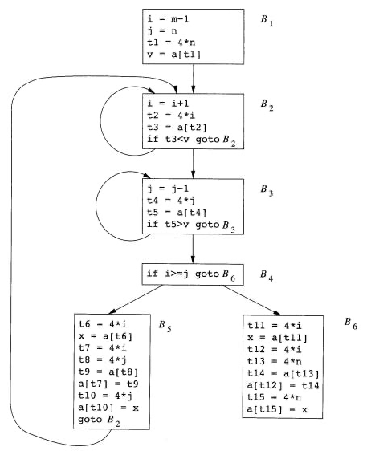
Data-Flow Analysis, cont’d
Break a program into basic blocks.
Code sequences with no branches in or out of the sequence.
What is the program state before entering and after leaving a basic block?
Compilers: Principles, Techniques, & Tools
by Aho, Lam, Sethi, and Ullman
Pearson Addison-Wesley, 2007
ISBN 0-321-486681-1

Slide 18
JavaCC
“Java Compiler Compiler (JavaCC) is the most popular parser generator for use with Java applications.”
Reads a .jj grammar file and generates a top-down recursive descent LL(1) parser written in the Java language.
The generated parser includes visit methods.
Includes JJTree, a powerful tree-building preprocessor.
https://javacc.github.io/javacc/

Slide 19
JJTree
JJTree augments a JavaCC grammar by inserting tree-building code.
When a parser is generated from the augmented grammar, and ...
The generated parser is executed against a source program …
An AST (abstract syntax tree) is created.
.jjt
JJTree
javac
Generated
Parser
.java
AST
.jj
javacc
source
program

Slide 20
JavaCC Parser Specification
Use JavaCC regular expressions to specify tokens.
Use EBNF to specify JavaCC production rules.
Phone number example.
Example phone number: 408-123-4567
EBNF:
<digit> ::= 0|1|2|3|4|5|6|7|8|9
<three digits> ::= <digit> <digit> <digit>
<four digits> ::= <digit> <digit> <digit> <digit>
<phone number> ::= <three digits> - <three digits> - <four digits>

Slide 21
JavaCC Parser Specification, cont’d
EBNF:
<digit> ::= 0|1|2|3|4|5|6|7|8|9
<three digits> ::= <digit> <digit> <digit>
<four digits> ::= <digit> <digit> <digit> <digit>
<phone number> ::= <three digits> - <three digits> - <four digits>
JavaCC:
TOKEN : {
<FOUR_DIGITS : (<DIGITS>){4}>
| <THREE_DIGITS : (<DIGITS>){3}>
| <#DIGITS : ["0"-"9"]>
}
void PhoneNumber() : {}
{
<THREE_DIGITS> "-" <THREE_DIGITS> "-" <FOUR_DIGITS> <EOF>
}
Token specifications
Java statements can go in here!
Nonterminal
Production rule
Terminal
Literal
Terminal
Literal
Terminal
Terminal

Slide 22
JavaCC Production Rule Methods
JavaCC generates a top-down recursive-descent parser.
Each production rule becomes a Java method of the parser class.
You can pass parameters to the methods.
void PhoneNumber() : {
StringBuffer sb = new StringBuffer();
}
{
AreaCode(sb) "-"
<THREE_DIGITS> {sb.append(token.image);} "-"
<FOUR_DIGITS> {sb.append(token.image);}
<EOF> {System.out.println("Number: " + sb.toString());}
}
void AreaCode(StringBuffer buf) : {}
{
<THREE_DIGITS> {buf.append(token.image);}
}
Java statement.
Syntactic action.

Slide 23
Example: Simple Calculator
void Expression() : {}
{
{System.out.println("EXPRESSION STARTS");}
Operator()
{System.out.println("EXPRESSION ENDS");}
}
void Operator() : {}
{
Operand()
"+" {System.out.println("Operator: " + tokenImage[PLUS]);}
Operand()
}
void Operand() : {Token t;}
{
t=<DIGITS> {System.out.println("Operand: " + t.image);}
}

Slide 24
Example: A Simple AST
PARSER_BEGIN(Calculator)
import java.io.*;
public class Calculator
{
public static void main(String[] args)
{
Reader sr = new StringReader(args[0]);
Calculator calc = new Calculator(sr);
try {
SimpleNode node = calc.Expression();
node.dump(">");
}
catch (ParseException ex) {
ex.printStackTrace();
}
}
}
PARSER_END(Calculator)
SimpleNode Expression() : {}
{
Operator()
{return jjtThis;}
}
void Operator() : {}
{
Operand() "+" Operand()
}
void Operand() : {}
{
<DIGITS>
}
jjtThis represents
the current AST node.
SimpleNode
implements the
JJTree Node class.
dump() is the
AST print method.

Slide 25
Example: Operating Calculator
SimpleNode Expression() : {}
{
Operator()
{
SimpleNode operator = (SimpleNode) jjtThis.jjtGetChild(0);
SimpleNode first = (SimpleNode) operator.jjtGetChild(0);
int firstValue = (Integer) first.jjtGetValue();
SimpleNode second = (SimpleNode) operator.jjtGetChild(1);
int secondValue = (Integer) second.jjtGetValue();
if (((String) operator.jjtGetValue()).equals("+")) {
jjtThis.jjtSetValue(firstValue + secondValue);
}
else {
System.out.println("Unknown operator");
}
return jjtThis;
}
}
First child
Second child

Slide 26
Calculator and the Visitor Design Pattern
public class CalculatorVisitorAdapter implements CalculatorVisitor
{
public Object visit(SimpleNode node, Object data)
{
return node.childrenAccept(this, data);
}
public Object visit(ASTExpression node, Object data)
{
return node.childrenAccept(this, data);
}
public Object visit(ASTOperator node, Object data)
{
return node.childrenAccept(this, data);
}
public Object visit(ASTOperand node, Object data)
{
return node.childrenAccept(this, data);
}
}
JJTree generates the CalculatorVisitor interface.
One visit() method
for each tree node type
that can accept visitors.
The default action
when visiting each type
of tree node is to tell
each of the node’s
children to accept the
visitor. (In other words,
recursively walk down the
tree.) This action can be overridden by subclasses.

Slide 27
Calculator and the Visitor Design Pattern, cont’d
public class SumVisitor extends CalculatorVisitorAdapter
{
public int sum = 0;
public Object visit(ASTOperand operand, Object data)
{
sum += (Integer) operand.jjtGetValue();
return super.visit(operand, data);
}
}
Only override the visit method
of the ASTOperand node.
After summing, do the default action (super.visit) for any children. (This is a preorder traversal.)
SumVisitor’s visit() method is called whenever the tree node is an ASTOperand (i.e., an ASTOperand node is being visited).
The SumVisitor object simply adds the value stored in the operand node to its running sum .
Then it performs the default action for any children.
SumVisitor is a subclass of CalculatorVisitorAdaptor.
The adaptor implements visit() methods for the other node types.

