Slide 1
CS 153 Concepts of Compiler Design October 11 Class Meeting
Department of Computer Science San Jose State University Fall 2023 Instructor: Ron Mak
www.cs.sjsu.edu/~mak

Slide 2
Midterm: Question #1
Explain in no more than 50 words how the software architecture created by ANTLR enables the developer of a Pascal interpreter to write code to process the same parse tree in both pass 2 and pass 3.
ANTLR creates the visitor interface and a base implementation class. We write one subclass of the base class that contains overriding visit methods to process the tree during pass 2, and another subclass that contains different overriding visit methods to process the same tree during pass 3.

Slide 3
Midterm: Question #2
Explain in no more than 50 words how it is possible for the developer of a Pascal interpreter not to override every visit method generated by ANTLR.
ANTLR generates a base class of the visitor interface where the default action of each visit method for a parse tree node is simply to visit the node’s children. Therefore, if the default action of a visit method is appropriate, we don’t have to override the method.

Slide 4
Midterm: Question #3
PROGRAM WithExample(output); TYPE rec1 = RECORD a1, a2 : integer END; rec2 = RECORD b1, b2 : integer END; VAR r1: rec1; r2 : rec2; BEGIN WITH r1 DO BEGIN a1 := 1; a2 := 2 END; WITH r1, r2 DO BEGIN b1 := 10*a1; b2 := 10*a2; END; writeln('r1.a1 = ', r1.a1); writeln('r1.a2 = ', r1.a2); writeln('r2.b1 = ', r2.b1); writeln('r2.b2 = ', r2.b2); END.
Output:
r1.a1 = 1 r1.a2 = 2 r2.b1 = 10 r2.b2 = 20
What would be the ANTLR grammar rule for the WITH statement?
withStatement : WITH recordIdentifierList DO statement ;
recordIdentifierList : IDENTIFIER ( ',' IDENTIFIER )* ;

Slide 5
Midterm: Question #4
The Pascal WITH statement allows us to use record field names such as simply a1 instead of r1.a1 -- we don't have to include the record variable name. Explain in no more than 50 words, what semantic actions during Pass 2 are needed to process a WITH statement.
When processing the WITH statement, push the symbol tables of the record types of the record variables onto the symbol table stack in the order that the variables are listed. Then the field names will be found in those symbol tables.

Slide 6
Midterm: Question #5
Explain in no more than 50 words how, in both pass 2 and pass 3, the appropriate visit method is called for each parse tree node.
Each parse tree node has a datatype which is an ANTLR context type. Each visit method takes an argument of a particular context type. Polymorphism enables the correct visit method to be called for a tree node according to the node’s context type.

Slide 7
Review: Interpreter, Converter, Compiler
Same front end
parser, scanner, tokens
one set of visit methods for semantic operations (symbol table, type checking, etc.)
Same intermediate tier
symbol tables, parse trees
Different backend operations
different sets of visit methods (execution, conversion, compilation, etc.)

Slide 8
It’s all about Translation!
Interpreter: Visit methods use the symbol tables and parse trees to execute the source program.
executor (example: translate Pascal programs to actions)
Converter: Visit methods use the symbol tables and parse trees to generate an object program written in a different high-level language.
code generator (example: translate Pascal to Java)
Compiler: Visit methods use the symbol tables and parse trees to generate an object program written in a low-level language such as assembly language.
code generator (example: translate Pascal to Jasmin assembly)

Slide 9
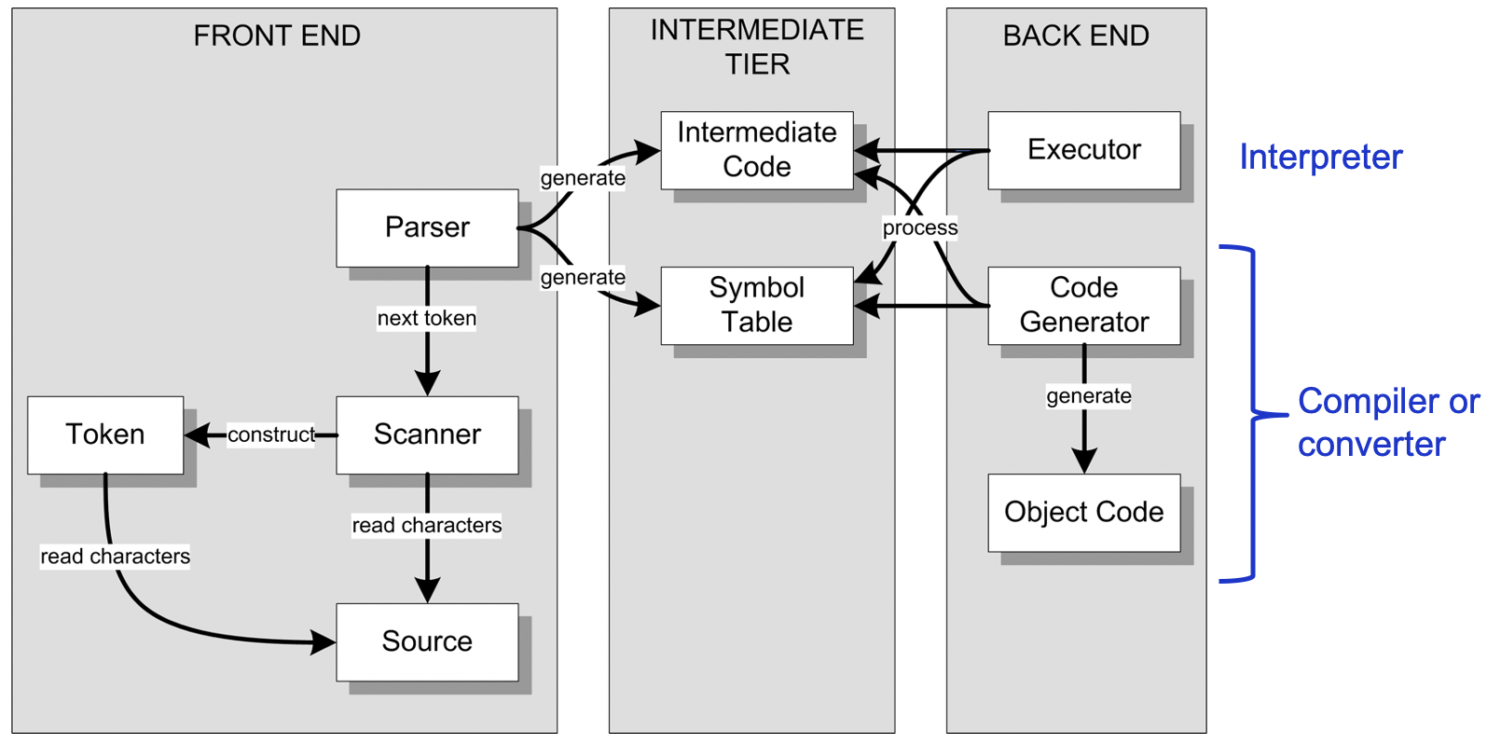
Backend Converter
Create a different set of visit methods than the set for the interpreter’s class Executor.
Keep the set of visit methods for class Semantics.

Slide 10
Conversion to a Different Language
Pascal source program ➔ parse tree
Perform the usual semantic checks.
Then parse tree ➔ Java program
In the visit methods, instead of performing the action (i.e., executing a statement or evaluating an expression), emit the equivalent Java statement or expression that will perform that action.

Slide 11
Convert Pascal’s REPEAT Statement
Pascal:
Java:
REPEAT
i := i + 1;
writeln('#', i:1, ': Hello, world!')
UNTIL i = 5
do
{
i = i + 1;
System.out.printf("#%1d: Hello, world!\n", i);
}
while (!(i == 5));

Slide 12
Convert Pascal’s REPEAT Statement, cont’d
public Object visitRepeatStatement(PascalParser.RepeatStatementContext ctx)
{
boolean needBraces = ctx.statementList().statement().size() > 1;
code.emit("do");
if (needBraces) code.emitLine("{");
code.indent();
visit(ctx.statementList());
code.dedent();
if (needBraces) code.emitLine("}");
code.emitStart("while (!(");
code.emit((String) visit(ctx.expression()));
code.emitEnd("));");
return null;
}
do
{
i = i + 1;
System.out.printf("#%1d: Hello, world!\n", i);
}
while (!(i == 5));
Converter.java

Slide 13
Convert Pascal’s Assignment Statement
Converter.java
public Object visitAssignmentStatement(
PascalParser.AssignmentStatementContext ctx)
{
String lhs = (String) visit(ctx.lhs().variable());
String expr = (String) visit(ctx.rhs().expression());
code.emit(lhs + " = " + expr);
code.emitEnd(";");
return null;
}
Backend code generation methods.
Example:
public void emit(String code)
{
objectFile.print(code);
objectFile.flush();
length += code.length();
needLF = true;
}
CodeGenerator.java

Slide 14
Pascal ➔ Java Conversion
public class TestRepeat
{
private static java.util.Scanner _sysin = new java.util.Scanner(System.in);
private static int i;
private static int j;
public static void main(String[] args)
{
java.time.Instant _start = java.time.Instant.now();
i = 1;
do
{
System.out.printf("i = %d\n", i);
i = i + 1;
}
while (!(i > 5));
System.out.println();
i = 1;
do
{
j = 10;
do
{
System.out.printf("i = %d, j = %d\n", i, j);
j = j + 10;
}
while (!(j > 30));
i = i + 1;
}
while (!(i > 2));
java.time.Instant _end = java.time.Instant.now();
long _elapsed = java.time.Duration.between(_start, _end).toMillis();
System.out.printf("\n[%,d milliseconds execution time.]\n", _elapsed);
}
}
TestRepeat.pas
PROGRAM TestRepeat;
VAR
i, j : integer;
BEGIN
i := 1;
REPEAT
writeln('i = ', i);
i := i + 1;
UNTIL i > 5;
writeln;
i := 1;
REPEAT
j := 10;
REPEAT
writeln('i = ', i, ', j = ', j);
j := j + 10
UNTIL j > 30;
i := i + 1
UNTIL i > 2;
END.
TestRepeat.java

Slide 15
Assignment #5: Converter
Complete the Pascal ➔ Java converter:
WHILE statements (TestWhile.pas)
IF statements (TestIf.pas)
FOR statements (TestFor.pas)
CASE statements (TestCase.pas)
procedure definitions and calls (TestProcedure.pas)
function definitions and calls (Newton3.pas)
Start with Asgn05.zip.
Run the generated Java programs and produce similar runtime output that the Pascal interpreter produces.

Slide 16
Target Machines
A compiler’s backend code generator produces object code for a target machine.
Target machine: Java Virtual Machine (JVM)
Object language: Jasmin assembly language
The Jasmin assembler translates assembly language programs into binary .class files.
The JVM loads and executes .class files.

Slide 17
Target Machines, cont’d
Instead of using javac to compile a source program written in Java into a .class file ...
Use your compiler to compile a source program written in your chosen language into a Jasmin object program.
Then use the Jasmin assembler to create the .class file.

Slide 18
Target Machines, cont’d
No matter what language the source program was originally written in, once it’s been compiled into a .class file, the JVM will be able to load and execute it.
The JVM runs on a wide variety of hardware platforms.

Slide 19
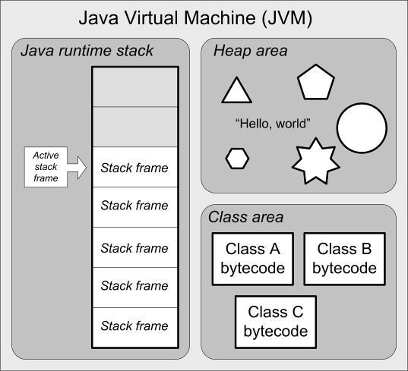
Java Virtual Machine (JVM) Architecture
Java runtime stack
stack frames
Heap area
dynamically allocated objects
automatic garbage collection
Class area
code for methods
constants pool
Native method stacks
support native methods, e.g., written in C
(not shown)

Slide 20
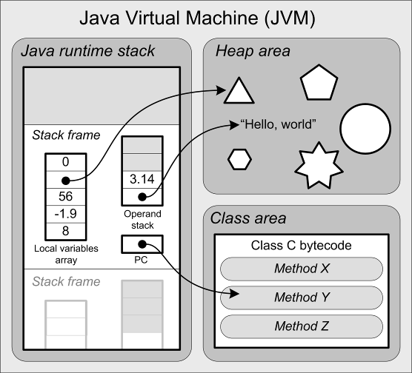
Java Virtual Machine Architecture, cont’d
The runtime stack contains stack frames.
Each stack frame contains:
local variables array
operand stack
program counter (PC)
What is missing in the JVM
that we had in our
Pascal interpreter?

Slide 21
The JVM’s Java Runtime Stack
Each method invocation pushes a stack frame.
The stack frame currently on top of the runtime stack is the active stack frame.
A stack frame is popped off when the method returns, possibly leaving behind a return value on top of the caller’s operand stack.

Slide 22
Stack Frame Contents
Operand stack
For doing computations.
Local variables array
Equivalent to the memory map in our interpreter’s stack frame.
Program counter (PC)
Keeps track of the currently executing instruction.
Automatically managed, so we don’t have to worry about this.

Slide 23
JVM Instructions
Load and store values
Arithmetic operations
Type conversions
Object creation and management
Runtime stack management (push/pop values)
Branching
Method call and return
Throwing exceptions
Concurrency

Slide 24
Jasmin Assembler
Download from:
http://jasmin.sourceforge.net/
Site also includes:
User Guide
Instruction set
Sample programs

Slide 25
Example Jasmin Program
.class public HelloWorld
.super java/lang/Object
.method public static main([Ljava/lang/String;)V
.limit stack 2
.limit locals 1
getstatic java/lang/System/out Ljava/io/PrintStream;
ldc " Hello, world!"
invokevirtual java/io/PrintStream/println(Ljava/lang/String;)V
return
.end method
hello.j
Assemble:
jasmin hello.j
Execute:
java HelloWorld
jasmin.sh
#!/bin/bash
java -jar /Users/rmak/Java/jasmin-2.4/jasmin.jar $1
Demo

Slide 26
Jasmin Assembly Instructions
A Jasmin instruction consists of a mnemonic optionally followed by arguments.
Example:
ldc 2 ; Push the constant 2 onto the operand stack
Reference: The Java Virtual Machine Instruction Set https://docs.oracle.com/javase/specs/jvms/se7/html/jvms-6.html

Slide 27
Jasmin Assembly Instructions, cont’d
Some instructions require operands on the operand stack.
Examples:
iadd ; Pop the two integer values on top of the ; operand stack, add them, and push the result
; back onto the operand stack
if_icmpeq L004 ; Pop the two integer values on top of
; operand stack, compare them, and then
; branch to label L004 if they're equal

Slide 28
Jasmin Assembly Instructions, cont’d
The JVM (and Jasmin) supports five basic datatypes:
int
long
float
double
reference
Examples:
Long and double values each requires two consecutive entries in the local variables array and two elements on the operand stack.
Letter | Type
a | reference
b | byte or boolean
c | char
d | double
f | float
i | int
l | long
s | short
isub ; integer subtraction fmul ; float multiplication
Byte, boolean, char, and short are treated as ints on the operand stack and in the local variables array.

Slide 29
Loading Constants onto the Operand Stack
Use the instructions ldc and ldc2_w (load constant and load double-word constant) to push constant values onto the operand stack of the active stack frame (the one currently on top of the runtime stack).
Examples:
ldc 2 ldc "Hello, world” ldc 1.0 ldc2_w 1234567890L ldc2_w 2.7182818284D aconst_null ; push null
2-word long integer
2-word double

Slide 30
Shortcuts for Loading Constants
Special shortcuts for loading certain small values of constant x: iconst_m1 ; Push int -1 iconst_x ; Push int x, x = 0, 1, 2, 3, 4, or 5 lconst_x ; Push long x, x = 0 or 1 fconst_x ; Push float x, x = 0, 1, or 2 dconst_x ; Push double x, x = 0 or 1 bipush x ; Push byte x, -128 <= x <= 127 sipush x ; Push short x, -32,768 <= x <= 32,767
Shortcut instructions take up less memory and can execute faster.
Smaller operand, or no separate operand at all.

