Slide 1
CS 153: Concepts of Compiler Design September 15 Class Meeting
Department of Computer Science San Jose State University Fall 2023 Instructor: Ron Mak
www.cs.sjsu.edu/~mak

Slide 2
The antlr4 Alias
export ANTLR_JAR="$HOME/ANTLR4.13.0/antlr-4.13.0-complete.jar"
export CLASSPATH="$CLASSPATH:$ANTLR_JAR"
alias antlr4="java -jar $ANTLR_JAR -visitor -no-listener"
alias grun='java org.antlr.v4.gui.TestRig'
antlr4 Expr.g4
grun Expr program –gui input.txt
Equivalent to:
Windows .bat files:
java -jar /Users/rmak/ANTLR4.13.0/antlr-4.13.0-complete.jar -visitor -no-listener Expr.g4
java org.antlr.v4.gui.TestRig Expr program -gui input.txt
antlr4.bat
java -jar C:\ANTLR4.13.0\antlr-4.13.0-complete.jar -visitor -no-listener %1
grun.bat
java -cp .;C:\ANTLR4.13.0\antlr-4.13.0-complete.jar org.antlr.v4.gui.TestRig %1 %2 %3 %4

Slide 3
What Does ANTLR Do for Us?
Generate a lexer (scanner) based on the token specifications (regular expressions) in the grammar file.
Generate a parser based on the production rules in the grammar file.
Create graphical parse trees from the grammar and source files.
Generate visit interfaces and default visit methods for the back end.
Expr.g4
ExprLexer
ExprParser
ExprVisitor
ExprBaseVisitor

Slide 4
The ANTLR Eclipse Plug-In
Create graphical syntax diagrams from the grammar file.
Create graphical parse trees from the grammar and source files.
Demo

Slide 5
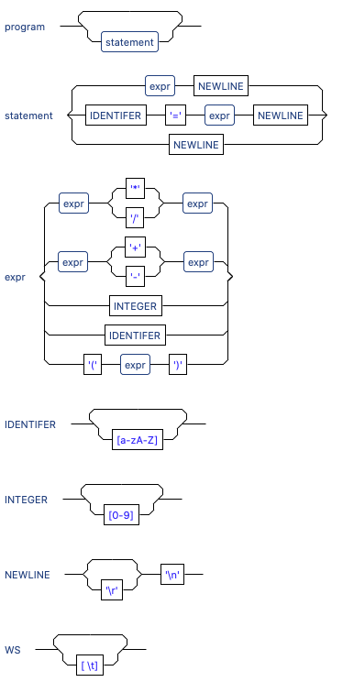
Syntax Diagrams (Eclipse Plugin)

Slide 6
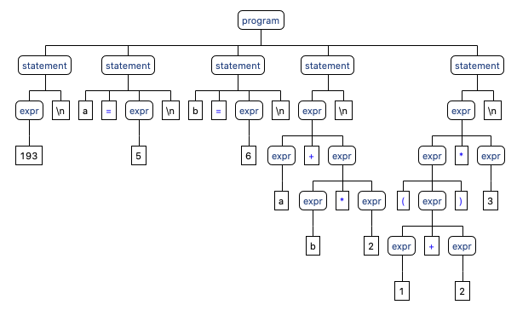
Parse Tree (Eclipse Plugin)

Slide 7
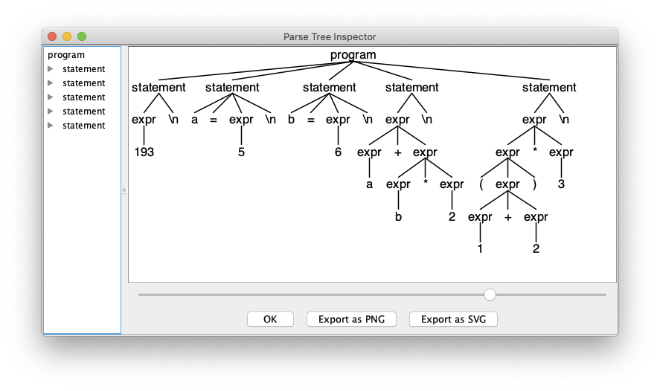
Parse Tree (Command Line)
alias grun='java org.antlr.v4.gui.TestRig'
grun Expr program -gui input.txt
grun is a Java program that
provides a main for the
generated lexer and parser.

Slide 8
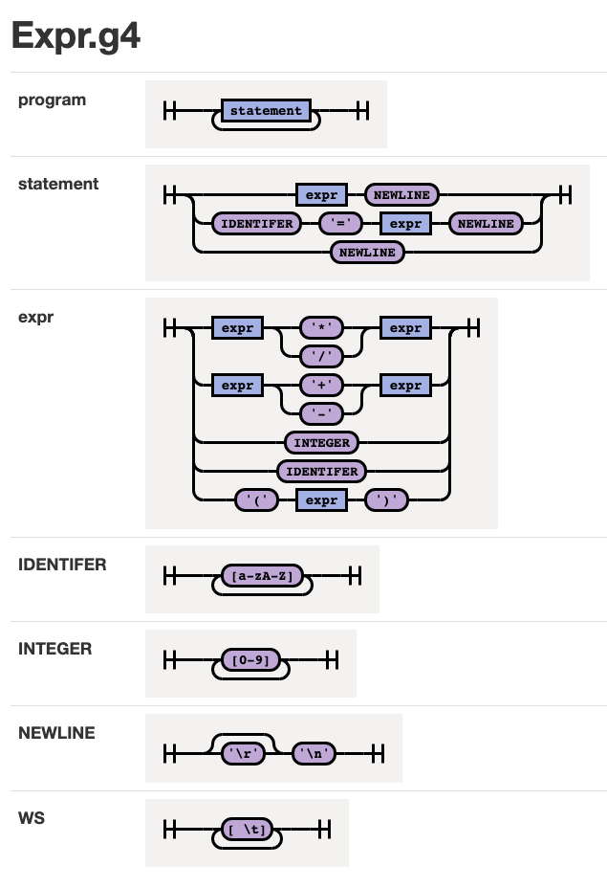
Syntax Diagrams (Command Line)
java -jar rrd-antlr4-0.1.2.jar Expr.g4
https://github.com/bkiers/rrd-antlr4
Demo

Slide 9
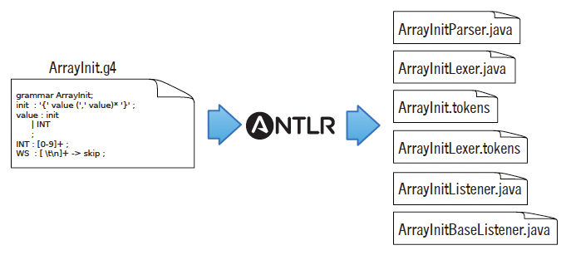
ANTLR Workflow
Generate compiler components based on the .g4 grammar file:
Use the generated components on a source file:
The Definitive ANTLR 4 Reference
by Terence Parr
The Pragmatic Programmers, 2012

Slide 10
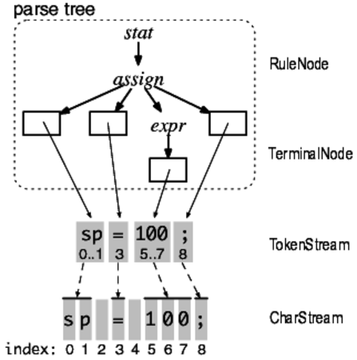
ANTLR Parse Trees
A token stream is the “pipe” between the lexer and the parser.
Each token object records the start and stop character indexes in the character stream.
The Definitive ANTLR 4 Reference
by Terence Parr
The Pragmatic Programmers, 2012

Slide 11
ANTLR Parse Trees, cont’d
ANTLR generates a RuleNode subclass for each grammar rule.
They are called context objects because they record everything about the recognition phase of a rule.
The Definitive ANTLR 4 Reference
by Terence Parr
The Pragmatic Programmers, 2012

Slide 12
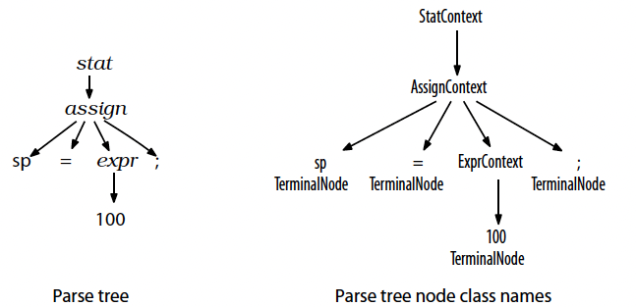
ANTLR Parse Trees, cont’d
The ANTLR-generated parser has corresponding parse tree node class names.
The Definitive ANTLR 4 Reference
by Terence Parr
The Pragmatic Programmers, 2012

Slide 13
Syntax Error Handling
An ANTLR-generated parser has basic syntax error handling and recovery.
You can improve the error handling.
193
a = 5
b = 6
(a+b*2
(1+2)*3
Parse tree (Lisp format):
(prog
(stat (expr 193) \n)
(stat a = (expr 5) \n)
(stat b = (expr 6) \n)
(stat (expr ( (expr (expr a) + (expr (expr b) * (expr 2))) <missing ')'>) \n)
(stat (expr (expr ( (expr (expr 1) + (expr 2)) )) * (expr 3)) \n))
line 4:6 missing ')' at '\n'

Slide 14
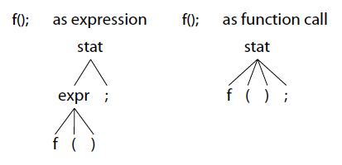
Resolving Ambiguities
Is f() a function call as a standalone statement, or a function call in an expression?
stat: expr ';'
| ID '(' ')' ';'
;
expr: ID '(' ')'
| INT
;
The Definitive ANTLR 4 Reference
by Terence Parr
The Pragmatic Programmers, 2012

Slide 15
Resolving Ambiguities, cont’d
Is begin a reserved word or an identifier?
ANTLR resolves an ambiguity by choosing the first alternative in the grammar.
BEGIN : 'begin' ;
ID : [a-z]+ ;

Slide 16
The Visitor Interface
We want ANTLR to generate the visitor interface for our back end.
By default, it generates the listener interface which we won’t use in this class.

Slide 17
The Visitor Interface, cont’d
Specify “visitor” and “no listener” when you run ANTLR to generate components.
Command line:
alias antlr4="java -jar $ANTLR_JAR -visitor -no-listener"
ANTLR-ExprTestJava: antlr4 Expr.g4
ANTLR-ExprTestJava: ls
Expr.g4 ExprLexer.interp ExprParser.java
Expr.interp ExprLexer.java ExprVisitor.java
Expr.tokens ExprLexer.tokens error.txt
ExprBaseVisitor.java ExprMain.java input.txt

Slide 18
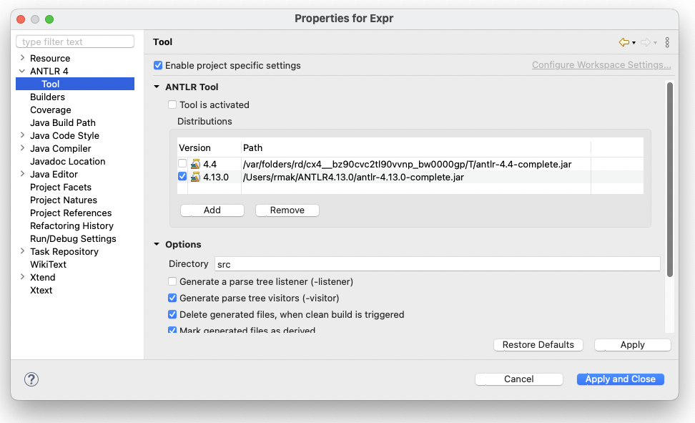
The Visitor Interface, cont’d
Specify “visitor” and “no listener” when you run ANTLR to generate components.
Eclipse (project properties):
NOTE: You may need to reset these properties each time you restart Eclipse or switch to this workspace.

Slide 19
Interface ExprVisitor
grammar Expr;
program: statement+ ;
statement : expr NEWLINE
| IDENTIFER '=' expr NEWLINE
| NEWLINE
;
expr : expr ('*'|'/') expr
| expr ('+'|'-') expr
| INTEGER
| IDENTIFER
| '(' expr ')'
;
Expr.g4
ExprVisitor.java
// Generated from Expr.g4 by ANTLR 4.13.0
import org.antlr.v4.runtime.tree.ParseTreeVisitor;
/**
* This interface defines a complete generic visitor for a parse tree produced
* by {@link ExprParser}.
*
* @param <T> The return type of the visit operation. Use {@link Void} for
* operations with no return type.
*/
public interface ExprVisitor<T> extends ParseTreeVisitor<T>
{
T visitProgram(ExprParser.ProgramContext ctx);
T visitStatement(ExprParser.StatementContext ctx);
T visitExpr(ExprParser.ExprContext ctx);
}
You can think of each ctx as
a pointer to a parse tree node
of a particular type.

Slide 20
The Base Visitor Class ExprBaseVisitor
// Generated from Expr.g4 by ANTLR 4.13.0
import org.antlr.v4.runtime.tree.AbstractParseTreeVisitor;
/**
* This class provides an empty implementation of {@link ExprVisitor},
* which can be extended to create a visitor which only needs to handle a subset
* of the available methods.
*
* @param <T> The return type of the visit operation. Use {@link Void} for
* operations with no return type.
*/
public class ExprBaseVisitor<T> extends AbstractParseTreeVisitor<T>
implements ExprVisitor<T>
{
@Override public T visitProgram(ExprParser.ProgramContext ctx)
{
return visitChildren(ctx);
}
@Override public T visitStatement(ExprParser.StatementContext ctx)
{
return visitChildren(ctx);
}
@Override public T visitExpr(ExprParser.ExprContext ctx)
{
return visitChildren(ctx);
}
}
ExprBaseVisitor.java

Slide 21
The Base Visitor Class, cont’d
Each default visit method for each node in the base visitor class ExprBaseVisitor simply visits the node’s children.
If the node has no children, then nothing happens.
All that the default methods together accomplish is to visit each node of the tree and do nothing else.
Therefore, to do real work in the back end, we must create a subclass of ExprBaseVisitor where we override the default visit methods.
ANTLR has created a framework for our back end.

Slide 22
The Base Visitor Class, cont’d
ANTLR generated a separate visit method for each production rule:
visitProgram
visitStatement
visitExpr
But that’s too “coarse” since some rules have multiple options:
Expr.g4
grammar Expr;
program: statement+ ;
statement : expr NEWLINE
| IDENTIFER '=' expr NEWLINE
| NEWLINE
;
expr : expr ('*'|'/') expr
| expr ('+'|'-') expr
| INTEGER
| IDENTIFER
| '(' expr ')'
;

Slide 23
Labeled Production Rules
Add a # label to each rule option and rerun ANTLR to generate a new parser:
ExprLabeled.g4
grammar ExprLabeled;
program: statement+ ;
statement : expr NEWLINE # print
| IDENTIFER '=' expr NEWLINE # assign
| NEWLINE # empty
;
expr : expr ('*'|'/') expr # mulDiv
| expr ('+'|'-') expr # addSub
| INTEGER # int
| IDENTIFER # id
| '(' expr ')' # parens
;
These are labels,
not comments!

Slide 24
Interface ExprLabeledVisitor
program: statement+ ;
statement : expr NEWLINE # print
| IDENTIFER '=' expr NEWLINE # assign
| NEWLINE # empty
;
expr : expr ('*'|'/') expr # mulDiv
| expr ('+'|'-') expr # addSub
| INTEGER # int
| IDENTIFER # id
| '(' expr ')' # parens
;
ExprLabeled.g4
ExprLabeledVisitor.java
// Generated from ExprLabeled.g4 by ANTLR 4.13.0
import org.antlr.v4.runtime.tree.ParseTreeVisitor;
public interface ExprLabeledVisitor<T> extends ParseTreeVisitor<T>
{
T visitProgram(ExprLabeledParser.ProgramContext ctx);
T visitPrint(ExprLabeledParser.PrintContext ctx);
T visitAssign(ExprLabeledParser.AssignContext ctx);
T visitEmpty(ExprLabeledParser.EmptyContext ctx);
T visitParens(ExprLabeledParser.ParensContext ctx);
T visitAddSub(ExprLabeledParser.AddSubContext ctx);
T visitId(ExprLabeledParser.IdContext ctx);
T visitInt(ExprLabeledParser.IntContext ctx);
T visitMulDiv(ExprLabeledParser.MulDivContext ctx);
}
Having more visit methods gives you greater flexibility and control when you walk the parse tree.

Slide 25
Base Class ExprLabeledBaseVisitor
As before, the default implementation of each method is to visit the node’s children.
// Generated from ExprLabeled.g4 by ANTLR 4.13.0
import org.antlr.v4.runtime.tree.AbstractParseTreeVisitor;
public class ExprLabeledBaseVisitor<T> extends AbstractParseTreeVisitor<T>
implements ExprLabeledVisitor<T>
{
@Override public T visitProgram(ExprLabeledParser.ProgramContext ctx)
{
return visitChildren(ctx);
}
@Override public T visitPrint(ExprLabeledParser.PrintContext ctx)
{
return visitChildren(ctx);
}
...
}
ExprLabeledBaseVisitor.java

Slide 26
Class Executor, cont’d
statement : expr NEWLINE # print
| IDENTIFIER '=' expr NEWLINE # assign
| NEWLINE # empty
;
ExprLabeled.g4
Executor.java
@Override
public Object visitPrint(ExprLabeledParser.PrintContext ctx)
{
Object value = visit(ctx.expr()); // evaluate the expression
System.out.println(value); // print the result
return null;
}
The method call ctx.expr() on the print context ctx returns its expression context.

Slide 27
Class Executor
statement : expr NEWLINE # print
| IDENTIFIER '=' expr NEWLINE # assign
| NEWLINE # empty
;
ExprLabeled.g4
Executor.java
public class Executor extends ExprLabeledBaseVisitor<Integer>
{
// The symbol table to store runtime values (our hack).
Map<String, Integer> symtab = new HashMap<String, Integer>();
@Override
public Integer visitAssign(ExprLabeledParser.AssignContext ctx)
{
String idName = ctx.IDENTIFIER().getText();
int value = visit(ctx.expr()); // compute the expression value
symtab.put(idName, value); // store it into the symbol table
return value;
}

Slide 28
Class Executor, cont’d
expr : expr op=('*'|'/') expr # mulDiv
| expr op=('+'|'-') expr # addSub
| INTEGER # int
| IDENTIFIER # id
| '(' expr ')' # parens
;
ExprLabeled.g4
@Override
public Object visitInt(ExprLabeledParser.IntContext ctx)
{
return Integer.valueOf(ctx.INTEGER().getText()); // integer value
}
@Override
public Object visitId(ExprLabeledParser.IdContext ctx)
{
String id = ctx.IDENTIFIER().getText();
if (symtab.containsKey(id))
{
return symtab.get(id); // value from symbol table
}
else return 0; // dummy value
}
Executor.java

Slide 29
Class Executor, cont’d
expr : expr op=('*'|'/') expr # mulDiv
| expr op=('+'|'-') expr # addSub
| INTEGER # int
| IDENTIFIER # id
| '(' expr ')' # parens
;
MUL : '*' ;
DIV : '/' ;
ADD : '+' ;
SUB : '-' ;
ExprLabeled.g4
Executor.java
@Override
public Object visitMulDiv(ExprLabeledParser.MulDivContext ctx)
{
int left = (Integer) visit(ctx.expr(0)); // left child expression
int right = (Integer) visit(ctx.expr(1)); // right child expression
if (ctx.op.getType() == ExprLabeledParser.MUL) return left*right;
else return left/right;
}

Slide 30
Class Executor, cont’d
expr : expr op=('*'|'/') expr # mulDiv
| expr op=('+'|'-') expr # addSub
| INTEGER # int
| IDENTIFIER # id
| '(' expr ')' # parens
;
MUL : '*' ;
DIV : '/' ;
ADD : '+' ;
SUB : '-' ;
ExprLabeled.g4
Executor.java
@Override
public Object visitAddSub(ExprLabeledParser.AddSubContext ctx)
{
int left = (Integer) visit(ctx.expr(0)); // left child expression
int right = (Integer) visit(ctx.expr(1)); // right child expression
if (ctx.op.getType() == ExprLabeledParser.ADD) return left + right;
else return left - right;
}

Slide 31
Class Executor, cont’d
expr : expr op=('*'|'/') expr # mulDiv
| expr op=('+'|'-') expr # addSub
| INTEGER # int
| IDENTIFIER # id
| '(' expr ')' # parens
;
MUL : '*' ;
DIV : '/' ;
ADD : '+' ;
SUB : '-' ;
ExprLabeled.g4
Executor.java
@Override
public Object visitParens(ExprLabeledParser.ParensContext ctx)
{
return visit(ctx.expr()); // return parenthesized expression value
}

Slide 32
Main Class Main
ExprLabeledMain.java
import org.antlr.v4.runtime.*;
import org.antlr.v4.runtime.tree.*;
import java.io.FileInputStream;
import java.io.IOException;
public class Main
{
public static void main(String[] args)
{
...
// Create a parser which parses the token stream
// to create a parse tree.
ExprLabeledParser parser = new ExprLabeledParser(tokens);
ParseTree tree = parser.program();
// Execution.
System.out.println("Execution:");
Executor executor = new Executor();
executor.visit(tree);
}
}
Demo

