Slide 1


CS 144
Advanced C++ Programming
April 23 Class Meeting
Department of Computer Engineering
San Jose State University
Spring 2019
Instructor: Ron Mak
www.cs.sjsu.edu/~mak

Slide 2
Assignment #10. Recursion
Recursive destructor.
  Each person object recursively deletes its children.
Recursive print
  First print the person’s name and spouse.
  Then recursively print the person’s children.
Person::~Person()
{
// Recursively delete the children.
for (Person *child : children) delete child;
cout << "deleted " << name << endl;
}

Slide 3
void Person::print() const
{
if (parent != nullptr) cout << "+---";
// Print the name and the spouse's name, if any.
cout << name;
if (spouse_name.length() > 0) cout << " (" << spouse_name << ")";
cout << endl;
// Print the children, if any.
for (Person *child : children)
{
// Print any ancestors' bars.
print_bar(); cout << "|" << endl;
print_bar();
// Recursively print a child.
child->print();
}
}

Slide 4
Assignment #10, cont’d
Charles (Mary)
|
+---Susan (Bob)
| |
| +---Dick (Cindy)
| | |
| | +---Ron
| |
| +---Harry
|
+---George
|
+---Tom (Alice)
|
+---Eliza (Bud)
|
+---Emily (Carl)
| |
| +---Tim
|
+---Charlotte (Frank)
|
+---Carol
|
+---Sara
Recursively print the vertical bar emanating from a parent.
But don’t print the bar for a parent’s last child.

Slide 5
Assignment #10, cont’d
void Person::print_bar() const
{
if (parent != nullptr)
{
// Recursively print my parent's bar.
parent->print_bar();
// Am I my parent's last child?
if (this == parent->children.back()) cout << " "; // yes
else cout << "| "; // no
}
}

Slide 6
Review: Templates
A template enables the C++ compiler to generate different versions of some code,
each version of the code for a different type.
  function templates
  class templates
The C++ compiler does not generate code
from a template for a particular type unless
the program uses the template with that type.

Slide 7
Review: The Standard Template Library (STL)
The Standard Template Library (STL) is a collection of function and class templates
for various data structures, including:
  vector
  stack
  queue
  list (doubly-linked list)
  map (hash table)
  set
Example:
vector<int> v;

Slide 8
Review: Iterators
Iterators provide a uniform way to
successively access values in a data structure.
  Go through the values of a data structure one after another and perform some operation on each value.
Iterators spare you from having to know
how a data structure is implemented.
Iterators are part of the STL.
An iterator is similar to a pointer.

Slide 9
Containers
STL container classes are data structures
that hold data.
  Examples: lists, stacks, queues, vectors
Each container class has its own iterator.
  However, all the iterators have the same operators and the member functions begin and end have the same meanings.
Sequential containers arrange their values such that there is a first value, a next value, etc. until the last value.

Slide 10
The list Template Class
The STL list is a doubly linked list.
  Each element has two pointers.
  One pointer points forward to the next element
  (as in a singly linked list).
  One pointer points back to the previous element.
You can traverse the list from either direction.
Therefore, there are two pointers to maintain when inserting or deleting an element.
  The STL does this for you.

Slide 11
List and Vector
STL list functions are similar to
STL vector functions.
To append to a list: lst.push_back(value)
Forward and reverse iterators.
Insert an element before position specified by an iterator: lst.insert(pos, value)
Remove the element at a position specified by an iterator : lst.erase(pos)

Slide 12
Additional List Functions
Remove all the elements with a given value: lst.remove(value)
Merge two sorted lists: lst1.merge(lst2)
  List lst1 is the merged list.
  List lst2 is empty after the merge.
Make the list elements unique: lst.unique()
Demo

Slide 13
Hash Tables
Consider an array or a vector.
  To access a value, you use an integer index.
The array maps the index to a data value
stored in the array.
  The mapping function is very efficient.
  As long as the index value is within range,
  there is a strict one-to-one correspondence
  between an index value and a stored data value.
We can consider the index value to be the key to the corresponding data value.

Slide 14
Hash Tables, cont’d
A hash table also stores data values.
  Use a key to obtain the corresponding data value.
The key does not have to be an integer value.
  For example, the key could be a string.
There might not be a one-to-one correspondence between keys and data values.
The mapping function might not be trivial.

Slide 15
Hash Tables, cont’d
We can implement a hash table as an
array of cells.
  Refer to its size as TableSize.
If the hash table’s mapping function
maps a key value into an integer value
in the range 0 to TableSize – 1,
then we can use this integer value
as the index into the underlying array.

Slide 16
Hash Tables, cont’d
Suppose we’re storing employee data records
into a hash table.
We use an employee’s name as the key.

Slide 17
Hash Tables, cont’d
Suppose that the name
  john hashes (maps) to 3
  phil hashes to 4
  dave hashes to 6
  mary hashes to 7
This is an ideal situation because each employee record ended up in a different table cell.
Data Structures and Algorithms in Java, 3rd ed.
by Mark Allen Weiss
Pearson Education, Inc., 2012
ISBN 0-13-257627-9

Slide 18
Hash Function
We need an ideal hash function to map
each data record into a distinct table cell.
  It can be very difficult to find such a hash function.

Slide 19
A Simple Hash Function
Suppose our keys are words and the table size is 10,007 (a prime number).
Problem: This hash function does not distribute the keys well if the table is large.
  The maximum ASCII character value is 127.
  If a typical word is 8 characters long, the hash function generally has values from 0 to 1,016.
int hash(const string& word, int table_size)
{
int hashVal = 0;
for (char ch : word) hashVal += ch;
return hashVal%table_size;
}

Slide 20
Another Simple Hash Function
int hash(const string& word, int table_size)
{
return (key[0] + 27*key[1] + 729*key[2])%table_size;
}
We use only the first three letters of each word.
  27 letters in the alphabet + space
  729 = 27²
Good distribution into a table of 10,007 if the first three letters are random.
  But the English language is not random and
  many words will start with the same three letters.

Slide 21
A Better Hash Function
int hash(const string& word, int table_size)
{
unsigned int hashVal = 0;
for (char ch : word) hashVal = 37*hashVal + ch;
return hashVal%table_size;
}
Calculates a polynomial function
by nested multiplication (Horner’s rule).
Easy and fast to calculate.
Distributes the keys well into a large table.

Slide 22
Collisions
The more data we put into a hash table,
the more collisions occur.
A collision is when two or more data records
are mapped to the same table cell.
How can a hash table handle collisions?

Slide 23
Keys for Successful Hashing
Good hash function
Good collision resolution
Size of the underlying array a prime number

Slide 24
Collision Resolution
Separate chaining
Open addressing
  Linear probing
  Quadratic probing

Slide 25
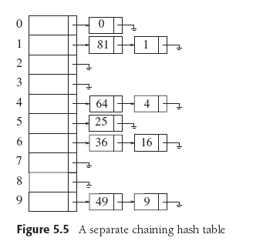
Collision Resolution: Separate Chaining
Each cell in a hash table is a pointer to a linked list of all the data records that hash to that entry.
To retrieve a data record, we first hash
to the cell.
Data Structures and Algorithms in Java, 3rd ed.
by Mark Allen Weiss
Pearson Education, Inc., 2012
ISBN 0-13-257627-9

Slide 26
Collision Resolution: Separate Chaining, cont’d
Then we search the associated linked list
for the data record.
We can sort the linked lists to improve search performance.
Data Structures and Algorithms in Java, 3rd ed.
by Mark Allen Weiss
Pearson Education, Inc., 2012
ISBN 0-13-257627-9

Slide 27
Collision Resolution: Open Addressing
Does not use linked lists.
All the data resides in the table.
When a collision occurs,
try a different table cell.
We will consider two types of open addressing:
  linear probing
  quadratic probing

Slide 28
Collision Resolution: Linear Probing
Try in succession h₀(x), h₁(x), h₂(x), …
h_{i}(x) = (hash(x) + f(i)) mod TableSize, with f(0) = 0
      hash(x) produces the home cell.
Function f is the collision resolution strategy.
With linear probing, f is a linear function of i,
typically, f(i) = i

Slide 29
Collision Resolution: Linear Probing, cont’d
Insertion
  If a cell is filled, look for the next empty cell.
Search
  Start searching at the home cell, keep looking at the next cell until you find the matching key is found.
  If you encounter an empty cell, there is no key match.
Deletion
  Empty cells will prematurely terminate a search.
  Leave deleted items in the hash table but
  mark them as deleted.

Slide 30
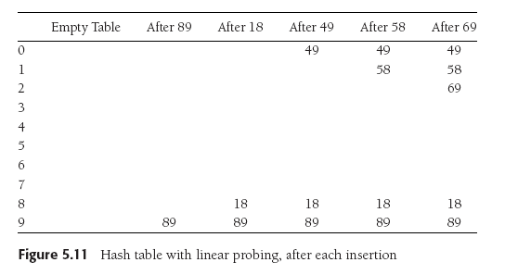
Collision Resolution: Linear Probing, cont’d
Suppose TableSize is 10, the keys are integer values, and the hash function is the key value modulo 10.
  We want to insert keys 89, 18, 49, 58, and 69.
Data Structures and Algorithms in Java, 3rd ed.
by Mark Allen Weiss
Pearson Education, Inc., 2012
ISBN 0-13-257627-9

Slide 31
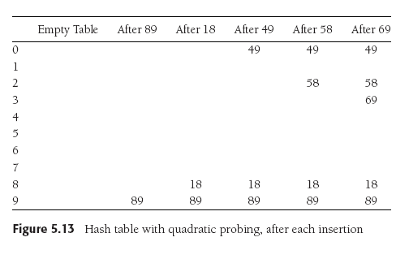
Collision Resolution: Quadratic Probing
Linear probing causes primary clustering.
Try quadratic probing instead: f(i) = i².
49 collides with 89:
the next empty cell
is 1 away.
58 collides with 18:
the next cell is filled.
Try 2² = 4 cells away
from the home cell.
Same for 69.
Data Structures and Algorithms in Java, 3rd ed.
by Mark Allen Weiss
Pearson Education, Inc., 2012
ISBN 0-13-257627-9

Slide 32
Collision Resolution: Quadratic Probing, cont’d
Try quadratic probing instead: f(i) = i².
i² is easy to compute, for i = 0, 1, 2, ...
1 = 1²
1 + 3 = 4 = 2²
1 + 3 + 5 = 9 = 3²
1 + 3 + 5 + 7 = 16 = 4²
…

Slide 33
Load Factor
The load factor λ of a hash table is the ratio of the number of elements in the table to the table size.
  λ is much more important than table size.
For probing collision resolution strategies,
it is important to keep λ under 0.5.
  Don’t let the table become more than half full.
If quadratic probing is used and the table size
is a prime number, then a new element can always be inserted if the table is at most half full.

Slide 34
Assignment #11. STL Vector, List, and Map
Time and compare the performance of
the following operations on an STL vector
STL list, and an STL map:
  inserting elements
  searching for elements
  accessing the i ^{th} element
  deleting elements
Use std::chrono::steady_clock
to calculate elapsed time.

Slide 35
Assignment #11, cont’d
Read a file containing the text of the U.S. Constitution and its amendments.
  http://www.cs.sjsu.edu/~mak/CS144/assignments/11/USConstitution.txt
Build concordance tables implemented as a vector, a linked list, and a map.
  Each table contains in alphabetical order all the unique words of the constitution.
  Associated with each word is the number of times that word appears.
  To make string comparisons case insensitive,
  store each word in all lower case.

Slide 36
Assignment #11, cont’d
Because the vector is sorted and random access is possible, use a binary search.
The STL map uses an efficient hash function.
What about the linked list?
Which data structure is best for insertions and deletions? For searching?

