Slide 1
CMPE 226 Database Systems May 2 Class Meeting
Department of Computer Engineering San Jose State University Spring 2017 Instructor: Ron Mak
www.cs.sjsu.edu/~mak

Slide 2
Remaining Weeks!
April 25
NoSQL databases
May 2 (today)
Data visualization and the Cisco Information Server
Data mining
May 9 and May 16
Team project presentations
May 17
Team projects due
May 23
Final exam

Slide 3
Final Project
Put your emphasis on data management.
How you manage the data are you are using.
Data models:
Operational tables
Analytical tables
Data operations:
Queries and updates of the operational tables.
How the analytical tables are loaded.
Queries of the analytical tables for data analysis.

Slide 4
Final Project, cont’d
A user application that invokes the data operations.
Web-based or desktop-based.
PHP, Java, etc.
Fancy GUI or data visualization not necessary.
How well did you use the technologies you learned during the semester?
RDBM, DW, XML, NoSQL, data virtualization (CIS)
Not all technologies have to be used.

Slide 5
Final Project, cont’d
Written report
What is the application?
What data did you use, and where did you get it?
Overview of your data models (in words).
ER diagram
Relational schemas
Star schemas
Example user actions and screen shots of results.

Slide 6
Team Presentations
PowerPoint talk.
What is the application?
What data did you use? Where did you get it?
Overview of your data models (in words).
Briefly show and explain the highlights of:
ER diagram
Relational schemas
Star schemas
Demo
Maximum
15 minutes
per team.

Slide 7
Presentation Schedule
May 9
May 16
ACID
Fancy Coders
Spartans
Team Ultimate
Star Schema
Infinite
DBtarians
Data Miners
Forkhead
SQL Ninjas
Team Longshot
Team 666
No Brainers
Deadlock
Teams can trade days!

Slide 8
Data Virtualization
An approach to data management that allows an application to retrieve and manipulate data without requiring technical details about the data, such as how it is formatted or where it is physically located.
An agile data integration approach that organizations use to gain more insight from their data, respond faster to ever changing analytics and BI needs and save 50-75% over data replication and consolidation.
https://en.wikipedia.org/wiki/Data_virtualization
http://www.compositesw.com/data-virtualization/

Slide 9
Data Virtualization, cont’d
Differs from traditional ETL.
The original data remains in place.
A real-time process accesses the data sources.
Reduces the risk of data errors.
Reduces the workload of extracting, transforming, and loading data that may never be used by an application.
Provides applications a “virtual view” of the data.
Applications can treat the disparate and heterogeneous data as a single relational database.

Slide 10
Data Virtualization Functionality
Abstraction
Abstract the technical aspects of stored data, such as location, storage structure, API, access language, and storage technology.
Virtualized data access
Connect to different data sources and make them accessible from a common logical data access point.
Transformation
Transform, improve quality, reformat, etc. source data for consumer use.
https://en.wikipedia.org/wiki/Data_virtualization

Slide 11
Data Virtualization Functionality, cont’d
Data federation
Combine result sets from across multiple source systems.
Data delivery
Publish result sets as views and/or data services executed by client applications or users when requested.
https://en.wikipedia.org/wiki/Data_virtualization

Slide 12
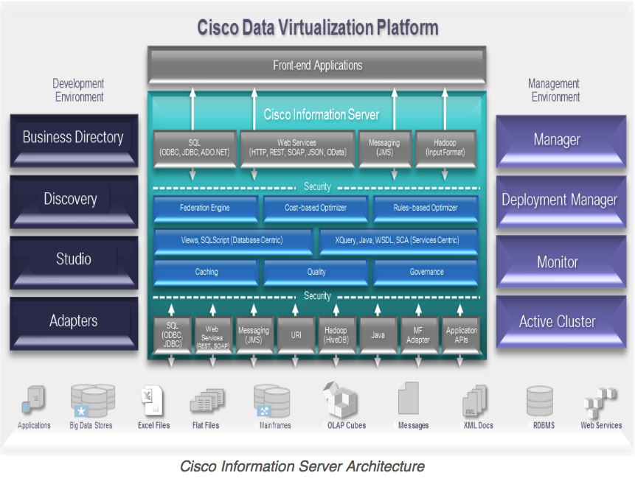
Cisco Information Server (CIS)
The Cisco Information Server (CIS) forms the core of the Cisco Data Virtualization Platform.
http://www.compositesw.com/data-virtualization/

Slide 13
Install the CIS Studio
Studio is the client-side application that connects to the CIS server.
As delivered, it runs only on Windows.
A student has enabled it to run on Mac and Linux.
Download and install Studio.
See http://www.cs.sjsu.edu/~mak/CMPE226/CIS7.0.4/
“Cisco Information Server and Studio” contains both the CIS server and the client Studio app.
Install only Studio.
See the Installation Guide.

Slide 14
CIS Team Accounts
Each team has a CIS account.
Same team username and password as your MySQL account.
On the server, CIS is installed in /opt/Cisco_Systems/CIS_7.0

Slide 15
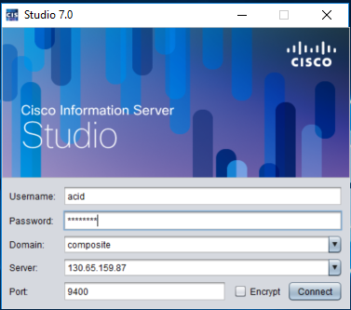
Logging into CIS
To log in, start the client-side Studio application.
Domain: composite
Server: 130.65.159.87
Port: 9400

Slide 16
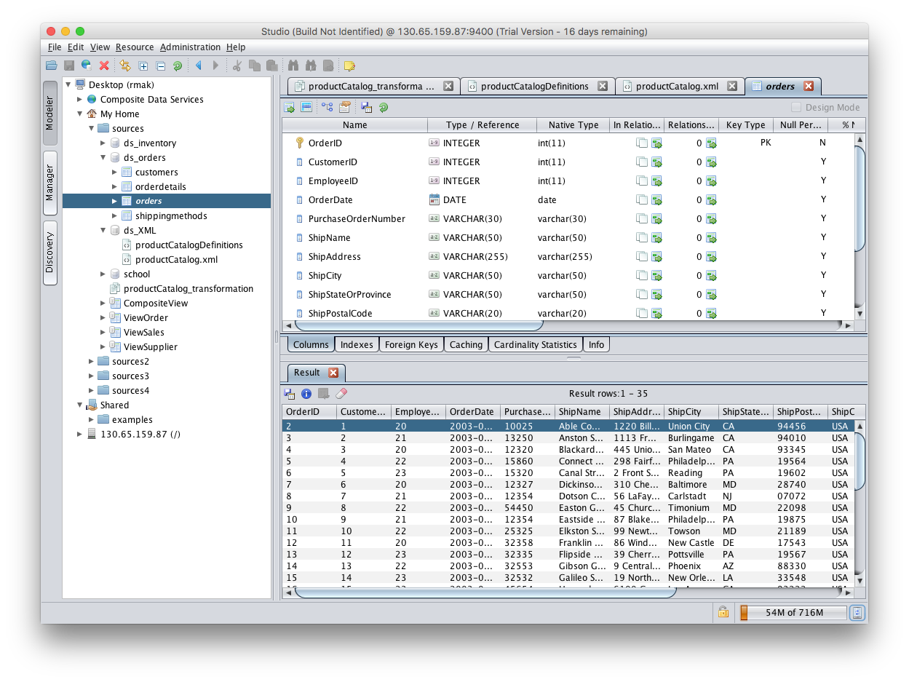
Browse Database Sources

Slide 17
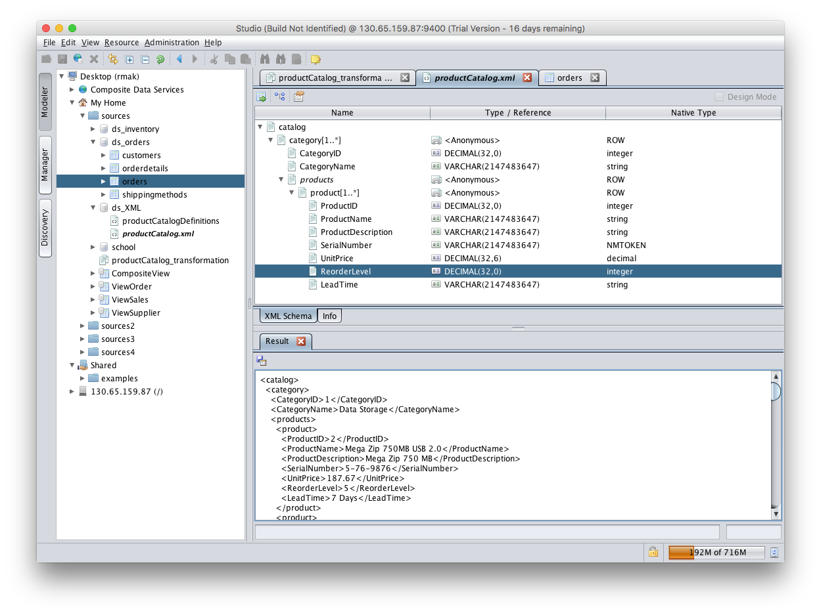
Browse XML Data Sources

Slide 18
XML Data ➔ Database Table
First define a transformation that maps an XML file to a relational database table.
Then CIS can dynamically load the XML data into the database table.

Slide 19
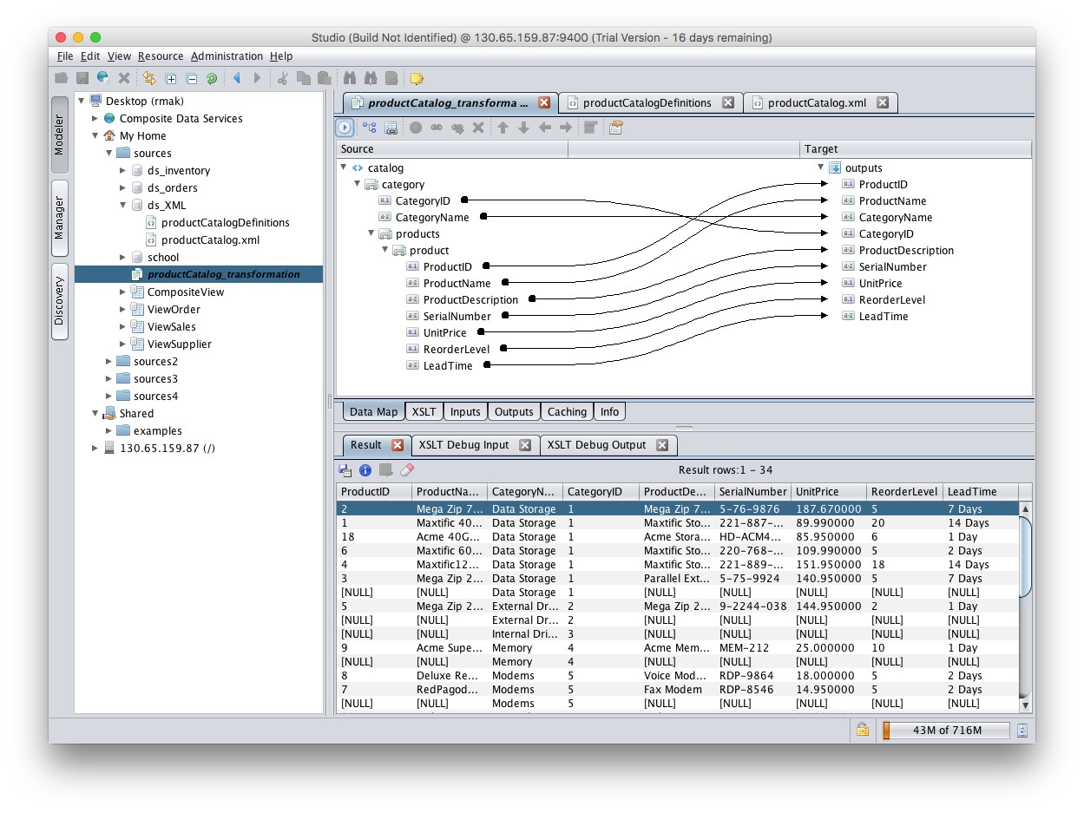
XML Data ➔ Database Table, cont’d

Slide 20
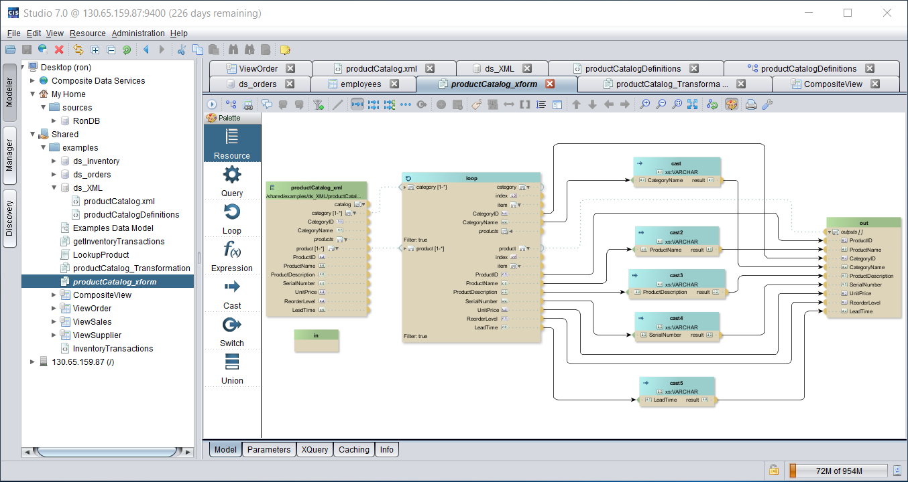
XML Data ➔ Database Table, cont’d

Slide 21
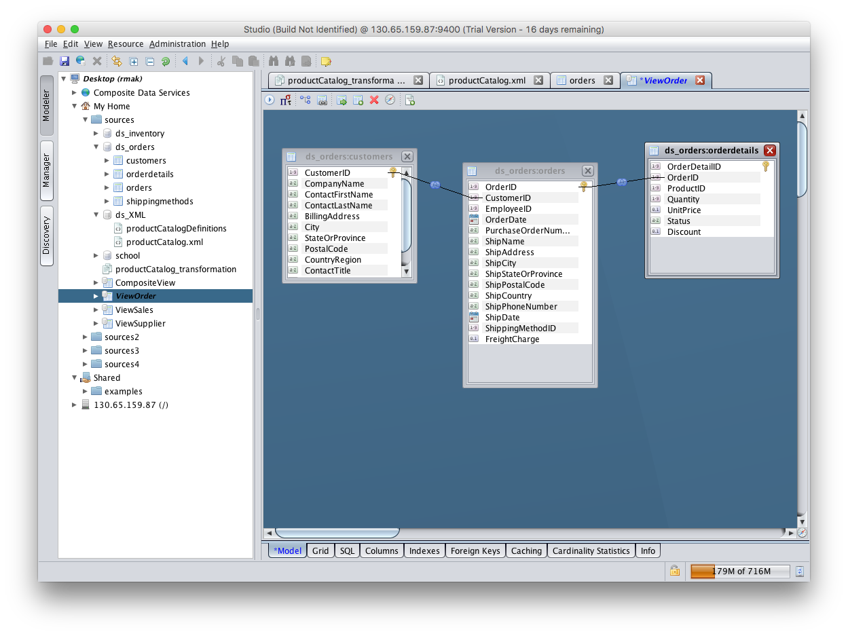
Create Views by Joining Tables

Slide 22
Publish the Results
“Publish” the transformations and views.
Applications can then access them as if they were actual relational database tables.
Cisco provides a JDBC driver for Java programs.

Slide 23
CIS and Your Projects
Try the demo described in the Getting Started Guide.
Can you find ways to use CIS in your project?

Slide 24
Assignment #10: CIS
Upload (part of) your database to 130.65.159.87 and run it on the MySQL database server.
Follow the guidelines of the CIS Getting Started Guide.
Create a sources folder in Studio under My Home

Slide 25
Assignment #10: CIS, cont’d
In your sources folder, create and introspect a MySQL 5.5 data source and connect it to your database:
Datasource name: (you choose)
Host: localhost
Port: 3306 (the standard MySQL port)
Database name: (based on your group name)
Login and password
Make a screen shot of the introspection window.

Slide 26
Assignment #10: CIS, cont’d
Make a screen shot of Studio displaying the column details and the contents of one of your database tables.
Such as the ds_orders example.

Slide 27
Assignment #10: CIS, cont’d
Upload an XML file to the server and make it a data source.
Such as the ds_XML example.
Make Studio screen shots of the XML contents and associated schema.
Create an XML data transformation and make a screen shot.
Such as the productCatalog_xform example

Slide 28
Assignment #10: CIS, cont’d
Create a view by joining two or more of your database tables (virtual or real), and make a screen shot of the table join graphic.
Such as the ViewOrder example.

Slide 29
Break

Slide 30
Data Mining
The analysis step of the overall process of “Knowledge Discovery in Databases” (KDD)
We are “data rich but information poor”.
Make predictions based on current data.
Discover (“mine”) knowledge from large data sets.
Discover patterns hidden in the data.
Two types of data mining:
descriptive
predictive
Key word:
DISCOVERY
Find something new!

Slide 31
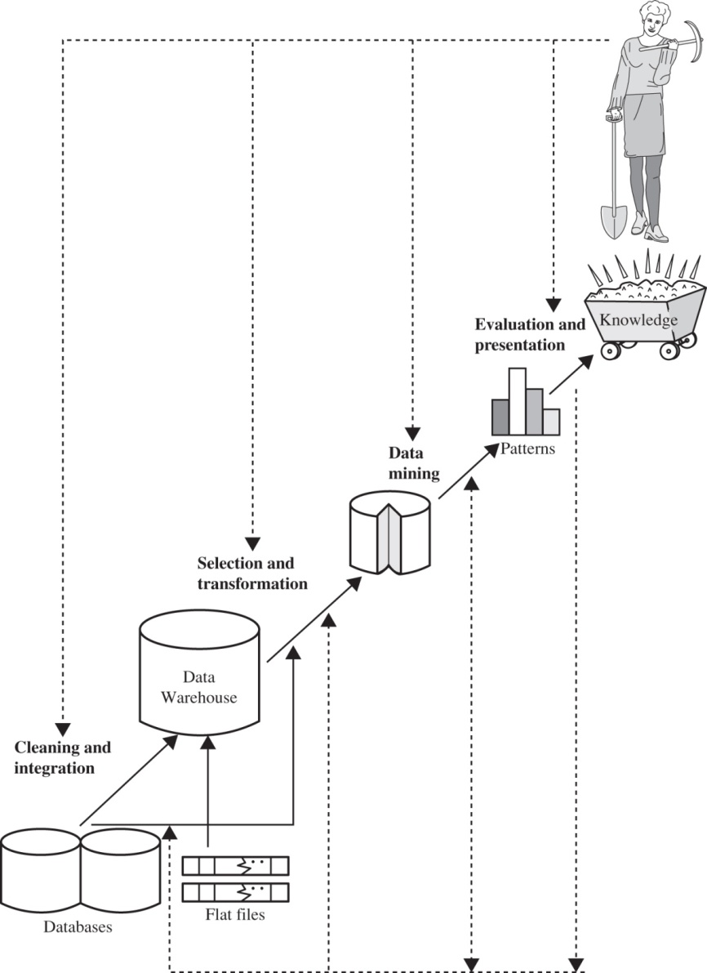
Knowledge Discovery
To be defined: knowledge
Data Mining: Concepts and Techniques
by Jiawei Han, Micheline Kamber, and Jian Pei
Elsevier, 2011

Slide 32
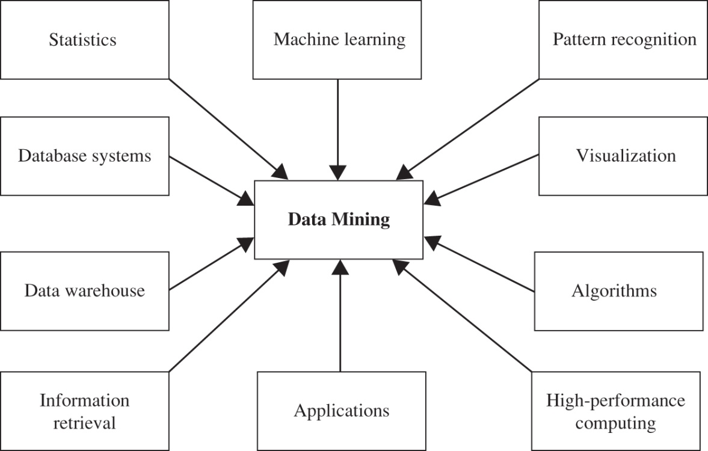
Data Mining Techniques
Integrates techniques from multiple disciplines:
database technology
statistics
machine learning (AI)
high-performance computing
pattern recognition
fuzzy set theory
neural networks
data visualization
information retrieval
knowledge representation
image and signal processing
spatial data analysis
One of the most important frontiers in database systems.
One of the most promising interdisciplinary developments in the information industry.
Data Mining: Concepts and Techniques
by Jiawei Han, Micheline Kamber, and Jian Pei
Elsevier, 2011

Slide 33
Uses of Data Mining
Market segmentation
Identify the common characteristics of customers who buy the same products from your company.
Customer churn
Predict which customers are likely to leave your company and go to a competitor.
Fraud detection
Identify which transactions are most likely to be fraudulent.
http://www.laits.utexas.edu/~anorman/BUS.FOR/course.mat/Alex/

Slide 34
Uses of Data Mining, cont’d
Direct marketing
Identify which prospects should be included in a mailing list to obtain the highest response rate.
Interactive marketing
Predict what each individual accessing a website is most likely interested in seeing.
Market basket analysis
Understand what products or services are commonly purchased together; e.g., beer and diapers.
http://www.laits.utexas.edu/~anorman/BUS.FOR/course.mat/Alex/

Slide 35
New Business Opportunities from Data Mining
Trend analysis
Reveal the difference between a typical customer this month and last.
Automated prediction of trends and behaviors
Automate the process of finding predictive information in a large database.
Questions that traditionally required extensive hands-on analysis can now be directly answered from the data.
http://www.laits.utexas.edu/~anorman/BUS.FOR/course.mat/Alex/

Slide 36
New Business Opportunities, cont’d
Automated prediction of trends and behaviors, cont’d
Example: Targeted marketing.
Use data on past promotional mailings to identify the targets most likely to maximize return on investment in future mailings.
Example: Forecast bankruptcy and other forms of default.

Slide 37
New Business Opportunities, cont’d
Automated discovery of previously unknown patterns.
Sweep through databases and identify previously hidden patterns.
Example: Analyze retail sales data to identify seemingly unrelated products that are often purchased together.
Example: Detect fraudulent credit card transactions.
Example: Identify anomalous data that could represent data entry keying errors.
http://www.laits.utexas.edu/~anorman/BUS.FOR/course.mat/Alex/

Slide 38
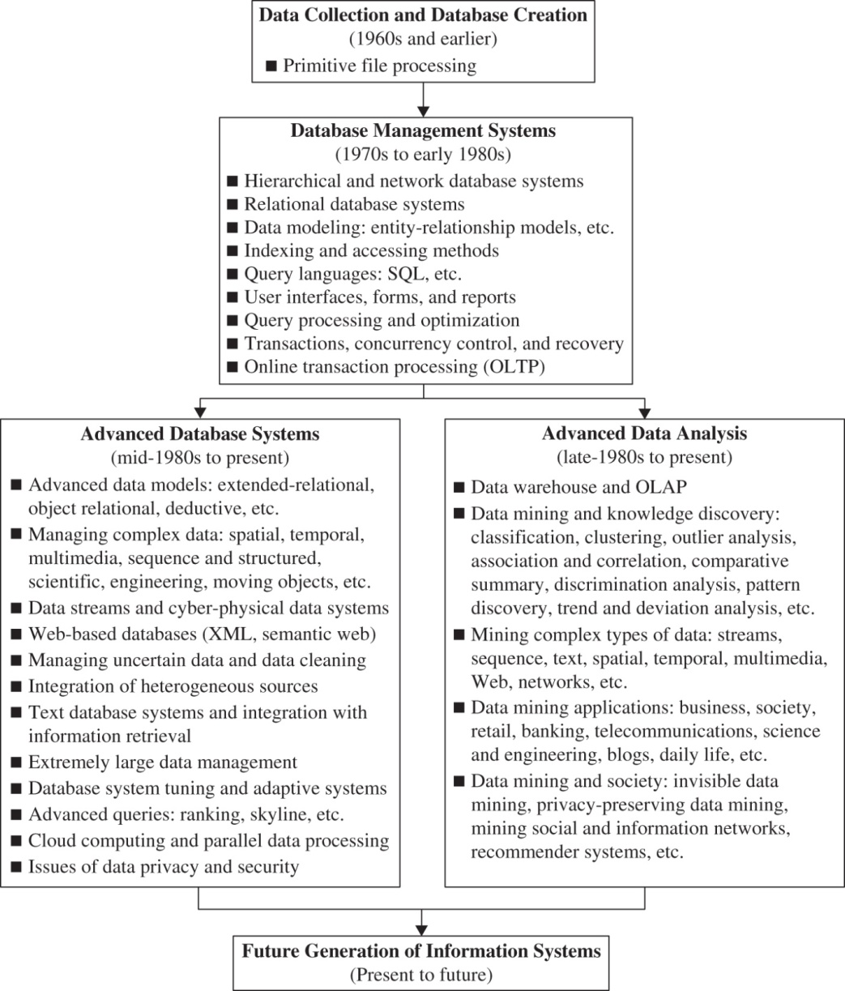
History of Data Mining
Data Mining: Concepts and Techniques
by Jiawei Han, Micheline Kamber, and Jian Pei
Elsevier, 2011

Slide 39
Types of Database Queries
“Standard” query
Extract data that’s in the database.
Example: What was the revenue from a certain product at a particular store on a given date?
OLAP
Slice, dice, drill up, drill down, pivot
Generate views using aggregation and “group by”.
Example: What revenue did we get during Q3 from our northeastern stores?

Slide 40
Types of Database Queries, cont’d
Predictive analytics (data mining)
Use statistical methods to forecast based on existing data.
Example: What are the predicted revenue figures for next quarter?
Finding patterns (data mining)
What interesting patterns exist in the data?
You may not even know ahead of time what questions to ask!

Slide 41
Data Mining Examples
Transactional data
“Market basket data analysis”
What product items sell well together?
Spatial data
What characteristics do houses have that are located near a park?
What climates are found in mountainous areas at various altitudes?
How does the poverty rate change with distance from major highways?

Slide 42
Data Mining Examples, cont’d
Temporal and time-series data
How should we schedule bank tellers based on customer volume?
What patterns are there in the price of a certain stock?
Web data
What patterns are there in path traversals?
What patterns are there in social networks?

Slide 43
Mining Patterns in Data
Characterization
Summarize the general characteristics or features of a target class of data.
Example: What is the profile of a customer who spends over $1000/year at our store?

Slide 44
Mining Patterns in Data, cont’d
Discrimination
Compare the general characteristics or features of a target class of data with those of another class of data.
Example: How do the features of software products whose sales increased by 10% last year compare with those products whose sales decreased by 10%?

Slide 45
Mining Patterns in Data, cont’d
Associations
Discover association rules among attributes and values for frequently occurring conditions.
Example: Customers aged 20-29 with incomes $30-50K/year will purchase Priuses with 60% probability.
Rules of the form X → Y
age(X, 20...29) && income(X, 30K...50K) → buys(X, Prius) confidence = 60%
Example: Amazon recommends books to you based on books you’ve previously looked at or purchased.

Slide 46
Mining Patterns in Data, cont’d
Classification and prediction
Discover a set of models that describe the classes that objects belong to.
Use the models to predict what classes objects belong to.
Implement with IF-THEN rules, decision trees, or neural networks.

Slide 47
Mining Patterns in Data, cont’d
Classification and prediction, cont’d
Example: You want to label products in your store as poor sellers, good sellers, or best sellers. Discover a model that uses a product’s characteristics, such as price, color, size, etc. to predict which label to attach to each product.

Slide 48
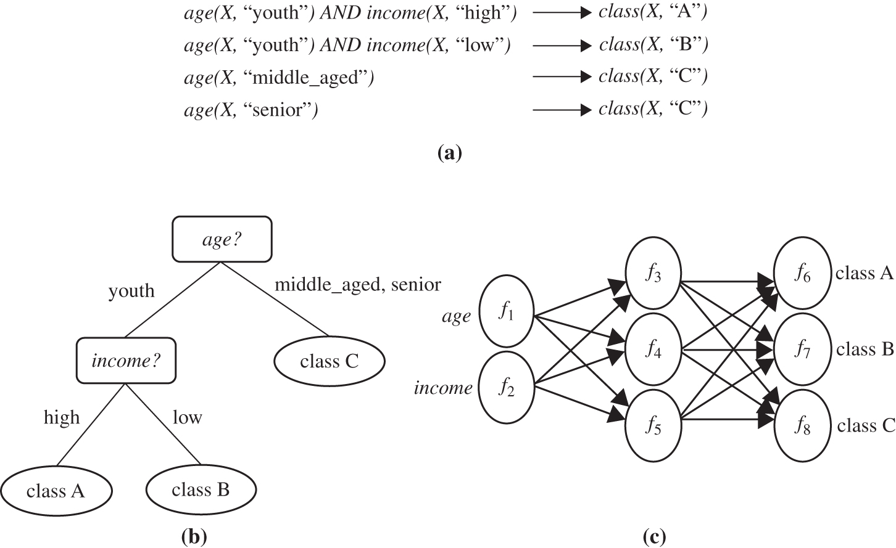
Classification
Data Mining: Concepts and Techniques
by Jiawei Han, Micheline Kamber, and Jian Pei
Elsevier, 2011
A classification model can be represented in various forms:
(a) IF-THEN rules, (b) a decision tree, or (c) a neural network.

Slide 49
Mining Patterns in Data, cont’d
Clusters
Cluster or group objects based on the principle of:
maximize intraclass similarity (similarity within a class)
minimize interclass similarity (separation between classes)
In other words, you want separate and distinct clusters.
Cluster analysis is often used to generate labels for subsequent classification and prediction.

Slide 50
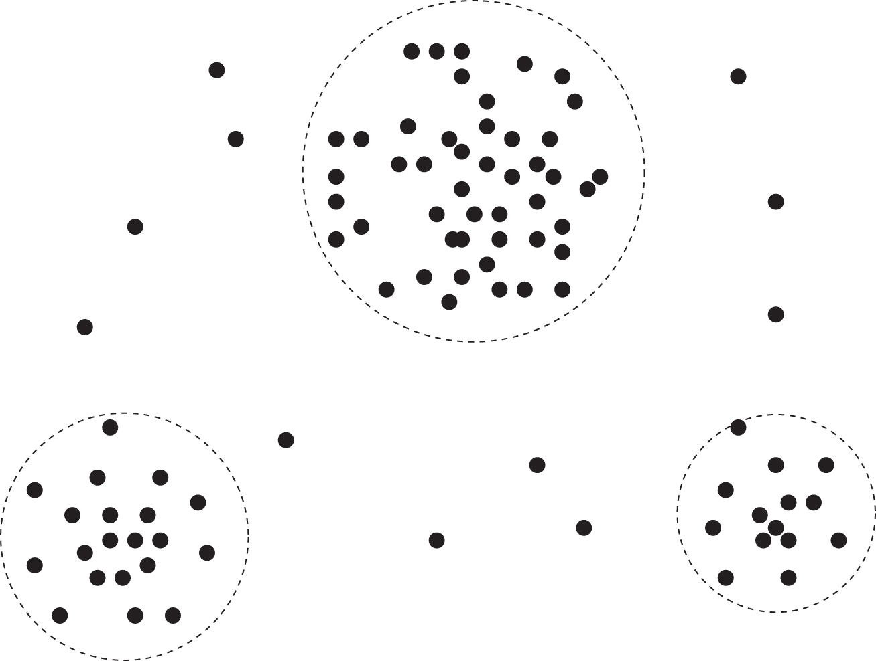
Clusters
Data Mining: Concepts and Techniques
by Jiawei Han, Micheline Kamber, and Jian Pei
Elsevier, 2011
A 2-D plot of customer data with respect to customer locations in a city, showing three data clusters.

Slide 51
Mining Patterns in Data, cont’d
Outliers
Discover data objects that do not comply with the general behavior or model of the data.
Use statistical tests and distance measures.
Do not always discard as noise!
Example: Uncover fraudulent credit card usage.

Slide 52
Mining Patterns in Data, cont’d
Evolution
Discover regularities or trends for data objects whose behavior changes over time.
Analysis can include time-series data analysis, sequence, or periodicity pattern matching, etc.
Example: Look for patterns in the behavior of stocks.

Slide 53
Interesting Patterns
Generally, only a small percentage of patterns discovered by data mining are “interesting”.
A pattern is interesting for a given application if it:
is easily understood by humans
is valid on new data with some degree of certainty
is potentially useful
is novel or unexpected
validates a hypothesis the user wishes to confirm

Slide 54
Interesting Patterns, cont’d
An interesting pattern represents knowledge.
Do not expect a data mining system to
generate all patterns
generate only interesting patterns

Slide 55
Measuring Interest
Objective measures
Let X → Y be an association rule where X and Y are item-sets.
Let T be a set of transactions of a database.
The support value of X with respect to T is the proportion of transactions in the database which contains the item-set X.
The confidence value of the rule X → Y with respect to T is the proportion of the transactions that contain X and which also contain Y.
An application
sets thresholds
for support and
confidence.

Slide 56
Measuring Interest, cont’d
Subjective measures are based on user beliefs in the data.
unexpected patterns
patterns that offer strategic information (“actionable patterns”)
A good data mining system discovers knowledge (interesting patterns) at all levels of data abstraction.

Slide 57
Major Data Mining Issues
Methodology
Diverse data types
User interactions
data mining languages
ad hoc data mining
presentation and visualization of results
handling noisy or incomplete data
evaluating how interesting are the discovered patterns

Slide 58
Major Data Mining Issues
Performance
Ethics, privacy, social impacts
Big Brother is watching you.
Big Brother knows everything about you.
Still a new field!

