Slide 1
CMPE 226 Database Systems April 25 Class Meeting
Department of Computer Engineering San Jose State University Spring 2017 Instructor: Ron Mak
www.cs.sjsu.edu/~mak

Slide 2
Dilbert Cartoon

Slide 3
Remaining Weeks!
April 25 (today)
NoSQL databases
May 2
Data virtualization and the Cisco Information Server
Data mining
May 9 and 16
Team project presentations
May 17
Team projects due
May 23
Final exam

Slide 4
Server Host 130.65.159.87
Each student has an individual account.
Account name is last name + first initial
Example: Mary Jane is janem
Password is pw + the first six digits of your student id, not including leading zeros
Example: pw123456
arorat | gengt | kailashr | liuq | patelm | tamanampudia
atyams | huw | kaleo | lujiheng | pateln | tangh
bhattk | huas | kaurm | lujing | sanglikarp | vadalis
caim | huangy | kodaliv | manneh | shahk | waglec
chana | janakiramand | krishnab | miaol | sheny | wangt
chenx | jianh | krothapallis | misraa | shim | xingl
chengr | jinc | kukrejas | nuthalapativ | sobhanim | yangd
doddapanenis | jux | lama | oberoij | soltanil | zhongz
dubeya | kvh | liq | panigrahis | syedk | zhuc

Slide 5
Virtual Private Network (VPN)
To connect to the server when you’re not on the campus network, you must use VPN.
Download the VPN client from http://its.sjsu.edu/services/internet-connectivity/vpn/

Slide 6
Server Host 130.65.159.87, cont’d
Log in using Secure Shell
Example:
Each student belongs to a group based on his or her team name.
Team members can share files on the server by enabling group read/write/execute access:
ssh janem@130.65.159.87
acid
dataminers
dbtarian
deadlock
fancycoders
forkhead
infinite
nobrainers
spartans
sqlninjas
starschema
team666
teamlongshot
teamultimate
chmod g+rwx foo.txt

Slide 7
MySQL Team Accounts on the Server
MySQL is running on the server.
Each team has a MySQL account.
Your team username is based on your team name (same as the group names).
Your initial password is your username@226.
Each team can only access the database with the same name as the team username:
mysql -u acid -pacid@226
mysql> show databases;
+--------------------+
| Database |
+--------------------+
| information_schema |
| acid |
+--------------------+
2 rows in set (0.00 sec)

Slide 8
Uploading Files to the Server
Use the secure copy command on your local machine to upload a file to your home directory on the server:
Local
~: ls *.txt
HomeSiteSerialNos.txt greeting.txt profile.txt
bash_profile.txt hello.txt ron.txt
bashrc.txt lorem.txt svnlist.txt
foo.txt phpInfo.txt
~: scp foo.txt ron@130.65.159.87:
ron@130.65.159.87's password:
foo.txt 100% 0 0.0KB/s 00:00
Note the final colon!
[ron@coe-cmpe-cis ~]$ ls *.txt
bar.txt foo.txt
Server
Or use a utility program like
FileZilla to transfer files.

Slide 9
Downloading Files from the Server
Use the same command to download files to the current directory (or any other directory) of your local machine.
Local
~: scp ron@130.65.159.87:bar.txt .
ron@130.65.159.87's password:
bar.txt 100% 0 0.0KB/s 00:00
~: ls *.txt
HomeSiteSerialNos.txt foo.txt phpInfo.txt
bar.txt greeting.txt profile.txt
bash_profile.txt hello.txt ron.txt
bashrc.txt lorem.txt svnlist.txt

Slide 10
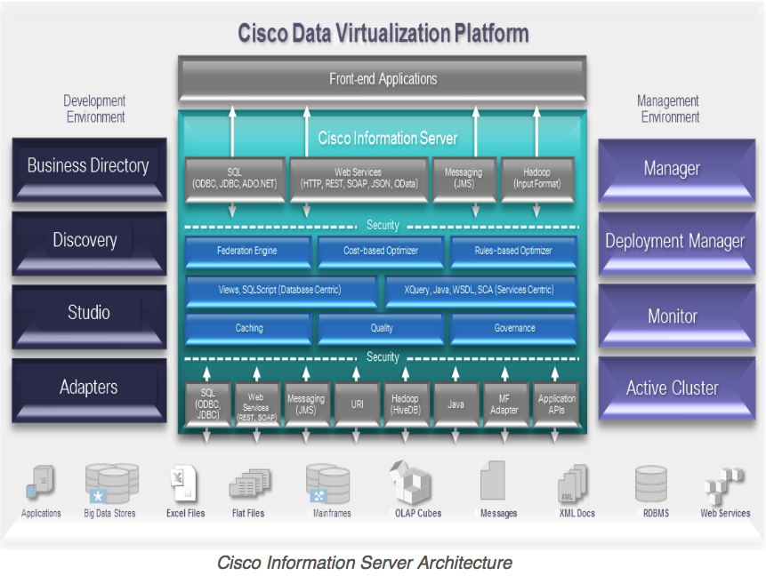
Cisco Information Server (CIS)
The Cisco Information Server (CIS) forms the core of the Cisco Data Virtualization Platform.
http://www.compositesw.com/data-virtualization/

Slide 11
Install the CIS Studio
Studio is the client-side application that connects to the CIS server.
As delivered, it runs only on Windows.
A student has enabled it to run on Mac and Linux.
Download and install Studio:
http://www.cs.sjsu.edu/~mak/CMPE226/CIS7.0.4/
See the Installation Guide.
For now, Studio runs on Windows only.
A student got an older version to run on Linux and Mac.

Slide 12
CIS Team Accounts
Each team has an account on the CIS server.
Same team username and password as your MySQL account.

Slide 13
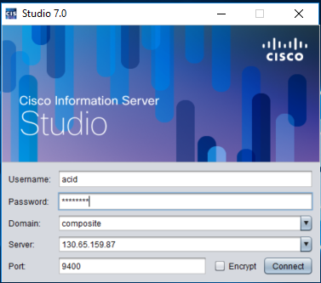
Logging into CIS
To log in, start the client-side Studio application.
Domain: composite
Server: 130.65.159.87
Port: 9400

Slide 14
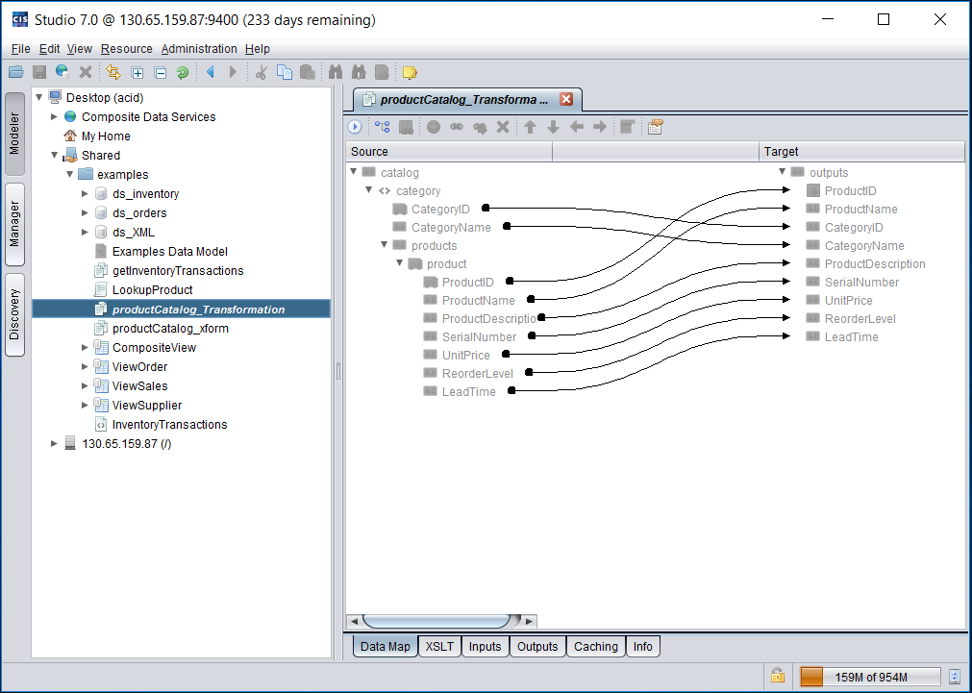
CIS Studio

Slide 15
CIS and Your Projects
Try the demo described in the Getting Started Guide.
Can you find ways to use CIS in your project?

Slide 16
NoSQL
“Not only SQL”
A mechanism to store and retrieve data that uses a model other than the tabular relations used in relational databases.
Big data and real-time web applications.
Existed since the early 1960s but the term “NoSQL” became popular with Web 2.0 companies such as Google, Facebook, and Amazon.

Slide 17
NoSQL Benefits
Simpler design.
Object-oriented programming that is easier to use and more flexible.
Data structures are more flexible than relational tables.
More scalable and better performance than relational databases for certain applications.
Large volumes of rapidly changing structured, semi-structured, and unstructured data.

Slide 18
NoSQL Benefits, cont’d
More suitable for agile development.
Agile sprints, quick schema iteration, and frequent code pushes.
Finer control over data availability.
Geographically distributed scale-out architecture instead of an expensive, monolithic architecture.
scale-out: Add more nodes to a distributed system to expand it horizontally rather than vertically.

Slide 19
NoSQL Disadvantages
Many NoSQL databases compromise consistency in favor of availability, partition tolerance, and speed.
More on this later.
Low-level query languages instead of SQL.

Slide 20
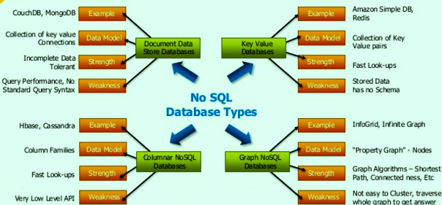
Types of NoSQL Databases
http://www.devinline.com/2015/01/nosql-intorduction.html

Slide 21
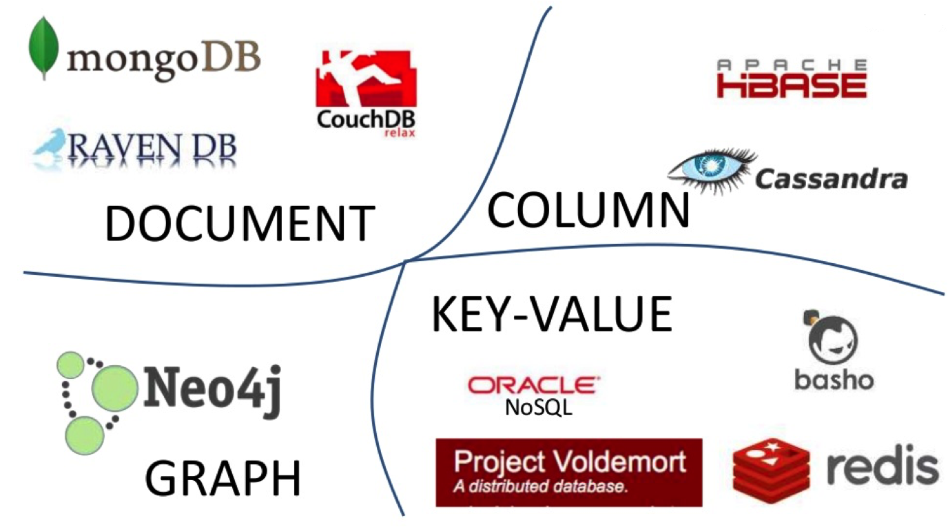
Types of NoSQL Databases, cont’d
http://bigdata-blog.com/nosql-definition

Slide 22
Types of NoSQL Databases: Key-Value Stores
Key-value stores
The simplest NoSQL databases.
Every single item in the database is stored as an attribute name (or “key”), together with its value.
Some key-value stores allow each value to have a type, such as integer, which adds functionality.
Store session information, user profiles, shopping cart data, etc.
Examples: Riak, Berkeley DB and Redis.

Slide 23
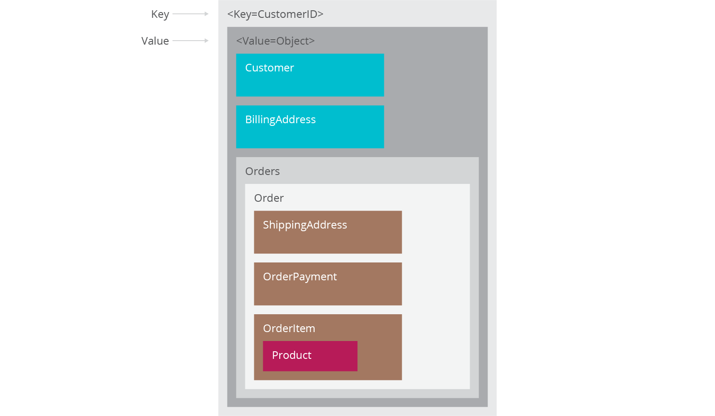
Key-Value Stores, cont’d
Key-value store
https://www.thoughtworks.com/insights/blog/nosql-databases-overview

Slide 24
Types of NoSQL Databases: Graph Stores
Graph stores
Store information about connected data, such as social networks, spatial data, routing information for goods and money, recommendation engines, etc.
Examples: Neo4J and Giraph

Slide 25
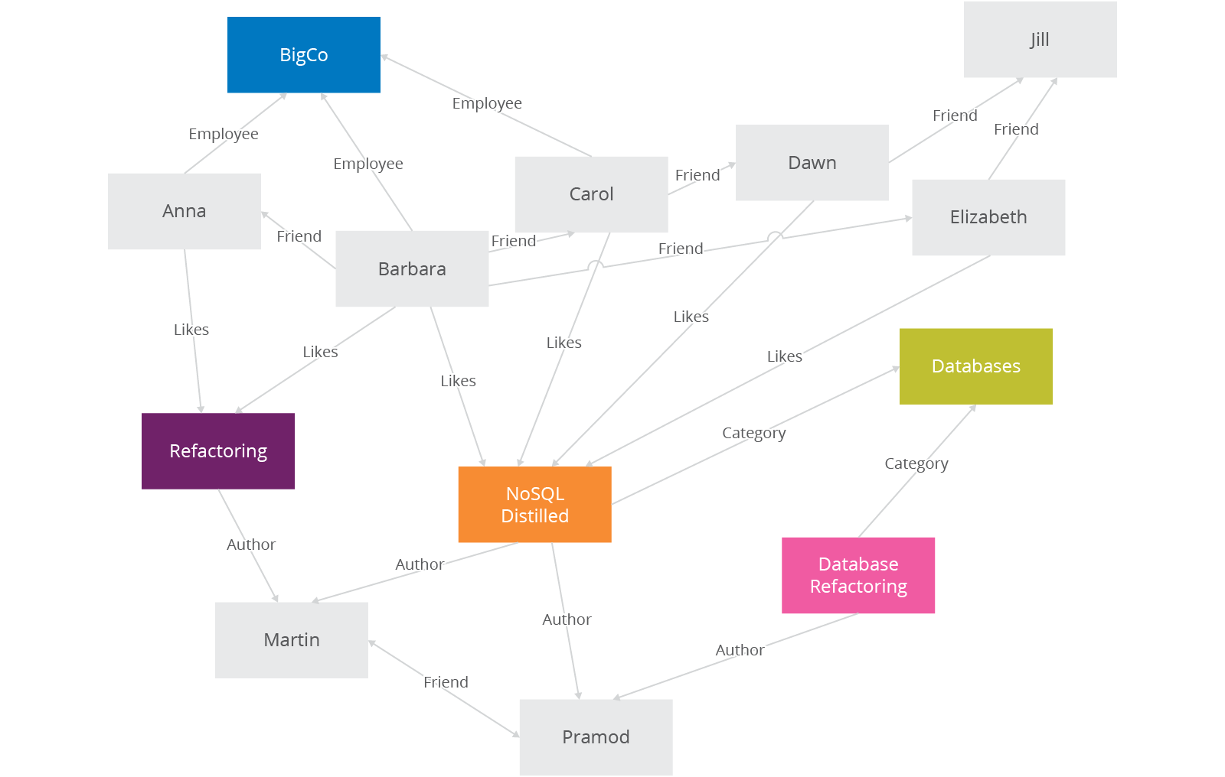
Graph Stores, cont’d
Graph store
https://www.thoughtworks.com/insights/blog/nosql-databases-overview

Slide 26
Types of NoSQL Databases: Wide-Column Stores
Wide-column stores
Optimized for queries over large datasets.
Store columns of data together, instead of rows.
The number of columns and the format of the data in a column can vary from row to row.
Useful for content management systems, blogging platforms, etc.
Examples: Apache Cassandra and Apache HBase

Slide 27
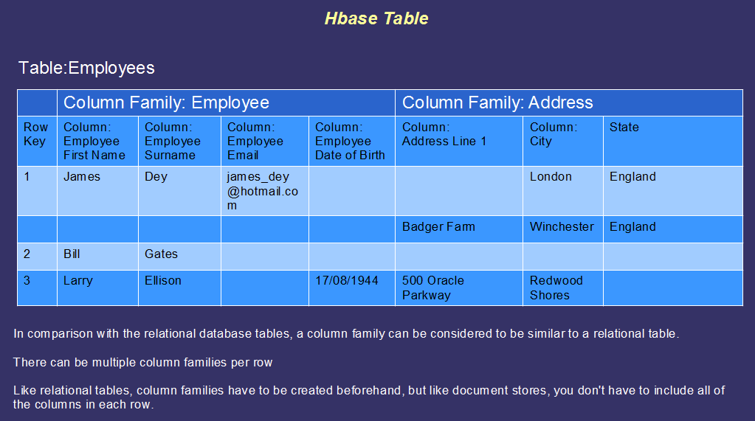
Wide-Column Stores, cont’d
Wide-column store
https://bigdatalondon.files.wordpress.com/2015/06/hbase-table2.png

Slide 28
Types of NoSQL Databases: Document Databases
Document databases
Document: Each key is paired with a complex data structure.
Documents can contain many different key-value pairs, or key-array pairs, or even nested documents.
Useful for content management systems, blogging platforms, web analytics, real-time analytics, ecommerce-applications, etc.
Example: MongoDB

Slide 29
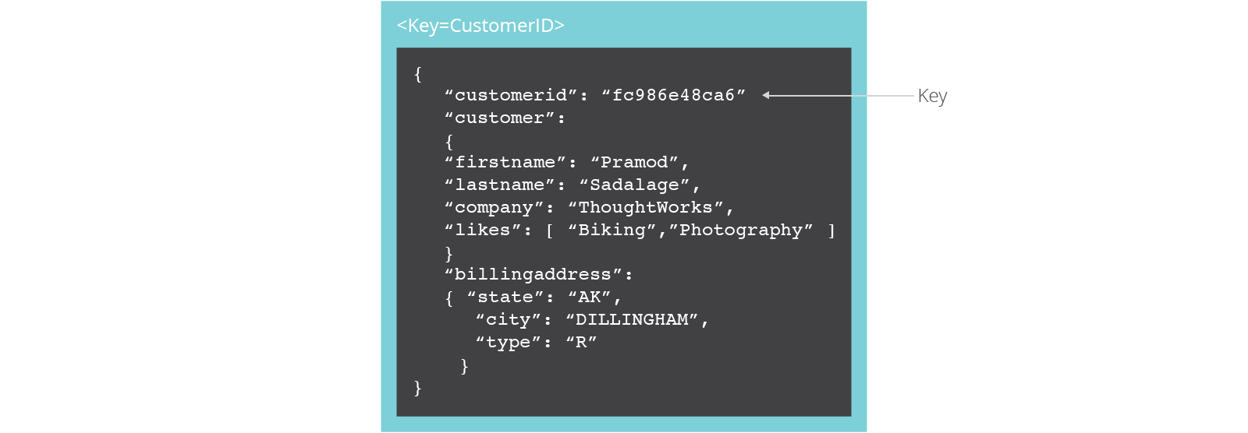
Document Databases, cont’d
Document database
https://www.thoughtworks.com/insights/blog/nosql-databases-overview

Slide 30
Comparisons of NoSQL Database Types
Data Model | Performance | Scalability | Flexibility | Complexity | Functionality
Key–Value Store | high | high | high | none | variable (none)
Column-Oriented Store | high | high | moderate | low | minimal
Document-Oriented Store | high | variable (high) | high | low | variable (low)
Graph Database | variable | variable | high | high | graph theory
Relational Database | variable | variable | low | moderate | relational algebra
https://en.wikipedia.org/wiki/NoSQL

Slide 31
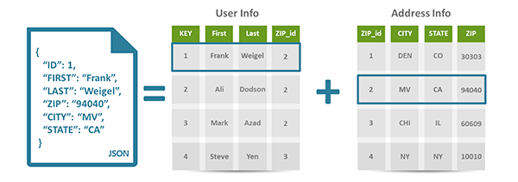
The Document Model
Semi-structured data.
Typically JSON (JavaScript Object Notation).
The document’s internal structure provides the metadata to use for query optimization.
Type information is embedded in the data.
Each instance of data is different from others.
Data stored as
key-value pairs
in a document.
http://www.devinline.com/2015/01/nosql-intorduction.html

Slide 32
The Document Model, cont’d
Query on any field within a document.
Most natural and productive.
Maps directly to the objects of an object-oriented language.

Slide 33
Break

Slide 34
NoSQL Agile Development
Unlike relational databases, NoSQL does not require schemas to be defined in advance.
No database downtime to update a schema.
NoSQL can effectively address data that’s completely unstructured or unknown in advance.
Insert data without a predefined schema.
Apply validation rules within the database.
Enforce governance across data.
Maintain the agility benefits of a dynamic schema.

Slide 35
Scalability
Scale-up
Relational databases scale vertically.
Increase the database server’s capabilities in order to increase performance.
Scale-out
Scale horizontally to support rapidly growing applications by adding more servers.
NoSQL databases support auto-sharding.

Slide 36
Auto-Sharding
NoSQL databases natively and automatically spread data across an arbitrary number of servers.
Applications do not need to be aware of the composition of the server pool.
Data and query load are automatically balanced across servers.
When a server goes down, it can be quickly and transparently replaced without application disruption.

Slide 37
Cloud Computing
Auto-sharding works well with cloud computing.
Example: Amazon Web Services
Provides virtually unlimited capacity on demand.
Takes care of all the necessary infrastructure administration tasks.
Developers no longer need to construct complex, expensive platforms to support their applications.

Slide 38
NoSQL Data Replication
Automatic database replication maintains availability in the event of outages or planned maintenance events.
Automated failover and recovery.
Distribute the database across multiple geographic regions to withstand regional failures and enable data localization.
No requirement for separate applications or expensive add-ons to implement replication.

Slide 39
NoSQL Data Caching
Integrated caching capabilities.
Keep frequently-used data in system memory as much as possible.
No need for a separate caching layer.
Available fully managed, integrated in-memory database management layer.
Support workloads that demand the highest throughput and lowest latency.

Slide 40
CAP Theorem
Consistency
All nodes of a distributed system see the same data at the same time.
Availability
A guarantee that every request gets a response whether the request succeeded or failed.
Partition tolerance
The system continues to operate despite arbitrary network partitioning (splitting) due to device failures.

Slide 41
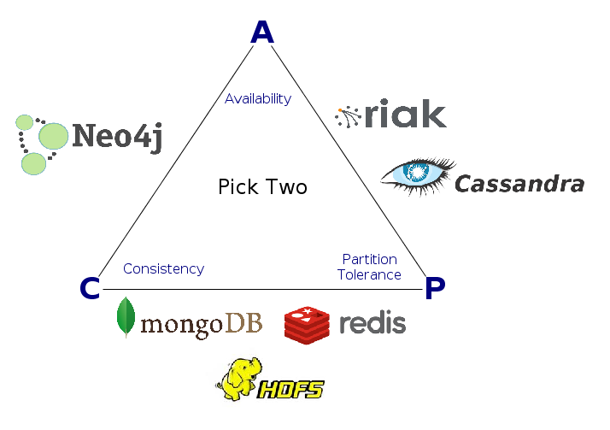
CAP Theorem, cont’d
Consistency, availability, partition tolerance: You can only choose two out of three.
Different NoSQL databases emphasize different pairs of CAP.

Slide 42
SQL vs. NoSQL
 | SQL | NoSQL
Types | SQL database | Key-value, graph, wide-column, document
Development history | Early 1970s | Late 2000s
Data model | Relational | Various
Schemas | Fixed | Dynamic
Scaling | Vertical | Horizontal
Development model | Mix of closed- and open-source | Open-source
Transaction support | Yes | At certain levels (e.g., document vs. database) depending on the application
Data manipulation | Via SQL language | Via object-oriented API
Consistency | Can be strong | Depends on the database product

Slide 43
MongoDB
From “humongous”
Scalable
High performance
Open-source
Document-oriented
Schema-free

Slide 44
MongoDB Features
Horizontal scaling
Indexing
Replication/failover support
Documents are stored in BSON (binary JSON)
Binary serialization of JSON-like objects.
Import or query any valid JSON object.
Query syntax based on JavaScript.

Slide 45
MongoDB Documents and Collections
Documents are analogous to records of a relational database.
JSON objects stored in a binary format.
Collections are analogous to relational tables.
A MongoDB query returns a cursor instead of records.

Slide 46
MongoDB Cursor
A query returns a cursor.
Use the cursor to iterate through a result set.
Better performance.
More efficient than loading all the objects into memory.

Slide 47
MongoDB Consistency
The document model (and the graph model) can be consistent or eventually consistent.
Eventually consistent: Database changes are propagated to all nodes “eventually”.
Typically within milliseconds
Stale reads: Updated data not immediately returned.
MongoDB consistency is tunable.
By default, all data is consistent.
All reads and writes access the primary data copy.
Read operations possible on the secondary copies.

Slide 48
Eventually Consistent Data
Advantages
Fast data inserts.
Disadvantages
Updates and deletes are more complex.
Periods of time during which not all copies of the data are synchronized.

Slide 49
MongoDB Interfaces
Drivers
For many programming languages and development environments.
GUI front-ends
Not included with the database.
Several third-party products for administration and data viewing.
Example: MongoDB Compass

Slide 50
MongoDB Compass
Developed by the MongoDB engineers.
Visually explore the data.
Interact with the data with full CRUD functionality.
Run ad hoc queries.
View detailed information about indexes.
View execution plans in order to optimize query performance.

Slide 51
MongoDB Compass, cont’d
https://docs.mongodb.com/ecosystem/tools/administration-interfaces/

Slide 52
MongoDB Demo
Install MongoDB: https://docs.mongodb.com/master/administration/install-community/
Start the MongoDB server:
Start the MongoDB interactive shell:
/usr/local/Cellar/mongodb/3.2.10/bin/mongod
/usr/local/Cellar/mongodb/3.2.10: ./bin/mongo
MongoDB shell version: 3.2.10
connecting to: test
>

Slide 53
MongoDB Demo, cont’d
Create the school database:
Insert a document into the teacher collection:
Who’s in there now?
> use school
switched to db school
> db.teacher.insert( {id: 7003, last: "Rogers", first: "Tom"} )
WriteResult({ "nInserted" : 1 })
> db.teacher.find()
{ "_id" : ObjectId("582a7630f22e3c2f12d899ac"),
"id" : 7003, "last" : "Rogers", "first" : "Tom" }

Slide 54
MongoDB Demo, cont’d
Insert the rest of the teachers as an array of documents:
> db.teacher.insert([
... { id: 7008, last: "Thompson", first: "Art" },
... { id: 7012, last: "Lane", first: "John" },
... { id: 7051, last: "Flynn", first: "Mabel" }
... ])

Slide 55
MongoDB Demo, cont’d
Find all of them and pretty print:
> db.teacher.find().pretty()
{
"_id" : ObjectId("582a7630f22e3c2f12d899ac"),
"id" : 7003,
"last" : "Rogers",
"first" : "Tom"
}
{
"_id" : ObjectId("582a7808f22e3c2f12d899ad"),
"id" : 7008,
"last" : "Thompson",
"first" : "Art"
}
{
"_id" : ObjectId("582a7808f22e3c2f12d899ae"),
"id" : 7012,
"last" : "Lane",
"first" : "John"
}
{
"_id" : ObjectId("582a7808f22e3c2f12d899af"),
"id" : 7051,
"last" : "Flynn",
"first" : "Mabel"
}

Slide 56
MongoDB Demo, cont’d
A simple query with $or:
> db.teacher.find(
... { $or: [ {id: 7008}, {first: "John"} ] }
... ).pretty()
{
"_id" : ObjectId("582a7808f22e3c2f12d899ad"),
"id" : 7008,
"last" : "Thompson",
"first" : "Art"
}
{
"_id" : ObjectId("582a7808f22e3c2f12d899ae"),
"id" : 7012,
"last" : "Lane",
"first" : "John"
}

Slide 57
MongoDB Demo, cont’d
Update a document:
> db.teacher.find()
{ "_id" : ObjectId("582a7630f22e3c2f12d899ac"), "id" : 7003, "last" : "Rogers", "first" : "Tom" }
{ "_id" : ObjectId("582a7808f22e3c2f12d899ad"), "id" : 7008, "last" : "Thompson", "first" : "Art" }
{ "_id" : ObjectId("582a7808f22e3c2f12d899ae"), "id" : 7012, "last" : "Lane", "first" : "John" }
{ "_id" : ObjectId("582a7808f22e3c2f12d899af"), "id" : 7051, "last" : "Flynn", "first" : "Mabel" }
> db.teacher.update(
... {id: 7051},
... {$set: {first: "Mabeline"}}
... )
WriteResult({ "nMatched" : 1, "nUpserted" : 0, "nModified" : 1 })
> db.teacher.find( {id: 7051} ).pretty()
{
"_id" : ObjectId("582a7808f22e3c2f12d899af"),
"id" : 7051,
"last" : "Flynn",
"first" : "Mabeline"
}

Slide 58
MongoDB Demo, cont’d
Projection: Show only the ids and last names:
> db.teacher.find( {}, {_id: 0, id: 1, last: 1} )
{ "id" : 7003, "last" : "Rogers" }
{ "id" : 7008, "last" : "Thompson" }
{ "id" : 7012, "last" : "Lane" }
{ "id" : 7051, "last" : "Flynn" }

Slide 59
MongoDB Demo, cont’d
Sort in ascending or descending order by last name:
> db.teacher.find( {}, {_id: 0, id: 1, last: 1} ).sort({last: 1})
{ "id" : 7051, "last" : "Flynn" }
{ "id" : 7012, "last" : "Lane" }
{ "id" : 7003, "last" : "Rogers" }
{ "id" : 7008, "last" : "Thompson" }
> db.teacher.find( {}, {_id: 0, id: 1, last: 1} ).sort({last: -1})
{ "id" : 7008, "last" : "Thompson" }
{ "id" : 7003, "last" : "Rogers" }
{ "id" : 7012, "last" : "Lane" }
{ "id" : 7051, "last" : "Flynn" }

Slide 60
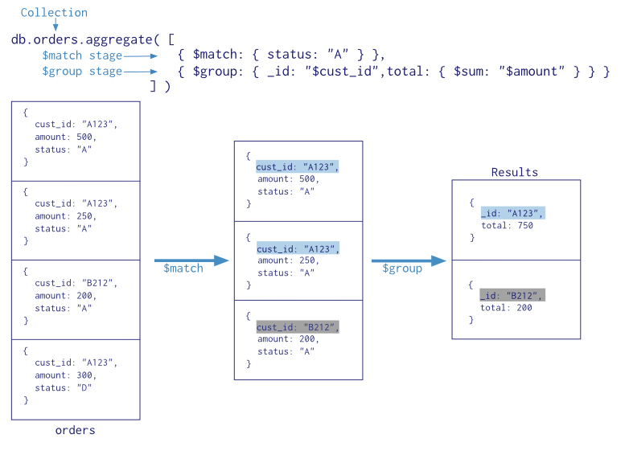
Aggregation
Documents enter a “pipeline” where the data is matched, grouped, and aggregated.
https://docs.mongodb.com/v3.2/aggregation/

Slide 61
Map-Reduce for Aggregation
Map stage
Process each document.
Emit one or more objects per document.
Reduce stage
Combine the output of the map operation.
Finalize stage
Make final modifications to the result.

Slide 62
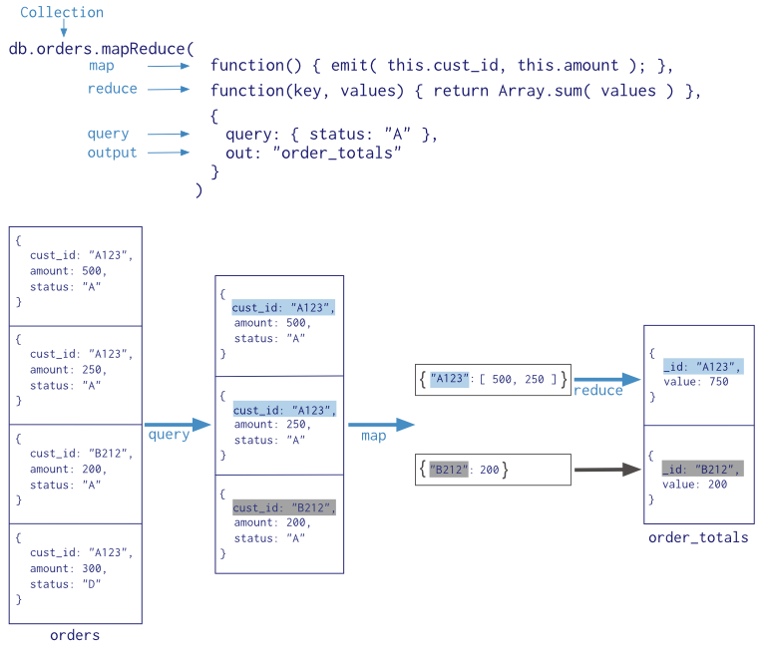
Map-Reduce for Aggregation, cont’d
https://docs.mongodb.com/v3.2/aggregation/

Slide 63
MongoDB Driver for PHP
File mongodb.so (Linux and Mac) and mongodb.dll (Windows) are MongoDB drivers for PHP.
Add in configuration file php.ini:
Now you can have a backend MongoDB database accessible via the PHP server code.
extension="mongodb.so"

Slide 64
MongoDB + PHP: Create a Collection
<?php
// connect to mongodb
$m = new MongoClient();
echo "Connection to database successfully";
// select a database
$db = $m->mydb;
echo "Database mydb selected";
$collection = $db->createCollection("mycol");
echo "Collection created succsessfully";
?>
https://www.tutorialspoint.com/mongodb/mongodb_php.htm

Slide 65
MongoDB + PHP: Insert a Document
<?php
// connect to mongodb
$m = new MongoClient();
echo "Connection to database successfully";
// select a database
$db = $m->mydb;
echo "Database mydb selected";
$collection = $db->mycol;
echo "Collection selected succsessfully";
$document = array(
"title" => "MongoDB",
"description" => "database",
"likes" => 100,
"url" => "http://www.tutorialspoint.com/mongodb/",
"by", "tutorials point"
);
$collection->insert($document);
echo "Document inserted successfully";
?>
https://www.tutorialspoint.com/mongodb/mongodb_php.htm

Slide 66
MongoDB + PHP: Find All Documents
<?php
// connect to mongodb
$m = new MongoClient();
echo "Connection to database successfully";
// select a database
$db = $m->mydb;
echo "Database mydb selected";
$collection = $db->mycol;
echo "Collection selected succsessfully";
$cursor = $collection->find();
// iterate cursor to display title of documents
foreach ($cursor as $document) {
echo $document["title"] . "\n";
}
?>
https://www.tutorialspoint.com/mongodb/mongodb_php.htm

Slide 67
MongoDB + PHP: Update a Document
<?php
// connect to mongodb
$m = new MongoClient();
echo "Connection to database successfully";
// select a database
$db = $m->mydb;
echo "Database mydb selected";
$collection = $db->mycol;
echo "Collection selected succsessfully";
// now update the document
$collection->update(array("title"=>"MongoDB"),
array('$set'=>array("title"=>"MongoDB Tutorial")));
echo "Document updated successfully";
// now display the updated document
$cursor = $collection->find();
// iterate cursor to display title of documents
echo "Updated document";
foreach ($cursor as $document) {
echo $document["title"] . "\n";
}
?>
https://www.tutorialspoint.com/mongodb/mongodb_php.htm

Slide 68
MongoDB + PHP: Delete a Document
<?php
// connect to mongodb
$m = new MongoClient();
echo "Connection to database successfully";
// select a database
$db = $m->mydb;
echo "Database mydb selected";
$collection = $db->mycol;
echo "Collection selected succsessfully";
// now remove the document
$collection->remove(array("title"=>"MongoDB Tutorial"),false);
echo "Documents deleted successfully";
// now display the available documents
$cursor = $collection->find();
// iterate cursor to display title of documents
echo "Updated document";
foreach ($cursor as $document) {
echo $document["title"] . "\n";
}
?>
https://www.tutorialspoint.com/mongodb/mongodb_php.htm

Slide 69
MongoDB Tutorials
Google “MongoDB tutorials” to access many tutorials on the Web.

Slide 70
Assignment #9
Create a MongoDB database.
Create two collections for the database and insert sample documents into each collection.
For each collection:
Pretty-print the contents of all its documents.
Make three queries with various search criteria and sorting options.
Make one query that does “pipeline” aggregation.
Make one query that does aggregation using map-reduce.

Slide 71
Assignment #9, cont’d
Submit a zip file named after your team which contains:
Your statements that populated your collections.
Your queries and their output.
Cut-and-paste into text files, or make screenshots.
Due Tuesday, May 2 at 11:59 PM.

