Slide 1


CMPE 226
Database Systems
April 4 Class Meeting
Department of Computer Engineering
San Jose State University
Spring 2017
Instructor: Ron Mak
www.cs.sjsu.edu/~mak

Slide 2
Midterm Stats
median | 86.0
average | 85.9
std.dev. | 8.9

Slide 3
Midterm Solutions: Question 1
Briefly describe the necessary steps to normalize a proper relational table
to first normal form (1NF).
  No steps are necessary.
  Any proper relational table is already in
  first normal form.

Slide 4
Midterm Solutions: Question 2
Briefly describe the necessary steps to normalize a proper relational table
that has a non-composite primary key to second normal form (2NF).
  No steps are necessary.
  Second normal form removes partial functional dependencies, where fields are dependent on a component of the composite primary key. If the primary key is non-composite, there are no partial functional dependencies.

Slide 5
Midterm Solutions: Question 3.a
Year | Department | Leader | ID | Amount
2015 | CMPE | Sigurd Meldal | 007777777 | $12,000
2015 | CS | Sami Khuri | 002222222 | $11,000
2016 | Math | Bem Cayco | 005555555 | $10,000
2016 | CMPE | Xiao Su | 008888888 | $12,000
You want to record the fact that in the year 2017, Mary Jane, who has ID 003333333 and does not belong to a department, is the leader of the Spartan Committee. Briefly explain why you can or cannot add a 2017 row for her and enter nulls for the Department and Amount fields.
  You cannot add a 2017 row where the Department field is null. The Department field is part of the composite primary key. Therefore, leaving that field null violates the entity integrity constraint.

Slide 6
Midterm Solutions: Question 3.b
Year | Department | Leader | ID | Amount
2015 | CMPE | Sigurd Meldal | 007777777 | $12,000
2015 | CS | Sami Khuri | 002222222 | $11,000
2016 | Math | Bem Cayco | 005555555 | $10,000
2016 | CMPE | Xiao Su | 008888888 | $12,000
Normalize this table to third normal form (3NF).
  ID → Leader is a transitive functional dependency. We can move those columns into a new table:
Year
Department
ID
Amount
ID
Leader

Slide 7
Midterm Solutions: Question 3.c
Give a good reason why you may want to leave this table unnormalized.
  The original table has faster query response.

Slide 8
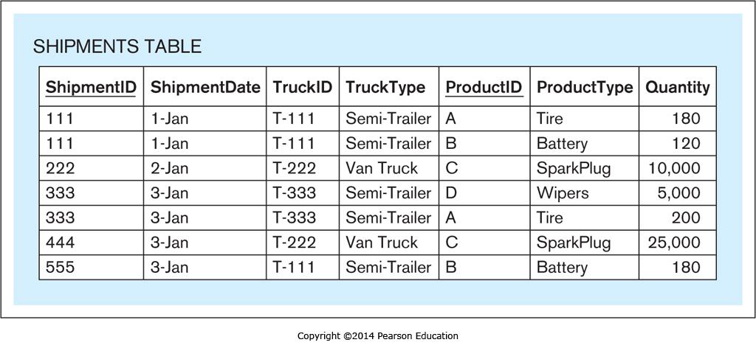
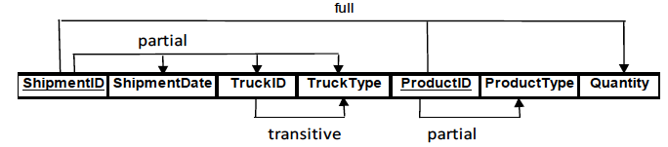
Midterm Solutions: Question 4.a

Slide 9
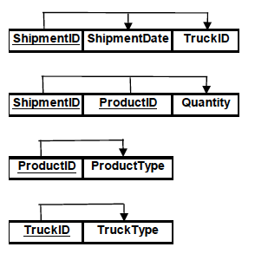
Midterm Solutions: Question 4.b

Slide 10
Midterm Solutions: Question 5.a
Display the ProductID and ProductName of the cheapest product without using a nested query.
SELECT productid, productname
FROM product
ORDER BY productprice
LIMIT 1;

Slide 11
Midterm Solutions: Question 5.b
Repeat the above task with a nested query.
SELECT productid, productname
FROM product
WHERE productprice = (SELECT MIN(productprice)
FROM product);

Slide 12
Midterm Solutions: Question 5.c
Display the ProductID, ProductName, and VendorName for products whose price is below the average price of all products
SELECT p.productid, p.productname, v.vendorname
FROM product p, vendor v
WHERE p.vendorid = v.vendorid
AND productprice < (SELECT AVG(productprice)
FROM product);

Slide 13
Midterm Solutions: Question 5.d
Display the ProductID for the product that has been sold the most (i.e., that has been sold in the highest quantity).
SELECT productid
FROM soldvia
GROUP BY productid
HAVING SUM(noofitems) = (SELECT MAX(SUM(noofitems))
FROM soldvia
GROUP BY productid);

Slide 14
Midterm Solutions: Question 5.e
The following query retrieves each product that has more than three items sold within all sales transactions:
SELECT productid, productname, productprice
FROM product
WHERE productid IN (SELECT productid
FROM soldvia
GROUP BY productid
HAVING SUM(noofitems) > 3);
Rewrite it without using a nested query
but instead with a join:
SELECT p.productid, productname, productprice
FROM product p, soldvia s
WHERE p.productid = s.productid
GROUP BY p.productid, p.productname, p.productprice
HAVING SUM(s.noofitems) > 3;

Slide 15
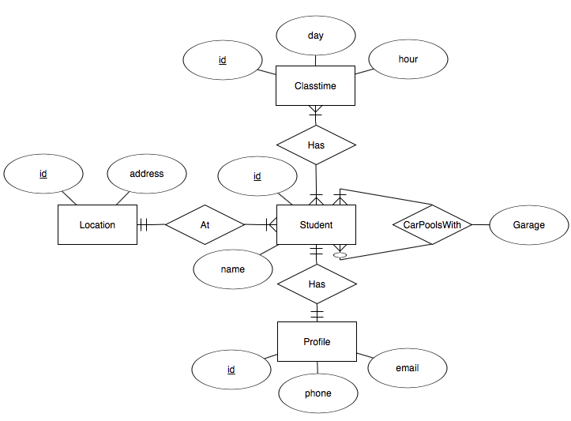
Midterm Solutions: Question 6.a

Slide 16
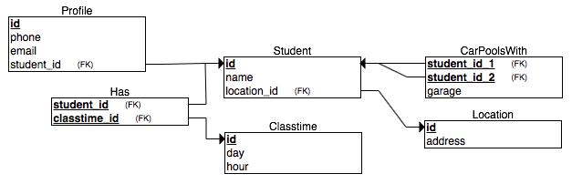
Midterm Solutions: Question 6.b

Slide 17
The Data Deluge
90% of all the data ever created
was created in the past two years.
2.5 quintillion bytes of data per day
is being created.
  2.5 x 10¹⁸
80% of the data is “dark data”
  i.e., unstructured data

Slide 18
A Transformation
collect values
Data
Often together
simply called “data”
add metadata
Information
add context
Knowledge
add insight
Wisdom

Slide 19
Operational Data
Support a company’s day-to-day operations.
  A company can have multiple
  operational data sources.
Contains operational information.
  AKA transactional information.
Example operational data:
  sales transactions
  ATM withdrawals
  airline ticket purchases

Slide 20
Analytical Data
Collected for decision support and data analysis.
Example analytical information:
  patterns of ATM usage during the day
  sales trends over the past year
Analytical information is based on
operational information.

Slide 21
Operational vs. Analytical Data
Create a data warehouse as a separate analytical database.
Don’t slow down the performance of the operational database by also making it
support analytical operations.
It’s often impossible to structure a single database that is optimal for both operational and analytical operations.

Slide 22
Time Horizon
Operational data
  Shorter time horizon: typically 60 to 90 days.
  Most queries are for a short time horizon.
  Archive data after 60 to 90 days.
  Don’t penalize the performance of typical queries
  for the sake of an occasional atypical query.
Analytical data
  Much longer time horizon.
  Look for patterns and trends over many years.

Slide 23
Level of Data Detail
Operational data
  Detailed data about each transaction.
  Summarized data are not stored but are
  derived attributes calculated with formulas.
  Summary data is subject to frequent changes.
Analytical data
  Summarized data is physically stored.
  Summarized data is often precomputed.
  Summarized data is historical and unchanging.

Slide 24
Data Time Representation
Operational data
  Contains the current state of affairs.
  Frequently updated.
Analytical data
  Current situation plus snapshots of the past.
  Snapshots are calculated once
  and physically stored for repeated use.

Slide 25
Data Amounts and Query Frequency
Operational data
  Frequent queries by more users.
  Small amounts of data per query.
Analytical data
  Fewer queries by fewer users.
  Can have large amounts of data per query.
Difficult to optimize for both:
  Frequent queries + small amounts of data
  Less frequent queries + large amounts of data

Slide 26
Data Updates
Operational data
  Regularly updated by end users.
  Insert, modify, and delete data.
Analytical data
  End users can only retrieve data.
  Updates by end users not allowed.

Slide 27
Data Redundancy
Operational data
  Goal is to reduce data redundancy.
  Eliminate update anomalies.
Analytical data
  Updates by end users not allowed.
  No danger of update anomalies.
  Eliminating data redundancies not as critical.

Slide 28
Data Audience
Operational data
  Support day-to-day operations.
  Used by all types of employees, customers, etc.
  for various tactical purposes.
Analytical data
  Used by a more narrow set of users
  for decision-making purposes.

Slide 29
Data Orientation
Operational data
  Application-oriented
  Created to support an application that serves
  one or more business operations and processes.
  Enable the efficient functioning of the application
  that it supports.
Analytical data
  Subject-oriented
  Created for the analysis of one or more business subject areas such as sales, returns, cost, profit, etc.

Slide 30
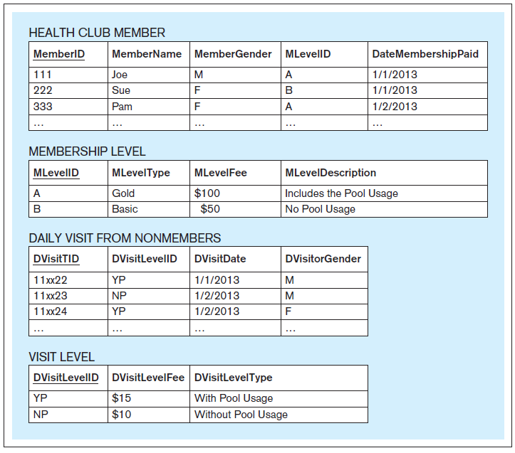
An Application-Oriented Operational Database
Support the
Visits and Payments application
of a health club.
Database Systems
by Jukić, Vrbsky, & Nestorov
Pearson 2014
ISBN 978-0-13-257567-6

Slide 31
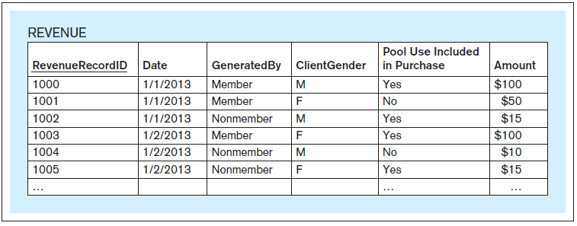
A Subject-Oriented Analytical Database
Support the analysis of the
subject of revenue
for a health club.
The data comes from
the operational database.
Database Systems
by Jukić, Vrbsky, & Nestorov
Pearson 2014
ISBN 978-0-13-257567-6

Slide 32
Operational vs. Analytical Data, cont’d
Operational Data | Analytical Data
Data Makeup
Typical time horizon: days/months | Typical time horizon: years
Detailed | Summarized (and/or detailed)
Current | Values over time (snapshots)
Technical Differences
Small amounts used in a process | Large amounts used in a process
High frequency of access | Low/Modest frequency of access
Can be updated | Read (and append) only
Non-redundant | Redundancy not an issue
Functional Differences
Used by all types of employees for tactical purposes | Used by fewer employees for decision making
Application oriented | Subject oriented

Slide 33
What is a Data Warehouse?
The data warehouse is a structured repository of integrated, subject-oriented, enterprise-wide, historical, and time-variant data.
The purpose of the data warehouse is
the retrieval of analytical information.
A data warehouse can store detailed
and/or summarized data.

Slide 34
Structured Repository
A data warehouse is a database that contains analytically useful information.
Any database is a structured repository.

Slide 35
Integrated
The data warehouse integrates analytically useful data from existing operational databases in the organization.
Copy the data from the operational databases into the data warehouse.

Slide 36
Subject-Oriented
Operational database
  Support a specific business operation.
Data warehouse
  Analyze specific business subject areas.

Slide 37
Enterprise-Wide
The data warehouse provides an
enterprise-wide view of analytical data.
Example subject: Cost
  Bring into the data warehouse all
  analytically useful cost data.

Slide 38
Historical
The data warehouse has a longer time horizon than in operational databases.
  Operational database: typically 60-90 days
  Data warehouse: typically multiple years

Slide 39
Time-Variant
The data warehouse contains slices or snapshots of data from different periods of time across its time horizon.
Example: Analyze and compare the cost for the first quarter of last year vs. the cost for the first quarter from two years ago.

Slide 40
Retrieval of Analytical Data
Users can only retrieve from a data warehouse.
Periodically load data from the operational databases into the data warehouse.
Automatically append the new data
to the existing data.
Data that has been loaded into the
data warehouse is not subject to changes.
Nonvolatile, static, read-only data warehouse.

Slide 41
Detailed and/or Summarized Data
Detailed data
  AKA atomic data, transaction-level data
    Example: An ATM transaction
Summarized data
  Each record represents calculations based on multiple instances of transaction-level data.
    Example: The total amount of ATM withdrawals
    during one month for one account.
  Coarser level of detail than transaction data.
  A data warehouse that contains the data at the
  finest level of detail is the most powerful.

Slide 42
Break

Slide 43
Data Warehouse Components
Source systems
Extract-transform-load (ETL) infrastructure
Data warehouse
Front-end applications
  Business Intelligence (BI) applications

Slide 44
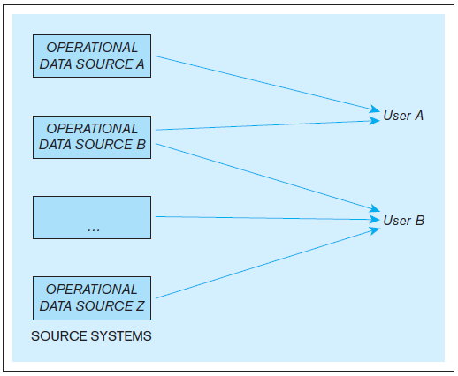
Data Warehouse Components, cont’d
Example: An organization where users use multiple operational data stores for daily operational purposes.
Database Systems
by Jukić, Vrbsky, & Nestorov
Pearson 2014
ISBN 978-0-13-257567-6

Slide 45
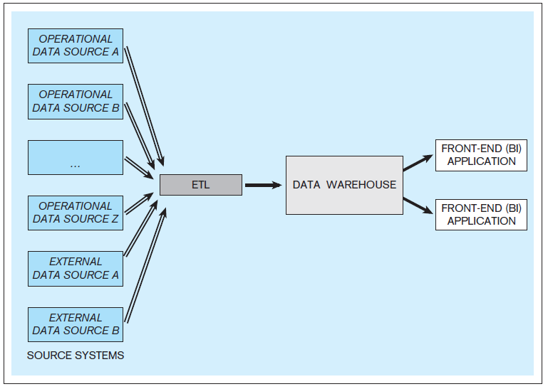
Data Warehouse Components, cont’d
Example: A data warehouse with multiple internal and external data sources.
Database Systems
by Jukić, Vrbsky, & Nestorov
Pearson 2014
ISBN 978-0-13-257567-6

Slide 46
Source Systems
Operational databases and other operational data repositories that provide analytically useful information for the data warehouse.
Therefore, each such operational data store
has two purposes:
  The original operational purpose.
  A source for the data warehouse.
Both internal and external data sources.
  Example external: third-party market research data

Slide 47
Extract-Transform-Load (ETL)
Extract analytically useful data from the operational data sources.
Transform the source data
  Make it conform to the structure of the
  subject-oriented data warehouse.
  Ensure data quality through processes such as
  data cleansing and scrubbing.
Load the transformed and quality-assured data into the target data warehouse.

Slide 48
Data Warehouse
Typically, an ETL occurs periodically for the target data warehouse.
  Common: Perform ETL nightly.
Active data warehouse: retrieval of data from the operational data sources is continuous.

Slide 49
Business Intelligence (BI)
A technology-driven process to analyze data and present actionable knowledge to help corporate executives, business managers and other end users make more informed business decisions.
Tools, applications and methodologies to collect data, prepare it for analysis, query the data, and create reports, dashboards, and other data visualizations.

Slide 50
Business Intelligence (BI) Applications
Front-end applications that allow users who are analysts to access the data and functions
of the data warehouse.

Slide 51
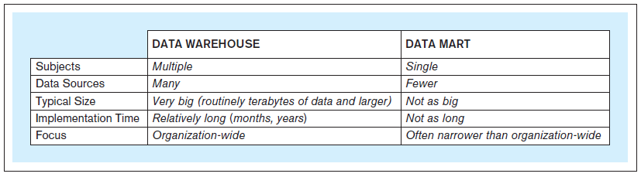
Data Marts
Same principles as a data warehouse.
More limited scope: one subject only.
Not necessarily an enterprise-wide focus.
Database Systems
by Jukić, Vrbsky, & Nestorov
Pearson 2014
ISBN 978-0-13-257567-6

Slide 52
Independent Data Marts
Standalone
Created the same way as a data warehouse.
Have their own data sources
and ETL infrastructure.

Slide 53
Dependent Data Marts
Does not have its own data sources.
Data comes from the data warehouse.
Provide users with a subset of the data.
  User get only the data they need or want
  or allowed to have access to.

Slide 54
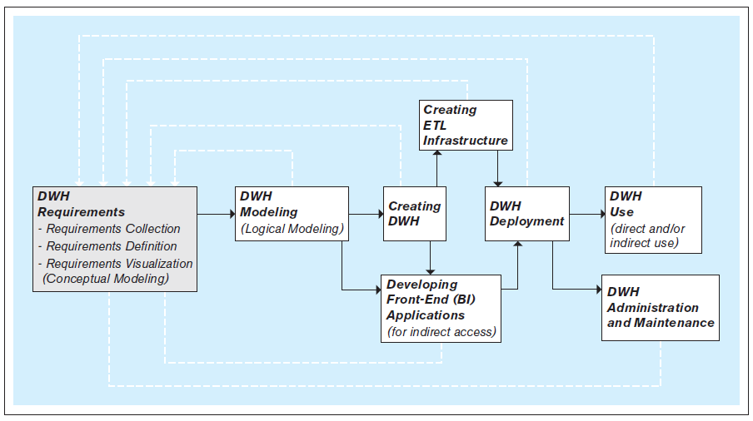
Steps to Create a Data Warehouse
An iterative process!
Database Systems
by Jukić, Vrbsky, & Nestorov
Pearson 2014
ISBN 978-0-13-257567-6

Slide 55
Create the ETL Infrastructure
Design and code the procedures to:
  Automatically extract data from the
  operational data sources.
  Transform the extracted data to
  assure its quality and to conform it
  to the model of the data warehouse.
  Seamlessly load the transformed data
  into the data warehouse.

Slide 56
Create the ETL Infrastructure, cont’d
The ETL infrastructure must reconcile all the differences between the multiple operational sources and the target data warehouse.
Decide how to bring in information without creating misleading duplicates.
Creating the ETL infrastructure is often
the most time- and resource-consuming part
of developing a data warehouse.

Slide 57
Develop the BI Applications
Front-end BI applications enable users to analyze the data in the data warehouse.
Typical business intelligence functions:
  Query the data.
  Perform ad hoc analyses on the fly.
  Generate reports and graphs.
  Control a dashboard, often in real time.
  Create data visualizations.
  Advanced: data mining.

Slide 58
Develop the BI Applications
For examples of data visualizations,
see the work of my CS 235 grad students:
http://cs61.cs.sjsu.edu/CS235Projects/
The primary goal of BI is to provide useful
business insights and actionable knowledge
for the decision makers.
New field: Data Science
  “A data scientist is a statistician
  who works at a start-up.”

Slide 59
Dimensional Modeling
A type of data model used for data warehouses and data marts.
  Subject-oriented analytical databases
The dimensional model is commonly based on the relational data model.
Two types of tables:
  dimension tables
  fact tables

Slide 60
Dimension Tables
Dimensions are descriptions of the business to which the subject of analysis belongs.
Dimension table columns contain descriptive information that is often textual.
  Examples: product brand, product color, customer gender, customer education level, etc.
Descriptive information can also be numeric:
  Examples: product weight, customer age, etc.

Slide 61
Dimension Tables, cont’d
Dimension information forms the basis
for the analysis of the subject.
Example: Analyze sales by product brand, customer gender, customer age, etc.

Slide 62
Fact Tables
Facts are measures related to the
subject of analysis.
  Typically numeric for computation
  and quantitative analysis.
Fact tables contain the measures
and foreign keys that associate the facts
with the dimensions tables.

Slide 63
Star Schema
A dimensional relational schema contains dimension tables and fact tables.
  Often called a star schema.
Each dimension table contains
  a primary key
  attributes that are used for the analysis
  of the measures in the fact tables
Each fact table contains
  fact-measure attributes
  foreign keys to the dimension tables

Slide 64
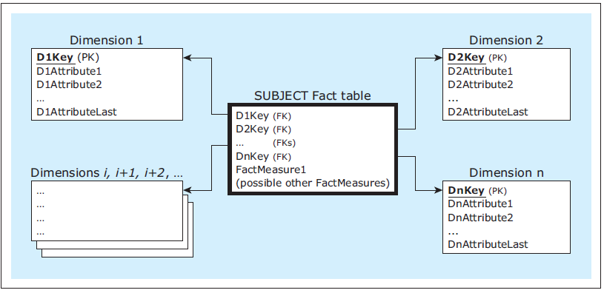
Star Schema, cont’d
A dimensional model
Database Systems
by Jukić, Vrbsky, & Nestorov
Pearson 2014
ISBN 978-0-13-257567-6

Slide 65
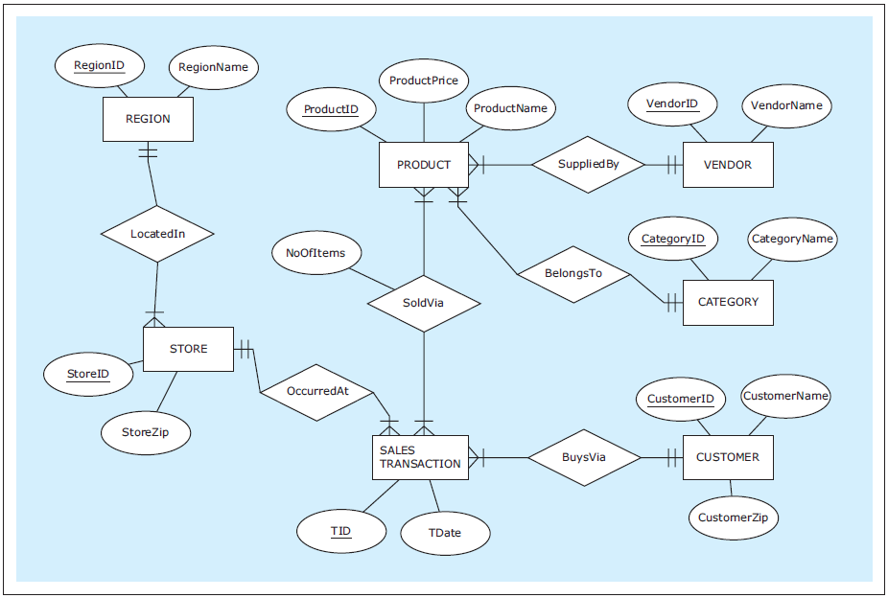
Dimensional Model Example
Database Systems
by Jukić, Vrbsky, & Nestorov
Pearson 2014
ISBN 978-0-13-257567-6

Slide 66
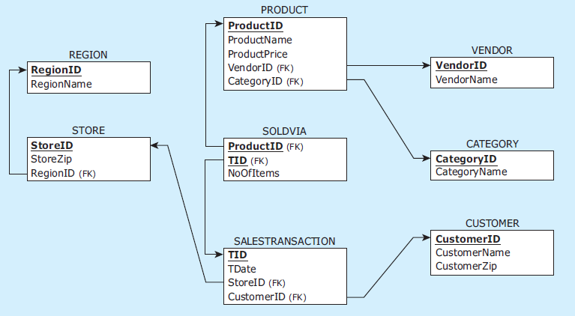
Dimensional Model Example, cont’d
The relational schema
Database Systems
by Jukić, Vrbsky, & Nestorov
Pearson 2014
ISBN 978-0-13-257567-6

Slide 67
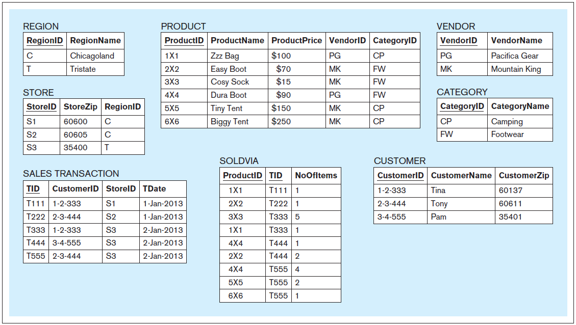
Dimensional Model Example, cont’d
Database Systems
by Jukić, Vrbsky, & Nestorov
Pearson 2014
ISBN 978-0-13-257567-6

Slide 68
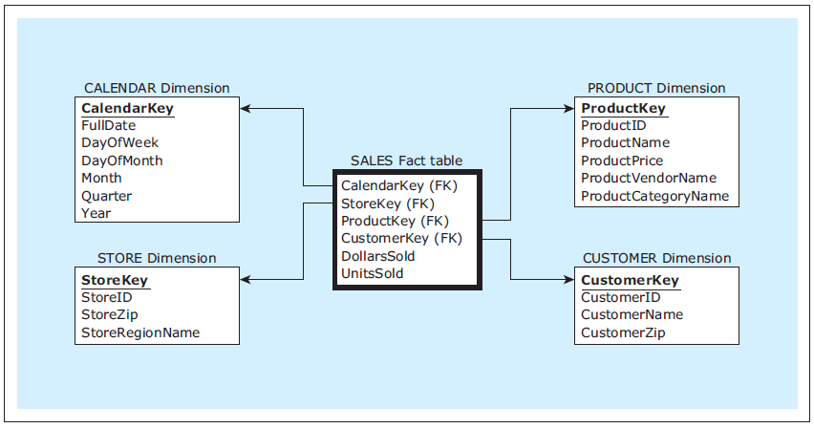
Dimensional Model Example, cont’d
Nearly every star schema includes
a date-related dimension.
The dimensional model
Database Systems
by Jukić, Vrbsky, & Nestorov
Pearson 2014
ISBN 978-0-13-257567-6

Slide 69
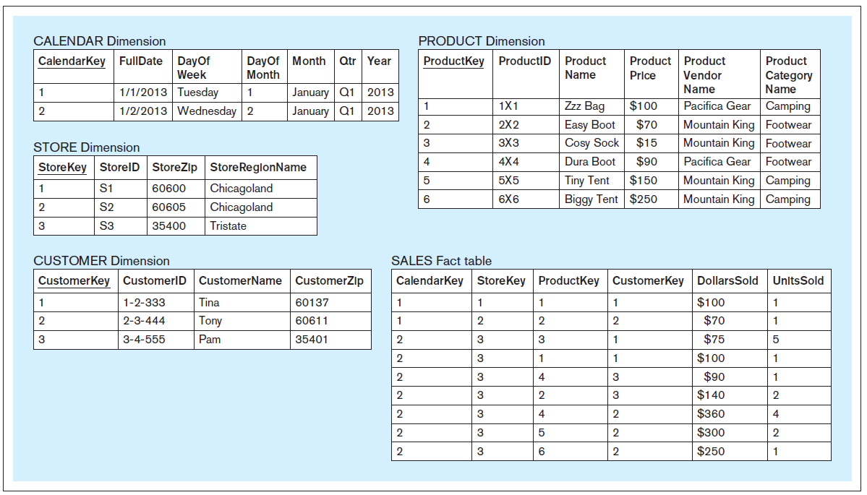
Dimensional Model Example, cont’d
Database Systems
by Jukić, Vrbsky, & Nestorov
Pearson 2014
ISBN 978-0-13-257567-6

Slide 70
Characteristics of Dimensions and Facts
The number of rows in any dimension table is relatively small compared to the number of rows in a fact table.
A dimension table contains relatively static data.
A typical fact table has records continually added to it and grows rapidly in size.
A fact table can have orders of magnitude more rows than a dimension table.

Slide 71
Surrogate Keys
Each dimension table is typically given a simple non-composite system-generated surrogate key.
Use a surrogate key as the primary key
rather than the operational key.
  Example: The Product dimension table uses
  the surrogate key ProductKey rather than
  the operational key ProductID.
Use a surrogate key to handle
slowly changing dimensions
(discussed later).
Other than serving
as the primary key
of a dimension table,
a surrogate key has
no other meaning.

Slide 72
Queries against a Star Schema
Analytical queries are simpler using a dimensional model vs. the original
relational model.
Example query: How do the quantities of sold products on Saturdays in the Camping category provided by vendor Pacific Gear within the Tristate region during the first quarter of 2013 compare to the second quarter of 2013?

Slide 73
Example Star Schema Query
SELECT SUM(SA.UnitsSold)‚ P.ProductCategoryName‚
P.ProductVendorName‚ C.DayofWeek‚ C.Qtr
FROM Calendar C‚ Store S‚ Product P‚ Sales SA
WHERE C.CalendarKey = SA.CalendarKey
AND S.StoreKey = SA.StoreKey
AND P.ProductKey = SA.ProductKey
AND P.ProductVendorName = 'Pacifica Gear'
AND P.ProductCategoryName = 'Camping'
AND S.StoreRegionName = 'Tristate'
AND C.DayofWeek = 'Saturday'
AND C.Year = 2013
AND C.Qtr IN ('Q1', 'Q2')
GROUP BY P.ProductCategoryName,
P.ProductVendorName,
C.DayofWeek,
C.Qtr;
Join the fact table SA
with three dimension
tables C, S, and P.

Slide 74
Equivalent Non-Dimensional Query
SELECT SUM( SV.NoOfItems ), C.CategoryName, V.VendorName,
EXTRACTWEEKDAY(ST.Date), EXTRACTQUARTER(ST.Date)
FROM Region R, Store S, SalesTransaction ST, SoldVia SV,
Product P, Vendor V, Category C
WHERE R.RegionID = S.RegionID
AND S.StoreID = ST.StoreID
AND ST.Tid = SV.Tid
AND SV.ProductID = P.ProductID
AND P.VendorID = V.VendorID
AND P.CateoryID = C.CategoryID
AND V.VendorName = 'Pacifica Gear'
AND C.CategoryName = 'Camping'
AND R.RegionName = 'Tristate'
AND EXTRACTWEEKDAY(St.Date) = 'Saturday'
AND EXTRACTYEAR(ST.Date) = 2013
AND EXTRACTQUARTER(ST.Date) IN ('Q1', 'Q2')
GROUP BY C.CategoryName,
V.VendorName,
EXTRACTWEEKDAY(ST.Date),
EXTRACTQUARTER(ST.Date);
Join all seven tables.
Use date-extraction
functions.

Slide 75
Transaction ID and Time
Besides the measure and foreign keys,
a fact table can contain other attributes.
For a retailer, useful additional attributes are transaction ID and time of day.
A transaction ID can provide business insight derived from market basket analysis.
  Which products do customers often buy together?
  AKA association rule mining, affinity grouping

Slide 76
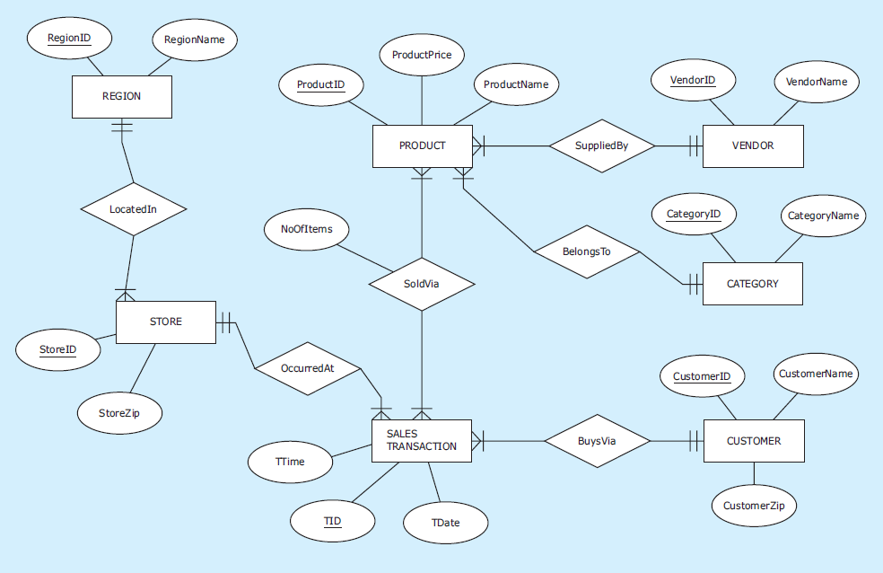
Transaction ID and Time, cont’d
Database Systems
by Jukić, Vrbsky, & Nestorov
Pearson 2014
ISBN 978-0-13-257567-6

Slide 77
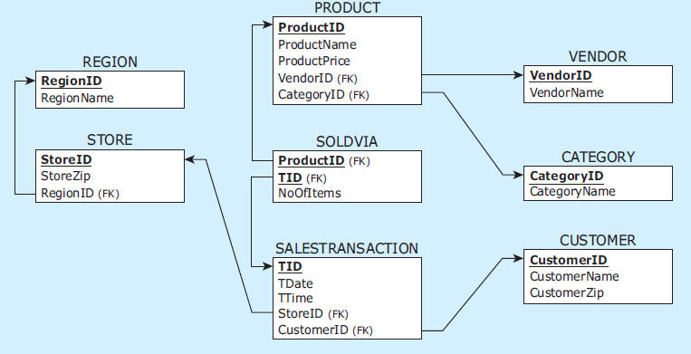
Transaction ID and Time, cont’d
The relational schema
Database Systems
by Jukić, Vrbsky, & Nestorov
Pearson 2014
ISBN 978-0-13-257567-6

Slide 78
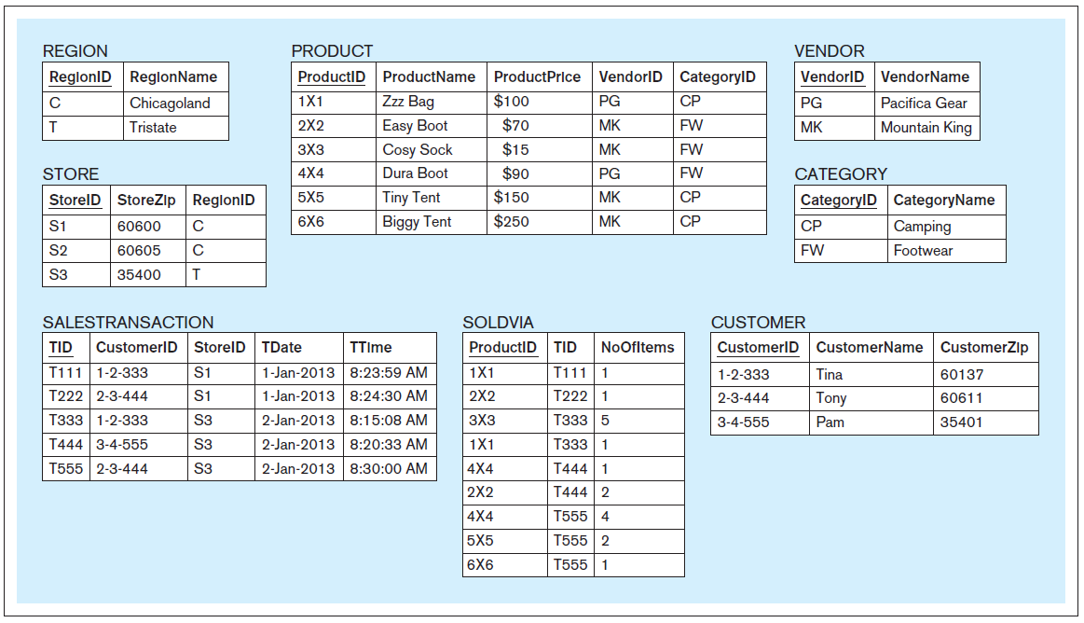
Transaction ID and Time, cont’d
Database Systems
by Jukić, Vrbsky, & Nestorov
Pearson 2014
ISBN 978-0-13-257567-6

Slide 79
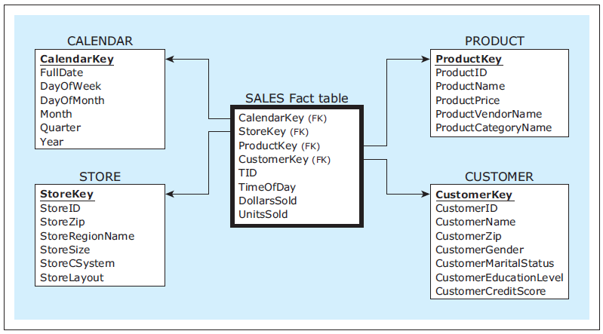
Transaction ID and Time, cont’d
The dimensional model
Database Systems
by Jukić, Vrbsky, & Nestorov
Pearson 2014
ISBN 978-0-13-257567-6

Slide 80
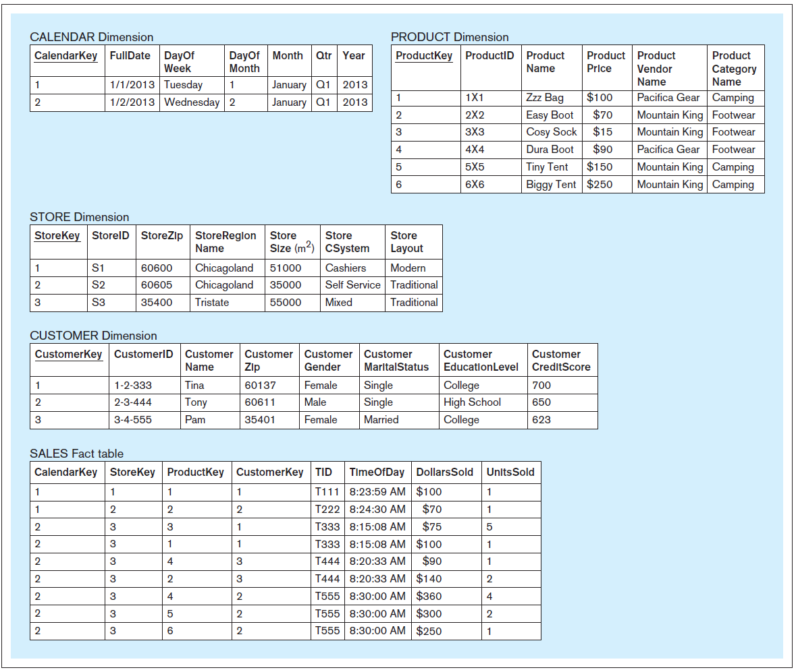
Transaction ID and Time, cont’d
Database Systems
by Jukić, Vrbsky, & Nestorov
Pearson 2014
ISBN 978-0-13-257567-6

Slide 81
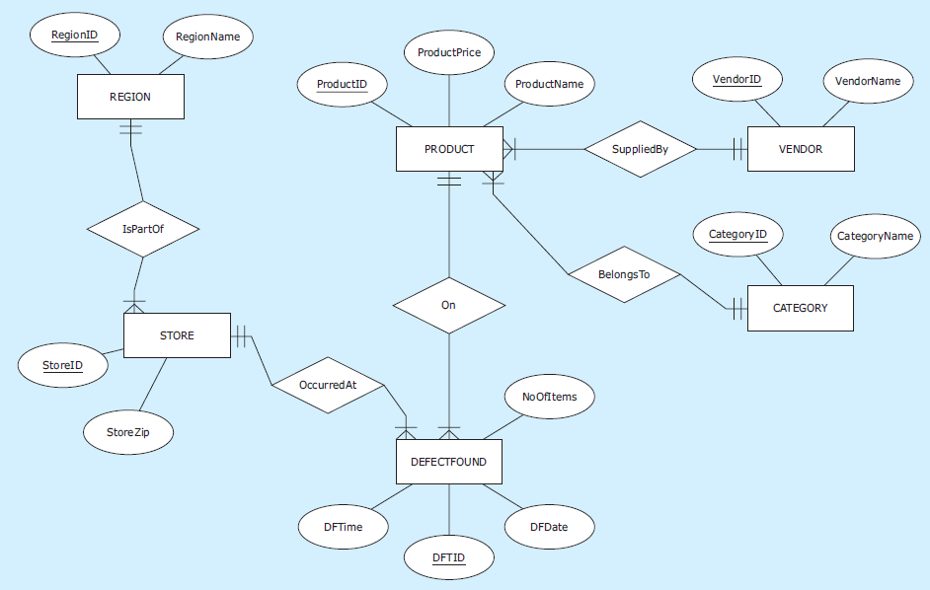
Multiple Fact Tables
Database Systems
by Jukić, Vrbsky, & Nestorov
Pearson 2014
ISBN 978-0-13-257567-6

Slide 82
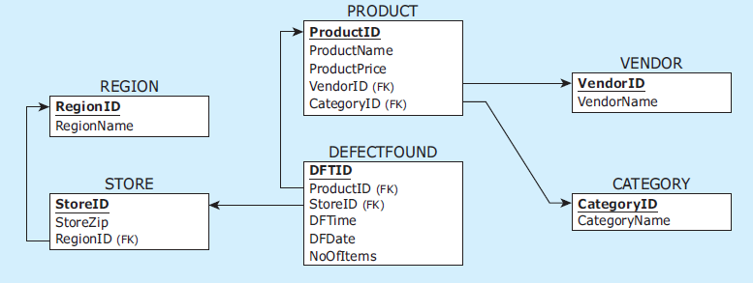
Multiple Fact Tables, cont’d
The relational schema
Database Systems
by Jukić, Vrbsky, & Nestorov
Pearson 2014
ISBN 978-0-13-257567-6

Slide 83
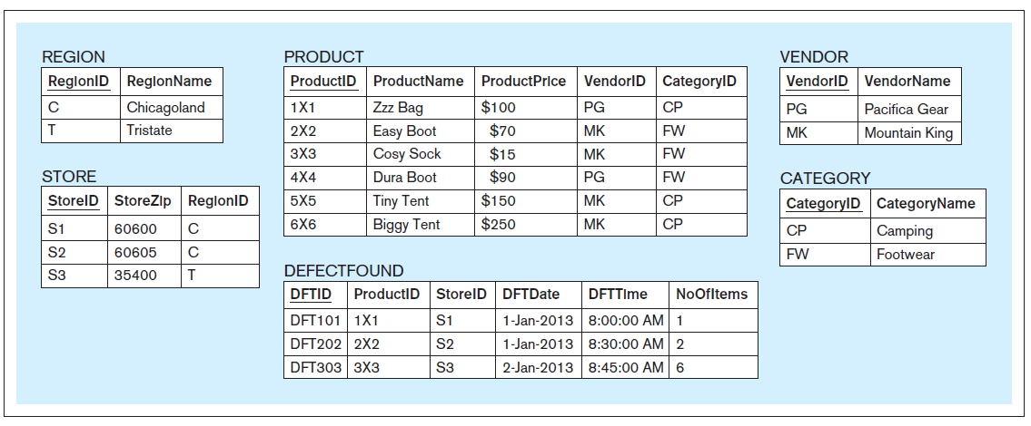
Multiple Fact Tables, cont’d
Database Systems
by Jukić, Vrbsky, & Nestorov
Pearson 2014
ISBN 978-0-13-257567-6

Slide 84
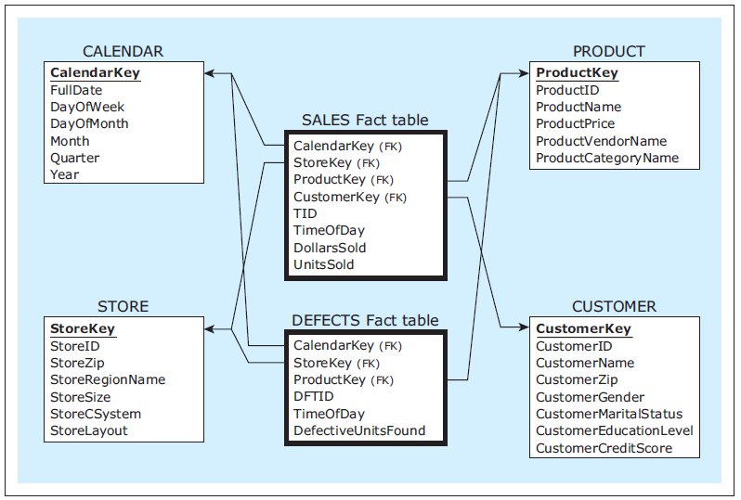
Multiple Fact Tables, cont’d
The dimensional model
Database Systems
by Jukić, Vrbsky, & Nestorov
Pearson 2014
ISBN 978-0-13-257567-6

Slide 85
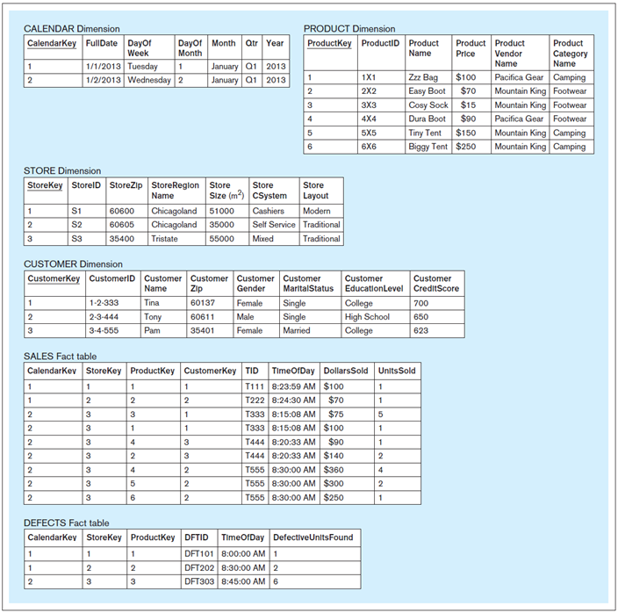
Multiple Fact Tables, cont’d
Database Systems
by Jukić, Vrbsky, & Nestorov
Pearson 2014
ISBN 978-0-13-257567-6

Slide 86
Assignment #6
Create a dimensional model with a star schema based on your project’s relational schema.
At least 4 dimension tables and 2 fact tables.
  Draw the dimensional model (star schema)
  using ERDPlus.
Include your relational schema and describe how your dimension and fact tables are populated from your operational tables.
  For now, your dimensional model can contain data that don’t come from your operational tables.

Slide 87
Assignment #6, cont’d
Put some sample data into your dimension and fact tables.
At least one query per fact table.
  Describe the query in English.
  Write and execute the SQL.
  Include a text file containing the query outputs.
Due Tuesday, April 11.

