Slide 1
CMPE 226 Database Systems February 28 Class Meeting
Department of Computer Engineering San Jose State University Spring 2017 Instructor: Ron Mak
www.cs.sjsu.edu/~mak

Slide 2
Structured Query Language (SQL)
Data Definition Language (DDL)
Create and modify the structure of a database.
tables, indexes, constraints, etc.
CREATE, ALTER, DROP
Data Manipulation Language (DML)
Insert, modify, delete, and retrieve data.
INSERT INTO, UPDATE, DELETE, SELECT

Slide 3
Structured Query Language (SQL), cont’d
Data Control Language (DCL)
Facilitate data access control.
Transaction Control Language (TCL)
Manage database transactions.

Slide 4
CREATE TABLE
Table name
Column expressions
column name
data type
column constraints
Table constraints
referential integrity

Slide 5
Common SQL Data Types

Slide 6
SQL Syntax
A semicolon at the end of an SQL command.
SQL keywords, as well as the table and column names used in the SQL commands, are not case sensitive.
For clarity and consistency, we will use all caps for SQL commands.
An SQL statement can be written as one long line of text.
For legibility reasons, SQL statements are usually written as multiple lines of text.

Slide 7
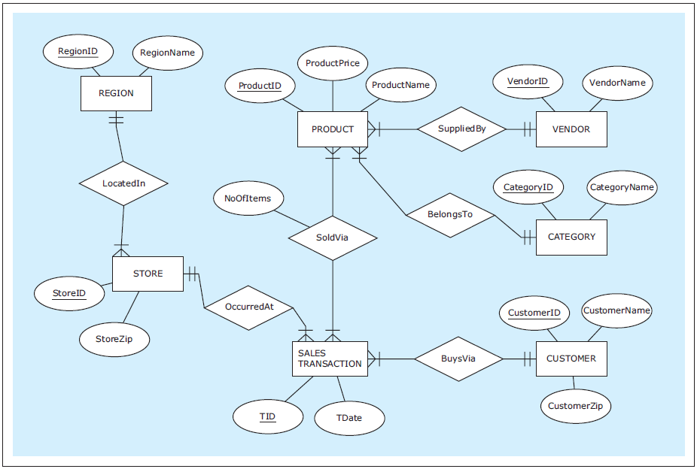
CREATE TABLE Examples
Database Systems
by Jukić, Vrbsky, & Nestorov
Pearson 2014
ISBN 978-0-13-257567-6

Slide 8
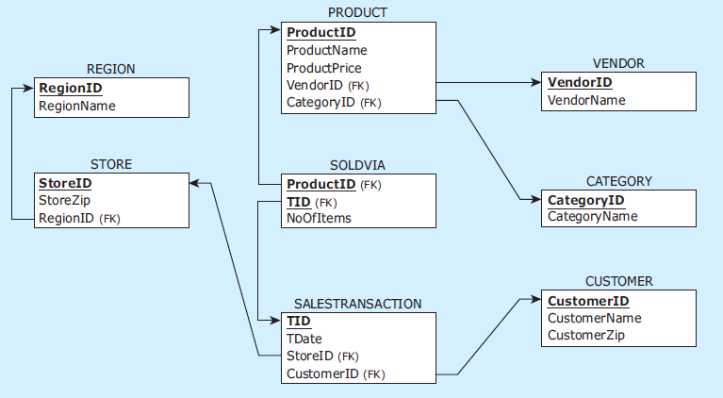
CREATE TABLE Examples, cont’d
Database Systems
by Jukić, Vrbsky, & Nestorov
Pearson 2014
ISBN 978-0-13-257567-6

Slide 9
CREATE TABLE Examples, cont’d
CREATE TABLE vendor
( vendorid CHAR(2) NOT NULL,
vendorname VARCHAR(25) NOT NULL,
PRIMARY KEY (vendorid)
);
CREATE TABLE category
( categoryid CHAR(2) NOT NULL,
categoryname VARCHAR(25) NOT NULL,
PRIMARY KEY (categoryid)
);
CREATE TABLE product
( productid CHAR(3) NOT NULL,
productname VARCHAR(25) NOT NULL,
productprice NUMERIC(7,2) NOT NULL,
vendorid CHAR(2) NOT NULL,
categoryid CHAR(2) NOT NULL,
PRIMARY KEY (productid),
FOREIGN KEY (vendorid) REFERENCES vendor(vendorid),
FOREIGN KEY (categoryid) REFERENCES category(categoryid)
);
data types
column constraints
table constraints

Slide 10
CREATE TABLE Examples, cont’d
CREATE TABLE region
( regionid CHAR(1) NOT NULL,
regionname VARCHAR(25) NOT NULL,
PRIMARY KEY (regionid)
);
CREATE TABLE store
( storeid VARCHAR(3) NOT NULL,
storezip CHAR(5) NOT NULL,
regionid CHAR(1) NOT NULL,
PRIMARY KEY (storeid),
FOREIGN KEY (regionid) REFERENCES region(regionid)
);
CREATE TABLE customer
( customerid CHAR(7) NOT NULL,
customername VARCHAR(15) NOT NULL,
customerzip CHAR(5) NOT NULL,
PRIMARY KEY (customerid)
);

Slide 11
CREATE TABLE Examples, cont’d
CREATE TABLE salestransaction
( tid VARCHAR(8) NOT NULL,
customerid CHAR(7) NOT NULL,
storeid VARCHAR(3) NOT NULL,
tdate DATE NOT NULL,
PRIMARY KEY (tid),
FOREIGN KEY (customerid) REFERENCES customer(customerid),
FOREIGN KEY (storeid) REFERENCES store(storeid)
);
CREATE TABLE soldvia
( productid CHAR(3) NOT NULL,
tid VARCHAR(8) NOT NULL,
noofitems INT NOT NULL,
PRIMARY KEY (productid, tid),
FOREIGN KEY (productid) REFERENCES product(productid),
FOREIGN KEY (tid) REFERENCES salestransaction(tid)
);
composite key

Slide 12
DROP TABLE
Referential integrity prevents deletion of a primary key that is referenced by foreign keys.
Invalid sequence:
DROP TABLE region;
DROP TABLE store;
DROP TABLE salestransaction;
DROP TABLE product;
DROP TABLE vendor;
DROP TABLE category;
DROP TABLE customer;
DROP TABLE soldvia;
Database Systems
by Jukić, Vrbsky, & Nestorov
Pearson 2014
ISBN 978-0-13-257567-6

Slide 13
DROP TABLE, cont’d
Valid sequence:
DROP TABLE soldvia;
DROP TABLE salestransaction;
DROP TABLE store;
DROP TABLE product;
DROP TABLE vendor;
DROP TABLE region;
DROP TABLE category;
DROP TABLE customer;
Database Systems
by Jukić, Vrbsky, & Nestorov
Pearson 2014
ISBN 978-0-13-257567-6

Slide 14
INSERT INTO
INSERT INTO vendor VALUES ('PG','Pacifica Gear');
INSERT INTO vendor VALUES ('MK','Mountain King');
INSERT INTO category VALUES ('CP','Camping');
INSERT INTO category VALUES ('FW','Footwear');
INSERT INTO product VALUES ('1X1','Zzz Bag',100,'PG','CP');
INSERT INTO product VALUES ('2X2','Easy Boot',70,'MK','FW');
INSERT INTO product VALUES ('3X3','Cosy Sock',15,'MK','FW');
INSERT INTO product VALUES ('4X4','Dura Boot',90,'PG','FW');
INSERT INTO product VALUES ('5X5','Tiny Tent',150,'MK','CP');
INSERT INTO product VALUES ('6X6','Biggy Tent',250,'MK','CP');
INSERT INTO region VALUES ('C','Chicagoland');
INSERT INTO region VALUES ('T','Tristate');

Slide 15
INSERT INTO, cont’d
INSERT INTO store VALUES ('S1','60600','C');
INSERT INTO store VALUES ('S2','60605','C');
INSERT INTO store VALUES ('S3','35400','T');
INSERT INTO customer VALUES ('1-2-333','Tina','60137');
INSERT INTO customer VALUES ('2-3-444','Tony','60611');
INSERT INTO customer VALUES ('3-4-555','Pam','35401');
INSERT INTO salestransaction VALUES ('T111','1-2-333','S1','01/Jan/2013');
INSERT INTO salestransaction VALUES ('T222','2-3-444','S2','01/Jan/2013');
INSERT INTO salestransaction VALUES ('T333','1-2-333','S3','02/Jan/2013');
INSERT INTO salestransaction VALUES ('T444','3-4-555','S3','02/Jan/2013');
INSERT INTO salestransaction VALUES ('T555','2-3-444','S3','02/Jan/2013');

Slide 16
INSERT INTO, cont’d
INSERT INTO soldvia VALUES ('1X1','T111',1);
INSERT INTO soldvia VALUES ('2X2','T222',1);
INSERT INTO soldvia VALUES ('3X3','T333',5);
INSERT INTO soldvia VALUES ('1X1','T333',1);
INSERT INTO soldvia VALUES ('4X4','T444',1);
INSERT INTO soldvia VALUES ('2X2','T444',2);
INSERT INTO soldvia VALUES ('4X4','T555',4);
INSERT INTO soldvia VALUES ('5X5','T555',2);
INSERT INTO soldvia VALUES ('6X6','T555',1);

Slide 17
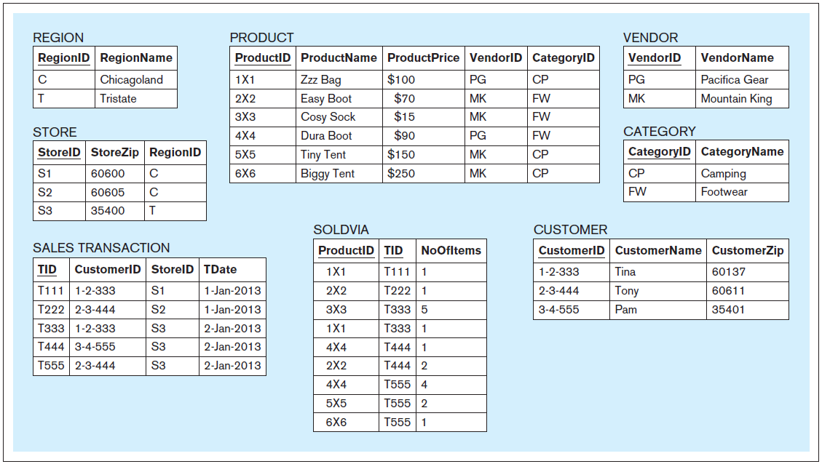
INSERT INTO, cont’d
Database Systems
by Jukić, Vrbsky, & Nestorov
Pearson 2014
ISBN 978-0-13-257567-6

Slide 18
INSERT INTO, cont’d
Explicitly specify column names:
Insert more than one row per command:
INSERT INTO soldvia(noofitems, tid, productid)
VALUES (1, 'T555', '6x6');
INSERT INTO customer VALUES ('1-2-333','Tina','60137'),
('2-3-444','Tony','60611'),
('3-4-555','Pam','35401');

Slide 19
SELECT
Retrieve data from database tables.
The most common SQL command.

Slide 20
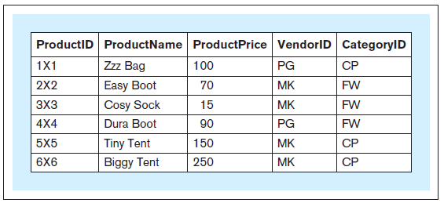
SELECT, cont’d
Retrieve the entire contents of the Product table.
SELECT * FROM product;
Database Systems
by Jukić, Vrbsky, & Nestorov
Pearson 2014
ISBN 978-0-13-257567-6

Slide 21
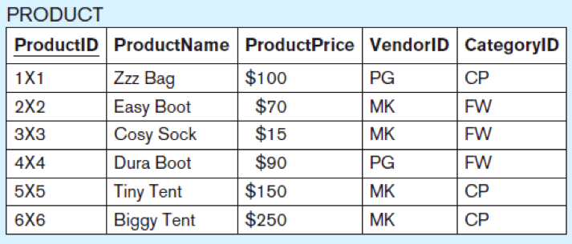
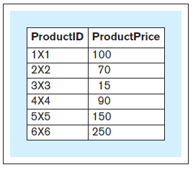
SELECT, cont’d
Retrieve only certain columns of the Product table.
Projection operation
SELECT productid, productprice FROM product;
Database Systems
by Jukić, Vrbsky, & Nestorov
Pearson 2014
ISBN 978-0-13-257567-6

Slide 22
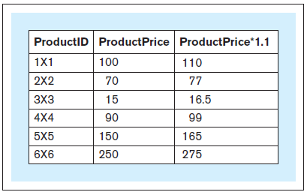
SELECT, cont’d
Calculate a column (derived attribute) from the Product table.
SELECT productid, productprice,
1.1 * productprice FROM product;
Database Systems
by Jukić, Vrbsky, & Nestorov
Pearson 2014
ISBN 978-0-13-257567-6

Slide 23
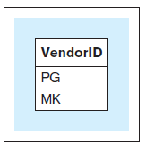
SELECT DISTINCT
Which vendor IDs are in the Product table?
SELECT DISTINCT vendorid FROM product;
Database Systems
by Jukić, Vrbsky, & Nestorov
Pearson 2014
ISBN 978-0-13-257567-6

Slide 24
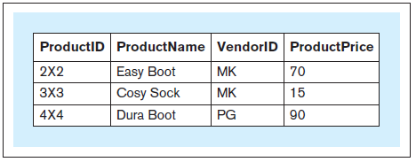
SELECT WHERE
Which products in the FW category have price less than or equal to $110?
SELECT productid, productname, vendorid, productprice FROM product WHERE productprice <= 110
AND categoryid = 'FW';
Database Systems
by Jukić, Vrbsky, & Nestorov
Pearson 2014
ISBN 978-0-13-257567-6

Slide 25
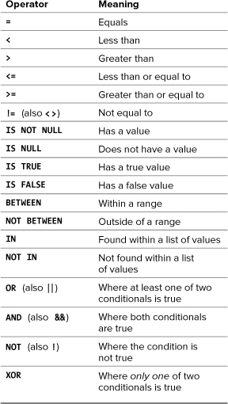
MySQL Conditional Operators
PHP and MySQL for Dynamic Web Sites, 4th ed.
by Larry Ullman
Peachpit Press, 2012
ISBN 978-0-321-78407-0

Slide 26
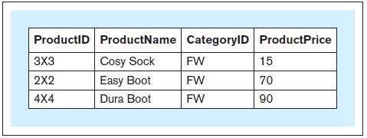
SELECT ORDER BY
Sort products by product price.
SELECT productid, productname,
categoryid, productprice FROM product WHERE categoryid = 'FW’ ORDER BY productprice;
Database Systems
by Jukić, Vrbsky, & Nestorov
Pearson 2014
ISBN 978-0-13-257567-6

Slide 27
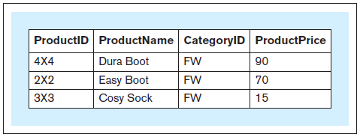
SELECT ORDER BY, cont’d
Sort products by product price in descending order.
SELECT productid, productname,
categoryid, productprice FROM product WHERE categoryid = 'FW’ ORDER BY productprice DESC;
Database Systems
by Jukić, Vrbsky, & Nestorov
Pearson 2014
ISBN 978-0-13-257567-6

Slide 28
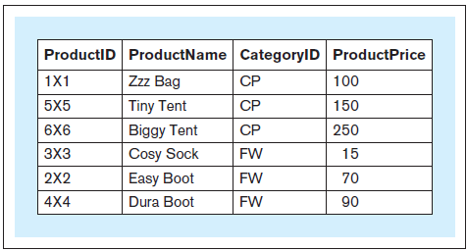
SELECT ORDER BY, cont’d
Sort products first by category ID and then by product price.
Database Systems
by Jukić, Vrbsky, & Nestorov
Pearson 2014
ISBN 978-0-13-257567-6
SELECT productid, productname,
categoryid, productprice FROM product ORDER BY categoryid,
productprice;

Slide 29
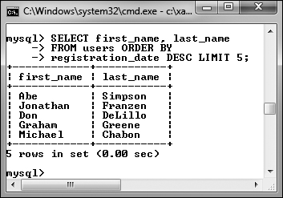
Limiting Query Results
SELECT first_name, last_name
FROM users ORDER BY
registration_date DESC
LIMIT 5;
Also:
Return n records starting with the i^{th} record.
Does not improve the query execution speed, since MySQL still has to match all the records.
Reduces the number of returned records.
Useful for “paging” the results.
LIMIT i, n
PHP and MySQL for Dynamic Web Sites, 4th ed.
by Larry Ullman
Peachpit Press, 2012
ISBN 978-0-321-78407-0

Slide 30
SELECT LIKE
Which products have “Boot” in their name?
SELECT * FROM product WHERE productname LIKE '%Boot%';
Database Systems
by Jukić, Vrbsky, & Nestorov
Pearson 2014
ISBN 978-0-13-257567-6

Slide 31
SELECT LIKE, cont’d
String comparisons using wildcard characters:
_ matches any single character
% matches any zero or more characters
mysql> select * from people;
+-----+---------+---------+--------+--------+
| id | first | last | gender | salary |
+-----+---------+---------+--------+--------+
| 101 | Charles | Jones | M | 100000 |
| 103 | Mary | Adams | F | 150000 |
| 105 | Susan | Miller | F | 50000 |
| 110 | Roger | Brown | M | 75000 |
| 112 | Leslie | Adamson | F | 105000 |
+-----+---------+---------+--------+--------+
5 rows in set (0.00 sec)
mysql> select * from people
-> where last like 'Adam%';
+-----+--------+---------+--------+--------+
| id | first | last | gender | salary |
+-----+--------+---------+--------+--------+
| 103 | Mary | Adams | F | 150000 |
| 112 | Leslie | Adamson | F | 105000 |
+-----+--------+---------+--------+--------+
2 rows in set (0.02 sec)

Slide 32
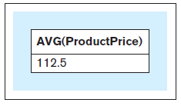
SELECT Aggregate Functions
What is the average price of all products?
SELECT AVG(productprice) FROM product;
Database Systems
by Jukić, Vrbsky, & Nestorov
Pearson 2014
ISBN 978-0-13-257567-6

Slide 33
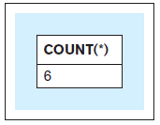
SELECT Aggregate Functions, cont’d
How many products are there?
SELECT COUNT(*)
FROM product;
Database Systems
by Jukić, Vrbsky, & Nestorov
Pearson 2014
ISBN 978-0-13-257567-6

Slide 34
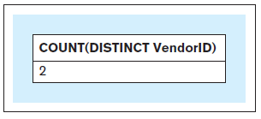
SELECT Aggregate Functions, cont’d
How many vendors supply the products?
SELECT COUNT(DISTINCT vendorid)
FROM product;
Database Systems
by Jukić, Vrbsky, & Nestorov
Pearson 2014
ISBN 978-0-13-257567-6

Slide 35
SELECT Aggregate Functions, cont’d
Aggregate functions COUNT, SUM, AVG, MIN, MAX
SELECT COUNT(*), AVG(productprice), MIN(productprice), MAX(productprice) FROM product WHERE categoryid = 'CP';
Database Systems
by Jukić, Vrbsky, & Nestorov
Pearson 2014
ISBN 978-0-13-257567-6

Slide 36
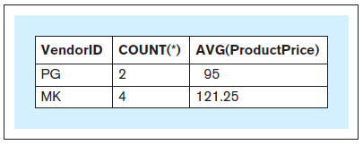
SELECT GROUP BY
What is the average price for each vendor?
SELECT vendorid, COUNT(*), AVG(productprice) FROM product GROUP BY vendorid;
Database Systems
by Jukić, Vrbsky, & Nestorov
Pearson 2014
ISBN 978-0-13-257567-6

Slide 37
SELECT GROUP BY, cont’d
When a SELECT has aggregate functions, it cannot have individual columns unless the columns are in a GROUP BY clause.
You can group by multiple columns.
SELECT vendorid, COUNT(*), AVG(productprice) FROM product GROUP BY vendorid;

Slide 38
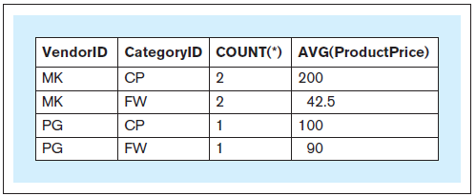
SELECT GROUP BY, cont’d
Group by vendor, and then by category.
SELECT vendorid, categoryid, COUNT(*), AVG(productprice) FROM product GROUP BY vendorid, categoryid;
Database Systems
by Jukić, Vrbsky, & Nestorov
Pearson 2014
ISBN 978-0-13-257567-6

Slide 39
SELECT GROUP BY HAVING
Group products $50 or more by vendor and category.
Count and average price only if more than one per group.
SELECT vendorid, categoryid, COUNT(*), AVG(productprice) FROM product WHERE productprice >= 50 GROUP BY vendorid, categoryid HAVING COUNT(*) > 1;
Database Systems
by Jukić, Vrbsky, & Nestorov
Pearson 2014
ISBN 978-0-13-257567-6

Slide 40
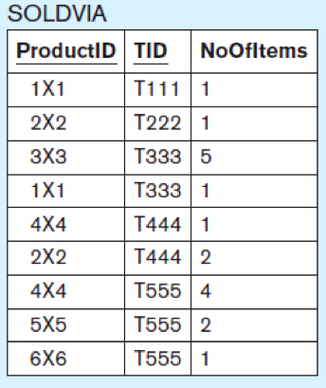
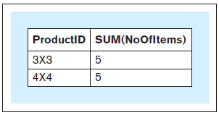
SELECT GROUP BY HAVING, cont’d
For products that sold more than 3 items in all sales transactions, what were the total number of items sold?
SELECT productid, SUM(noofitems) FROM soldvia GROUP BY productid HAVING SUM(noofitems) > 3;
The WHERE clause applies to records.
The HAVING clause
applies to groups.
Database Systems
by Jukić, Vrbsky, & Nestorov
Pearson 2014
ISBN 978-0-13-257567-6

Slide 41
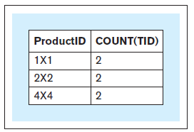
SELECT GROUP BY HAVING, cont’d
For each product that was sold in more than one sales transaction, what is the number of transactions in which the product was sold?
SELECT productid, COUNT(TID) FROM soldvia GROUP BY productid HAVING COUNT(TID) > 1;
Database Systems
by Jukić, Vrbsky, & Nestorov
Pearson 2014
ISBN 978-0-13-257567-6

Slide 42
Break

Slide 43
Nested Queries
An outer query makes use of the results from a nested (inner) query.

Slide 44
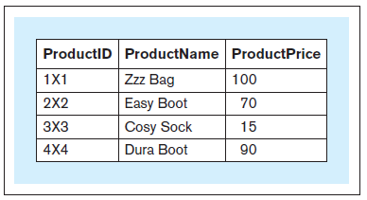
Nested Queries, cont’d
Which products sell below the average price?
SELECT productid, productname, productprice FROM product WHERE productprice < (SELECT AVG(productprice)
FROM product);
First, we need to
calculate the average.
Database Systems
by Jukić, Vrbsky, & Nestorov
Pearson 2014
ISBN 978-0-13-257567-6

Slide 45
Nested Queries, cont’d
Wrong:
Aggregate functions can only appear within a SELECT clause or a HAVING clause.
SELECT productid, productname, productprice FROM product WHERE productprice < AVG(productprice);
Database Systems
by Jukić, Vrbsky, & Nestorov
Pearson 2014
ISBN 978-0-13-257567-6

Slide 46
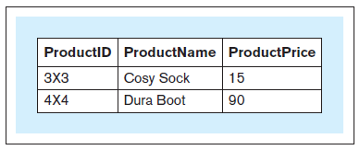
SELECT IN
Which products have more than 3 items sold in all sales transactions?
SELECT productid, productname, productprice FROM product WHERE productid IN (SELECT productid FROM soldvia
GROUP BY productid HAVING SUM(noofitems) > 3);
Database Systems
by Jukić, Vrbsky, & Nestorov
Pearson 2014
ISBN 978-0-13-257567-6

Slide 47
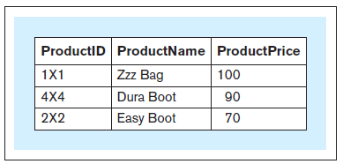
SELECT IN, cont’d
Which products were each sold in more than one sales transaction?
SELECT productid, productname, productprice FROM product WHERE productid IN (SELECT productid FROM soldvia GROUP BY productid HAVING COUNT(*) > 1);
Database Systems
by Jukić, Vrbsky, & Nestorov
Pearson 2014
ISBN 978-0-13-257567-6

Slide 48
Recall: Relational Algebra
The mathematical theory behind database operations:
project
which columns?
listed after the SELECT keyword
select
which rows?
WHERE and HAVING clauses
join
Query multiple tables at the same time.

Slide 49
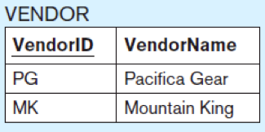
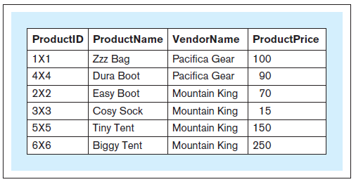
Joins
What is the id, product name, vendor name, and price of each product?
SELECT productid, productname,
vendorname, productprice FROM product, vendor WHERE product.vendorid
= vendor.vendorid;
Qualified names
Database Systems
by Jukić, Vrbsky, & Nestorov
Pearson 2014
ISBN 978-0-13-257567-6

Slide 50
Joins, cont’d
Without a join condition, you get a Cartesian product.
Each record of one table matched with every record from the other table.

Slide 51
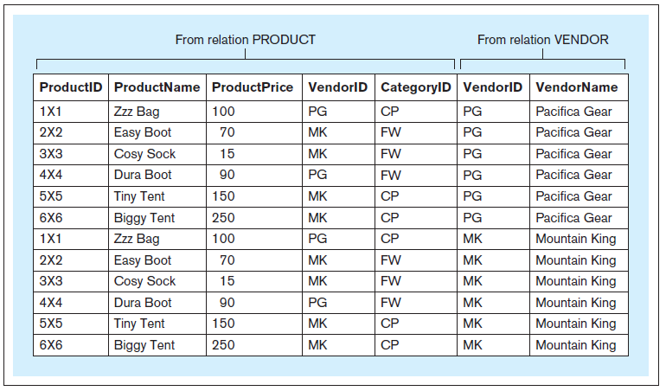
Joins, cont’d
SELECT * FROM product, vendor;
Database Systems
by Jukić, Vrbsky, & Nestorov
Pearson 2014
ISBN 978-0-13-257567-6

Slide 52
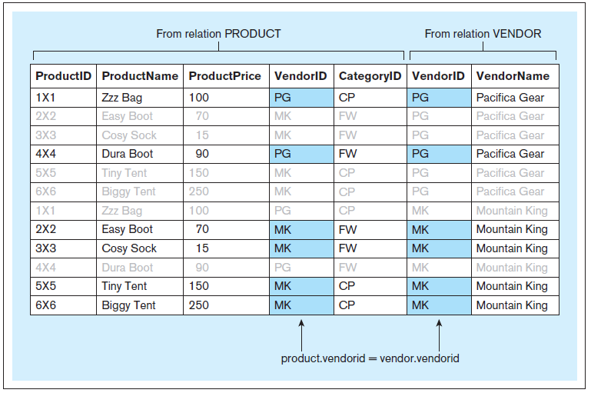
Joins, cont’d
Include the join condition
WHERE product.vendorid = vendor.vendorid

Slide 53
Join Alias
Use aliases anywhere within a query instead of the full table name.
No effect on the query itself.
Improve legibility.
SELECT productid, productname,
vendorname, productprice FROM product, vendor WHERE product.vendorid = vendor.vendorid;
SELECT p.productid, p.productname,
v.vendorname, p.productprice FROM product p, vendor v WHERE p.vendorid = v.vendorid;

Slide 54
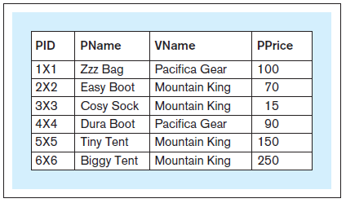
Join Alias, cont’d
Use aliases to rename columns in query results.
SELECT p.productid pid,
p.productname pname, v.vendorname vname,
p.productprice pprice FROM product p, vendor v WHERE p.vendorid = v.vendorid;
You cannot use aliased column
names in the WHERE clause.
Database Systems
by Jukić, Vrbsky, & Nestorov
Pearson 2014
ISBN 978-0-13-257567-6

Slide 55
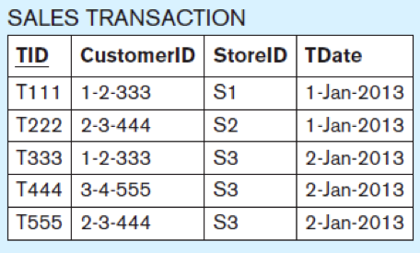
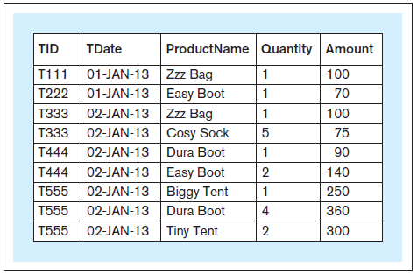
Joining Multiple Tables
SELECT t.tid, t.tdate, p.productname, sv.noofitems AS quantity, (sv.noofitems * p.productprice) AS amount FROM product AS p, salestransaction AS t, soldvia AS sv WHERE sv.productid = p.productid
AND sv.tid = t.tid ORDER BY t.tid;
You can use AS
to introduce an alias.
Database Systems
by Jukić, Vrbsky, & Nestorov
Pearson 2014
ISBN 978-0-13-257567-6
Oracle does not allow AS
for table aliases.

Slide 56
ALTER TABLE
Change the structure of an existing table.
Add a new column.
Example:
Drop a column.
Example:
ALTER TABLE vendor ADD (vendorphonenumber CHAR(11));
ALTER TABLE vendor DROP (vendorphonenumber);
Database Systems
by Jukić, Vrbsky, & Nestorov
Pearson 2014
ISBN 978-0-13-257567-6

Slide 57
UPDATE
Database Systems
by Jukić, Vrbsky, & Nestorov
Pearson 2014
ISBN 978-0-13-257567-6
Modify data in a table.
Examples:
UPDATE product SET productprice = 100 WHERE productid = '4×4';
ALTER TABLE product ADD (discount NUMERIC(3,2));
UPDATE product SET discount = 0.2;
Set the value of the discount column in all rows to 0.2.

Slide 58
DELETE
Delete rows from a table.
Example:
Without the WHERE clause, all the table rows will be deleted, resulting in an empty table.
DELETE FROM product WHERE productid = '4×4’;
Database Systems
by Jukić, Vrbsky, & Nestorov
Pearson 2014
ISBN 978-0-13-257567-6

Slide 59
Views
A view allows the structure of a query to be saved in the database.
AKA virtual table
Not an actual table – no data is saved.
Whenever a view is invoked, it executes a query to retrieve data from the actual tables.
A view is analogous to a procedure in a programming language.
Use a view like any other table.

Slide 60
Views, cont’d
Which products have more than 3 items sold in all sales transactions?
CREATE VIEW products_more_than_3_sold AS
SELECT productid, productname, productprice FROM product WHERE productid IN (SELECT productid FROM soldvia
GROUP BY productid HAVING SUM(noofitems) > 3);

Slide 61
Views, cont’d
CREATE VIEW products_more_than_3_sold AS
SELECT productid, productname, productprice FROM product WHERE productid IN (SELECT productid FROM soldvia
GROUP BY productid HAVING SUM(noofitems) > 3);
SELECT * FROM products_more_than_3_sold;
Database Systems
by Jukić, Vrbsky, & Nestorov
Pearson 2014
ISBN 978-0-13-257567-6

Slide 62
Views, cont’d
CREATE VIEW products_in_multiple_trnsc AS SELECT productid, productname, productprice FROM product WHERE productid IN (SELECT productid FROM soldvia GROUP BY productid HAVING COUNT(*) > 1);
Database Systems
by Jukić, Vrbsky, & Nestorov
Pearson 2014
ISBN 978-0-13-257567-6

Slide 63
Views, cont’d
SELECT * FROM products_in_multiple_trnsc;
Dropping views
Example:
DROP VIEW products_in_multiple_trnsc;
Database Systems
by Jukić, Vrbsky, & Nestorov
Pearson 2014
ISBN 978-0-13-257567-6

Slide 64
PHP query() vs. exec()
Use PDO::query() to execute an SQL SELECT statement.
Returns a result set as a PDOStatement object.
$con = new PDO("mysql:host=localhost;dbname=school",
"root", "sesame");
$con->setAttribute(PDO::ATTR_ERRMODE,
PDO::ERRMODE_EXCEPTION);
$query = "SELECT * FROM teacher WHERE id = $id";
$data = $con->query($query);

Slide 65
PHP query() vs. exec(), cont’d
Teacher
Use PDO::exec() to execute an SQL INSERT or DELETE statement.
Returns the count of affected rows.
Id | Last | First
7003 | Rogers | Tom
7008 | Thompson | Art
7012 | Lane | John
7051 | Flynn | Mabel
$con = new PDO("mysql:host=localhost;dbname=school",
"root", "sesame");
$con->setAttribute(PDO::ATTR_ERRMODE,
PDO::ERRMODE_EXCEPTION);
$query = "UPDATE teacher ".
"SET first = 'Ronald' ". "WHERE first = 'Ron'";
$count = $con->exec($query);

Slide 66
Table Join with PHP
$first = filter_input(INPUT_GET, "firstName");
$last = filter_input(INPUT_GET, "lastName");
try {
$con = new PDO("mysql:host=localhost;dbname=school",
"root", "sesame");
$con->setAttribute(PDO::ATTR_ERRMODE,
PDO::ERRMODE_EXCEPTION);
$query = "SELECT student.first, student.last, subject ".
"FROM student, teacher, class, student_class ".
"WHERE teacher.last = '$last' ".
"AND teacher.first = '$first' ".
"AND teacher_id = teacher.id ".
"AND code = class_code ".
"AND student.id = student_id ".
"ORDER BY subject, student.last";
$data = $con->query($query);
$data->setFetchMode(PDO::FETCH_ASSOC);

Slide 67
SQL Injection Attack
A simple query with a teacher id:
$id = filter_input(INPUT_GET, "id");
try {
$con = new PDO("mysql:host=localhost;dbname=school",
"root", "sesame");
$con->setAttribute(PDO::ATTR_ERRMODE,
PDO::ERRMODE_EXCEPTION);
$query = "SELECT * FROM teacher WHERE id = $id";
$data = $con->query($query);
$data->setFetchMode(PDO::FETCH_ASSOC);
$data contains a result set as a PDOStatement object.

Slide 68
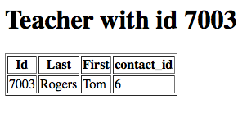
SQL Injection Attack, cont’d
Id | Last | First
7003 | Rogers | Tom
7008 | Thompson | Art
7012 | Lane | John
7051 | Flynn | Mabel

Slide 69
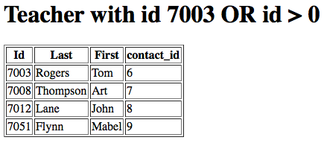
SQL Injection Attack, cont’d

Slide 70
Prepared Statement
$id = filter_input(INPUT_GET, "id");
try {
$con = new PDO("mysql:host=localhost;dbname=school",
"root", "sesame");
$con->setAttribute(PDO::ATTR_ERRMODE,
PDO::ERRMODE_EXCEPTION);
$query = "SELECT * FROM teacher WHERE id = :id";
$ps = $con->prepare($query);
$ps->execute(array(':id' => $id));
$data = $ps->fetchAll(PDO::FETCH_ASSOC);
$data contains an array.

Slide 71
Prepared Statement, cont’d

Slide 72
Prepared Statement, cont’d
Never insert text from a user on the client side directly into an SQL query on the server side.
A prepared statement provides some defense against SQL injection attacks.
A prepared statement is parsed and compiled once.
It can be reused.
Performance improvement for queries made from inside PHP loops.

Slide 73
Table Join with a Prepared Statement
$con = new PDO("mysql:host=localhost;dbname=school",
"root", "sesame");
$con->setAttribute(PDO::ATTR_ERRMODE,
PDO::ERRMODE_EXCEPTION);
$query = "SELECT student.first, student.last, subject ".
"FROM student, teacher, class, student_class ".
"WHERE teacher.last = :last ".
"AND teacher.first = :first ".
"AND teacher_id = teacher.id ".
"AND code = class_code ".
"AND student.id = student_id ".
"ORDER BY subject, student.last";
$ps = $con->prepare($query);
$ps->execute(array(':first' => $first, ':last' => $last));
$data = $ps->fetchAll(PDO::FETCH_ASSOC);

Slide 74
Parameter Binding
Instead of:
Use parameter binding:
$ps->execute(array(':first' => $first, ':last' => $last));
$data = $ps->fetchAll(PDO::FETCH_ASSOC);
$ps->bindParam(':first', $first);
$ps->bindParam(':last', $last);
$ps->execute();
$data = $ps->fetchAll(PDO::FETCH_ASSOC);

Slide 75
Assignment #4
You can add even more database tables to your project (or modify the ones you already have).
The tables should be in 3rd normal form.
Now do joins.
Use PHP prepared statements.
Due Tuesday, March 7

Slide 76
MySQL Workbench
Open-source version of some very expensive commercial database design and management tools (such as ERWin Data Modeler).
Download from http://dev.mysql.com/downloads/
Features
Manage databases and database connections.
Edit, execute, and save SQL scripts.
Forward- and reverse-engineering.
Generate a crow’s feet ER diagram from an existing database.
Manually create an ER diagram.
Automatically generate a database from the diagram.

Slide 77
MySQL Workbench: ER Diagrams
MySQL Workbench can generate a new ER diagram by “reverse engineering” an existing database.
Demo: Generate a new ER diagram.

Slide 78
MySQL Workbench: ER Diagrams, cont’d
MySQL Workbench can generate a new database by “forward engineering” an ER diagram.
Demo: Generate a new database.

