Slide 1


CMPE 226
Database Systems
February 14 Class Meeting
Department of Computer Engineering
San Jose State University
Spring 2017
Instructor: Ron Mak
www.cs.sjsu.edu/~mak

Slide 2
PHP Syntax
Very similar to C.
  End each statement with a semicolon.
Case sensitive:
  variables, constants, array keys
  class properties and constraints
Case insensitive:
  functions (pre-defined and user-defined)
  class constructors and methods
  reserved words

Slide 3
PHP Variables
All variable names start with $.
PHP is a dynamically typed language.
  You don’t declare a variable’s type.
  A variable can be assigned a value of any type.
PHP data types
  scalar: integer, float, boolean, string
  array
  object
  resource
  NULL

Slide 4
PHP Strings
Enclose a string with single or double quotes.
  Examples:
Variables embedded in a double-quoted string are evaluated:
  But not:
  "Hello, world!"
  'Hello, world!'
  "It's a nice day."
  'Define "string" for me.'
  "Define \"string\" please."
  "The first name is $first."
  'The first name is $first.'

Slide 5
PHP String Operations
The string concatenation operator is .
  Better:
Some string functions:
  strlen()
  strtoupper()
  strtolower()
  ucwords() capitalize the first letter of every word
  $name = $last . ", " . $first;
  $name .= ", Esq.";
  $name = "$last, $first";
Demo

Slide 6
Heredocs
Use a heredoc to avoid string quoting issues.
  Example:
$first = "John";
$last = "Smith";
print <<<HERE
<table border="1">
<tr>
<td>First name:</td>
<td>$first</td>
</tr>
<tr>
<td> Last name:</td>
<td>$last</td>
</tr></table>
HERE;
Must be on
a line by itself
with no indentation.
Demo

Slide 7
PHP Constants
Name constants with all uppercase letters,
by convention.
  Constants are not variables, so do not use $.
Examples
  But not:
  define (PI, 3.1415926);
  define (HOST_NAME, "localhost");
  print "Host name is " . HOST_NAME;
print "Host name is HOST_NAME";

Slide 8
Two Kinds of PHP Arrays
Indexed array
  Indexes are integers.
Associative array
  Indexes are strings.
  key-value pairs, like a hash table.

Slide 9
Creating PHP Indexed Arrays
$bands[] = "Beatles";
$bands[] = "Rolling Stones";
$bands[] = "Queen";
Use the array() function:
Specify the first index value.
  Subsequent elements are indexed incrementally.
An array of sequential numbers:
$bands = array("Beatles", "Rolling Stones", "Queen");
$bands = array(2=>"Beatles", "Rolling Stones", "Queen");
$values = range(5, 10);

Slide 10
Creating PHP Associative Arrays
$states["CA"] = "California";
$states["NY"] = "New York";
$states["TX"] = "Texas";
Use the array() function:
$states = array(
"CA" => "California",
"NY" => "New York",
"TX" => "Texas"
);
An associative array is like a hash table.

Slide 11
Looping over Array Elements
Use the foreach statement:
  Examples:
foreach ($arrayname as $variable) { … }
foreach ($arrayname as $key => $value) { … }
foreach ($bands as $bandName) {
print $bandName;
}
foreach ($states as $abbrev => $fullName) {
print "State $fullName is abbreviated $abbrev";
}
Demo

Slide 12
Multidimensional Arrays
$north = array("ND" => "North Dakota", "MN" => "Minnesota");
$south = array("TX" => "Texas", "FL" => "Florida");
$east = array("NY" => "New York", "ME" => "Maine");
$west = array("CA" => "California", "OR" => "Oregon");
$us = array(
"N" => $north,
"S" => $south,
"E" => $east,
"W" => $west
);

Slide 13
Multidimensional Arrays, cont’d
print "<ul>\n";
foreach ($us as $region => $states) {
print " <li>\n";
print " <h2>$region</h2>\n";
print " <ul>\n";
foreach ($states as $abbrev => $name) {
print " <li>$abbrev: $name</li>\n";
}
print " </ul>\n";
}
print "</ul>\n";
Demo

Slide 14
PHP Functions
Syntax for programmer-defined functions:
  Examples:
A function can optionally return a value.
function name (optional arguments)
{
// statements in the body
}
function doSomething() { … }
function sayHello($first, $last) { … }
function greet($name, $language = "English") { … }
function calculate($input, &$output) { … }
Default value
Passed by reference
return value;

Slide 15
Scope of PHP Variables
Variables have the scope of the PHP file
in which they reside.
A programmer-defined function
creates a scope for its variables.
  Variables defined in a function
  cannot be accessed outside the function.
  Variables defined outside the function
  are not accessible inside the function.
Use the global statement inside a function
to access outside variables.
  Example:
global $outsideVar;

Slide 16
PHP Data Objects (PDO)
Create a database abstraction layer:
Postgres
MySQL
Oracle
PHP Data Objects (PDO)
query()
PHP
PDO documentation:
http://php.net/manual/en/book.pdo.php

Slide 17
PDO Examples
// Connect to the database.
$con = new PDO("mysql:host=localhost;dbname=supercoders",
"supercoders", "sesame");
$con->setAttribute(PDO::ATTR_ERRMODE,
PDO::ERRMODE_EXCEPTION);
Create a new PDO object to represent the database connection.
Set the error mode attribute
to throw an exception if there is an error.

Slide 18
PDO Examples, cont’d
// Fetch the database field names.
$result = $con->query($query);
$row = $result->fetch(PDO::FETCH_ASSOC);
PDO::query() executes an SQL statement and returns a result set as a PDOStatement object.
PDOStatement::fetch() fetches the
next row of the result set.
  PDO::FETCH_ASSOC returns the row as an associative array indexed by column names.

Slide 19
PDO Examples, cont’d
// Construct the header row of the HTML table.
print " <tr>\n";
foreach ($row as $field => $value) {
print " <th>$field</th>\n";
}
print " </tr>\n";
Extract the column (field) names of the
fetched row to construct the header row
of the HTML table.

Slide 20
PDO Examples, cont’d
// Fetch the matching database table rows.
$data = $con->query($query);
$data->setFetchMode(PDO::FETCH_ASSOC);
// Construct the HTML table row by row.
foreach ($data as $row) {
print " <tr>\n";
foreach ($row as $name => $value) {
print " <td>$value</td>\n";
}
print " </tr>\n";
}
PDOStatement::setFetchMode sets the default fetch mode for this statement.

Slide 21
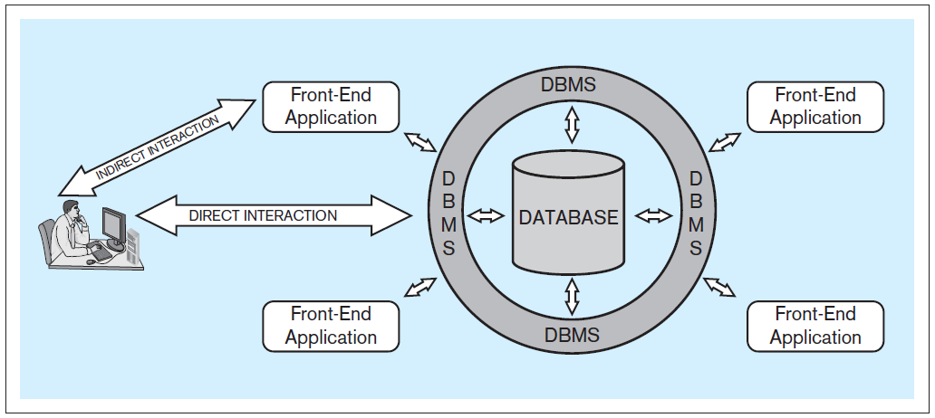
Database System Architecture
Database system: A computer-based system that enables efficient interaction between users and information stored in a database.
Database Systems
by Jukić, Vrbsky, & Nestorov
Pearson 2014
ISBN 978-0-13-257567-6

Slide 22
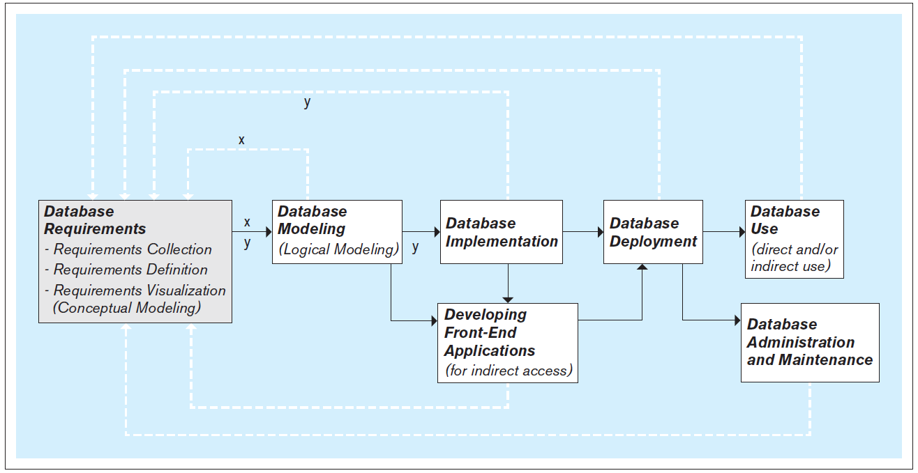
Steps to Develop a Database
It’s an iterative process!
Database Systems
by Jukić, Vrbsky, & Nestorov
Pearson 2014
ISBN 978-0-13-257567-6

Slide 23
Database Requirements
First and most critical step:
Collect, define, and visualize the requirements.
What data will the database hold and how?
What will be the capabilities and functionalities of the database?
Reliability, performance, and security issues?
Use the requirements to model and implement the database and to create the front-end applications.

Slide 24
Conceptual Database Model
Visualize the requirements.
Use a conceptual data modeling technique.
  Example: Entity-relationship (ER) modeling
Implementation independent:
No dependencies on the logic of a particular database management system (DBMS).
  Example DBMS: Oracle, MySQL, etc.
Blueprint for the logical model.

Slide 25
Logical Database Model
Create the relational database model.
  Later: Non-relational NoSQL models.
It’s usually straightforward to map
an ER model to a relational model.

Slide 26
Physical Database Model
The physical model is the actual
database implementation.
Use relational DBMS (RDBMS) software.
  Later: NoSQL systems
Structured Query Language (SQL) commands to create, delete, modify, and query database structures.

Slide 27
Front-End Application Development
End users generally do not access the database directly.
Front-end applications
  Access the database directly.
  Provide end users with safe application-oriented interfaces to query and manipulate the data.
  Fulfill the end user’s requirements.

Slide 28
Operational vs. Analytical Databases
Operational database
  Supports day-to-day operational business needs.
  Contains operational (transactional) information.
    Example: sales transactions
Analytical database
  Supports analytical business tasks.
  Contains analytical information.
    Examples: usage patterns, sales trends, etc.
    Derived from operational information.
  Often associated with data warehousing.

Slide 29
Break

Slide 30
Entities and Attributes
Entity
  Represents a real-world concept.
    Examples: customer, product, store, event, etc.
  Data that the database stores.
Attribute
  Characteristic of an entity that the database stores.
    Examples (for a customer): name, address, id, etc.
  A unique attribute of an entity has a value that is different for each entity instance.

Slide 31
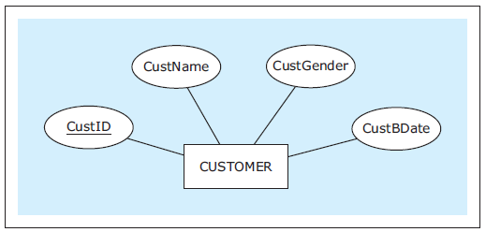
Entities and Attributes, cont’d
In an ER diagram (ERD), show an entity
with a rectangle and its attributes with ovals.
  Underline the unique attribute.
Database Systems
by Jukić, Vrbsky, & Nestorov
Pearson 2014
ISBN 978-0-13-257567-6

Slide 32
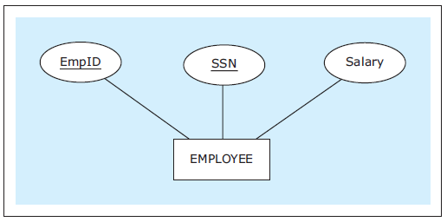
Entities and Attributes, cont’d
An entity can have multiple unique attributes.
  Each one is called a candidate key.
Database Systems
by Jukić, Vrbsky, & Nestorov
Pearson 2014
ISBN 978-0-13-257567-6

Slide 33
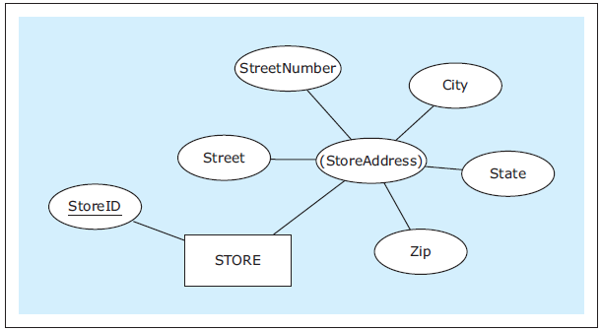
Composite Attributes
A composite attribute is composed of
several attributes.
  Parenthesize the name of the composite attribute.
Database Systems
by Jukić, Vrbsky, & Nestorov
Pearson 2014
ISBN 978-0-13-257567-6

Slide 34
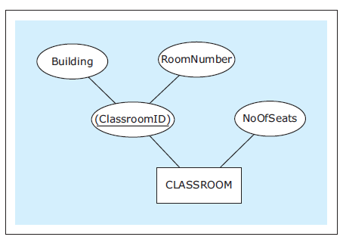
Composite Attributes, cont’d
An entity’s unique attribute can be composite.
Database Systems
by Jukić, Vrbsky, & Nestorov
Pearson 2014
ISBN 978-0-13-257567-6

Slide 35
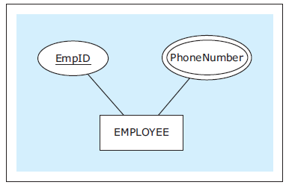
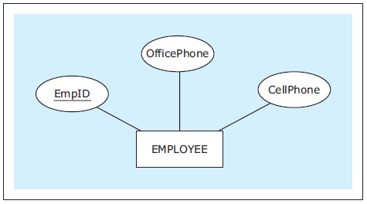
Multivalued Attributes
An entity instance can
have multiple values
for an attribute.
If the number of
values is fixed, we
can use separate
attributes instead.
Database Systems
by Jukić, Vrbsky, & Nestorov
Pearson 2014
ISBN 978-0-13-257567-6

Slide 36
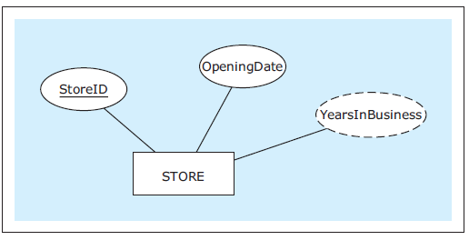
Derived Attributes
The value of a derived attribute is not stored.
  It’s calculated from the values of the other attributes and additional data such as the current date.
  Show with a dashed oval.
Database Systems
by Jukić, Vrbsky, & Nestorov
Pearson 2014
ISBN 978-0-13-257567-6

Slide 37
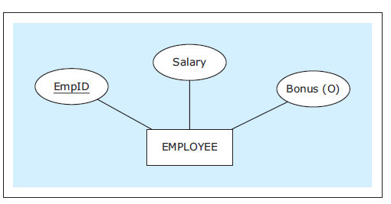
Optional Attributes
An optional attribute does not always have to have a value.
  Indicate with (O).
Database Systems
by Jukić, Vrbsky, & Nestorov
Pearson 2014
ISBN 978-0-13-257567-6

Slide 38
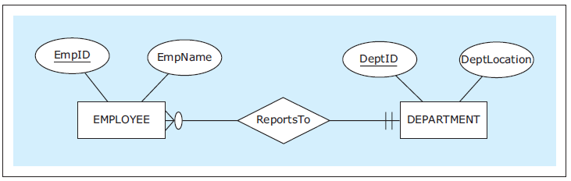
Relationships
Each entity in an ER diagram must be related
to at least one other entity.
Show a relationship with a diamond and connect the diamond to the entities that are part of the relationship.
Database Systems
by Jukić, Vrbsky, & Nestorov
Pearson 2014
ISBN 978-0-13-257567-6

Slide 39
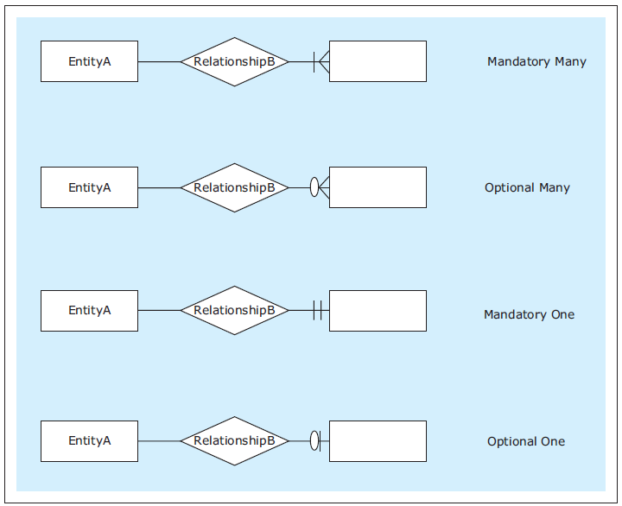
Relationship Cardinality
Show cardinality (how many instances of an entity) with symbols at the end of the relationship lines.
  Maximum symbol closest to the entity.
  Minimum symbol further away.
  Zero, one, many
Database Systems
by Jukić, Vrbsky, & Nestorov
Pearson 2014
ISBN 978-0-13-257567-6

Slide 40
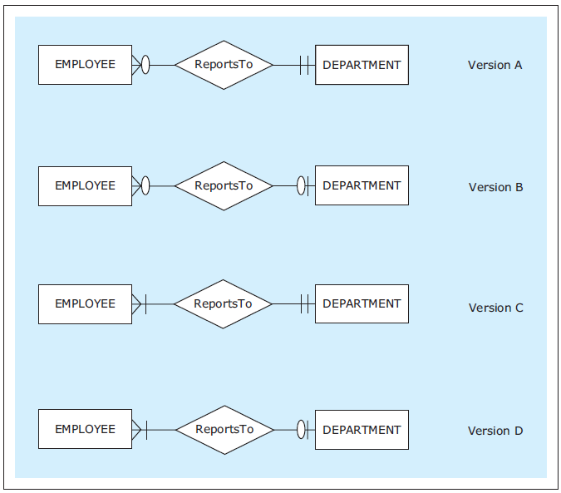
Relationship Cardinality, cont’d
Read each relationship in
both directions in this order:
  rectangle
  diamond
  cardinality
  rectangle
Database Systems
by Jukić, Vrbsky, & Nestorov
Pearson 2014
ISBN 978-0-13-257567-6

Slide 41
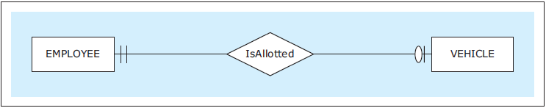
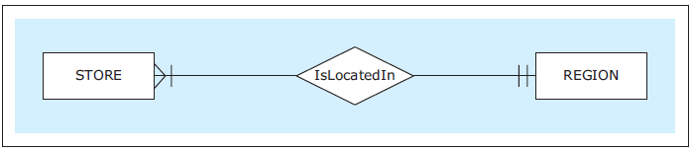
Types of Relationships
One-to-one (1:1)
One-to-many (1:M)
Each employee is allotted at most one vehicle.
Each vehicle is allotted to exactly one employee.
Each region has located in it at least one (i.e., many) stores.
Database Systems
by Jukić, Vrbsky, & Nestorov
Pearson 2014
ISBN 978-0-13-257567-6

Slide 42
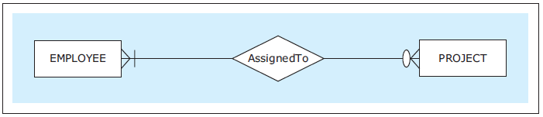
Types of Relationships, cont’d
Many-to-many (M:N)
Each employee is assigned to no or several (i.e., many) projects.
Each project has assigned to it at least one (i.e., many) employee.
Database Systems
by Jukić, Vrbsky, & Nestorov
Pearson 2014
ISBN 978-0-13-257567-6

Slide 43
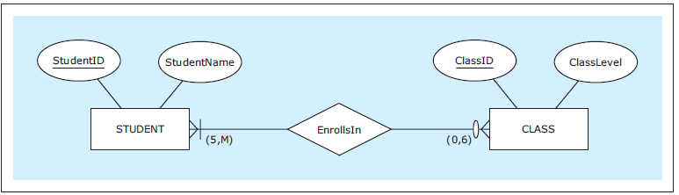
Exact Cardinalities
Indicate exact cardinalities with parenthesized minimum and maximum values.
  Example: (2, 6)
  Use M for a non-specific minimum or maximum.
Database Systems
by Jukić, Vrbsky, & Nestorov
Pearson 2014
ISBN 978-0-13-257567-6

Slide 44
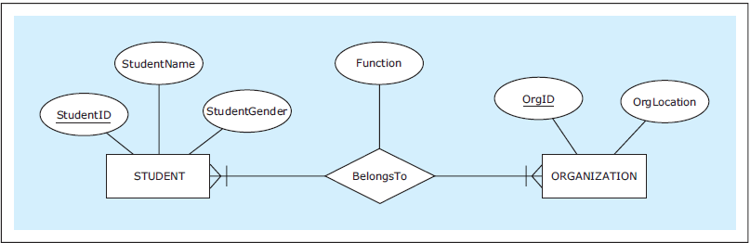
Relationship Attributes
An relationship can also have attributes.
Database Systems
by Jukić, Vrbsky, & Nestorov
Pearson 2014
ISBN 978-0-13-257567-6

Slide 45
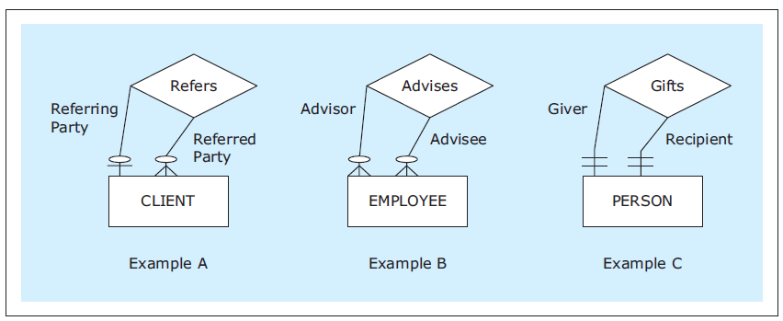
Unary Relationships
In a unary relationship, an entity is involved in a relationship with itself.
  One instance has a relationship with
  another instance of the same entity.
  You can indicate the relationship role.
Database Systems
by Jukić, Vrbsky, & Nestorov
Pearson 2014
ISBN 978-0-13-257567-6

Slide 46
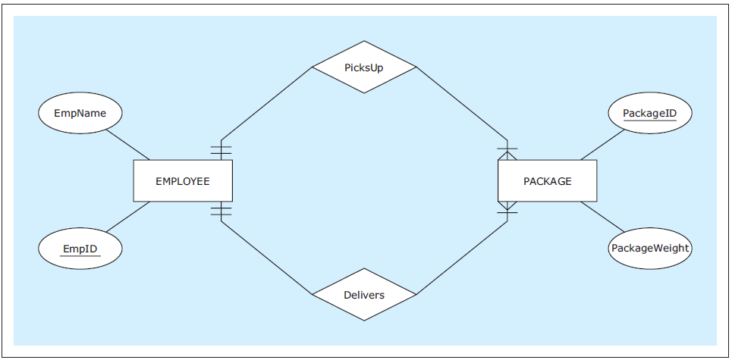
Multiple Relationships
Two entities can have multiple relationships with each other.
Database Systems
by Jukić, Vrbsky, & Nestorov
Pearson 2014
ISBN 978-0-13-257567-6

Slide 47
Weak Entities
A weak entity does not have its own
unique attribute.
  It only has a partial key.
  Underline the partial key with dashes.
Therefore, it must be associated with an
owner entity via an identifying relationship.
  Indicate the weak entity and the identifying relationship with double borders.
The partial key and the owner attribute’s unique attribute uniquely identifies the weak entity.

Slide 48
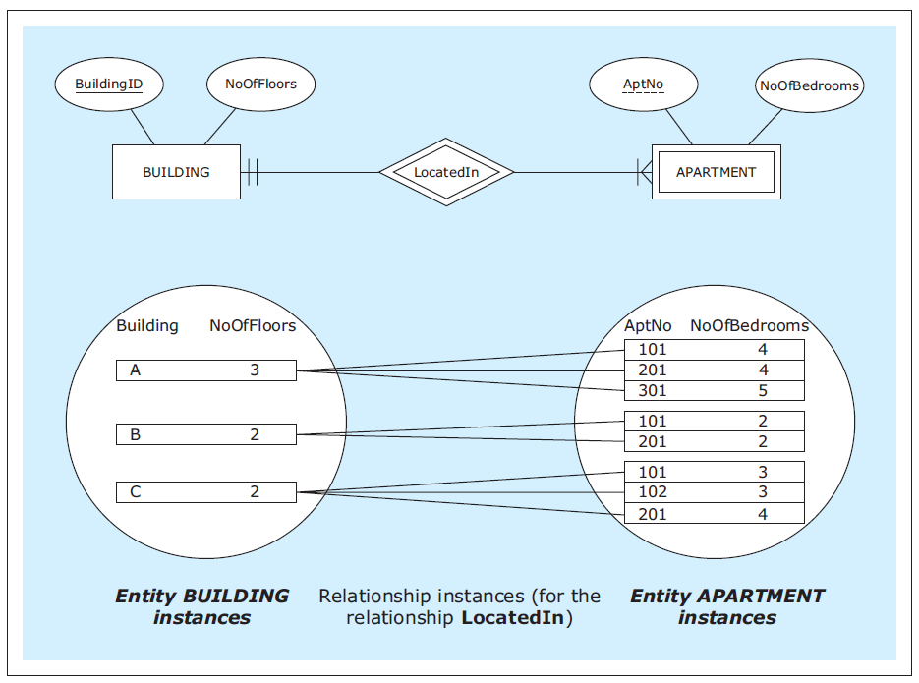
Weak Entities, cont’d
Database Systems
by Jukić, Vrbsky, & Nestorov
Pearson 2014
ISBN 978-0-13-257567-6

Slide 49
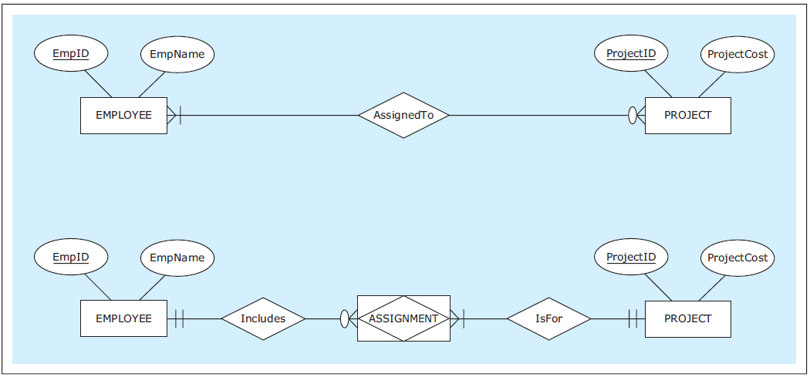
Associative Entities
An associative entity is an alternate way to depict a many-to-many (M:N) relationship.
Database Systems
by Jukić, Vrbsky, & Nestorov
Pearson 2014
ISBN 978-0-13-257567-6

Slide 50
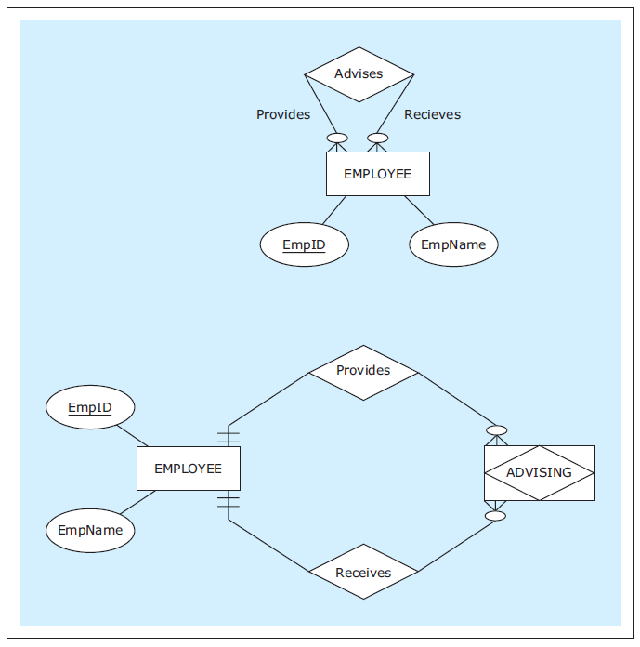
Associative Entities, cont’d
Associative entity
for a unary M:N
relationship.
Database Systems
by Jukić, Vrbsky, & Nestorov
Pearson 2014
ISBN 978-0-13-257567-6

Slide 51
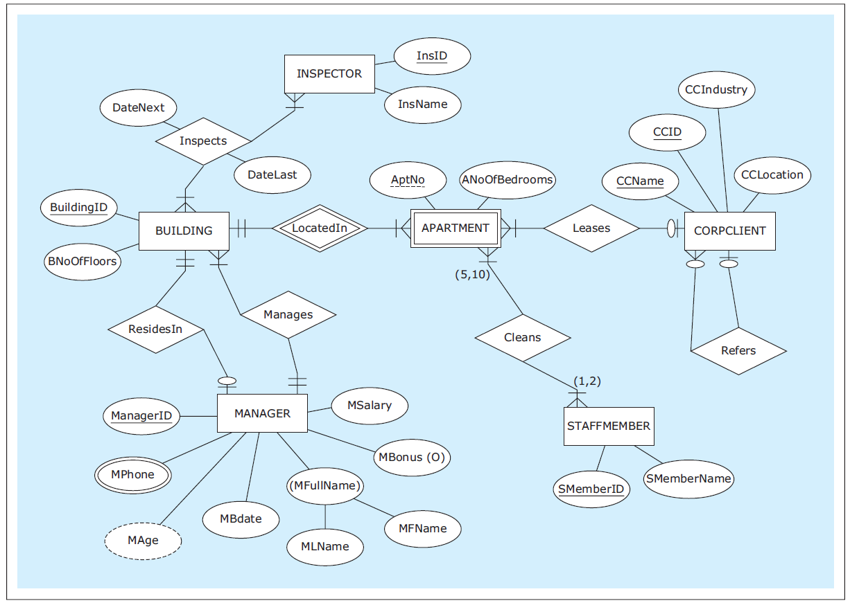
ER Diagram Example
Database Systems
by Jukić, Vrbsky, & Nestorov
Pearson 2014
ISBN 978-0-13-257567-6

Slide 52
Assignment #2
Describe your application in a few paragraphs.
  You may not have thought far enough yet,
  so use your imagination!
List your database’s requirements.
  What entities need to be in the database?
  What major attributes will the entities have?
  What relationships will be between entities?
  At least 10 requirements.

Slide 53
Assignment #2, cont’d
Create an ER diagram for your database.
Minimum requirements:
  At least 5 entities including at least one weak entity
  Different types of relationships and cardinalities
  Optional and derived attributes
  Multivalued attributes (e.g., phone numbers)
  Composite attributes (e.g., address)
  Some hierarchical data
  (e.g., university → school → department)

Slide 54
Assignment #2, cont’d
Use standard Chen ER notation from the textbook and these slides.
Free ERDPlus drawing tool: https://erdplus.com/#/
This ER diagram can be your preliminary design.
  You can make changes later.

Slide 55
Assignment #2, cont’d
Create a zip file containing:
  The application description.
  The database requirements.
  A PDF of your ER diagram as saved by ERDPlus.
  Name the zip file after your team, e.g. SuperCoders.zip
Submit into Canvas: Assignment #2
  One submission per team.
  Due Tuesday, Feb. 21 at 11:59 PM.

Slide 56
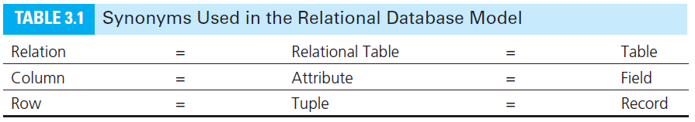
Logical Database Model
Map the ER diagram to a logical model represented as a relational schema.
Database Systems
by Jukić, Vrbsky, & Nestorov
Pearson 2014
ISBN 978-0-13-257567-6

Slide 57
Conditions for a Table to be a Relation
Each column must have a name.
  Within a table, each column name must be unique.
All values in each column must be from the same (predefined) domain.
Within a table, each row must be unique.
Within each row, each value in each column must be single-valued.
  Multiple values of the content represented by the column are not allowed in any rows of the table.

Slide 58
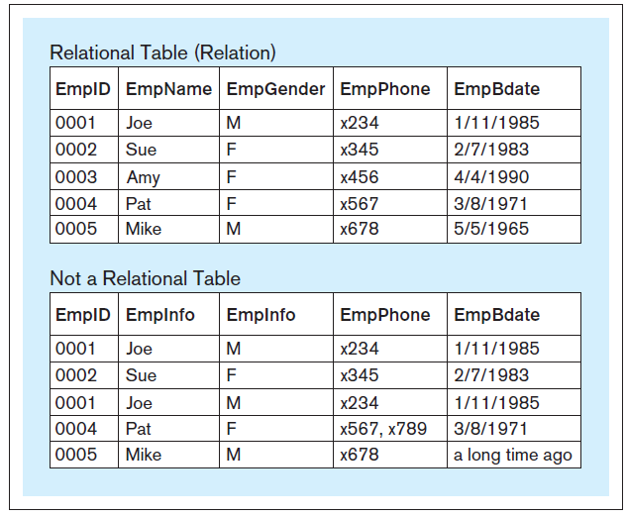
Relational vs. Non-Relational Tables
Database Systems
by Jukić, Vrbsky, & Nestorov
Pearson 2014
ISBN 978-0-13-257567-6

Slide 59
Additional Properties for a Relational Table
The order of columns is irrelevant.
The order of rows is irrelevant.

Slide 60
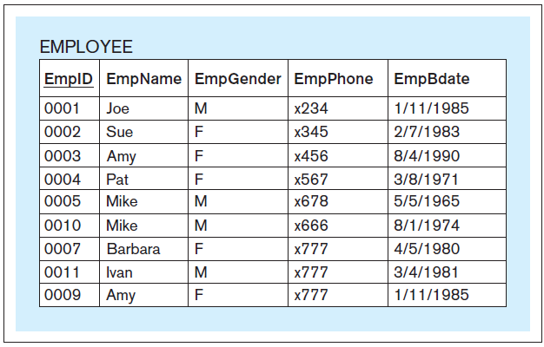
Primary Key
Each relation must have a primary key.
  A column or set of columns whose value
  uniquely identifies each row.
  Underline the primary key of the relational table.
Database Systems
by Jukić, Vrbsky, & Nestorov
Pearson 2014
ISBN 978-0-13-257567-6

Slide 61
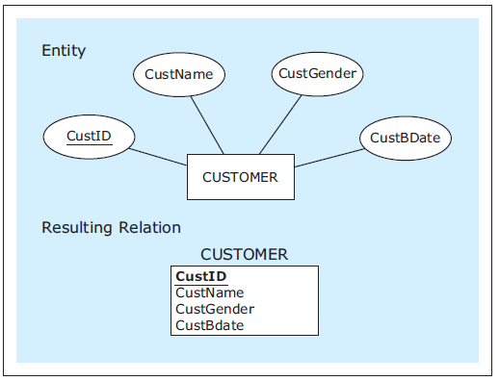
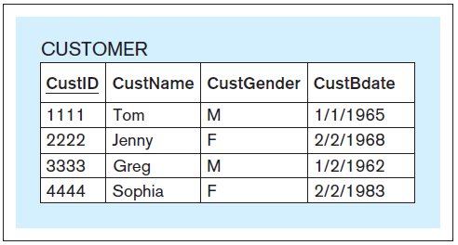
Mapping Entities
Database Systems
by Jukić, Vrbsky, & Nestorov
Pearson 2014
ISBN 978-0-13-257567-6

Slide 62
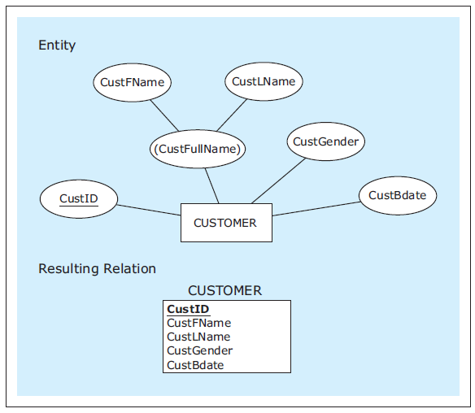
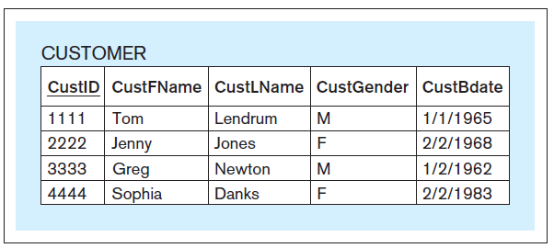
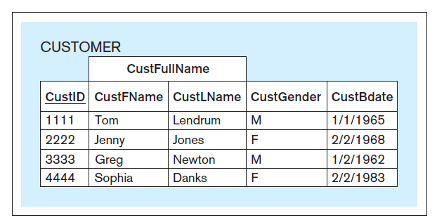
Mapping Entities, cont’d
As mapped.
Entity with a composite attribute.
As seen by a front-end application.
Database Systems
by Jukić, Vrbsky, & Nestorov
Pearson 2014
ISBN 978-0-13-257567-6

Slide 63
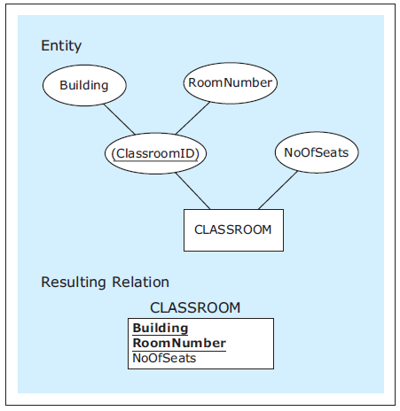
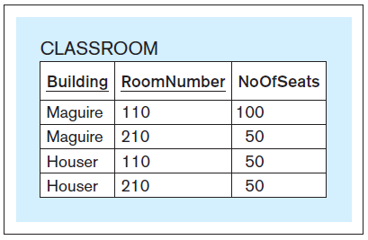
Mapping Entities, cont’d
Attribute with a
composite primary key.
Database Systems
by Jukić, Vrbsky, & Nestorov
Pearson 2014
ISBN 978-0-13-257567-6

Slide 64
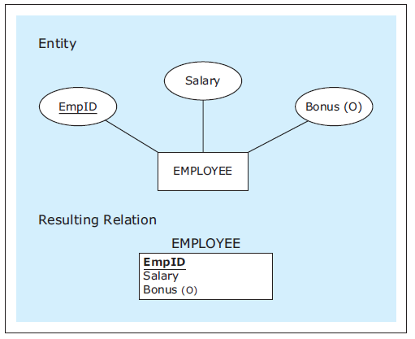
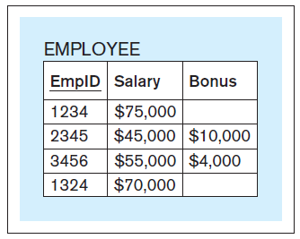
Mapping Entities, cont’d
Entity with an optional attribute.
Database Systems
by Jukić, Vrbsky, & Nestorov
Pearson 2014
ISBN 978-0-13-257567-6

Slide 65
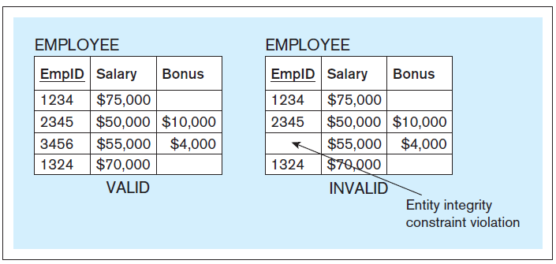
Entity Integrity Constraint
No primary key column of a relational table
can have null (empty) values.
Database Systems
by Jukić, Vrbsky, & Nestorov
Pearson 2014
ISBN 978-0-13-257567-6

Slide 66
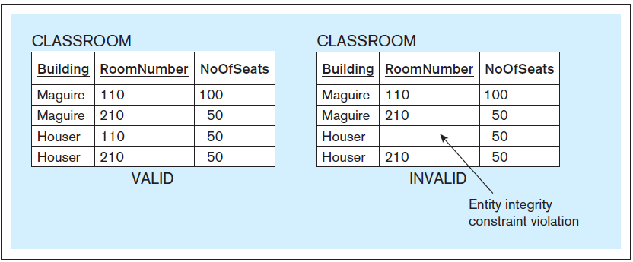
Entity Integrity Constraint, cont’d
Database Systems
by Jukić, Vrbsky, & Nestorov
Pearson 2014
ISBN 978-0-13-257567-6

