Slide 1


CMPE 202
Software Systems Engineering
March 25 Class Meeting
Engineering Extended Studies
San Jose State University
Spring 2025
Instructor: Ron Mak
www.cs.sjsu.edu/~mak

Slide 2
Today
My solution to Assignment #4
  Based on Assignment #3
  Design principles and patterns highlighted
Assignment #5
The Adapter Design Pattern
Break
The Façade Design Pattern

Slide 3
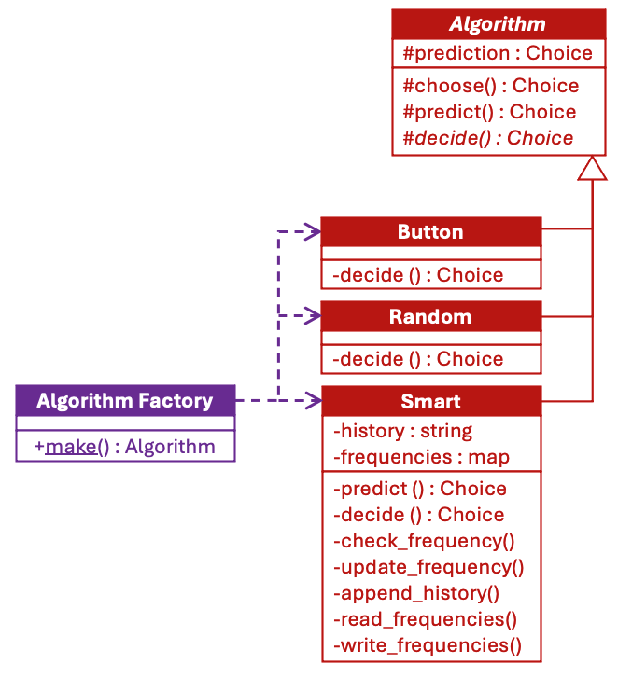
An Assignment #4 Solution
Open-closed
principle.
Factory class
AlgorithmFactory:
Underlined for static.

Slide 4
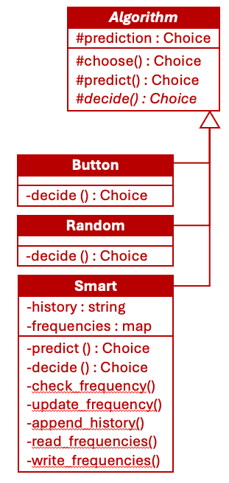
An Assignment #4 Solution, cont’d
The Template Method
Design Pattern:
  Template method choose() in superclass Algorithm defines the outline of how a choice algorithm subclass chooses:
  The subclasses define the member functions predict() and decide().
  The predict() functions in the Button and Random classes by default return Choice::NONE.
Choice choose()
{
prediction = predict();
choice = decide(prediction);
return choice;
}

Slide 5
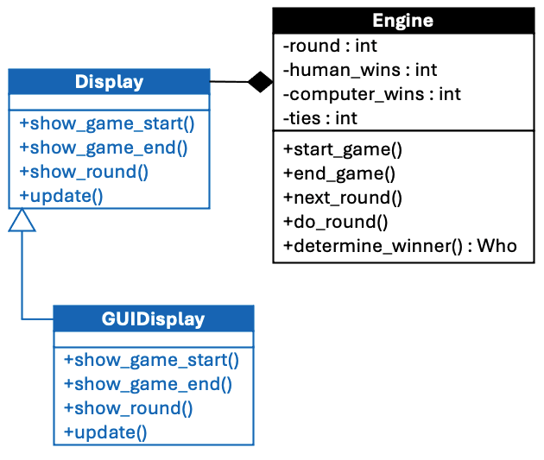
An Assignment #4 Solution, cont’d
Open-closed
principle.
Code to the interface:
  The Engine calls Display functions without knowing whether it’s a text display or a GUI display.
Display *display;
...
display->show_game_start();
...
display->show_game_end(...);
...
display->show_round(round);
...
display->update(...);

Slide 6
An Assignment #4 Solution, cont’d
Player
+choose() : Choice
The Strategy
Design Pattern:
  Class Player aggregates Algorithm subclasses
  (the strategies).
  Member functions predict() and decide() of the subclasses Human and Computer defer to their algorithms via their Player superclass.
Human
Computer
human_choice = human->choose();
computer_choice = computer->choose();

Slide 7
An Assignment #4 Solution, cont’d
Cohesive classes
  Engine
    Controls playing a game
  Display
    subclass GUIDisplay
  Player
    subclasses Human and Computer
  Algorithm
    AlgorithmFactory
    subclass ButtonAlgorithm (human)
    subclasses RandomAlgorithm
    and SmartAlgorithm (computer)

Slide 8
An Assignment #4 Solution, cont’d
Encapsulate what varies and open-closed
  Player and its subclasses
  Algorithm and its subclasses
  Display and its subclasses
Therefore, between the text and GUI versions of the RPS game application, most of the classes are shared except for class RPS:
  Text version’s RPS: create players and algorithms,
  set up and start the game engine.
  GUI version’s RPS: same as the text version,
  plus manage the GUI components.
Replace PromptAlgorithm with ButtonAlgorithm.
Replace TextDisplay with GUIDisplay.

Slide 9
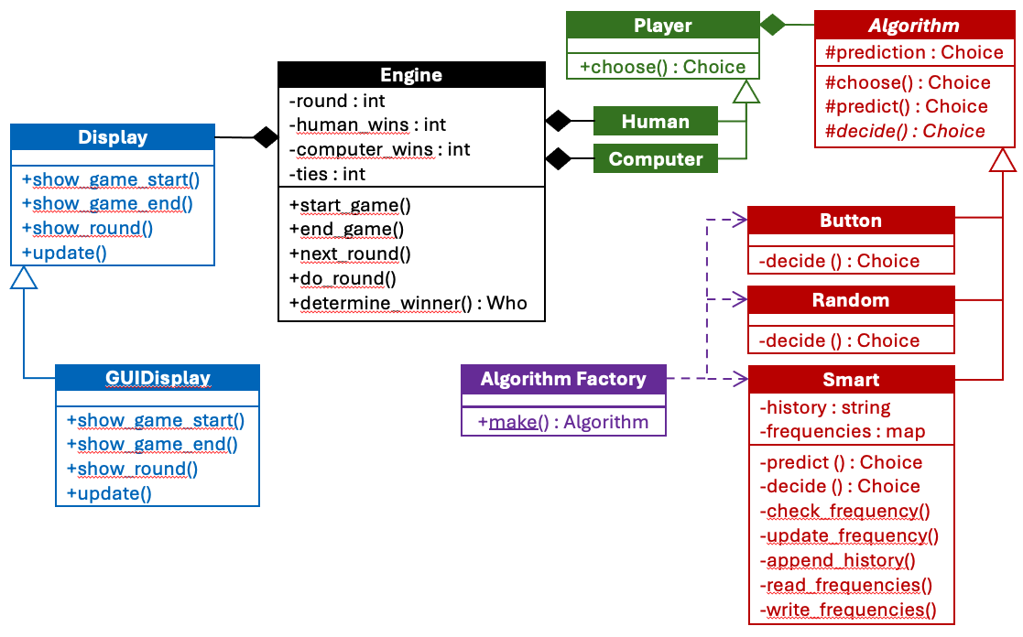
An Assignment #4 Solution, cont’d
Shared classes
Underlined to indicate static.
Inversion of control
What events cause the game to progress?

Slide 10
Your Team Projects
An application that is sufficiently substantial to demonstrate your use of good design principles and design patterns.
  There should be more to it than the example RPS application.
Mandatory: written in C++
Mandatory: GUI-based using Qt6

Slide 11
Assignment #5
Describe your proposed project
in a few paragraphs.
  What will it do?
  What will be some of its major classes?
Implement a key use case of your application.
  GUI-based user interface backed by working code.
  Describe what is happening in a paragraph or two with screenshots.
  Instructions on how the grader should run it.
Due Friday, April 11.

Slide 12
Assignment #5, cont’d
Example applications from past semesters.
Inventory management
Hot meals vending machine
Snakes game
Role-playing game
Distributed RPS
Bookstore chain
Morse code translator
Cookie shop inventory
First person shooter (FPS) game
Tetris game
Chess game
City building game
Meme machine
Trivia game
Boba barista simulator
Runners simulator
Auction management
Pong game with machine learning
Cupcake store management
Fireball game
Food ordering

Slide 13
The Adapter and Façade Design Patterns
The Adapter Design Pattern provides a model for a software architecture that needs to integrate external code, such as from a library, with code in an existing application.
  The external and application codes were not
  originally designed to work together.
  We cannot modify either of them.
The Façade Design Pattern provides a simpler higher-level interface that makes complex code easier to use.
  We cannot modify the code.

Slide 14
Example Application: More Sports Reports
A college’s athletics department needs to know the venue and the average number of fans attending each varsity baseball, varsity football, and intramural volleyball game.
The department gets this information from the baseball, football, and volleyball organizations.
Each sport organization reports its information differently.
  They don’t want to change how they report.

Slide 15
Desired Design Features
DF 1: We should not need to modify our application code or the external code to make them work together.
DF 2: Our application code should be isolated from any interface changes by the external code.
DF 3: It should be straightforward to add another sport to the report.

Slide 16
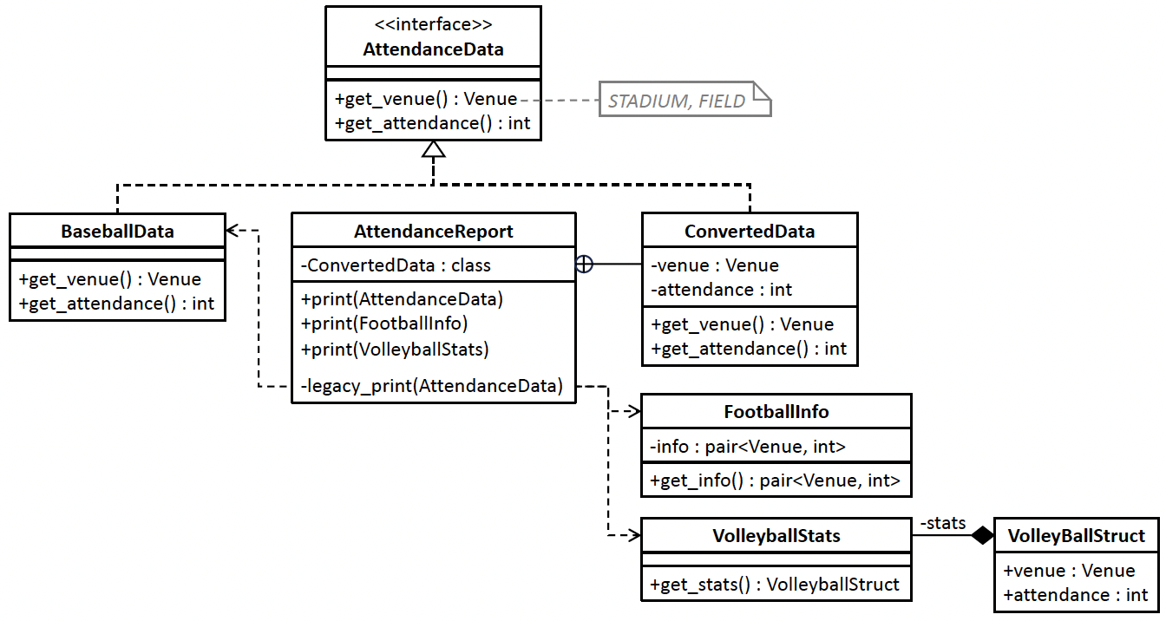

Before Using the Adapter DP
Nested class
Member function legacy_print() is not allowed to change!
Classes BaseballData, FootballInfo, and VolleyballStats present their venue and attendance data in different ways. Therefore, class AttendanceReport requires nested private class ConvertedData and three overloaded public print() member functions, and each function calls the private legacy_print() member function. The print() function for the football and volleyball sports uses class ConvertedData to convert data from FootballInfo and VolleyballStats, respectively, to the AttendanceData format. BaseballData is already in that format.
10.1/AttendanceData.h
10.1/BaseballData.h
10.1/AttendanceReport.h
10.1/FootballInfo.h
10.1/AttendanceReport.cpp
10.1/VollyballStats.h
10.1/Enums.h
10.1/tester.cpp

Slide 17
Problems with “Before”
Class with multiple responsibilities. Class AttendanceReport is responsible both for
converting data and for printing reports.
Classes not loosely coupled. AttendanceReport must know the internal implementations of classes FootballInfo and VolleyballStats to obtain their venues and attendance numbers.
Inflexible architecture design. If there is another source of venue and attendance data, such as for basketball games, it will require changes to class AttendanceReport.

Slide 18
The Adapter Design Pattern
The Adapter Design Pattern
“Convert the interface of a class into another interface clients expect. Adapter lets classes work together that couldn’t otherwise because of incompatible interfaces.” [GoF 139]

Slide 19
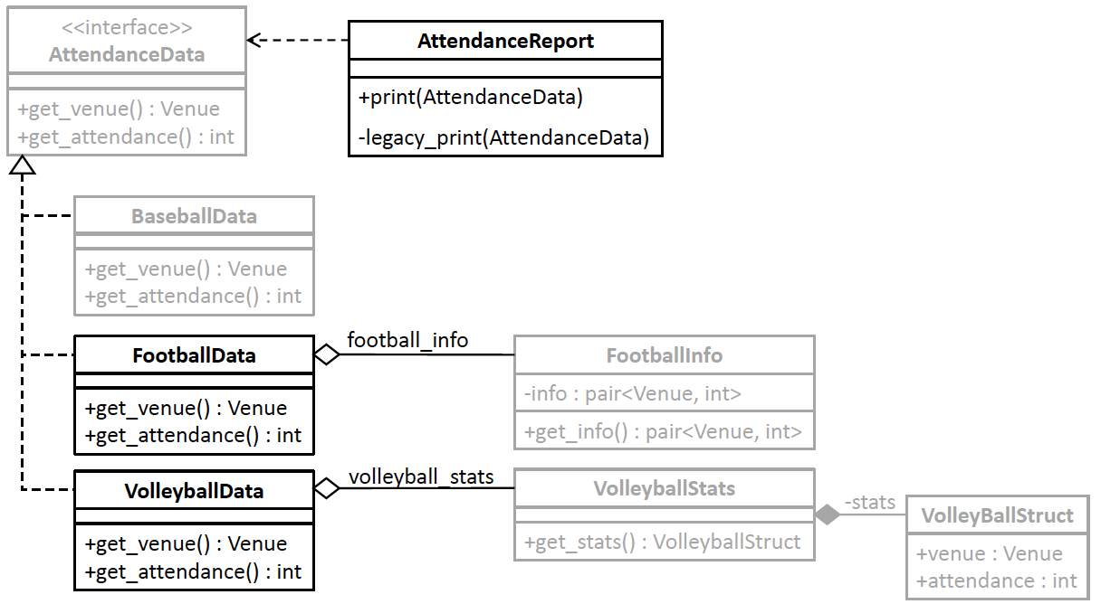

After Using the Adapter DP
10.2/AttendanceData.h
10.2/FootballInfo.h
10.2/AttendanceReport.h
10.2/FootballData.h
10.2/AttendanceReport.cpp
10.2/VollyballStats.h
10.2/BaseballData.h
10.2/VollyballStats.h
10.2/Enums.h
10.2/tester.cpp
Adapters FootballData and VolleyballData each implements the AttendanceData interface. They wrap classes FootballInfo and VolleyballStats, respectively, and encapsulate the data conversion code

Slide 20
Benefits of “After”
Encapsulated data conversions. The FootballData and VolleyballData adapter classes encapsulate data conversions from the FootballInfo and VolleyballStats classes, respectively. This is the Encapsulate What Varies Principle.
Single class responsibility. Class AttendanceReport now has only the responsibility to print the report. It no longer also has data conversion responsibilities. This is the Single Responsibility Principle. Each of the adapter classes FootballData and VolleyballData has the single responsibility to convert data.
Loosely coupled classes. By applying the Principle of Least Knowledge, class AttendanceReport is loosely coupled with the data classes FootballInfo and VolleyballStats. We can add new data classes and their adapters without changing class AttendanceReport.

Slide 21
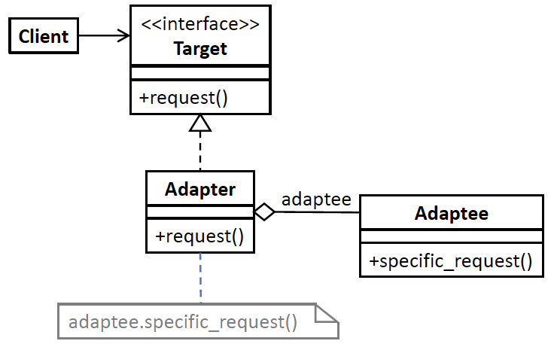
Adapter Generic Model
Design pattern | Applied by the example application
interface Target | interface AttendanceData
class Adapter | classes FootballData and VolleyballData
class Adaptee | class FootballInfo and VolleyballStats
function request() | functions get_venue() and get_attendance()
function specific_request() | FootballInfo::get_info().first FootballInfo::get_info().second VolleyballStats::get_stats().venue VolleyballStats::get_state().attendance

Slide 22
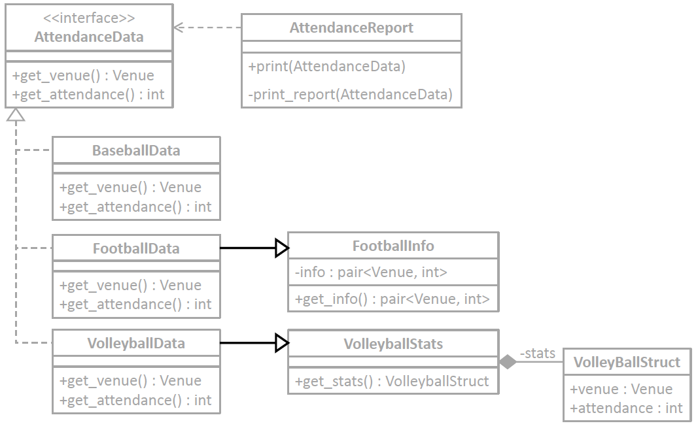
An Alternative Adapter Model
10.3/AttendanceData.h
10.3/FootballInfo.h
10.3/AttendanceReport.h
10.3/FootballData.h
10.3/AttendanceReport.cpp
10.3/VollyballStats.h
10.3/BaseballData.h
10.3/VollyballStats.h
10.3/Enums.h
10.3/tester.cpp
Use multiple inheritance.
FootballData inherits from both AttendanceData and FootballInfo.
VolleyballData inherits from both AttendanceData and VolleyballStats.

Slide 23
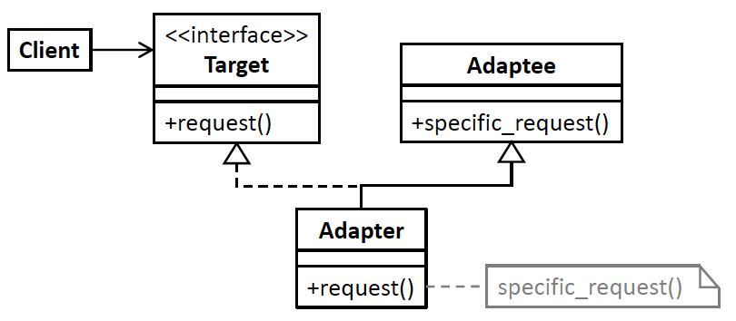
Alternative Adapter Generic Model
Often, it doesn’t matter which model you use.
Use whichever one is more convenient for you to program.

Slide 24
Break

Slide 25
The Façade Design Pattern
Another common problem that we may encounter with a body of existing code is that it’s complex and hard to use.
The Façade Design Pattern provides a model for an application architecture that hides a subsystem of multiple interfaces.
  The application accomplishes this feat by “fronting” the subsystem interfaces with a simpler interface.

Slide 26
Example Application: Fund Raising
The college athletics department must do fund raising for its sports several times a year:
  solicit alumni for money
  schedule fund-raising meetings with booster clubs
  collect student fees
The university administration also helps with the fund raising.

Slide 27
Desired Design Features
DF 1: The application should not depend on the interfaces or the implementations of any of its multiple components.
DF 2: The application should not be concerned with the order that its components perform their tasks.
DF 3: The application needs to interact with only a single interface to manage its components.

Slide 28
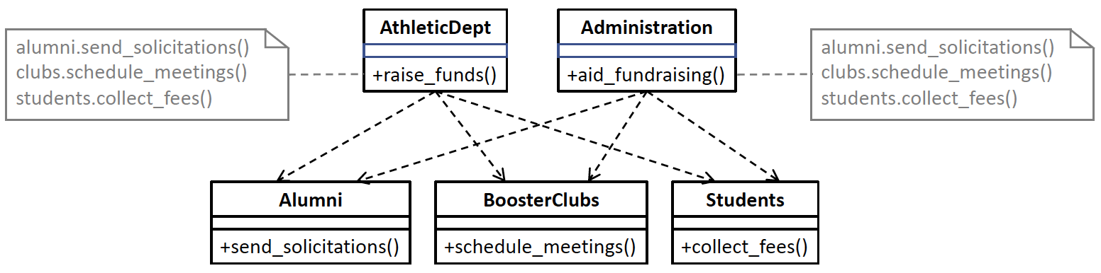
Before Using the Façade DP
Classes AthleticsDept and Administration each must call the appropriate member functions of classes Alumni, BoosterClubs, and Students.
10.4/BoosterClubs.h
10.4/AthleticsDept.h
10.4/Alumni.h
10.4/Administration.h
10.4/Students.h
10.4/tester.cpp

Slide 29
Problems with “Before”
Duplicated code in classes AthleticsDept and Administration that call the fund-raising member functions of classes Alumni, BoosterClubs, and Students.
  Classes AthleticsDept and Administration each must know in what order to call the fund-raising functions.
Inflexible code. If we add more classes for fund raising, both the AthleticsDept and Administration classes will need to change.

Slide 30
The Façade Design Pattern
The Façade Design Pattern
“Provide a unified interface to a set of interfaces in a subsystem. Façade defines a higher-level interface that makes the interface easier to use .” [GoF 139]

Slide 31
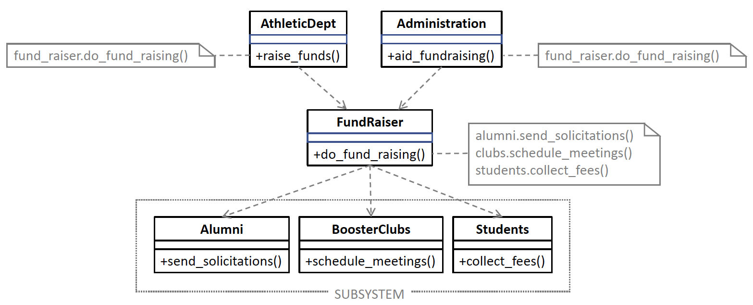
After Using the Façade DP
The Façade Design Pattern hides the details of fundraising behind the façade class FundRaiser which presents a higher-level interface that simplifies using the subsystem consisting of classes Alumni, BoosterClubs, and Students.
10.5/BoosterClubs.h
10.5/AthleticsDept.h
10.5/tester.cpp
10.5/Alumni.h
10.5/Administration.h
10.5/Students.h
10.5/FundRaiser.h

Slide 32
The Benefits of “After”
Reduced code duplication. The façade class encapsulates all the fund-raising operations, and that code needs to appear only once. This is the Don’t Repeat Yourself (DRY) Principle.
Loosely coupled classes. The AthleticsDept and Administration classes have no dependencies on the Alumni, BoosterClubs, and Students classes. This is the Principle of Least Knowledge.
More flexible code. If we add another class for fund raising, such as CorporateSponsors, only the façade class needs to change. This is the Encapsulate What Varies Principle.
Easier to use subsystem. The façade class makes the Alumni, BoosterClubs, and Students subsystem easier to use with a simple interface that hides the subsystem interfaces.

Slide 33
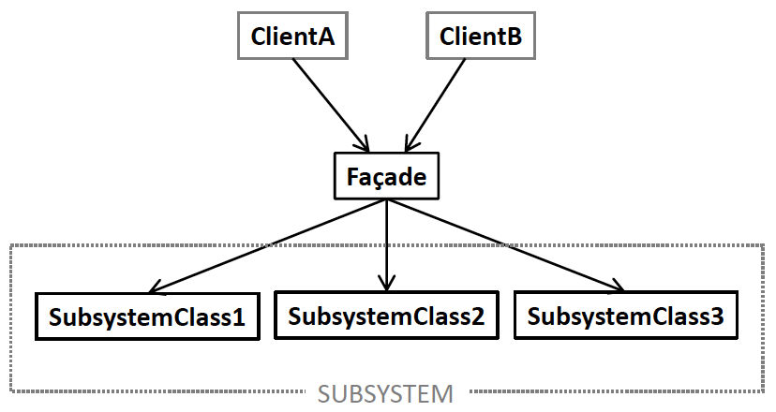
Façade Generic Model
Design pattern | Applied by the example application
classes ClientA, ClientB, etc. | classes AthleticsDept and Administration
class Façade | class FundRaiser
classes SubsystemClass1, SubsystemClass 2, etc. | classes Alumni, BoosterClubs, and Students

