Slide 1


CMPE 180A
Data Structures and Algorithms in C++
October 20 Class Meeting
Department of Computer Engineering
San Jose State University
Fall 2020
Instructor: Ron Mak
www.cs.sjsu.edu/~mak

Slide 2
Midterm Solutions: Question 76
Declaration of class Rational:
class Rational
{
public:
Rational();
Rational(int a, int b);
Rational operator +(const Rational& other) const;
Rational operator -(const Rational& other) const;
Rational operator *(const Rational& other) const
Rational operator /(const Rational& other) const;
friend ostream& operator <<(ostream& outs, const Rational& r);
friend istream& operator >>(istream& outs, Rational& r);
private:
int a, b;
};
default constructor
regular constructor
overloaded
arithmetic
operators
overloaded I/O operators

Slide 3
Midterm Solutions: Question 77
Definition of the default constructor:
Or:
Rational::Rational()
{
}
Rational::Rational() : a(0), b(1)
{
}

Slide 4
Midterm Solutions: Question 78
Definition of the regular constructor:
Rational::Rational(int a_value, int b_value) : a(a_value), b(b_value)
{
}

Slide 5
Midterm Solutions: Question 79
Definition of the overloaded addition operator:
Rational Rational::operator +(const Rational& other) const
{
int c = other.a, d = other.b;
Rational sum(a*d + b*c, b*d);
return sum;
}

Slide 6
Midterm Solutions: Question 80
Definition of the overloaded output operator
that outputs a rational number in the form (a, b) including the parentheses.
ostream& operator <<(ostream& outs, const Rational& r)
{
outs << "(" << r.a << "/" << r.b << ")";
return outs;
}

Slide 7
Assignment #7: Sample Solution
Overloaded >> operator to read coordinates:
istream& operator >>(istream& ins, Coordinate& coordinate)
{
string str;
// Latitude and longitude.
getline(ins, str, ',');
coordinate.latitude = stod(str);
getline(ins, str);
coordinate.longitude = stod(str);
return ins;
}

Slide 8
Assignment #7: Sample Solution, cont’d
Overloaded >> and << operators for city data:
ostream& operator <<(ostream& outs, const City& city)
{
outs << "*" << city.name << " " << city.state;
return outs;
}
istream& operator >>(istream& ins, City& city)
{
string str;
// Name and state.
getline(ins, city.name, ',');
getline(ins, city.state, ',');
// Coordinate.
ins >> city.coordinate;
return ins;
}

Slide 9
Assignment #7: Sample Solution, cont’d
Overloaded > operator to compare nodes.
bool Node::operator >(const Node &other)
{
// This node is greater than the other node if and only if
// this node's row is greater than the other node's row,
// or, if the two rows are equal, this node's column is greater
// than the other node's column.
return (row > other.row)
|| ((row == other.row) && (col > other.col));
}

Slide 10
Assignment #7: Sample Solution, cont’d
Overloaded << operator to output nodes.
  Boundary and city nodes.
ostream& operator <<(ostream& outs, const Node& node)
{
// City node: Output a * followed by the city's name and state.
if (node.name.length() > 0)
{
outs << "*" << node.name << " " << node.state;
}
// Boundary node: Output a #
else
{
cout << "#";
}
return outs;
}

Slide 11
Assignment #7: Sample Solution, cont’d
Linked list destructor:
SortedLinkedList::~SortedLinkedList()
{
Node *next;
// Loop to deallocate each node in the list.
for (Node *ptr = head; ptr != nullptr; ptr = next)
{
next = ptr->next;
delete ptr;
}
head = nullptr;
}

Slide 12
Assignment #7: Sample Solution, cont’d
Insert into the sorted linked list:
void SortedLinkedList::insert(Node *node)
{
// First node of the list.
if (head == nullptr)
{
head = node;
}
// Insert before the first node.
else if (!(*node > *head))
{
node->next = head;
head = node;
}

Slide 13
Assignment #7: Sample Solution, cont’d
// Insert somewhere else in the list.
else
{
Node *ptr = head; // pointer to iterate through the list
Node *prev; // stays one node behind ptr
// Loop until ptr reaches the end of the list or the
// insertion node is greater than the node ptr points to.
while ((ptr != nullptr) && (*node > *ptr))
{
prev = ptr;
ptr = ptr->next;
}
// Insert the new node between the node that prev points to
// and the node that ptr points to.
prev->next = node;
node->next = ptr;
}
}

Slide 14
Assignment #7: Sample Solution, cont’d
Overloaded << operator to print nodes.
ostream& operator <<(ostream& outs, const SortedLinkedList& list)
{
int line = 0; // current line
int position = 0; // current position in the current line
// Loop over the nodes in the list.
// Each time through the loop, ptr points to the next node.
for (Node *ptr = list.get_head(); ptr != nullptr; ptr = ptr->next)
{
// Output blank lines to catch up to the next node's line.
if (line != ptr->get_row())
{
position = 0;
do
{
cout << endl; // output a blank line
line++;
} while (line < ptr->get_row());
}

Slide 15
Assignment #7: Sample Solution, cont’d
// Output the next node only if its column is at or before
// the current print position.
if (position <= ptr->get_col())
{
// Output blank characters to catch up to the next node's column.
while (position < ptr->get_col())
{
cout << " "; // output a blank character
position++;
}
cout << *ptr; // output the next node
position++;
// If it's a city node, advance the position
// to account for the city's name and state.
if (ptr->get_name().length() > 0)
{
position += ptr->get_name().length()
+ ptr->get_state().length() + 1;
}
}
}
return outs;
}

Slide 16
Function Definitions in Header Files
You can put the definition of the member function inside the class declaration.
  You can have definition code in the header file.
  Often used for constructors, destructors, getters, and setters.
  Example:
Inline1.h
class Inline1
{
public:
Inline1(int v) : value(v) {}
int get_value() const { return value; }
void set_value(const int v) { value = v; }
private:
int value;
};

Slide 17
Function Definitions in Header Files, cont’d
InlineTest1.h
#include <iostream>
#include "Inline1.h"
using namespace std;
int main()
{
Inline1 it(5);
cout << it.get_value() << endl;
it.set_value(7);
cout << it.get_value() << endl;
return 0;
}
Output:
5
7

Slide 18
Function Definitions in Header Files, cont’d
When you put a member function definition inside the class declaration, the compiler can inline the function code.
  The compiler can decide whether or not to inline.
Instead of compiling a member function call
the usual way, the compiler will instead insert the function code itself in place of the call.
This will speed execution (since no calls are executed), but it will increase the size of the compiled code.

Slide 19
The inline Keyword
If you define a member function outside of the class declaration, you can use the inline keyword to ask the compiler to inline the function code.
  The compiler may decide to ignore the keyword.
  It’s usually better to let the compiler decide
  what’s best for code optimization.
Put the inlined member function definitions
in the header file.

Slide 20
The inline Keyword, cont’d
InlineTest2.h
class Inline2
{
public:
Inline2(int v) : value(v) {}
int get_value() const;
void set_value(const int v);
private:
int value;
};
inline int Inline2::get_value() const { return value; }
inline void Inline2::set_value(const int v) { value = v; }
This is preferred since it keeps the separation of function declaration and function definition.

Slide 21
The inline Keyword, cont’d
You can also inline regular functions,
not just member functions:
InlineTest3.cpp
#include <iostream>
using namespace std;
inline int adder(const int a, const int b);
int main()
{
int i = 2, j = 3;
cout << i << " " << j << " " << adder(i, j) << endl;
return 0;
}
inline int adder(const int a, const int b)
{
return a + b;
}
2 3 5

Slide 22
Object-Oriented Programming
Encapsulation
  Classes
Inheritance
  Subclasses
Polymorphism
  Virtual functions
Notes:
START HERE.

Slide 23
Inheritance
A very powerful and important feature
of object-oriented programming.
A new class (the derived class) is created from another class (the base class).
A derived class is also known as a child class.
The base class is the parent class.
A child class is also known as a subclass.
Therefore, the base class is also known as the superclass.

Slide 24
Inheritance, cont’d
A child class inherits all the member variables and member functions from its parent class.
Person.cpp
class Person
{
public:
string activity() { return "Eat and sleep."; }
};
class Student : public Person
{
public:
string study() { return "Study and study." ; }
};
A Student “is a” Person.

Slide 25
Inheritance, cont’d
class Person
{
public:
string activity() { return "Eat and sleep."; }
};
class Student : public Person
{
public:
string study() { return "Study and study." ; }
};
Let variable s be type Student.
  Valid: s.study()
  Valid: s.activity()
Study and activity are behaviors implemented by the member functions.

Slide 26
Inheritance, cont’d
class Person
{
public:
string activity() { return "Eat and sleep."; }
};
class Student : public Person
{
public:
string study() { return "Study and study." ; }
};
Subclass Student inherits the member function activity from its parent class.
  The Student class can also override the definition
  of function activity by defining its own version.

Slide 27
Inheritance, cont’d
Private members
  Even though the subclasses inherit the superclass’s private members, they cannot access the members.
Protected members
  Only the superclass’s subclasses can access its protected members.
Public members
  Any class can access the public members.

Slide 28
Subclasses
Animal.cpp
class Animal
{
public:
string speak() { return "Shhh!"; }
};
class Mammal : public Animal
{
public:
string speak() { return "Grrr!" ; }
};
class Cat : public Mammal
{
public:
string speak() { return "Roar!"; }
};
class Kitty : public Cat
{
public:
string speak() { return "Meow!"; }
};
string make_sound(Cat& c) { return c.speak(); }
int main()
{
Kitty k;
cout << make_sound(k) << endl;
}
Variable k is a Kitty.
  k is also a Cat,
  a Mammal,
  and an Animal.
  Each subclass overrides the definition of member function speak.
What is the output?
  The datatype of parameter c is a Cat.
Roar!
Demo

Slide 29
Polymorphism
Polymorphism is the ability of a variable or parameter to have different behaviors at run time.
How the variable or parameter behaves depends not on the datatype of the variable or parameter, but on the datatype of its value at run time.
Polymorphism is implemented in C++
with virtual functions.

Slide 30
Polymorphism, cont’d
Person.cpp
class Person
{
public:
virtual string activity() { return "Eat and sleep."; }
};
class Student : public Person
{
public:
string activity() { return "Study and study." ; }
};
class EngineeringMajor : public Student
{
public:
string activity() { return "Design and build."; }
};
class SoftwareMajor : public EngineeringMajor
{
public:
string activity() { return "Code and test."; }
};
string do_it(Student& s) { return s.activity(); }
int main()
{
SoftwareMajor sw;
cout << do_it(sw) << endl;
}
What is the output?
  Member function activity is virtual in Person and all subclasses.
  The datatype of parameter s is Student.
  The datatype of
  the value of s is SoftwareMajor.
Code and test.

Slide 31
Polymorphism, cont’d
Person.cpp
string activity(Student& s) { return s.activity(); }
int main()
{
SoftwareMajor sw;
cout << do_it(sw) << endl;
EngineeringMajor em;
cout << do_it(em) << endl;
Student st;
cout << do_it(st) << endl;
}
Code and test.
Design and build.
Study and study.
Demo

Slide 32
Virtual Destructors
From now on, make destructors virtual.
  Example:
A virtual destructor ensures that the
correct destructor is called for an object
when the object is being destroyed.
virtual ~Foo();

Slide 33
The Need for Virtual Destructors
class Employee
{
public:
Employee() { cout << "Employee called" << endl; }
~Employee() { cout << "~Employee called" << endl; }
};
class Manager : public Employee
{
public:
Manager() { cout << "Manager called" << endl; }
~Manager() { cout << "~Manager called" << endl; }
private:
string name;
};
Employee.h
Demo
#include "Employee.h"
int main()
{
Employee *ptr = new Manager();
delete ptr;
return 0;
}
Which destructor(s) is/are called?
DestructorTest.cpp

Slide 34
Calculation Puzzle
What is the output?
#include <iostream>
using namespace std;
int main()
{
double a = (100 + 1.0/3) - 100;
double b = 1.0/3;
cout << (a == b ? "equal" : "unequal") << endl;
}

Slide 35
Break
15 minutes

Slide 36
chrono
TimeVector1.cpp
#include <iostream>
#include <iomanip>
#include <vector>
#include <chrono>
using namespace std;
using namespace std::chrono;
long time_vector_initialization(vector<int> v, int n);
string commafy(const long i);
int main()
{
vector<int> v;
for (long n = 10000; n <= 100000000; n *= 10)
{
long elapsed_time = time_vector_initialization(v, n);
cout << "Elapsed_time for " << setw(11) << commafy(n) << " : "
<< setw(5) << commafy(elapsed_time) << " ms" << endl;
}
cout << endl << "Done!";
return 0;
}

Slide 37
chrono, cont’d
long time_vector_initialization(vector<int>& v, const int n)
{
steady_clock::time_point start_time = steady_clock::now();
// Do the work that we're timing.
v.clear();
for (int i = 0; i < n; i++) v.push_back(i);
steady_clock::time_point end_time = steady_clock::now();
// Other options include: nanoseconds, microseconds
long elapsed_time =
duration_cast<milliseconds>(end_time - start_time).count();
return elapsed_time;
}
TimeVector1.cpp
See http://en.cppreference.com/w/cpp/chrono

Slide 38
chrono, cont’d
string commafy(long i)
{
string str = to_string(i);
int pos = str.length() - 3;
while (pos > 0)
{
str.insert(pos, ",");
pos -= 3;
}
return str;
}
TimeVector1.cpp
Elapsed_time for 10,000 : 0 ms
Elapsed_time for 100,000 : 4 ms
Elapsed_time for 1,000,000 : 41 ms
Elapsed_time for 10,000,000 : 432 ms
Elapsed_time for 100,000,000 : 3,804 ms
Done!

Slide 39
The auto Keyword
In a declaration of a variable that is also being initialized, the compiler can infer the type of the variable from the initialization expression.
  type inference, AKA type determination
Use auto instead of a complicated type name.
  Examples: Instead of:
  Use:
steady_clock::time_point start_time = steady_clock::now();
auto start_time = steady_clock::now();
From the initialization expression steady_clock::now() the compiler
can infer that start_time has type steady_clock::time_point.

Slide 40
The decltype Pseudo-Function
decltype takes a variable as an argument.
Returns the datatype associated of the variable.
Use to create another variable
with the same datatype.
  Ensure that two variables have the same datatype.
  Example:
auto start_time = steady_clock::now();
...
decltype(start_time) end_time;

Slide 41
chrono, cont’d
long time_vector_initialization(vector<int>& v, const int n)
{
auto start_time = steady_clock::now();
// Do the work that we're timing.
v.clear();
for (int i = 0; i < n; i++) v.push_back(i);
decltype(start_time) end_time = steady_clock::now();
// Other options include: nanoseconds, microseconds
long elapsed_time =
duration_cast<milliseconds>(end_time - start_time).count();
return elapsed_time;
}
TimeVector2.cpp

Slide 42
Exception Handling
Exception handling is an elegant way to handle “exceptional” error situations at run time.
  Meant to be used sparingly.
Code (such as a function) that encounters an error situation can “throw” an exception.
“Catch” the exception by code elsewhere (possibly in another function) that
handles the exception.

Slide 43
Exception Handling Example
int main()
{
int value;
cout << "Enter positive integers, 0 to quit." << endl;
do
{
cout << "Value? ";
try
{
cin >> value;
if (value < 0) throw value;
if (value > 0) cout << "You entered " << value << endl;
}
catch (int v)
{
cout << "*** Error: You entered the negative value " << v << endl;
}
} while (value != 0);
cout << "Done!" << endl;
return 0;
}
exception1.cpp
Throw the exception value.
The rest of the try block
is skipped whenever
an exception is thrown.
Try-catch
block
Catch and handle the exception.

Slide 44
Exception Classes
You can throw a value of any type.
You can define your own exception classes.
A try-catch block can throw and catch
multiple exceptions.

Slide 45
Exception Classes Example
class SomeNumber
{
public:
SomeNumber(int n) : value(n) {}
int get_value() const { return value; }
private:
int value;
};
class NegativeNumber : public SomeNumber
{
public:
NegativeNumber(int n) : SomeNumber(n) {};
};
class NumberTooBig : public SomeNumber
{
public:
NumberTooBig(int n) : SomeNumber(n) {};
};
exception2.cpp
Invoke the base
class constructor.

Slide 46
Exception Classes Example, cont’d
exception2.cpp
int main()
{
...
try
{
cin >> value;
if (value < 0) throw NegativeNumber(value);
if (value >= 10) throw NumberTooBig(value);
if (value > 0) cout << "You entered " << value << endl;
}
catch (NegativeNumber& v)
{
cout << "*** Error: Negative value: " << v.get_value() << endl;
}
catch (NumberTooBig& v)
{
cout << "*** Error: Value too big: " << v.get_value() << endl;
}
...
}

Slide 47
Throwing Exceptions in a Function
A function can throw exceptions.
The caller of the function must call the function inside a try-catch block to catch any exceptions thrown by the function.

Slide 48
Throwing Exceptions in a Function, cont’d
void read_numbers() throw(NegativeNumber, NumberTooBig);
int main()
{
try
{
read_numbers();
}
catch (NegativeNumber& v)
{
cout << "*** Error: Negative value: " << v.get_value() << endl;
return -1;
}
catch (NumberTooBig& v)
{
cout << "*** Error: Value too big: " << v.get_value() << endl;
return -2;
}
cout << "Done!" << endl;
return 0;
}
exception3.cpp

Slide 49
Throwing Exceptions in a Function, cont’d
void read_numbers() throw(NegativeNumber, NumberTooBig)
{
int value;
cout << "Enter positive integers < 10, 0 to quit." << endl;
do
{
cout << "Value? ";
cin >> value;
if (value < 0) throw NegativeNumber(value);
if (value >= 10) throw NumberTooBig(value);
if (value > 0) cout << "You entered " << value << endl;
} while (value != 0);
}
exception3.cpp

Slide 50
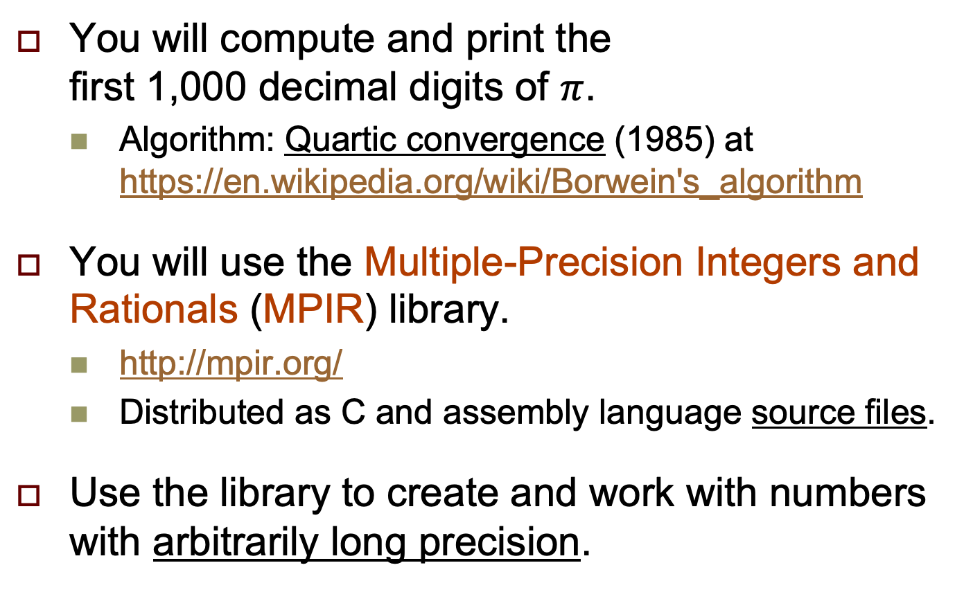
Assignment #9: Big Pi
There is no Assignment #8
because it’s now week 9.
You will compute and print the
first 1,000 decimal digits of $π$.
  Algorithm: Quartic convergence (1985) at https://en.wikipedia.org/wiki/Borwein's_algorithm
You will use the Multiple-Precision Integers and Rationals (MPIR) library.
  http://mpir.org/
  Distributed as C and assembly language source files.
Use the library to create and work with numbers with arbitrarily long precision.
See footnote 3!

Slide 51
Assignment #9: Big Pi, cont’d
You will learn how to download the source files, and configure, build, test, and install the MPIR library.
Useful skills to have, because you will most likely need to use other libraries in the future.
  graphics libraries
  circuit simulation libraries
  numerical computing libraries
  etc.

Slide 52
Assignment #9: Big Pi, cont’d
Building and installing the MPIR library is straightforward on Linux and MacOS X.
If you are on Windows 10, use the
Linux Subsystem for Windows
to install the Ubuntu distribution of Linux:
  https://docs.microsoft.com/en-us/windows/wsl/install-win10
  https://www.microsoft.com/en-us/p/ubuntu-1804-lts/9n9tngvndl3q?rtc=1#activetab=pivot:overviewtab

Slide 53
Assignment #9: Big Pi, cont’d
My tutorials: http://www.cs.sjsu.edu/~mak/tutorials/index.html
  “Install Ubuntu on Windows 10 and on VirtualBox”
  “Configure Ubuntu for Software Development”
  “Install MPIR on Ubuntu and MacOS X”

Slide 54
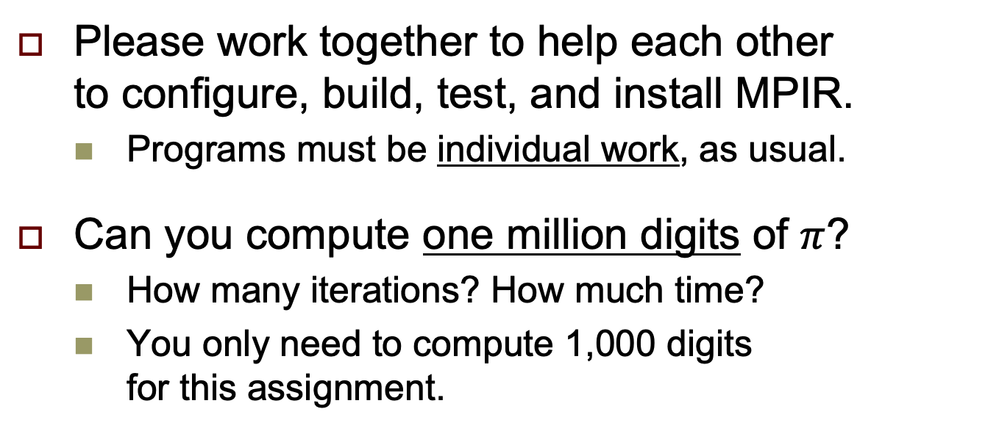
Assignment #9: Big Pi, cont’d
Please work together to help each other
to configure, build, test, and install MPIR.
  Programs must be individual work, as usual.
Can you compute one million digits of $π$?
  How many iterations? How much time?
  You only need to compute 1,000 digits
  for this assignment.
The first 100,200 digits of π were computed in 1961
on an IBM 7090 computer using the arctangent formula
It required 8 hours and 43 minutes.

Slide 55
A Review of Iteration (Looping)
First initialize the value of the control variable:
The loop body must update the value
of the control variable.
Test the control variable for the terminal value.
  Each update brings the control variable’s value closer to the terminal value.
Initialize the
control variable i
int i = 0;
while (i < 10)
{
cout << i << endl;
i++;
}
Test the value of the control variable
for the terminal value
Loop body
Update the value
of the control variable

Slide 56
A Review of Iteration (Looping), cont’d
Initialize the
control variable i
int i = 0;
while (i < 10)
{
cout << i << endl;
i++;
}
Test the value of the control variable
for the terminal value
Loop body
Update the value
of the control variable
This review of iteration is a way to introduce
the concept of recursion.

Slide 57
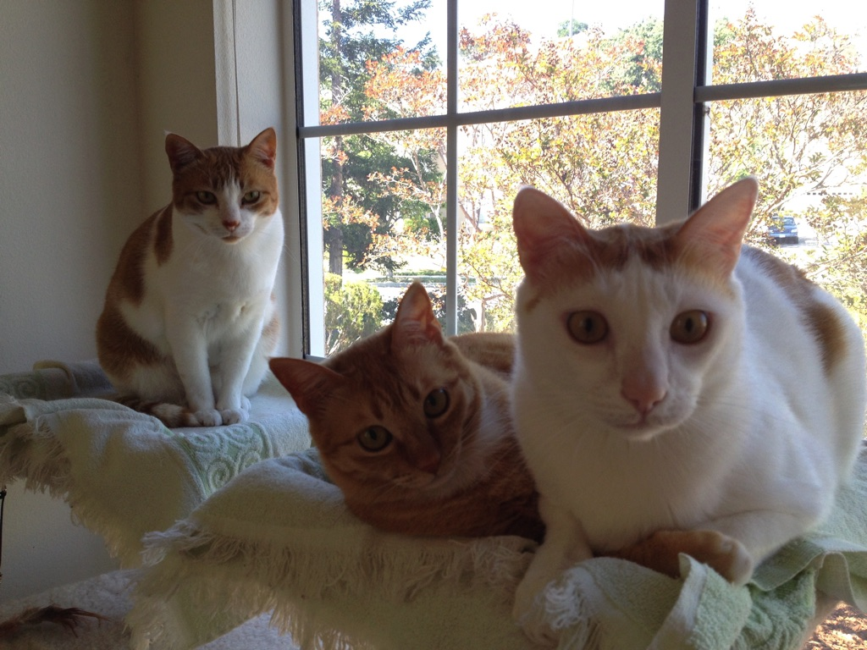
Recursion
A new way to think???
Recursion requires a whole new way of thinking.
Recursion is a required skill for all programmers.

Slide 58
How to Think Recursively
Does this problem contain a
simpler but similar case of the problem?
Can I solve the overall problem
if I can solve the simpler case?
Is there a simplest case that has
an immediate and obvious solution?
  Ever simpler cases must approach the simplest case.
The simplest case is called the base case.
  There may be more than one base case.

Slide 59
Some Initial Examples of Recursion
We’ll start with some examples of simple problems that we’ll solve using recursion.
Recursion is not necessarily the best way
to solve these problems.
But these simple problems help us to understand how to use recursion.

Slide 60
Factorials: The Classic Recursion Problem
5! = 5 x 4 x 3 x 2 x 1
= 5 x 4!
Therefore, we can solve 5! if we can solve 4!
  4! is a simpler but similar case of the problem.
We can solve 4! = 4 x 3! if we can solve 3!
We can solve 3! = 3 x 2! if we can solve 2!
We can solve 2! = 2 x 1! if we can solve 1!
But by definition, 1! = 1
Ever simpler
cases approach
the base case.
The base case.

Slide 61
Factorials, cont’d
But by definition, 1! = 1
  That’s the simplest case (the base case)
  with an immediate and obvious solution.
Therefore, 2! = 2 x 1! = 2 x 1 = 2
Therefore, 3! = 3 x 2! = 3 x 2 = 6
Therefore, 4! = 4 x 3! = 4 x 6 = 24
Therefore, 5! = 5 x 4! = 5 x 24 = 120

Slide 62
Factorials, cont’d
Solve n! recursively:
What’s the base case?
  1! = 1
What’s the simpler but similar case?
  (n-1)!
  Note that n-1 is closer to the base case of 1.
Factorial.cpp
int fact(int n)
{
if (n == 1) return 1;
else return n*fact(n-1);
}
Reaching the base case stops the recursion
and returns an immediate value.
Otherwise, recursively solve the simpler case.

Slide 63
Recursive Multiplication
Solve i x j recursively.
Base cases:
  i equals 0: product = 0
  i equals 1: product = j
Simpler but similar case:
  If we can solve the problem for i-1
  (which is closer to 0 and 1),
  then i x j is j + [(i-1) x j]

Slide 64
Recursive Multiplication, cont’d
Multiply.cpp
long multiply(int i, int j)
{
switch (i)
{
case 0: return 0;
case 1: return j;
default: return j + multiply(i-1, j);
}
}

Slide 65
Iterative Fibonacci
Fibonacci sequence: 1 1 2 3 5 8 13 21 34 55
  f_{n} = f_{n-2} + f_{n-1}
  f₁ = 1
  f₂ = 1
An iterative
solution:
Fibonacci1.cpp
long fibonacci(int n)
{
if (n <= 2) return 1;
else
{
long older = 1;
long old = 1;
long next = 1;
for (int i = 3; i <= n; i++)
{
next = older + old;
older = old;
old = next;
}
return next;
}
}

Slide 66
Recursive Fibonacci
  According to the definition:
    f_{n} = f_{n-2} + f_{n-1}
    f₁ = 1
    f₂ = 1
Fibonacci2.cpp
long fibonacci(int n)
{
if (n <= 2) return 1;
else return fibonacci(n-2) + fibonacci(n-1);
}

Slide 67
Recursive Fibonacci, cont’d
Why does the recursive solution
take a long time when n is large?
Let’s trace the recursive calls:
Fibonacci3.cpp
long fibonacci(int n)
{
cout << "Called fibonacci(" << n << ")" << endl;
long f;
if (n <= 2) f = 1;
else f = fibonacci(n-2) + fibonacci(n-1);
cout << "Returning fibonacci(" << n << ") = " << f << endl;
return f;
}

Slide 68
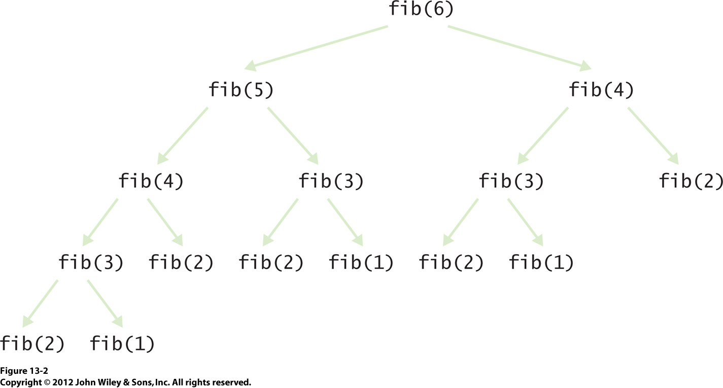
Recursive Fibonacci, cont’d
Recursion is
not always good!

Slide 69
Member of
Given a vector of n integers, is x in the list?
Base case
  The vector is empty: x is not in the vector.
Simpler but similar case:
  Either x is equal to the first element in the vector,
  or x is in the rest of the vector.
  The rest of the vector is one element shorter,
  so it’s closer to the base case.

Slide 70
Member of, cont’d
MemberOf.cpp
bool member_of(const int value, vector<int>& v)
{
if (v.size() == 0) return false; // Base case
if (v[0] == value) return true; // Is it the first element?
v.erase(v.begin()); // Remove the first element.
return member_of(value, v); // Is it in the rest of the vector?
}
0 10 20 30 40 50 60 70 80 90 100
50 is in the vector.
75 is not in the vector.
80 is in the vector.
92 is not in the vector.

Slide 71
Reverse
Reverse the values of a list of n integers.
Base case
  The list is empty, or it contains only one value:
  Just return the list.
Simpler but similar case:
  Remove the first value of the list.
  Reverse the rest of the list, which is one element shorter.
  Append the removed value to the end of the reversed rest of the list.

Slide 72
Reverse, cont’d
Reverse.cpp
void reverse(vector<int>& v)
{
if (v.size() <= 1) return; // Base case
int first = v.front(); // Remember the first element.
v.erase(v.begin()); // Remove the first element.
reverse(v); // Reverse the rest of the vector.
v.push_back(first); // Append the first element to the end.
}
10 20 30 40 50 60 70 80 90
90 80 70 60 50 40 30 20 10

Slide 73
Unique
Given a list of n integers in a list, remove all the duplicate values so that what remains is a list of unique values.
Base case
  The list is empty, or it contains only one value:
  Just return the list (it’s empty or it has a single unique value).
Simpler but similar case:
  Remove the first value. Make the rest of the list unique. Then if the value we took out is not in the rest of the list, put it back. Otherwise, leave it out.

Slide 74
Unique, cont’d
Unique.cpp
void unique(vector<int>& v)
{
if (v.size() <= 1) return; // Base case
int first = v.front(); // Remember the first element.
v.erase(v.begin()); // Remove the first element.
unique(v); // Make the rest of the vector unique.
if (!member_of(first, v)) // If the first element
{ // is not in the rest of the list,
v.insert(v.begin(), first); // put back the first element.
}
}
30 10 50 80 50 10 40 10 70
30 80 50 40 10 70

Slide 75
Better Recursion Problems
Some problems are a natural fit for recursion.
They are much more easily solved
with recursion than without.

Slide 76
Word Permutations
Given a word, generate all the permutations of the letters of the word.
  Example: “eat”: eat eta aet ate tea tae
Base cases
  Empty word: No permutations.
  Single-letter word: The only permutation is the letter.
Simpler but similar case:
  One letter at a time, remove the letter and generate the permutations of the rest of the word.
  Prepend the removed letter to each permutation.

Slide 77
Word Permutations, cont’d
vector<string> generate_permutations(string word)
{
vector<string> permutations;
// Base case: Return an empty vector.
if (word.length() == 0) return permutations;
// Base case: Return a vector with a one-letter word.
if (word.length() == 1)
{
permutations.push_back(word);
return permutations;
}
...
Permutations.cpp

Slide 78
Word Permutations, cont’d
...
// Simpler but similar case.
else
{
// Loop for each letter of the word.
for (int i = 0; i < word.length(); i++)
{
// Remove the ith letter to create a shorter word.
char removed_letter = word[i];
string shorter_word = word;
shorter_word.erase(i, 1);
// Generate permutations with the shorter word.
vector<string> shorter_permutations =
generate_permutations(shorter_word);
// Prepend the removed letter to the permutations.
for (string shorter_perm : shorter_permutations)
{
permutations.push_back(removed_letter + shorter_perm);
}
}
return permutations;
}
Permutations.cpp
If you’re not convinced
that this can ever work,
print out the intermediate
permutations!

Slide 79
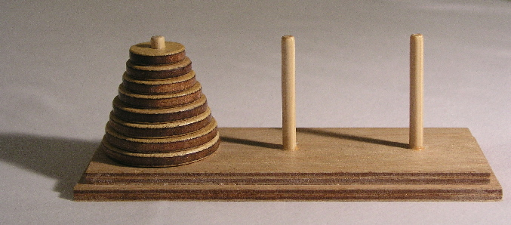
Towers of Hanoi
Goal: Move the stack of disks from the source pin
to the destination pin, subject to these rules:
  You can move only one disk at a time.
  You cannot put a larger disk on top of a smaller disk.
  Use the third pin for temporary disk storage.
Animation: http://towersofhanoi.info/Animate.aspx
Notes:
Start here.

Slide 80
Towers of Hanoi, cont’d
Label the pins A, B, and C. Initial roles:
  A: source
  B: destination
  C: temporary
Base case: n = 1 disk
  Move disk from A to B (source ➔ destination)
Simpler but similar case: n-1 disks
  Solve for n-1 disks: A to C (source ➔ temp)
  Move 1 disk from A to B (source ➔ destination)
  Solve for n-1 disks: C to B (temp ➔ destination)
During recursive calls, the pins
will each assume different roles.

Slide 81
Towers of Hanoi, cont’d
Hanoi.cpp
enum Pin { A = 'A', B = 'B', C = 'C' };
void solve(const int n, const Pin source, const Pin dest, const Pin temp);
void move(const Pin from, const Pin to);
int main()
{
int n;
cout << "Number of disks? ";
cin >> n;
cout << "Solve for " << n << " disks:" << endl << endl;
solve(n, Pin::A, Pin::B, Pin::C);
}
void move(Pin from, Pin to)
{
cout << "Move disk from " << static_cast<char>(from)
<< " to " << static_cast<char>(to) << endl;
}

Slide 82
Towers of Hanoi, cont’d
Solve n disks (source = A, destination = B)
  Solve for n-1 disks: A to C (source ➔ temp)
  Move 1 disk from A to B (source ➔ destination)
  Solve for n-1 disks: C to B (temp ➔ destination)
void solve(const int n, const Pin source, const Pin dest, const Pin temp)
{
if (n == 1) move(source, dest); // Base case
else
{
solve(n-1, source, temp, dest); // Solve source ==> temp
move(source, dest); // Move 1 disk source ==> dest
solve(n-1, temp, dest, source); // Solve temp ==> dest
}
}

