Slide 1


CMPE 180A
Data Structures and Algorithms in C++
October 6 Class Meeting
Department of Computer Engineering
San Jose State University
Fall 2020
Instructor: Ron Mak
www.cs.sjsu.edu/~mak

Slide 2
Assignment #6 Sample Solution
See the sample solution source files
  Book.h
  Book.cpp
  BookApp.cpp

Slide 3
A “Safe” Array Type: Version 1
We will develop a new array type that is “safe”.
  It will allocate the array dynamically.
  It will check all subscript values to ensure that they are in the legal range (0 ≤ index < array length).
We’ll start with an integer array.

Slide 4
A “Safe” Array Type: Version 1, cont’d
SafeArray1.h
class SafeArray
{
public:
SafeArray();
SafeArray(int len);
~SafeArray();
int get_length() const;
int at(int i) const;
void set(int i, int value);
private:
int *elements;
int length;
};

Slide 5
A “Safe” Array Type: Version 1, cont’d
SafeArray1.cpp
#include <iostream>
#include <cassert>
#include "SafeArray1.h"
using namespace std;
SafeArray::SafeArray() : elements(nullptr), length(0)
{
}
SafeArray::SafeArray(int len) : elements(nullptr), length(len)
{
elements = new int[length];
}
SafeArray::~SafeArray()
{
if (elements != nullptr) delete[] elements;
}
int SafeArray::get_length() const { return length; }

Slide 6
A “Safe” Array Type: Version 1, cont’d
SafeArray1.cpp
int SafeArray::at(int i) const
{
assert((i >= 0) && (i < length));
return elements[i];
}
void SafeArray::set(int i, int value)
{
assert((i >= 0) && (i < length));
elements[i] = value;
}

Slide 7
A “Safe” Array Type: Version 1, cont’d
int main()
{
SafeArray a1(10), a2;
for (int i = 0; i < 10; i++) a1.set(i, 10*i);
a2 = a1;
a1.set(4, -a1.at(4));
cout << "a1 ="; print(a1);
cout << "a2 ="; print(a2);
return 0;
}
void print(SafeArray& a)
{
for (int i = 0; i < a.get_length(); i++) cout << " " << a.at(i);
cout << endl;
}
SafeArrayTests1.cpp
a1 = 0 10 20 30 -40 50 60 70 80 90
a2 = 0 10 20 30 -40 50 60 70 80 90
SafeArray1(77847,0x7fff9e25d340) malloc:
*** error for object 0x7fdabfc02690: pointer being
freed was not allocated
*** set a breakpoint in malloc_error_break to debug

Slide 8
Default Assignment Operator
The default assignment operator for objects assigns a bitwise copy of the source object to the target variable.
Recall that a SafeArray object contains a pointer to a dynamic array:
SafeArray1.h
class SafeArray
{
...
private:
int *elements;
int length;
};

Slide 9
Default Assignment Operator, cont’d
SafeArray::SafeArray(int len) : elements(nullptr), length(len)
{
elements = new int[length];
}
SafeArray1.cpp
SafeArray a1(10), a2;
for (int i = 0; i < 10; i++) a1.set(i, 10*i);
a2 = a1;
a1.set(4, -a1.at(4));
SafeArrayTests1.cpp
Therefore, the assignment made both variables a1 and a2 point to the same dynamic array!
a1.elements
a2.elements

Slide 10
A “Safe” Array Type: Version 1, cont’d
Recall the destructor function:
When the program finished, both variables
a1 and a2 go out of scope and therefore
the destructor is called on each object.
  When the destructor is called on a1’s object,
  the array is deallocated.
  Then when the destructor is called on a2’s object, the destructor tries to deallocate an array that was already deallocated.
SafeArray1.cpp
SafeArray::~SafeArray()
{
if (elements != nullptr) delete[] elements;
}

Slide 11
A “Safe” Array Type: Version 2
class SafeArray
{
public:
SafeArray();
SafeArray(int len);
~SafeArray();
void operator =(const SafeArray& rhs);
int get_length() const;
int at(int i) const;
void set(int i, int value);
private:
int *elements;
int length;
};
The solution:
We must oveload the default assignment operator to do what we want.
  Make a copy of the dynamic array data, not just a copy of the pointer to the array.

Slide 12
A “Safe” Array Type: Version 2, cont’d
SafeArray2.cpp
void SafeArray::operator =(const SafeArray& rhs)
{
if (elements != nullptr) delete[] elements;
length = rhs.length;
elements = new int[length];
for (int i = 0; i < length; i++)
{
elements[i] = rhs.elements[i];
}
}
Why delete?
a1 = 0 10 20 30 -40 50 60 70 80 90
a2 = 0 10 20 30 40 50 60 70 80 90

Slide 13
A “Safe” Array Type: Version 3
What happens if you try to chain assignments?
SafeArray a1(10), a2;
SafeArray a3;
...
a3 = a2 = a1;
../SafeArrayTests.cpp:20:8: error: no viable overloaded '='
a3 = a2 = a1;
~~ ^ ~~~~~~~
../SafeArray.h:16:10: note: candidate function not viable:
cannot convert argument of incomplete type 'void' to 'const SafeArray'
void operator =(const SafeArray& rhs);
^
1 error generated.

Slide 14
A “Safe” Array Type: Version 3, cont’d
SafeArray3.h
SafeArray& operator =(const SafeArray& rhs);
SafeArray& SafeArray::operator =(const SafeArray& rhs)
{
if (elements != nullptr) delete[] elements;
length = rhs.length;
elements = new int[length];
for (int i = 0; i < length; i++)
{
elements[i] = rhs.elements[i];
}
return *this;
}
SafeArray3.cpp

Slide 15
A “Safe” Array Type: Version 3, cont’d
SafeArrayTests3.cpp
int main()
{
SafeArray a1(10), a2, a3;
for (int i = 0; i < 10; i++) a1.set(i, 10*i);
a3 = a2 = a1;
a1.set(4, -a1.at(4));
cout << "a1 ="; print(a1);
cout << "a2 ="; print(a2);
cout << "a3 ="; print(a3);
return 0;
}
a1 = 0 10 20 30 -40 50 60 70 80 90
a2 = 0 10 20 30 40 50 60 70 80 90
a3 = 0 10 20 30 40 50 60 70 80 90

Slide 16
A “Safe” Array Type: Version 4
What happens the program executes
a1 = a1;
SafeArray& SafeArray::operator =(const SafeArray& rhs)
{
if (elements != nullptr) delete[] elements;
length = rhs.length;
elements = new int[length];
for (int i = 0; i < length; i++)
{
elements[i] = rhs.elements[i];
}
return *this;
}
SafeArray3.cpp

Slide 17
A “Safe” Array Type: Version 4
The solution:
SafeArray& SafeArray::operator =(const SafeArray& rhs)
{
if (this == &rhs) return *this;
if (elements != nullptr) delete[] elements;
length = rhs.length;
elements = new int[length];
for (int i = 0; i < length; i++)
{
elements[i] = rhs.elements[i];
}
return *this;
}
SafeArray4.cpp

Slide 18
A “Safe” Array Type: Version 5
The at and set member functions
are awkward to use.
Why can’t we use subscripts on a smart array as if it were a regular array?
We can overload the subscript operator []
  We want the subscripts to be usable
  on either side of an assignment.
  Example:
a1[4] = -a1[4];

Slide 19
A “Safe” Array Type: Version 5, cont’d
class SafeArray
{
public:
SafeArray();
SafeArray(int len);
~SafeArray();
SafeArray& operator =(const SafeArray& rhs);
int& operator [](int i) const;
int get_length() const;
int at(int i) const;
void set(int i, int value);
private:
int *elements;
int length;
};
SafeArray5.h

Slide 20
A “Safe” Array Type: Version 5, cont’d
int& SafeArray::operator [](int i) const
{
assert((i >= 0) && (i < length));
return elements[i];
}
SafeArray5.cpp

Slide 21
A “Safe” Array Type: Version 5, cont’d
int main()
{
SafeArray a1(10), a2, a3;
for (int i = 0; i < 10; i++) a1[i] = 10*i;
a3 = a2 = a1;
a1[4] = -a1[4];
cout << "a1 ="; print(a1);
cout << "a2 ="; print(a2);
cout << "a3 ="; print(a3);
return 0;
}
void print(SafeArray& a)
{
for (int i = 0; i < a.get_length(); i++) cout << " " << a[i];
cout << endl;
}
SafeArrayTests5.cpp
a1 = 0 10 20 30 -40 50 60 70 80 90
a2 = 0 10 20 30 40 50 60 70 80 90
a3 = 0 10 20 30 40 50 60 70 80 90
Note that we’ve been passing the
SafeArray object by reference.

Slide 22
A “Safe” Array Type: Version 6
int main()
{
SafeArray a1(10);
for (int i = 0; i < 10; i++) a1[i] = 10*i;
cout << "a1 ="; print(a1);
return 0;
}
void print(SafeArray a)
{
for (int i = 0; i < a.get_length(); i++)
{
cout << " " << a[i];
}
cout << endl;
}
SafeArrayTests6.cpp
Let’s pass the SafeArray object
by value instead of by reference
a1 = 0 10 20 30 40 50 60 70 80 90
SafeArray6(87122,0x7fff9e25d340) malloc:
*** error for object 0x7f9b7d402690: pointer being freed was not allocated
*** set a breakpoint in malloc_error_break to debug

Slide 23
A “Safe” Array Type: Version 6
A very unexpected side effect!
  It appears that it has to do with freeing data.
SafeArray6.cpp
SafeArray::~SafeArray()
{
cout << "Calling destructor ... ";
if (elements != nullptr) delete[] elements;
cout << "done!" << endl;
}
a1 = 0 10 20 30 40 50 60 70 80 90
Calling destructor ... done!
Calling destructor ... SafeArray6(87866,0x7fff9e25d340) malloc:
*** error for object 0x7fda05c02690: pointer being freed was not allocated
*** set a breakpoint in malloc_error_break to debug

Slide 24
A “Safe” Array Type: Version 6
int main()
{
SafeArray a1(10);
for (int i = 0; i < 10; i++) a1[i] = 10*i;
cout << "a1 ="; print(a1);
return 0;
}
void print(SafeArray a)
{
for (int i = 0; i < a.get_length(); i++)
{
cout << " " << a[i];
}
cout << endl;
}
SafeArrayTests6.cpp
a1 = 0 10 20 30 40 50 60 70 80 90
Calling destructor ... done!
Calling destructor ... SafeArray6(87866,0x7fff9e25d340) malloc:
*** error for object 0x7fda05c02690: pointer being freed was not allocated
*** set a breakpoint in malloc_error_break to debug
Why is the destructor called twice at the end?

Slide 25
A “Safe” Array Type: Version 6, cont’d
When a SafeArray object is passed by value to the print function, a copy is made.
  Like the default assignment operator, the
  default copy constructor makes a bitwise copy.
This copy will point to the same dynamic array.
a1 (main)
elements
a (function)
elements

Slide 26
A “Safe” Array Type: Version 6, cont’d
When the print function completes and returns, its local variables go out of scope.
The SafeArray object’s destructor is called, which deletes the dynamic array.
  Now variable a1 has a
  dangling pointer.
  When the program is ready to
  terminate, it calls a1’s destructor.
  An error occurs because of
  the attempt to delete memory
  that has already been deleted.
a1 (main)
elements
a (function)
elements

Slide 27
A “Safe” Array Type: Version 6, cont’d
Therefore, we must overload the default copy constructor to make a copy of the array data.
class SafeArray
{
public:
SafeArray();
SafeArray(int len);
SafeArray(const SafeArray& other); // copy constructor
~SafeArray();
SafeArray& operator =(const SafeArray& rhs);
int& operator [](int i) const;
int get_length() const;
private:
int *elements;
int length;
};
SafeArray6.h

Slide 28
A “Safe” Array Type: Version 6, cont’d
SafeArray::SafeArray(const SafeArray& other)
: elements(nullptr), length(0)
{
length = other.length;
elements = new int[length];
for (int i = 0; i < length; i++)
{
elements[i] = other.elements[i];
}
}
SafeArray6.cpp
a1 = 0 10 20 30 40 50 60 70 80 90
Calling destructor ... done!
Calling destructor ... done!
in print()
in main()

Slide 29
The “Big Three”
Collectively called the “big three” of a class:
  overloaded assignment operator
  copy constructor
  destructor
Rule of thumb: If you must define a destructor,
you must also define a copy constructor
and an overloaded assignment operator.
Manage dynamic memory consistently.
  Do not rely on the default implementations!

Slide 30
The “Big Three”, cont’d
As if remembering the “big three” weren’t enough, in the most recent versions of C++,
they’ve become the “big five”.
Read all about them yourself:
  http://www.technical-recipes.com/2011/the-big-three-in-c/
  http://www.cppsamples.com/common-tasks/rule-of-five.html

Slide 31
Break

Slide 32
Shorthand for Pointer Expressions
class Node
{
public:
Node(int value);
~Node();
int data;
Node *next;
};
Node *head;
The expression head->data is the preferred shorthand for (*head).data

Slide 33
Searching a Sorted Linked List
Node *SortedLinkedList::find(int value) const
{
Node *p = head;
// Search the sorted list.
while ((p != nullptr) && (value > p->data)) p = p->next;
if ((p != nullptr) && (value == p->data)) return p; // found
else return nullptr; // not found
}
Search for 20:
Search for 25:
head
10
20
30
Found!
p
head
10
20
30
Not found!
p

Slide 34
Inserting into a Sorted Linked List
Insert the first element into a sorted linked list.
if (head == nullptr)
{
head = new_node;
return new_node;
}
head
10
new_node

Slide 35
Inserting into a Sorted Linked List, cont’d
Insert at the beginning of
an existing sorted linked list.
else if (value < head->data)
{
new_node->next = head;
head = new_node;
return new_node;
}
head
10
20
30
5
new_node

Slide 36
Inserting into a Sorted Linked List, cont’d
Insert into the middle of a sorted linked list.
p = head;
while ((p != nullptr) && (value >= p->data))
{
prev = p;
p = p->next;
}
prev->next = new_node;
new_node->next = p;
return new_node;
head
10
20
30
prev
p
25
new_node

Slide 37
Removing from a Sorted Linked List
Remove from the head of a sorted list.
if (value == head->data)
{
Node *next = head->next;
delete head;
head = next;
return;
}
head
10
20
30
next

Slide 38
Removing from a Sorted Linked List, cont’d
Remove from the middle of a sorted list.
while ((p != nullptr) && (value > p->data))
{
prev = p;
p = p->next;
}
if ((p != nullptr) && (value == p->data))
{
Node *next = p->next;
delete p;
prev->next = next;
}
head
10
20
30
prev
p
next

Slide 39
Stack
A stack is a data structure where you can
insert objects and remove objects.
The stack maintains the order
that the objects are inserted.
Objects are removed from the stack
in the reverse order that they were inserted.
This is commonly known as last-in first-out (LIFO).

Slide 40
Stack, cont’d
We can use a linked list to implement a stack.
Insert (push) new objects at the head.
Remove (pop) objects at the head.
Insert an
object here.
Remove this
object here.
head

Slide 41
Midterm Next Week
Combination of multiple-choice, short answer, and short programming (such as a function or a class declaration).
Covers
  all lectures through today
  Savitch book chapters 1 – 13
  assignments 1 – 6
Open book and laptop. Regular browser.
75 minutes (first half of class)

Slide 42
Assignment #7
Practice with linked lists.
First read an input file boundary.csv that contains the geographic coordinates of a series of points on the border of the continental U.S.
  Sample:
  One point per line
  Each point is in the form
  latitude, longitude
  Random order
Due Tuesday, October 20
(Two weeks from today!)
42.258373,-80.556416
41.99385,-124.184283
42.023529,-70.649609
41.311172,-72.335129
40.441448,-124.395634
40.280175,-124.282443
40.28276,-73.944546
39.916698,-123.94305

Slide 43
Assignment #7, cont’d
Read these point one at a time and insert them into a linked list that is sorted first by latitude and then by longitude.
Use the coordinates to print an
outline of the continental U.S.
  You will need to scale the geo coordinates
  to fit a page (or screen).

Slide 44
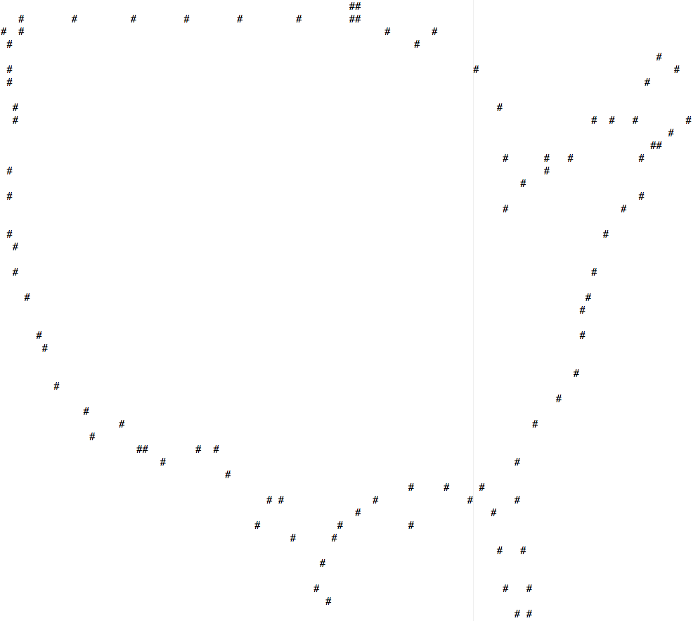
Assignment #7, cont’d

Slide 45
Assignment #7, cont’d
Then read another input file cities.csv where each line contains the name, state, and geo coordinates
of a U.S. city.
  Sample:
  Alphabetical
  order.
Merge the city data into the border data
linked list to print a map of the U.S.
Henderson,NV,36.0397222,-114.9811111
Huntington,WV,38.4191667,-82.4452778
Idaho Falls,ID,43.4666667,-112.0333333
Indianapolis,IN,39.7683333,-86.1580556
Jackson,MS,32.2986111,-90.1847222
Jacksonville,FL,30.3319444,-81.6558333
Jersey City,NJ,40.7280556,-74.0780556
Kansas City,MO,39.0997222,-94.5783333
Knoxville,TN,35.9605556,-83.9208333

Slide 46
Assignment #7, cont’d
##
# # # # # # # # # # ##
# # # #
# *Grand Forks ND# #
*Seattle WA *Great Falls MT # #
# *Missoula MT *Bismarck ND # #
# # #
*Vancouver WA *Billings MT # #
# *Portland OR *Aberdeen SD # # #
#*Salem OR *Saint Paul MN # # # *Bangor ME
*Green Bay WI # *Colchester VT
# *Eugene OR *Rapid City SD *Rochester MN *Portland ME
*Nampa ID*Idaho Falls ID *Sioux Falls SD # ## *Rochester NY #
# *Pocatello ID *Madison WI # *Buffalo NY*Bennington VT
*Ashland OR *Rockford IL*Warren MI *Worcester MA
# *Cedar Rapids IA*Toledo OH *Springfield MA
*Laramie WY *Omaha NE *Davenport IA #*Cleveland OH *Bridgeport CT
*Eureka CA *West Valley City UT *Lincoln NE *Paterson NJ
# *Provo UT *Pittsburgh PA
# *Denver CO *Indianapolis IN *Wilmington DE
*Parkersburg WV
# *Colorado Springs CO*Overland Park KS *Silver Spring MD
# *Sacramento CA *Louisville KY
#*San Francisco CA *Wichita KS *Evansville IN #
#*San Jose CA *Springfield MO *Richmond VA
*Norfolk VA
# *Las Vegas NV *Tulsa OK *Nashville TN #
# *Paradise NV *Santa Fe NM *Fayetteville AR *Knoxville TN
# *Oklahoma City OK *Charlotte NC
*Albuquerque NM *Little Rock AR #
###
#*Los Angeles CA *Atlanta GA #
# *Phoenix AZ *Birmingham AL
*San Diego CA *Dallas TX *North Charleston SC
# # # *Tucson AZ *Shreveport LA *Montgomery AL
## # # *Savannah GA
# # # *Hattiesburg MS #
## *Mobile AL #
*Austin TX *Baton Rouge LA *Jacksonville FL
# # # ### *New Orleans LA #
# # # *San Antonio TX ##
# # # # # #
# # #
# #*Tampa FL
# # #
#
# # #
# # *Miami FL
# #

