Slide 1
CMPE 180A Data Structures and Algorithms in C++ August 25 Class Meeting
Department of Computer Engineering San Jose State University Fall 2020 Instructor: Ron Mak
www.cs.sjsu.edu/~mak

Slide 2
Basic Info
Office hours
TuTh 4:30 – 5:30 PM online via Zoom
ENG 250 (but working from home)
Website
Faculty webpage: http://www.cs.sjsu.edu/~mak/
Class webpage: http://www.cs.sjsu.edu/~mak/CMPE180A/index.html
Syllabus
Assignments
Lecture notes

Slide 3
Course Objectives
The primary goal of this class is to learn a useful subset of C++ programming language and fundamental data structures and algorithms expressed in C++.
You will learn best practices for developing reliable software.
You will acquire software development skills that are valued by employers.

Slide 4
Not Course Objectives
Complete knowledge of C++
C++ is a huge, complex language!
The class will hit the important features.
You can learn the rest by yourself from online tutorials or the textbooks.
We will briefly touch the new features of C++ 11 and 14.
Advanced data structures and algorithms
Advanced algorithm analysis

Slide 5
C++ Tutoring
We hope to provide C++ tutoring during the week by the instructional student assistant (ISAs).
Past students have found this very helpful.
Please take advantage of this service!
But offering it depends on the department’s budget.
ISA and his schedule to be announced.

Slide 6
Required Textbooks
Problem Solving with C++, 10th edition
Author: Walter Savitch
Publisher: Pearson, 2017
ISBN: 978-0134448282
Data Structures Using C++, 2nd edition
Author: D.S. Malik
Publisher: Cengage Learning, 2010
ISBN: 978-0324782011
You are responsible for doing the chapter readings before each class, as indicated in the class schedule.

Slide 7
Software to Install
Install an integrated development environment (IDE) for C++ development on the Mac or Linux platform, such as:
Eclipse CDT (C/C++ Development Tooling): https://eclipse.org/cdt/
You can choose your favorite IDE.

Slide 8
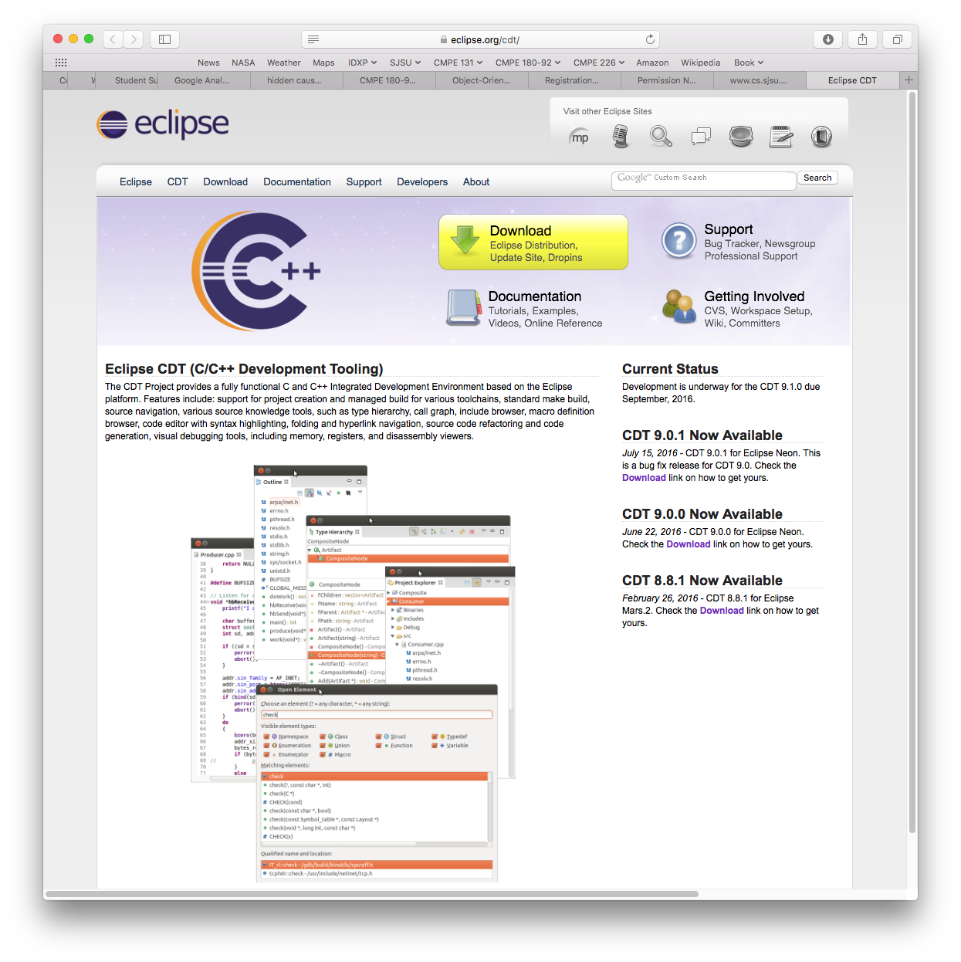
Software to Install, cont’d

Slide 9
C++ on the Mac and Linux Platforms
GNU C++ is usually pre-installed on the Mac and Linux platforms.
No further action required!
Avoid using Apple’s Xcode on the Mac for this class.
You run the risk of writing programs that will not port to other platforms.

Slide 10
C++ on Windows 10
The Windows platform has proven to be problematic for this class.
Difficult to install the Cygwin environment correctly.
Difficult to install C++ libraries successfully.
Serious compatibility challenges.
Avoid using Microsoft’s Visual C++ on Windows for this class.
You run the risk of writing programs that will not port to other platforms.

Slide 11
C++ on Windows 10, cont’d
Install the Windows Subsystem for Linux (WSL).
See https://docs.microsoft.com/en-us/windows/wsl/install-win10
Recommended: Install the Ubuntu distribution.
See https://www.microsoft.com/en-us/p/ubuntu/9nblggh4msv6?activetab=pivot:overviewtab
We will not provide support for Windows.
If you insist on running Windows,
you are on your own!

Slide 12
Useful Tutorials
“Install Ubuntu on Windows 10 and on VirtualBox”
http://www.cs.sjsu.edu/~mak/tutorials/InstallUbuntu.pdf
“Configure Ubuntu for Software Development”
http://www.cs.sjsu.edu/~mak/tutorials/ConfigureUbuntu.pdf
“Install Eclipse for Java and C++ Development”
http://www.cs.sjsu.edu/~mak/tutorials/InstallEclipse.pdf

Slide 13
C++ 2011 Standard
We will use the 2011 standard version of C++.
You must set this standard explicitly for your project in Eclipse or your chosen IDE.
On the command line:
g++ foo.cpp --std=c++11 –o foo
Two hyphens!

Slide 14
Set the C++ 2011 Standard in Eclipse
Right-click on your project in the project list at the left side of the window.
Select “Properties” from the drop-down context menu.
In the left side of the properties window, select “C/C++ Build” ➔ “Settings”.
In the Settings dialog, select “GCC C++ Compiler” ➔ “Dialect”.
For “Language standard” select “ISO C++ 11”.
Click the “Apply” button, answer “Yes”, and then click the “OK” button.
Remember to do all these steps for every C++ project
in Eclipse.

Slide 15
Assignments
You will get lots of programming practice!
A main programming assignment each week.
Several small practice programs that emphasize specific skill needed to solve the main assignment.
We will use the online CodeCheck system which will automatically check your output against a master.
You will be provided the URL for each assignment.
You can submit as many times as necessary to get satisfactory output.

Slide 16
Assignments, cont’d
Assignments will be due the following week, before the next lecture.
Solutions will be discussed at the next lecture.
Assignments will not be accepted after solutions have been discussed in class.
Late assignments will receive a 0 score.

Slide 17
Individual Work
You may study together.
You may discuss the assignments together.
But whatever you turn in must be your individual work.

Slide 18
Academic Integrity
Copying another student’s work or sharing your work is a violation of academic integrity.
Violations will result in harsh penalties by the university.
Academic probation.
Disqualified for TA positions in the university.
Lose internship and OPT sponsorship at local companies.
Instructors are obligated to report violations.

Slide 19
Moss
Department policy is for programming assignments to be run through Stanford University’s Moss application.
Measure of software similarity
Detects programming plagiarism
http://theory.stanford.edu/~aiken/moss/
Moss is not fooled by
Renaming variables and functions
Reformatting code
Re-ordering functions
Example Moss output:
http://www.cs.sjsu.edu/~mak/Moss/

Slide 20
Exams
The midterm and final examinations will be open book and conducted online.
Instant messaging, e-mails, texting, tweeting, file sharing, or any other forms of communication with anyone else during the exams violates academic integrity.

Slide 21
Exams, cont’d
There can be no make-up midterm examination unless there is a documented medical emergency.
Make-up final examinations are available only under conditions dictated by University regulations.

Slide 22
Final Class Grade
65% assignments
15% midterm
20% final exam
The class is graded CR/NC.
Students who have a weighted score above the passing threshold at the end of the semester will receive the CR grade.
We expect least 80% of students will pass.
In some past semesters when I’ve taught this class, the pass rate has been higher than 95% in the past.

Slide 23
Take Roll

Slide 24
Fast Pace!
This class will move forward at a fast pace.
Lectures will consist of:
New PowerPoint slides by the instructor
PowerPoint slides from the textbook publishers
Program examples and live demos
Questions, answers, and discussion
Lecture materials will be posted to the class webpage: http://www.cs.sjsu.edu/~mak/CMPE180A/index.html

Slide 25
Discussion Forum
Please use the Discussions feature of Canvas.
Ask questions
Answer questions
Chat
If you have a question, please ask it in the Discussions feature .
Others may have the same question.
I’ll only have to answer the question once.
Other students can provide answers before I do.

Slide 26
What is C++
An object-oriented programming (OOP) language.
Supports encapsulation, inheritance, polymorphism.
Based on the C language with added OOP features.
A powerful but complex language!
Lots of features.
Somewhat arcane syntax.
Easy to make programming errors.
Things happen automatically at run time that you may not expect.

Slide 27
A Useful Subset of C++
We will only learn a useful subset of C++.
Very few people (not including your instructor) know the entire language.
Among professional C++ programmers, everybody knows a different subset, depending on experience, training, and application domains.

Slide 28
What Happened?
We may have to figure out together what happened when …
You’ve accidentally stumbled onto an obscure language feature.
Your program runs slower than expected.
Your program mysteriously crashes.
Your program may appear to run fine on your machine but then crash in CodeCheck.
It’s usually because your program attempted to access protected memory via a bad pointer.

Slide 29
Our First C++ Program
The infamous “Hello, world!” program.
Compiled and run on the command line:
#include <iostream>
using namespace std;
int main()
{
cout << "Hello, world!" << endl;
return 0;
}
helloworld.cpp
~/programs/HelloWorld: g++ helloworld.cpp --std=c++11 -o helloworld
~/programs/HelloWorld: ./helloworld
Hello, world!

Slide 30
Algorithms and Program Design
Savitch_ch_01.ppt: slides 57– 60
Display 1.4
Compiling and Running a C++ Program
Display 1.5
Preparing a C++ Program for Running
Display 1.7
Program Design Process

Slide 31
Sample C++ Program: Pods and Peas
Savitch_ch_01.ppt: slides 34 – 44
“A Sample C++ Program”
Display 1.8
Pods and peas program
Savitch_ch_01.ppt: slide 61

Slide 32
Identifiers and Variables
Identifiers are names.
Variables represent values that can change.
Variables have names (variable identifiers).
Declare variables before you use them.
A declaration tells what is the variable’s datatype (integer, float, double, character, boolean, etc.).
A declaration can also give an initial value to the variable.
int n;
double ratio;
bool is_prime;
char ch;
string name;
int length = 0;
double temp = 98.6;
string name = "Frank";

Slide 33
Keywords
Keywords are reserved by C++ and you cannot use them as identifiers.
Examples: if for while

Slide 34
Assignment Statements
At run time, be sure to initialize a variable (give it a value) before you use it.
Either initialize the variable when you declare it.
Example:
Or execute an assignment statement.
Example:
Do not confuse = (assignment) with == (equality comparison).
int i = 5;
i = 10;
i = 10; // assign the value of 10 to variable i
if (i == 10) // test whether or not i is equal to 10

Slide 35
Break

Slide 36
Output Stream
Values written by the program at run time.
Standard output stream: cout
Default: the display
Example:
Insert (write) the string “x equals” followed by the value of variable x followed by a carriage return (endl) to the display.
cout << "x equals " << x << endl;
insertion
operator

Slide 37
Formatting Real Numbers for Output
Call methods of cout to format real numbers.
cout.setf(ios::fixed);
Use fixed-point notation (not scientific).
cout.precision(2);
How many places after the decimal point (e.g., 2).
You can also write:
#include <iostream>
#include <iomanip>
...
cout << fixed << setprecision(16);

Slide 38
Input Stream
Data read by the program at run time.
Standard input stream: cin
Default: the keyboard
Example:
Extract (read) the next two values from the keyboard and assign the values to x and y, respectively.
cin >> x >> y;
extraction operator

Slide 39
Input From cin
Read values into multiple variables.
The input values should be separated by one or more spaces.
The values are not read until you press the return key.
Therefore, you can backspace and make corrections.
cin >> v1 >> v2 >> v3;

Slide 40
#include and using namespace
#include <iostream>
Include the definitions of cin and cout in your program.
using namespace std;
Make the standard namespace std available to the program.
The names cin and cout and other important names reside in the standard namespace.

Slide 41
Some Basic Data Types
A datatype (also: data type) determines
what kind of data values
what operations are allowed
Data type int for integer values without decimal points.
Examples: 0 2 45 -64
Data type short for small integer values.
Data type long for very large integer values.

Slide 42
Some Basic Data Types, cont’d
Data type double for real numbers.
Fixed-point notation: 34.1 23.0034 -1.0 89.9
Scientific notation: 3.67e17 5.89E-6 -7.23e+12
Data type float for less precision and smaller magnitude.
Data type char for individual characters.
Examples: 'a' 'Z'
Use only single quotes for character constants in a program.

Slide 43
Some Basic Data Types, cont’d
Data type bool for the Boolean values true and false.
The Boolean value false is stored as the integer 0.
The Boolean value true is stored as the integer 1.

Slide 44
cin Skips Input Blanks
The statements when given the input will set ch1 to 'A' and ch2 to 'B'.
char ch1, ch2;
cin >> ch1 >> ch2;
A B
cin uses blanks and line feeds to separate input data values, but otherwise it skips the blanks and line feeds.

Slide 45
String Type
#include <string>
Required if your program uses strings.
Enclose string values with double quotes in your program.
Example: "Hello, world!"
To input a string from cin that includes spaces, all in one line:
string str;
getline(cin, str);

Slide 46
Type Compatibilities and Conversions
int pi = 3.14;
double → int is invalid. You cannot set a double value into an int variable .
Some valid conversions:
int → double
char → int
int → char
bool → int
int → bool
Any nonzero integer value is stored as true.
Zero is stored as false.

Slide 47
Arithmetic
Arithmetic operators: + - * / %
Integer / result if both operands are integer.
Quotient only.
Example: The value of 11/3 is 3.
Use the modulo operator % to get a remainder.
Example: The value of 11%3 is 2.
Double / result (includes fractional part) if either or both operands are double.

Slide 48
Operator Shorthand
n += 5 shorthand for n = n + 5
n -= 5 shorthand for n = n - 5
n *= 5 shorthand for n = n*5
n /= 5 shorthand for n = n/5
n %= 5 shorthand for n = n%5

Slide 49
The if Statement
Example if statement:
Example if else statement:
if (n <= 0)
{
cout << "Please enter a positive number." << endl;
}
if (hours > 40)
{
gross_pay = rate*40 + 1.5*rate*(hours - 40);
}
else
{
gross_pay = rate*hours;
}

Slide 50
while Loops
Example while loop:
Example do while loop:
while (count_down > 0)
{
cout << "Hello ";
count_down = count_down - 1;
}
do
{
cout << "Hello ";
count_down = count_down - 1;
} while (count_down > 0)

Slide 51
Named Constants
It’s good programming practice to give names to constants:
Easier for humans to read the program.
Easier to modify the program.
Convention: Use ALL_CAPS with underscores if necessary for the names of constants.
const double PI = 3.1415626;

Slide 52
Boolean Operators
Relational operators: == != < <= > >=
And: &&
Or: ||
Not: !
Short-circuit operation: p && q
q is not evaluated if p is false
Short-circuit operation: p || q
q is not evaluated if p is true

Slide 53
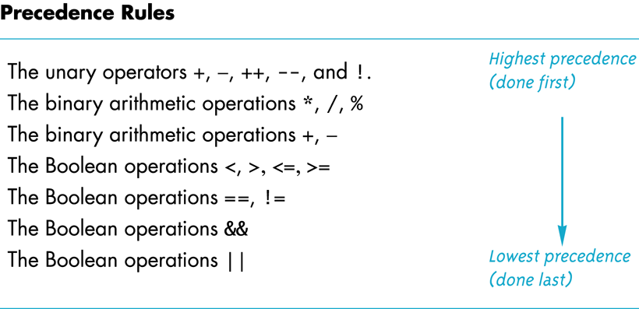
Precedence Rules
Savitch_ch_03.ppt: slides 8-13

Slide 54
Enumeration Types
A data type with values defined by a list of constants of type int
Examples:
enum Direction {NORTH, SOUTH, EAST, WEST};
enum MonthLength{JAN_LENGTH = 31, FEB_LENGTH = 28, MAR_LENGTH = 31, … DEC_LENGTH = 31};

Slide 55
Nested if Statements
Example:
if (net_income <= 15000)
{
tax_bill = 0;
}
else if ((net_income > 15000) && (net_income <= 25000))
{
tax_bill = (0.05*(net_income - 15000));
}
else // net_income > $25,000
{
five_percent_tax = 0.05*10000;
ten_percent_tax = 0.10*(net_income - 25000);
tax_bill = (five_percent_tax + ten_percent_tax);
}

Slide 56
The switch Statement
Use a switch statement instead of nested if statements to compare a single integral value for equality.
Note the need for the break statements.
Note the default case at the bottom.
int digit;
...
switch(digit)
{
case 1: digit_name = "one"; break;
case 2: digit_name = "two"; break;
case 3: digit_name = "three"; break;
case 4: digit_name = "four"; break;
case 5: digit_name = "five"; break;
case 6: digit_name = "six"; break;
case 7: digit_name = "seven"; break;
case 8: digit_name = "eight"; break;
case 9: digit_name = "nine"; break;
default: digit_name = ""; break;
}

Slide 57
The Increment and Decrement Operators
++n
Increase the value of n by 1.
Use the increased value.
n++
Increase the value of n by 1.
Use the value before the increase.

Slide 58
The Increment and Decrement Operators, cont’d
--n
Decrease the value of n by 1.
Use the decreased value.
n--
Decrease the value of n by 1.
Use the value before the decrease.

Slide 59
for Loops
Example:
int sum = 0;
for (int n = 1; n <= 10; n++)
{
sum = sum + n;
}
cout << "The sum of the numbers 1 to 10 is "
<< sum << endl;
Note that variable n
is local to the loop body.

Slide 60
for Loops, cont’d
The for loop uses the same components as the while loop, but in a more compact form.
for (n = 1; n <= 10; n++)
Initialization Action
Update Action
Boolean Expression

Slide 61
The break Statement
Use the break statement to exit a loop before “normal” termination.
Do not overuse!
Well-designed loops should end normally.
This use of break in a for statement is different from the necessary use of break in a switch statement.

Slide 62
Nested Loops
If you have an “outer loop” that contains an “inner loop”, then for each iteration (execution) of the outer loop, the inner loop goes through all of its iterations.
This concept extends to more than just one loop inside another.
Loops can nest deeply, although usually there are no more than three loops.
Nested loops are a very common in programs.

Slide 63
Nested Loops, cont’d
nestedloop.cpp
#include <iostream>
#include <iomanip>
using namespace std;
int main()
{
for (int i = 1; i <=2; i++)
{
for (int j = 9; j <= 12; j++)
{
cout << "i = " << i
<< ", j = " << j << endl;
}
}
return 0;
}
i = 1, j = 9
i = 1, j = 10
i = 1, j = 11
i = 1, j = 12
i = 2, j = 9
i = 2, j = 10
i = 2, j = 11
i = 2, j = 12

Slide 64
Loop Considerations
Choosing the right kind of loop to use
Designing loops
How to control a loop
How to exit from a loop
Nested loops
Debugging loops
Savitch: Chapter 3

Slide 65
Main Assignment for Week 1
Assignment #1 will give you practice with C++ arithmetic expressions, built-in math functions, and control statements.
Write-up: http://www.cs.sjsu.edu/~mak/CMPE180A/assignments/1/Assignment1.pdf
CodeCheck http://codecheck.it/files/20082407544wvyblyxihynvq7qdnc6pvfs0
Follow carefully the instructions on how to use CodeCheck and how to submit into Canvas.
100 points

Slide 66
Practice Problems for Week 1
During the beginning of the semester, each week will also have practice problems.
Short programming problems in CodeCheck that emphasize certain C++ features.
You shouldn’t have to spend much time on the practice problems!
Access all the assignments in Canvas.
5 points each

